Slide 1

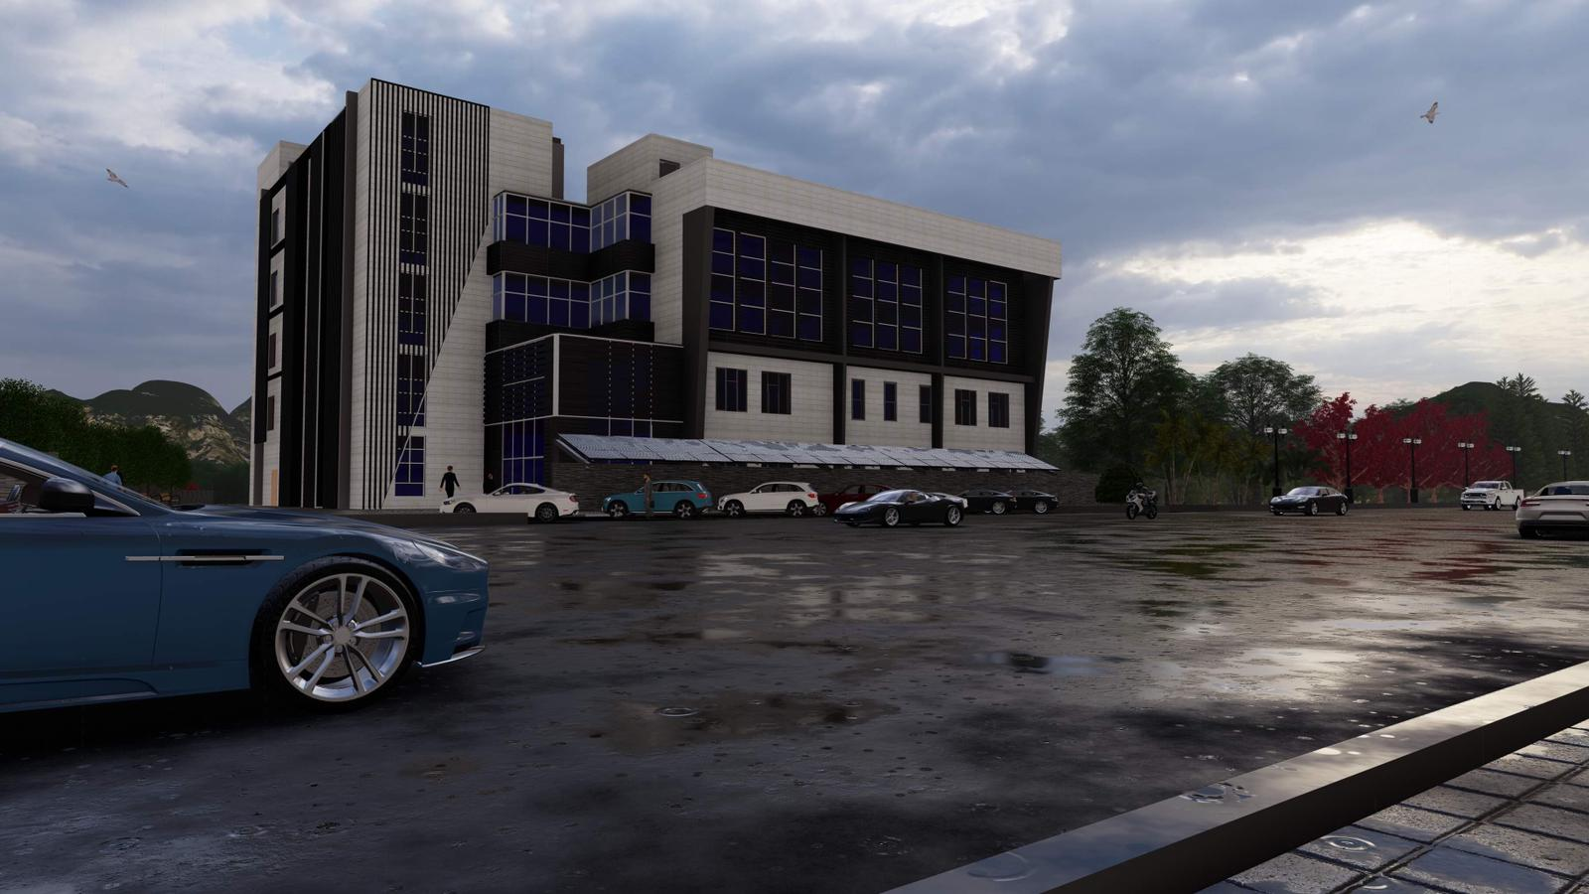
An-Najah National University
Faculty of Engineering and Information Technology
Building Engineering
Graduation Project (2)
" integrated design for Nablus municipality building "
Prepared by:
Sally Mahamdeh
Abed Allateef Rabaya
Saja Salem
Supervisor Name: Eng. Moayad Salhab
2021/2022

Slide 2
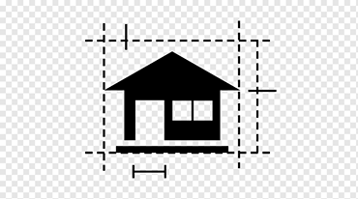



Content
Architectural
Aspects
Site Analysis
Environmental
Aspects
Introduction

Slide 3



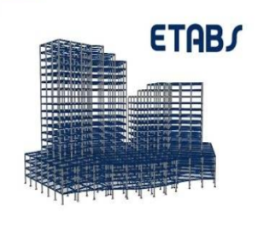
Content
Electrical Aspects
Mechanical Aspects
Quantity surveying
Structural
Aspects

Slide 4
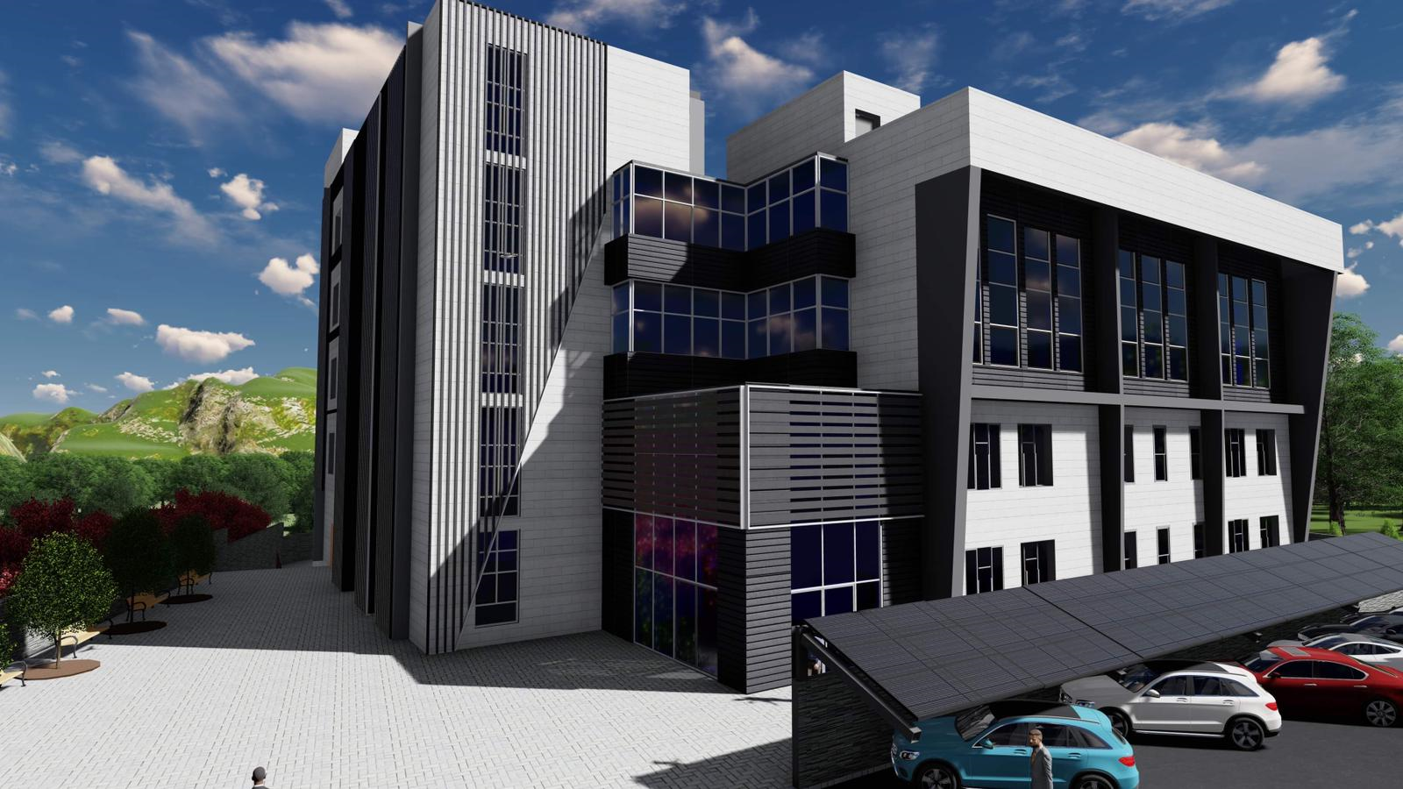
Introduction
Nablus municipality on Yaffa Street
The main objective of this project is to study and analyze the building to
Reach an integrated design and nearly zero energy building

Slide 5

Site analysis
Site Analysis
content

Slide 6
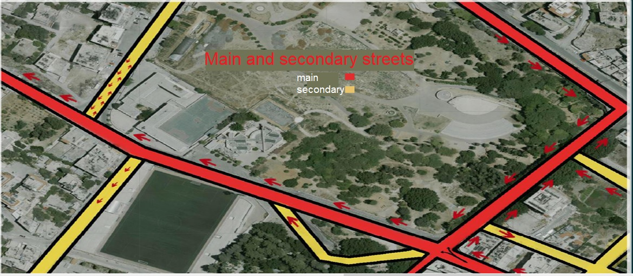
The building is located on a 3250 square meters of land and is supposed to be designed inside Nablus - Yaffa Street.
And it is located on longitude 35.25° and latitude 32.22°

Slide 7
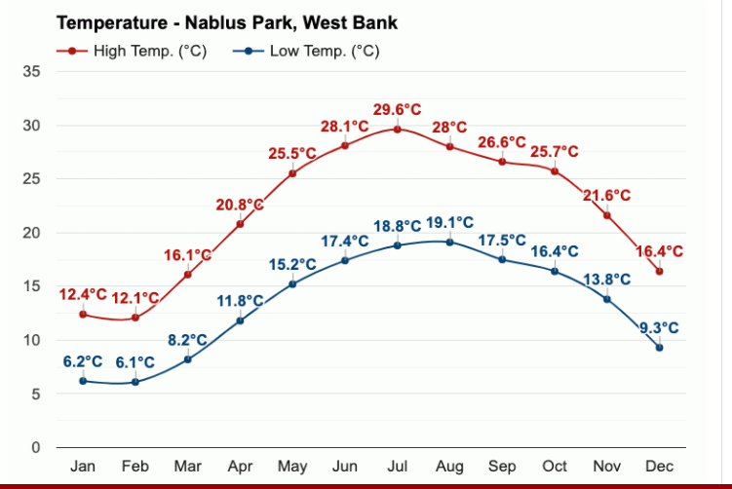
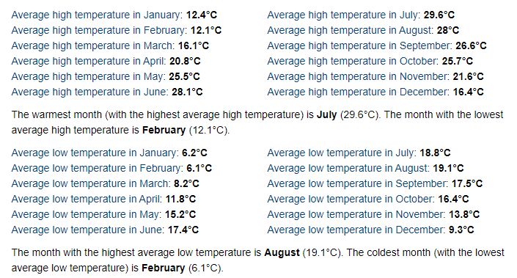
Climatic conditions

Slide 8
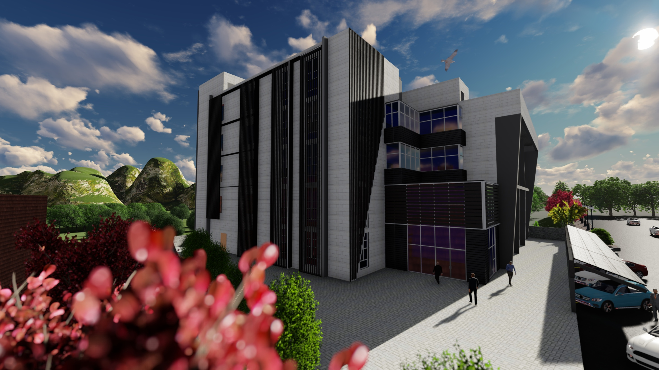
Architectural aspect
content

Slide 9
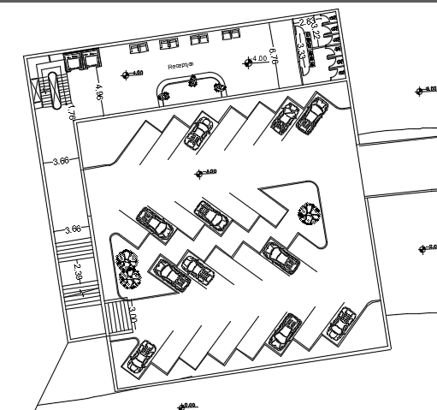
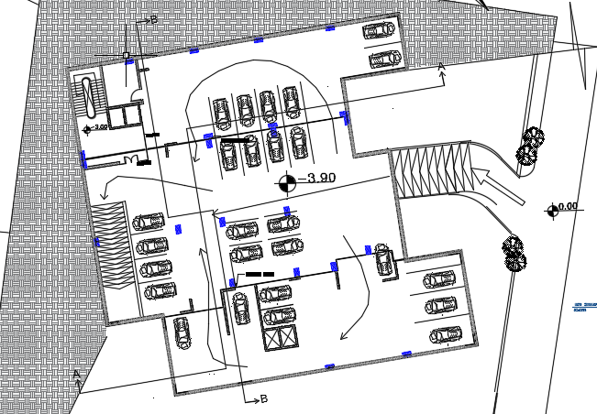
Architectural modification
Our project contain one basement floor
35 parking spaces
Basement floor before
Basement 1 floor after

Slide 10
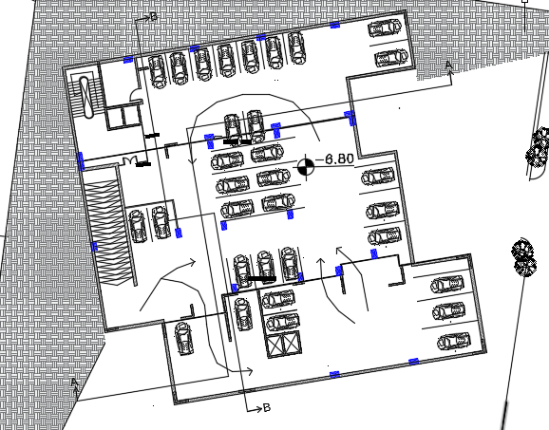
Architectural modification
Basement 2 floor after

Slide 11
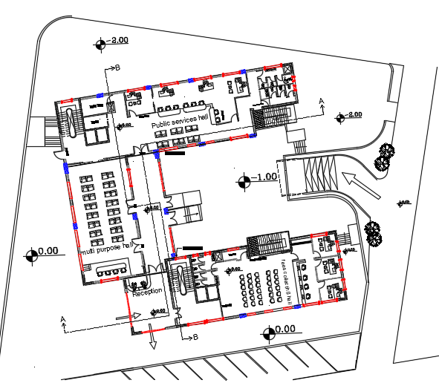
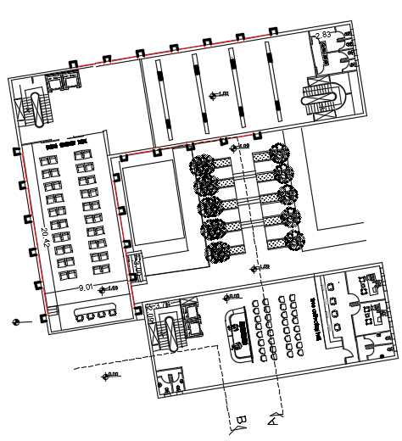
No main entrance
Emergency stair & Road for the disabled
Ground floor after
public service hall
Ground floor before

Slide 12
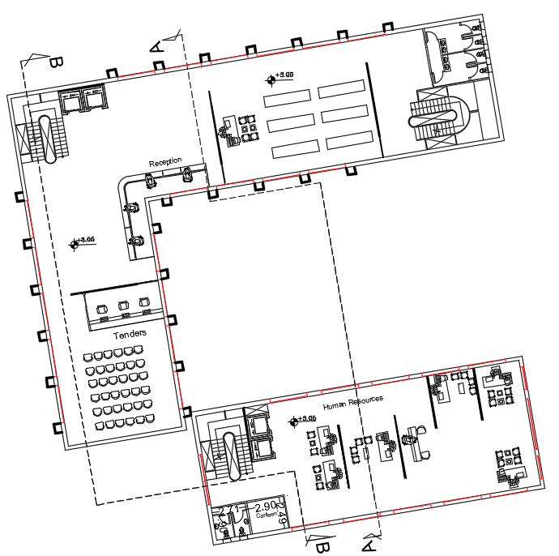
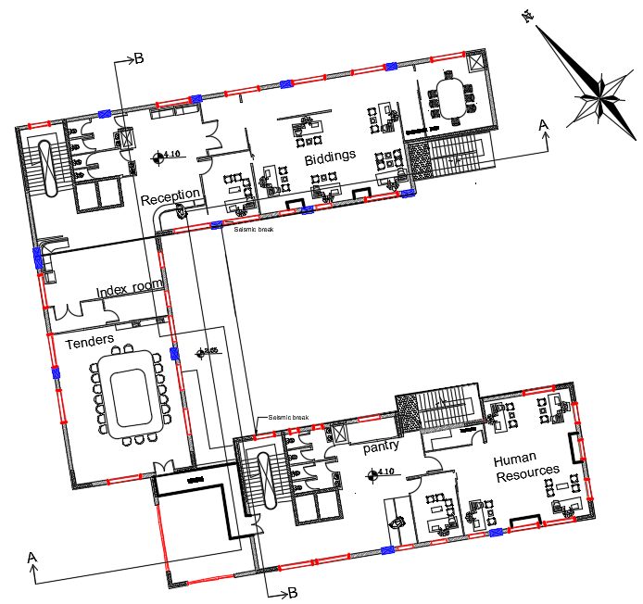
Connected bridge
Bidding room
Fist Floor Before
First Floor After

Slide 13
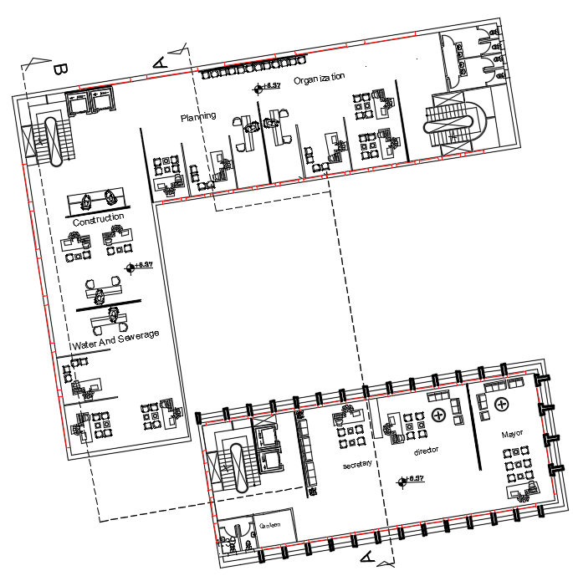
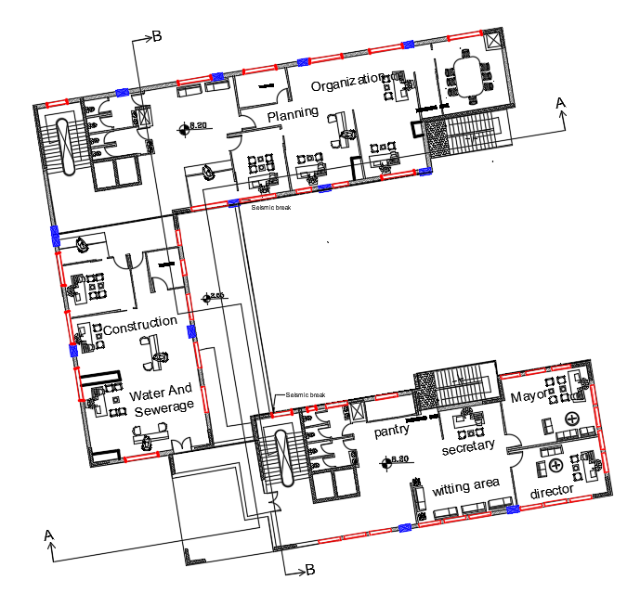
Second Floor Before
Second Floor After

Slide 14
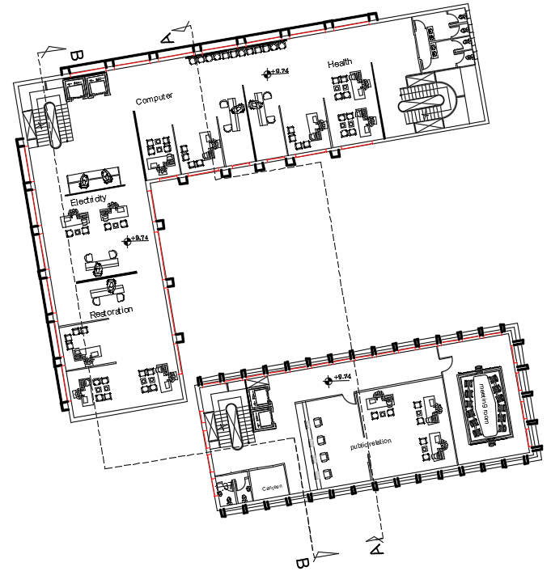
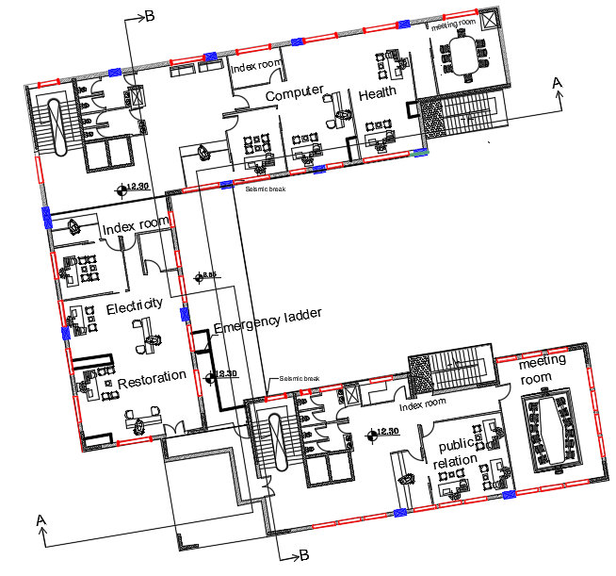
archive rooms and conference rooms.
Third Floor Before
Third Floor After

Slide 15
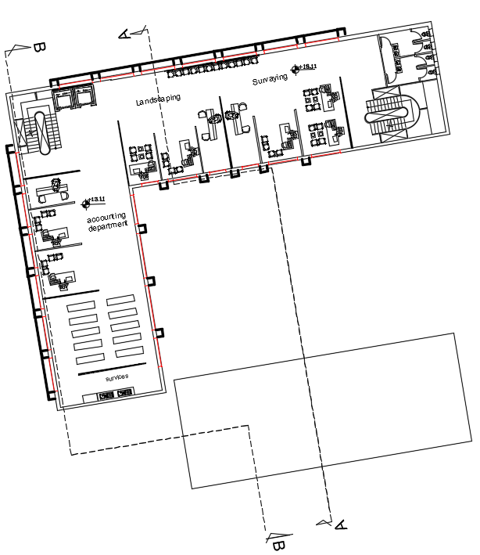
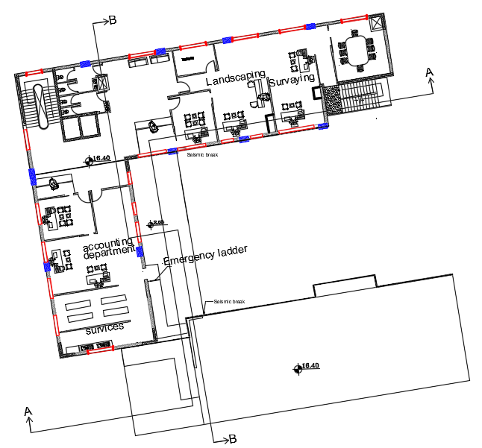
Emergency ladder
Fourth Floor Before
Fourth Floor After

Slide 16
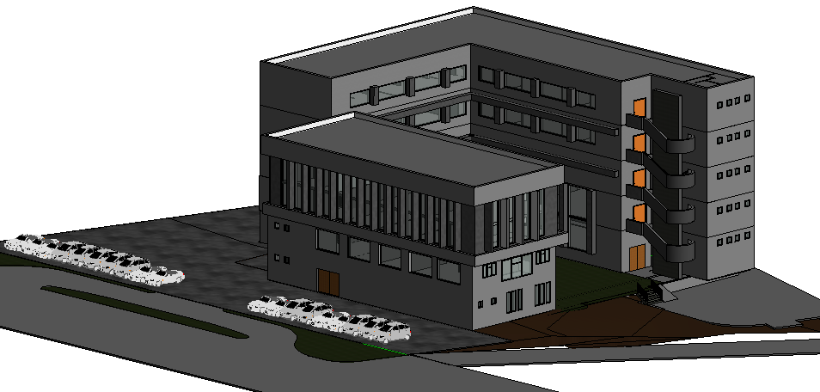
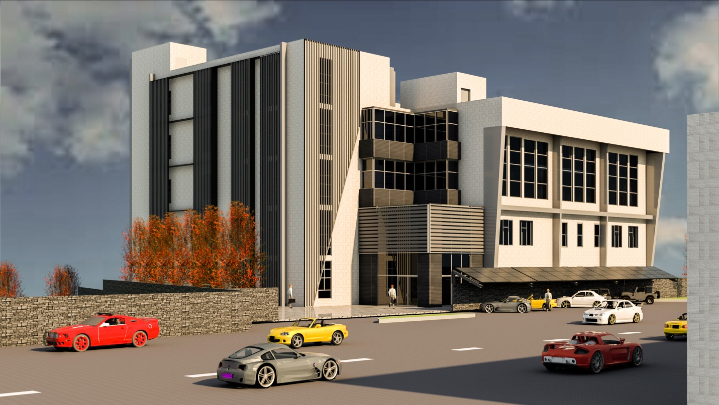
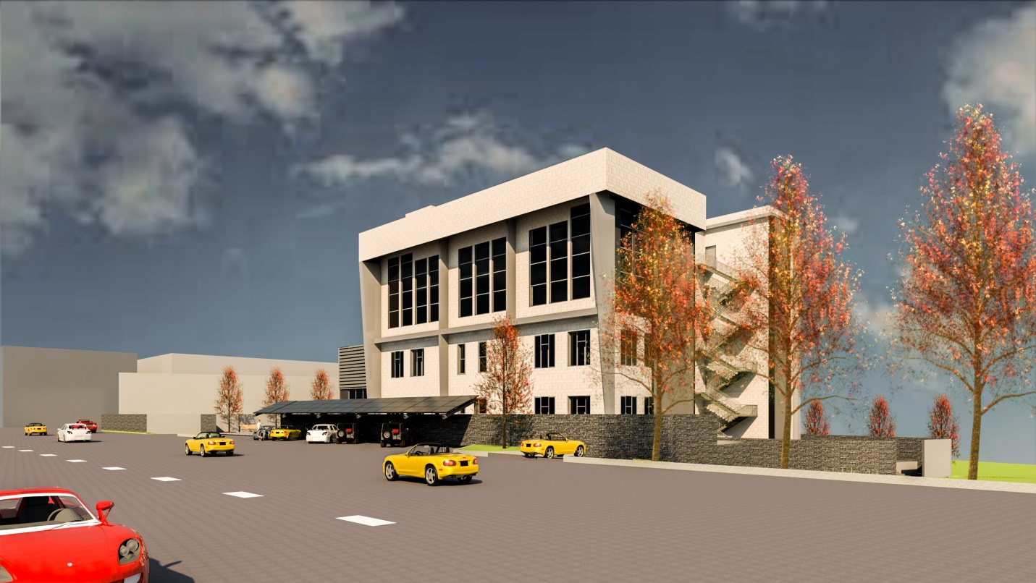
3D model after modification
After
After

Slide 17
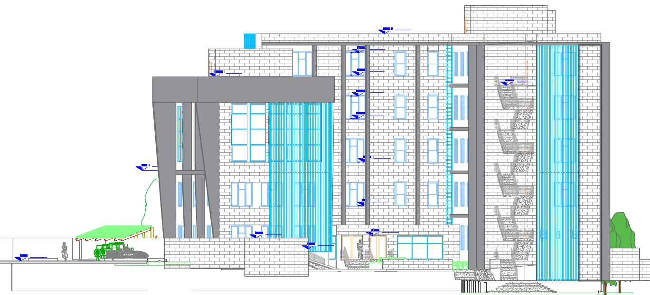
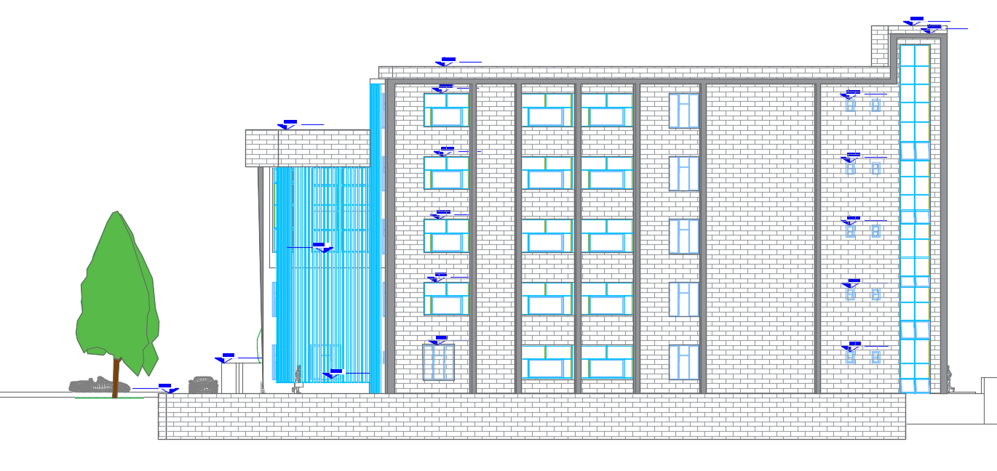
North Elevation
Elevations and sections after modification
East Elevation

Slide 18
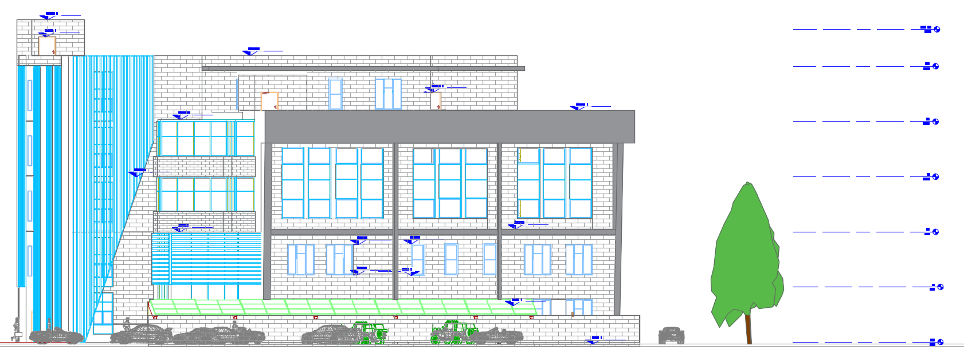
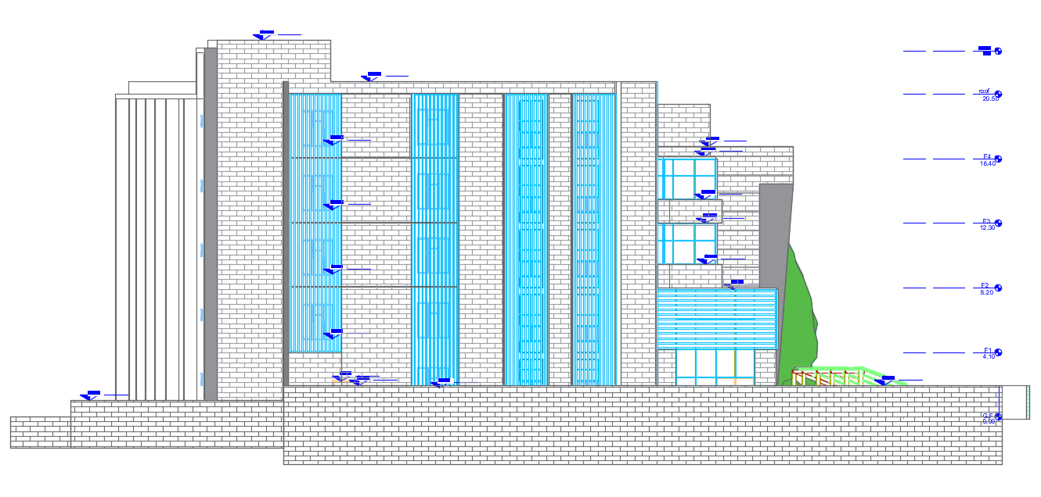
South Elevation
West Elevation

Slide 19
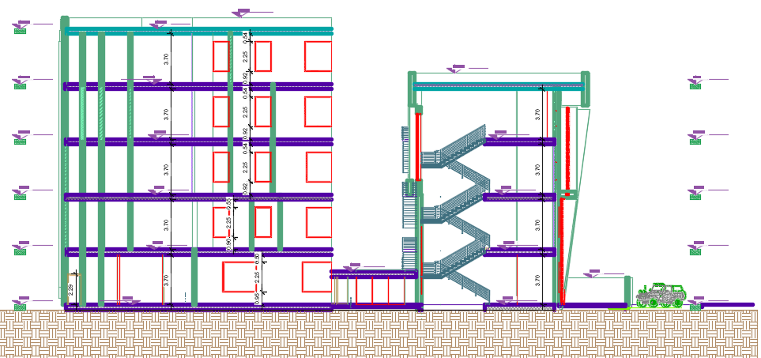
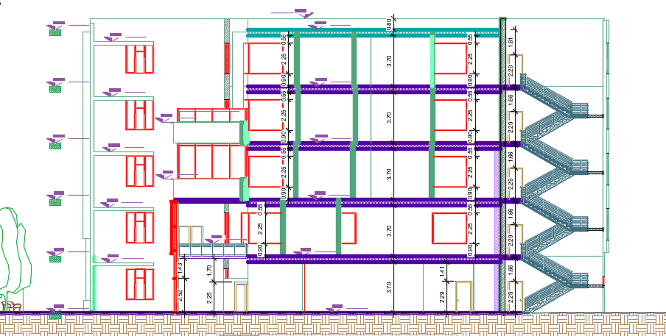
Section A-A
Section B-B

Slide 20

Environmental Aspect
content

Slide 21


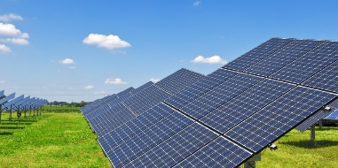


The important parameter of environmental assessment
Acoustical design
Daylight factor
Energy Simulation and Thermal Comfort
PV Design
Environmental Adjustments
content

Slide 22
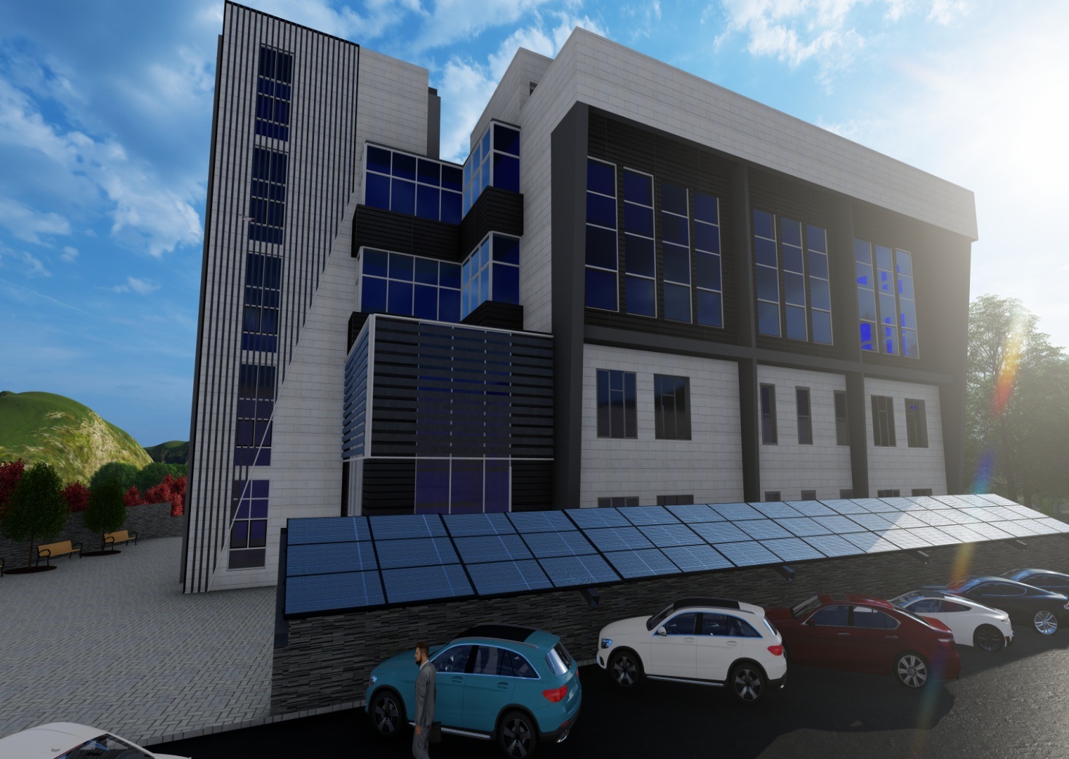
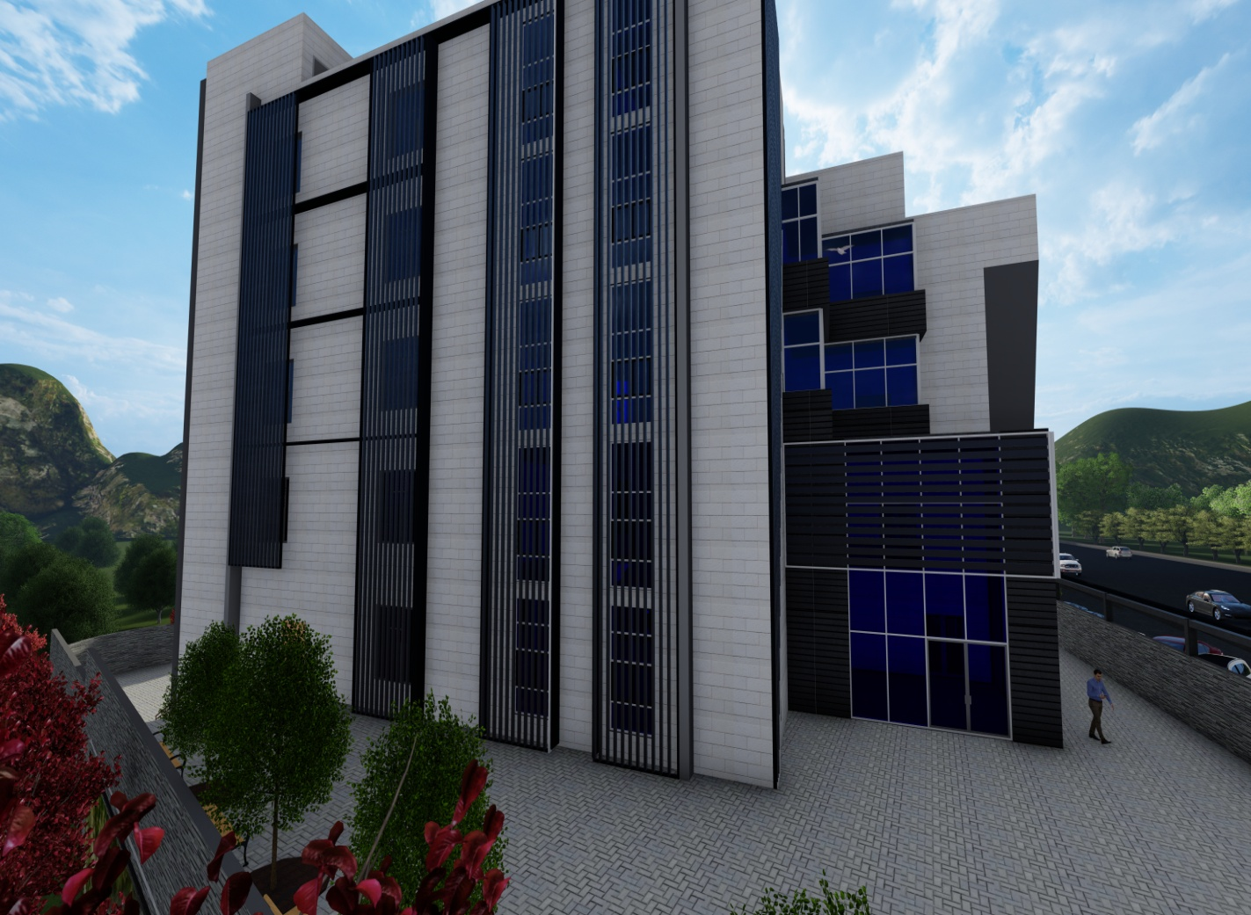
Environmental Adjustments

Slide 23
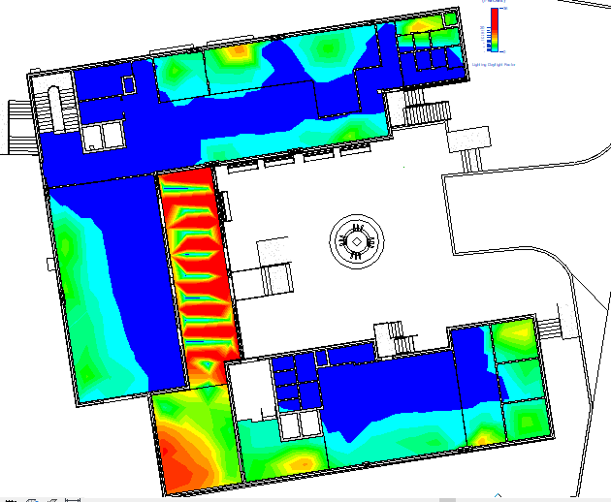
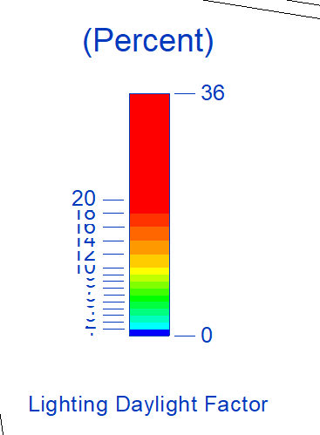
Daylight analysis
Ground Floor

Slide 24
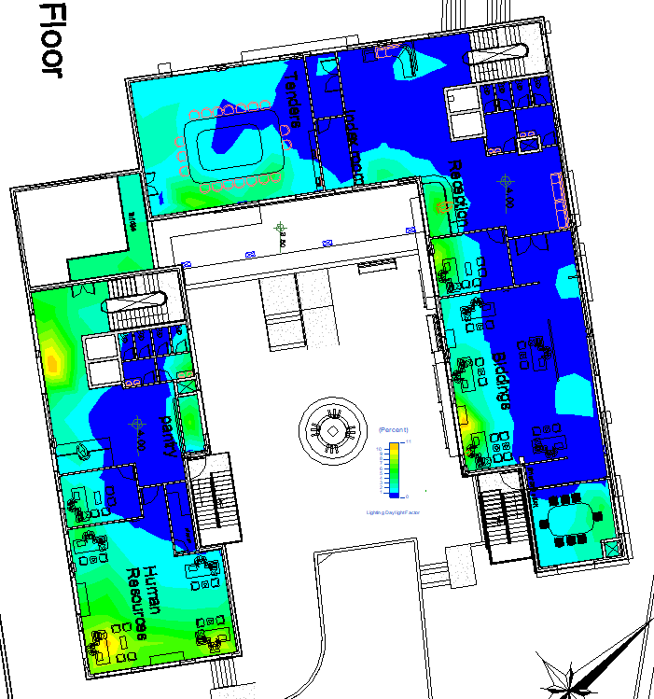
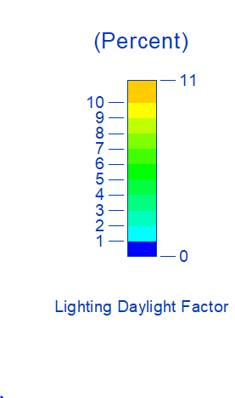
First Floor

Slide 25
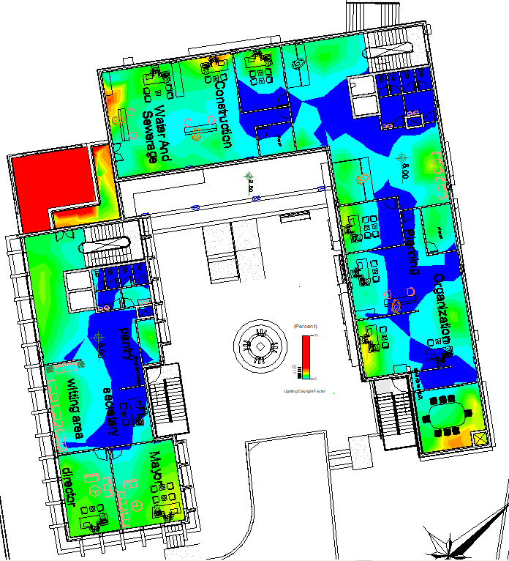
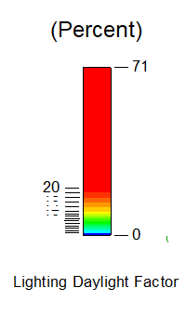
Second Floor

Slide 26
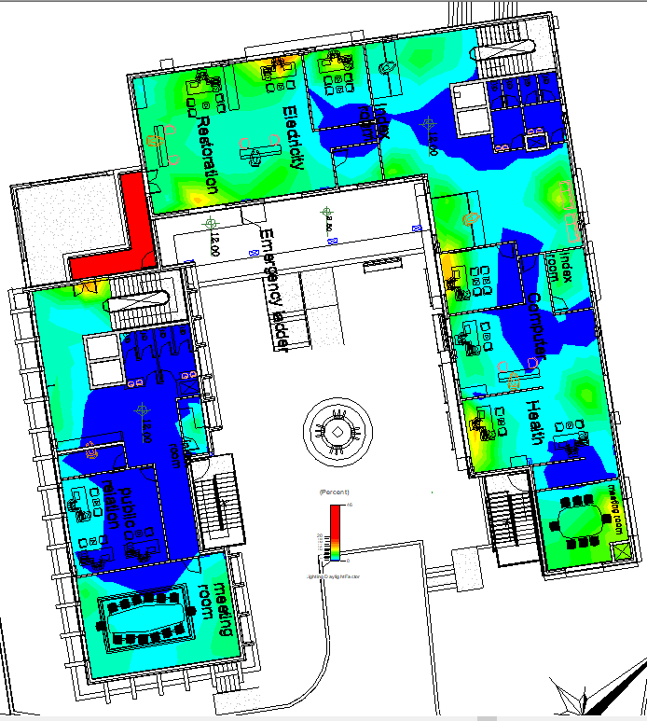
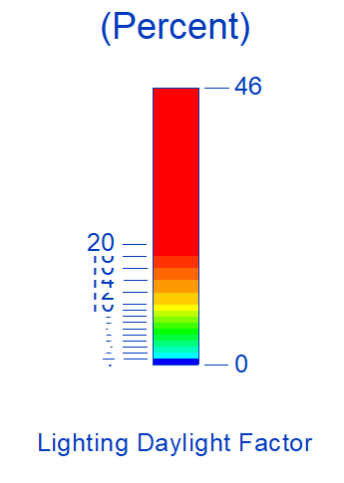
Third Floor

Slide 27
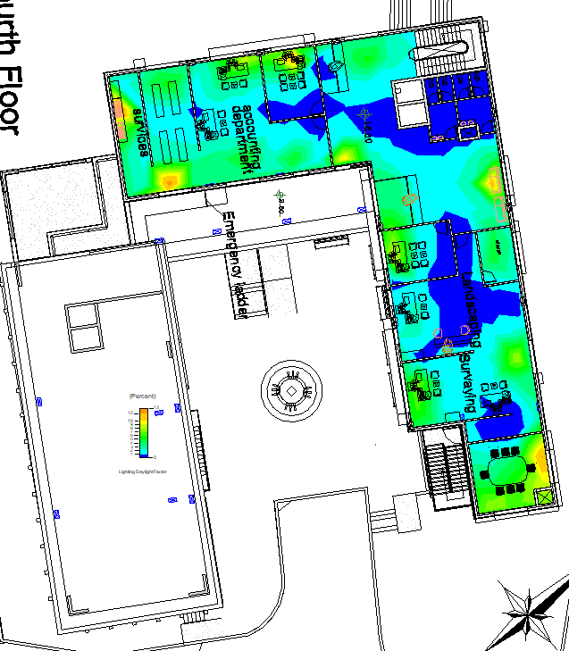
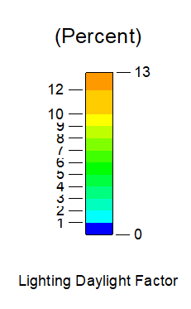
Fourth Floor

Slide 28
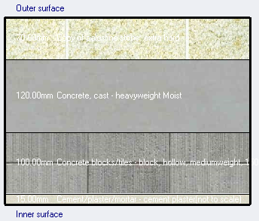
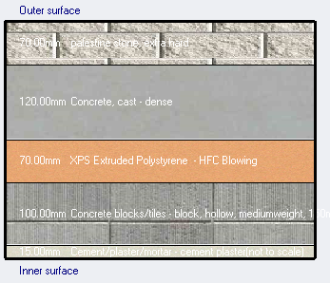
Energy Simulation and thermal comfort
Material Properties
External Wall Without Insulation
U-value = 2.207 W/m^2.K
External Wall With Insulation
U-value = 0.359 W/m^2.K

Slide 29
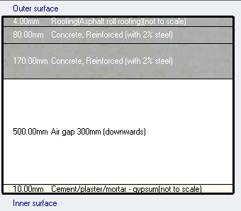
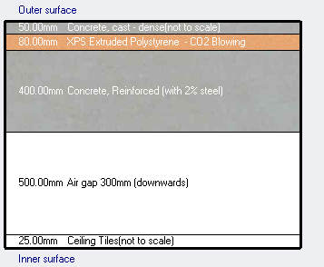
Energy Simulation and thermal comfort
Material Properties
Flat Roof Without Insulation
U-value = 1.75 W/m^2.K
Flat Roof With Insulation
U-value = 0.298 W/m^2.K

Slide 30
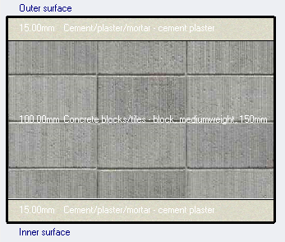
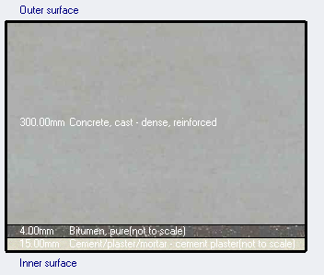
Energy Simulation and thermal comfort
Material Properties
Internal Partitions
U-value = 2.31 W/m^2.K
Under Ground Wall
U-value = 2.68 W/m^2.K

Slide 31
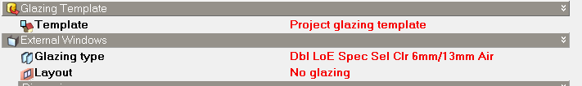
Energy Simulation and thermal comfort
Material Properties
Glazing Area U-value = 1.63 W/m^2.K

Slide 32
Energy Simulation and thermal comfort
Thermal analysis
Case | Description | Heating Load(kW) | Cooling Load(kW) | Load/Area(w/m2)
Case 1 | Without Insulation | 979.32 | 322.62 | 75.53
Case 2 | With Insulation | 110.52 | 126.71 | 40.2

Slide 33


Heating load
Heating Load = 110.52 kW

Slide 34


Cooling load
Cooling Load = 126.71 kW

Slide 35

Thermal Comfort
Thermal Comfort for Building
predicted mean vote

Slide 36
Thermal Comfort
 | Facility [Hours]
Time Setpoint Not Met During Occupied Heating | 12.83
Time Setpoint Not Met During Occupied Cooling | 145.33
Time Not Comfortable Based on Simple ASHRAE 55-2004 | 1026.50

Slide 37
Energy Consumption
 | Total Energy [kWh] | Energy Per Total Building Area [kWh/m2]
Without Insulation | 335514.6 | 113.62
With Insulation and Environmental Adjustments | 129173.897 | 39.37

Slide 38
Energy Consumption

Slide 39
Acoustical analysis
The spaces that were designed acoustically in the faculty
1) Office
2) Fees collection hall
3) Multipurpose hall
The absorption coefficient for the element

Slide 40
Reverberation time (RT60)
The reverberation time for the multipurpose hall
The reverberation time for the fees collection hall
The Standard 0.4 to 1.8 second
The Standard 0.4 to 1.8 second
Frequency | 125 Hz | 250 Hz | 500 Hz | 1000 Hz | 2000 Hz | 4000 Hz
RT 60 (Second) | 1.65 | 1.5 | 1.43 | 1.21 | 1.15 | 1
Frequency | 125 Hz | 250 Hz | 500 Hz | 1000 Hz | 2000 Hz | 4000 Hz
RT 60 (Second) | 2.41 | 2.30 | 2.15 | 2.0 | 1.82 | 1.68
All reverberation time at all frequency are ok.
Reverberation time at all frequency are not ok,
So we need an acoustic treatment for this space.
Frequency | 125 Hz | 250 Hz | 500 Hz | 1000 Hz | 2000 Hz | 4000 Hz
RT 60 (Second) | 1.55 | 1.51 | 1.45 | 1.39 | 1.36 | 1.35

Slide 41


Sound Transmission loss (STC)
The sound transmission loss (STC) for the internal walls between different spaces
The OITC for the external walls =58 dB more than the required = 55 dB , so it is ok for the external walls.
* Sound transmission loss
* STC and transmission loss

Slide 42

Impact Insulation Class (IIC)
The impact insulation class for the floor =65 dB more than the IIC required = 60 dB , so it is ok.
* Impact sound level for the floor

Slide 43


Loud Speaker
The speaker type: AFMG CM20T 2WAY speaker
Multipurpose hall
The direct SPL distribution in the multipurpose hall

Slide 44


PV-System
Specific photovoltaic power output | PVOUT_specific | 1792 | kWh/kWp
Direct normal irradiation | DNI | 2198 | kWh/m²
Global horizontal irradiation | GHI | 2032 | kWh/m²
Diffuse horizontal irradiation | DIF | 601 | kWh/m²
Global tilted irradiation at optimum angle | GTI_opta | 2254 | kWh/m²
Air temperature | TEMP | 18.4 | °C
Optimum tilt of PV modules | OPTA | 28 | °
Terrain elevation | ELE | 555 | m

Slide 45
PV-System
E | 129173.897 | kWh/Year
Yearly Total | 1792 | kWh/kWp
System Size | 72.08 | kWp
Wpv | 480 | Wp
No. of Module | 150.17 | Module
E | 129173.897 | kWh/Year
E | 353.901088 | kWh/day
G | 6.1 | Hr./Day
Efficiency | 0.7 | -
System Size | 83.90 | kWp
Wpv | 480 | Wp
No. of Module | 174.79 | Module
We chose the smallest number, which is 150, but it has resulted from the design that 154 cells are required

Slide 46

PV-System
Results for parking cover

Slide 47

PV-System
Results for Roof

Slide 48


PV-System
Monthly Production for Roof
Monthly Production for Parking cover

Slide 49

PV-System
Shadow
Parking cover

Slide 50

Structural Aspect
content

Slide 51

Marital, Codes & Loads
Material
Design Codes
Concrete with compressive strength of 28 MPa
Steel rebar with yielding strength of 420MPa
ACI 318-14, ( Building Code Requirements for Structural Concrete )
Seismic design UBC 97 ( Uniform Building Code )
ASCE 7 for load design (American Society of Civil Engineers )
EQ Loads (UBC97):
Loads
I= 1 (Importance factor)
Cv=0.4 (Seismic coefficient )
R= 5.5 (Response modification)
Ca=0.28 (Seismic coefficient )
Z= 0.2 (Seismic zone factor)
Ct= 0.0488 (Seismic coefficient )
Live 5 KN/m²
SID 4.266 kN/m²

Slide 52

The structural system use two way voided slab ( U-Boot slab)
We divided the building into three blocks {Block A, Block B, Block C}, taking into account the seismic design.

Slide 53

Structural analysis
Checks
Compatibility check
Equilibrium check
Stress σ & Strain ɛ check
Period check
Modal mass participation
ratio check
Base shear check
Drift check
P−∆ Effects check

Slide 54

Thickness of slab for all blocks = 40 cm according shear check .

Slide 55



For block B
Compatibility check
For block A
For block C

Slide 56
For block B
Equilibrium Checks
Loads (KN) | manual | Etabs | %Error
Dead | 14324.89 | 14069.77 | 1.813
Live | 8859.9 | 8860.79 | 0.010
SID | 7659.744 | 7660.502 | 0.010
For block A
Loads (KN) | manual | Etabs | %Error
Dead | 24697.51 | 24422.05 | 1.128
Live | 10630.58 | 10631.45 | 0.008
SID | 9586.806 | 9587.475 | 0.007
For block C
Loads (KN) | manual | Etabs | %Error
Dead | 15107.75 | 15238.17 | 0.856
Live | 7123.04 | 7123.337 | 0.004
SID | 6405.599 | 6405.337 | 0.004

Slide 57

Internal forces checks
For edge column
Axial force manual
Dead | Live | Sid
1906.87 | 955.55 | 859.96
Loads (KN) | manual | Etabs | %Error
Dead | 1906.87 | 1843.68 | 3.43
Live | 955.55 | 905.19 | 5.56
SID | 859.96 | 811.62 | 5.96
Axial force Etabs
Dead | Live | Sid
1843.68 | 905.19 | 811.62

Slide 58

Period check.
For Block A
TB = 0.764 sec.
TA = Ct (hn) ^ (¾)
TA = 0.0488 (27) ^ (¾)=0.57 sec
1.4 TA = 0.79 sec.
TB ≤ 1.4 TA so the check is ok.

Slide 59

Modal mass participation ratio check.
For Block A
sum UX= 0.9008.
sum UY= 0.952.
sum of UX and UY ≥ 0.9 so the check is ok.

Slide 60
Base shear check.
For Block A
soil | SD
I | 1
Ca | 0.28
Cv | 0.4
R | 5.5
Ω | 2.8
Ct | 0.0488
hn | 27
Ta | 0.578
1.4Ta | 0.809
Tetabs | 0.76
w | 35324.83
Vmain | 3380.366
Vsecondry | 1126.789
EQX main = 3391.75 KN
EQY main = 3423.61 KN
EQ ≥ V its ok.

Slide 61
Drift check.
For Block A
Drift in X
#of story | R | H floor (mm) | T structure (second) | δx elastic (mm) | total δx inelastic(mm) | max. δx inelastic(mm) | Result
9 | 5.5 | 2500 | 0.76 | 24.459 | 4.68545 | 50 | safe
8 | 5.5 | 3700 | 0.76 | 23.242 | 8.90505 | 74 | safe
7 | 5.5 | 3700 | 0.76 | 20.929 | 15.7157 | 74 | safe
6 | 5.5 | 3700 | 0.76 | 16.847 | 17.9949 | 74 | safe
5 | 5.5 | 3700 | 0.76 | 12.173 | 17.9872 | 74 | safe
4 | 5.5 | 3700 | 0.76 | 7.501 | 15.11125 | 74 | safe
3 | 5.5 | 3700 | 0.76 | 3.576 | 13.7676 | 74 | safe
2 | 5.5 | 2500 | 0.76 | 0 | -1.64395 | 50 | safe
1 | 5.5 | 2500 | 0.76 | 0.427 | 1.64395 | 50 | safe
Drift in Y
#of story | R | H floor (mm) | T structure (second) | δy elastic (mm) | Total δy inelastic(mm) | max. δy inelastic(mm) | Result
9 | 5.5 | 2500 | 0.76 | 15.419 | -32.1552 | 50 | safe
8 | 5.5 | 3700 | 0.76 | 23.771 | 13.7214 | 74 | safe
7 | 5.5 | 3700 | 0.76 | 20.207 | 17.23645 | 74 | safe
6 | 5.5 | 3700 | 0.76 | 15.73 | 18.04495 | 74 | safe
5 | 5.5 | 3700 | 0.76 | 11.043 | 17.0016 | 74 | safe
4 | 5.5 | 3700 | 0.76 | 6.627 | 13.33255 | 74 | safe
3 | 5.5 | 3700 | 0.76 | 3.164 | 12.1814 | 74 | safe
2 | 5.5 | 2500 | 0.76 | 0 | -2.66805 | 50 | safe
1 | 5.5 | 2500 | 0.76 | 0.693 | 2.66805 | 50 | safe
max δx inelastic ≥ δx inelastic : 50 ≥ 4.68 mm , so it ok
max δx inelastic ≥ δx inelastic : 50mm ≥ 32.155mm, so it is ok.

Slide 62
P−∆ Effects check.
For Block A
P-Delta -EQX
#of story | H floor (mm) | P gravity load combination(KN) | Ex (KN) | Ux (mm) | ∆_{X} _{(mm)} | ƟX | Result
9 | 2500 | 424.5652 | 157.59 | 25.568 | 1.471 | 0.00158525 | NO P-DELTA
8 | 3700 | 4201.0749 | 936.85 | 24.097 | 2.487 | 0.00301416 | NO P-DELTA
7 | 3700 | 9296.7837 | 1802.2 | 21.61 | 4.256 | 0.00593391 | NO P-DELTA
6 | 3700 | 14392.5035 | 2418.8 | 17.354 | 4.837 | 0.00777864 | NO P-DELTA
5 | 3700 | 19488.2235 | 2871.6 | 12.517 | 4.811 | 0.00882421 | NO P-DELTA
4 | 3700 | 24485.2776 | 3186.7 | 7.706 | 4.022 | 0.0084 | NO P-DELTA
3 | 3700 | 28600.2989 | 3344.8 | 3.684 | 3.684 | 0.0085 | NO P-DELTA
2 | 2500 | 30691.6546 | 3371.8 | 0 | -0.4 | 0.0015 | NO P-DELTA
1 | 2500 | 35011.993 | 3391.8 | 0.402 | 0.402 | 0.0017 | NO P-DELTA
P-Delta -EQY
#of story | H floor (mm) | P gravity load combination(KN) | EY (KN) | Uy (mm) | ∆_{y} _{(mm)} | ƟY | Result
9 | 2500 | 424.5652 | 111.36 | 16.014 | -4.75 | 0.0072394 | NO P-DELTA
8 | 3700 | 4201.0749 | 907.95 | 20.761 | 2.605 | 0.00325767 | NO P-DELTA
7 | 3700 | 9296.7837 | 1772.4 | 18.156 | 3.729 | 0.00528653 | NO P-DELTA
6 | 3700 | 14392.5035 | 2402.4 | 14.427 | 4.06 | 0.00657384 | NO P-DELTA
5 | 3700 | 19488.2235 | 2862 | 10.367 | 3.923 | 0.00721966 | NO P-DELTA
4 | 3700 | 24485.2776 | 3175.8 | 6.444 | 3.412 | 0.0071 | NO P-DELTA
3 | 3700 | 28600.2989 | 3344.3 | 3.032 | 3.032 | 0.0070 | NO P-DELTA
2 | 2500 | 30691.6546 | 3379.8 | 0 | -0.48 | 0.0017 | NO P-DELTA
1 | 2500 | 35011.993 | 3423.6 | 0.476 | 0.476 | 0.0019 | NO P-DELTA
θx = (P X Ux)/(Ex X H)=0.0015 $≤$0.1 so its ok .
θy = (P X Uy)/(Ey X H)=0.0072 ≤ 0.1 so its ok .

Slide 63


Structural analysis
Detailing:
Slab details

Slide 64

Structural analysis
Detailing:
Columns details.

Slide 65

Structural analysis
Detailing:
Columns details.

Slide 66


Structural analysis
Detailing:
Shear wall details.

Slide 67

Structural analysis
Detailing:
Single Footing details.

Slide 68

Structural analysis
Detailing:
Single Footing details.

Slide 69

Structural analysis
Detailing:
Matt Footing details.

Slide 70

Structural analysis
Detailing:
Matt Footing details.

Slide 71


Water Tank details

Slide 72


Water Tank details

Slide 73

Basement wall details

Slide 74

Electrical design
content

Slide 75
Electrical design
Socket distribution
Artificial lighting
board distribution and low voltage

Slide 76





Sockets plan for the fees collection hall
The electrical load of power, lighting in the ground floor
Distribution of the circuit breaker in distribution board 1
The electrical symbols
Main distribution board of circuit breaker in the ground floor

Slide 77


The electrical load of power, lighting in the main distribution board 1
The system UPS in the Ground Floor
The main UPS distribution board 1
The main distribution board for the faculty
The electrical load of elevators and HVAC system in the main distribution board
HVAC and Elevator
Main DB | M.D.B | Normal load | Light load | Total power | I load | I C.B | I cable | C.B | Cable (IEC )
3 phases | H-VAC C.B | Total load |  | 28000.00 | 44.91 | 51.64 | 59.39 | 63 | (77A) , 25 mm^2
3 phases | Elevators C.B | Total load |  | 44000.00 | 70.57 | 81.15 | 93.32 | 100 | (117A) , 50 mm^2
3 phases | M.D.B | Total load |  | 72000.00 | 115.47 | 132.79 | 152.71 | 160 | (180A) , 95 mm^3

Slide 78


Electrical Plan
First Floor
Electrical power distribution of spaces

Slide 79


Electrical Plan
Third Floor
Electrical power distribution of spaces

Slide 80



Artificial lighting
multipurpose hall

Slide 81



Artificial lighting
Mayor office

Slide 82



Artificial lighting
Meeting room

Slide 83

Mechanical design
content

Slide 84




Mechanical design
Fire Fighting
Drainage system
HVAC system
Water system
content

Slide 85

Water System
Water Tanks
Distribution tanks

Slide 86

Total Fu
Total FU | Floor
65 | Ground Floor
56 | First Floor
56 | Second Floor
56 | Third Floor
34 | Fourth Floor
267 | Total
Water supply system distribution

Slide 87

Drainage system
Summary for diameter and pipe slop
Diameter of pipe(Inch) | Slope | Material pipe | Type fixture
4" | 1.00% | PVC | Stack
2" | 1.00% | PVC | Sewer
4" | 0.00% | PVC | Vent
6" | 1.00% | PVC | Between Manhole
Water drainage system distribution

Slide 88


Drainage system
Drainage pipe and Manhole on the site
Manhole on the site

Slide 89


HVAC system
From the Design Builder program:
Total Heating Load = 112.03 kW.
Total Cooling Load = 113.81 kW.
Total Flowrate = 6.65 $m^{3}$/s
content

Slide 90


Distribution of Indoor unit in ground floor.

Slide 91


Distribution of Indoor unit in first floor.

Slide 92


Distribution of Indoor unit in third floor.

Slide 93



Fire Fighting System:

Slide 94



Fire Fighting System:

Slide 95



Fire Fighting System:

Slide 96

Quantity surveying
& Cost Estimate
content

Slide 97
The total cost of the project is 12105301 ₪ , And the unit cost is 1931.1 ₪/m²
Project cost
Percentage % | Unit Cost (Nis/SM) | Budget Cost | Work
13.8 | 267.3 | 1675312 | Sub-Structure
20.3 | 392.6 | 2461008 | Super Structure
24.4 | 471.5 | 2955836 | Finishing
18.9 | 364.4 | 2284205 | Mechanical Work
5.8 | 111.7 | 700343 | Electrical Work
16.8 | 323.6 | 2028599 | Details
100.0 | 1931.1 | 12105301 | Total Budget Cost

Slide 98

Thank you
content

