Slide 1










KIRA
TASK MANAGER
SOFTWARE GRADUATION PROJECT
By: Nimer Ziad As’ad & Anwar Mustafa Bakr
Supervised: Haya Samaana & Abdallah Rashed

Slide 2





KIRA OVERVIEW
Table of contents
1
Project Overview
2
Technologies used
3 Features
4
Constraints & CHALLENGES
5
Future Work

Slide 3
KIRA OVERVIEW
The project:
Kira is an AI-powered digital platform designed to manage tasks and human resources efficiently.
It connects administrators, HR staff, trainees, and users within a
unified web and mobile system.
The platform automates task assignment, trainee management,
and communication using intelligent AI-driven features.

Slide 4

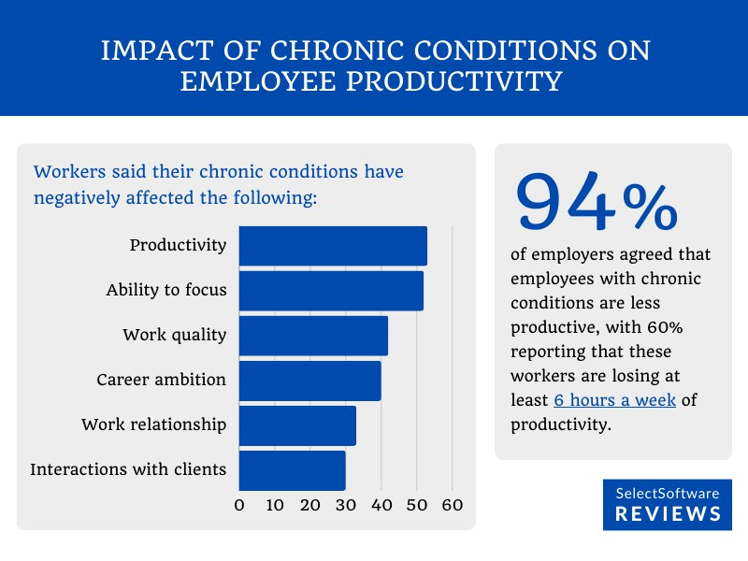
WHY KIRA?
Studies show that employees spend up to 20– 30% of their working time searching for tasks, emails, and information due to poor task organization.
According to workplace productivity reports, over 60% of organizations still rely on manual or semi-digital methods for task and HR management.
HR departments report that more than 50% of trainee-related issues are caused by poor task distribution and lack of progress tracking.

Slide 5
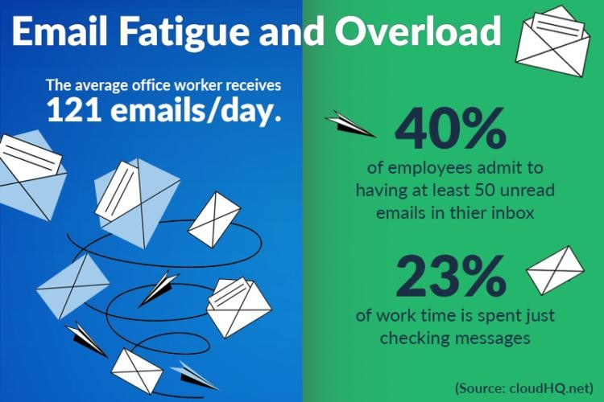
WHY KIRA?
Email remains the primary communication tool in organizations, yet over 70% of emails are not linked to actionable tasks, leading to missed deadlines and inefficiency.
Recent surveys indicate that organizations using AI-assisted workflow tools can improve
productivity by 25–40% compared to
traditional systems.
These challenges highlight the need for an intelligent, unified platform like Kira.

Slide 6









SOFTWARE TECHNOLOGIES USED
Tailwind CSS
Express Js
Node JS
MongoDB
AI Assistant AP
Postman
React
Vite

Slide 7







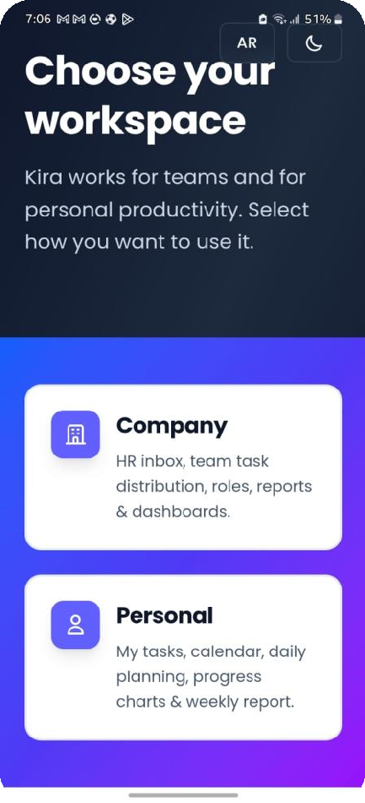
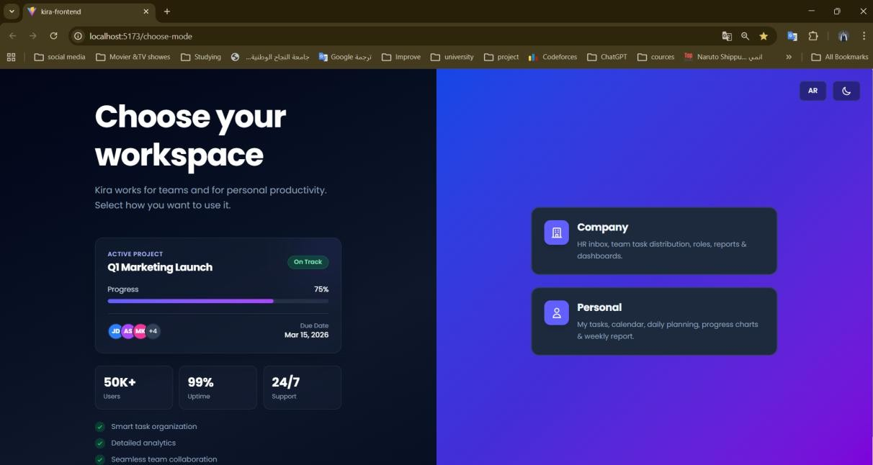






FEATURES

Slide 8
Secure account creation for different user roles (Admin, HR, Trainee, Personal User).
Role-based authentication and
authorization.
Secure login using encrypted credentials
and session management.
User profile management and account settings.
Access control based on user permissions.
Account creation &
login

Slide 9
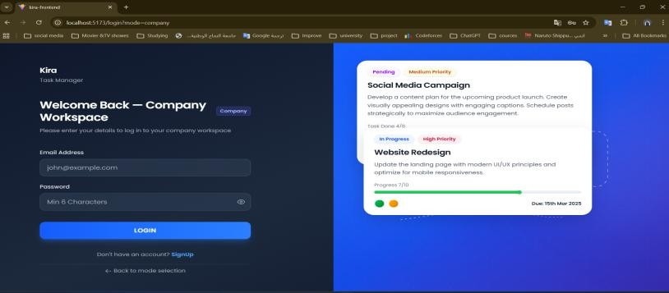
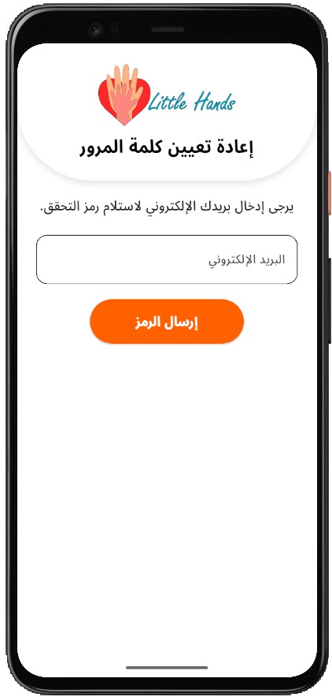
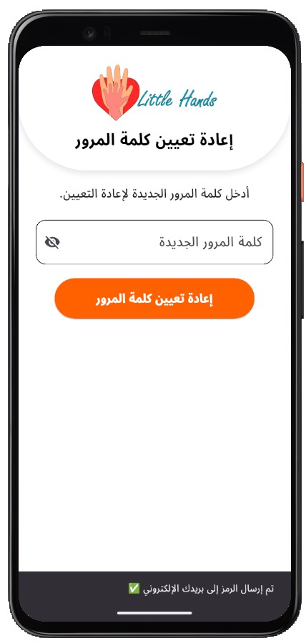
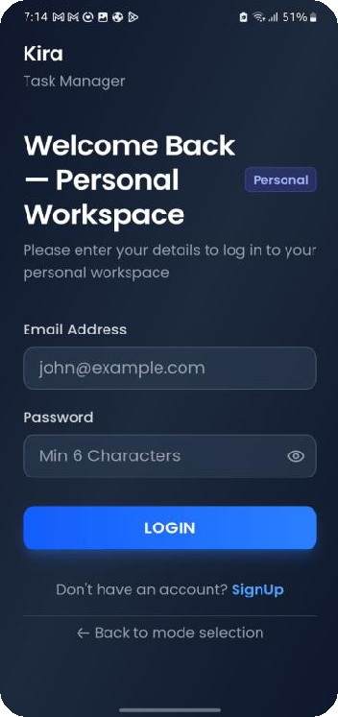
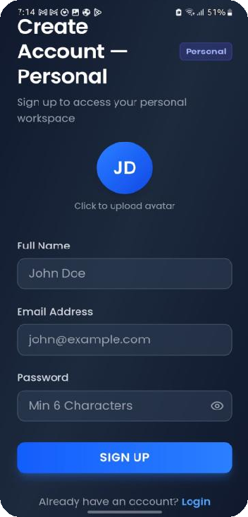
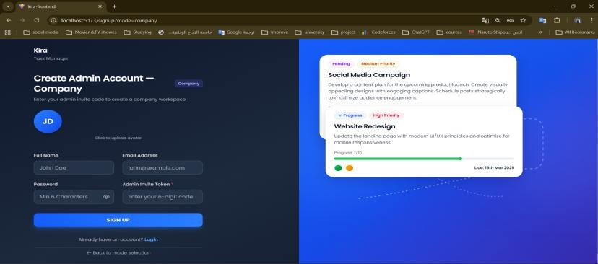

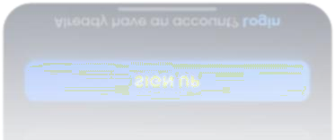
LOG IN & SIGN UP
Login & sign up Company
Login & sign up Personal

Slide 10
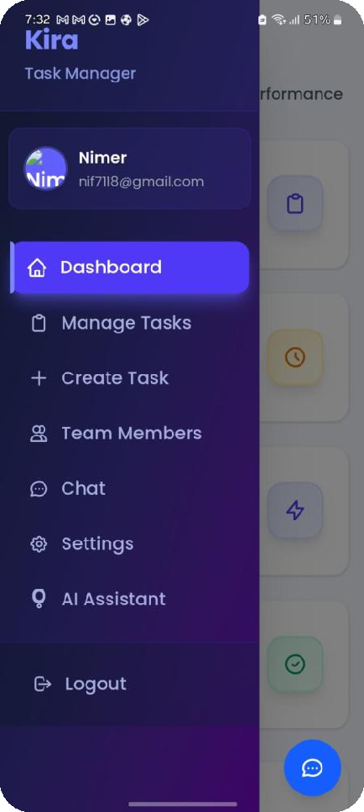
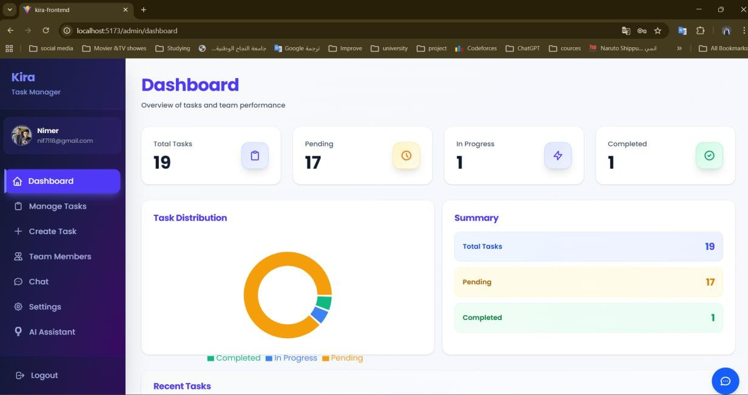

ADMIN PAGE
Dashboard & SideBar

Slide 11
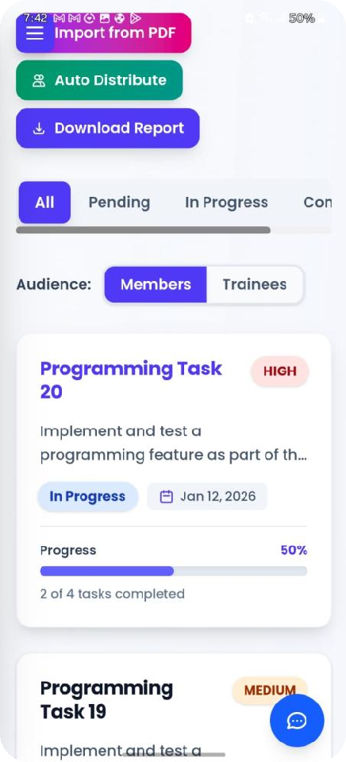
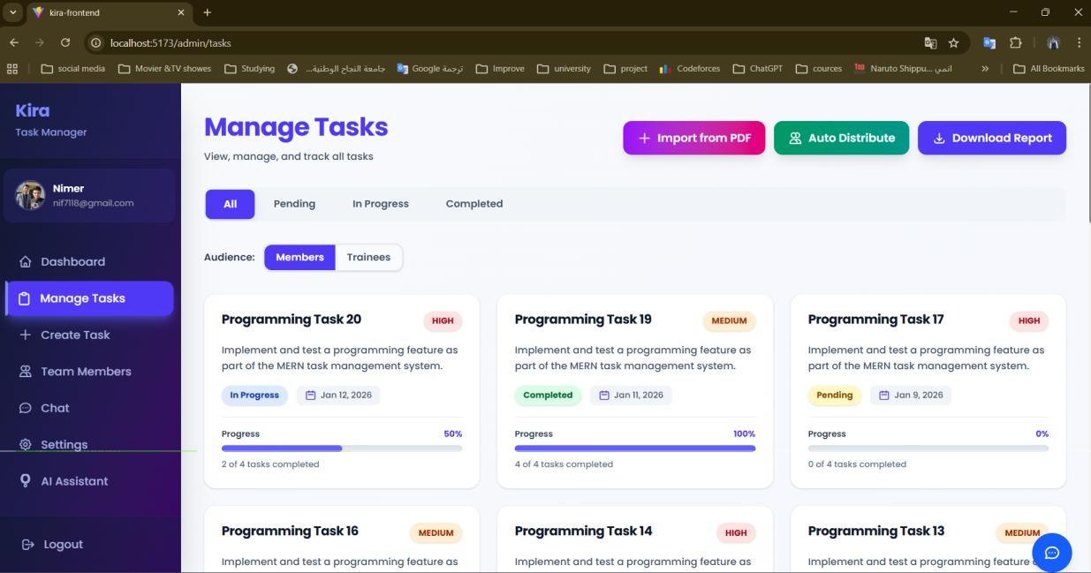

ADMIN PAGE
Manage Tasks

Slide 12
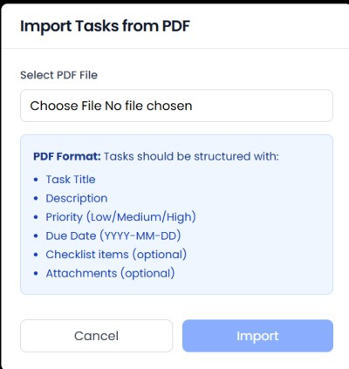
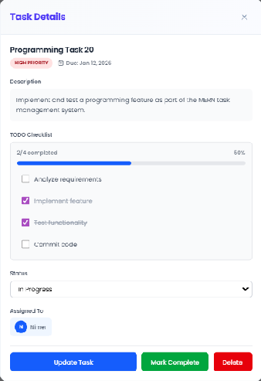
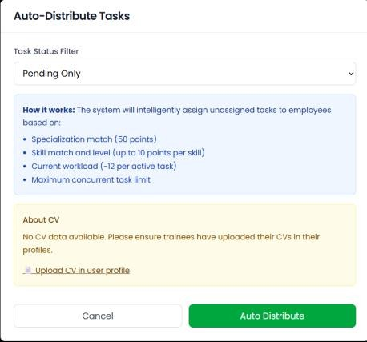
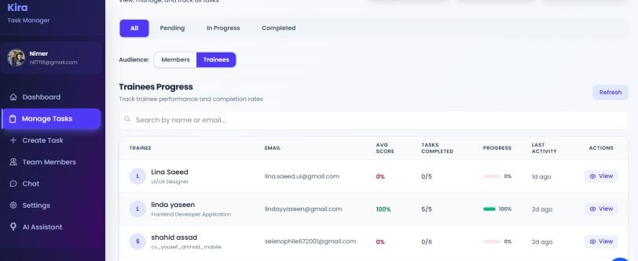
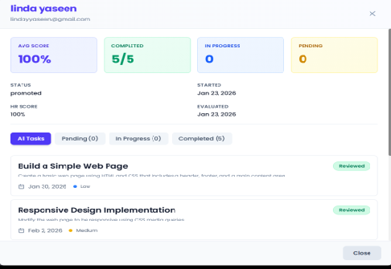
Manage Tasks

Slide 13
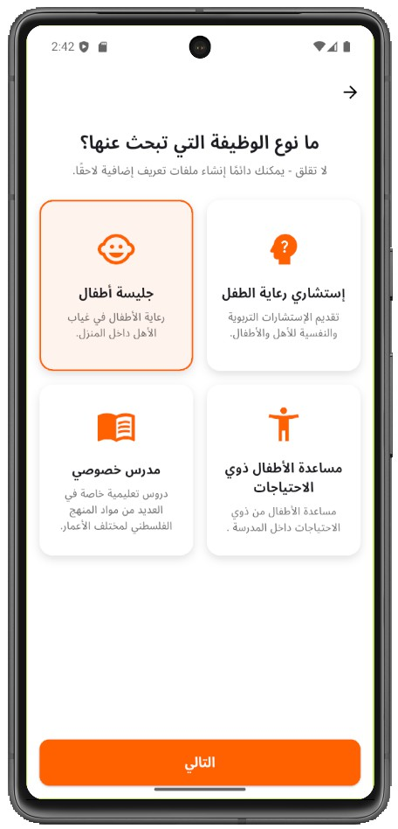
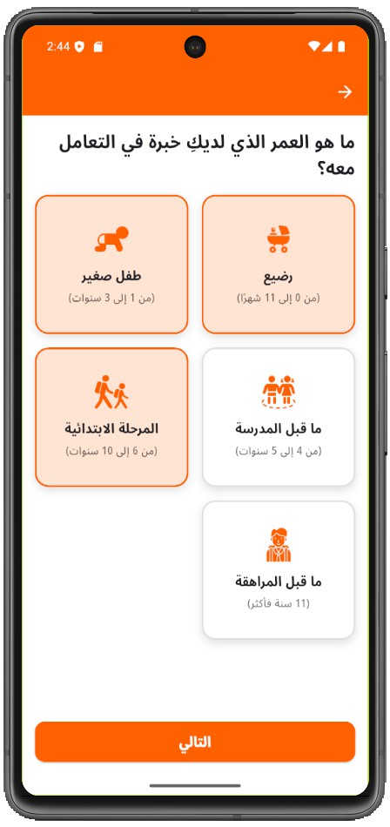
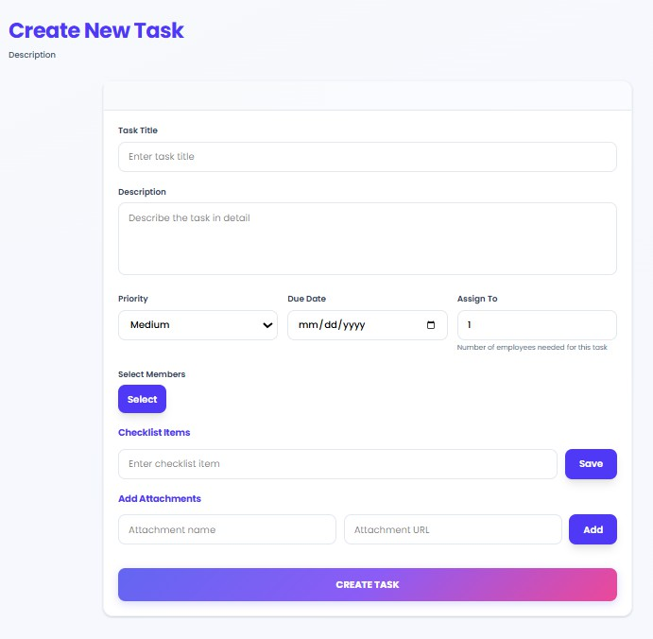
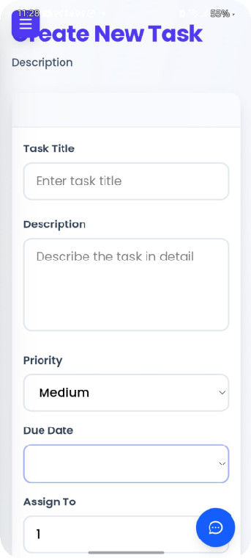
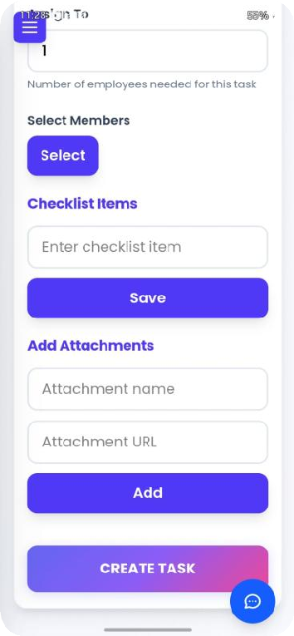
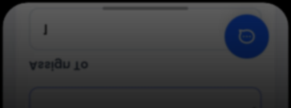

Create New Task

Slide 14
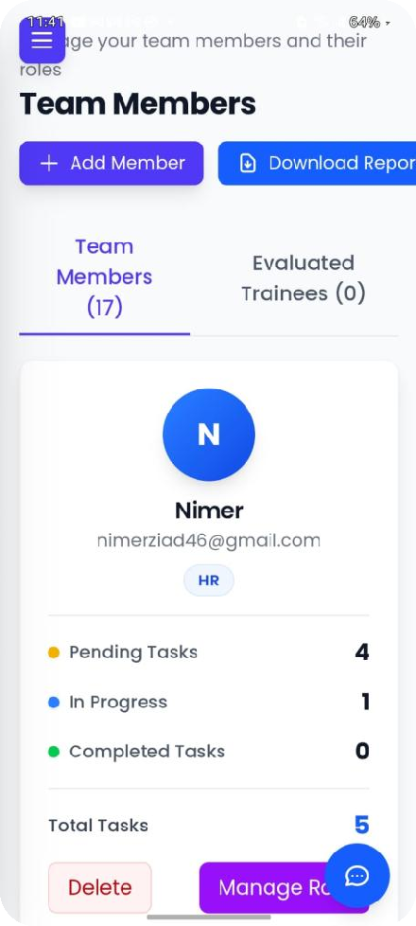
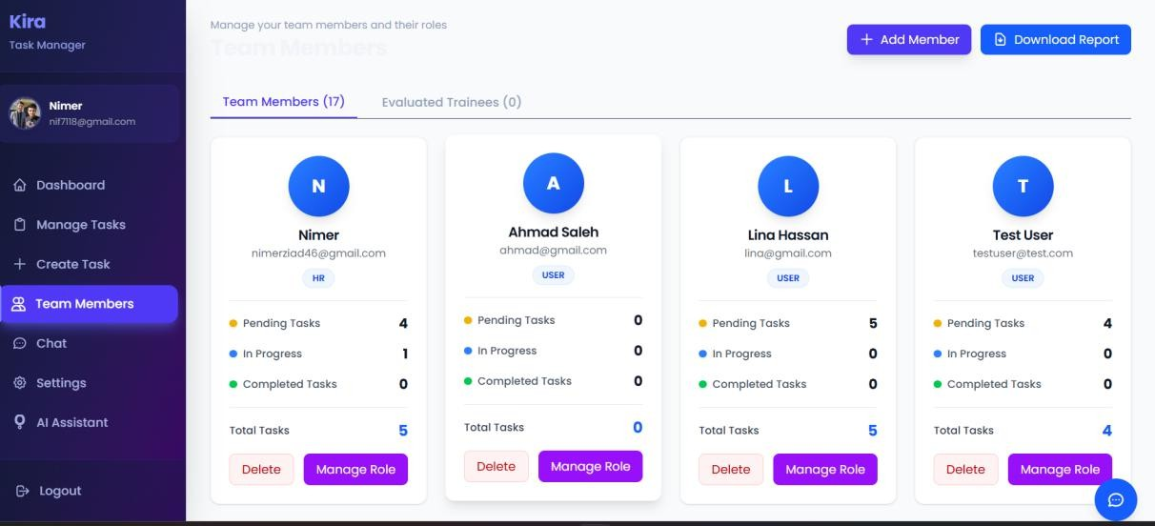

Team Members

Slide 15
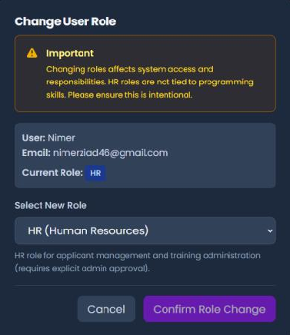
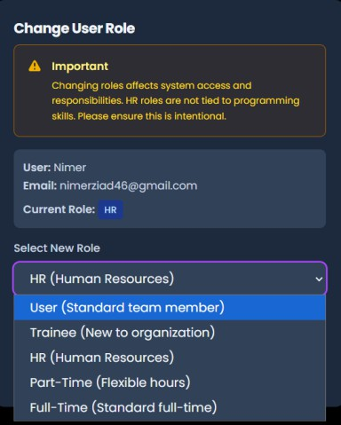
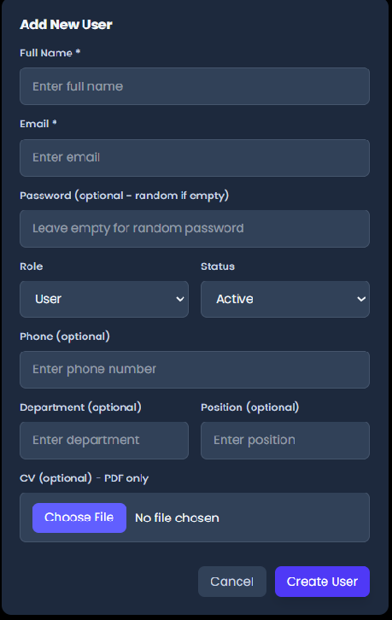
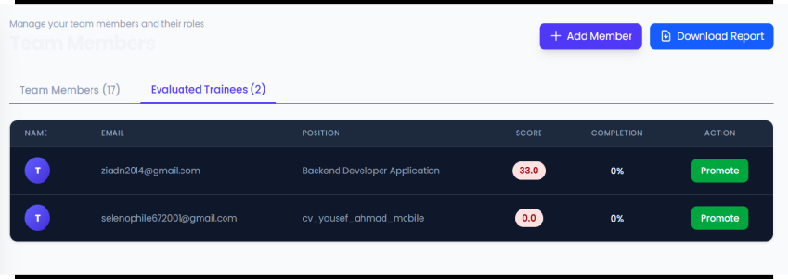
Team Members

Slide 16
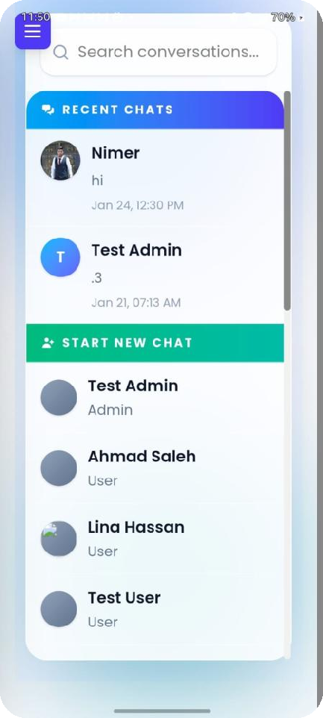
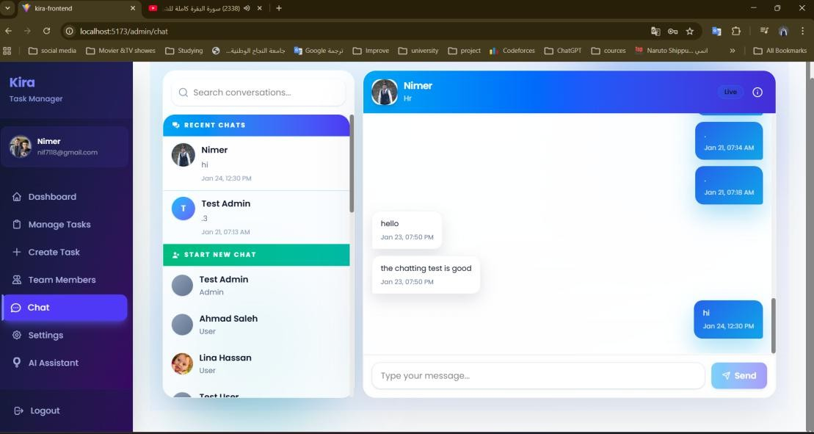

Chat

Slide 17
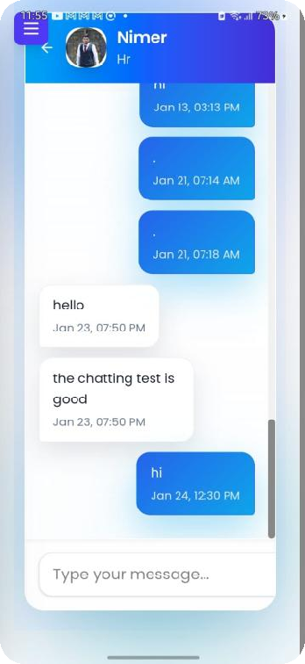
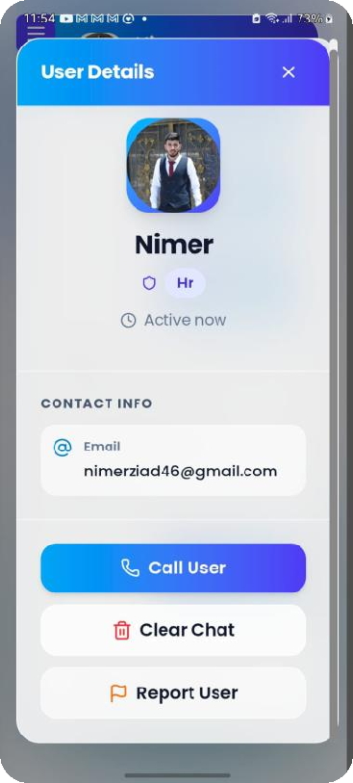
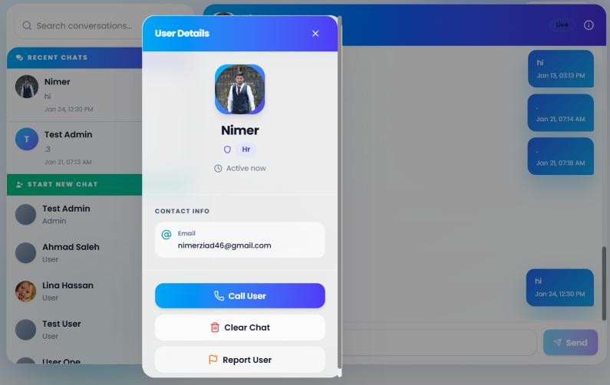
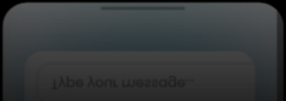

Chat

Slide 18
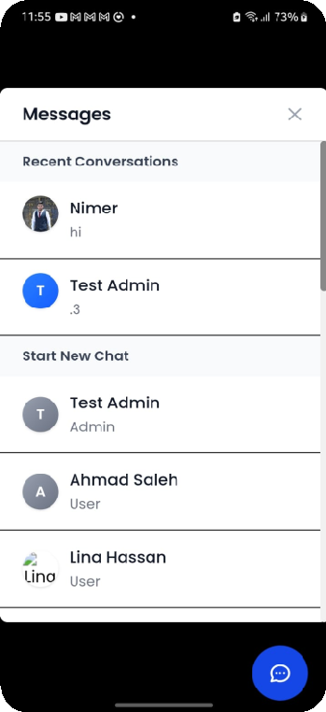
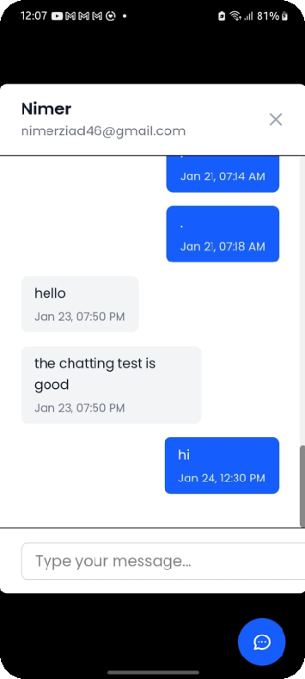
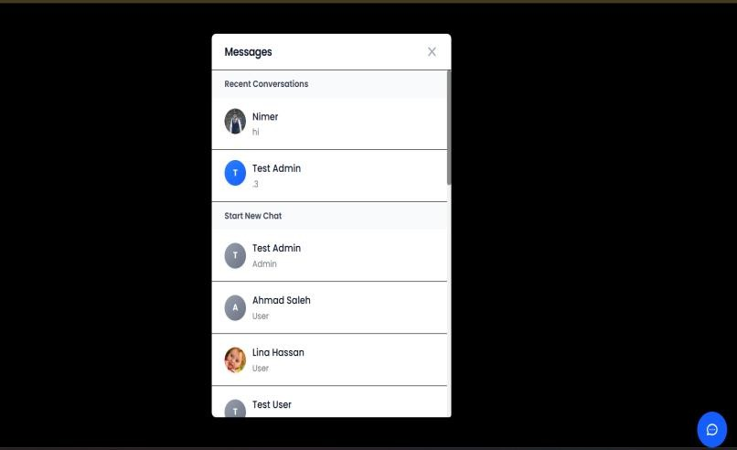


Pop Chat

Slide 19
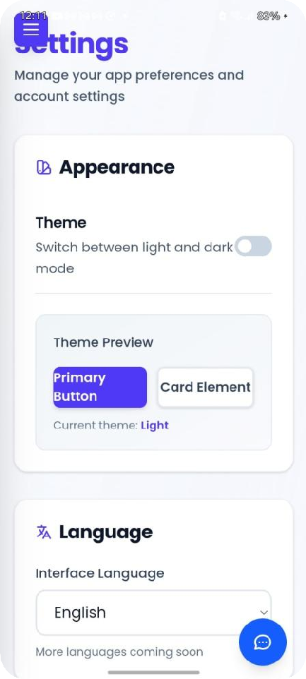
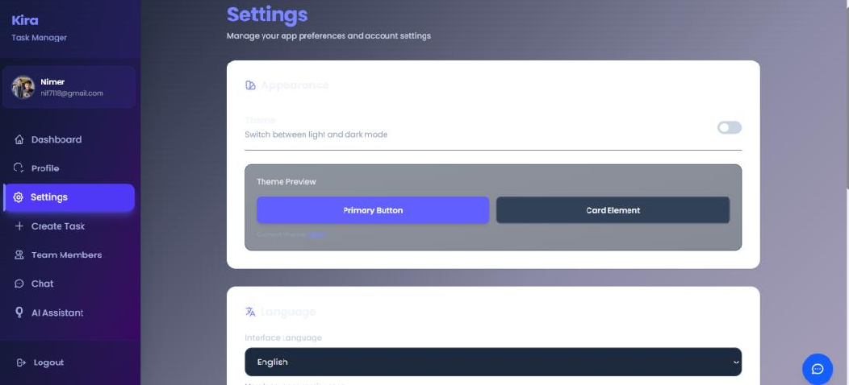

Settings

Slide 20
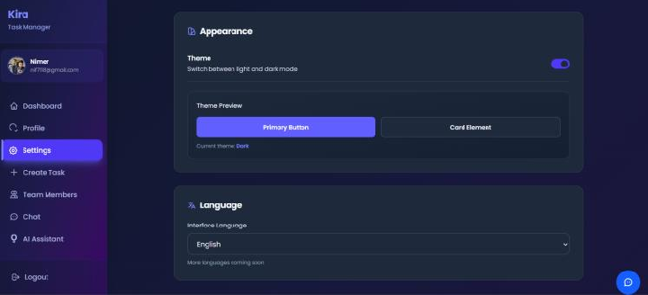
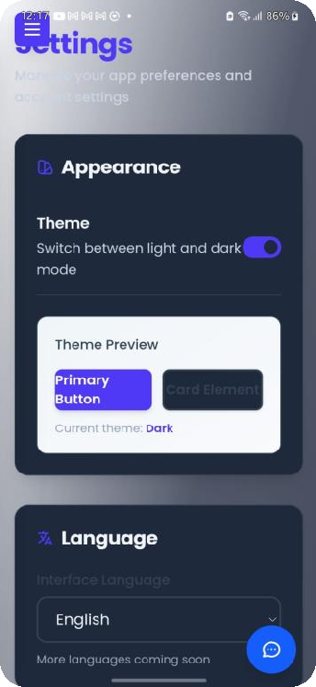
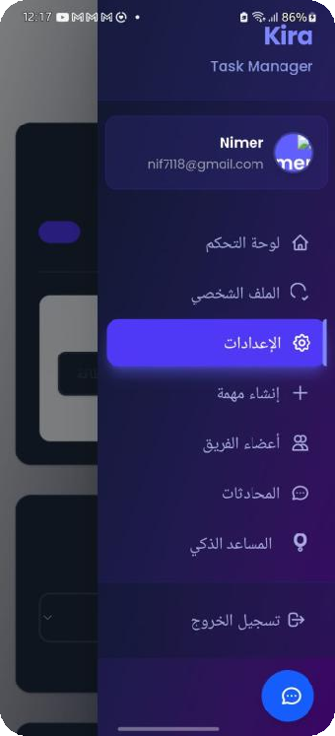
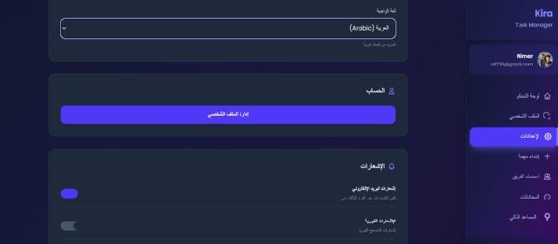
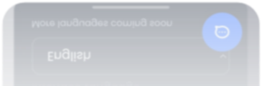

Settings

Slide 21
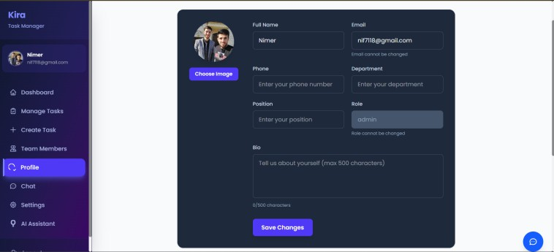
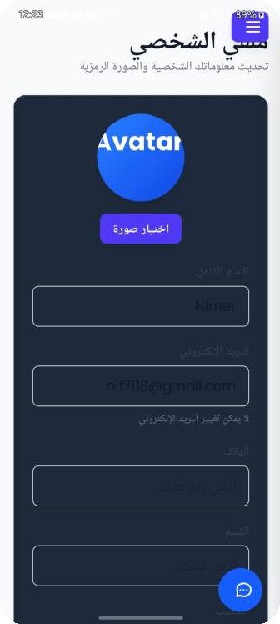




My Profile

Slide 22



Kira Assistant

Slide 23




HR page

Slide 24



Inbox

Slide 25






Inbox

Slide 26



Applicants

Slide 27



Applicants

Slide 28






Trainees

Slide 29





Trainees

Slide 30


Trainees

Slide 31



Training Page

Slide 32


Training Page

Slide 33



Training Page

Slide 34


Evaluate Trainees

Slide 35






Users

Slide 36



Personal Page

Slide 37






Personal Page

Slide 38




Personal Page

Slide 39
CONSTRAINTS & CHALLENGES
Limited development time, which restricted the ability to implement additional advanced features.
API limitations when integrating external services such as AI services and Gmail API, including rate limits and configuration complexity.
Database storage limitations, as the free database tier supports only up to 0.5 GB, affecting data expansion and scalability.
Dependency on third-party services, which introduced constraints related to availability, quotas, and performance.

Slide 40
FUTURE WORK
Public market launch of the personal version of Kira, enabling individuals to manage tasks, emails, and productivity using AI assistance.
Enterprise transformation of Kira into a scalable API and extension- based solution, allowing companies to integrate Kira directly into their existing platforms and systems.
Advanced AI automation, including smart task recommendations, workflow optimization, and context-aware assistance.
Enhanced security and trust measures, such as advanced authentication, audit logs, and compliance-ready access control.

Slide 41




