Slide 1

Prepared by : Anhar Dwaikat & Haya Taqatqa
Supervisors : Dr. Samer Arandi & Dr. Emad Natsheh

Slide 2

Acknowledgments
First and foremost , we would like to thank almighty God, to reconcile us at each step and for giving us everything to make our
work continuous without laziness and foil.
We also thank our supervisor Dr.Samer Arandi and Dr.Emad Natsheh who did his at most, by their advice, encouragement and guidelines to helped us and followed-up the project until the end.
Last and not least; we convey our warmest thanks to our families, friends and all the people who helped, supported and encouraged us to successfully finish the graduated project whether they were in the university or in our special lives.

Slide 3
Introduction
Practical training is part of the most complete degrees at universities. Practical training means studying which takes place in a company or business, and offers the student the opportunity to adapt to what she or he has learned in practice and develop professionally. Since the practical training is part of a student's studies, it must be planned well and supervision.
When the student wishes to train may face difficulties in some cases to obtain information on training views
And the type of training provided by the company as well as the need to organize training and follow-up of trainees students .
also the supervisor of academic training needed to determine the views and follow-up students and take an impression of their training and how they benefit from it and communicate with their fields supervisors.
The idea of this project which is online Practical Training Website and mobile application that we are going to make an easier and efficient way to control the management of the practical training and other details about who control them and then main work of them.
Then after we get that idea we start add new features to it, in order to make more efficient and reliable for them to make their management easier.

Slide 4
Abstract
The system is a web-site project that represents online Practical Training site. we prepared the system to include many activities, in our project we design and implement the system with five sides: Administration, Company, Field supervisor, Academic Supervisor and Student.
The student needs to register to web-site and then he can send a request Practical training and wait for administrator to accept his request. Then he can send a report every week and send the finally report. also he can upload files and send them.
Field supervisor added by company .he can see the report and modified it before the student send it. Also he can evaluate the students.

Slide 5
In our website have many pages , with the following content :
The admin page which can accept or remove the user , delete a supervisor or update supervisor's information. Also can determine the training destinations for students , see the training of the students requests and see the training company and their supervisors and the student who training at them .
The academic supervisor page which can show the train orders for their student and assign train place to them. In addition he follow-up reports and display field supervisors information to facilitate communication.
The student page which can introduce the order and fill the reports , also he can see the companies that related to his specialization and information about it .
The company page which can update her information and accept the orders of training for student and assign field supervisor to them.
The field supervisors page which can update his information and follow-up to his students and reports and assessment their at the end of training.

Slide 6
The Environment:
Actually, we have used many languages in building this system and there are :
HTML, JavaScript, CSS.
PHP language.
Wamp Server.
Dreamweaver.
Applications Used:
Microsoft Expression Web 4.
Adobe Dreamweaver .
Android Studio.
PHP storrm.
Notepad++.

Slide 8


Slide 9
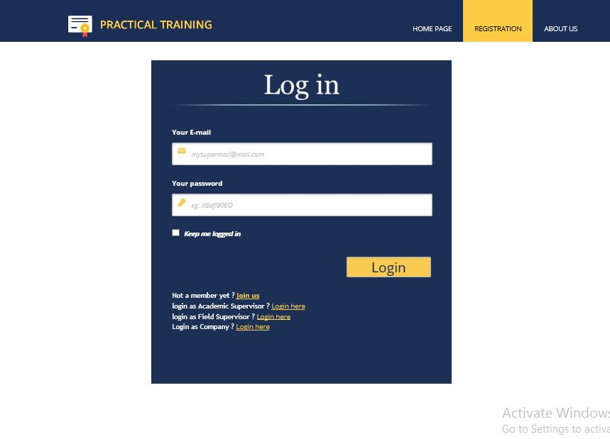

Slide 10


Slide 11
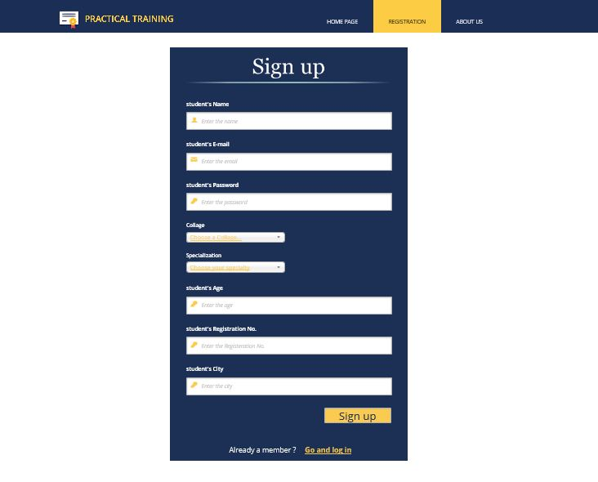

Slide 12
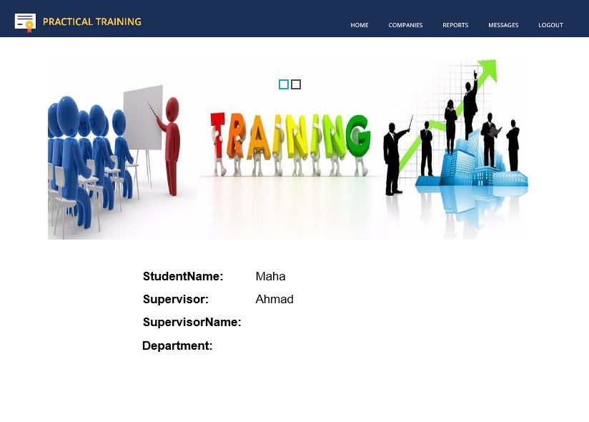
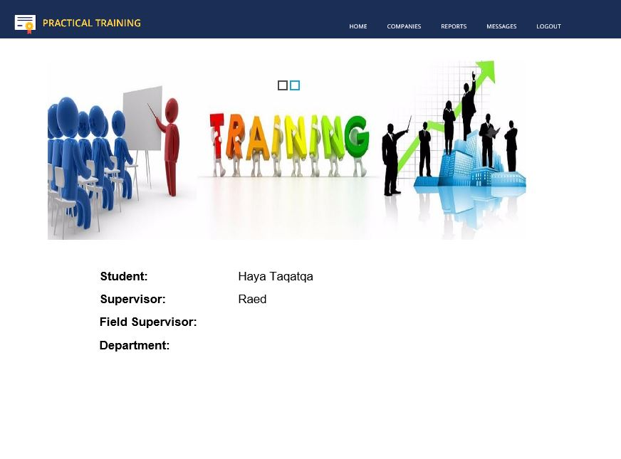

Slide 13
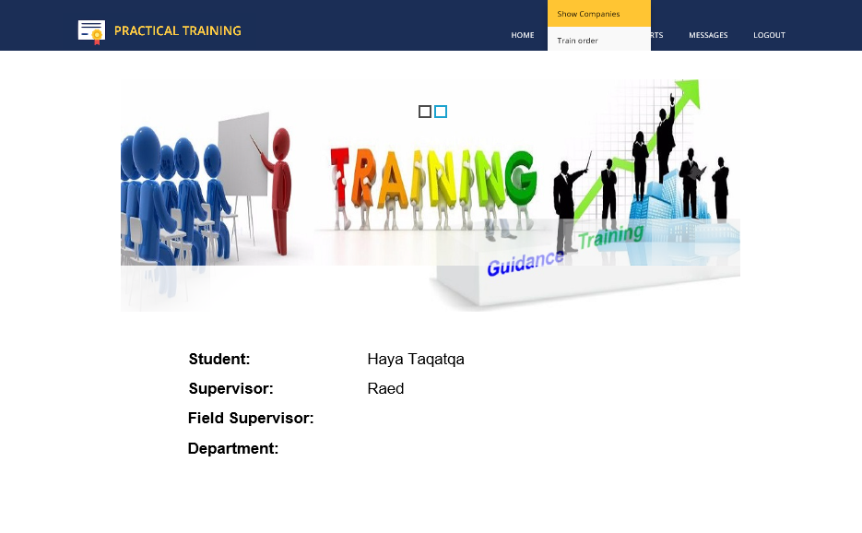
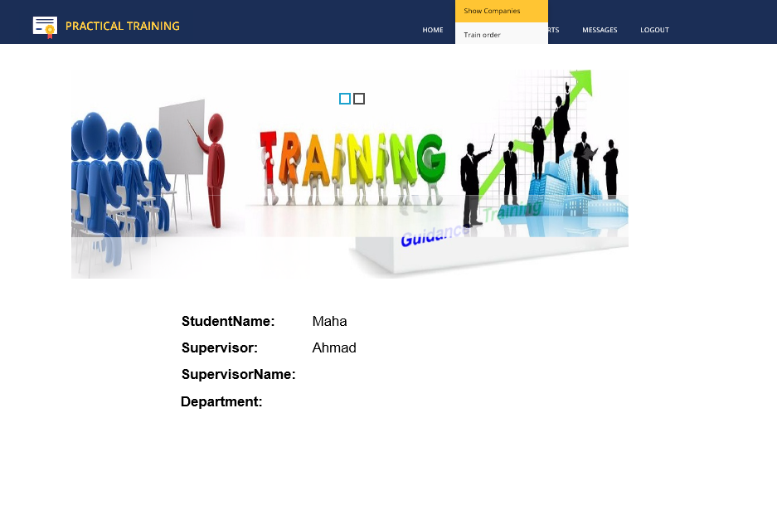

Slide 14
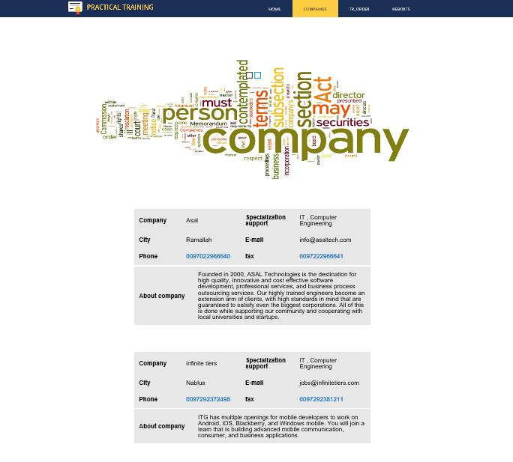

Slide 15
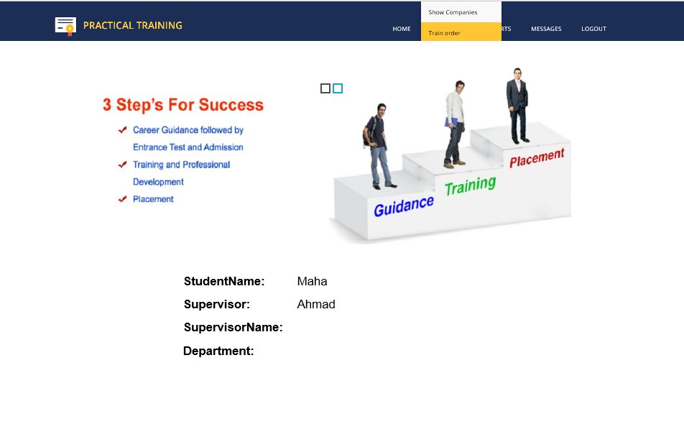

Slide 16
Train Order before send

Slide 17
Train Order after send

Slide 18
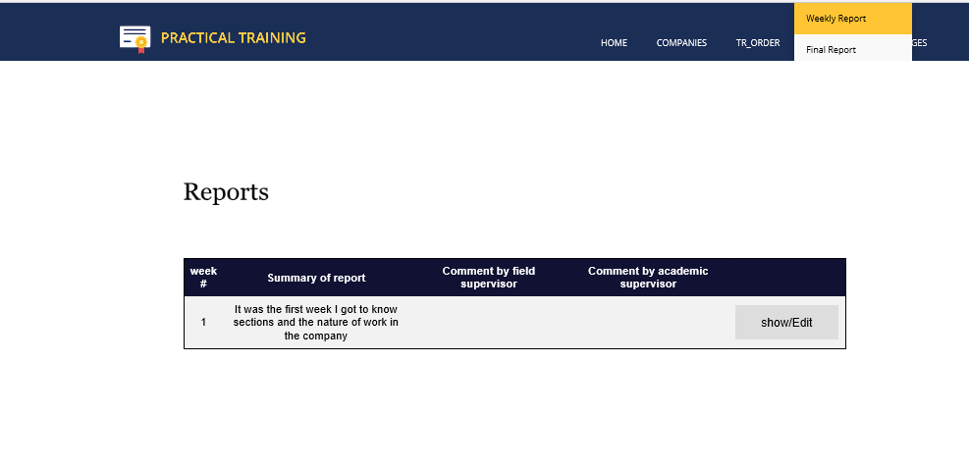

Slide 19
Weekly Report

Slide 20
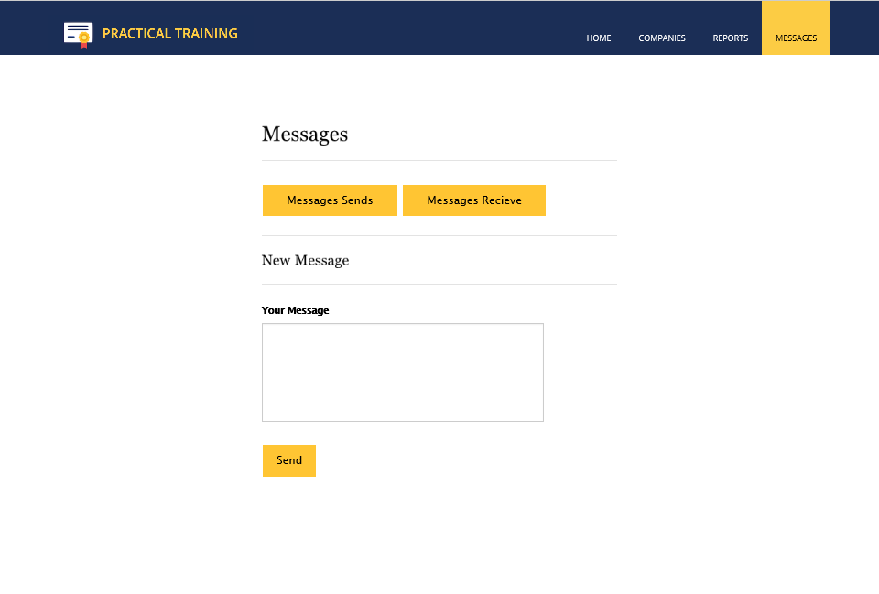

Slide 21
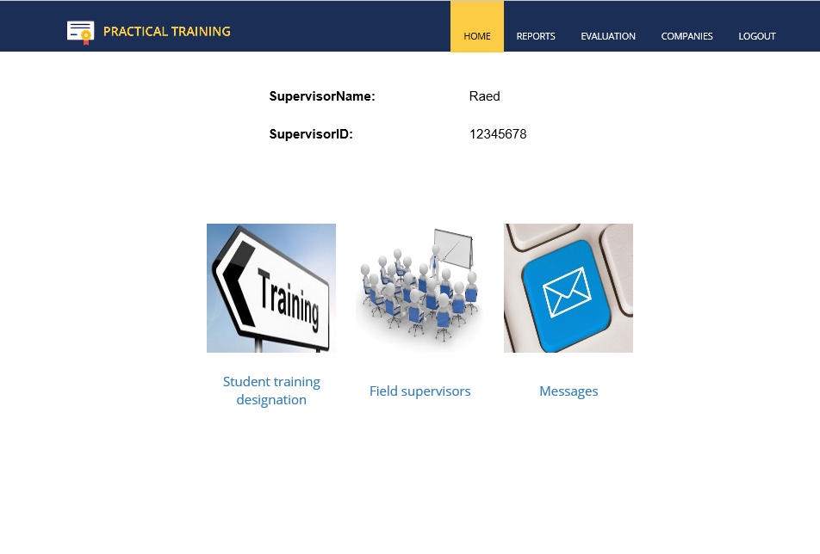

Slide 22
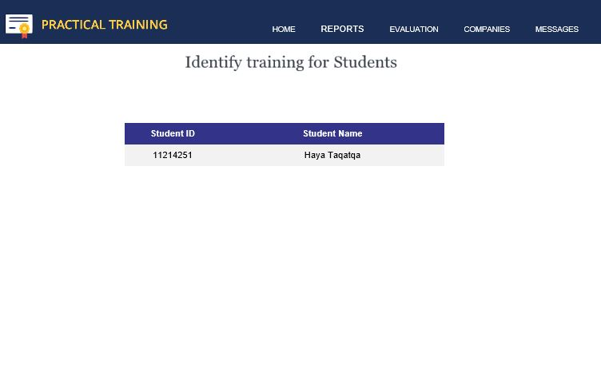
عرض أسماء المتقدمين بطلبات التدريب

Slide 23
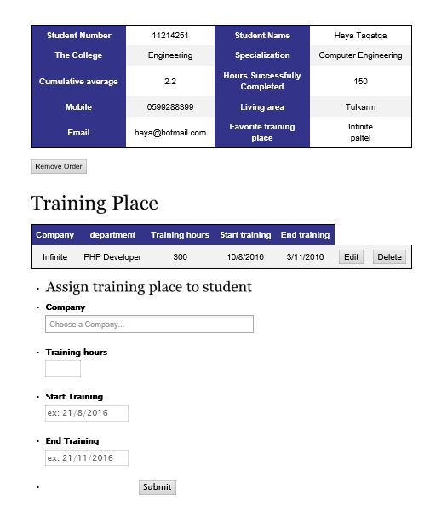
عرض طلب التدريب

Slide 24
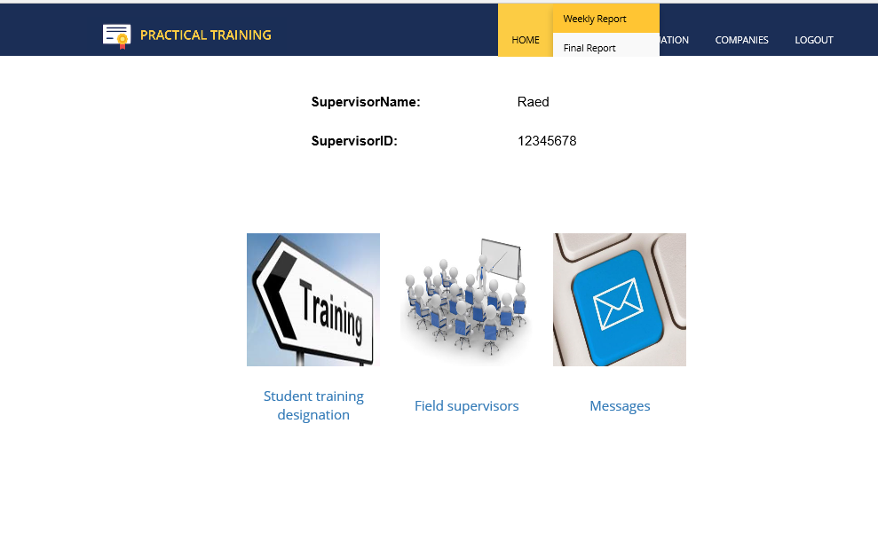

Slide 25
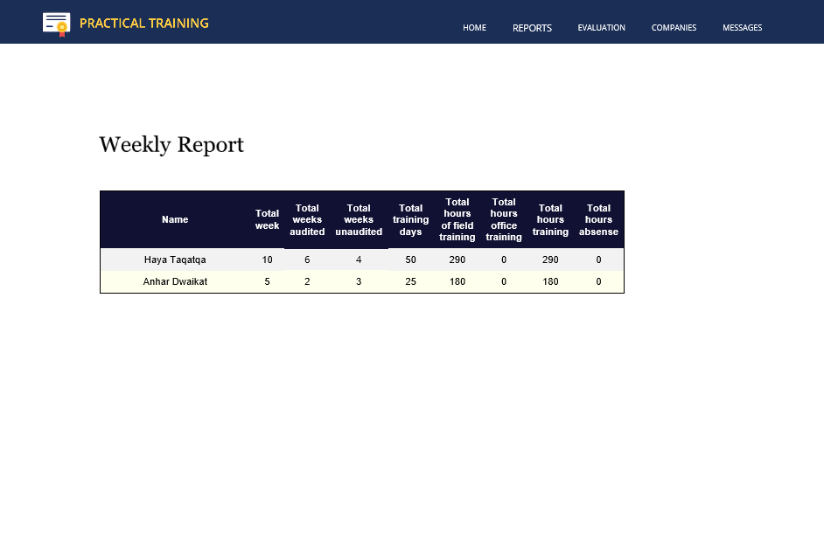

Slide 26

Company

Slide 27
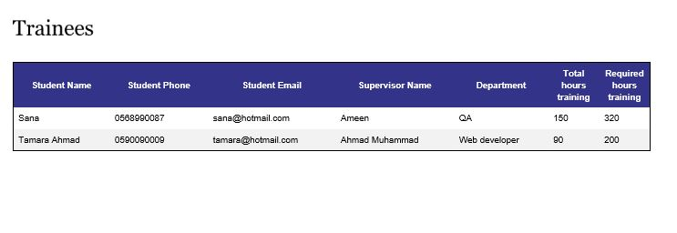
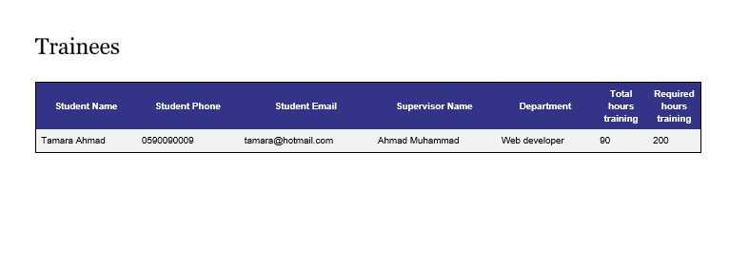

Slide 28
عرض المتقدمين بطلبات تدريب

Slide 30
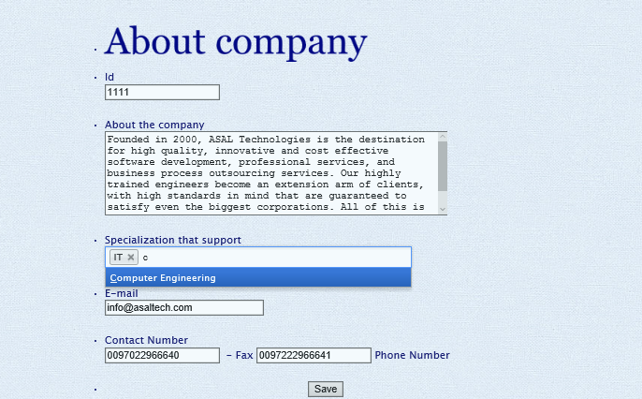

Slide 31
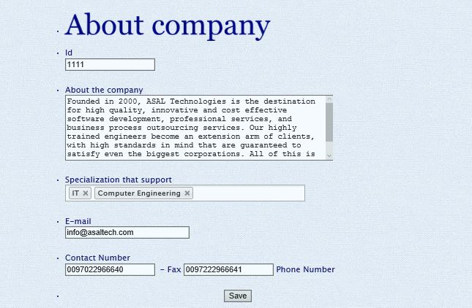

Slide 32
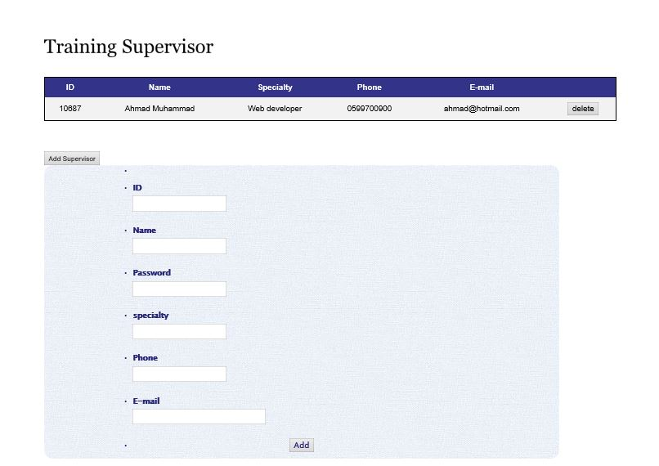
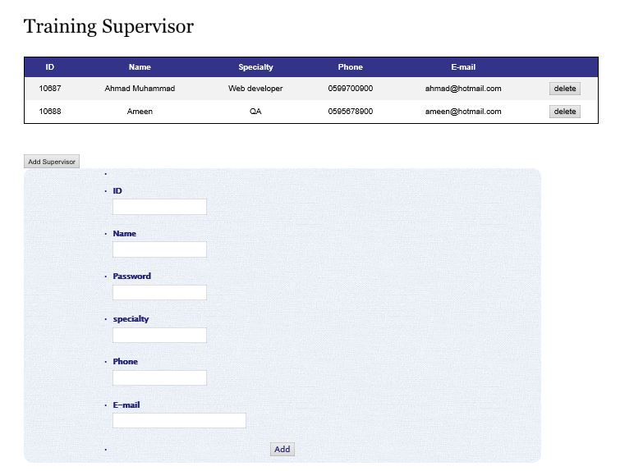
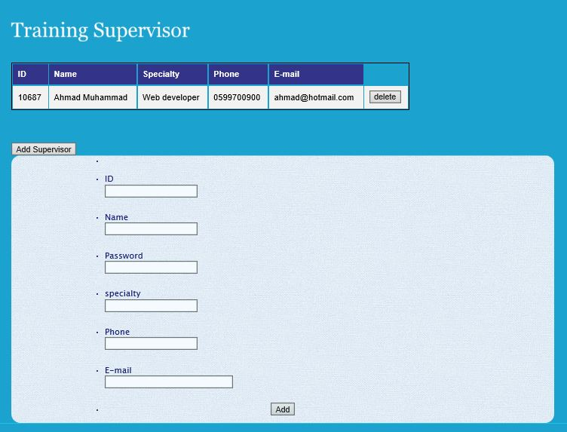
إضافة مشرف

Slide 33
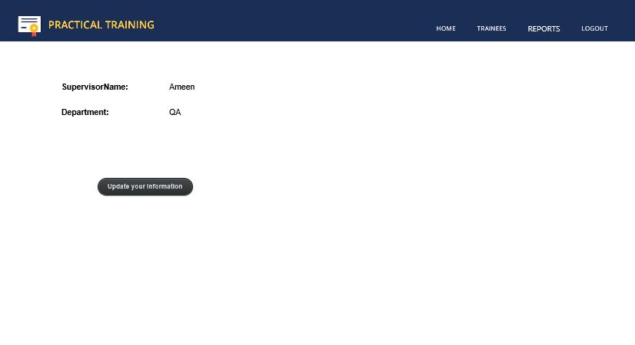

Slide 34
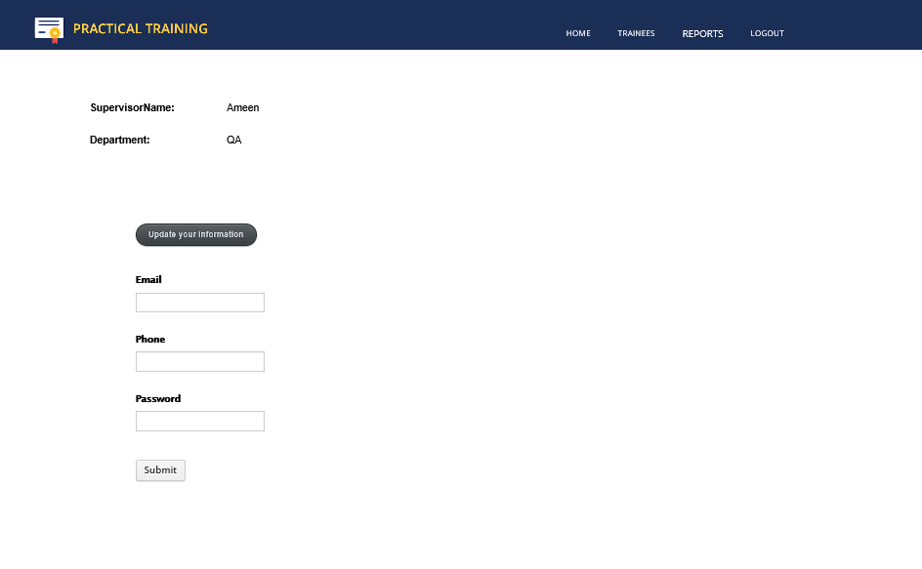

Slide 35
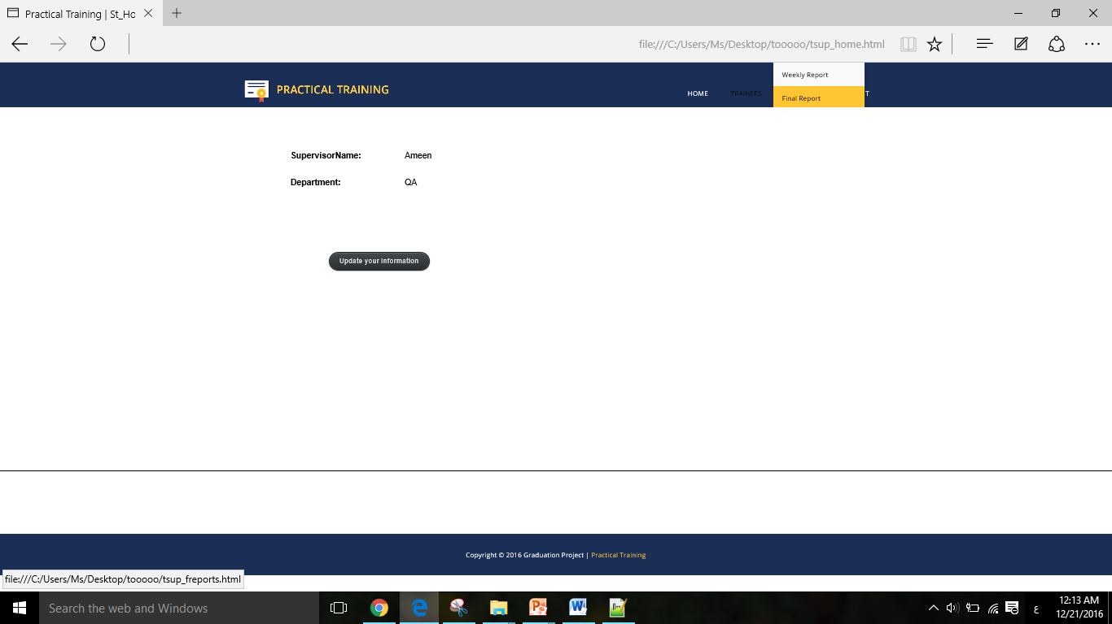

Slide 36
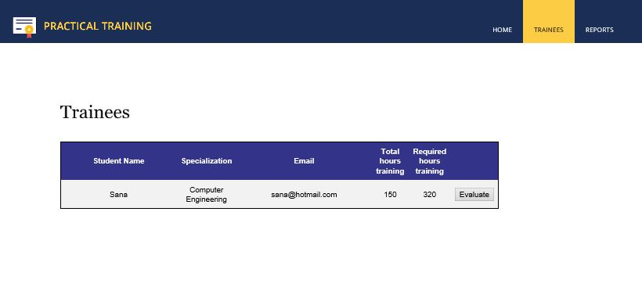

Slide 37
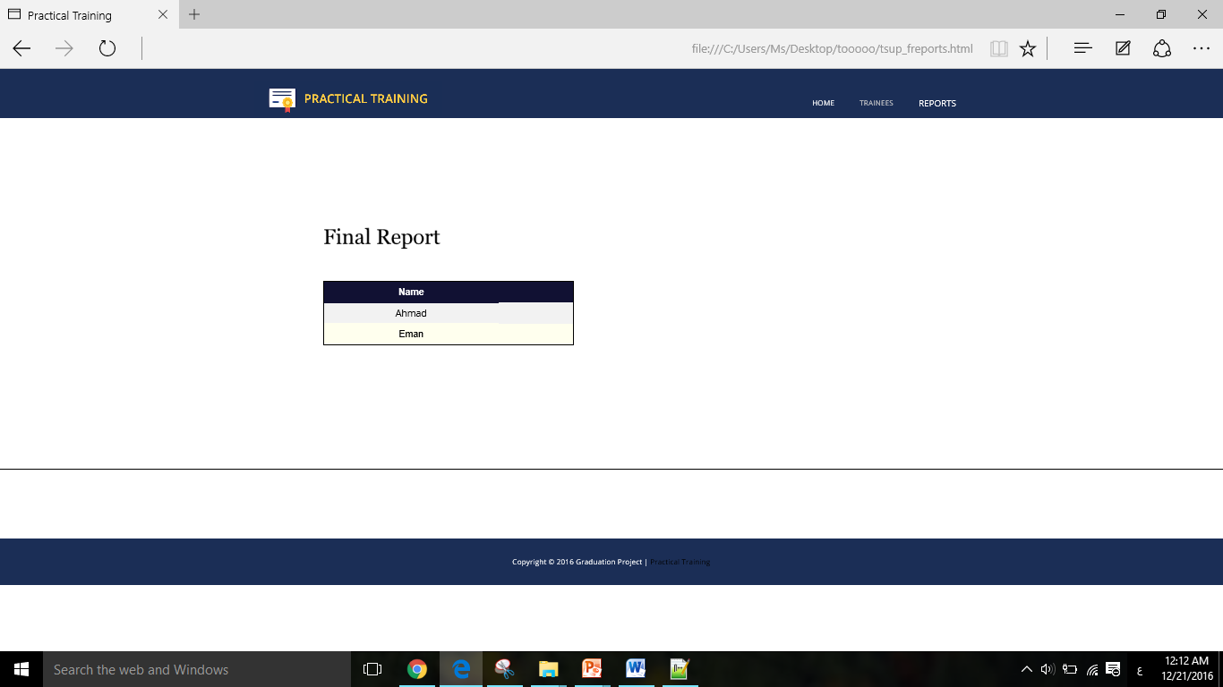

Slide 38
عرض التقرير النهائي

Slide 39

Android Part

Slide 40
Practical Training Android App in presentation:
- Android Studio v2.3.3 the latest version.
- Build on Latest android API 5 Lollipop and above.
- Photoshop for designing and build UI screens, Sketch App for design mockup and Layout
- Use the latest technologies API like GSM fire base notification and more.
- Use Material design theme and follow the Android UI Guidelines
- For coding and development we use OOP, Design patterns and best practices.
- Support all screens resolution like phones and tablets.
- We Considered App performance and smooth UI

Slide 41
Android App :
- Login
- Home : Student basic information
- Messages : Badge messages , incoming and outgoing and send messages
- Training order :Submit, edit.
- Weekly report : Show all weekly report, add , edit ,delete weekly report
- Final report : Submit, Edit
- About us : Information and contact us
- Setting : logout and and change profile picture

Slide 42
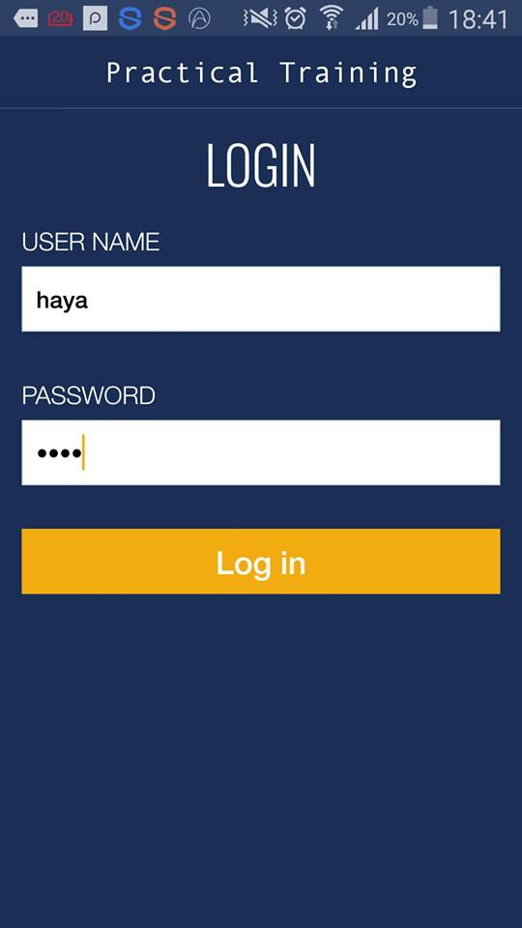

Slide 43
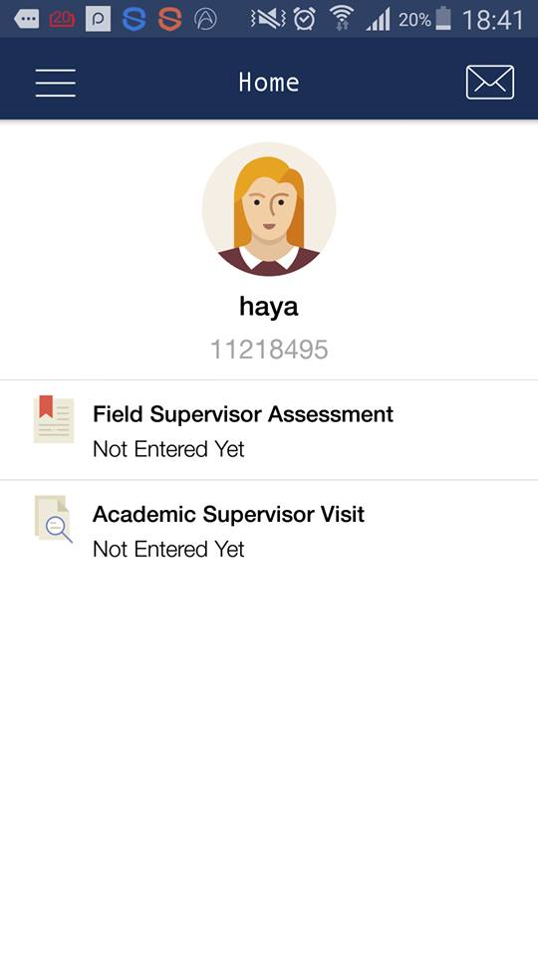
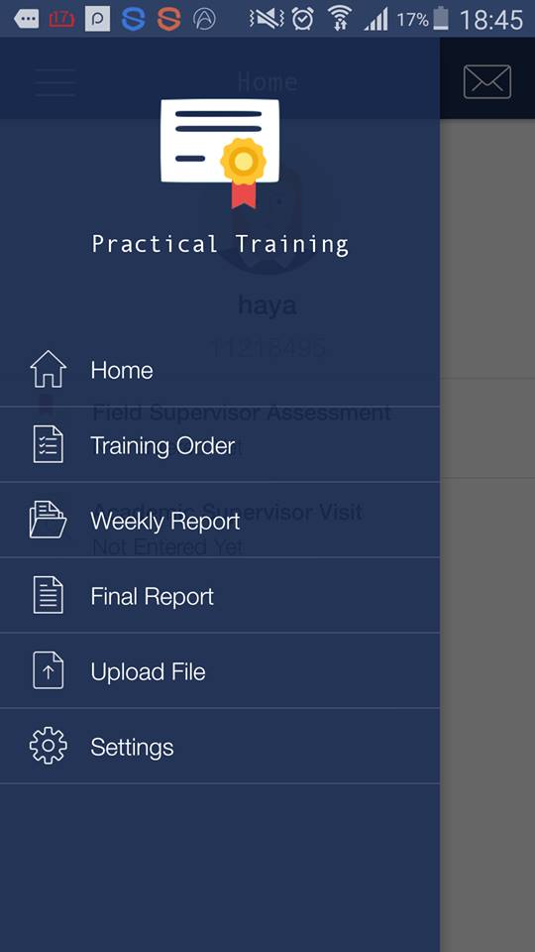
Student Account in Android:

Slide 44
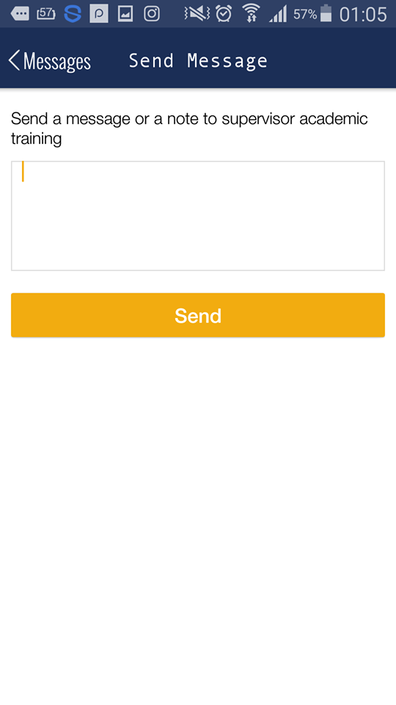

Slide 45
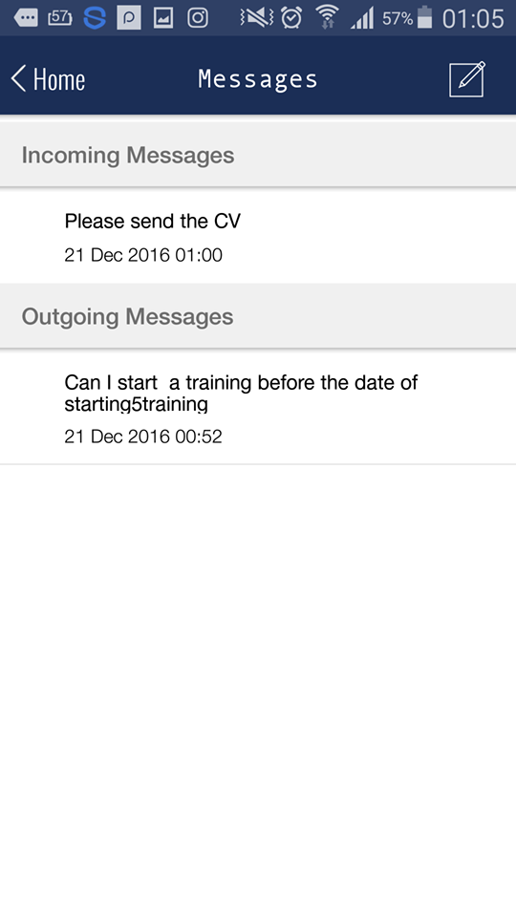

Slide 46
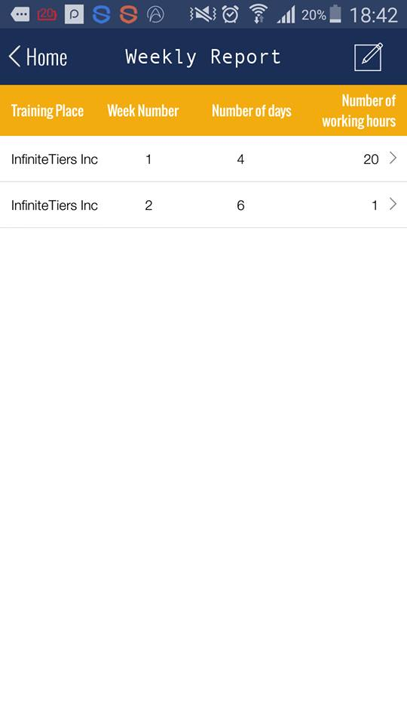

Slide 47
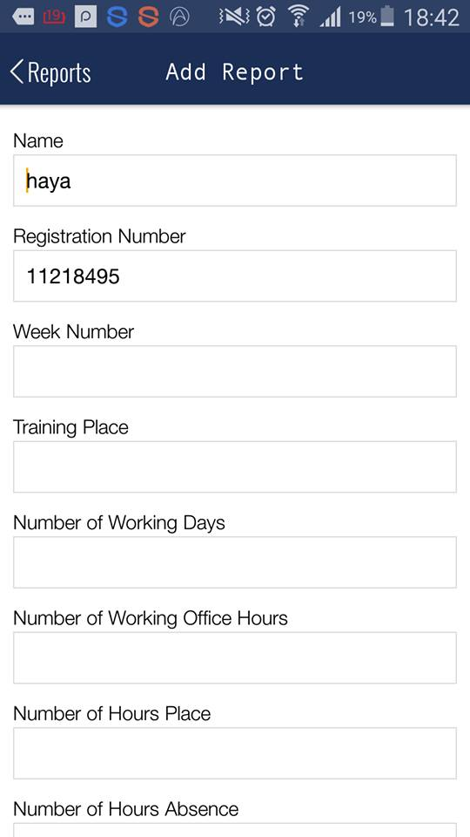
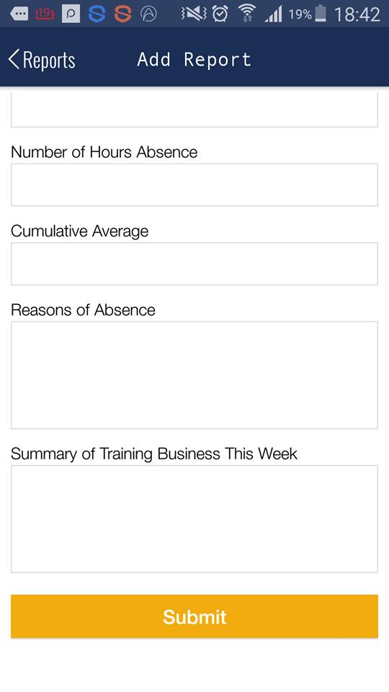

Slide 48
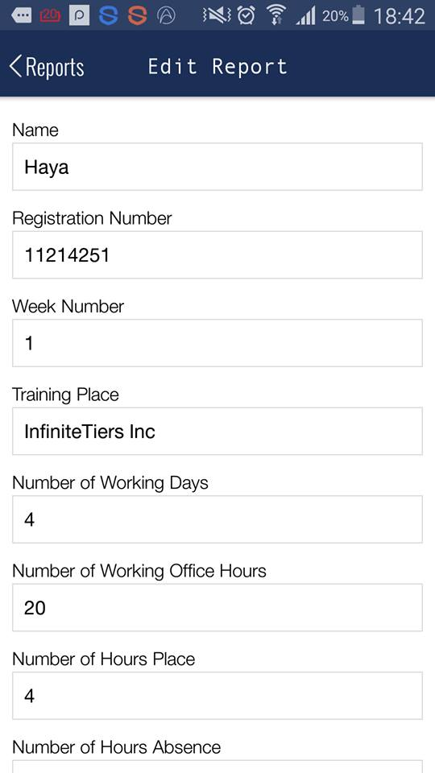
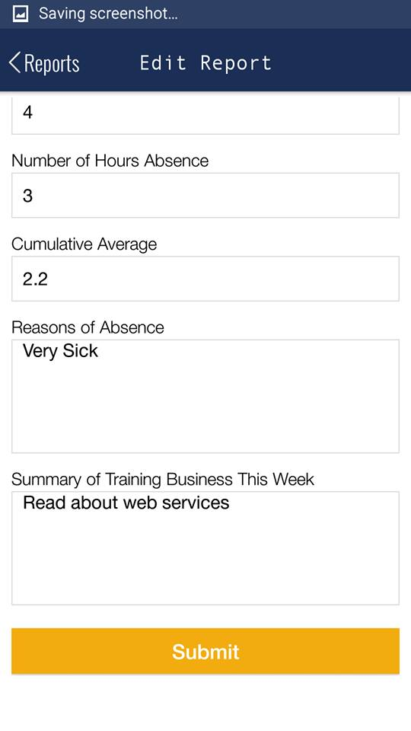

Slide 49
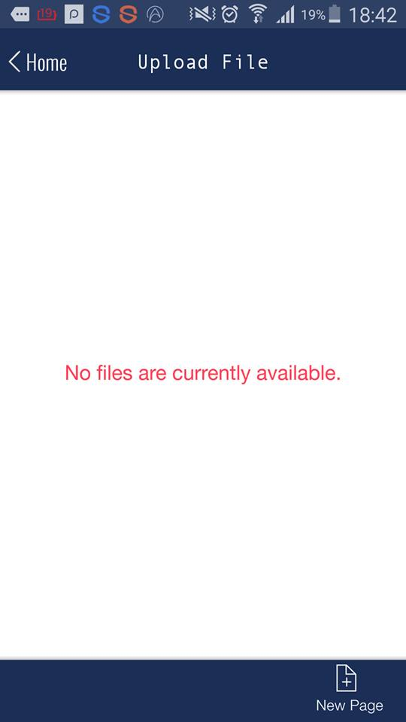
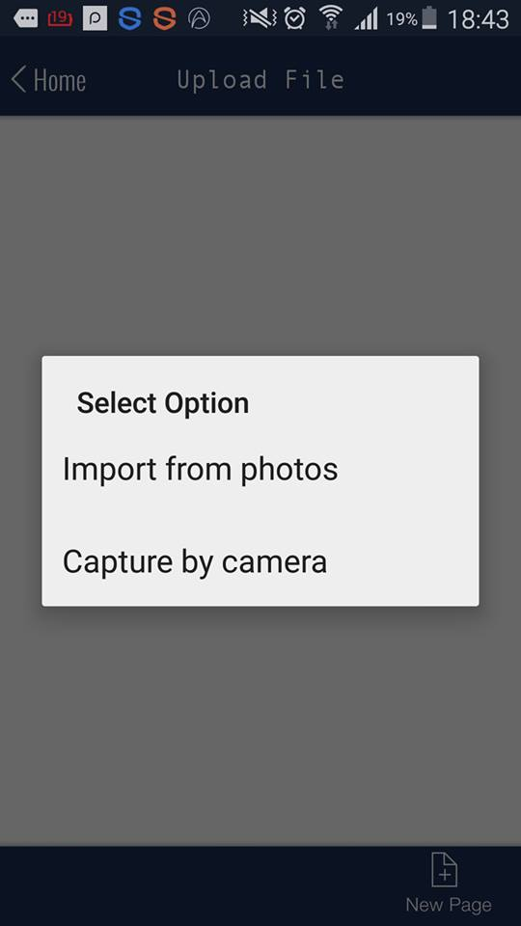

Slide 50
Future Work:
We hope to complete and expand this project after we finish this semester. There is a future can added to our project in future which is:
-The possibility of the use of the mobile application by the supervisor to facilitate the process.
-Chat In addition to facilitating communication between the student and the academic & field supervisor

Slide 51


