Slide 1
Aurora
self-driving car
Rola Khatatba
Salaheddin Badawi
Supervisors:
DR. Emad Natsheh
DR. Anas Tomah

Slide 2
Outline
Introduction
Motivation & Importance
Features
Technologies
Methodology
Results
Future Work

Slide 3
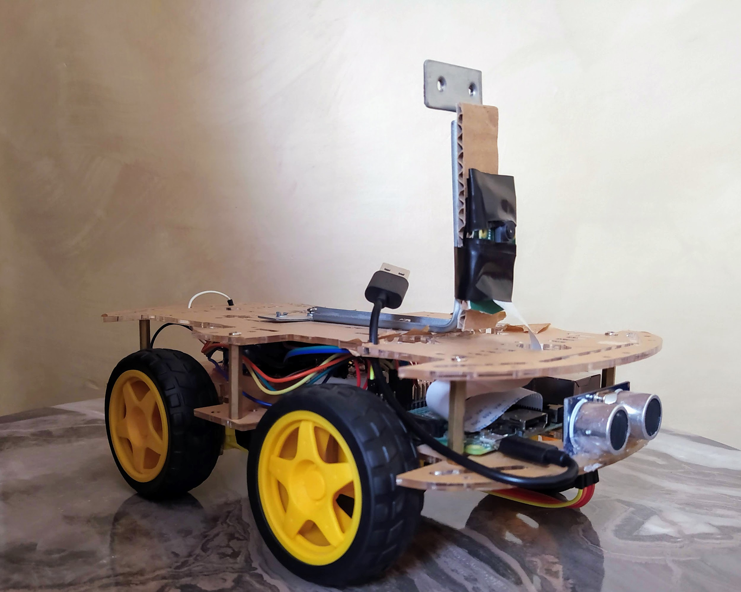
What is Aurora?
It is a self-driving vehicle, that uses image processing for detecting the angle of the road, recognise traffic signs and traffic lights, and act accordingly.
Figure 1: Aurora image

Slide 4
Motivation and Importance
Advances in autonomous cars industry, ex: tesla.
Reduce car accidents.
Control traffic.
Reduce air pollution.
Transportation without driver or a licence

Slide 5
Features
Angle detection of the road.
Detection and recognition of some Road signs and traffic lights.
Decision making (moving in the right direction and angle).
Obstacle detection and collision avoidance.
Commit to traffic laws.

Slide 6





Technologies
Figure-2:Raspberry PI
Figure-3:OpenCV
Figure-4:Python
Figure-5:VNC viewer
Figure-6:Putty

Slide 7
Methodology
Sign detection and Recognition.
Hardware.
Angle detection.
Path construction.

Slide 8
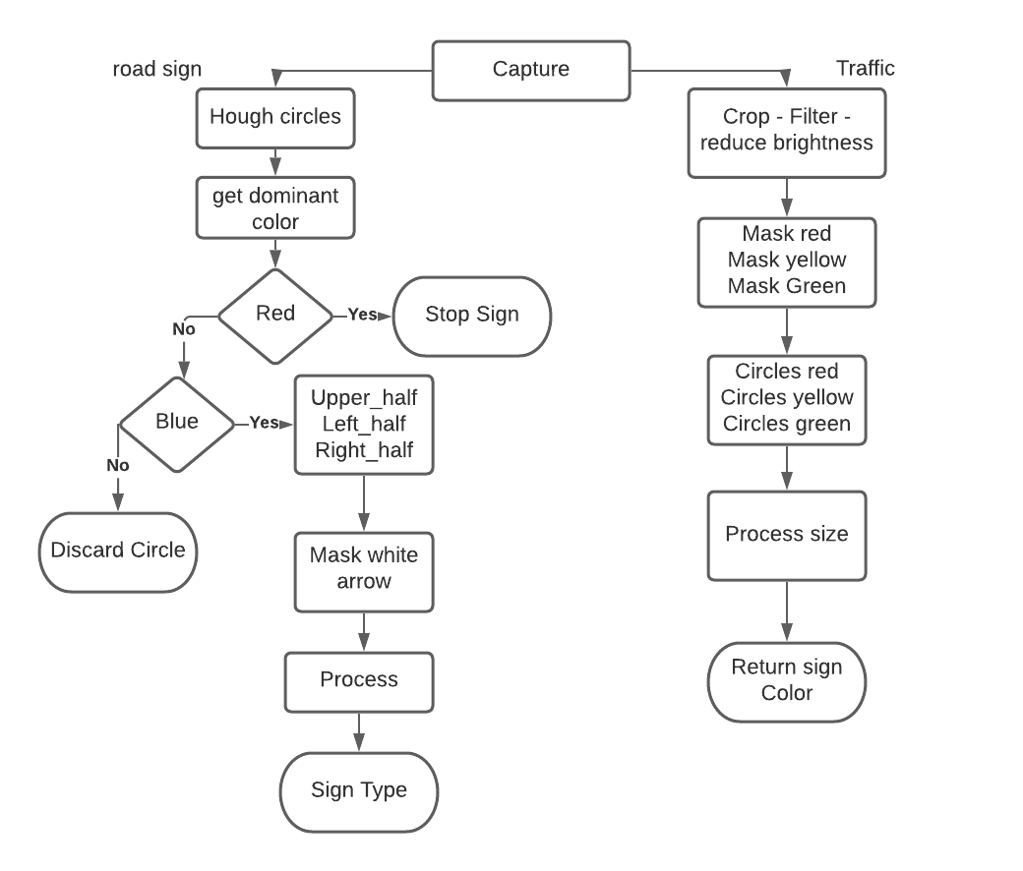
Signs Flow Chart

Slide 9
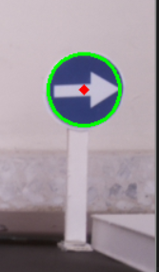
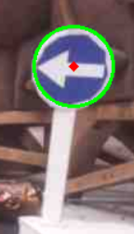
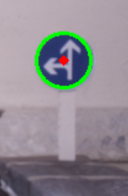
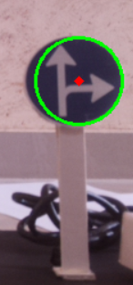
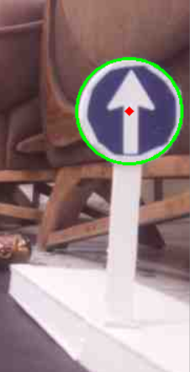
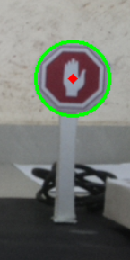
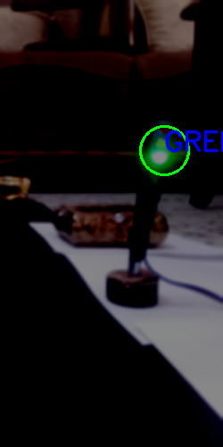
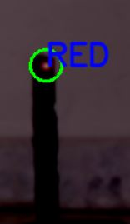

Software : sign recognition

Slide 10
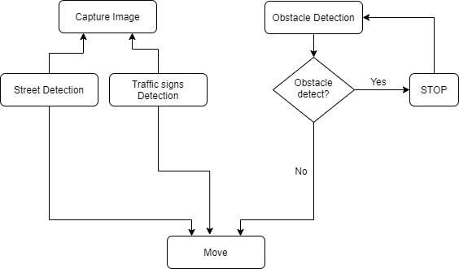
Car Movement flowchart
Figure-7:System flowchart

Slide 11
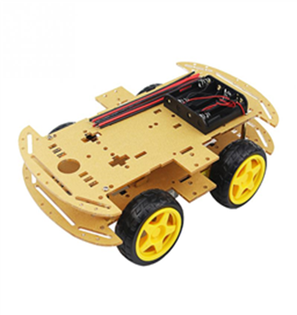
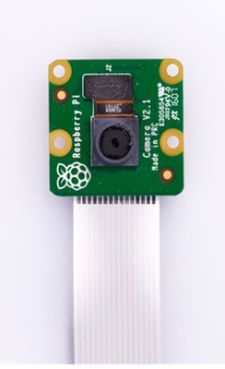
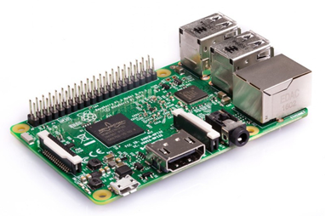
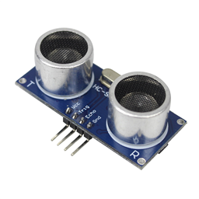
Hardware
Implemented using raspberry pi as a controller, with a mini-model of a car skeleton and 4-DC motors for each wheel,plus a camera and an ultrasonic sensor.
Figure-8:Raspberry PI model 3 b+
Figure-9:Raspberry PI camera module
Figure-10:Ultrasonic sensor
Figure-11: Car chassis kit

Slide 12

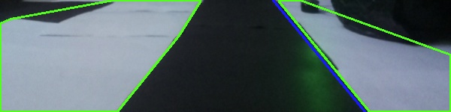
software : angle detection
Image preprocessing.
Detecting lanes or lane (beside on angle of movement)
Compare it to the ideal case (straight street)
Subtract the angle of the lane from the angle of comparing
Figure-12: case 1
Figure-13: case 2

Slide 13
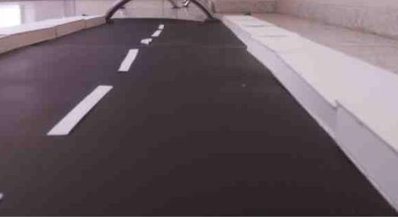
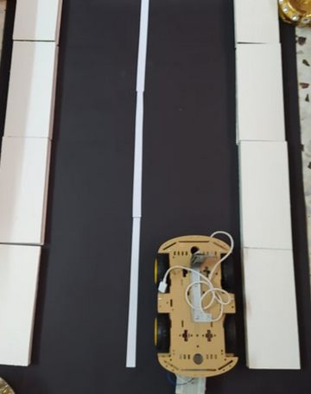
Path construction

Slide 14
Future Work
Improve movement ( speed and smoothness).
Add more traffic signs (more signs).
Add destination feature and GPS.
Improve angle detection by using AI
and machine learning!

