Slide 1
Farmbot
by: Adli Mousa& Mohammad Barakat
Supervisors: Ashraf Armoush& Aladdin Masri

Slide 2
Outline
Farming in Palestine
What’s Farmbot
How does it work
Why FarmBot
Initial Design
Our Design
Hardware
Challenges
Constraints
Future Work

Slide 3
Farming in Palestine
Lack of natural resources.
Lack of technical knowledge.
Lack of fund.
Tiring and needs a lot of effort.

Slide 4
What’s Farmbot?
Agricultural robot.
Space efficient seeding.
Efficient watering system.
Automated farming process.
Remotely controlled.
Notes:
tbc

Slide 5
How does it work?
FarmBot will use the seed injector to grab a seed and start planting at the specified locations
FarmBot then will read the humidity sensor
Then it will start the irrigation process based on the humidity.

Slide 6
Why Farmbot?
Efficient use for land, water and other resources.
Time and effort saving.
Remote controlling & monitoring.
Notes:
tbc

Slide 7
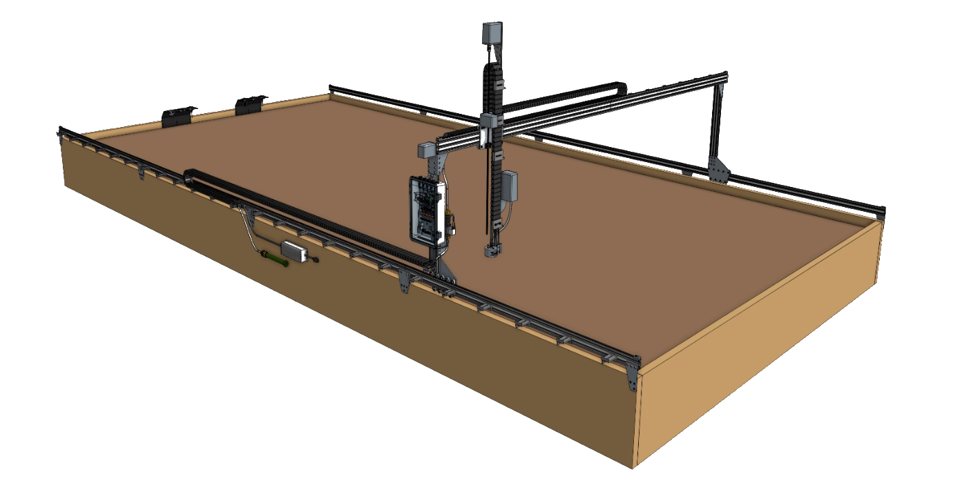
Initial Design

Slide 8
Cost
2500$
Notes:
Lack of hardware
Lack of time to inquiry hardware

Slide 9
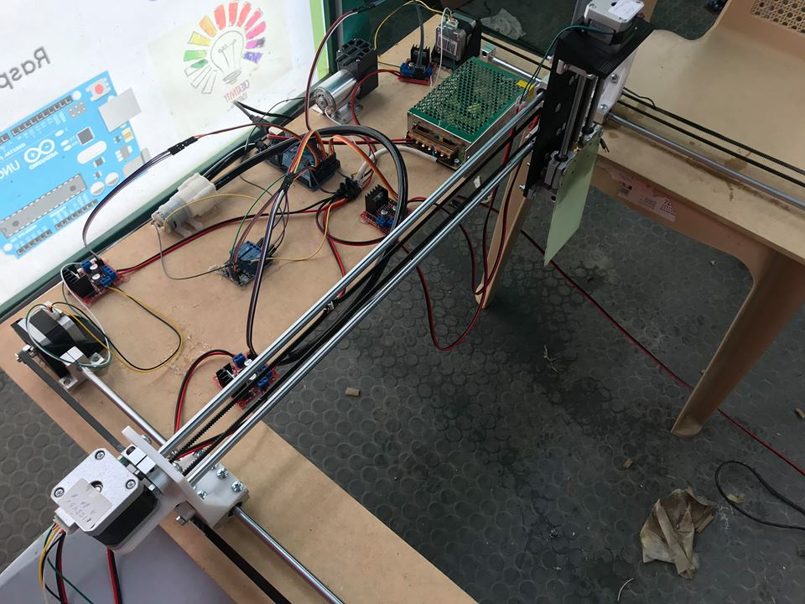
Our design
Less Cost
Same features.
Practical Implemntion.
Notes:
Picture for the whole project here
Why our design? - you may separate them into two designs

Slide 10
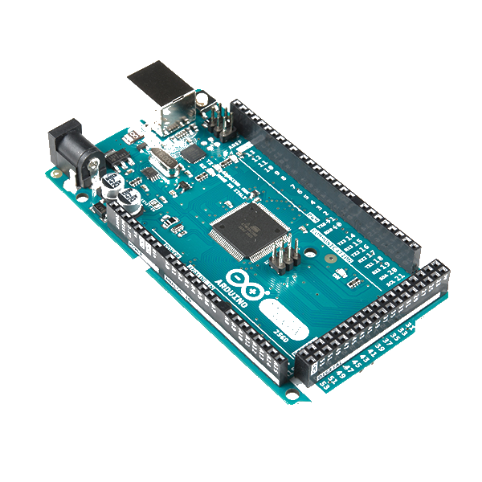
Microcontroller
Arduino Mega - 2560
The main controller of the project.
It controls the stepper motors.
It reads sensors data and process them.
It controls the Vacuum pump and the Water pump.

Slide 11
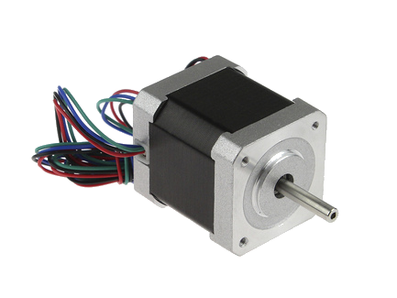
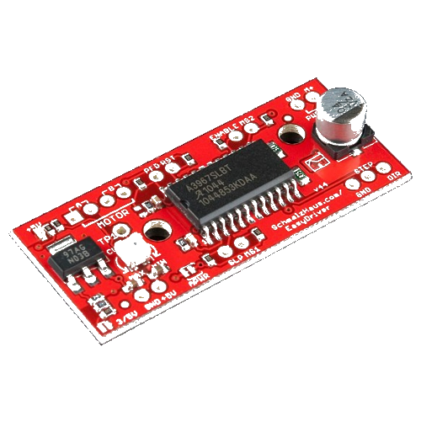
Hardware
Stepper Motors
4 Stepper motors to move the Farmbot.
2 for x-axis, 1 for y-axis, 1 for z-axis.
Stepper Motor Drivers:
Provide adjustable current control.
Provide multiple steps resolution.
Built-in translators to allow the motor to be controlled with simple step and direction inputs.

Slide 12
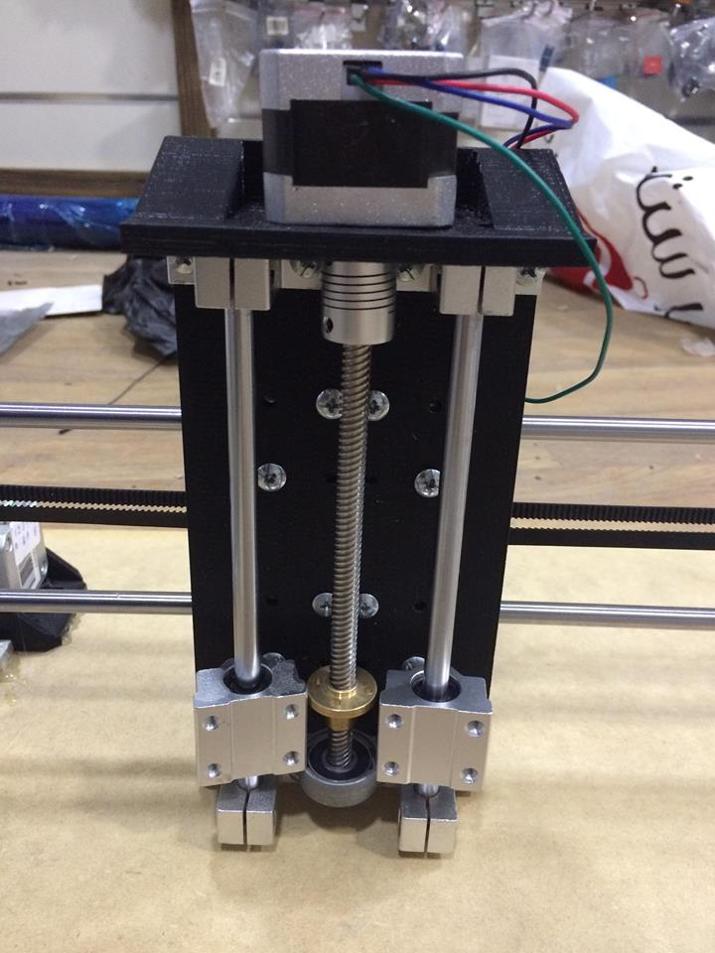
Hardware – cont.
Z-axis
4 Base components.
2 supporting rods.
1 Screw rod.
Base for the universal mount tool.

Slide 13
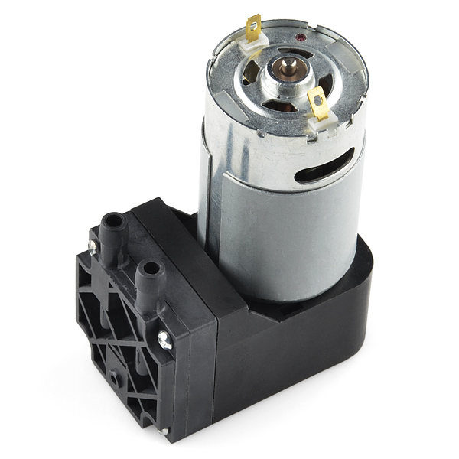
Hardware – cont.
Vacuum Pump
Vacuum Pump is used to suction-hold a single seed.
Used by the seed injector in the planting seed.

Slide 14
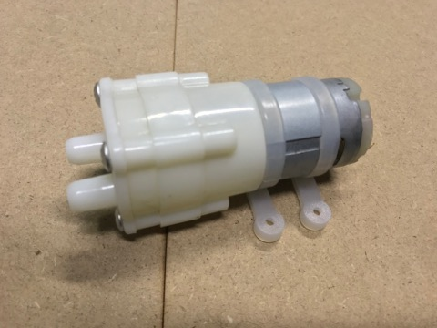
Hardware – cont.
Water Pump
It is used in the water irrigation process.
It will draw water from fresh source.
Farmbot will transfer the drawn water to the needed location.

Slide 15
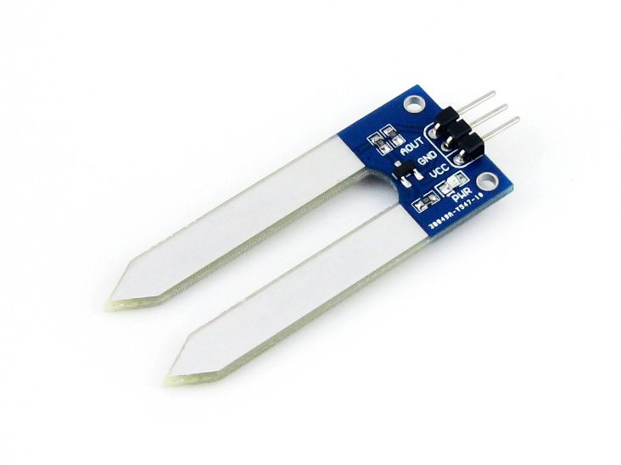
Hardware – cont.
Humidity Sensor
It is used before the irrigation process.
Farmbot will read the degree of humidity
Start the irrigation process based on that data.

Slide 16
Challenges & Constraints
Design problems.
Challenge in total costs.
Challenge in making the Z-axis.
Problems with 3D printer.
Time due to design changes, and 3D printer.

Slide 17
Future Work
Centralized control panel website that provides:
  Remote controlling and monitoring.
  Control the positions of the seed.
  Advice for the farmers depending on technical knowledge, to utilize the resources.
Use solar cell to power the robot as it will be always outside.
Expand the size to be capable of large farming fields.
Water proofing.
Notes:
Monitoring based on feedback sensors.

Slide 18
Demo

Slide 19
Questions?

