Slide 1

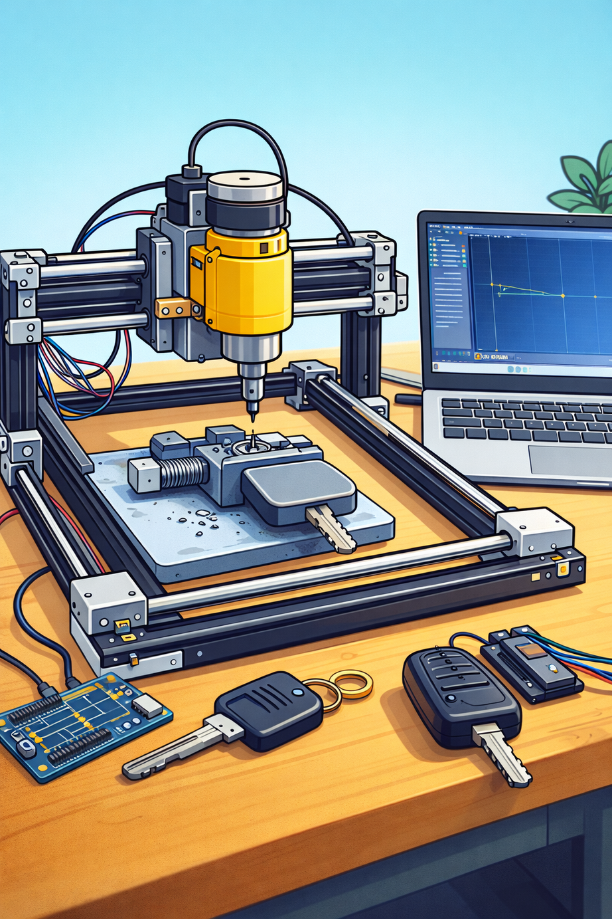
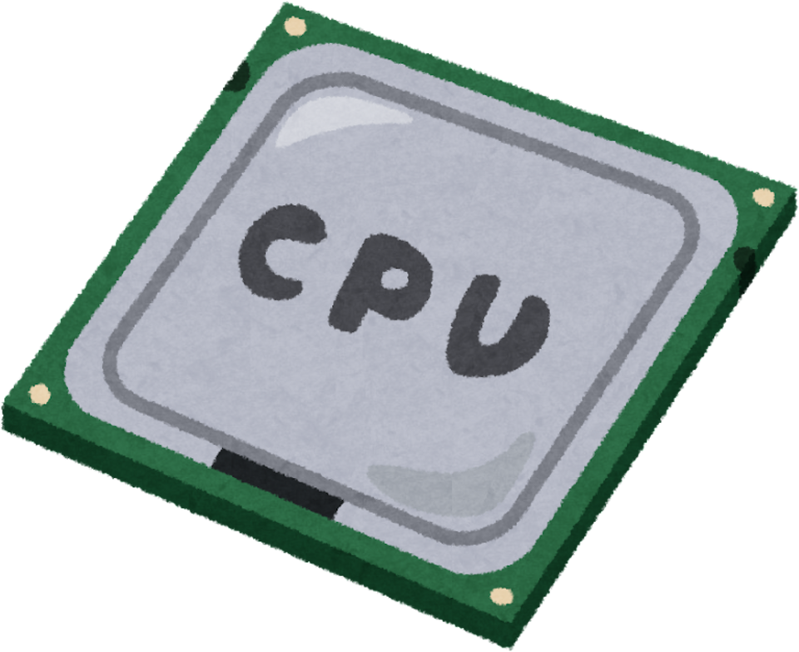

CNC Car Keys Cutting Machine

Slide 2
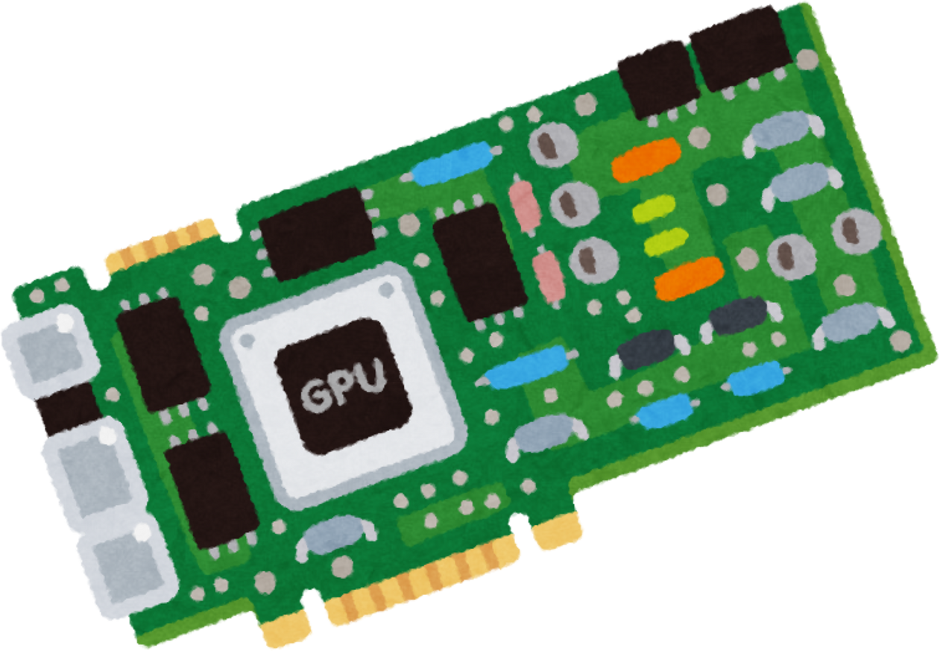
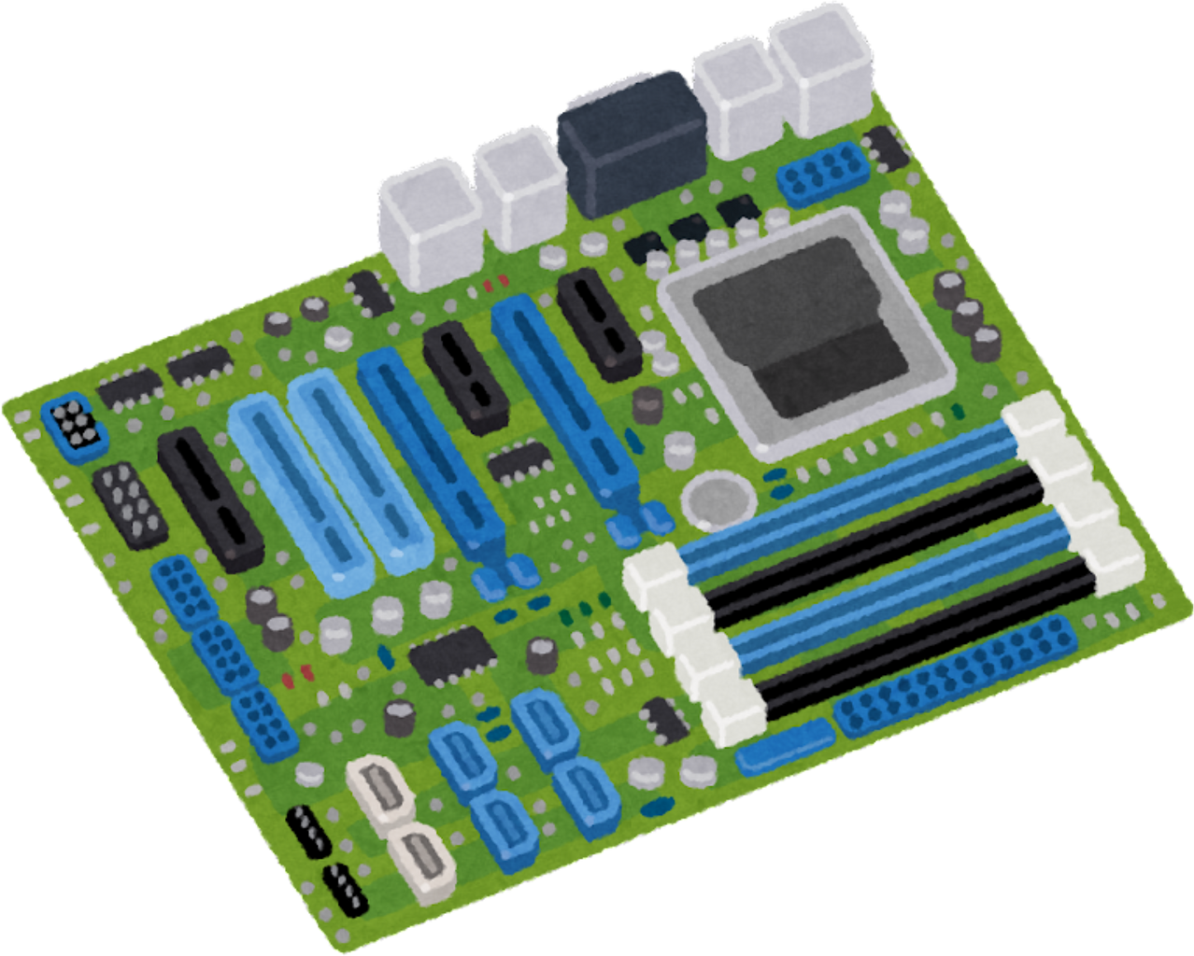
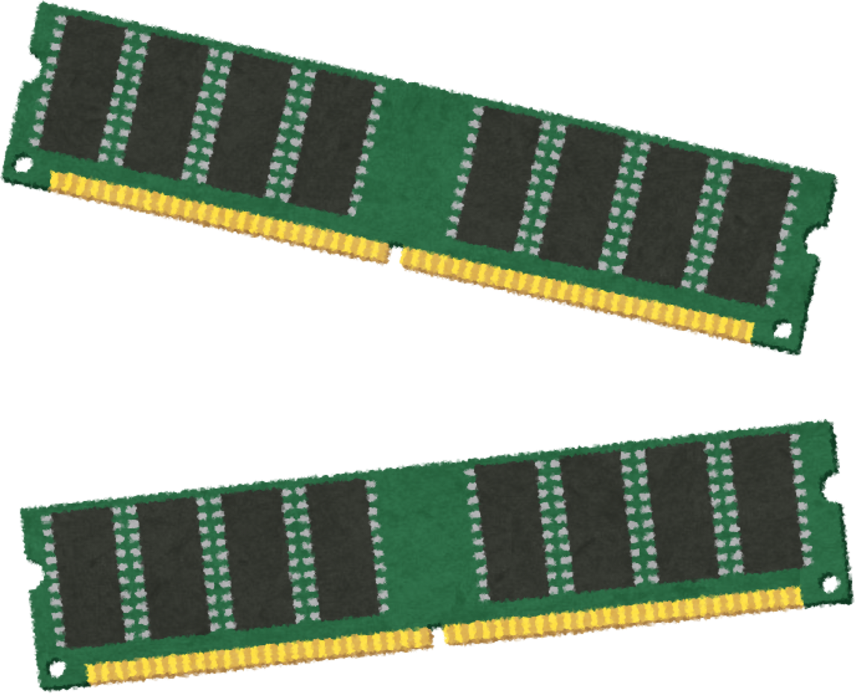
Our Team
Mohammed Alhasoun
Obada Huseen
Our TeamSupervisor:
Dr. Samer Mayala

Slide 3
Introduction
Losing or breaking car keys is common
Car key cutting requires high precision
Manual machines not high precision
CNC commercial machines are vary expensive
Need for a low-cost automated solution

Slide 4
Problem Statement
  The Problem:
  Manual car key cutting depends on operator skill and leads to inconsistent accuracy.
  Commercial CNC key cutting machines are expensive and not easily accessible.
  Students, technicians, and small workshops lack access to affordable and precise key duplication tools
  Our Solution:
  Develop a low-cost Arduino-based CNC key cutting machine.
  Use digital G-code files to automate cutting and eliminate human error.
  Provide an educational, precise, and accessible key manufacturing platform.

Slide 5
Project Objectives
  Design a CNC machine for cutting car keys.
  Convert digital key designs into real keys.
  Achieve good accuracy and repeatability.
  Provide a low-cost, educational CNC platform for students and small workshops.

Slide 6
Project Process
  System Workflow:
  The car key profile is designed digitally.
  The digital model is converted into a G-code toolpath.
  The G-code is uploaded to the LaserGRBL.
  The machine automatically cuts the key based on the generated toolpath.

Slide 7
System Overview
  Electronic control subsystem.
  Mechanical subsystem.
  Software & G-code subsystem.
  The system consists of:

Slide 8
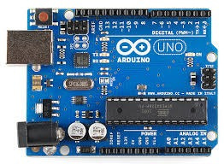
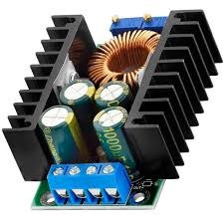
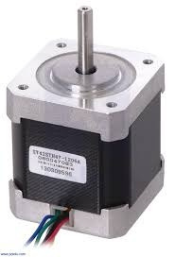
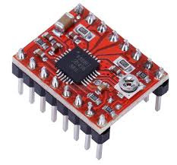
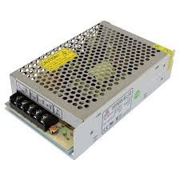
Electronic Components
Arduino Uno:
DC step-down converter:
Stepper motor drivers:
A4899 Stepper Motor Driver:
Power supply (12V):

Slide 9
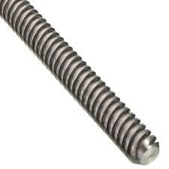
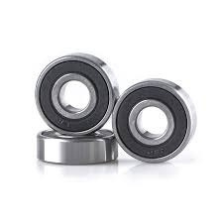
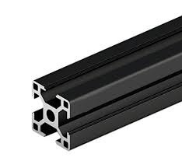
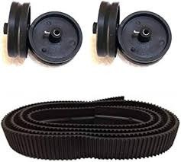
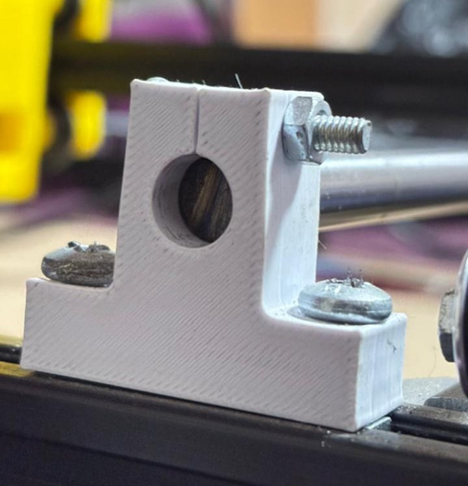
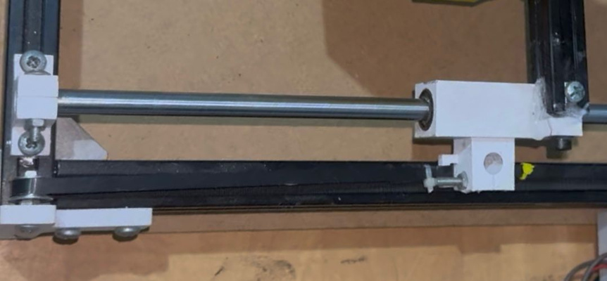
Mechanical Design
Mechanical V-slot aluminum frame:
Lead screws (8 mm, 2 mm pitch):
Linear bearings (12 mm):
Rubber wheels & belts:
Mechanical Key Clamp:
Crankshaft(12 mm):

Slide 10
Mechanical Design
Motion Axes:
Cutting System
  X-axis: Left ↔ Right
  Y-axis: Forward ↔ Backward
  Z-axis: Spindle up & down
  Stepper motors for precise positioning
8 – Cutting System
  DC spindle motor (12V, 120W)
  Collet size: 3.17 mm
  Cutting bit diameter: 2 mm
  Constant cutting depth using Z-axis

Slide 11
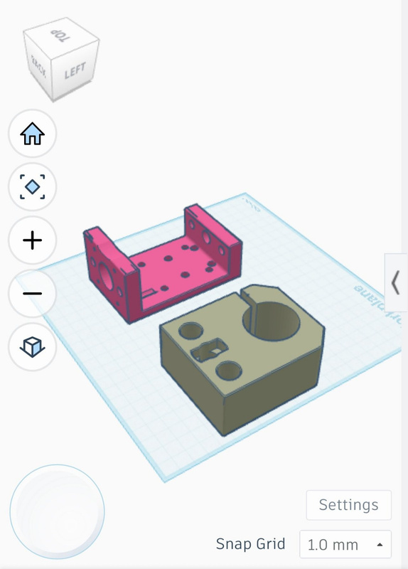
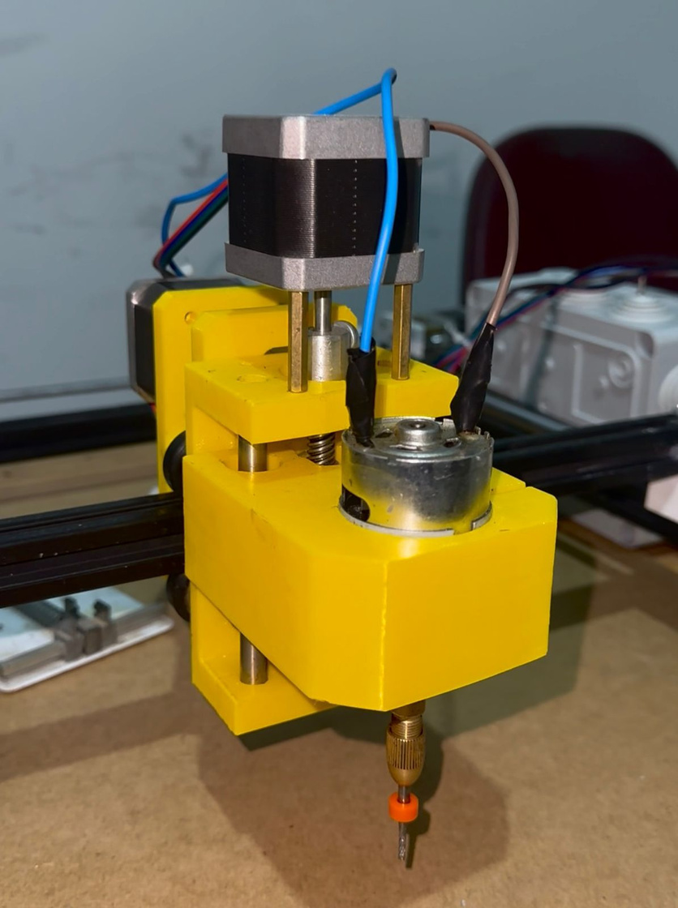
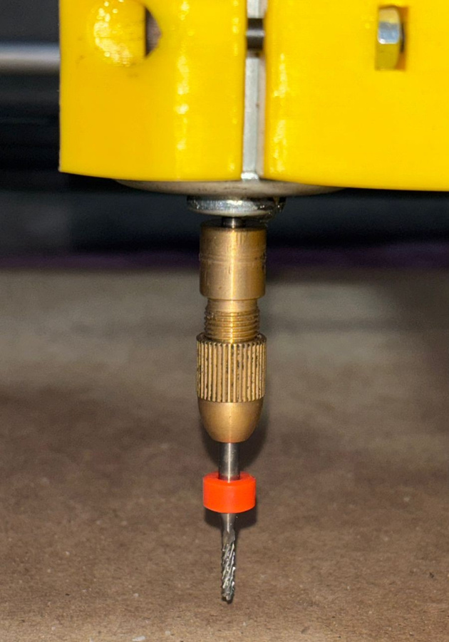
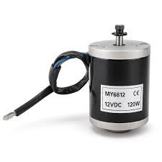
Design For Z-axis:
Z-axis ( Cutting System )
  Collet size: 3.17 mm
  Cutting bit diameter: 2 mm
DC spindle motor (12V, 120W):

Slide 12

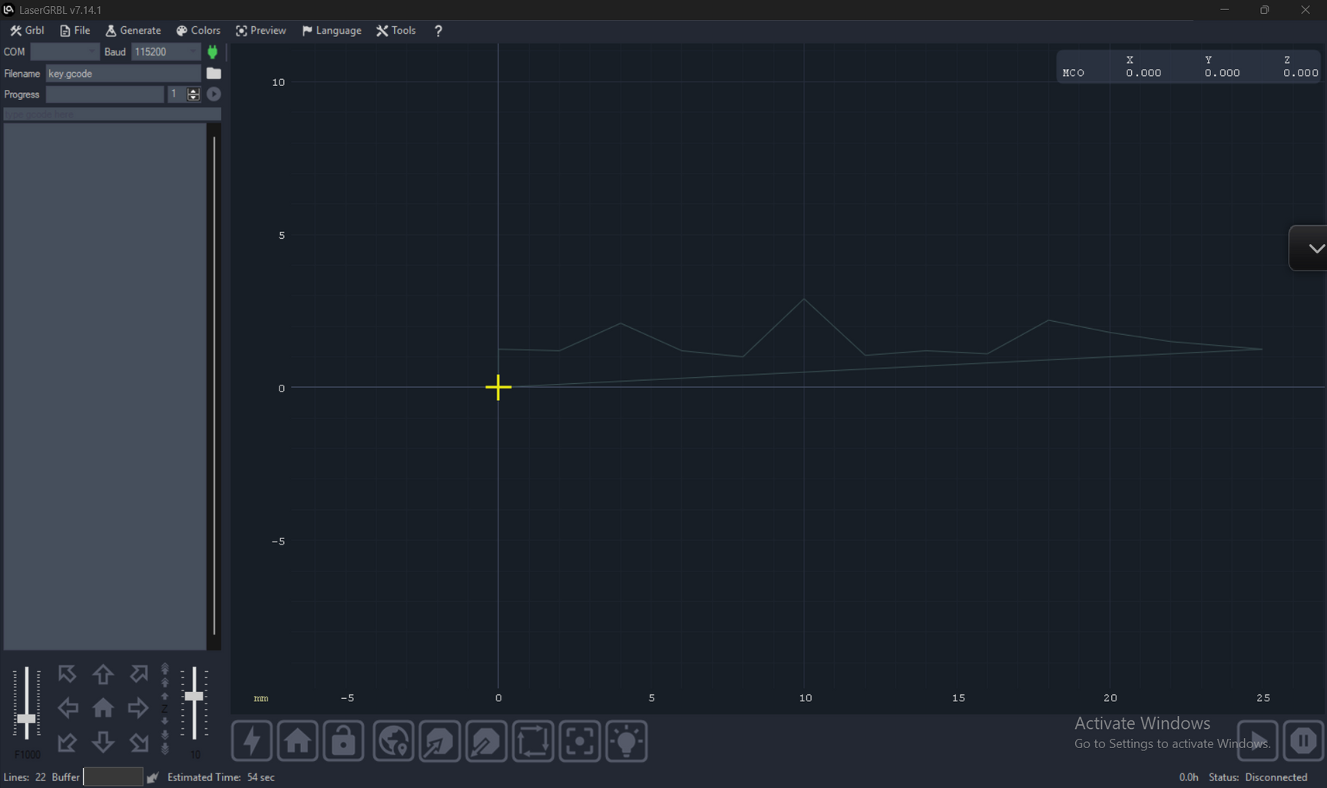
Software & G-code subsystem
LeaserGRBL

Slide 13
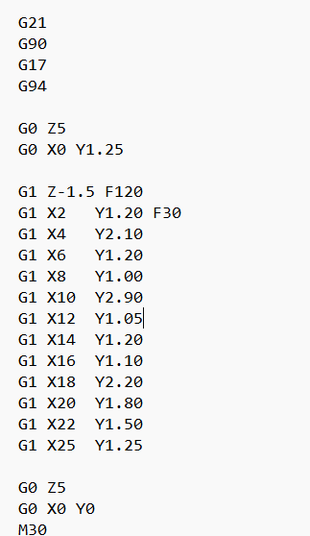
G-code
  G21-Set Units to Millimeters
  G90 - Absolute Positioning Mode
  G17-XY Plane Selection
  G94-Feed Rate per Minute
  GO - Rapid Positioning (Non-Cutting Movement)
  G1-Linear Interpolation (Cutting Movement)
  Z-axis Depth Control
  F - Feed Rate Control
  M30 - Program End and Reset

Slide 14
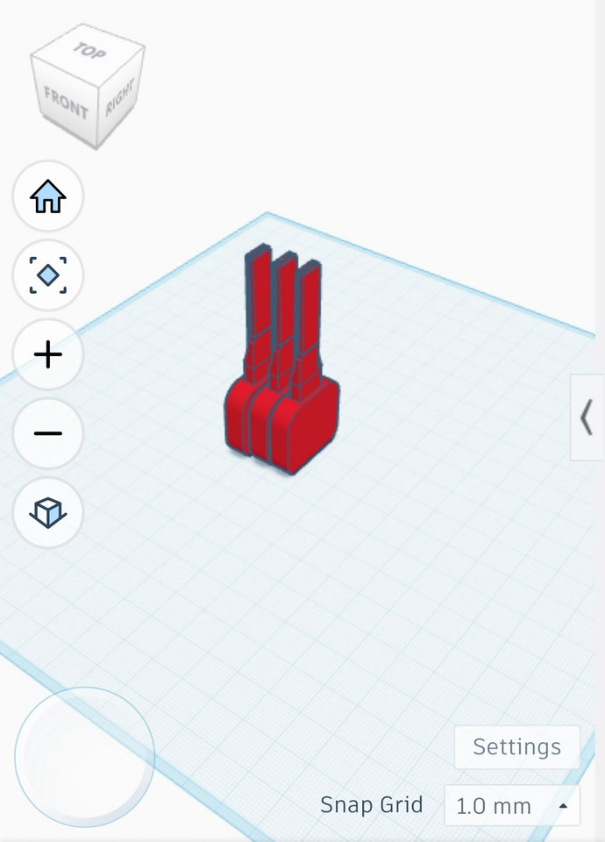
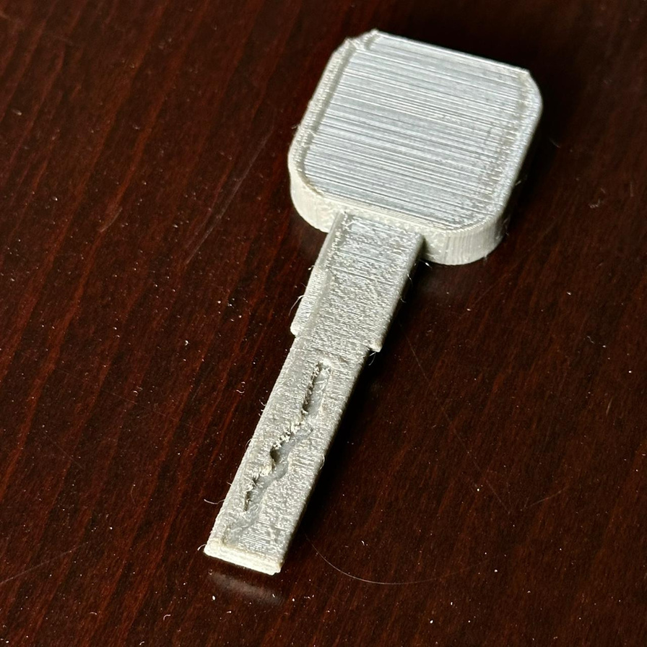
Key Template Design

Slide 15
Problems & Challenges Encountered
  mechanical durability of the plastic support components.
  proper electrical current distribution.
  Heat generation during operation .
  vibration and noise during the cutting process.

Slide 16
Future Work
  Support more key types.
  Full metal cutting optimization.
  Automatic key alignment.
  Protective enclosure.
  AI-based key shape detection (Raspberry Pi).

Slide 17
Conclusion
  Successful CNC car key cutting machine.
  Low-cost & educational.
  Combines hardware, software & automation.
  Suitable for academic & small workshops.

Slide 18
Thank You

