Slide 1
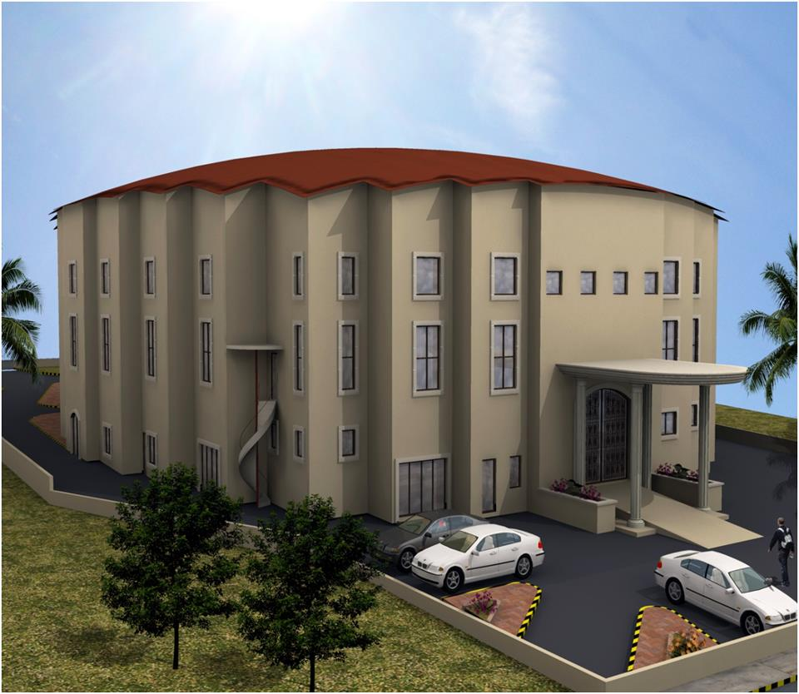
An-Najah National University
Faculty Of Engineering
civil Department
Construction project management
Prepared by :
Fares Obaid
Mohamad Barqawi
Hisham Melhim
Supervisor :
Eng. Rema Nassar
An-najah national university construction project management date: 24-5-2012

Slide 2
Overview
Construction project management :
Part 1) includes preparing a theoretical research
Part 2) includes the application of the principles in construction project management
An-najah national university construction project management date: 24-5-2012

Slide 3
Case Study
Construction of Multipurpose sport Hall
1-Location: Sulfite City
2-Area: (2500) m2
3-1000 audience loading capacity
4-The Hall including four Olympic sport Courts
Hand, Basket, Volley ball and Tennis.
An-najah national university construction project management date: 24-5-2012

Slide 4
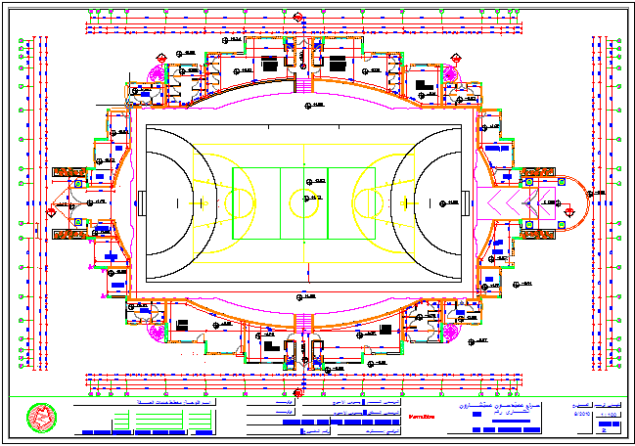
Case Study
Shop drawing:
An-najah national university construction project management date: 24-5-2012

Slide 5
Assumptions
1-Working days are all days except Friday
2-each working day is full eight hour
3-The electrical and mechanical works will be done by sub contractors.
4-Fixing the value of dollar with
(1dollar =3.7 NIS).
5-Labor unit cost:
Foreman: 60 $/day
Helper: 20 $/day
An-najah national university construction project management date: 24-5-2012

Slide 6
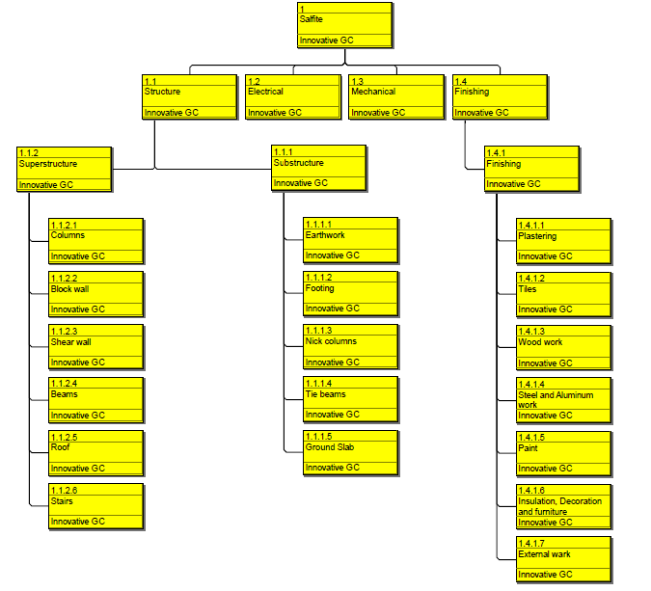
Work Breakdown Structure
An-najah national university construction project management date: 24-5-2012

Slide 7
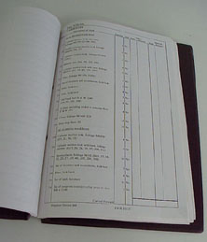
Bill of Quantity Preparation
Calculations were made depending on Drawings to find
The Quantities and tabulating it.
An-najah national university construction project management date: 24-5-2012

Slide 8

pricing
1-The costing process based upon past experience for the contractor.
2-The pricing for each element of unit was
different from each other, some units
were priced according to the area, others were
priced according to the number of units.
An-najah national university construction project management date: 24-5-2012

Slide 9
Cost estimation
These values obtained from filling WBS with each cost of each activity .
Labor cost= 72460 $
Equipment cost= 91590 $
Material cost= 737873 $
Total direct cost= labor cost + equipment cost + material cost= 901923.6 $
An-najah national university construction project management date: 24-5-2012

Slide 10
Cost estimation
Total indirect cost =99211 $
Total price = direct cost + indirect cost + profit = 1564850 $

Slide 11
Cost estimation
              These calculation obtained from primavera:

Slide 12
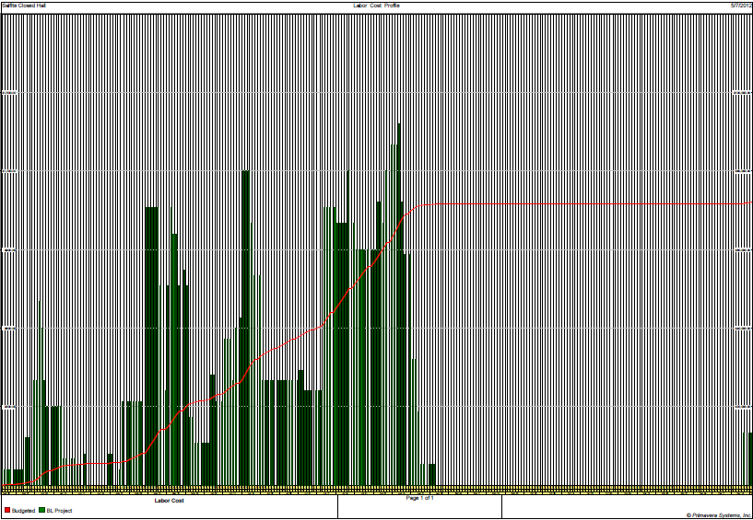
Cost estimation
Labor cost:
An-najah national university construction project management date: 24-5-2012

Slide 13
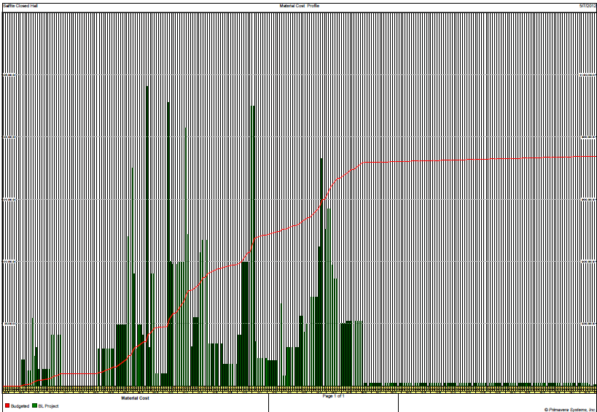
Cost estimation
Material cost:
An-najah national university construction project management date: 24-5-2012

Slide 14
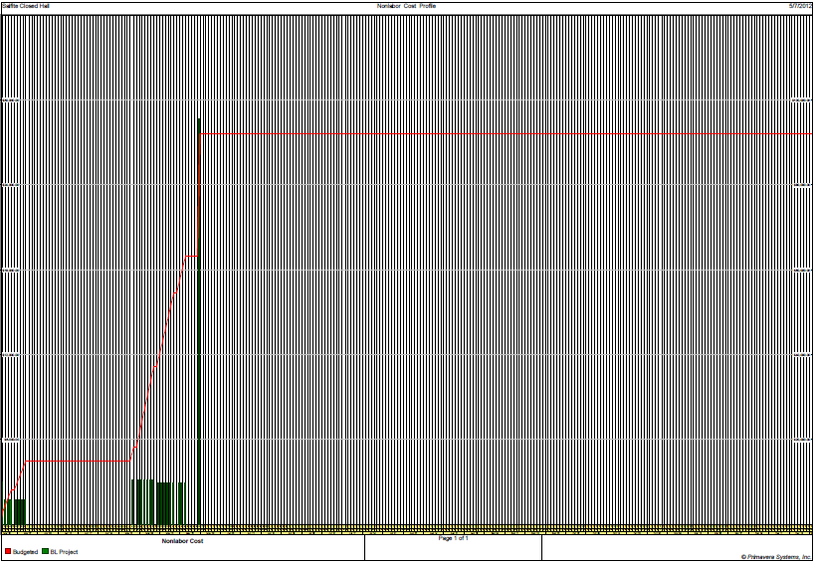
Cost estimation
Equipment cost:
An-najah national university construction project management date: 24-5-2012

Slide 15
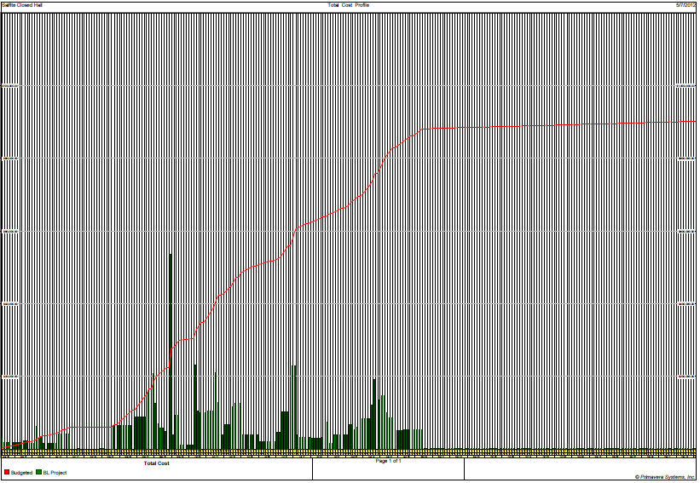
Cost estimation
Total direct cost= 901987$
An-najah national university construction project management date: 24-5-2012

Slide 16
Cost estimation
direct cost from primavera =901987$
direct cost by using excel = 901923$
difference = 63$.
Why ?
An-najah national university construction project management date: 24-5-2012

Slide 17
Cost calculation
From contractor:
price = 1771388 $
Our calculation:
price=1564850.86 $
why ?

Slide 18
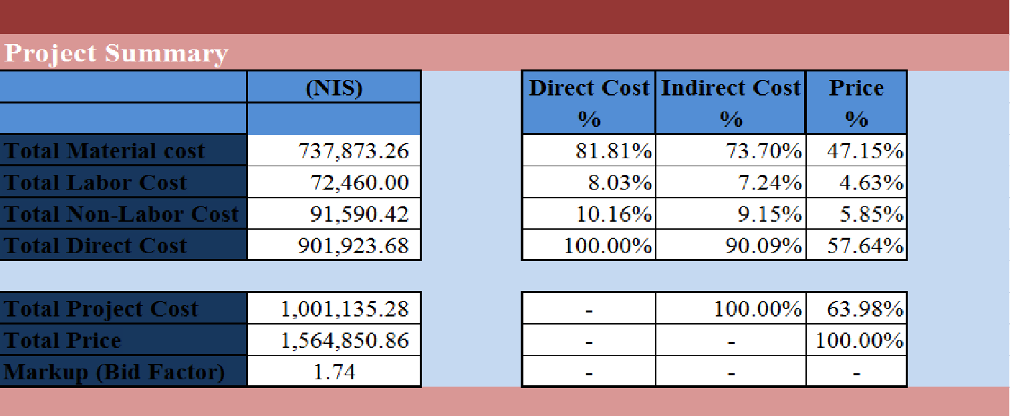
Results summary

Slide 19
Problems
The project faces some problems in funding, it was funded by the ministry of finance and some payments delayed which leaded to delay of the project. This delay causes increasing in the cost of the project.
So, we applied management techniques and programs like primavera to control the time and cost.

Slide 20
Time calculation
1-The planned duration of the project is 360 calendar day
2-we obtained that from primavera we need 240 calendar day to complete the project.
An-najah national university construction project management date: 24-5-2012

Slide 21
Recommendation
Most of the project in Palestine funded by donor countries ,so these projects faces problems in funding which leads to delay in these projects because of that ,the using of management program is difficult due to the difference between what we planned and what we done in the field

