Slide 1
FarmManager
Supervised by :
Dr.Hanal Abuzant
Ms.Haya Samaneh
By :
Ahmed Daghameen
Tariq Aseedih
Mohammed Hijaz

Slide 2
Introduction
Problem
Solution
What Can “FarmManager” do ?
Website View and features
How does it work !
Mobile View and features
Challenges
Future Work
Demo
Outlines

Slide 3

Introduction
What is the “FarmManager” ?
Who can use it ?

Slide 4
Problem!
Why did we choose this project ?

Slide 5

Solution

Slide 6
What does FarmManager do ?

Slide 7



Tasks Management
Staff Management
Financial Management
Resources Management

Slide 8

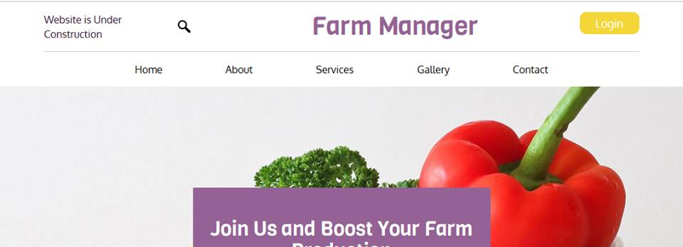
Website and
Android Application

Slide 9
Website View and Features
Main Frame
Farmer Frame
Workers Frame

Slide 10
How does it work ?

Slide 11
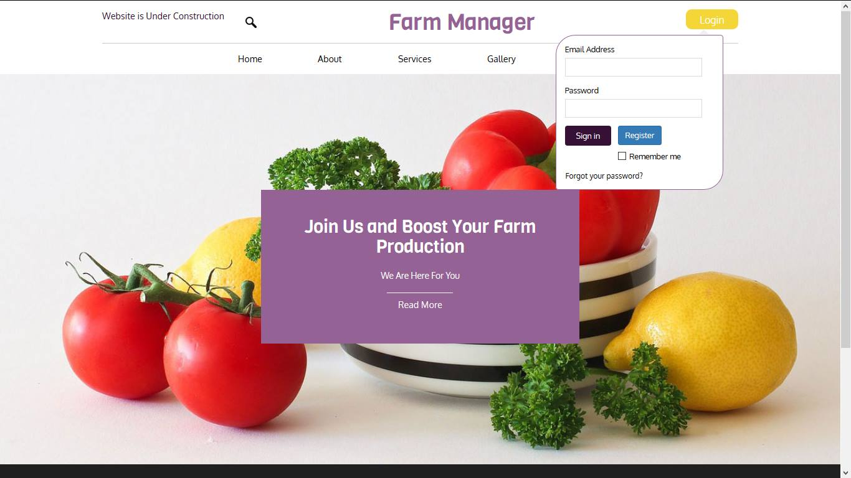

Slide 12
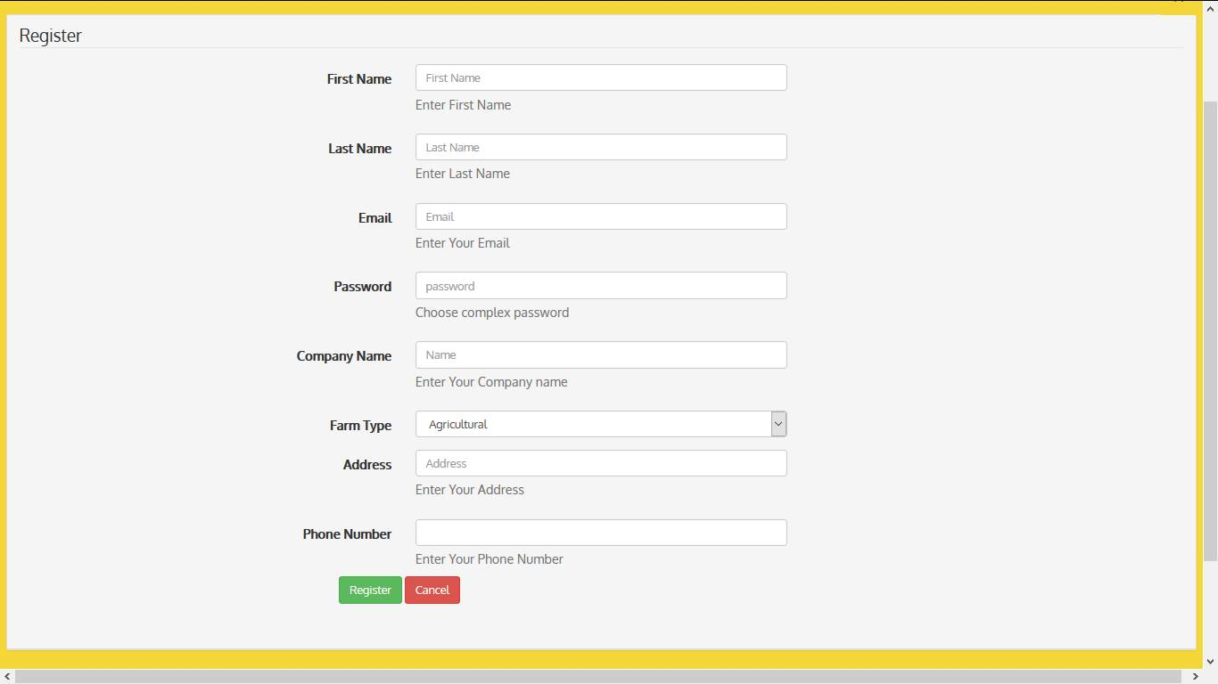
Register Page

Slide 13
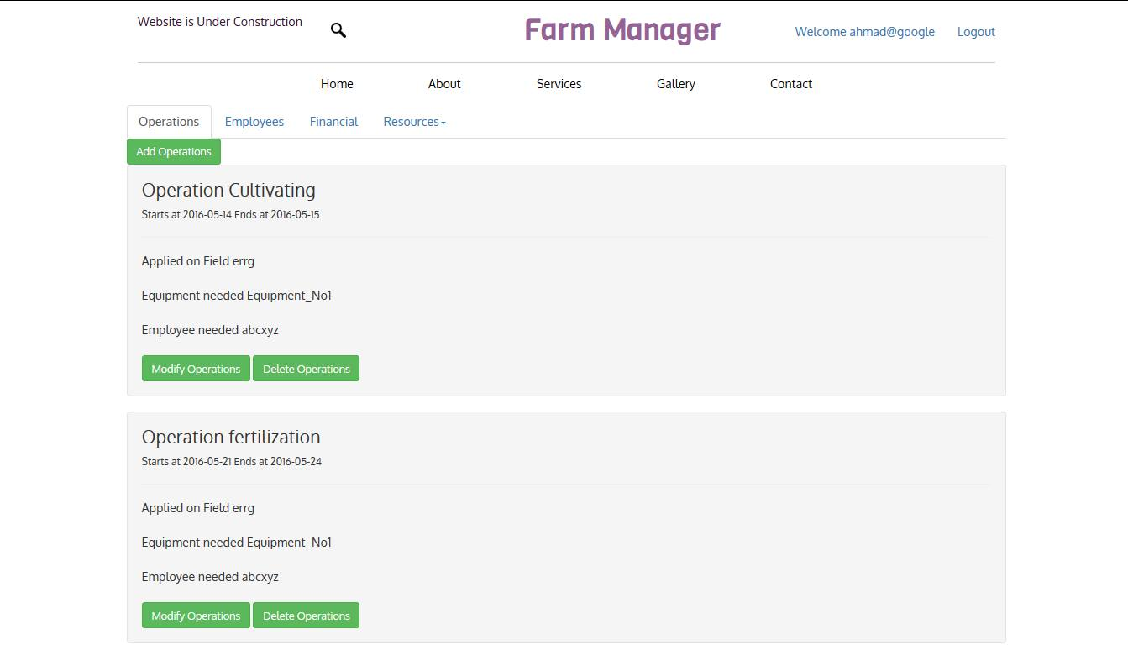
Operations

Slide 14
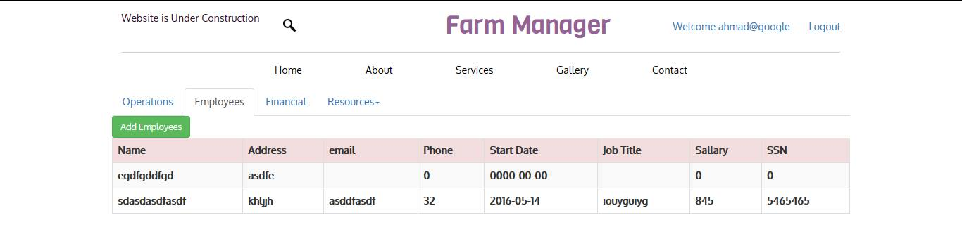
Employees

Slide 15
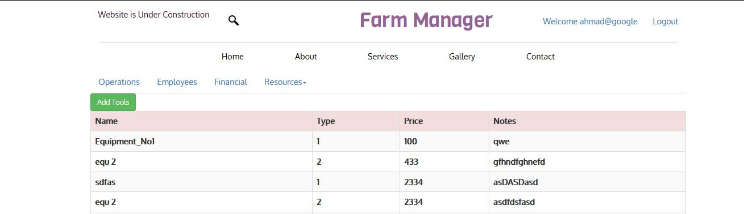
Resources

Slide 16
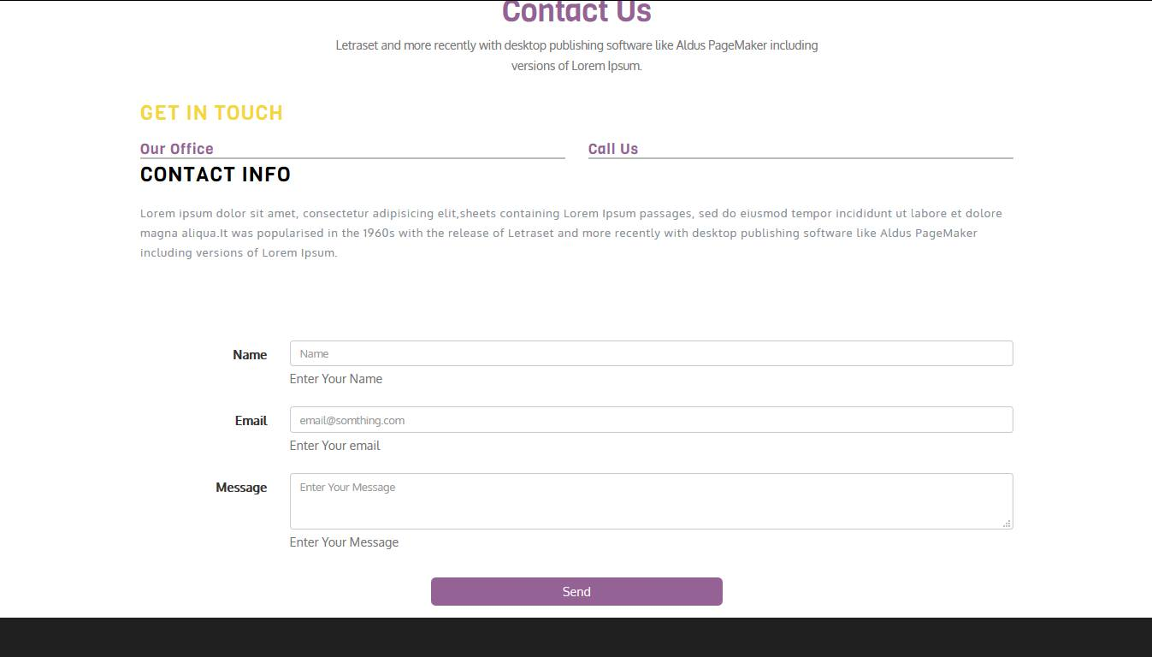
Contact

Slide 17

Mobile Application

Slide 18




Building the Application

Slide 19
Manager
Profile
Workers
Tasks
Resources
Finance
Items
Edit
View
Register New worker
delete
Add Task
LogIn Page
Worker
Register
Profile
Edit
Tasks
View
Send Notification
Cost
Type
Duration
Calculate Income
Add New Resource
View

Slide 20
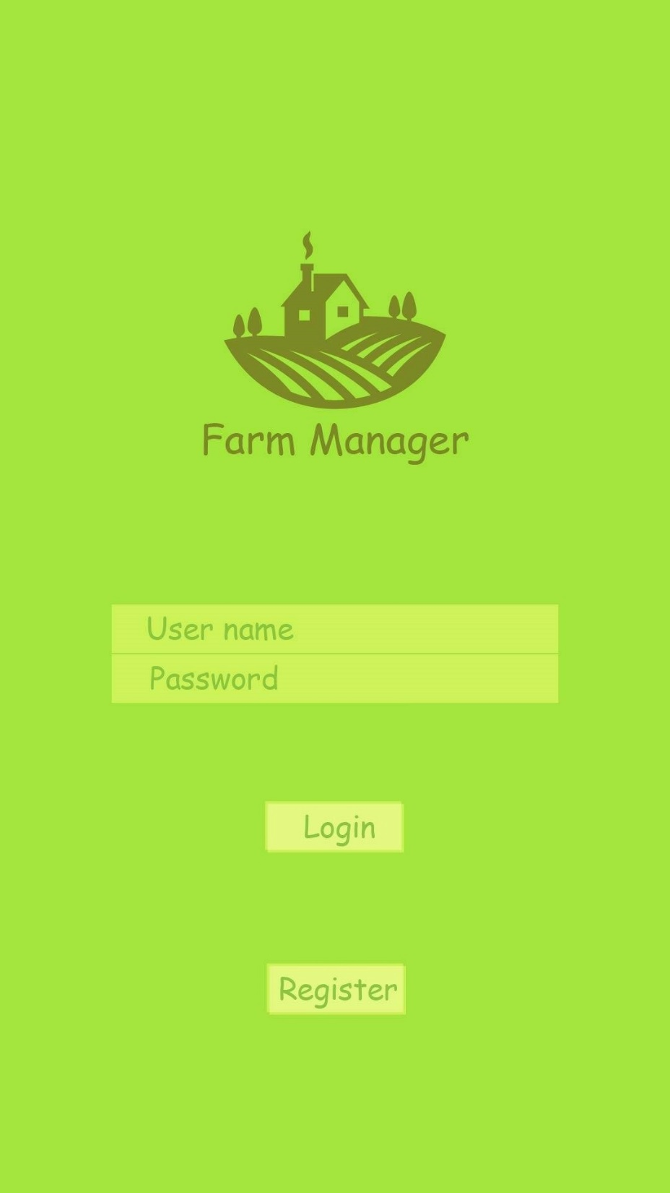

Slide 21
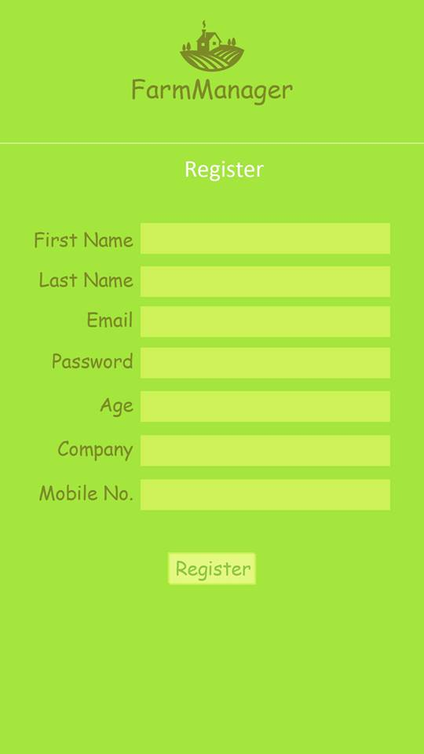

Slide 22
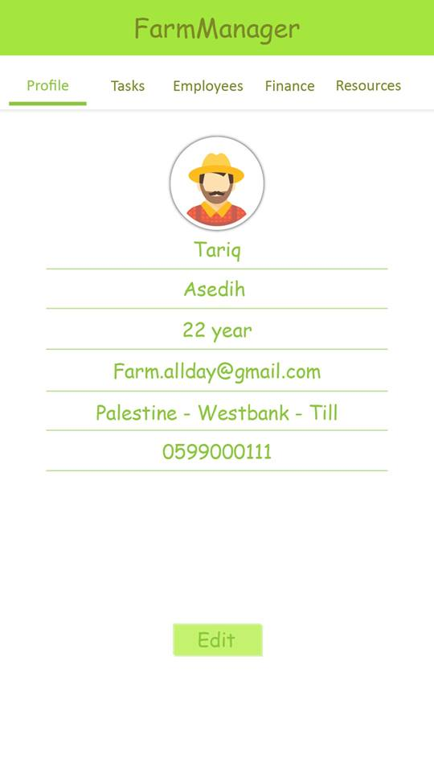

Slide 23
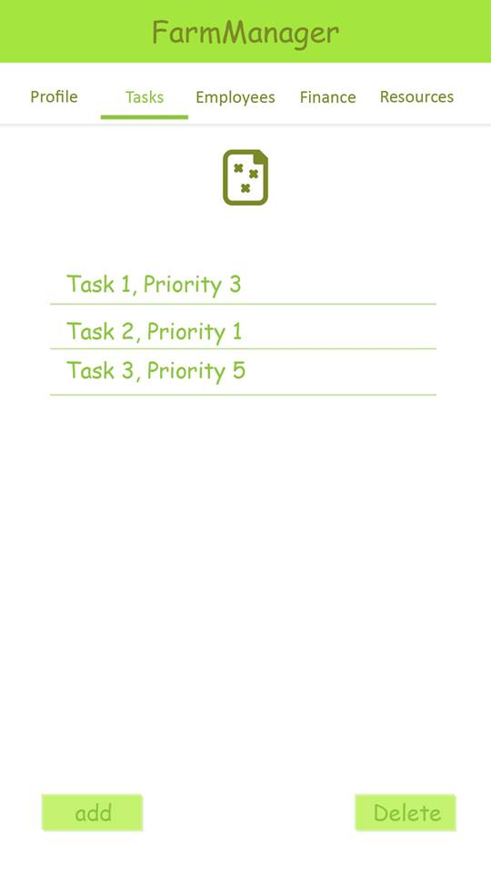

Slide 24
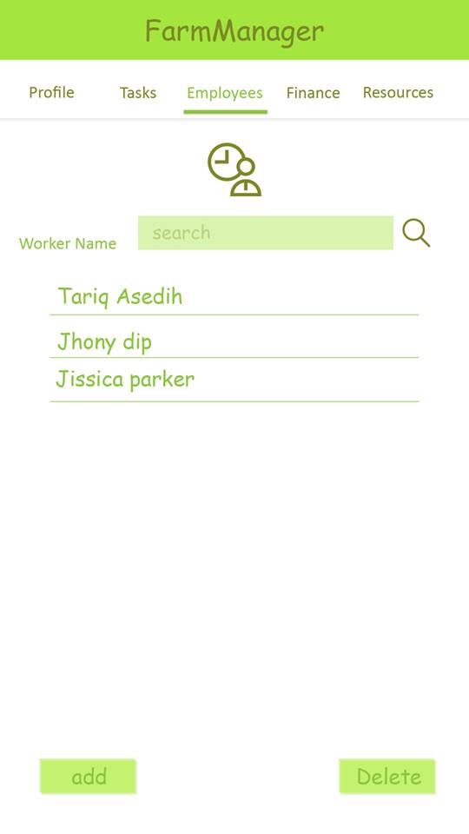

Slide 25
CHALLENGES
Data Collection
Financial Management
Target

Slide 26
Future work
Trending
Tips
Video Monitoring
Specialists platform
Full Financial management

Slide 27
DEMO TIME !

