Slide 1

Civil & Chemical Engineering Department
Graduation Project 2
A conceptual Design for Rural Wastewater Treatment at Household Level in Palestine
Students name:
Ihteda’ Hasan
Sahar Hijjawi
Muna Istetiah
Supervisors name:
Abdel Fattah Hasan, Ph.D.
Dec,24, 2014, Wednesday

Slide 2
Outline:
Background
Objectives
Rural Palestinian
Septic tank
Steady Analysis
STOAT Analysis
Results
Conclusion & Recommendation

Slide 3
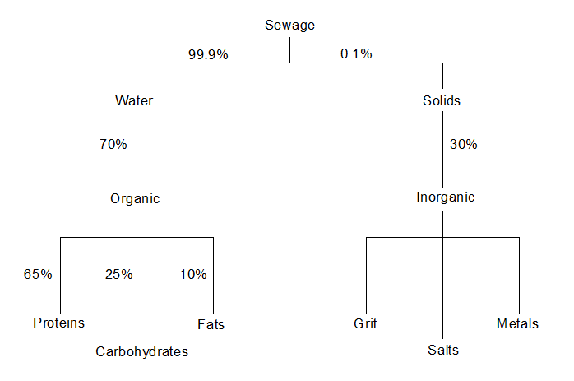
Background:
Wastewater is that part of the water supply to the community or to the industry which has been used for different purposes and has been mixed with solids either suspended or dissolved.

Slide 4
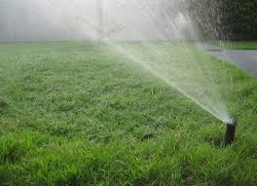
Objective:
General wastewater treatment is to allow human and industrial effluents to be disposed of without danger to human health or unacceptable damage to the natural environment.
Specific in our project, to design a household wastewater treatment plant that generates water suitable for garden irrigation.

Slide 5
Rural Palestinian:-
85 localities (16%) are connected to sewage system.
511 localities use cesspits for wastewater disposal.
Community | Population | No. of cesspits | ww. flow (m³/hr) 2015 | % Connected to wastewater network
Azmout | 3500 | 150 | 9.59 | 80%
Deir al-Hatab | 3000 | 700 | 5.95 | 0%
Salem | 6000 | 400 | 19.89 | 60%
beitFureek | 14000 | 2000 | 30.76 | 0%
Rujib | 4750 | 100-150 | 14.83 | 70%
Kafrkallil | 4500 | 200 | 6.56 | 80%

Slide 6
Disadvantages of Cesspits:-
Infiltration of wastewater into ground water .
Methane produced from cesspits increase the potential of fires and explosions.
Evacuation process of cesspits is always accompanied with septic odor nuisance and possibility of surface contamination .
Evacuated wastewater into wadis and remote locations imposes environmental hazards on groundwater.
Provide a suitable environment for growth and spread of flies, mosquitoes, victors and rodents.

Slide 7
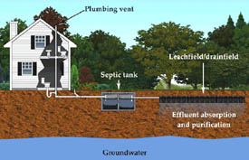
Septic tank:
Septic tanks are settling chambers that reduce turbulence and velocity of household wastewater discharges and permit time for physical separation of most floating and settleable solids in the` wastewater

Slide 8
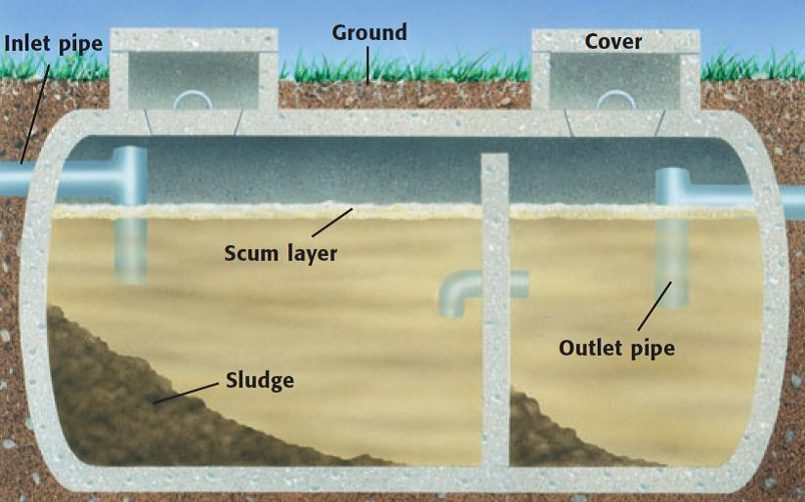

Slide 9
Activated Sludge
Septic Tank
Suspended growth process for removing organic matter from sewage by saturating it with air and microorganisms
that can break down the organic matter (aerobic) .
It is an efficient process for BOD,COD and nutrients removal.
Is a tank buried in the ground used to treat sewage without the presence of oxygen (anaerobic).
Septic tanks are a type of onsite wastewater treatment system in which the organic waste is decomposed and solid settle out.

Slide 10
Data Collection:
wastewater generation= 156 L/c/d
Assume 6 people in a Palestinian family
Flow 95m²/d
Total BOD in wastewater= 500 mg/L
Total suspended solid TSS=650 mg/L
TKN=40 mg/L, NH3-N= 25 mg/L

Slide 11
Design & Methodology
Aeration tank design
Circular cylinder aeration tank
Volume of aeration tank=1 m³ and the depth of the tank= 1m
diameter=1.12m

Slide 12
Secondary sedimentation tank design
HRT= 4 hour and over flow rate = 20m³/m².d
Volume= time*flow= 0.16 m³
Surface area As= flow /over flow rate = 0.0475 m²
Diameter d= (4*As/π) ^{½} = 0.24 m

Slide 13
Programs used in Design & Results
Steady
STOTA

Slide 14
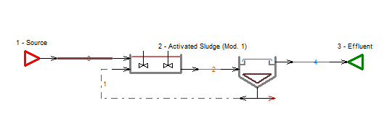
Steady

Slide 15
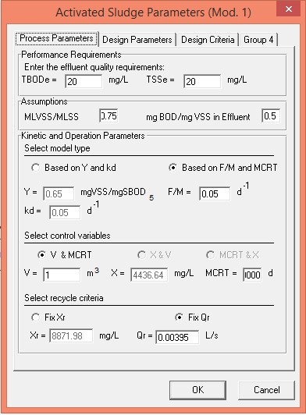
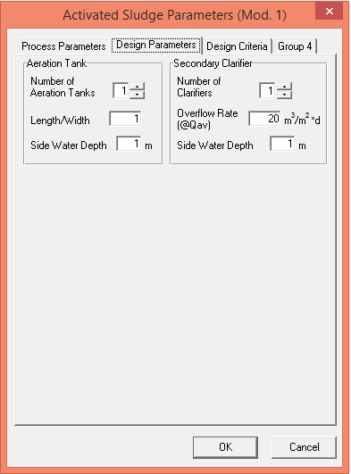

Slide 16
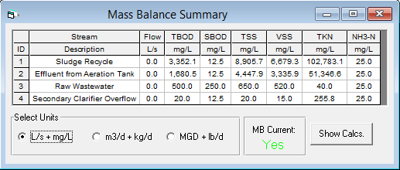
Steady Results

Slide 17
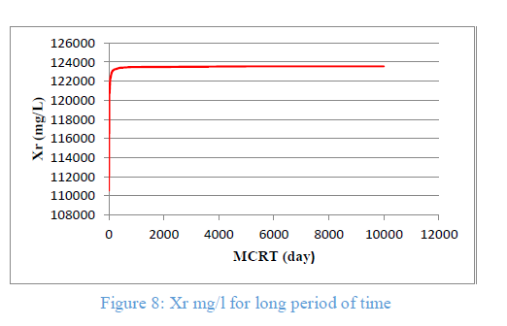
Recycle TSS

Slide 18
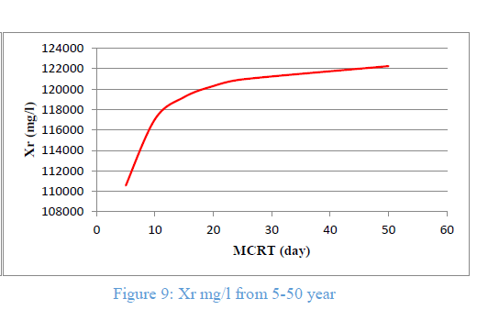

Slide 19
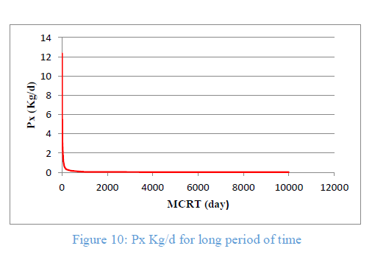
Sludge production rate

Slide 20
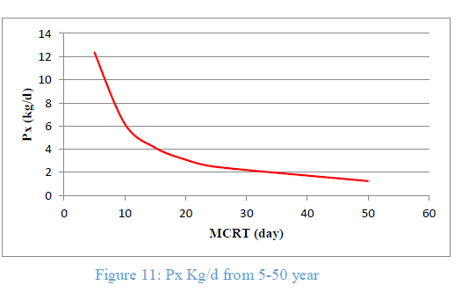

Slide 21
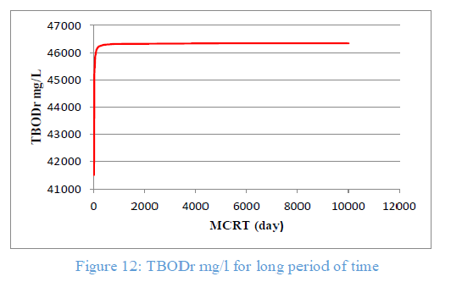
TBODr

Slide 22
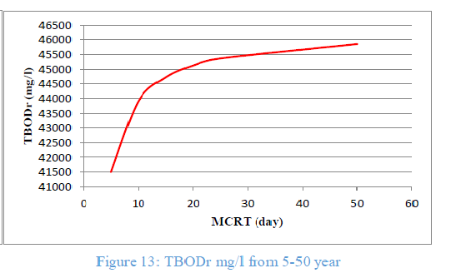

Slide 23
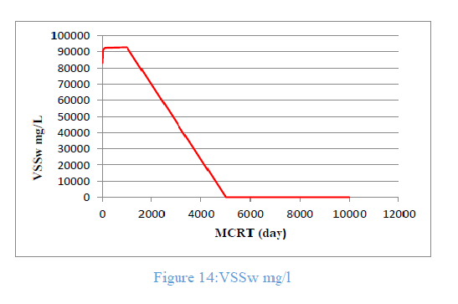
Volatile Suspended Solid in wastage

Slide 24
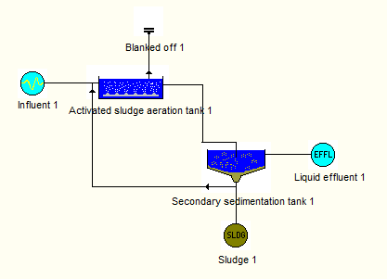
STOAT

Slide 25
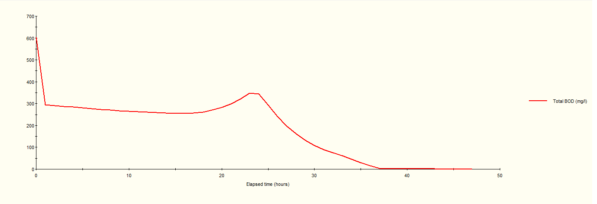
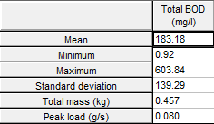
BOD

Slide 26
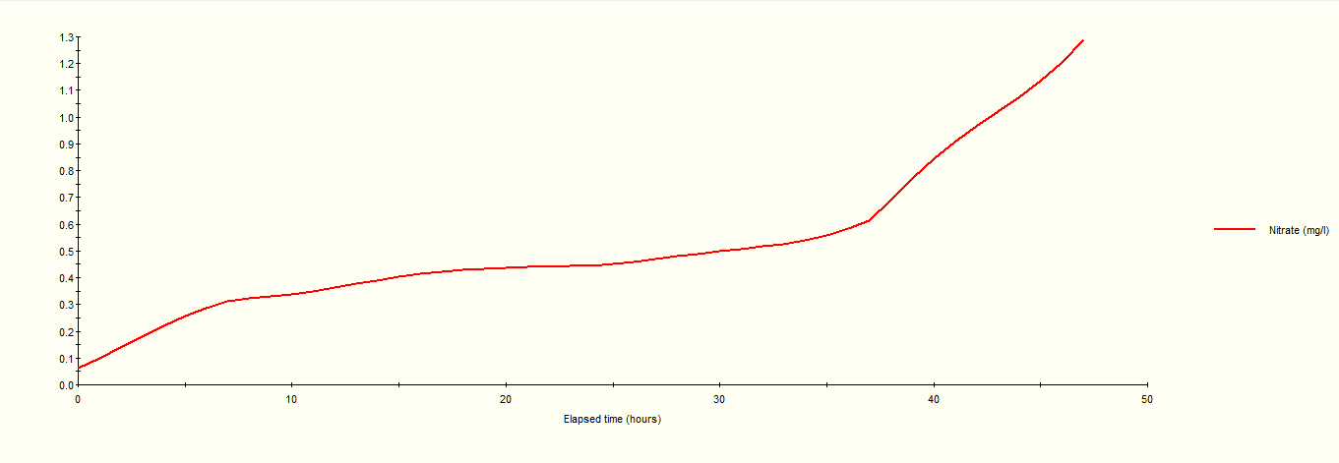
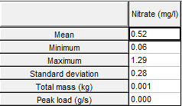
Nitrate

Slide 27
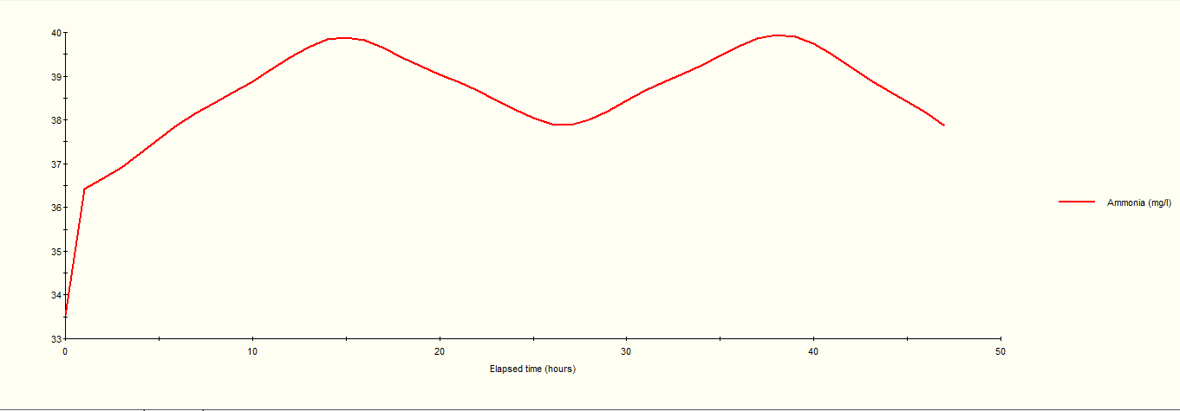
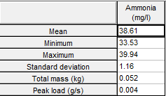
Ammonia

Slide 28
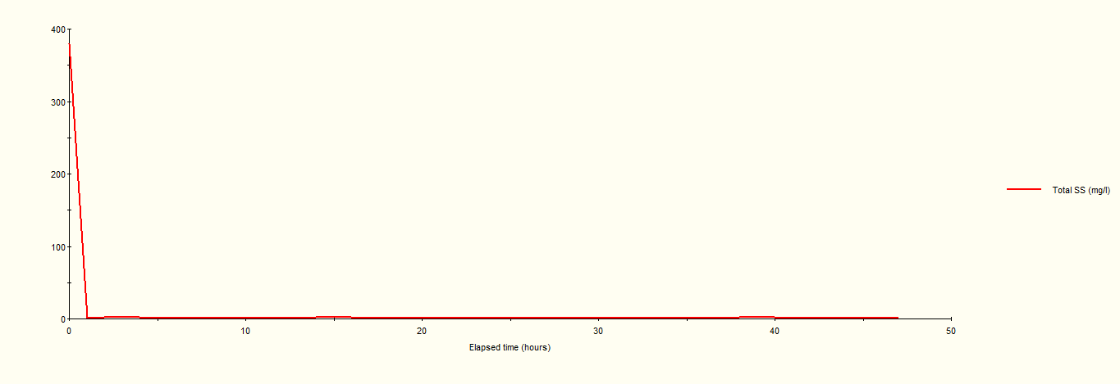
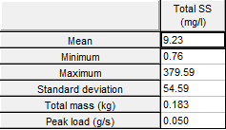
Total SS

Slide 29
STOAT discussion
 | TBOD mg/l | TSS mg/l | Nitrate mg/l | Ammonia mg/l
STOAT | 183.18 | 9.23 | 0.52 | 38.61
Standards | 40 | 30 | 50 | 50
From table above TBOD from STOAT = 183.18 mg/l which is greater than the standards (40 mg/l). For rest parameters they are satisfied the standards.

Slide 30
Suggested solution :
In order to decrease the value of TBOD to make it satisfy the standard for re-used; self-clean sand filter can be used.
manual
Automatic

Slide 31
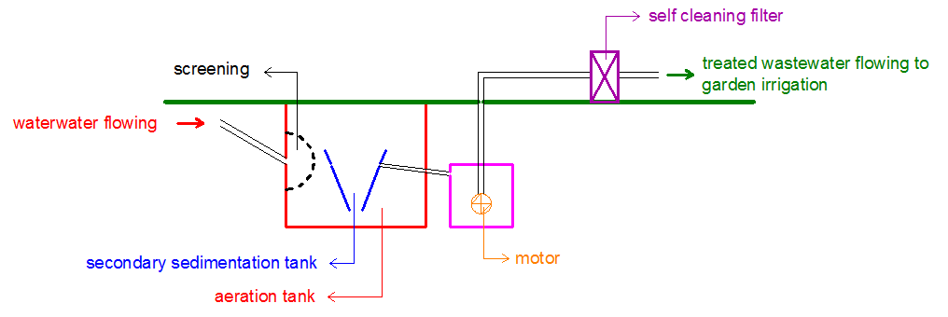

Slide 32
Conclusion & Recommendation:-
This project solves the problem of effluent discharge.
The volume of the whole tanks is 1.16 m³, which means it does not need large spaces or excavations.
The cost of the tanks and the self-clean filter will be adequate.
Treated water can be used for garden, trees and loans irrigation, which means saving the use of potable water in this field.
This design contribute in preventing groundwater and soil pollution that represent a result of septic tanks, also since the design is aerobic; no odors will be produces.

Slide 33
Great thanks for Dr. Abdel Fattah Al- Mallah for his support…….
And we give our thanks for
Dr. Amer El-Hamouze

