Slide 1
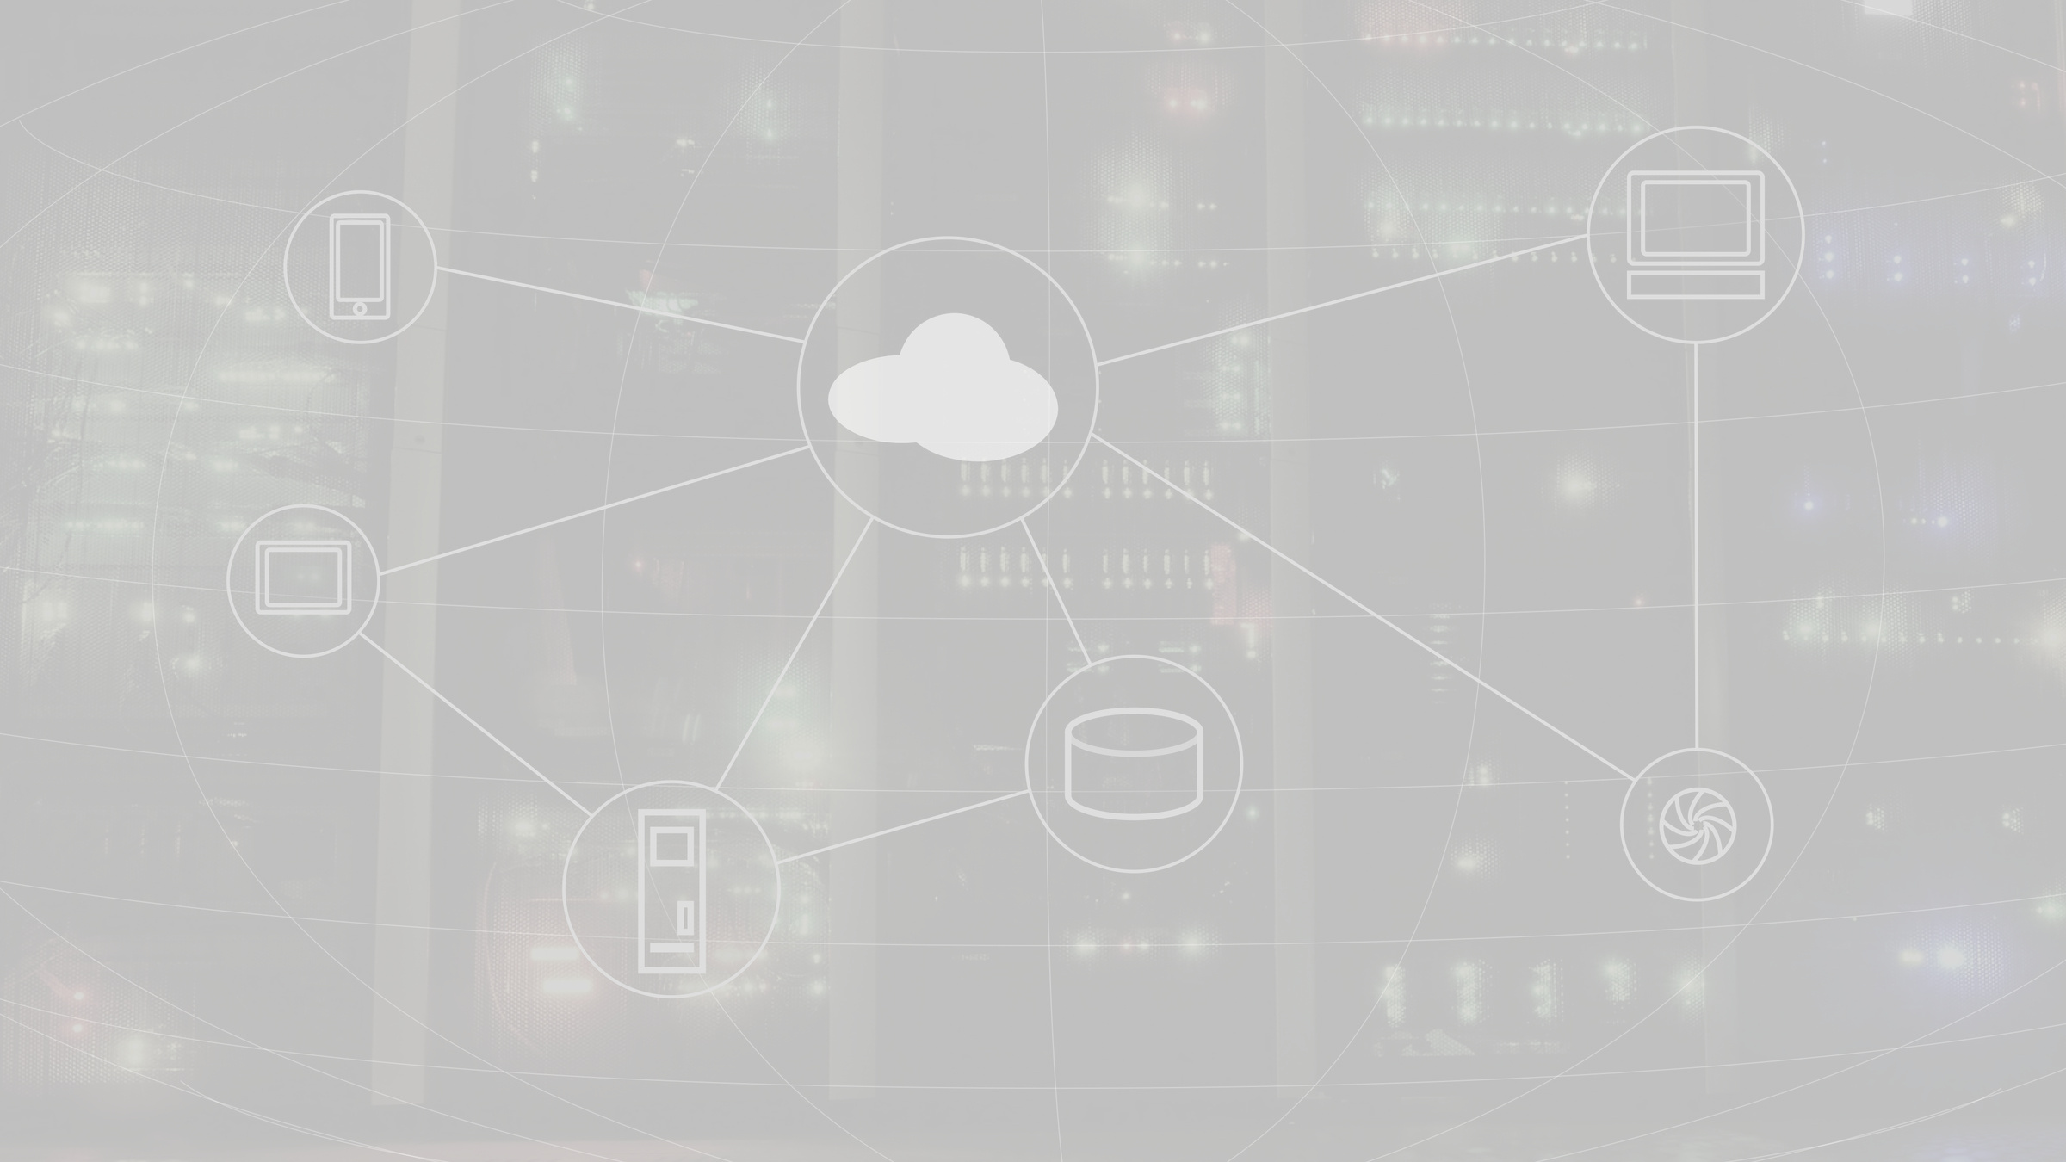
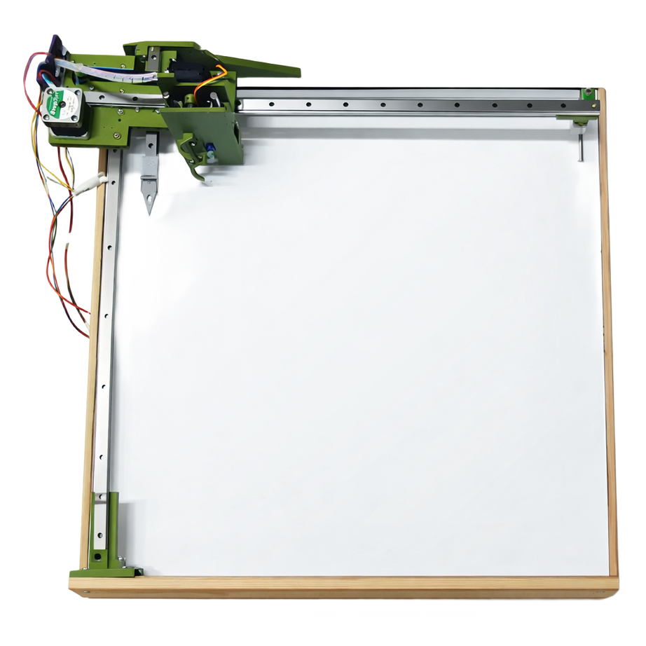
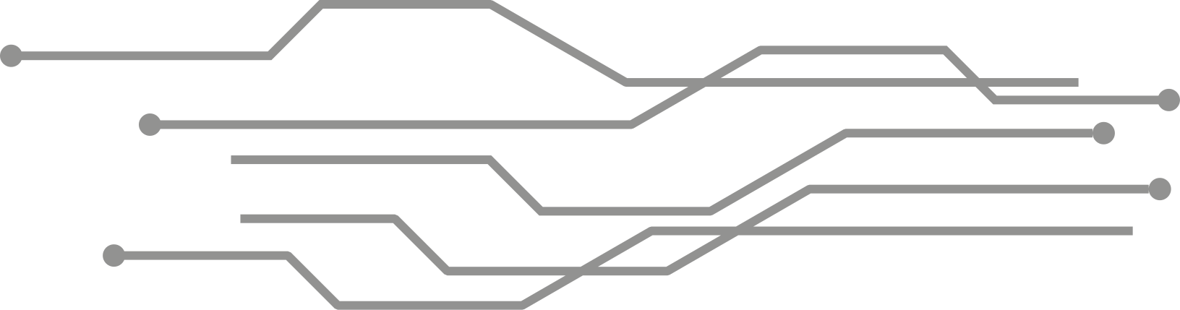
NEXA BOARD
ABDULQADER WADDAH OSAMA AMMAR
PAGE 01

Slide 2
TABLE OF CONTENTS
  INTRODUCTION AND OVERVIEW
  PROBLEM
  PROJECT OBJECTIVES
  HARDWARE COMPONENTS.
  COMMUNICATION AND DATA FLOW.
  FUTURE WORK
  CHALLENGES
  CONCLUSION
WWW.REALLYGREATSITE.COM
PAGE 02

Slide 3
INTRODUCTION
In recent years, educational technologies have advanced rapidly, creating a need for smarter and more efficient classroom tools. Although whiteboards are still widely used, manual writing and drawing can be time-consuming and difficult to document.
To address this issue, our project introduces Nexa Board, an intelligent CNC-based automated whiteboard system. The system is designed to automatically write, draw, erase, and capture board content. It integrates a web-based platform, remote control functionality, and a secure authentication mechanism to ensure ease of use and safe operation.
Nexa Board provides a practical and cost-effective alternative to smart boards while enhancing teaching efficiency and supporting modern learning environments.
WWW.REALLYGREATSITE.COM
PAGE 03

Slide 4

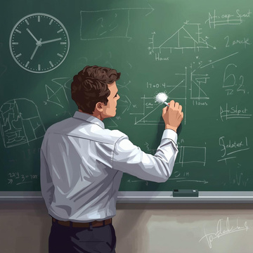


PROBLEM STATEMENT
01
02
INABILITY TO SAVE AND RETRIEVE CONTENT
03
PHYSICAL EFFORT
AND TIME
HIGH COST
Handwriting, drawing, and erasing boards consume a lot of time and effort from the teacher.
Commercial "smart panels" are expensive and require a special infrastructure.
There is no automatic way to save or retrieve handwritten content on a traditional blackboard, making it difficult to review previous lessons later.
WWW.REALLYGREATSITE.COM
PAGE 04

Slide 5
PROJECT OBJECTIVES
1
2
3
Automate writing and drawing on whiteboards using a CNC-based system.
Enhance teaching efficiency and reduce manual effort for educators.
Offer an affordable, smart educational tool as an alternative to expensive smart boards.
WWW.REALLYGREATSITE.COM
PAGE 05

Slide 6


HARDWARE COMPONENT
PAGE 06

Slide 7
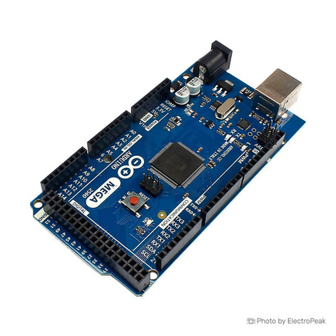
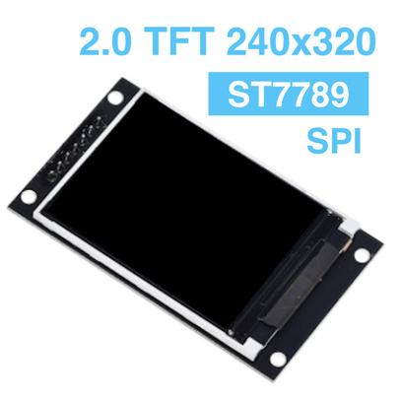
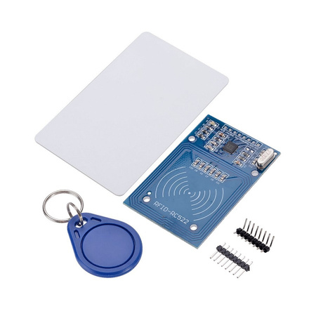
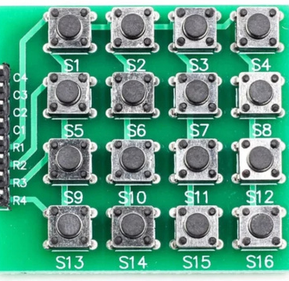
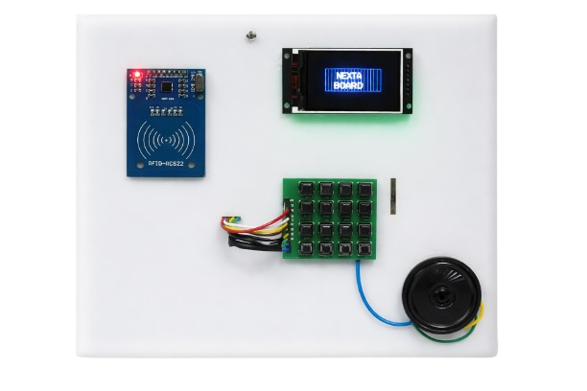
CONTROLLER BOX
ARDUINO MEGA
TFT LCD SCREEN
RFID
KEYPAD
PAGE 06

Slide 8
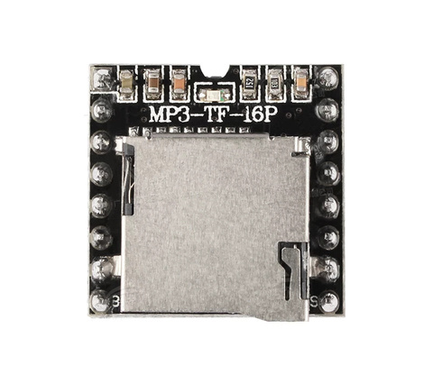
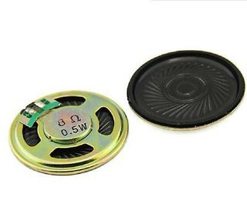
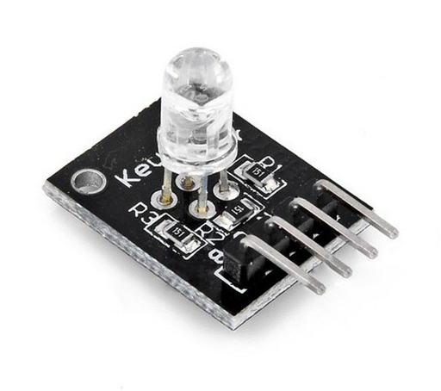
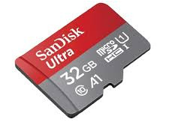
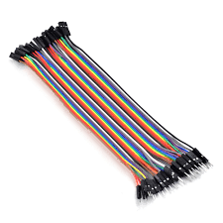
CONTROLLER BOX
DFPLAYER MINI
SPEAKERS
RGB LED
SD CARD
JUMPER WIRE
PAGE 07

Slide 9
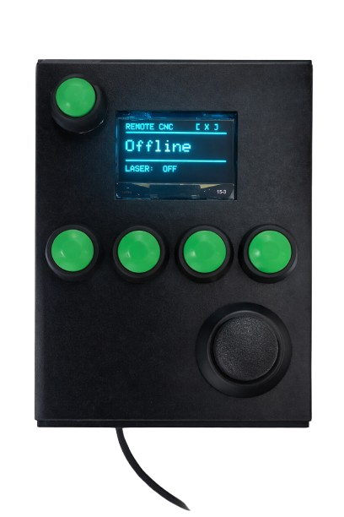
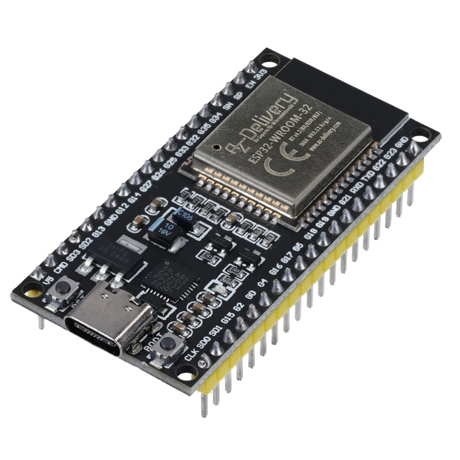
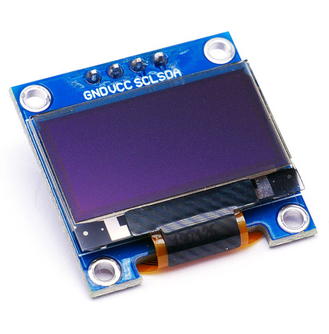
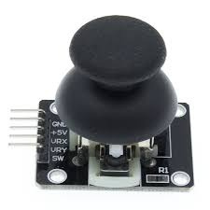
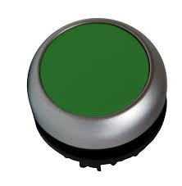
REMOTE CONTROL
ESP32
OLED SCREN
JOYSTICK
PUSH BUTTONS
PAGE 08

Slide 10
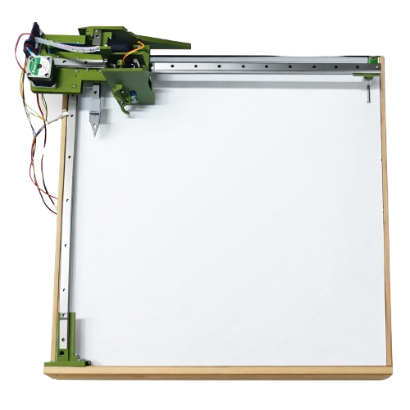
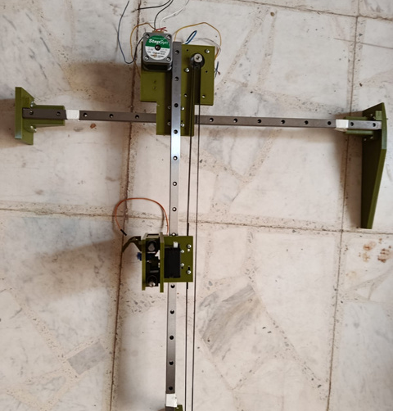
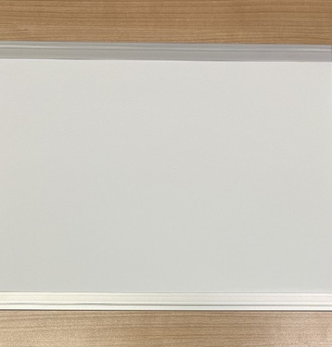
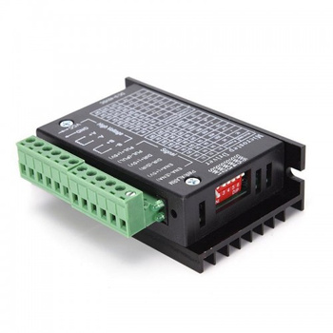
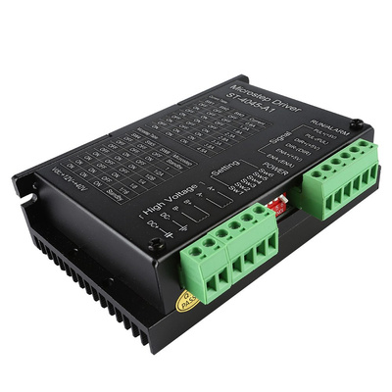
CNC CONTROLLER
CNC FRAME
WHITE BOARD
TB6600 DRIVER
TB6600 DRIVER
PAGE 09

Slide 11
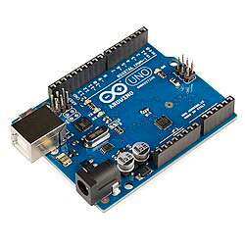
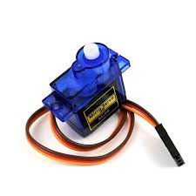
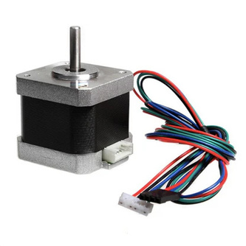
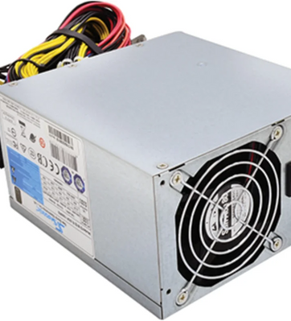
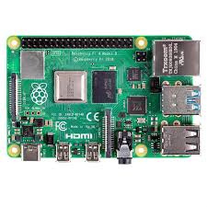
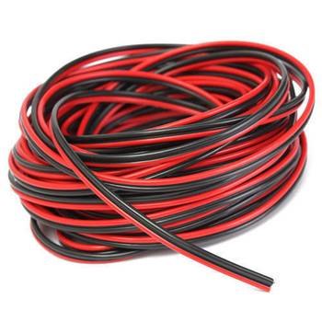
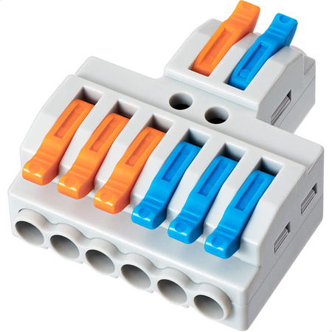
CNC CONTROLLER
ARDUINO UNO
SERVO MOTOR
STEPPER MOTOR
POWER SUPPLY
RASPBERRY PI 4
CONEECTION WIRE
CONNECTORS
JUMPER WIRES
PAGE 10

Slide 12
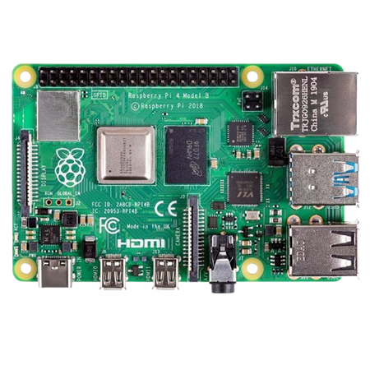
SYSTEM ARCHITECTURE
BOX CONTROLLER
CNC CONTROLLER
RASPBERRY PI 4
REMOTE CONTROLLER
PAGE 11

Slide 13

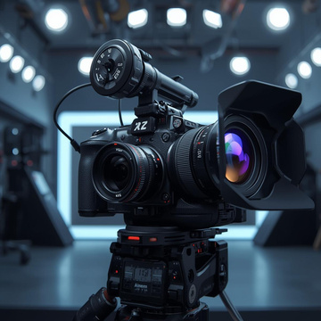
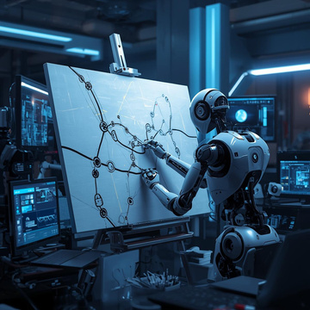
FUTURE WORK
INTELLIGENT AND AI-BASED FEATURES
CAMERA SYSTEM ENHANCEMENT
Implementing advanced features such as handwriting recognition, automatic content scheduling, and AI-assisted drawing optimization to make the system more adaptive and intelligent.
Upgrading the camera module to support higher resolution image capture, better stabilization, and video recording for improved documentation and online learning support.
DRAWING OPTIMIZATION AND PATH PLANNING
Improving image vectorization and toolpath generation algorithms to reduce drawing time, minimize unnecessary movements, and enhance drawing accuracy.
PAGE 12

Slide 14

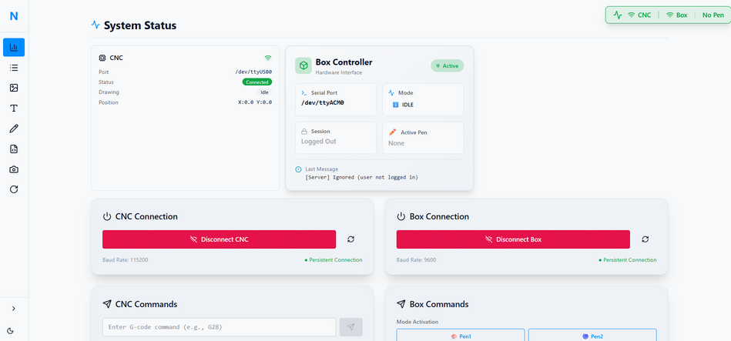
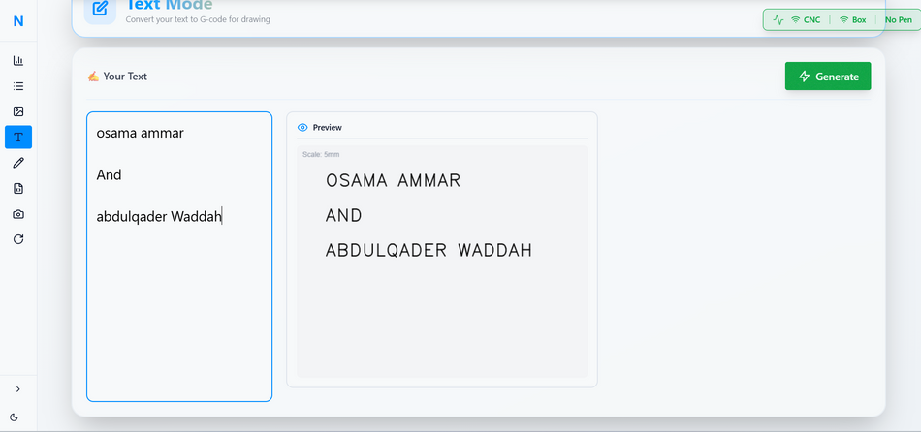
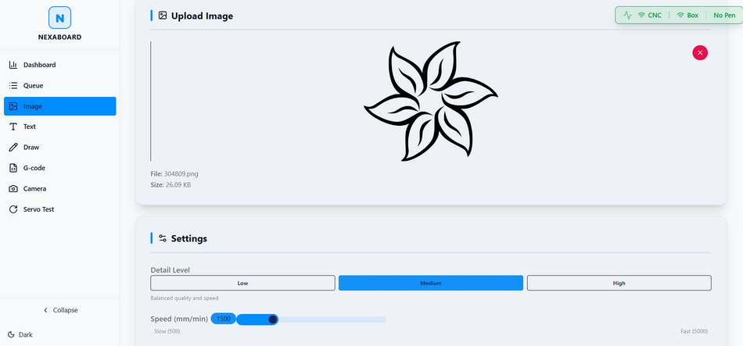
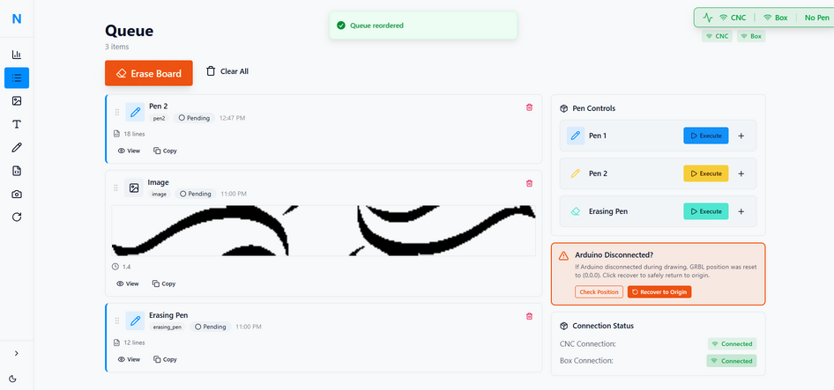
SOFTWARE COMPONENT
System monitoring dashboard to check device status
Text Mode : write any text with live preview before drawing
Image Upload Mode : upload images and draw them on the board
DRAWING QUEUE MANAGEMENT
PAGE 13

Slide 15


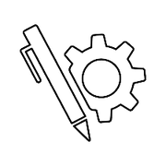
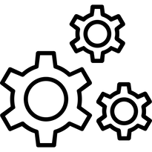

CHALLENGES
Mechanical Stability
Multi-Unit Communication
Pen Mechanism Design
Synchronizing communication between multiple controllers (Arduino Mega, Arduino Uno, Raspberry Pi, ESP32) without delays or data loss
Ensuring the CNC frame was rigid enough to prevent vibrations and maintain precision during movement.
Creating a reliable automatic pen switcher that could change colors without smudging or misalignment.
01
02
03
PAGE 14

Slide 16
THANK
YOU!
PAGE 10

