Slide 1

AN- Najah National University
Faculty of Engineering
Electrical Engineering Department
Introduction to Graduation Project
Optimum Performance of Tulkarim Governorate Network
& Sarra Connection Point
Prepared by:
Woroud Turabi
Ahmad Nasralla
Supervised by:
Dr. Imad Ibrik

Slide 2
Contents
Introduction
Sarra connection point and Tulkarem electricity network
- Electrical supply
- Elements of the network
- Problems in the network
Analysis Summary
Analysis of supply Sarra connection point and Tulkarem from central substation
The maximum load case improvement
overloaded transformers
Mechanical design of the network
Conclusion

Slide 3
Introduction
1-Collect all data about Tulkarim network and Sarra connection point including all parameters (transformers, transmission lines , load ).
2-Analyze the unified networks under maximum conditions using load flow analyses.
3-analysis of Sarra connection point and Tulkarem networks after we connecting them to Sarra electricity distribution substation (161\33)
KV.
4-Improve the voltage level and the power factor in the network.
Benefits and advantages to improving the distribution of electrical networks:
  Reduction of power losses
  Increasing voltage levels
  Power factor correction
  Increasing the capability of the distribution transformer

Slide 4
Sarra Electrical Supply:
Sarra connection point is provided by Israel Electrical Company (IEC)
The voltage of the transmission line is (33 kv)
The main circuit breaker is rated at (320 A)
The maximum demand reached is equal to (20 MVA)

Slide 5
Tulkarim Electrical Supply:
Tulkarim is provided by Israel Electrical Company (IEC)
The voltage of the transmission line is (22 kv)
The main circuit breaker is rated at:
  (350 A) for the first network
  (320A) for the second network
The max demand reached is equal to:
  (13 MVA) for the first network
  (11.968 MVA) for the second network

Slide 6
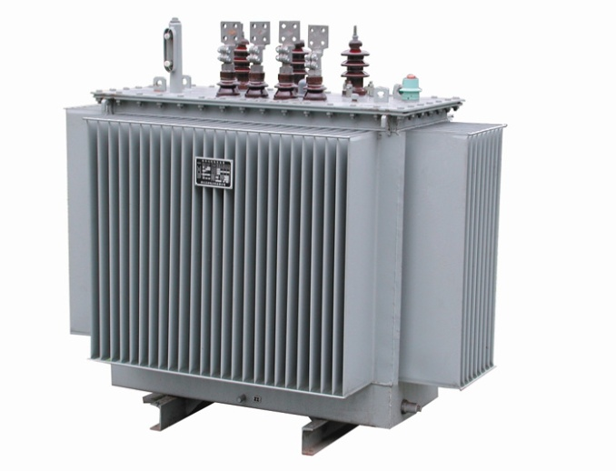
Elements of The Networks in Sarra
Number of transformers in Sarra connection point is equal to: 92 Δ/Υ (33/0.4) KV distribution transformers
The table below shows the number of each of them and the rated KVA:
Number of transformer | Transformer rating (KVA)
1 | 160
17 | 250
33 | 400
2 | 500
30 | 630
4 | 1500
2 | 1000

Slide 7
Elements of The Networks in Tulkarim
Number of Transformers in tulkarem : 101 Δ/Υ (22/0.4) KV distribution transformers.
Number of transformer | Transformer rating (KVA)
1 | 100
3 | 160
27 | 250
21 | 400
49 | 630

Slide 8
Problems in The Network :
The P.F. (Power Factor) is less than 92 %, this causes penalties and power losses
There is a voltage drop
There is power losses
High load factor (L.F. > 1) for some transformer (i.e., T29, T38, T55 in Tulkarim1)
We analyze the networks before and after the connection with a new main substation 161\33 kV

Slide 9
# of Load | Rated V (KV) | PF % | Terminal V (KV)
Load 2 | 0.4 | 90 | 0.395
Load 3 | 0.4 | 90 | 0.395
Load 4 | 0.4 | 90 | 0.395
Load 5 | 0.4 | 90 | 0.395
Load 6 | 0.4 | 90 | 0.394
Load 7 | 0.4 | 90 | 0.394
Load 8 | 0.4 | 90 | 0.394
Load 9 | 0.4 | 90.1 | 0.394
Load 10 | 0.4 | 90.1 | 0.395
Load 11 | 0.4 | 90.1 | 0.395
Load 12 | 0.4 | 90 | 0.395
Load 13 | 0.4 | 90 | 0.395
Load 14 | 0.4 | 90 | 0.396
Load 15 | 0.4 | 90 | 0.395
Load 16 | 0.4 | 90 | 0.395
Load 17 | 0.4 | 90 | 0.395
Load 18 | 0.4 | 90 | 0.395
Load 19 | 0.4 | 90 | 0.393
Load 20 | 0.4 | 90 | 0.393
Load 21 | 0.4 | 90 | 0.394
Load 22 | 0.4 | 90 | 0.394
Load 23 | 0.4 | 90 | 0.394
Load 24 | 0.4 | 90 | 0.396
Load 25 | 0.4 | 90 | 0.396
Load 26 | 0.4 | 90 | 0.396
Load 27 | 0.4 | 90 | 0.396
Load 28 | 0.4 | 90 | 0.396
Load 29 | 0.4 | 90 | 0.396
Load 30 | 0.4 | 90 | 0.396
Load 31 | 0.4 | 90 | 0.396
Load 32 | 0.4 | 90.1 | 0.395
Load 33 | 0.4 | 90 | 0.395
The maximum case
The low tension voltages
The actual low voltage on each transformer is shown in the table below :
Sarra connection point

Slide 10
# of load | Rated V (KV) | PF % | Terminal V (KV)
Load1 | 33 | 90 | 32.66
Load2 | 0.4 | 90 | 32.66
Load3 | 0.4 | 90 | 0.395
Load4 | 0.4 | 90 | 0.395
Load5 | 0.4 | 90 | 0.395
Load6 | 0.4 | 90 | 0.394
Load7 | 0.4 | 90 | 0.394
Load8 | 0.4 | 90 | 0.394
Load9 | 0.4 | 90 | 0.394
Load10 | 0.4 | 90.1 | 0.395
Load11 | 0.4 | 90 | 0.395
Load12 | 0.4 | 90 | 0.395
Load13 | 0.4 | 90 | 0.395
Load14 | 0.4 | 90 | 0.395
Load15 | 0.4 | 90 | 0.395
Load16 | 0.4 | 90 | 0.395
Load17 | 0.4 | 90 | 0.395
Load18 | 0.4 | 90 | 0.395
Load19 | 0.4 | 90 | 0.395
Load20 | 0.4 | 90 | 0.396
Load21 | 0.4 | 90 | 0.396
Load22 | 0.4 | 90 | 0.395
Load23 | 0.4 | 90.1 | 0.395
Load24 | 0.4 | 90 | 0.394
Load25 | 0.4 | 90 | 0.395
Load26 | 0.4 | 90 | 0.394
Load27 | 0.4 | 90 | 0.394
Load28 | 0.4 | 90 | 0.394
Load29 | 0.4 | 90 | 0.394
Load30 | 0.4 | 90.1 | 0.385
Load31 | 0.4 | 90 | 0.384
Load32 | 0.4 | 90 | 0.383
Load33 | 0.4 | 90.1 | 0.383
Load34 | 0.4 | 90 | 0.383
Load35 | 0.4 | 90 | 0.382
Load36 | 0.4 | 90 | 0.382
Load37 | 0.4 | 90 | 0.382
Load38 | 0.4 | 90 | 0.38
Load39 | 0.4 | 90 | 0.381
Load40 | 0.4 | 90 | 0.381
Load41 | 0.4 | 90 | 0.38
Load42 | 0.4 | 90 | 0.38
Load43 | 0.4 | 90.1 | 0.38
Load44 | 0.4 | 90 | 0.38
Load45 | 0.4 | 90.1 | 0.377
Load46 | 0.4 | 90.1 | 0.377
Load47 | 0.4 | 90 | 0.376
Load48 | 0.4 | 90.1 | 0.376
Load49 | 0.4 | 90.1 | 0.376
Load50 | 0.4 | 90 | 0.376
Load51 | 0.4 | 90 | 0.376
Load52 | 0.4 | 90.1 | 0.375
Load53 | 0.4 | 90 | 0.388
Load54 | 0.4 | 90 | 0.386
Load55 | 0.4 | 90 | 0.387
Load56 | 0.4 | 90 | 0.387
Load57 | 0.4 | 90.1 | 0.387
Load58 | 0.4 | 90 | 0.387
Load59 | 0.4 | 90.1 | 0.387

Slide 11
Tulkarim 1
# of Load | Rated V (KV) | Power factor | Terminal V (KV)
خضوري 1 | 0.4 | 90 | 0.396
بئر رقم 1 | 0.4 | 90 | 0.396
خضوري 2 | 0.4 | 90 | 0.396
دوار جمال عبد الناصر1 | 0.4 | 90 | 0.396
دوار جمال عبد الناصر2 | 0.4 | 90 | 0.396
بئر رقم 2 | 0.4 | 90 | 0.396
دوار خضوري | 0.4 | 90 | 0.396
الدلهوم | 0.4 | 90 | 0.395
د.ثابت | 0.4 | 90 | 0.394
الحي الجنوبي | 0.4 | 90 | 0.394
هواش | 0.4 | 90 | 0.393
ارتاح الغربي | 0.4 | 90 | 0.392
مصنع العاصي | 0.4 | 90 | 0.392
برك المجاري | 0.4 | 90 | 0.391
بئر ابو حسين | 0.4 | 90 | 0.39
ورشه الميكانيك | 0.4 | 90 | 0.39
الهوجي | 0.4 | 90 | 0.39
ارتاح 1 | 0.4 | 90 | 0.39
ارتاح الصباح | 0.4 | 90 | 0.39
المحطه | 0.4 | 90 | 0.382
مستشفى الزكاة | 0.4 | 90 | 0.38
مفرق السلمان | 0.4 | 90 | 0.381
ديوان الجلاد | 0.4 | 90 | 0.38
المخبز الفرنسي | 0.4 | 90 | 0.39
دوار السلام | 0.4 | 90 | 0.38
عزبة شوفة | 0.4 | 90 | 0.38
فرعون | 0.4 | 90 | 0.38
عزبة ناصر | 0.4 | 90 | 0.385
ابو خضرة | 0.4 | 90 | 0.382
بئر ذياب | 0.4 | 90 | 0.381
حاره ذياب | 0.4 | 90 | 0.38
مدرسه مسقط | 0.4 | 90 | 0.382
مصعب بن عمير | 0.4 | 90 | 0.378
ابو صفيه | 0.4 | 90 | 0.378
المسلخ | 0.4 | 90 | 0.38
المخابرات | 0.4 | 90 | 0.376
عزبة الجراد | 0.4 | 90 | 0.378
انشراح الددو | 0.4 | 90 | 0.374
بئر الصديق | 0.4 | 90 | 0.374
بئر التفال | 0.4 | 90 | 0.374
مقبره التايه | 0.4 | 90 | 0.374
اسامه مناصره | 0.4 | 90 | 0.374
بئر السفاريني | 0.4 | 90 | 0.375
مربعه حنون | 0.4 | 90 | 0.373
البلاونه | 0.4 | 90 | 0.372
الميريلاند | 0.4 | 90 | 0.371
المخيم الوكالة 1 | 0.4 | 90 | 0.371
المخيم الوكالة 2 | 0.4 | 90 | 0.372
المخيم الوكالة 3 | 0.4 | 90 | 0.372
القدس المفتوحه | 0.4 | 90 | 0.371
الاسكان | 0.4 | 90 | 0.371
ذنابه خريشه | 0.4 | 90 | 0.371
بئر 6 | 0.4 | 90 | 0.388
الحرباوي | 0.4 | 90 | 0.392
الحمدلله | 0.4 | 90 | 0.392
الشرعب | 0.4 | 90 | 0.283
دائره السير | 0.4 | 90 | 0.372
منشار نور | 0.4 | 90 | 0.372
منشار نصار | 0.4 | 90 | 0.372
منشار الكوكب | 0.4 | 90 | 0.39

Slide 12
Tulkarim 2
# of Load | Rated V (KV) | Power factor | Terminal V (KV)
اكتابا | 0.4 | 90 | 0.394
بئر ناصر | 0.4 | 90 | 0.393
مصنع الاسلاميه 1 | 0.4 | 90 | 0.395
مصنع النور | 0.4 | 90 | 0.395
مصنع الاسلاميه 2 | 0.4 | 90 | 0.393
زيد برهم | 0.4 | 90 | 0.395
مسجد الروضه | 0.4 | 90 | 0.392
بنك القدس | 0.4 | 90 | 0.391
مجمع الاشقر | 0.4 | 90 | 0.392
بئر قزمار | 0.4 | 90 | 0.391
بئر رقم 3 | 0.4 | 90 | 0.389
ابو يونس | 0.4 | 90 | 0.388
مخمر الموز | 0.4 | 90 | 0.389
بئر ابو صالح | 0.4 | 90 | 0.39
بئر ابو ربحي | 0.4 | 90 | 0.385
بئر الخواجا | 0.4 | 90 | 0.388
منجره الجعرون | 0.4 | 90 | 0.389
مصنع البرق | 0.4 | 90 | 0.388
ظهره اكباريه | 0.4 | 90 | 0.385
مفرق الجعرون | 0.4 | 90 | 0.389
بئر ملعب شويكه | 0.4 | 90 | 0.382
بئر ابو صالح | 0.4 | 90 | 0.39
المهداوي | 0.4 | 90 | 0.385
بئر الميناوي 1 | 0.4 | 90 | 0.389
بئر الميناوي 2 | 0.4 | 90 | 0.39
واد الشام | 0.4 | 90 | 0.384
جمعية شويكه | 0.4 | 90 | 0.385
دوار شويكه | 0.4 | 90 | 0.39
بنك القاهرة عمان | 0.4 | 90 | 0.389
البنك العربي | 0.4 | 90 | 0.389
بنك فلسطين | 0.4 | 90 | 0.388
مستشفى ثابت 1 | 0.4 | 90 | 0.387
مستشفى ثابت 2 | 0.4 | 90 | 0.389
العدويه | 0.4 | 90 | 0.39
مجمع دعباس | 0.4 | 90 | 0.39
مجمع التاج | 0.4 | 90 | 0.389
مجمع الخاروف | 0.4 | 90 | 0.385
الشاهد | 0.4 | 90 | 0.388
المحافظه | 0.4 | 90 | 0.389
المقاطعه | 0.4 | 90 | 0.388

Slide 13
Value of maximum loads in table below:(before improvement)
Sarra connection point
Transformer number | Rated (KVA) | load (KVA) | Power factor
Tr2madakh al- jneed | 400 | 200 | 90.01
Tr3 amena saaed | 160 | 80 | 90.04
Tr4 khalele | 400 | 200 | 90.01
Tr5 jalal yaseen | 400 | 200 | 90.01
Tr6 tayba 1 | 400 | 200 | 90.01
Tr7 tayba 2 | 400 | 200 | 90.01
Tr8 al ameria | 630 | 315 | 90.02
Tr9 eskan almohandesen | 250 | 125 | 90.05
Tr10 eskan Shinar | 250 | 125 | 90.05
Tr11 bet wazan | 250 | 125 | 90.05
Tr12 hajez | 400 | 200 | 90.01
Tr13 jneed | 400 | 200 | 90.01
Tr14 orabee | 400 | 200 | 90.01
Tr15 alferdaws | 630 | 315 | 90.02
Tr16 khateeb | 630 | 315 | 90.02
Tr17 afonneh | 630 | 315 | 90.02
Tr18 seha | 400 | 200 | 90.01
Tr19 jaber | 400 | 200 | 90.01
Tr20 msjed al makhfeha | 400 | 200 | 90.01
Tr21 kamal jnblat | 630 | 315 | 90.02
Tr22 etsalat 1 | 400 | 200 | 90.01
Tr23 etsalat 2 | 630 | 315 | 90.02
Tr24 reyada | 630 | 315 | 90.02
Tr25 saydleh | 630 | 315 | 90.02
Tr26 funon | 1500 | 750 | 89.99
Tr27 tamred | 1500 | 750 | 89.99
Tr28 oloom | 1500 | 750 | 89.99
Tr29 hndesah | 1500 | 750 | 89.99
Tr30 sejen jneed | 630 | 315 | 90.02
Tr31 seefe | 400 | 200 | 90.01
Tr32 eskan shinar khalf jneed | 250 | 125 | 90.05
Tr33 al bydar | 400 | 200 | 90.01

Slide 14
Transformers number | Rated power (KVA) | load (KVA) | Power factor
Tr3 karakon feeder | 630 | 315 | 90.02
Tr4 heteen | 400 | 200 | 90.01
Tr5 yasmeen hotel | 630 | 315 | 90.02
Tr6 bab saha | 630 | 315 | 90.02
Tr7 malhes | 630 | 315 | 90.02
Tr8 aqaree bank | 630 | 315 | 90.02
Tr9 Jordan bank | 630 | 315 | 90.02
Tr10 othmanee | 250 | 125 | 90.05
Tr11 revolee | 630 | 315 | 90.02
Tr12 Palestine bank | 400 | 200 | 90.01
Tr13 abo salha | 630 | 315 | 90.02
Tr14 alkonee | 630 | 315 | 90.02
Tr15 alsook alekhdar | 500 | 250 | 89.95
Tr16 alhewaree | 630 | 315 | 90.02
Tr17 tokan | 630 | 315 | 90.02
Tr18 shakaa | 400 | 200 | 90.01
Tr19 malhees | 400 | 200 | 90.01
Tr20 alenjeehe | 500 | 250 | 89.95
Tr21 kalbone1 | 630 | 315 | 90.02
Tr22 ksheka | 400 | 200 | 90.01
Tr23 krom ashoor | 250 | 125 | 90.05
Tr24 aeen al asel | 400 | 200 | 90.01
Tr25 madakhet ras eleen | 630 | 315 | 90.02
Tr26 salah deen | 400 | 200 | 90.01
Tr27 Samsung | 630 | 315 | 90.02
Tr28 el basha | 630 | 315 | 90.02
Tr29 omer ben el aas | 400 | 200 | 90.01
Tr30 kalboneh 2 | 250 | 125 | 90.05
Tr31 madakhet 24 | 250 | 315 | 90.02
Tr32 abo raed | 630 | 315 | 90.02
Tr33 blaza | 630 | 125 | 90.05
Tr34 takhasosee | 250 | 500 | 90.01
Tr35 sharea 24 | 1000 | 315 | 90.02
Tr36 Kazan janobee | 630 | 200 | 90.01
Tr37 jneed janobee | 400 | 200 | 90.01
Tr38 karajat el jameaa | 400 | 315 | 90.02
Tr39 maktabet el jameaa | 630 | 200 | 90.01
Tr40 jameaa nor | 400 | 200 | 90.01
Tr41 eskan naqabat | 400 | 200 | 90.01
Tr42 sharea tel | 400 | 315 | 90.02
Tr43 arade shinar | 630 | 125 | 90.05
Tr44 Nablus jadeeda | 250 | 315 | 90.02
Tr45 Iraq boreen 1 | 630 | 125 | 90.05
Tr46 Iraq boreen 2 | 250 | 125 | 90.05
Tr47 tel sharqee | 250 | 200 | 90.01
Tr48 tel lehef | 400 | 125 | 90.05
Tr49 tel el bald | 250 | 125 | 90.05
Tr50 tel gharbee | 250 | 200 | 90.01
Tr51 tareeq sarra | 400 | 200 | 90.01
Tr52 tel madakha | 400 | 125 | 90.05
Tr53 raze | 250 | 200 | 90.01
Tr54 dardok | 400 | 200 | 90.01
Tr55 joharee | 400 | 200 | 90.01
Tr56 shohadaa | 400 | 200 | 90.01
Tr57 qteshat | 250 | 125 | 90.05
Tr58 el qaser | 1000 | 500 | 90.01
Tr59 shanaa | 250 | 125 | 90.05

Slide 15
Tulkarim1
Powerfactor | Load (KVA) | Rated (KVA) | Transformers name
90 | 436 | 630 | خضوري 1
90 | 346 | 630 | بئر رقم 1
90 | 208 | 630 | خضوري 2
90 | 544 | 630 | دوار جمال عبد الناصر1
90 | 544 | 630 | دوار جمال عبد الناصر2
90 | 346 | 630 | بئر رقم 2
90 | 277 | 400 | دوار خضوري
90 | 208 | 400 | الدلهوم
90 | 208 | 400 | د.ثابت
90 | 208 | 250 | الحي الجنوبي
90 | 277 | 400 | هواش
90 | 208 | 400 | ارتاح الغربي
90 | 173 | 250 | مصنع العاصي
90 | 173 | 250 | برك المجاري
90 | 277 | 400 | بئر ابو حسين
90 | 346 | 630 | ورشه الميكانيك
90 | 242 | 400 | الهوجي
90 | 277 | 400 | ارتاح 1
90 | 312 | 630 | ارتاح الصباح
90 | 242 | 630 | المحطه
90 | 277 | 630 | مستشفى الزكاة
90 | 346 | 630 | مفرق السلمان
90 | 312 | 630 | ديوان الجلاد
90 | 208 | 250 | المخبز الفرنسي
90 | 242 | 400 | دوار السلام
90 | 277 | 400 | عزبة شوفة
90 | 139 | 250 | فرعون
90 | 242 | 250 | عزبة ناصر
90 | 208 | 250 | ابو خضرة
90 | 173 | 250 | بئر ذياب
90 | 173 | 250 | حاره ذياب
90 | 346 | 360 | مدرسه مسقط
90 | 208 | 250 | مصعب بن عمير
90 | 277 | 250 | ابو صفيه
90 | 416 | 630 | المسلخ
90 | 139 | 250 | المخابرات
90 | 208 | 400 | عزبة الجراد
90 | 139 | 250 | انشراح الددو
90 | 173 | 250 | بئر الصديق
90 | 173 | 250 | بئر التفال
90 | 277 | 630 | مقبره التايه
90 | 173 | 250 | اسامه مناصره
90 | 55.4 | 160 | بئر السفاريني
90 | 554 | 630 | مربعه حنون
90 | 544 | 630 | البلاونه
90 | 139 | 630 | الميريلاند
90 | 544 | 630 | المخيم الوكالة 1
90 | 544 | 630 | المخيم الوكالة 2
90 | 416 | 400 | المخيم الوكالة 3
90 | 208 | 630 | القدس المفتوحه
90 | 208 | 250 | الاسكان
90 | 208 | 400 | ذنابه خريشه
90 | 346 | 630 | بئر 6
90 | 69.3 | 400 | الحرباوي
90 | 69.3 | 250 | الحمدلله
90 | 208 | 630 | الشرعي
90 | 312 | 630 | دائره السير
90 | 277 | 400 | منشار نور
90 | 277 | 400 | منشار نصار
90 | 277 | 400 | منشار الكوكب

Slide 16
Tulkarim 2
Power factor | Load(KVA) | Rated (KVA) | Transformers name
90 | 139 | 400 | اكتابا
90 | 55.4 | 160 | بئر ناصر
90 | 416 | 630 | مصنع الاسلاميه 1
90 | 139 | 400 | مصنع النور
90 | 589 | 630 | مصنع الاسلاميه 2
90 | 208 | 630 | زيد برهم
90 | 312 | 630 | مسجد الروضه
90 | 208 | 400 | بنك القدس
90 | 416 | 630 | مجمع الاشقر
90 | 69.3 | 250 | بئر قزمار
90 | 346 | 630 | بئر رقم 3
90 | 416 | 630 | ابو يونس
90 | 277 | 630 | مخمر الموز
90 | 41.6 | 250 | بئر ابو صالح
90 | 139 | 250 | بئر ابو ربحي
90 | 69.3 | 250 | بئر الخواجا
90 | 277 | 630 | منجره الجعرون
90 | 277 | 630 | مصنع البرق
90 | 139 | 250 | ظهره اكباريه
90 | 242 | 630 | مفرق الجعرون
90 | 55.4 | 100 | بئر ملعب شويكه
90 | 69.3 | 400 | بئر ابو صالح
90 | 139 | 250 | المهداوي
90 | 277 | 630 | بئر الميناوي 1
90 | 139 | 630 | بئر الميناوي 2
90 | 139 | 160 | واد الشام
90 | 69.3 | 250 | جمعية شويكه
90 | 242 | 630 | دوار شويكه
90 | 346 | 630 | بنك القاهرة عمان
90 | 346 | 630 | البنك العربي
90 | 242 | 400 | بنك فلسطين
90 | 554 | 630 | مستشفى ثابت 1
90 | 346 | 630 | مستشفى ثابت 2
90 | 173 | 630 | العدويه
90 | 173 | 630 | مجمع دعباس
90 | 346 | 630 | مجمع التاج
90 | 173 | 250 | مجمع الخاروف
90 | 416 | 630 | الشاهد
90 | 346 | 630 | المحافظه
90 | 416 | 630 | المقاطعه

Slide 17
Analysis Summary
We have to summarize the results, total generation, demand, loading, percentage of losses, and the total power factor.

Slide 18
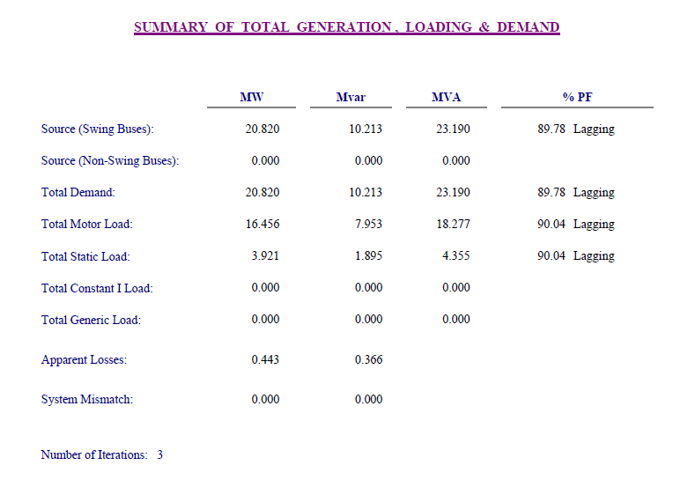
Sarra Connection Point

Slide 19
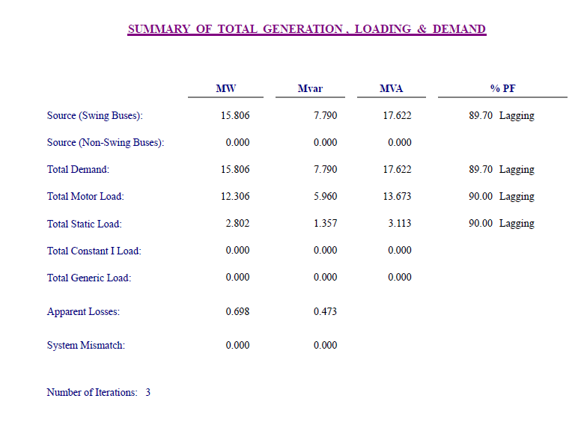
Tulkarim (1) Connection Point

Slide 20
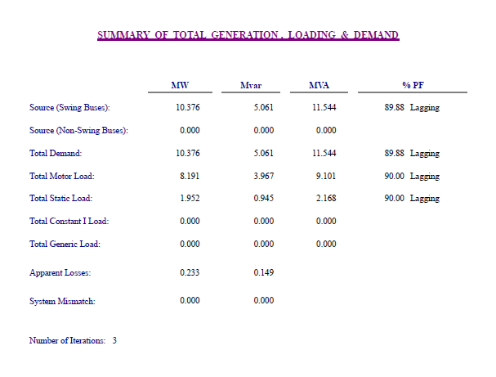
Tulkarim (2) Connection Point

Slide 21
Analysis of supply Sarra connection point and Tulkarem from central substation
At this stage of our graduation project we will Study the new condition of the two networks (Tulkarem and Sarra connection point) after connecting them to Sarra electricity distribution substation (161\33) KV directly without relying on Israeli national electricity company. Then we will improve the voltage level and decrease the real power losses and increase the reliability of the networks.
After the analysis of Sarra connection point and Tulkarem networks after we connecting them to Sarra electricity distribution substation (161\33) KV also many problems in the network appears as we mentioned before

Slide 22
Analysis Summary
We have to summarize the results, total generation, demand, loading, percentage of losses, and the total power factor.

Slide 23
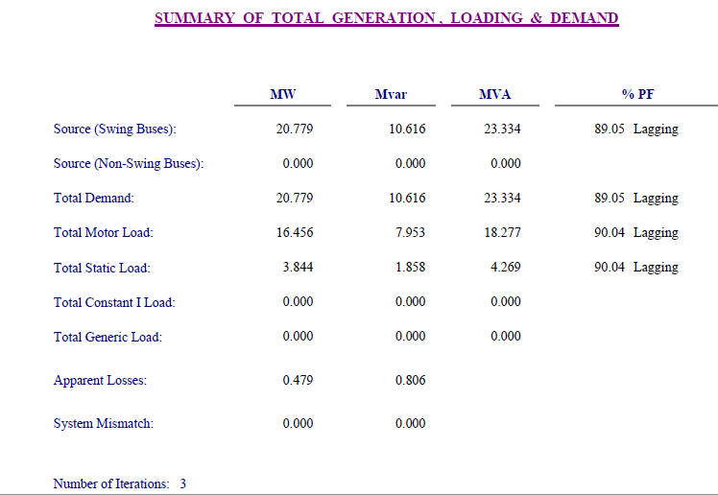
Sarra Connection Point

Slide 24
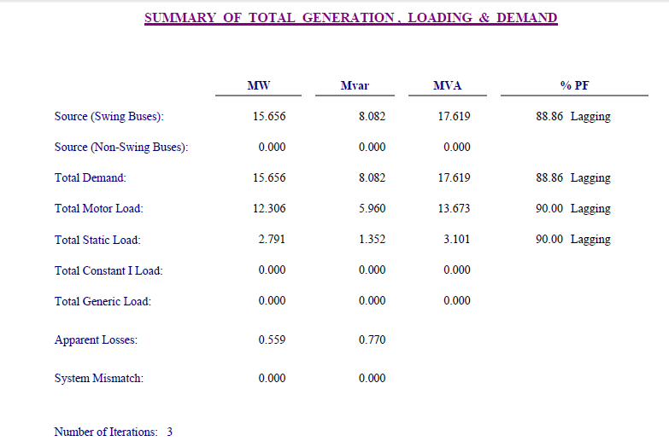
Tulkarim (1) Connection Point

Slide 25
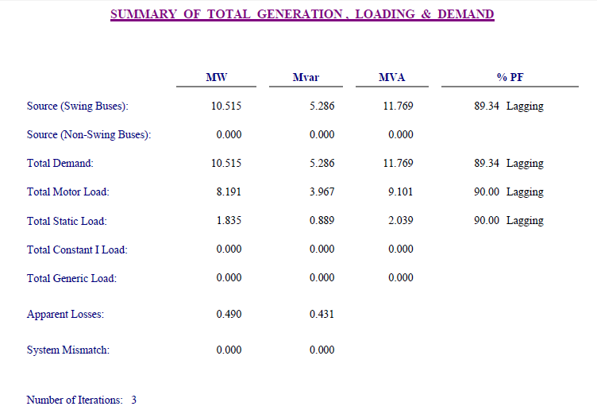
Tulkarim (2) Connection Point

Slide 26
The problems of the two networks after connection with Sarra main substation
1. The P.F in the network is less than 92% and this value causes many problems specially paying banalities and this value must be (0.92-0.95)
2. The voltages of buses are not acceptable and this voltage will be less when it reaches the consumer
3. The network have over loaded transformer .
4. High losses of power .

Slide 27
The maximum load case improvement
The methods we used to do that are:
Tab changing in the transformers.
Adding capacitors to produce reactive power.
Changing transformer.

Slide 28
Improvement the maximum case using taps changing and power factor improving .
The method of tab changing involves changing in the tab ratio on the transformer but in limiting range which not accede (5%) .
The P.F need to be improved to reduce the penalties on municipalities, reduce the current flows in the network which reduces the losses.
The power factor after the improving must be in the range (0.92- 0.95) lag

Slide 29
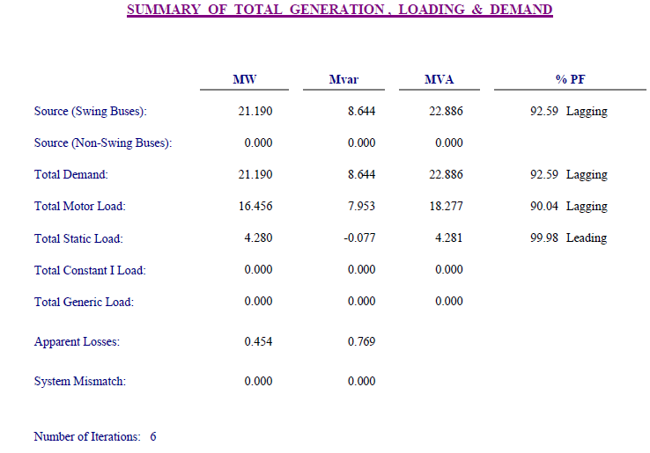
Sarra Connection Point

Slide 30
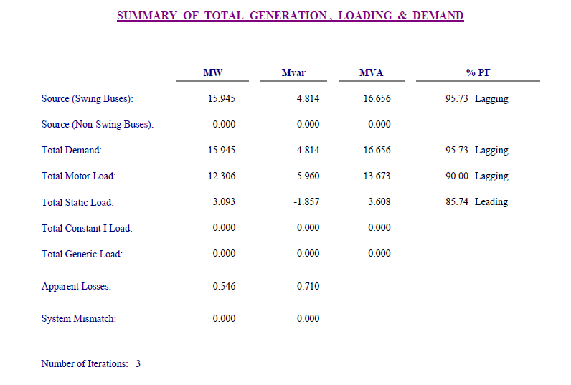
Tulkarim (1) Connection Point

Slide 31
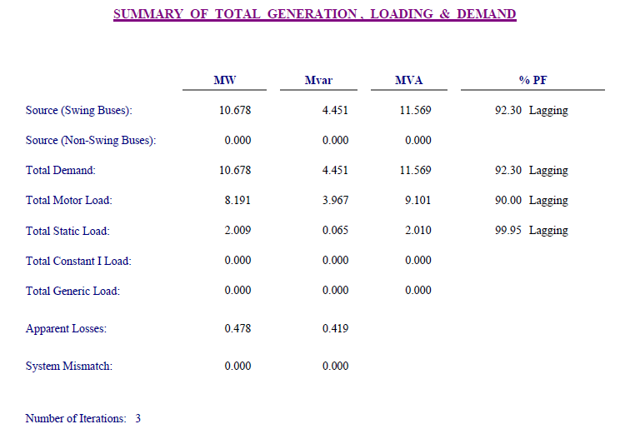
Tulkarim (2) Connection Point

Slide 32
overloaded transformers
After the improvement of Tulkarem (1) network in the maximum case there is some problems Where we have the overload transformer and we will increase the capacity of the transformer through changing them with the over size transformer . this will need to buy new transformers.
The following table shows the transformers which are needed to be bought:
Number of transformers | KVA
1 | 400

Slide 33
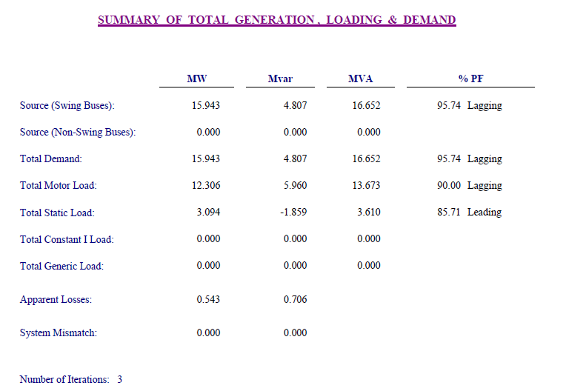
The Flowing table summarizes the analysis results after changing transformer

Slide 34
Mechanical design of the network
Main Components of overhead lines:
In general, the main components of overhead lines are:
Conductors:
Which carry electric power from the sending end station to receiving end station.
Supports:
Which may be poles or towers and keep the conductors at suitable level above the ground.
Insulators:
Which are attached to supports and insulate the conductors from the ground.
Cross Arms:
Which provide support to the insulators.
Miscellaneous Items:
Such as phase plates, danger plates, lightning arrestors, anti climbing wires .

Slide 35
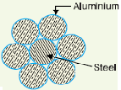
Conductors Material:
The conductor material used for transmission and distribution of electric power should be have the following properties:
High electrical conductivity .
High tensile strength in order to withstand mechanical stresses.
Low cost so that it can be used for long distances.
Low specific gravity so that weight per unit volume is small.
The Type of conductor that we used in this project is Steel Cord Aluminium as shown in Figure below :

Slide 36
Supports :
In general, the line supports should have the following properties:
High mechanical strength to withstand the weight of conductors and wind loads.
Light in weight without the loss of mechanical strength.
Cheap in cost and economical to maintain.
Longer life.
Easy accessibility of conductors for maintenance.
W e used Steel Towers Type and Steel Truss as shown in the figures below :

Slide 37
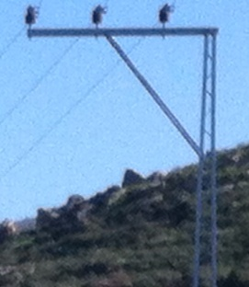
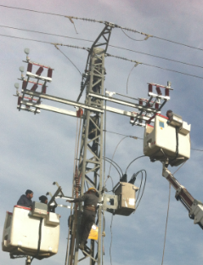
Number of steel towers and truss which we need :
Steel tower | Steel truss
61 | 182

Slide 38
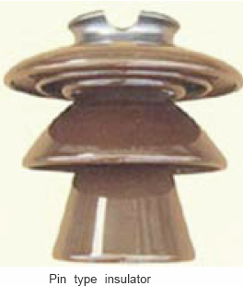
Insulators :
the insulators should have the following properties :
High mechanical strength in order to withstand conductor load, wind load etc.
High electrical resistance of insulator material in order to avoid leakage currents to earth.
High relative permittivity of insulator material in order that dielectric strength is high.
Types of Insulators :
Pin type insulators

Slide 39
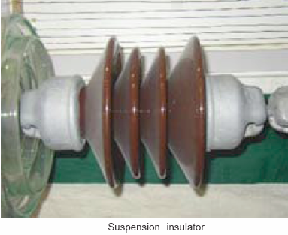
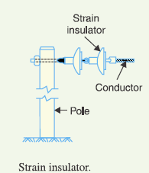
Suspension type insulators
Strain insulators

Slide 40
Number of insulators that we need in each type as shown in table below :
Types of insulator | Pin | Suspension | Strain
Number | 546 | 62 | 366
There is some of criteria we must take it into account in mechanical design of medium voltage :
Distances between the towers
The distance between each tow towers in the range (90 – 100) meter.

Slide 41
2. The high of tower is (12) meter in 33 (KV) voltage level.
3. Thickness of the steel material (80 – 90) mm, 90 mm from the base of tower and 80 mm toward the top of tower .
4. Base of tower (2-2-2.5) m, (0.5) m above the ground and each base need about (8) cup of concrete.
5. The distances between the insulators in the range (0.5-1) m.
6. Number of steel truss which we can put it in series in straight line without need to put the steel towers from 1 to 4 trusses until about 400 m distance.

Slide 42
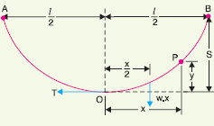

Calculation of Sag
When supports are at equal levels:
Consider a conductor between two equivalent supports A and B with O as the lowest point as shown in Fig.
Let
l = Length of span
w = Weight per unit length of conductor
T = Tension in the conductor.
we get,

Slide 43
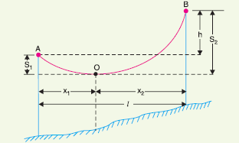


When supports are at unequal levels:
Fig. below shows a conductor suspended between two supports A and B which are at different levels. The lowest point on the conductor is O.
Let
l = Span length
h = Difference in levels between two supports
x1 = Distance of support at lower level (i.e. A) from O
x2 = Distance of support at higher level (i.e. B) from O
T = Tension in the conductor
We get,

Slide 44


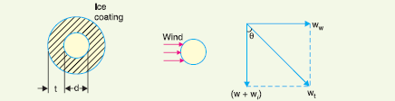

Where
x1 + x2 = l , and
Effect of wind and ice loading:
The above formulae for sag are true only in still air and at normal temperature when the conductor is acted by its weight only.
However, in actual practice, a conductor may have ice coating and simultaneously subjected to wind pressure.
As shown in Figure below :
So , we get

Slide 45
Conclusion
After analyzing the Sarra connection point and Tulkarim network with anew connection point with the central substation we found that the parameter of the network are suitable and the system will be stable . And in our study we recommended some measure for improving exciting network and reduction of electrical losses.

Slide 46


