Slide 1

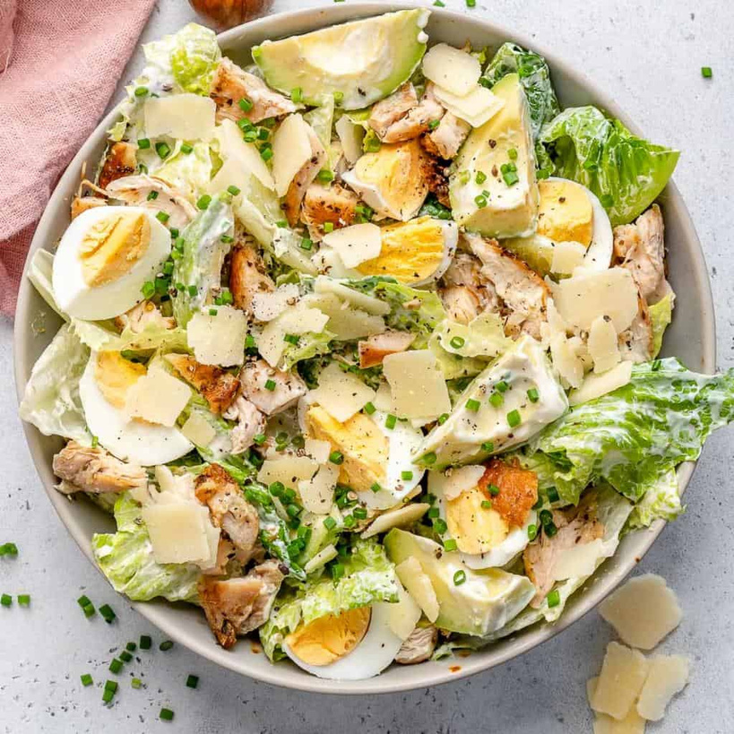


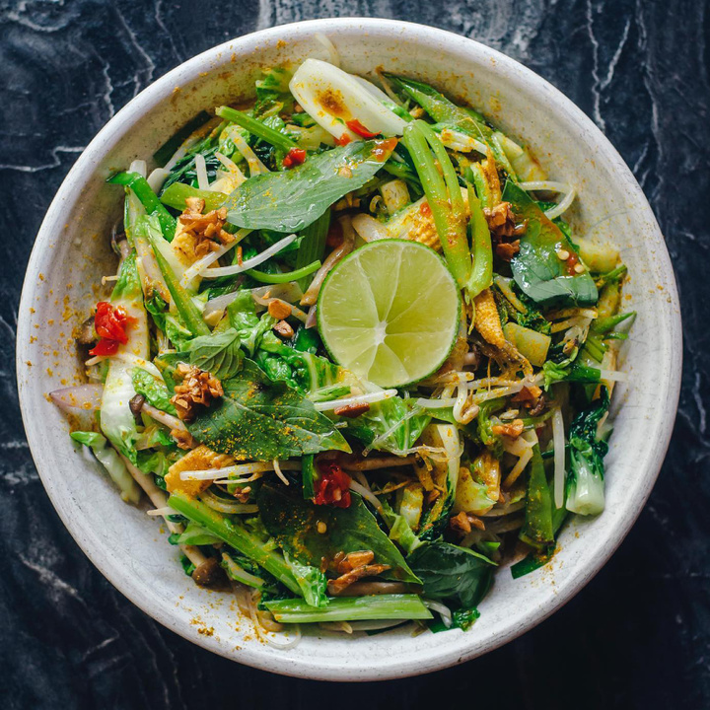
DISH DASH
Jana Khammash & Zain Abubaker
Supervisor: Dr. Samer Arandi

Slide 2


CONTENT
01
02
03
04
Introduction
Features & Screens
Programming Languages & APIs
Future Work

Slide 3




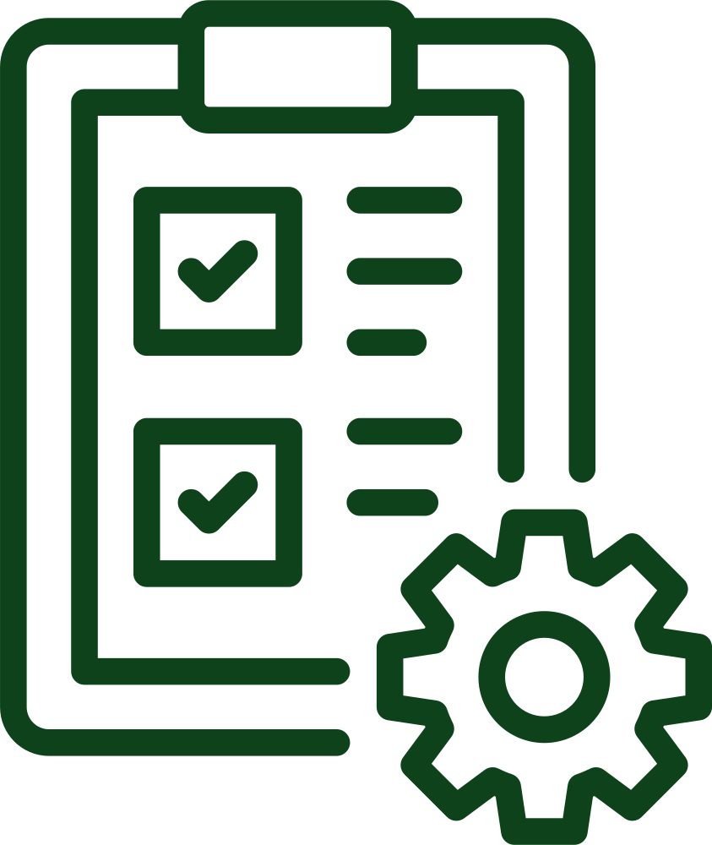

ABOUT
DISH DASH

Slide 4








Frameworks and Tools
Backend
Frontend
Database
Testing
Android Studio
GitHub
Figma
Canva

Slide 5





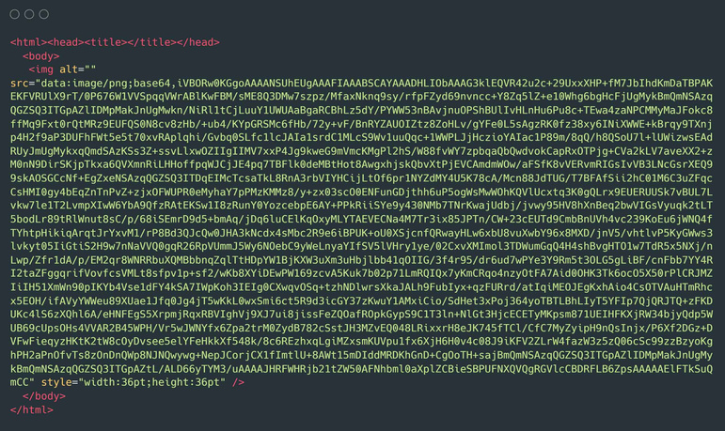
APIs
OpenAI
Edamam
Google Maps
Google Translate
Cloudinary
Base 64

Slide 6
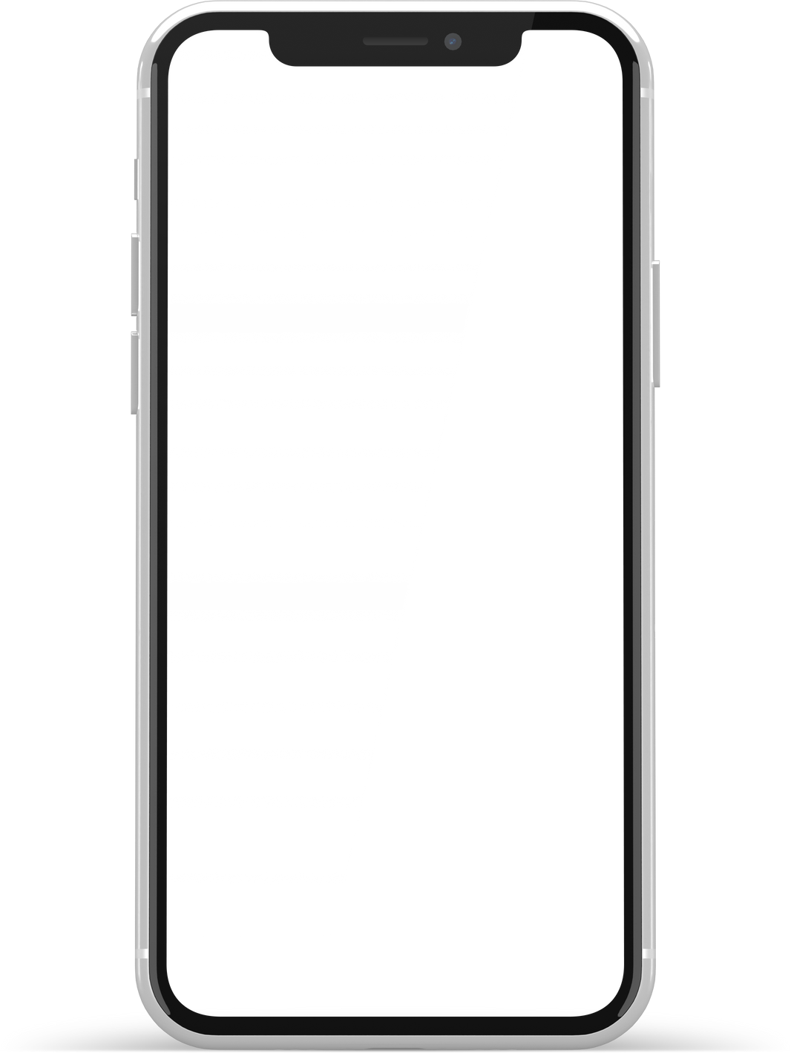
Features and Screens

Slide 7
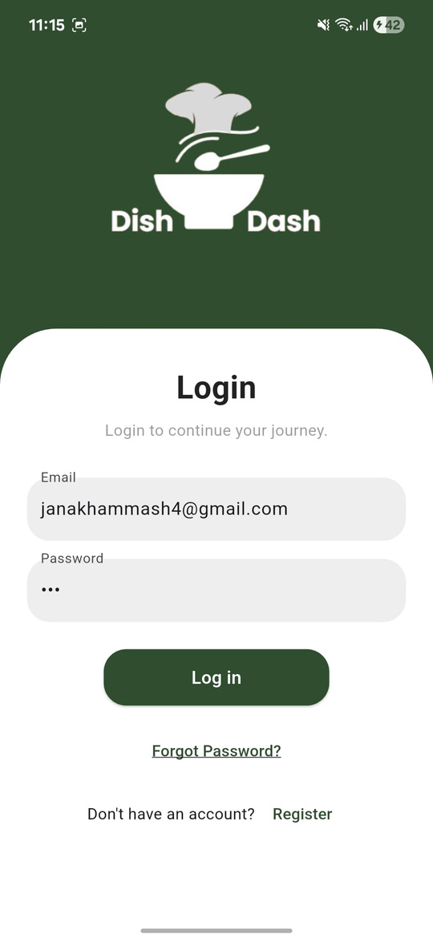
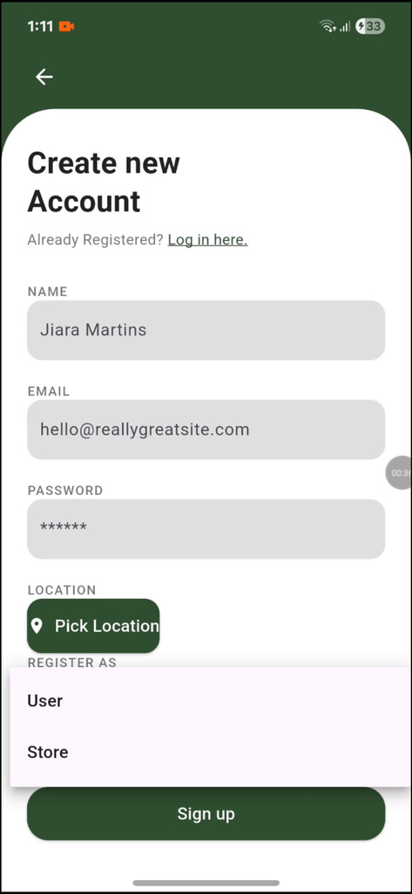
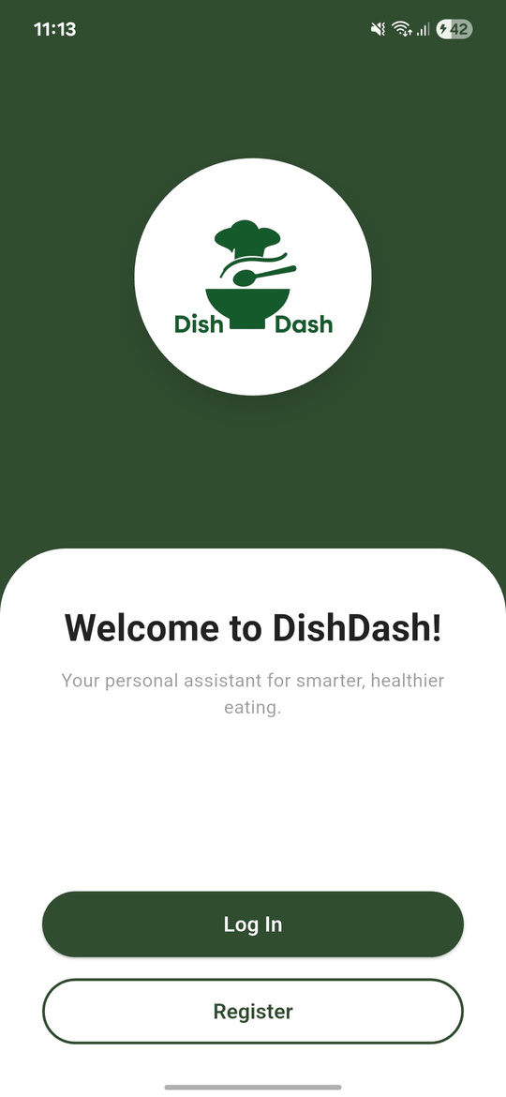
Login and Registration
Roles:
  Users
  Stores
  Admin

Slide 8
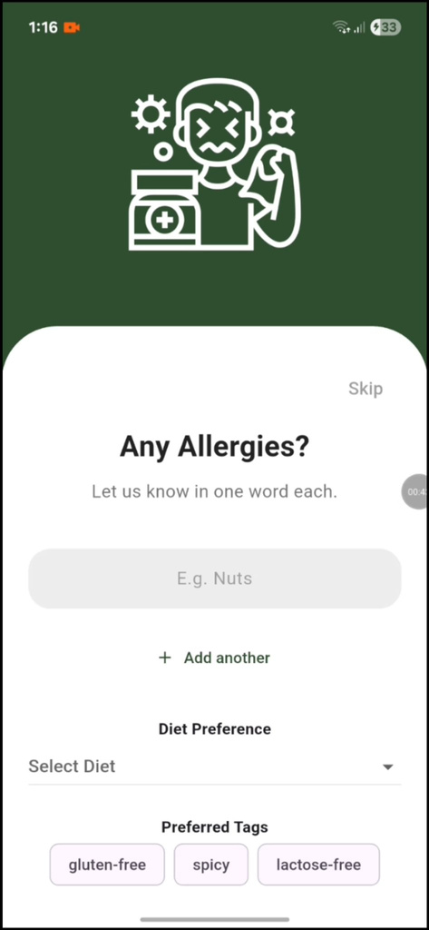
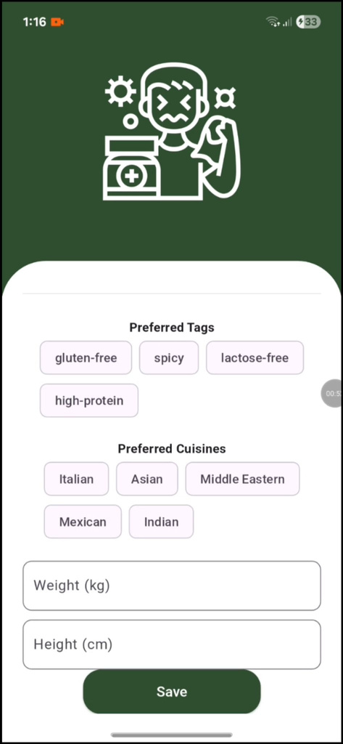
Survey Registration
  Allergies
  Diet
  Tags
  Height
  Weight

Slide 9
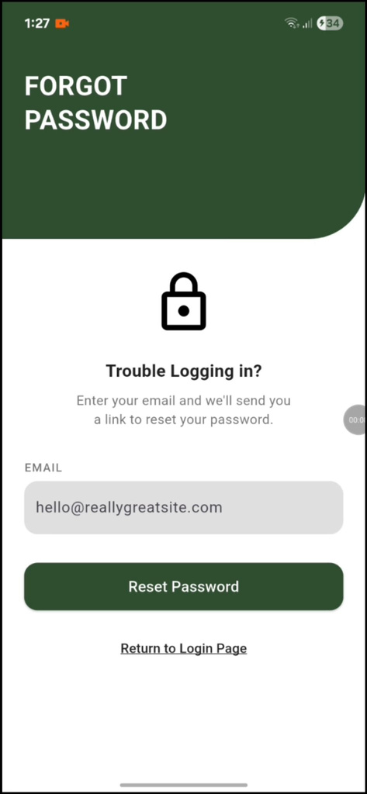
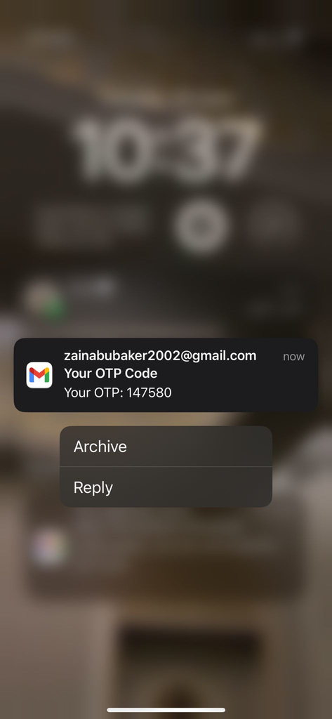
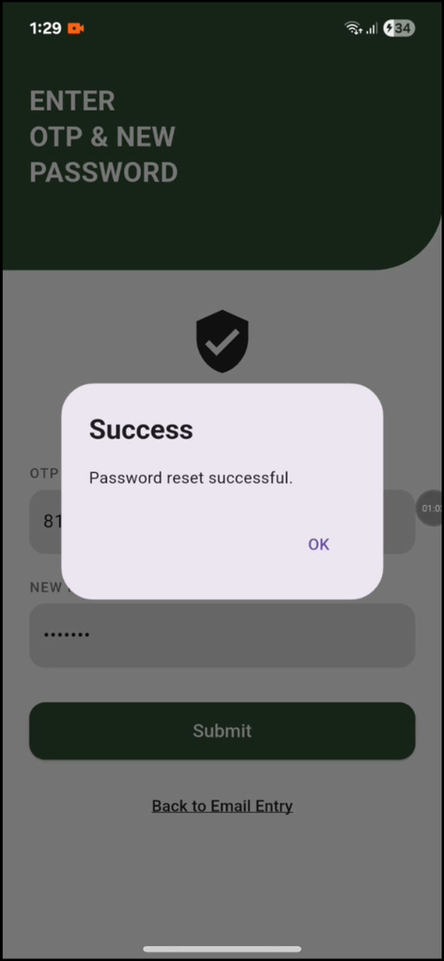
OTP Code

Slide 10
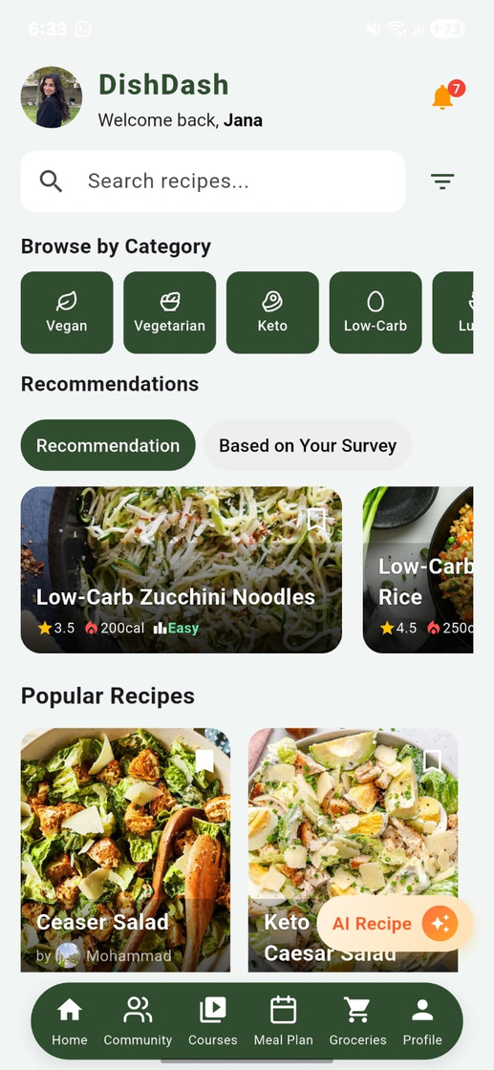
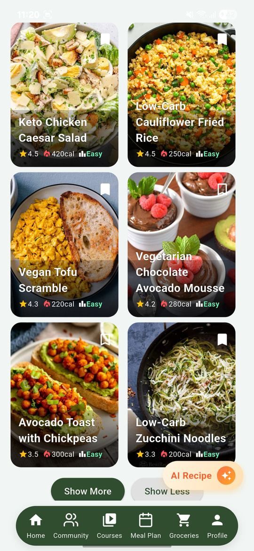
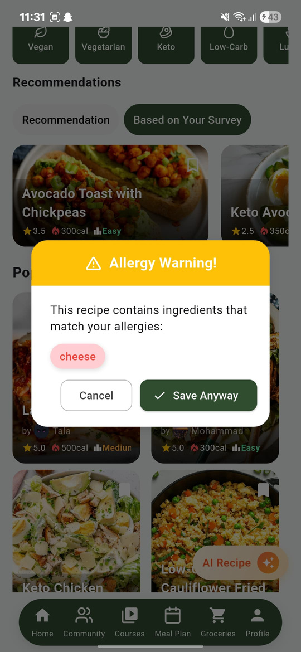
Home Screen
Recommendation Systems:
  User activity
  User survey

Slide 11
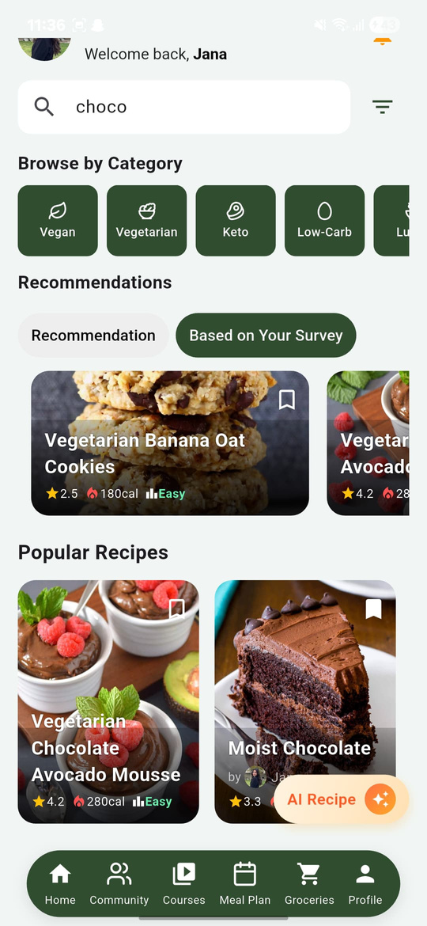
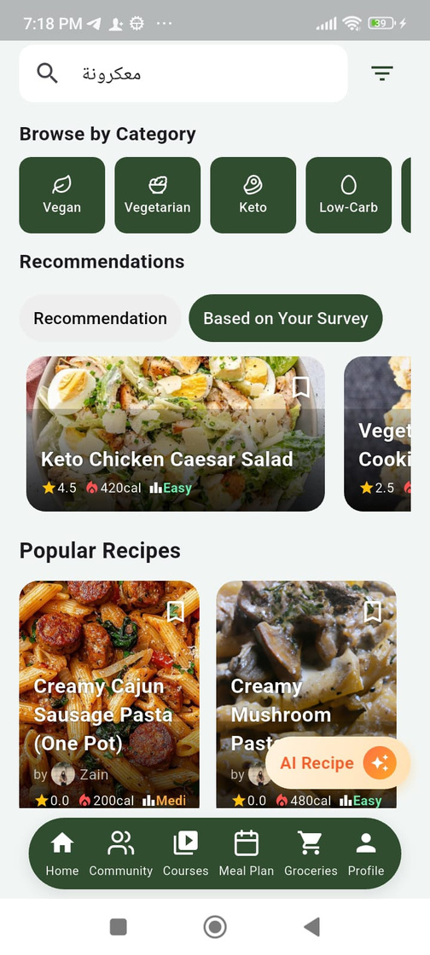

Search Bar

Slide 12
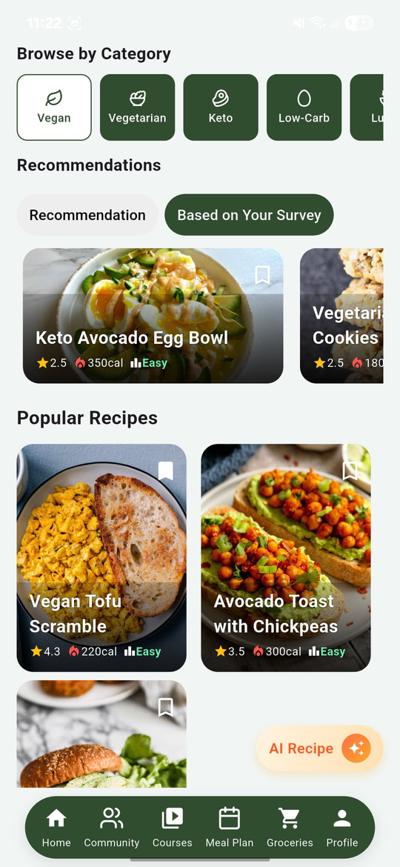
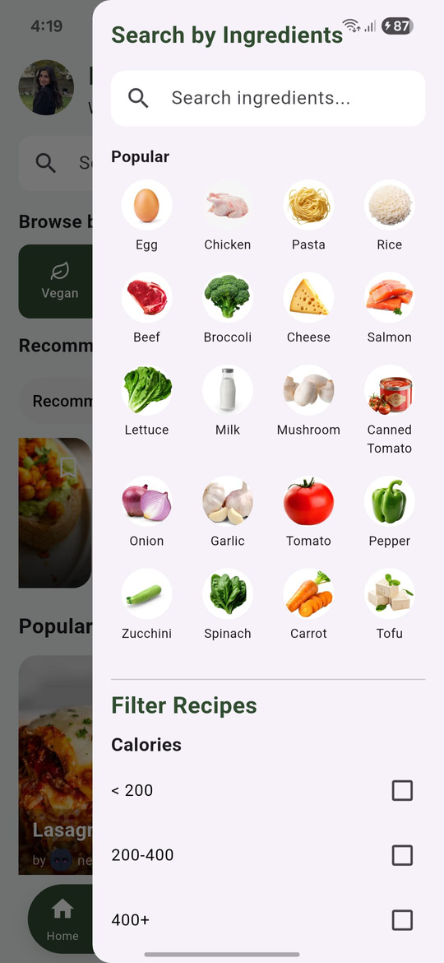
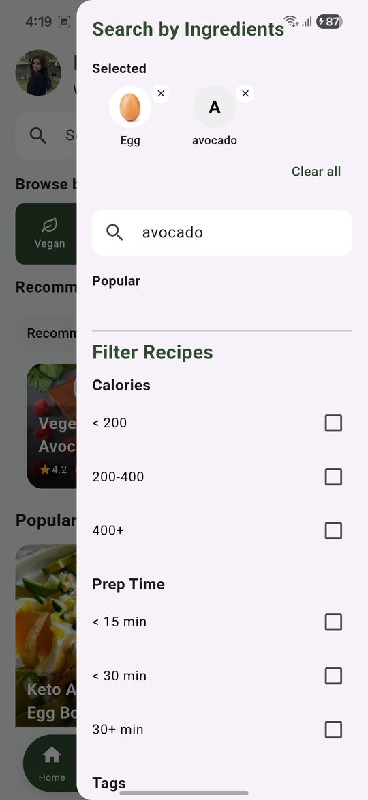
Filtering
  Diet
  Meal Time
  Ingredients
  Calories
  Prep Time
  Tags
  Difficulty

Slide 13
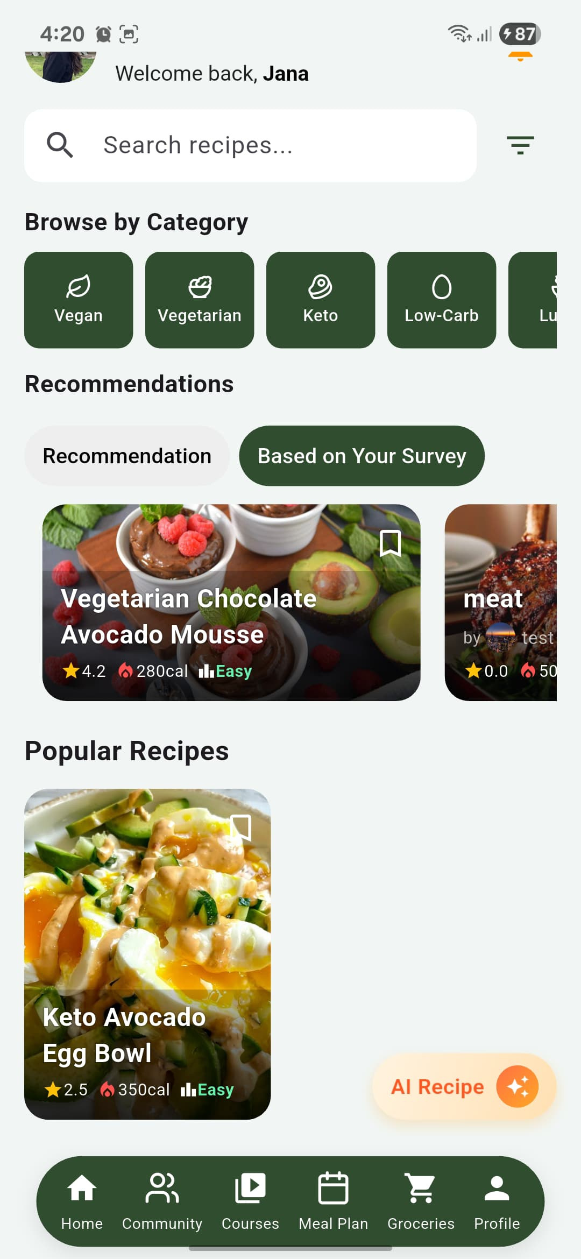
Navigation Bar
Community
Meal Plan
Profile
Home
Courses
Groceries

Slide 14
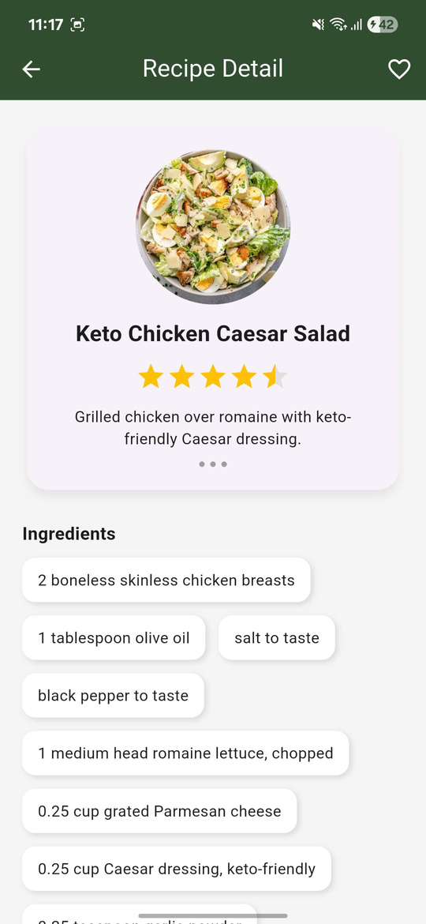
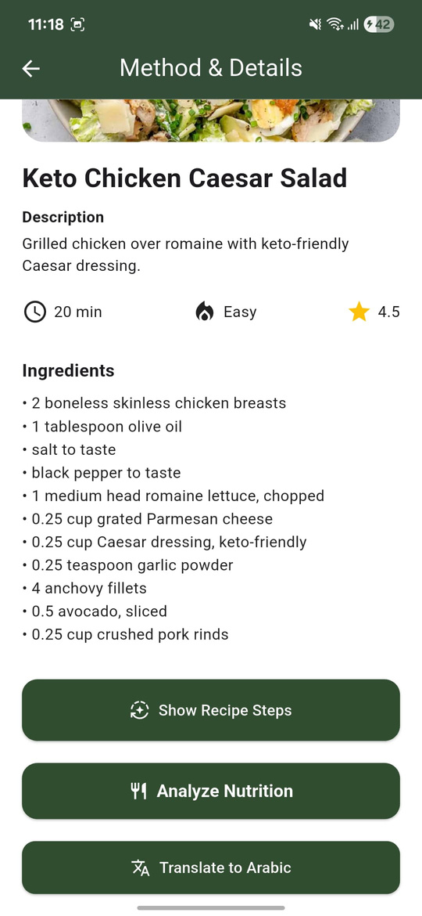
Recipe info & Details
Features:
  AI Steps Generator
  Nutrition Analysis
  Translation API

Slide 15
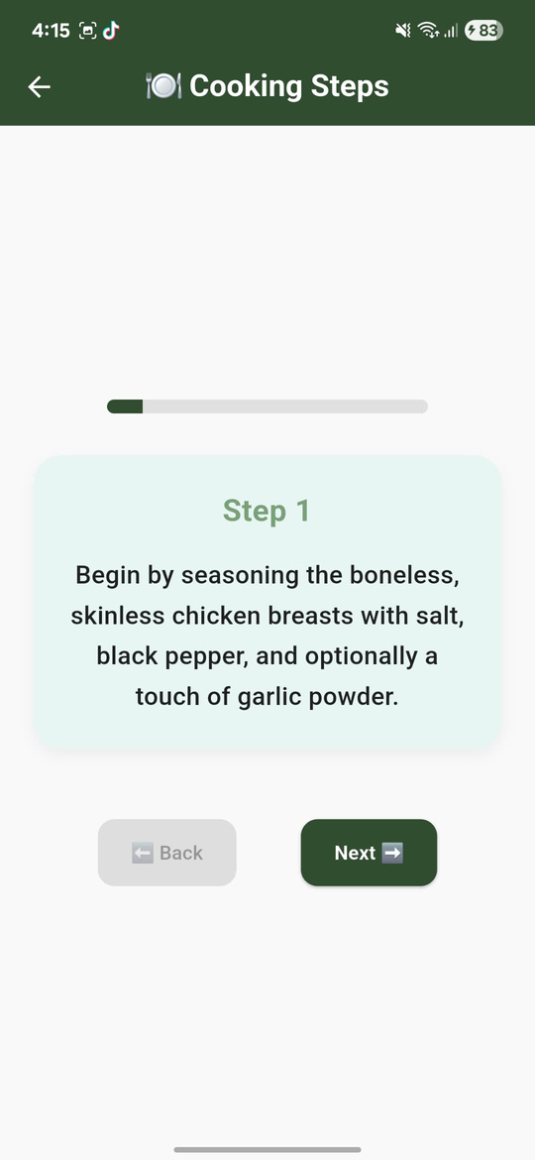
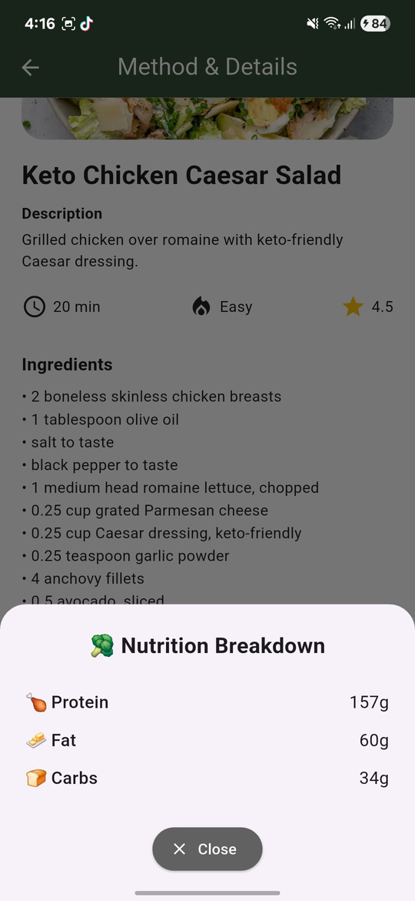
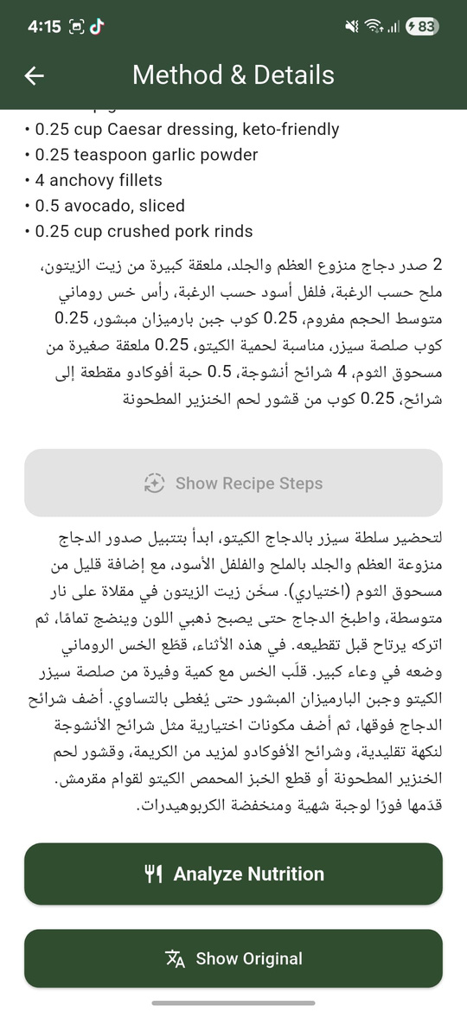
Recipe info & Details

Slide 16



Community
Users
Challenges
Stores

Slide 17
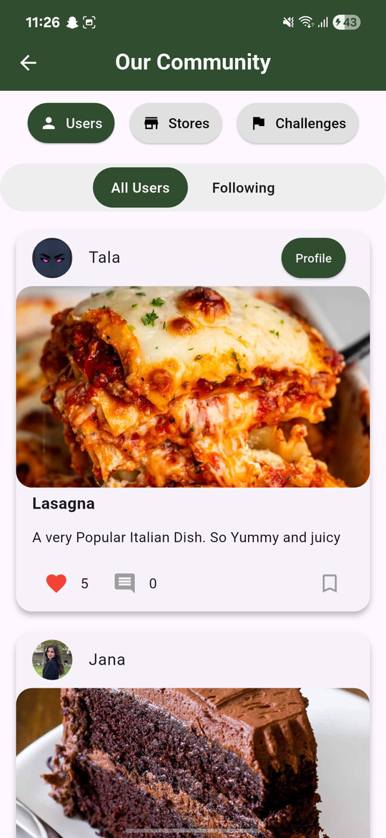
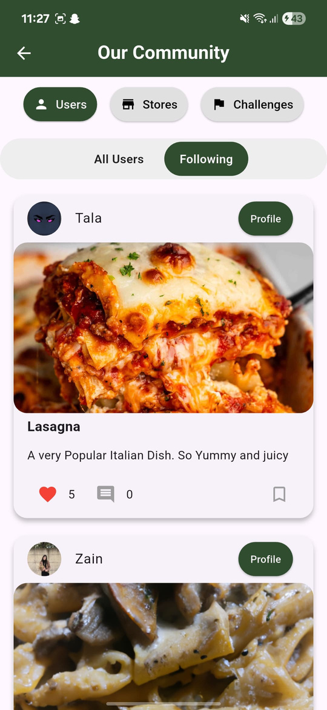
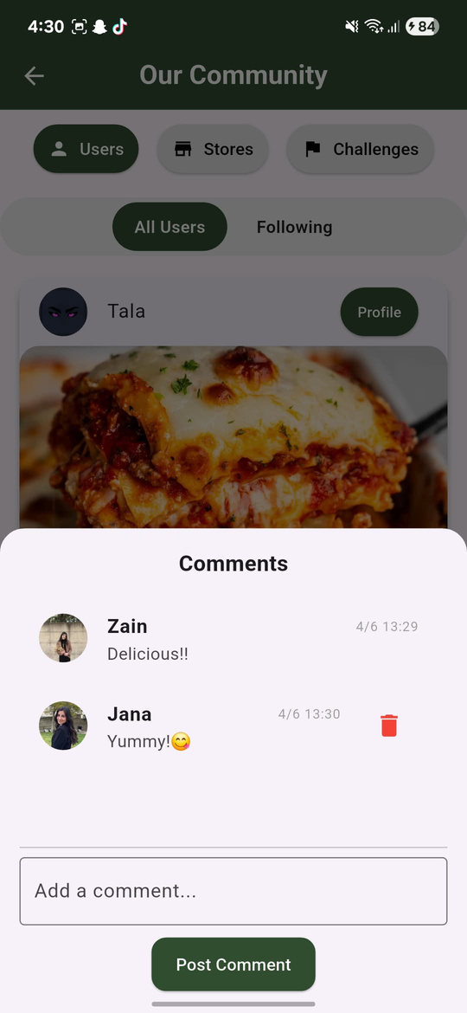
Users in Community

Slide 18
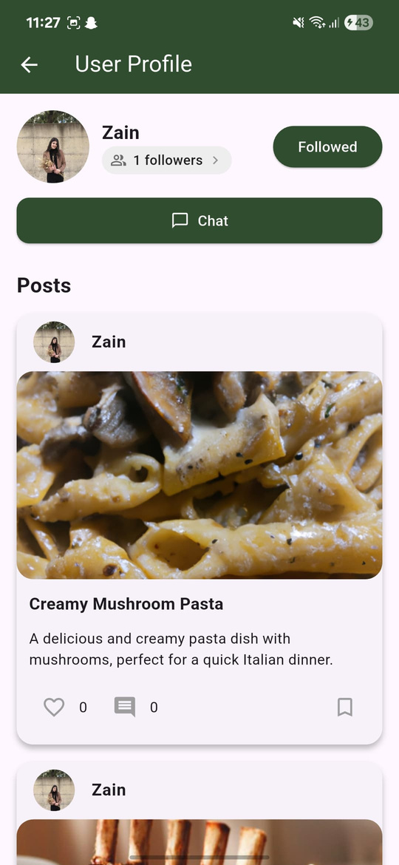
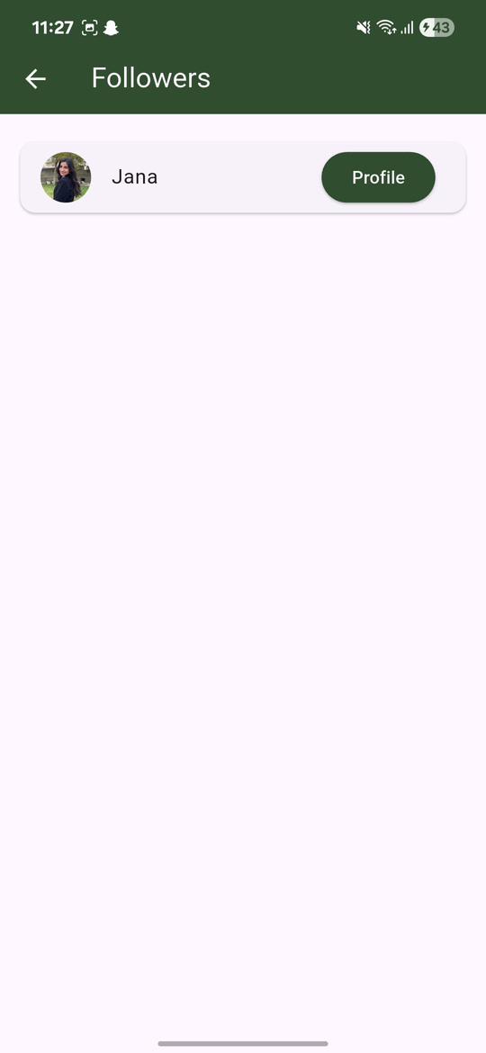
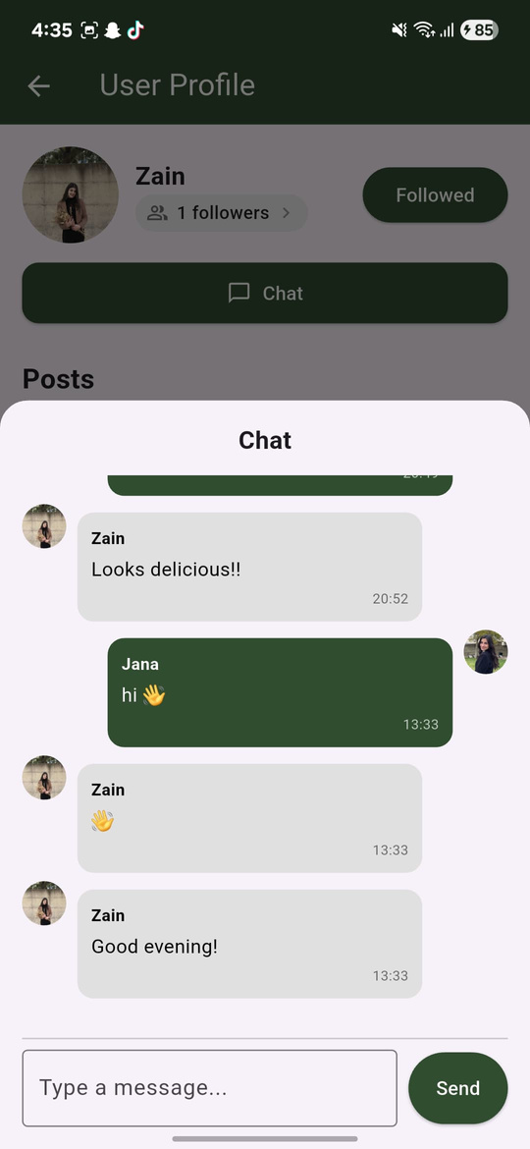
Users Profile

Slide 19
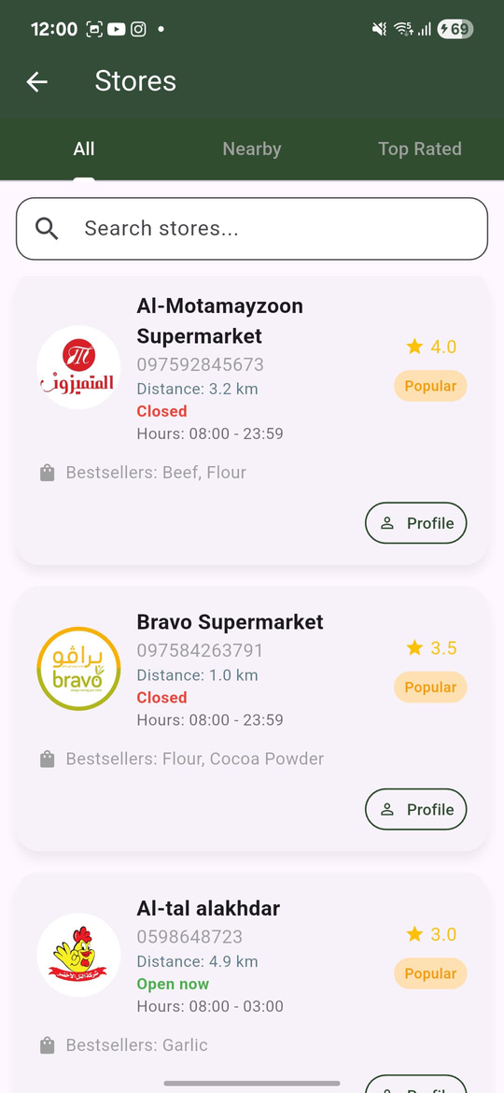
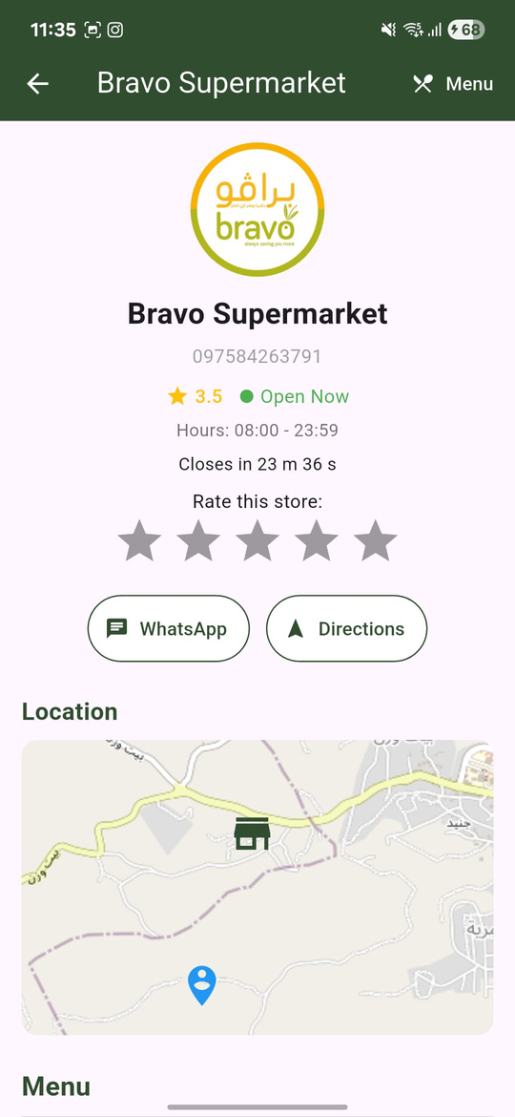
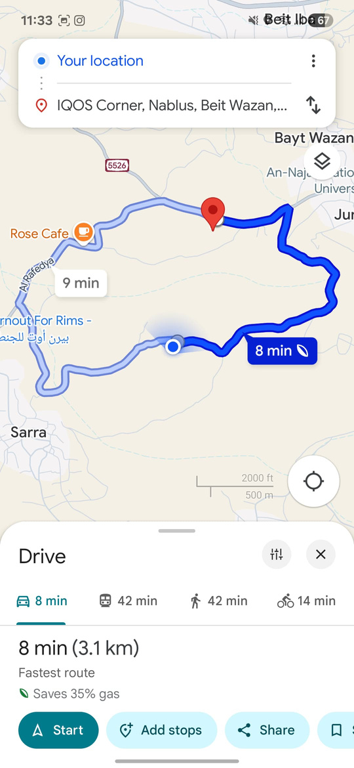
Stores in Community
Features:
  Google Map Directions
  WhatsApp Navigation

Slide 20
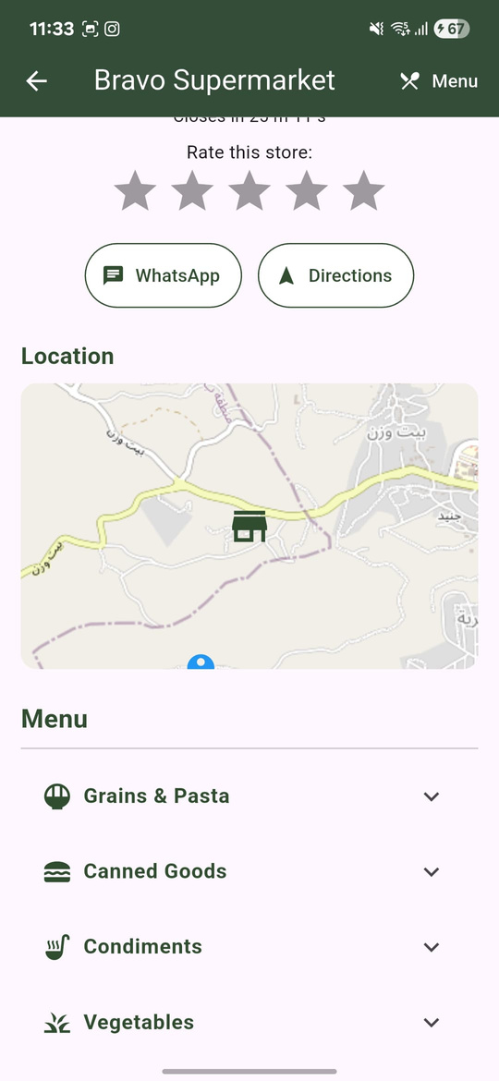
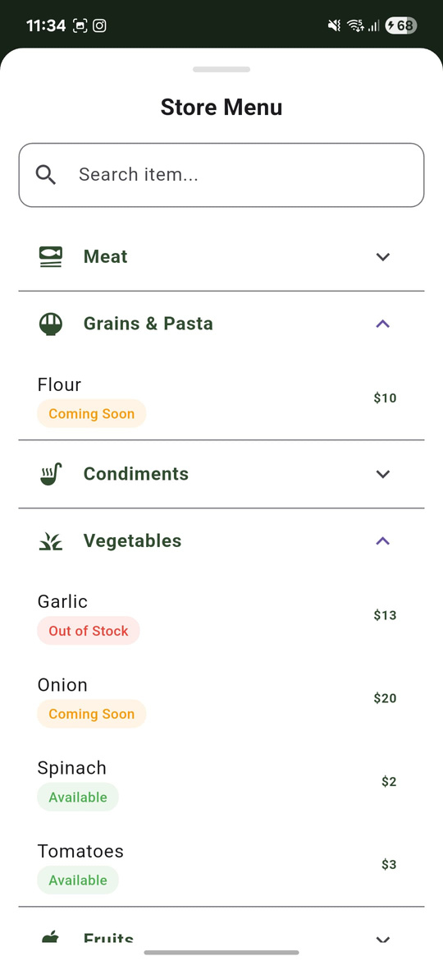
Stores Menu

Slide 21
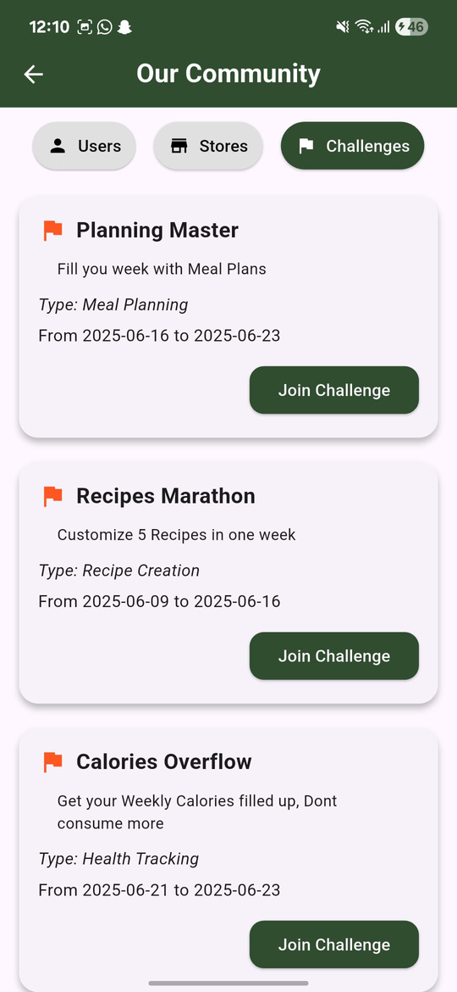
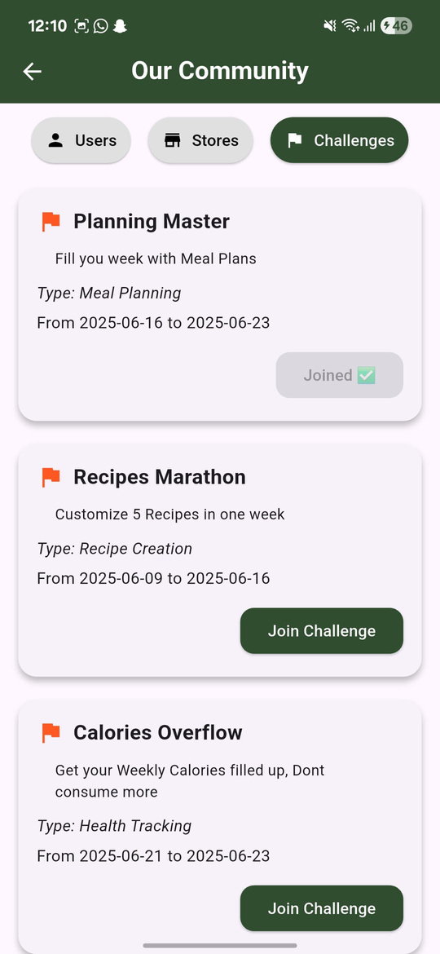
Challenges in Community

Slide 22
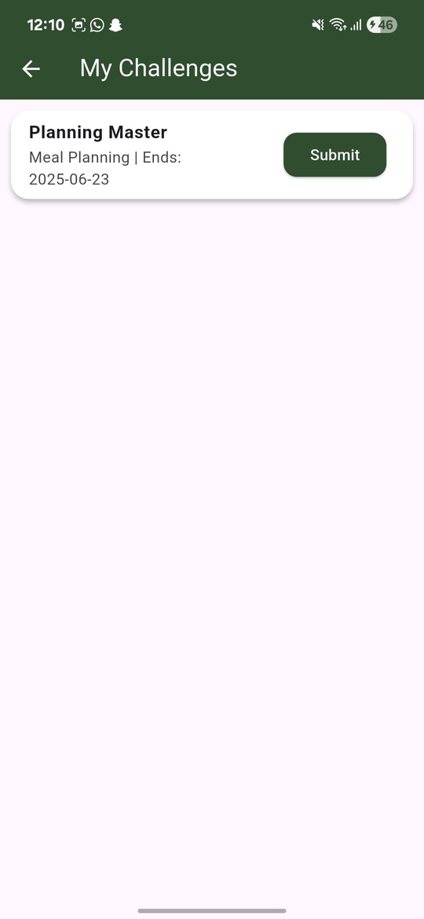
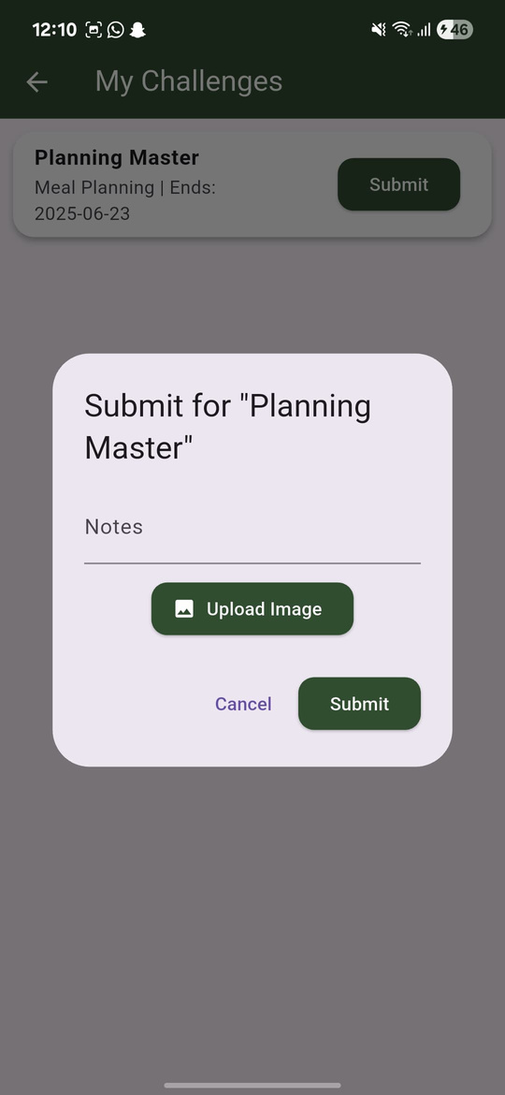
Challenges in Profile

Slide 23
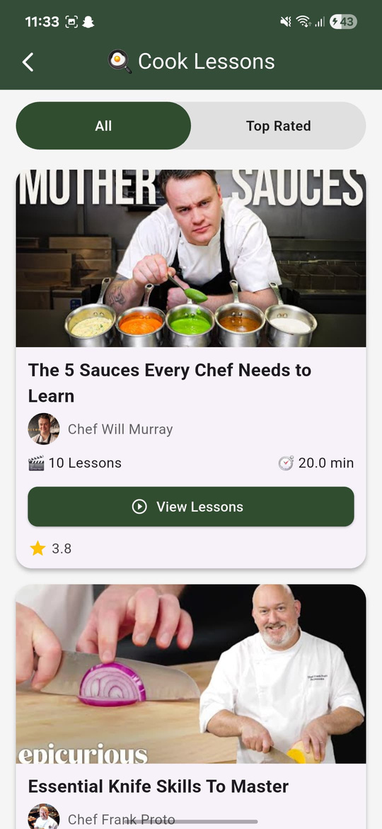
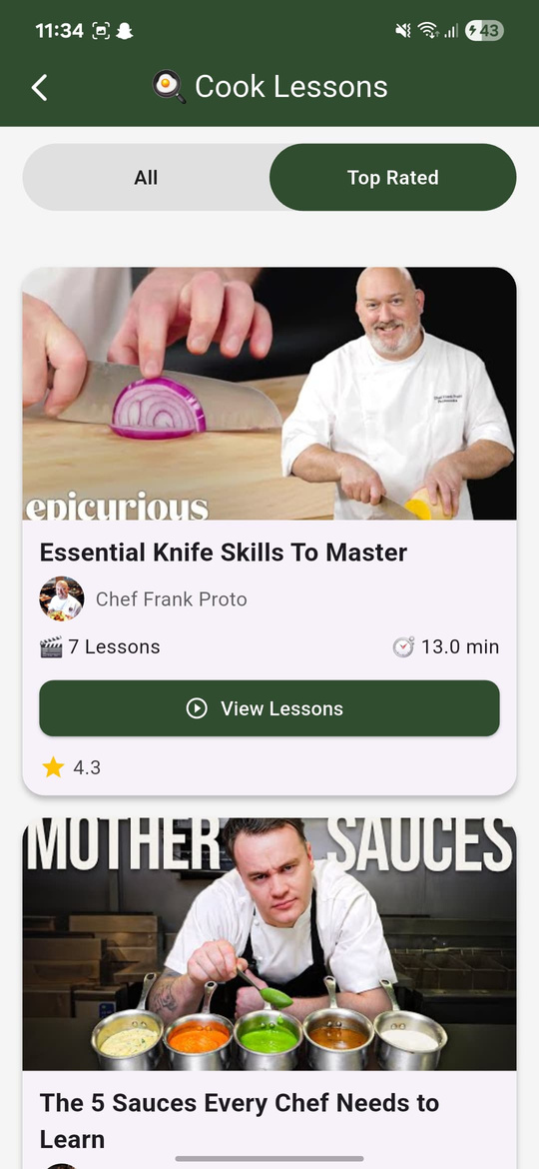
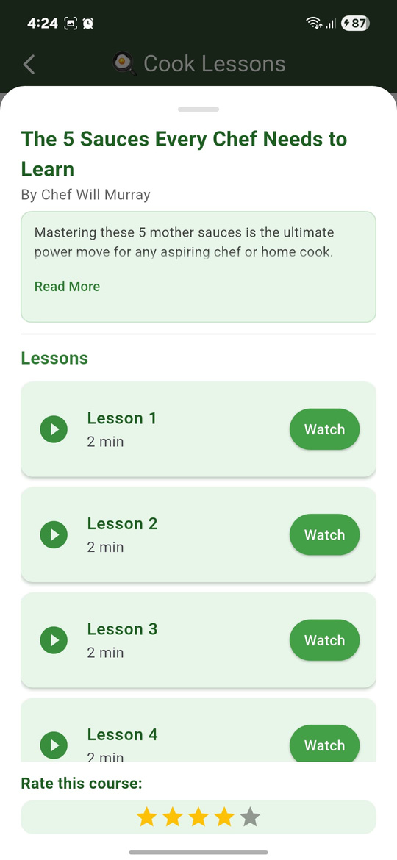
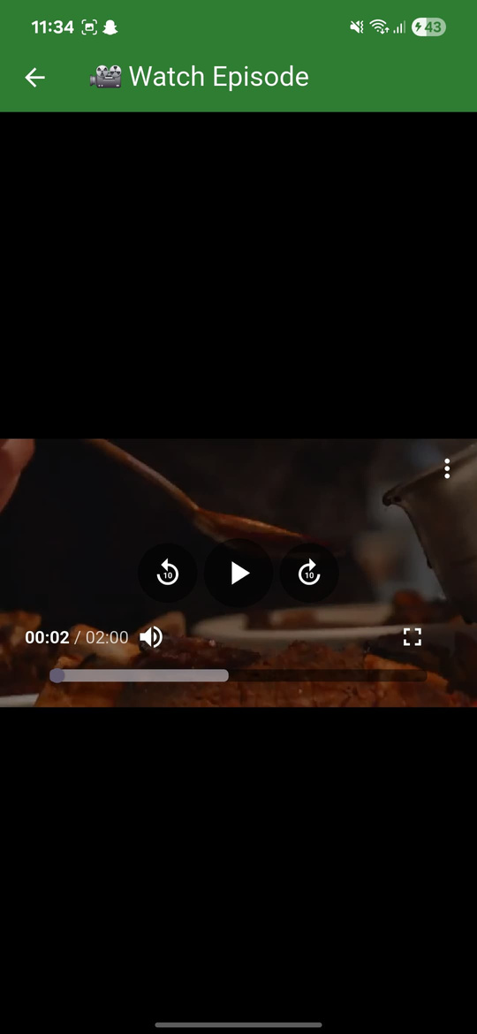
Courses and Cooking Lessons

Slide 24
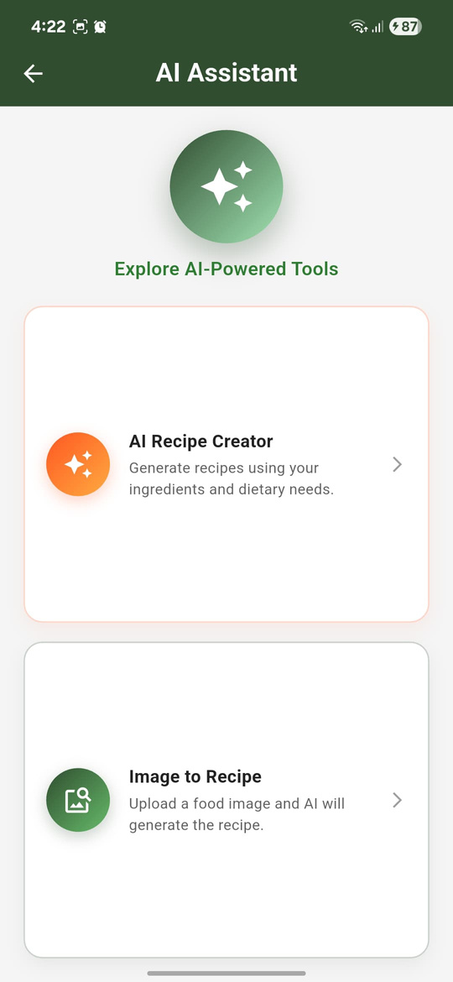

AI Assistant
AI Recipe Generator Model
Image To Recipe Model

Slide 25
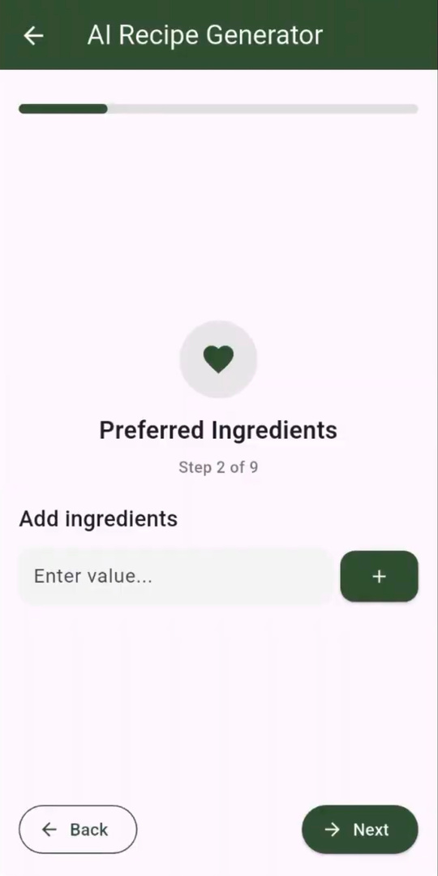
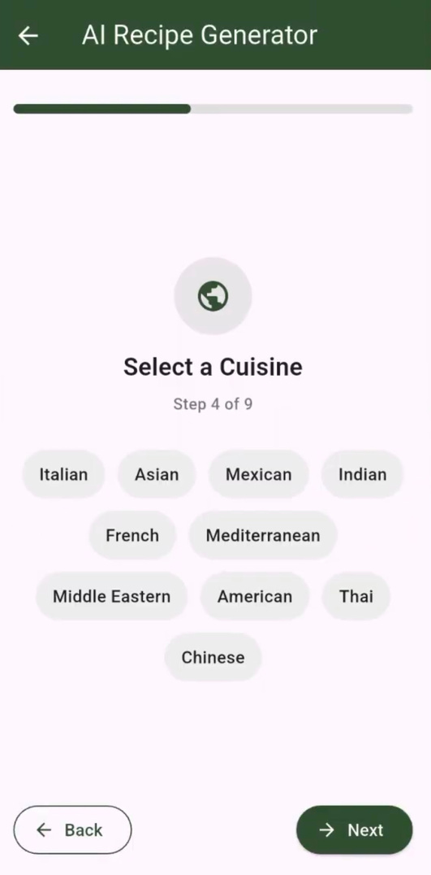
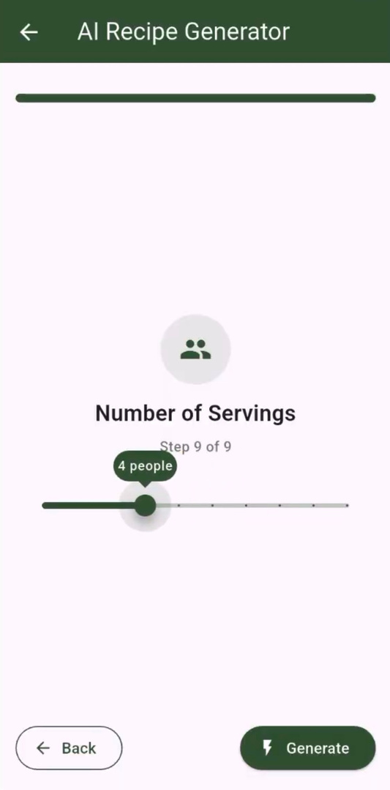
AI Recipe Creator Model
  Diet
  Preferred and avoid ingredients
  Cuisine
  Allergies
  Calories
  Servings

Slide 26


AI Recipe Creator Model

Slide 27

Expectation vs Reality: Unsplash Edition

Slide 28


Slide 29

DALL.E

Slide 30




Image To Recipe Model

Slide 31




Meal Planner

Slide 32




Calorie Score

Slide 33



Groceries

Slide 34




Available Ingredients Recipe

Slide 35




Ordering and Cart

Slide 36


User’s Orders in Profile

Slide 37




Profile Screen

Slide 38


Updating Profile and Survey

Slide 39


Scraping Recipe

Slide 40


My Recipes

Slide 41


Translation API

Slide 42


Analyze calories

Slide 43


Create Recipe

Slide 44


Saved Recipes

Slide 45



Chatting

Slide 46







Notifications
Notifications by users:
  Like
  Comment
  Follow
Notifications by Admin:
  Announcements
  Challenges
Notifications by Stores:
  Orders status update
MealPlans Reminders

Slide 47



Admin’s Dashboard

Slide 48



Store’s Dashboard

Slide 49



Store’s Dashboard
  Users Orders
  Users Ratings

Slide 50


DishDash’s Website
  Admin
  Stores
  Users

Slide 51

Admin’s Dashboard

Slide 52


Admin’s Website
Users

Slide 53

Admin’s Website
Users

Slide 54

Admin’s Website
Stores

Slide 55

Admin’s Website
Recipes

Slide 56


Admin’s Website
Courses

Slide 57



Admin’s Website
Challenges

Slide 58


Stores’ Website
Menu

Slide 59

Stores’ Website
Orders

Slide 60

Users’ Website
Home

Slide 61

Users’ Website
Profile

Slide 62




Users’ Website
Community

Slide 63


Users’ Website
Recipes

Slide 64

Users’ Website
Courses

Slide 65




Future Work
Multilingual Support.
Expanding integration with payment systems.
Enhancing collaboration in the DishDash community.
Include chefs as users.

Slide 66


THANK YOU!
Jana Khammash & Zain Abubaker

