Slide 1


SANAD SYSTEM
Digital Transformation for Sanad Society
Development of an Integrated System for Managing Sanad Society for Persons With Special Needs Using Odoo.
Ayda Sayeh
Rama Qadi
Sarah Mabrouk
Supervised by Dr.Najwan Deleq.

Slide 2





SANAD SYSTEM
Table of Content
INTRODUCTION
PROBLEM
WHY ODOO ?
SYSTEM MODULES
DASHBOARD
https://edu-sanad3.odoo.com

Slide 3
SANAD SYSTEM
About
Sanad
Sanad System is an Odoo-based platform for managing society operations, handling data, scheduling therapy, improving parent communication, providing analytical reports, and improving accessibility and community engagement.
https://edu-sanad3.odoo.com

Slide 4
SANAD SYSTEM
PROBLEMS
https://edu-sanad3.odoo.com

Slide 5

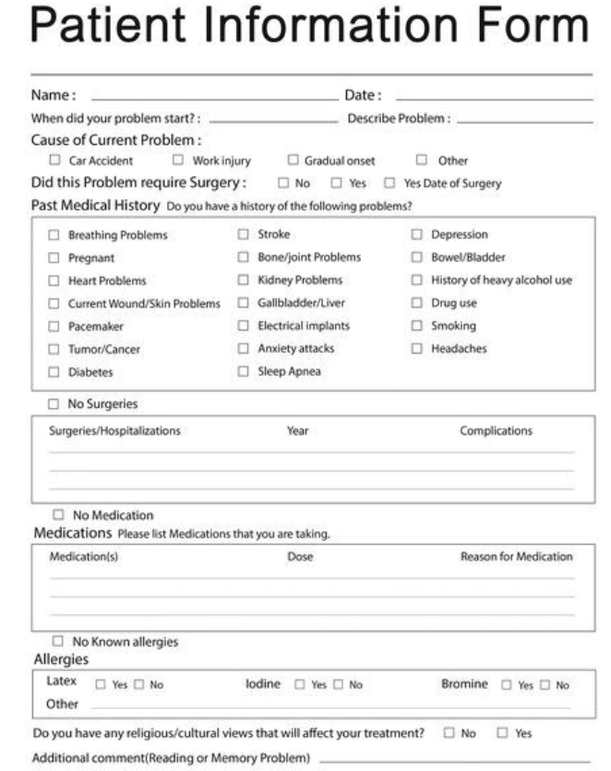
PROBLEM
Data dispersion and difficulty in linking operations together.

Slide 6

PROBLEM
Lack of periodic follow-up and failure to remind of session dates

Slide 7

PROBLEM
Poor quick access to information

Slide 8

PROBLEM
Lack of an HR system caused difficulties in managing staff data, attendance, and payroll, etc.

Slide 9

Why Odoo?
All-in-one
system
Easy to use
Open-source
and
customizable
Cost-effective
https://edu-sanad3.odoo.com

Slide 10



SANAD SYSTEM
System Modules
  BASIC MODULES
Beneficiary Management Module
Employee Module
Website Module
https://edu-sanad3.odoo.com

Slide 11






SANAD SYSTEM
System Modules
  COMPLEMENTARY MODULES
Time-Off Module
Attendance Module
Payroll Module
To-do Module
Live Chat Module
Appointments Module
https://edu-sanad3.odoo.com

Slide 12






SANAD SYSTEM
System Modules
  COMPLEMENTARY MODULES
Contacts Module
Expenses module
Billing Module
Dashboard
Email Marketing Module
Calendar Module
https://edu-sanad3.odoo.com

Slide 13

SANAD SYSTEM
Website Module
The Sanad Association website is a communication platform showcases mission, services, success stories, staff, FAQs, and offers free online consultation bookings to build trust.
https://edu-sanad3.odoo.com

Slide 14


The homepage warmly introduces visitors to Sanad’s mission through an image that gently reflects its care and commitment to children with special needs.

Slide 15
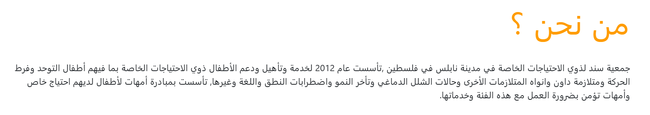
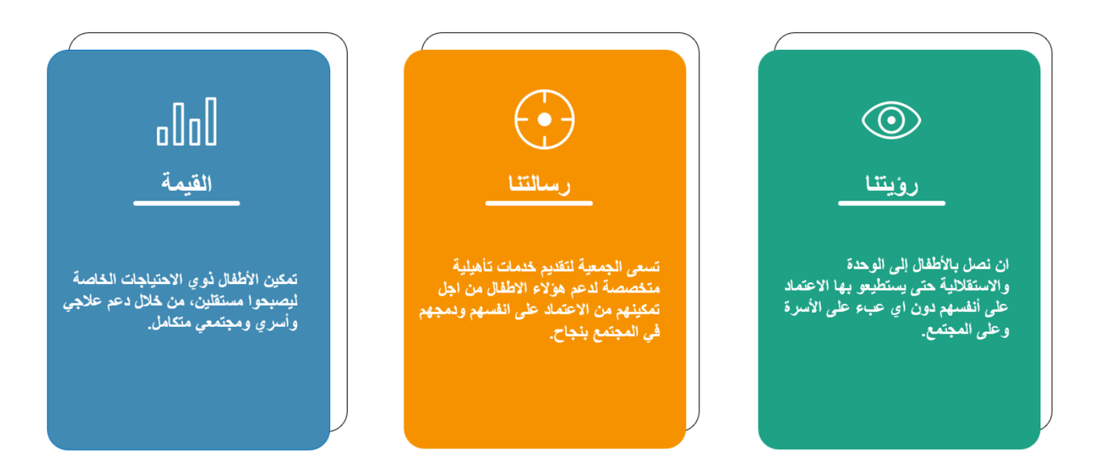

Slide 16





Slide 17


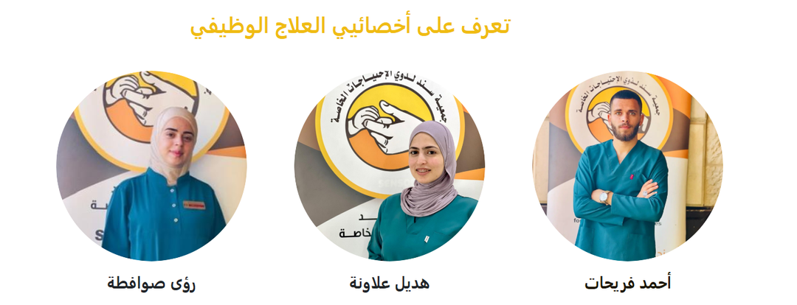

Slide 18
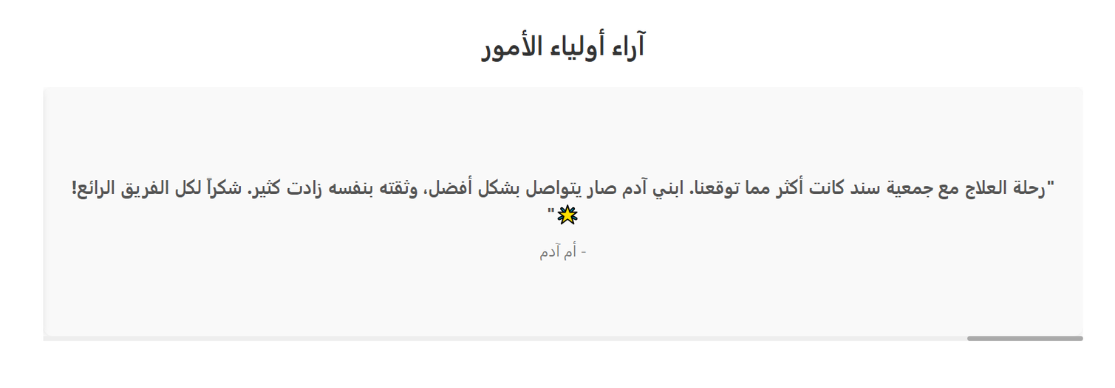

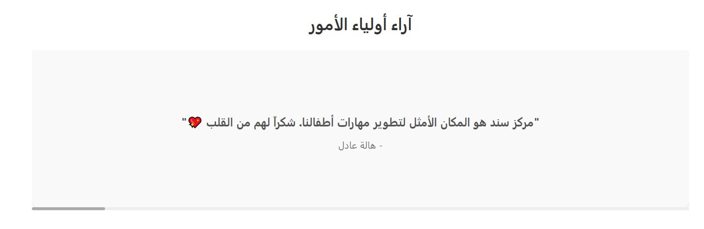

Slide 19
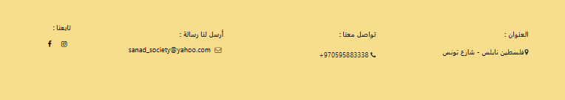

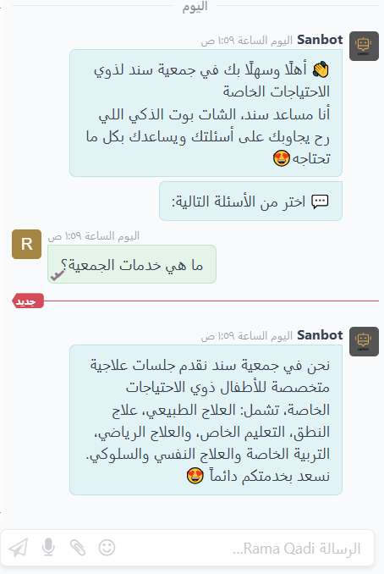
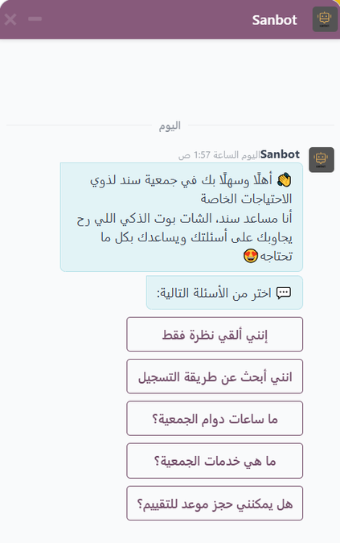
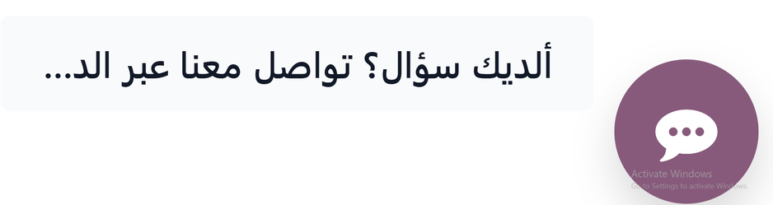


Slide 20
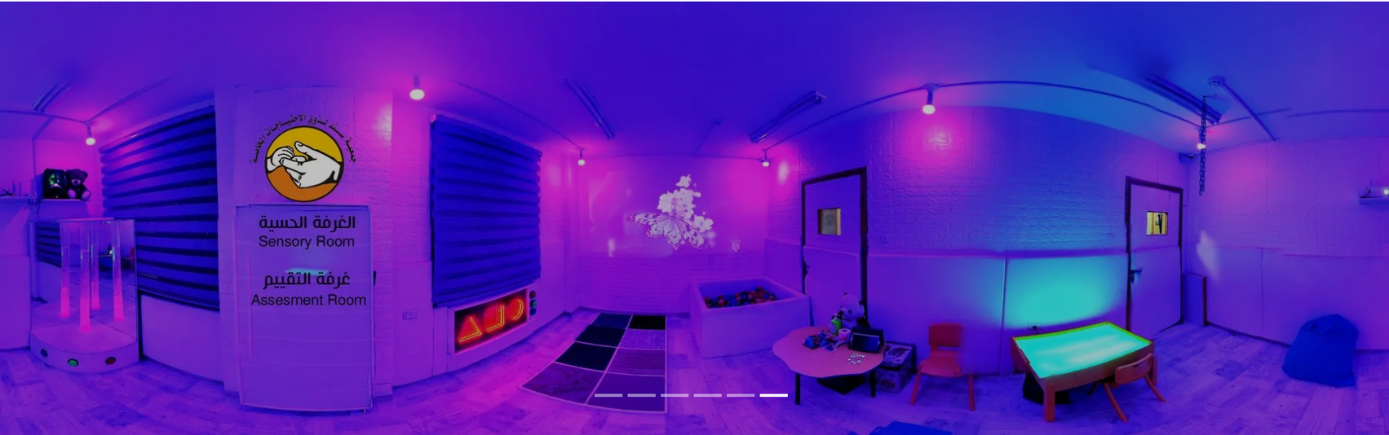
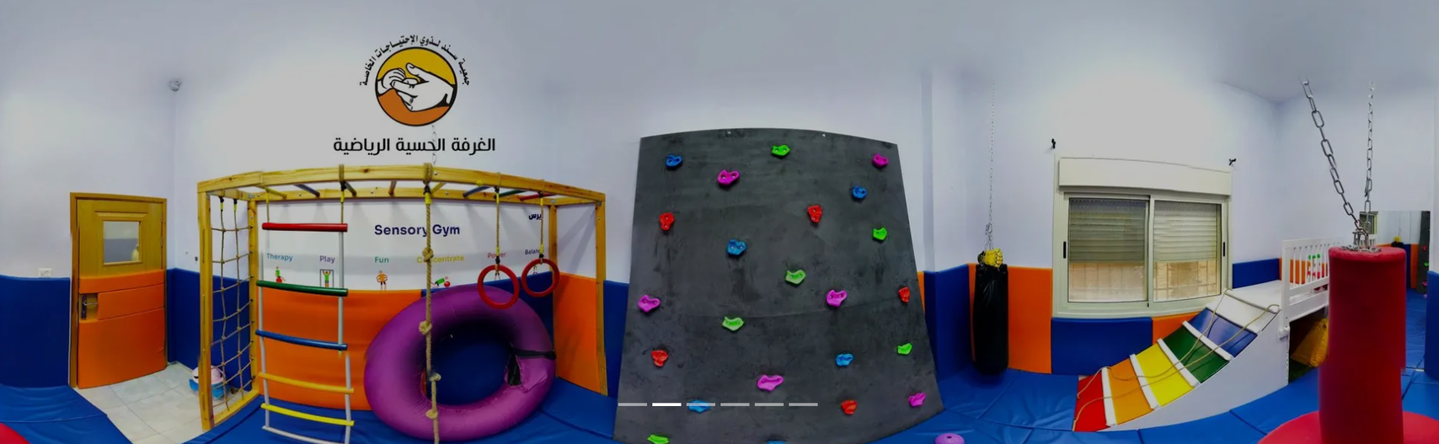

Slide 21
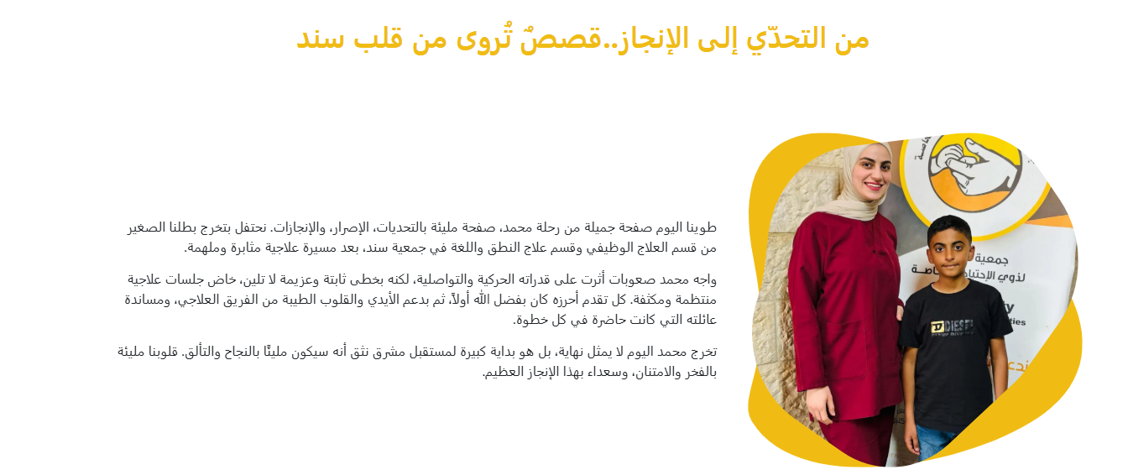
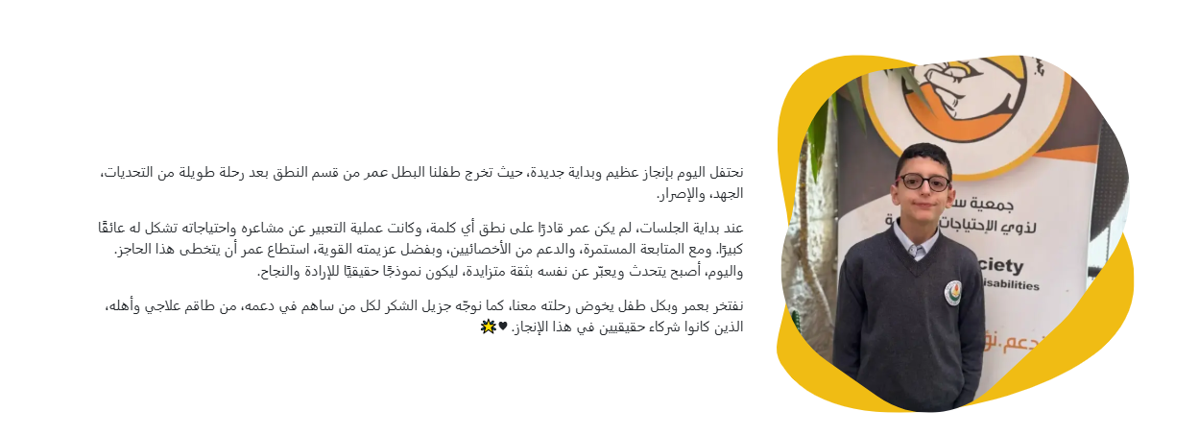

Slide 22
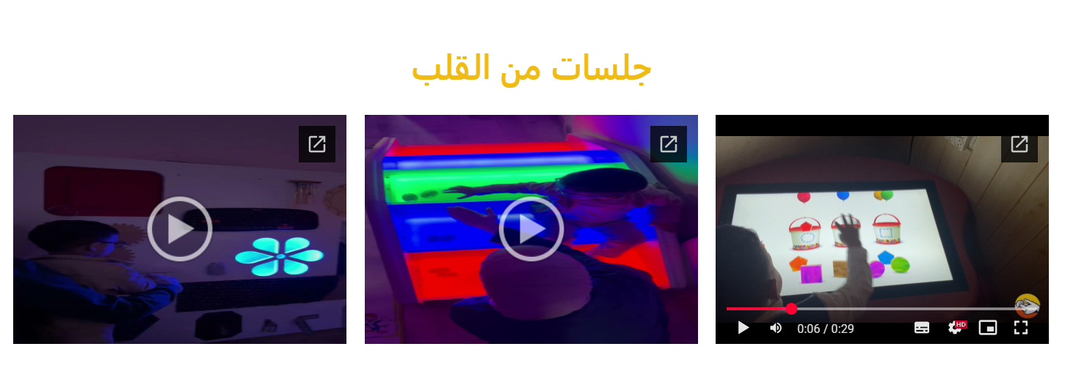
Therapy session videos are displayed to highlight the quality of care provided, raise awareness about available treatments, and build trust with families and the community.

Slide 23

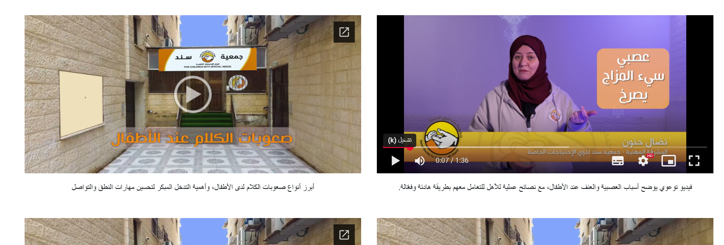

Slide 24

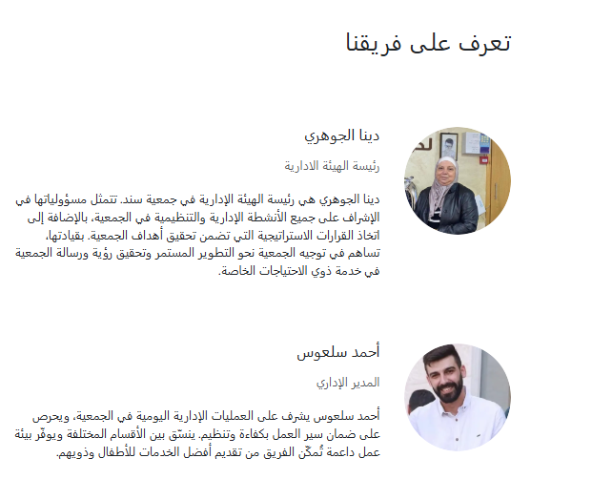
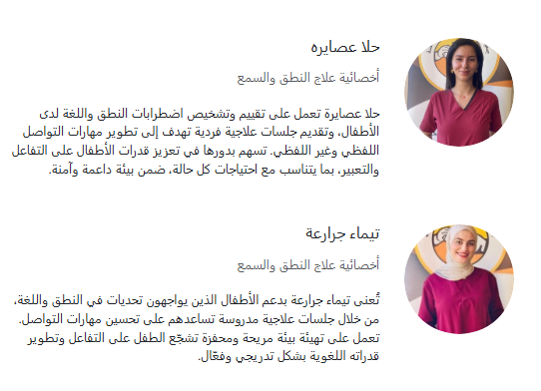
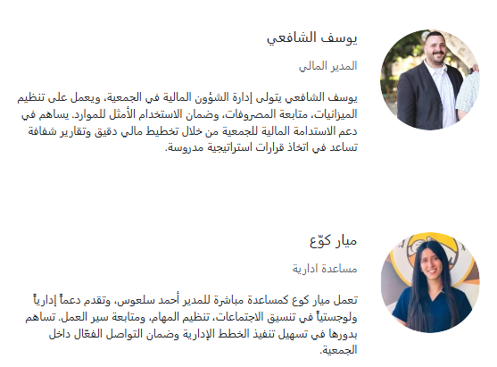
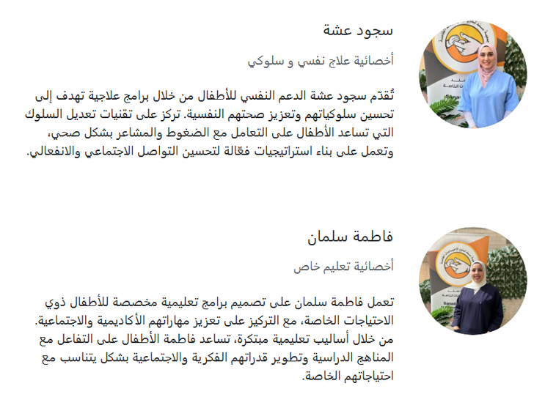
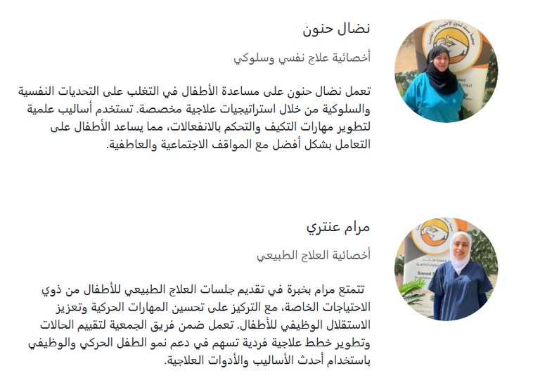
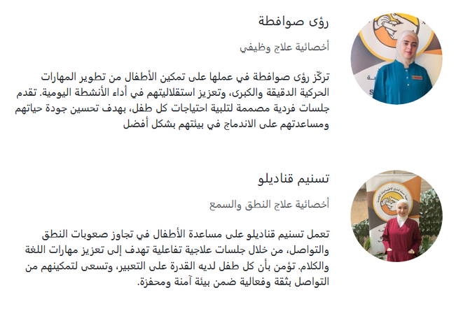

Slide 25

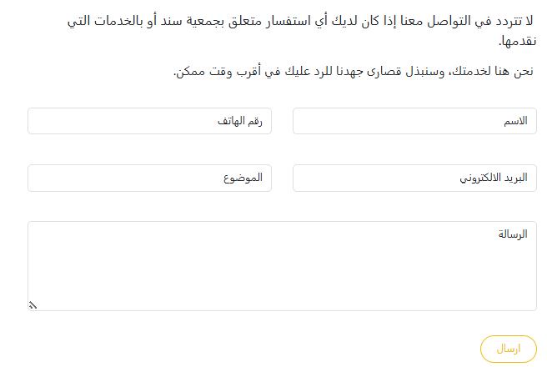
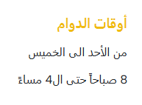


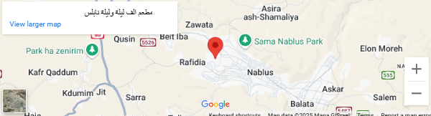

Slide 26

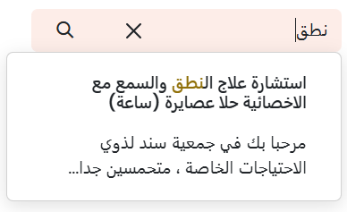


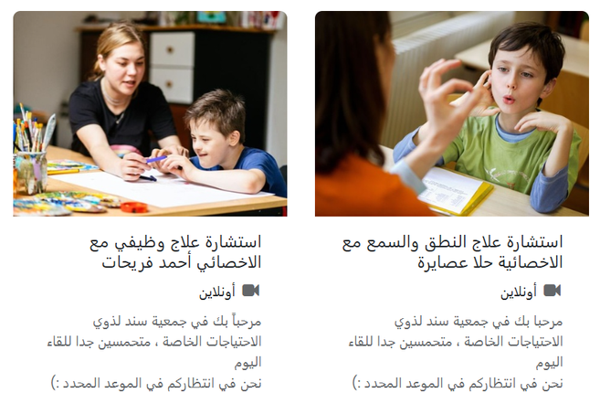


Slide 27

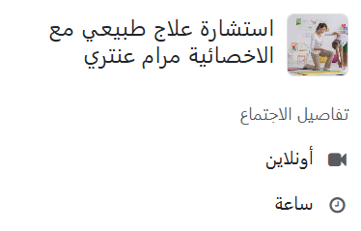

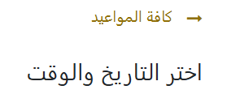
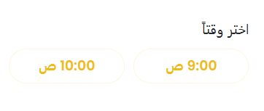
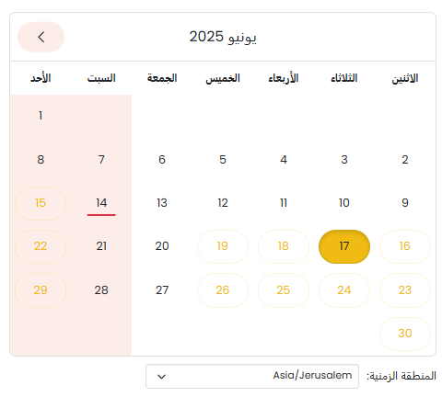

Slide 28
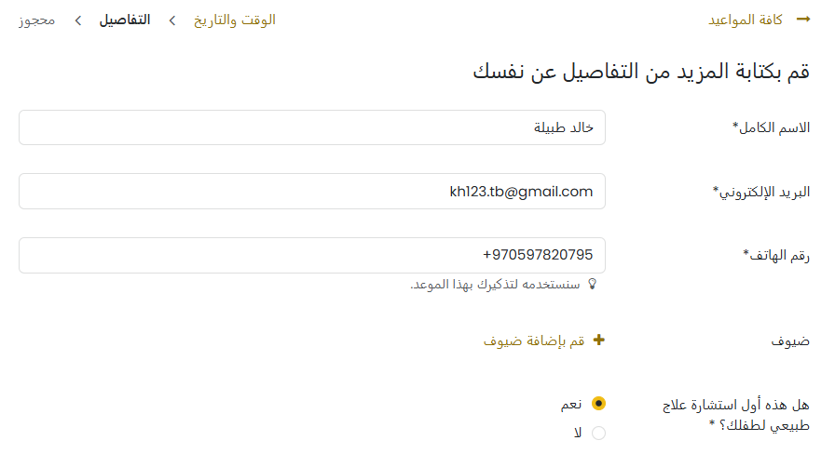
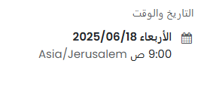
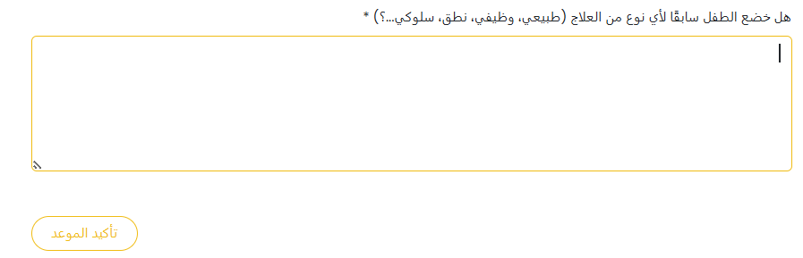

Compulsory question
Optional question

Slide 29
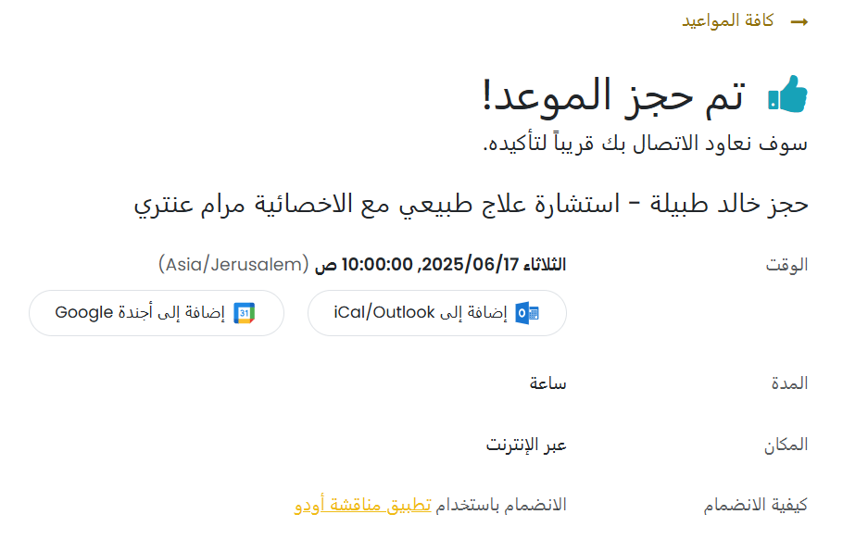
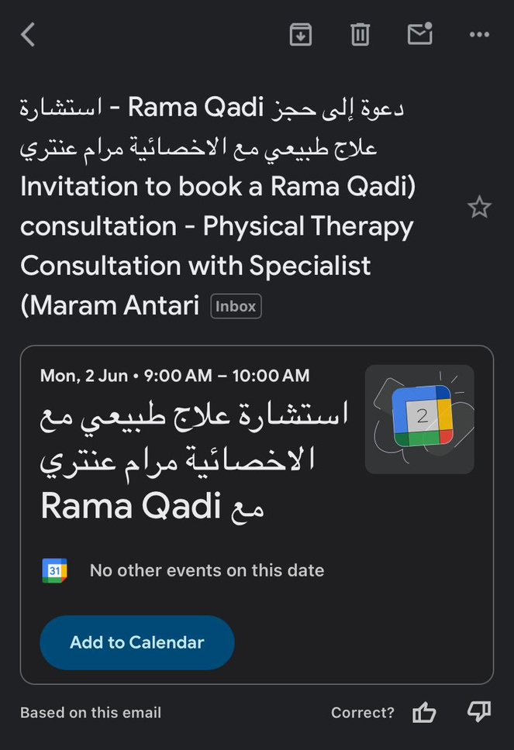
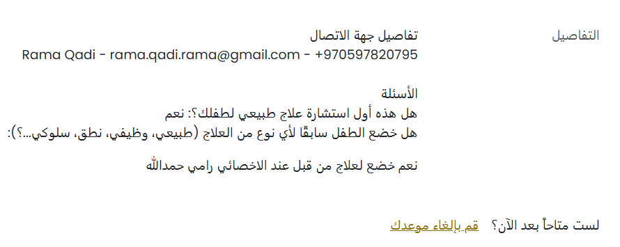

Slide 30
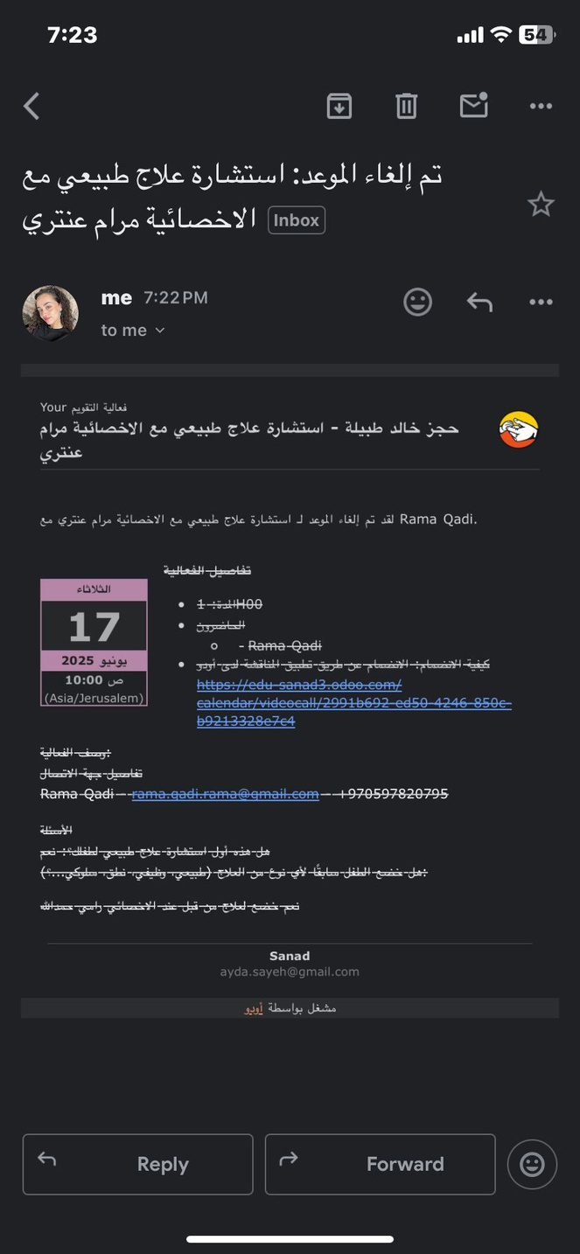
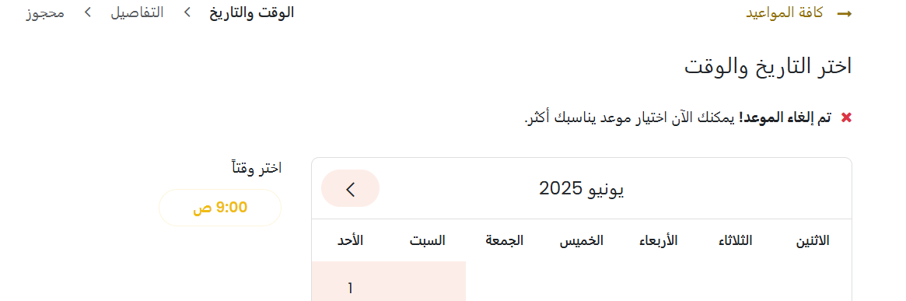

Slide 31
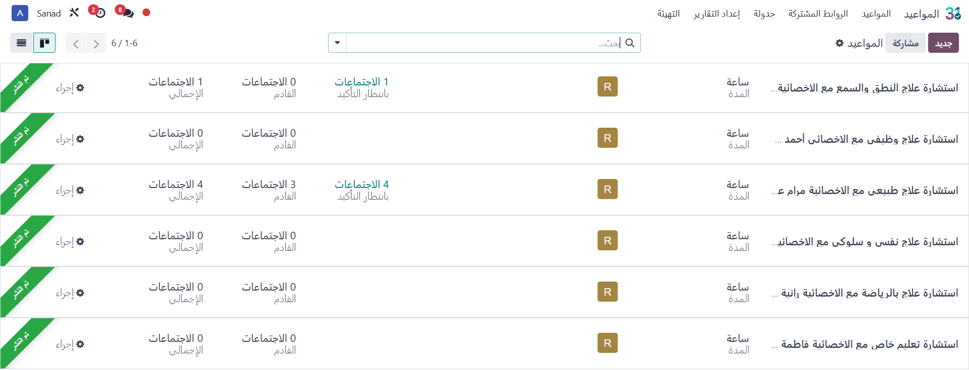
SANAD SYSTEM

Slide 32
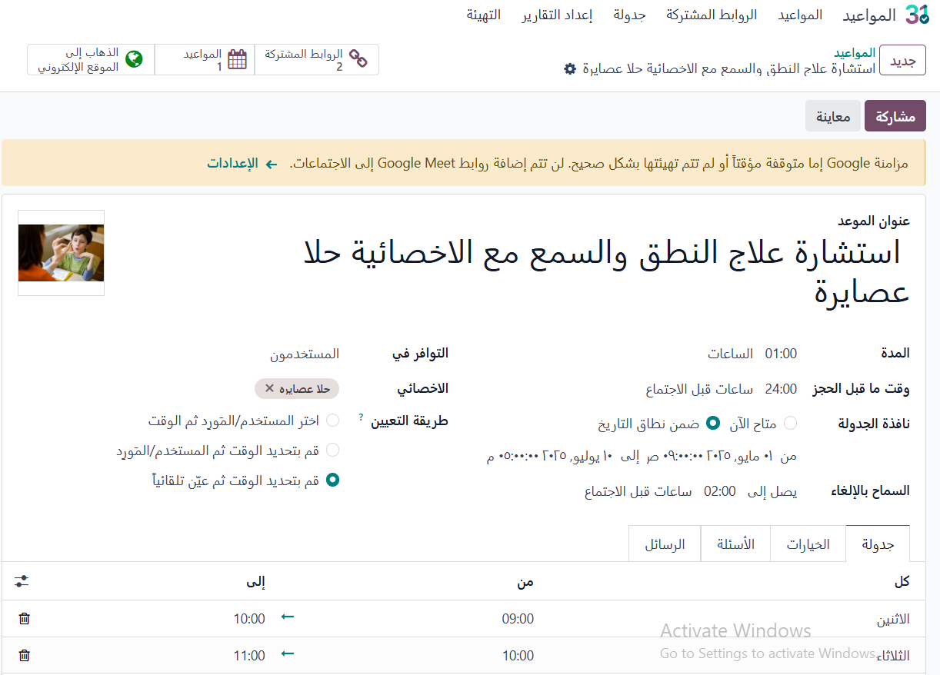


Slide 33
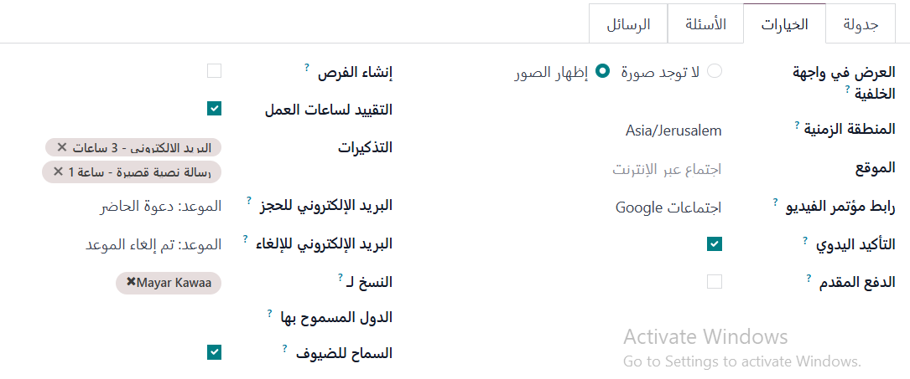


Slide 34
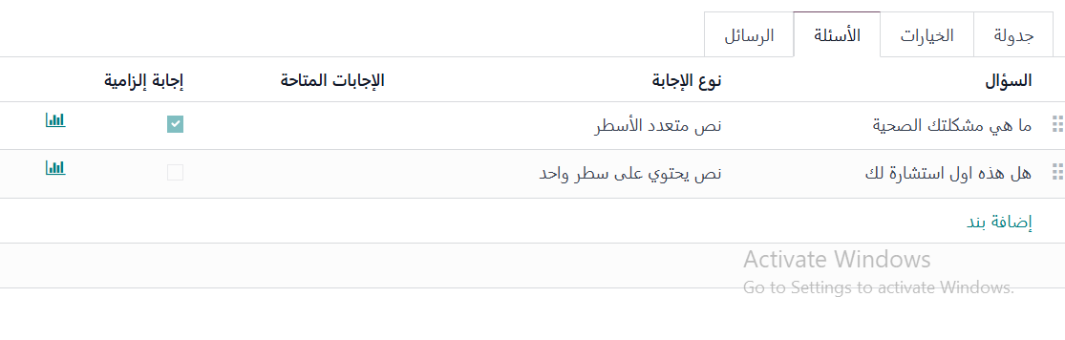
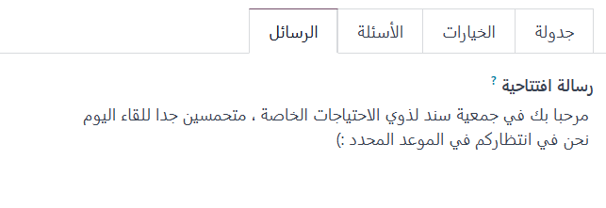

Slide 35
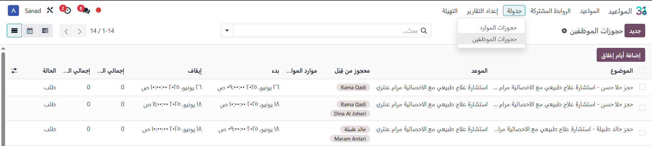

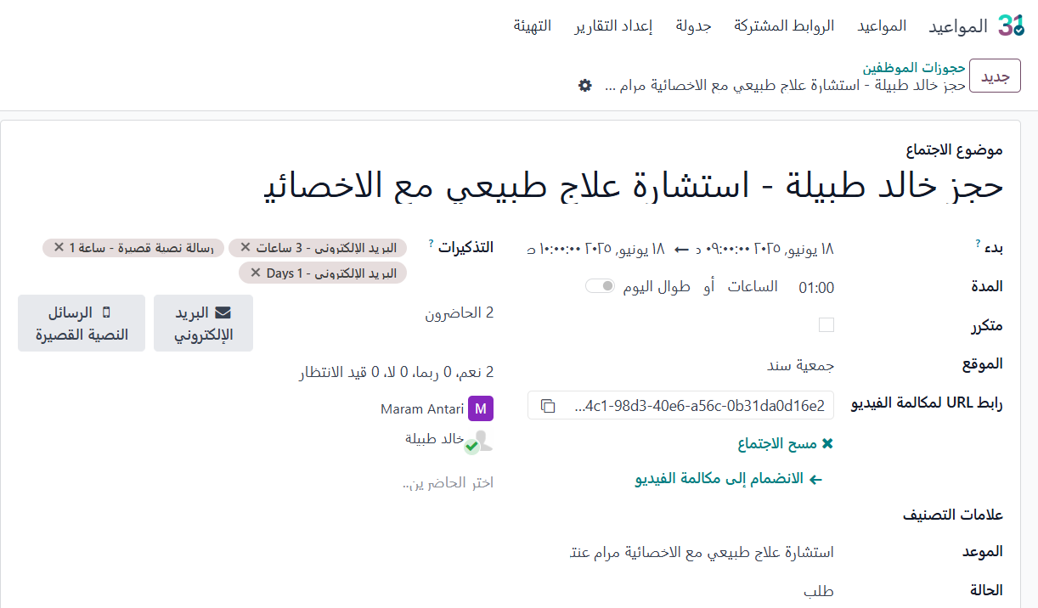
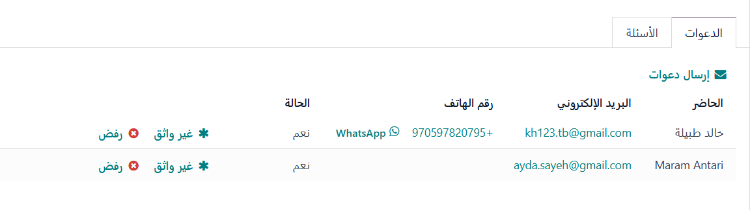
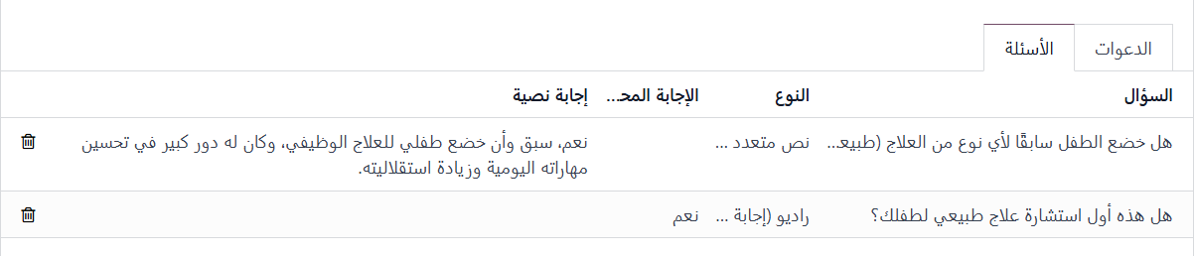

Slide 36
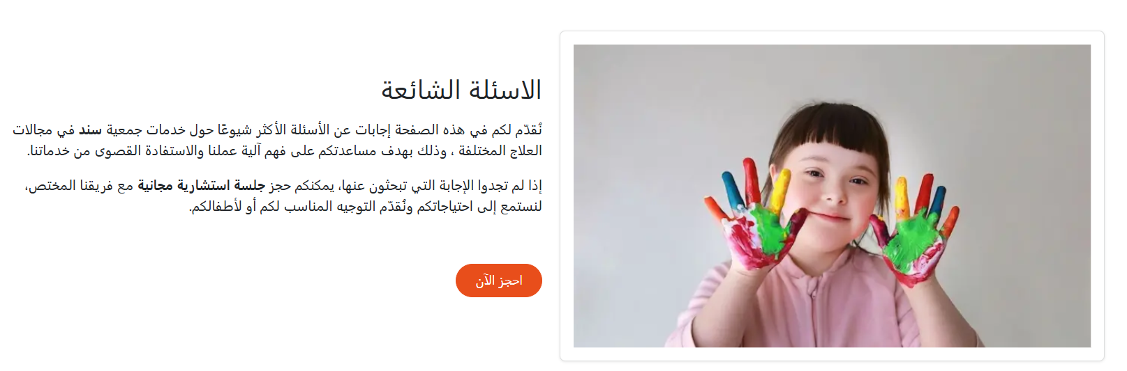

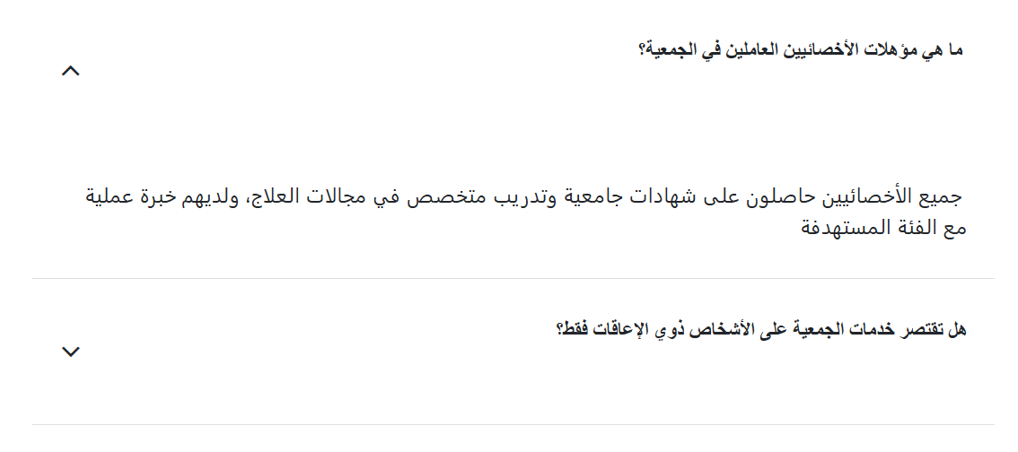
This button takes you back to the Book Now page.

Slide 37

SANAD SYSTEM
Beneficiary Management Module
A custom module developed in-house by our team.
Centralized module for registering, tracking, categorizing, and reporting beneficiary data to ensure personalized support, effective services, and informed decisions.
https://edu-sanad3.odoo.com

Slide 38

SANAD SYSTEM
This image displays the design of the beneficiary information management screen.

Slide 39


Slide 40



الاسم الموجز
يتم إدخال الاسم الكامل للمريض يدويًا عبر لوحة المفاتيح.

Slide 41

يتم تحديد الجنس من خلال قائمة اختيار (Selection) محددة مسبقًا.

Slide 42

تُحدَّد علاقة ولي الأمر بالمريض من خلال قائمة اختيار محددة مسبقًا.

Slide 43


و يتم اختيار التاريخ من خلال تقويم تفاعلي كما هو موضح في الواجهة.
أما باقي الحقول المشار إليها بالقوس، فيتم إدخال بياناتها يدويًا عبر لوحة المفاتيح.

Slide 44




تُحدَّد الخدمة العلاجية من قائمة اختيار تحتوي على مجموعة الخدمات المتاحة.
علاج نطق
علاج نطق
وكذلك يتم تحديد الأخصائي المشرف على العلاج من قائمة اختيار تحتوي على أسماء الأخصائيين المعتمدين.

Slide 45


Slide 46





Slide 47




Slide 48


Slide 49




The system also shows the current stage of treatment, indicating that the current beneficiary will be in the "New" stage.
The case status updates automatically based on the defined treatment start and end dates.

Slide 50

تعرض الصفحة الرئيسية معلومات المستفيد الأساسية: الاسم، التشخيص، الأخصائي، والخدمات لتسهيل الإدارة.

Slide 51


SANAD SYSTEM

Slide 52


Slide 53

SANAD SYSTEM

Slide 54

SANAD SYSTEM
يعرض النظام رسمًا بيانيًا دائريًا يوضح توزيع الخدمات العلاجية ونِسَبها، حيث تُعد علاج النطق الأكثر طلبًا.

Slide 55


(%5.20)
(%14.44)
علاج وظيفي 25 (27.78%)
(%5.54)
(%13.33)

Slide 56


Slide 57

SANAD SYSTEM

Slide 58

SANAD SYSTEM
إشعار بعقد وتوثيق جلسة علاج نطق
Notification of Completed and Logged Speech Therapy Session

Slide 59



SANAD SYSTEM
إشعار تذكير للأخصائي بجلسة علاج نطق مجدولة

Slide 60


SANAD SYSTEM
إشعار للأهل تذكير بجلسة علاج نطق مجدولة

Slide 61


Slide 62

SANAD SYSTEM
علاج نطق
علاج وظيفي

Slide 63

علاج نطق
علاج وظيفي

Slide 64




Slide 65

٠٤:٣٠ م جلسة علاج وظيفي
٠٢:٣٠ م جلسة علاج نطق

Slide 66
SANAD SYSTEM
Email Marketing Module
We use the Email Marketing module to send weekly progress reports and personalized updates, ensuring continuous, transparent communication with parents.
https://edu-sanad3.odoo.com

Slide 67




SANAD SYSTEM
تقرير أسبوعي مرفق لحالة طفلك

Slide 68




SANAD SYSTEM

Slide 69





SANAD SYSTEM

Slide 70

SANAD SYSTEM

Slide 71

SANAD SYSTEM
Dashboard
https://edu-sanad3.odoo.com

Slide 72

SANAD SYSTEM
Dashboard
https://edu-sanad3.odoo.com

Slide 73


SANAD SYSTEM
Dashboard
توزيع الخدمات العلاجية المقدّمة حسب الفئة العمرية للمستفيدين
توزيع المستفيدين حسب نوع الخدمة
علاج وظيفي
علاج نطق
علاج طبيعي
علاج سلوكي
تعليم خاص
علاج بالرياضة

Slide 74

SANAD SYSTEM
Dashboard
https://edu-sanad3.odoo.com

Slide 75

SANAD SYSTEM
Human Resource Module
Centralized HR system managing profiles, contracts, attendance, and salaries, integrated with therapy schedules to automate reports and streamline operations.
https://edu-sanad3.odoo.com

Slide 76




Slide 77
SANAD SYSTEM

Slide 78

SANAD SYSTEM

Slide 79

SANAD SYSTEM

Slide 80

SANAD SYSTEM

Slide 81

The image illustrates the key fields recorded for each employee in the system
SANAD SYSTEM
أحمد سلعوس
الوحدة التنظيمية
يتم ادخال اسم الموظف الكامل
دينا الجوهري
المشرف المباشر على الموظف

Slide 82


SANAD SYSTEM

Slide 83


SANAD SYSTEM

Slide 84

SANAD SYSTEM

Slide 85


SANAD SYSTEM

Slide 86

SANAD SYSTEM

Slide 87


SANAD SYSTEM

Slide 88


SANAD SYSTEM

Slide 89


SANAD SYSTEM
عقد أحمد السلعوس

Slide 90

SANAD SYSTEM
Attendance Module
The Attendance module is a core module in Odoo's Human Resources Management (HRM) system, providing an accurate mechanism for tracking employee attendance and leave. This module was developed to support time management processes and facilitate payroll calculations based on actual work days and hours.
https://edu-sanad3.odoo.com

Slide 91

SANAD SYSTEM

Slide 92






SANAD SYSTEM

Slide 93






Slide 94



Slide 95

SANAD SYSTEM

Slide 96

SANAD SYSTEM

Slide 97

SANAD SYSTEM
Time-Off Module
Managing all types of employee leave, whether paid or unpaid, in accordance with the organization’s internal policies. This module enables employees to request leaves, managers to approve and track them, and HR teams to manage leave records accurately and efficiently, ultimately enhancing work organization and simplifying administrative processes related to employee management.
https://edu-sanad3.odoo.com

Slide 98


SANAD SYSTEM

Slide 99


SANAD SYSTEM

Slide 100


SANAD SYSTEM

Slide 101


SANAD SYSTEM

Slide 102

SANAD SYSTEM
Dashboard
https://edu-sanad3.odoo.com

Slide 103

SANAD SYSTEM
Dashboard
https://edu-sanad3.odoo.com

Slide 104

SANAD SYSTEM
Dashboard
https://edu-sanad3.odoo.com

Slide 105

SANAD SYSTEM
Dashboard
https://edu-sanad3.odoo.com

Slide 106
SANAD SYSTEM
Payroll Module
The Payroll Module automates salary calculations, manages allowances/deductions, generates reports, and ensures accurate, efficient, and time-saving payroll processing.
https://edu-sanad3.odoo.com

Slide 107



SANAD SYSTEM
تشير حالة الرواتب "تم التأكيد" إلى أنها جاهزة للاعتماد، مع إمكانية متابعة جميع الإجراءات المتعلقة بها داخل النظام.

Slide 108



SANAD SYSTEM

Slide 109


SANAD SYSTEM

Slide 110


SANAD SYSTEM

Slide 111
SANAD SYSTEM

Slide 112

Printed Payslip:

Slide 113

SANAD SYSTEM
Email Notification:

Slide 114
SANAD SYSTEM
To-do Module
The Tasks Module enables task creation, assignment, tracking, and collaboration to enhance efficiency, accountability, and timely execution.

Slide 115


Slide 116

SANAD SYSTEM
اجتماع

Slide 117

SANAD SYSTEM
Expenses module
The Expenses module allows the association to track and analyze all financial inflows accurately, ensuring clear visibility over monthly and yearly spending. This supports effective financial planning and promotes transparency.
https://edu-sanad3.odoo.com

Slide 118



Slide 119


Slide 120

SANAD SYSTEM
Billing module
The Invoicing module is used to generate official invoices upon payment, serving as proof and documentation for clients, especially for monthly fees.
https://edu-sanad3.odoo.com

Slide 121




Slide 122




Slide 123




Slide 124


Slide 125


SANAD SYSTEM
Dashboard
https://edu-sanad3.odoo.com

Slide 126
SANAD SYSTEM
THANK YOU !
https://edu-sanad3.odoo.com

