Slide 1

An-Najah National University
Medical Analysis Laboratory Management
- MALM -
Supervised by:
Dr. Baker Abdulhaq
Information & Computer Science Dept.
2023 / 2024

Slide 2

INTRODUCTION:
Project Overview
Objectives
Impact

Slide 3
Features:
Contains different and useful features and additions.
Help the laboratory in his workflow.
Distributed on multiple different pages:
                Landing Page.
                Admin Page.
                Staff Page.
                Patient Page
                Doctor Page

Slide 4

Requirements:
Main Actors.
Functional Requirements.
Non-Functional Requirements.

Slide 5
Programming Information:
Software used in Front-End:
            HTML, CSS (Bootstrap5, Font Awesome Icons).
            JavaScript.
            React JS.
Software used in Back-End:
            Node JS - Express.
            Mongo DBMS.

Slide 6
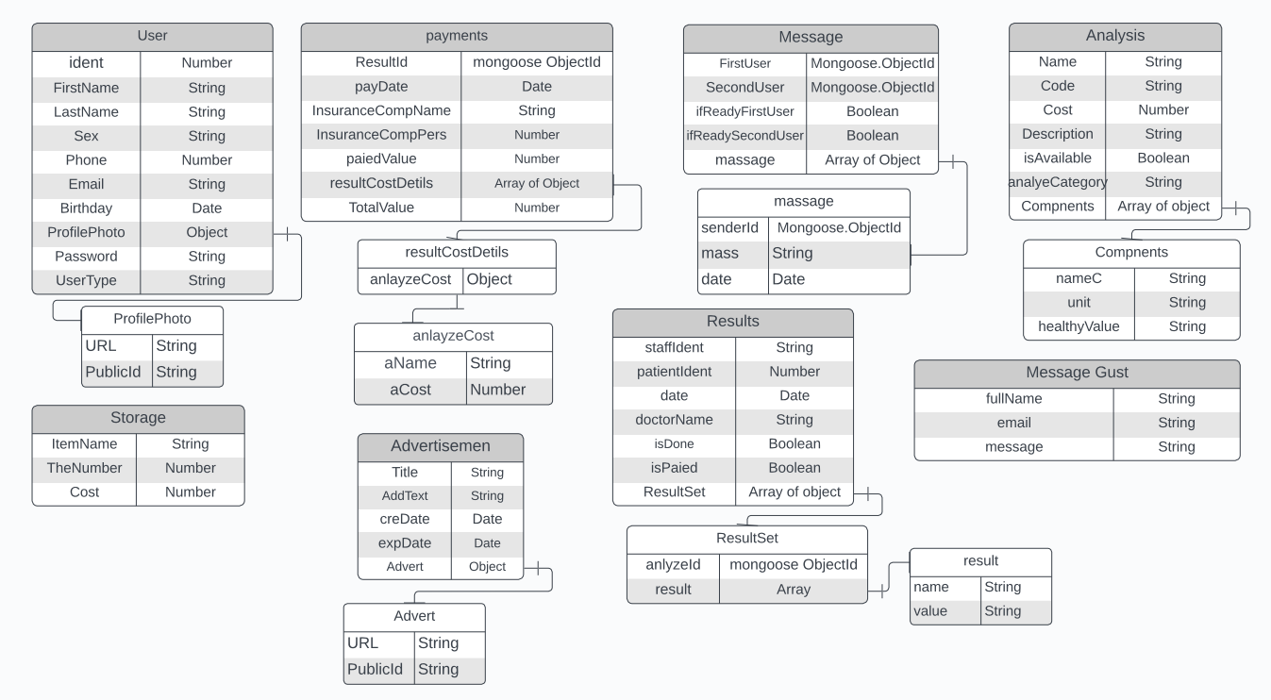
DB-Tables:

Slide 7

UML Diagrams:
Context Diagram.
Use Case Diagram.
Sequences Diagrams.
Class Diagram.

Slide 8
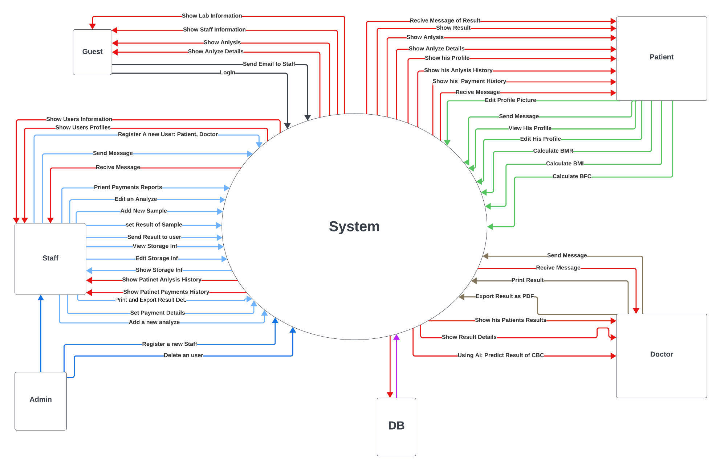
Context Diagram

Slide 9
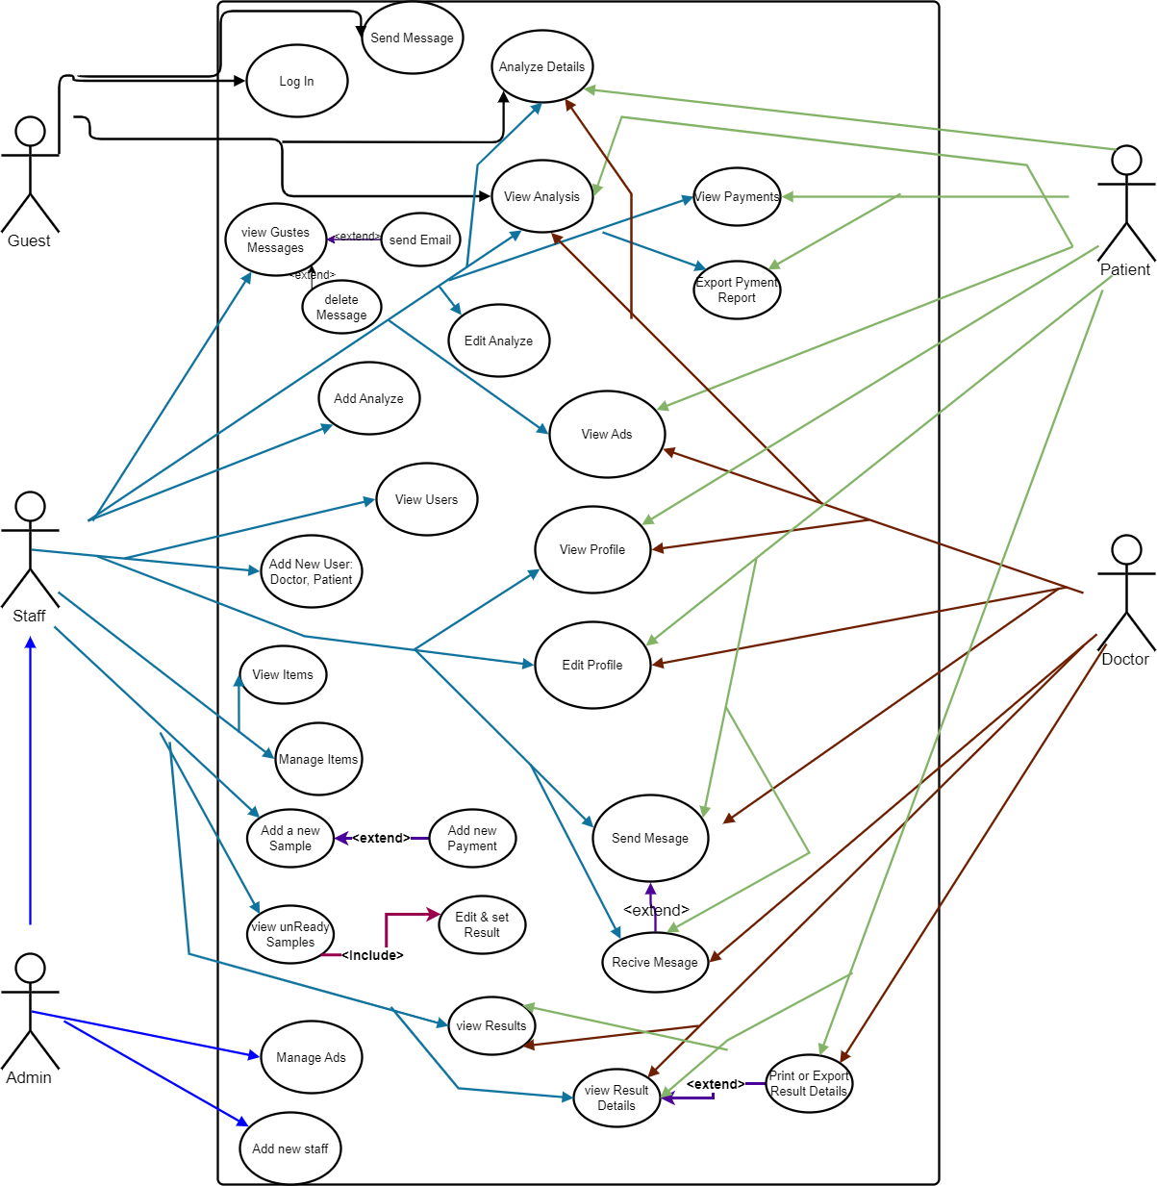
Use Case Diagram

Slide 10
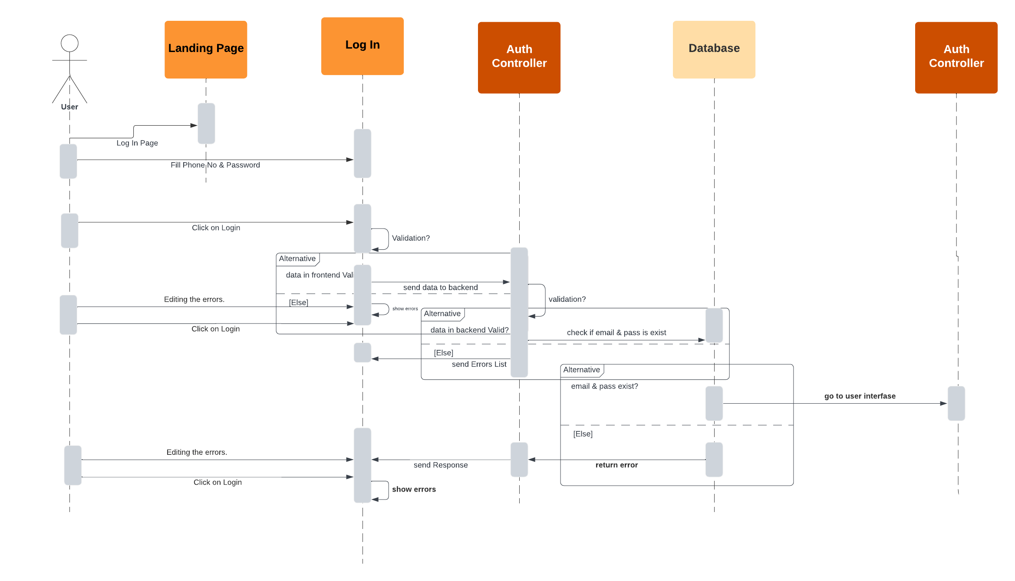
Sequences Diagrams - Login

Slide 11
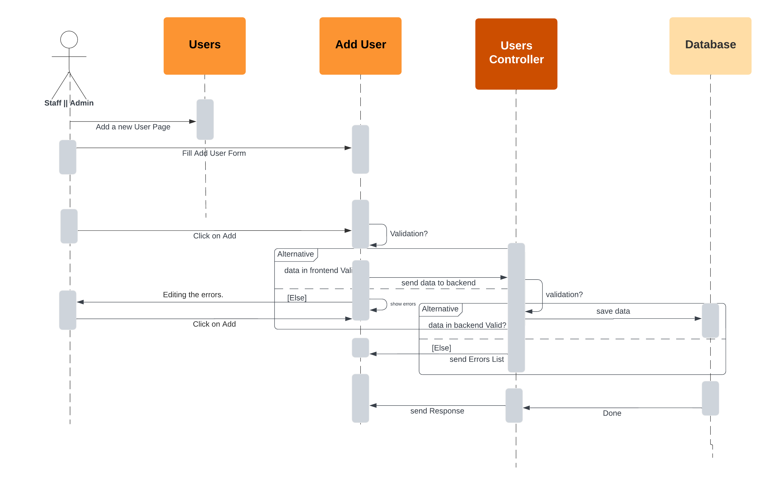
Sequences Diagrams – Register A New User

Slide 12

Sequences Diagrams – Add A New Sample

Slide 13
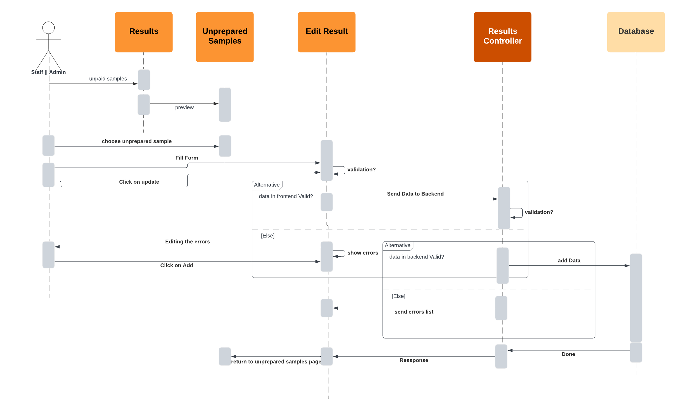
Sequences Diagrams – Update Unprepared Sample

Slide 14
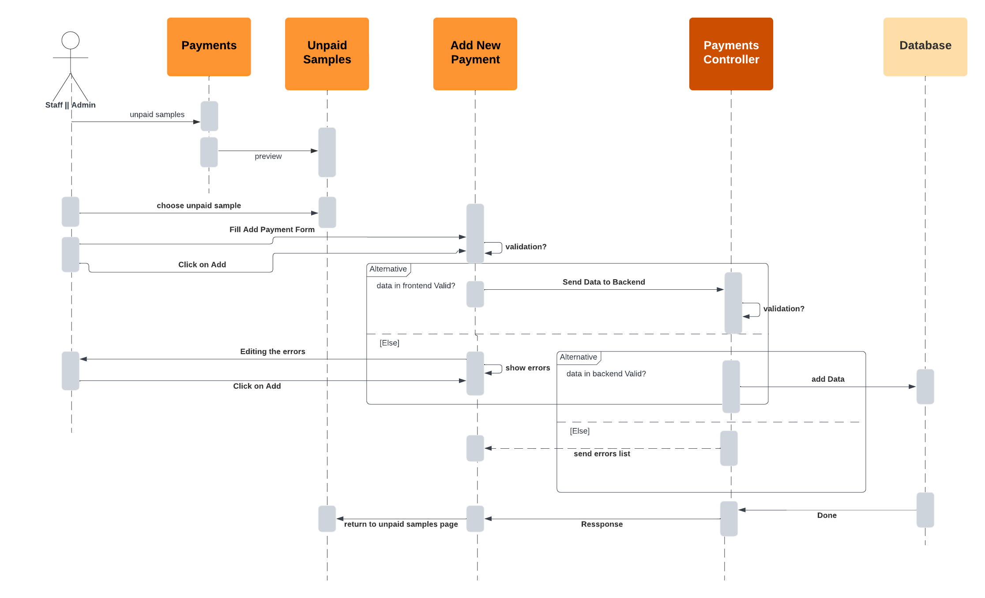
Sequences Diagrams – Add A New Payment

Slide 15
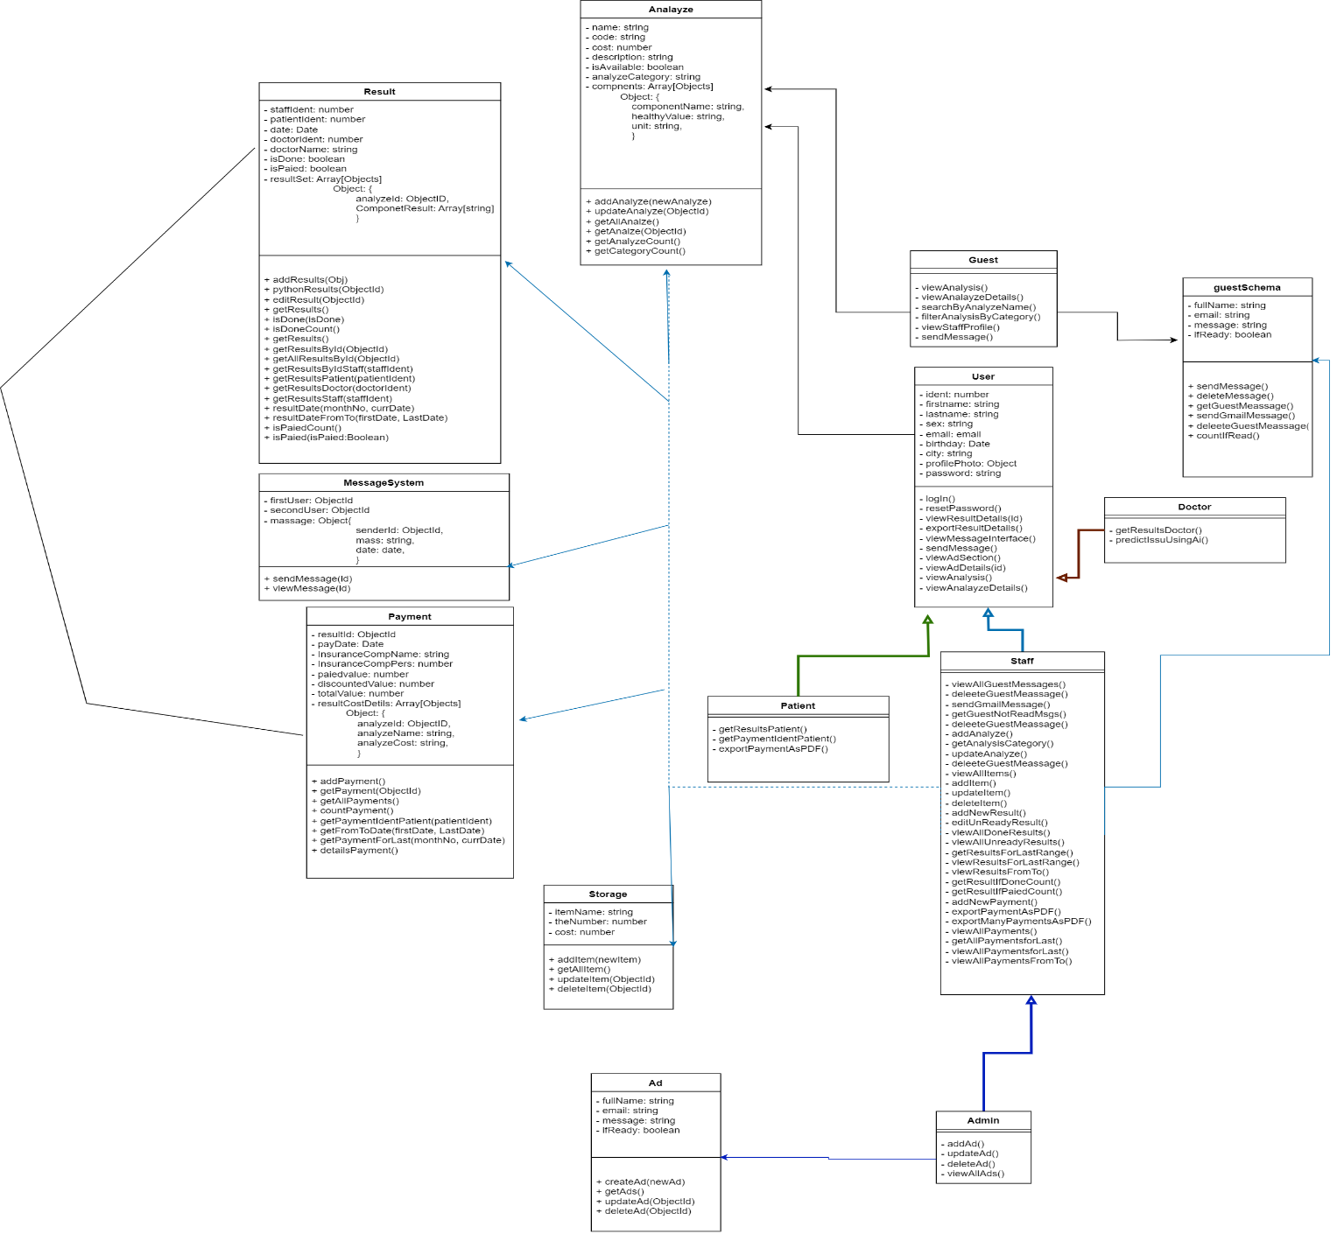
Class Diagram

Slide 16
Development Process:
Project Structure.
Frontend development.
Backend development.
Machine Learning.

Slide 17
Thank You All …
Omar Nasser Mousa Al Mahdi

