Slide 1
Title Layout
Subtitle

Slide 2
Graduation project 2 Integrated Design Of Orphanage
Prepared by:
Hassan Anati.
Mohammad Bheas.
Supervisor: Eng. Haitham Sawalha

Slide 3
Content:
Introduction
Site analysis
Architectural design
Structural design
Electrical Design
Environmental Design
Mechanical Design
Safety Design
Total Cost

Slide 4
Introduction:
The world is changing and going through difficult times.
1.54% of the children in Gaza strip are orphans, whereas 2.6% in the west bank.
The idea of designing an orphanage emerged and developed in this project.
Children will be given more chances to be productive and positive.
The project will provide the orphans and the working staff with life essentials and comfort.

Slide 5
Site analysis

Slide 6
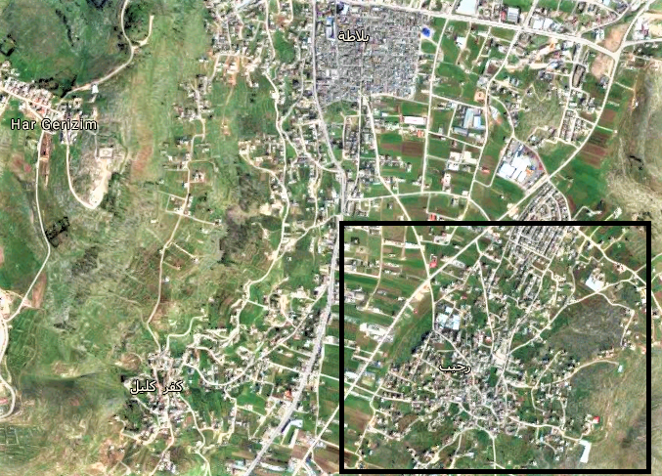

Slide 7
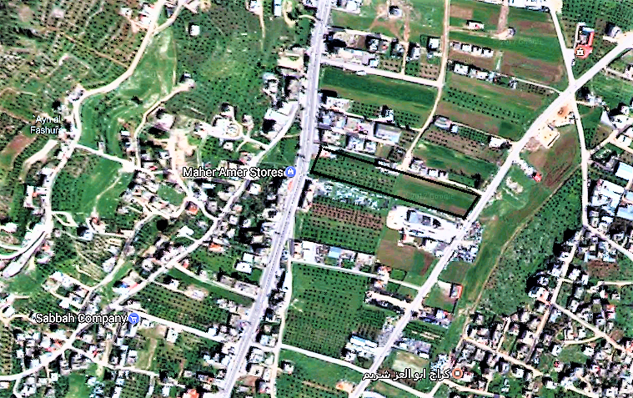

Slide 8
Architectural design

Slide 12
North elevation
N.E

Slide 13
S.E

Slide 14
E.E

Slide 15
S.E

Slide 16
Sec.A.A

Slide 17
Environmental design

Slide 18
Shading analysis

Slide 19
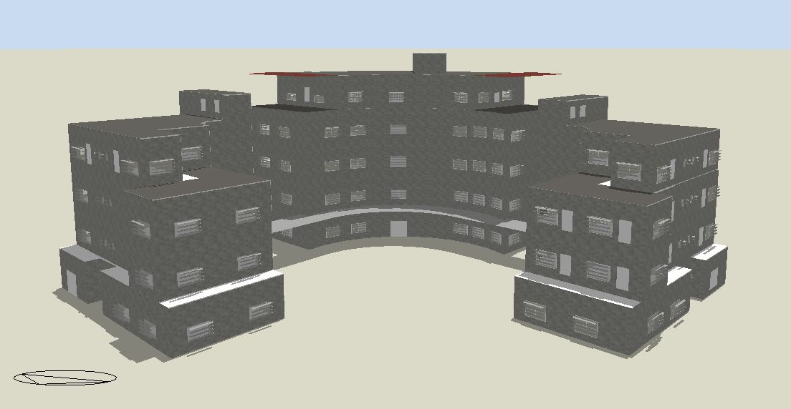
At 21/6. 12:00am

Slide 20
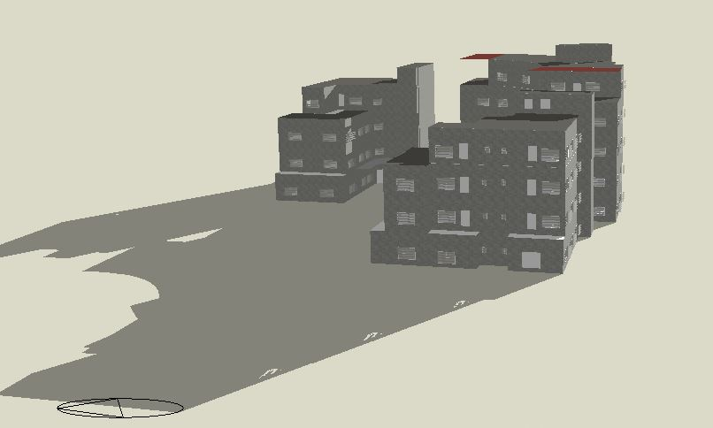
At 21/1. 8:00am

Slide 21
Day lighting analysis

Slide 22
Cafeteria

Slide 23
Library

Slide 24
Classroom

Slide 26
Acoustical design

Slide 27
Wall layers

Slide 28
Ceiling layers

Slide 29
Partition layers

Slide 30
Floor layers

Slide 31
Absorption coefficient for for plaster

Slide 32
Absorption coefficient for ceiling acoustical tile

Slide 33
Absorption coefficient for ceramic tiles

Slide 34
Absorption coefficient for plywood

Slide 35
RT60 for cafeteria

Slide 36
RT60 for library

Slide 37
RT60 for classroom

Slide 38
STC for cafeteria exterior wall

Slide 39
STC for partition

Slide 40
STC for ceiling

Slide 41
STC for computer room exterior wall

Slide 42
Noise reduction

Slide 43
Speakers design
The speakers was selection is LHM 0606/xx ceiling speaker from BOSCH company.
The diameter of coverage area = 7.9 m

Slide 44
Speaker distribution in cafeteria and library

Slide 45
Speaker distribution in computer room

Slide 46
Thermal analysis

Slide 47
Thermal comfort
Heating design at 20 oC and 50% relative humidity
Cooling design at 24 oC and 50% relative humidity

Slide 49
U-value

Slide 50
Speaker distribution in computer room

Slide 51
Speaker distribution in computer room

Slide 52
Speaker distribution in computer room

