Slide 1
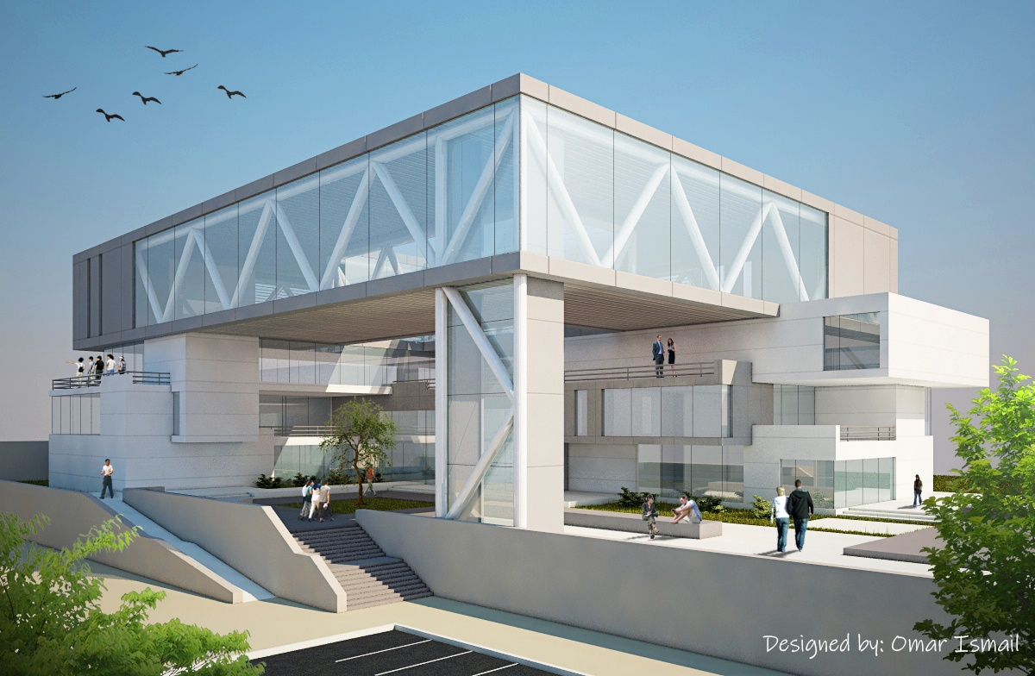


Analysis and design of engineering college
Supervisor :
D.Loay Dwaikat
Prepared by :
Hiba Shakhsheer
Maram Shehadeh
Mahmoud Abu Hanyia

Slide 2

OUTLINES
Introduction
Site description
Architectural design
Structural design
Environmental design
mechanical design
Electrical design
Quantity surveying
Life cycle

Slide 3
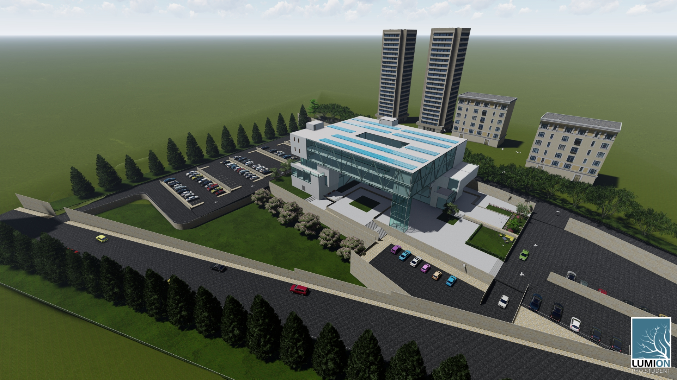
INTRODUCTION

Slide 4
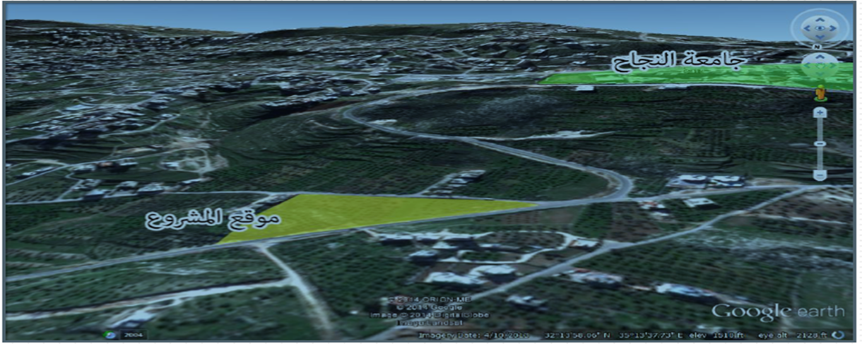
Site description
Site Location:
The project is located in the western part of the Nablus city, in bait wazan area specifically in the north about 500 meters from the new campus of Al-Najah University.

Slide 5
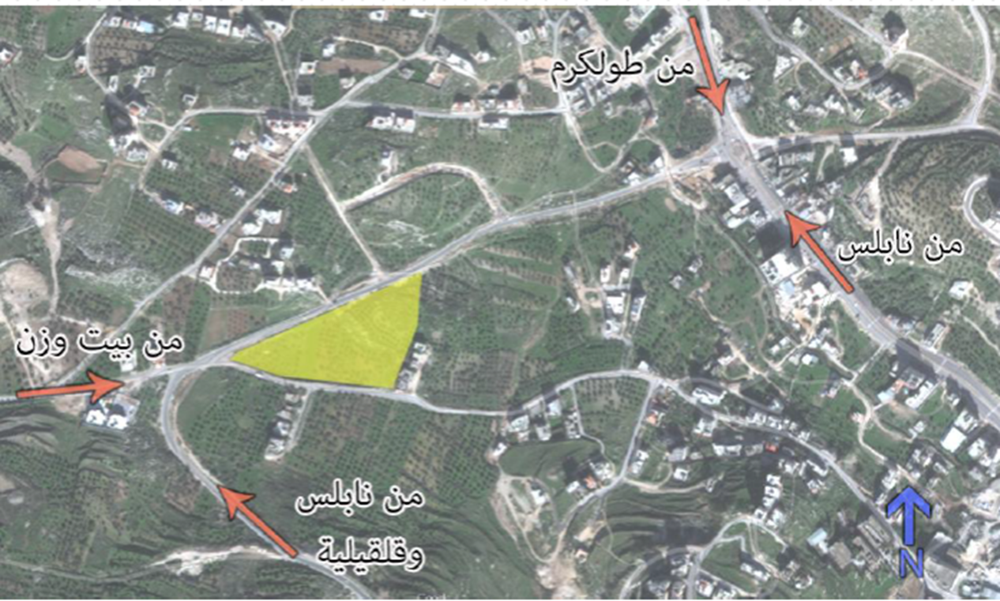
Site description
Traffic and entrances of the site

Slide 6
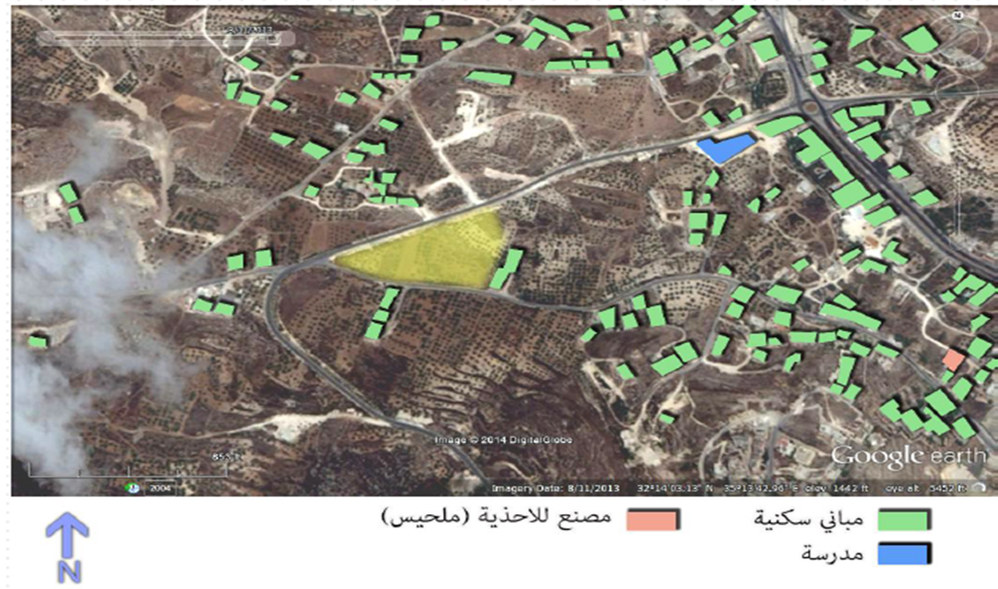
Site description
Analysis of adjacent buildings

Slide 7
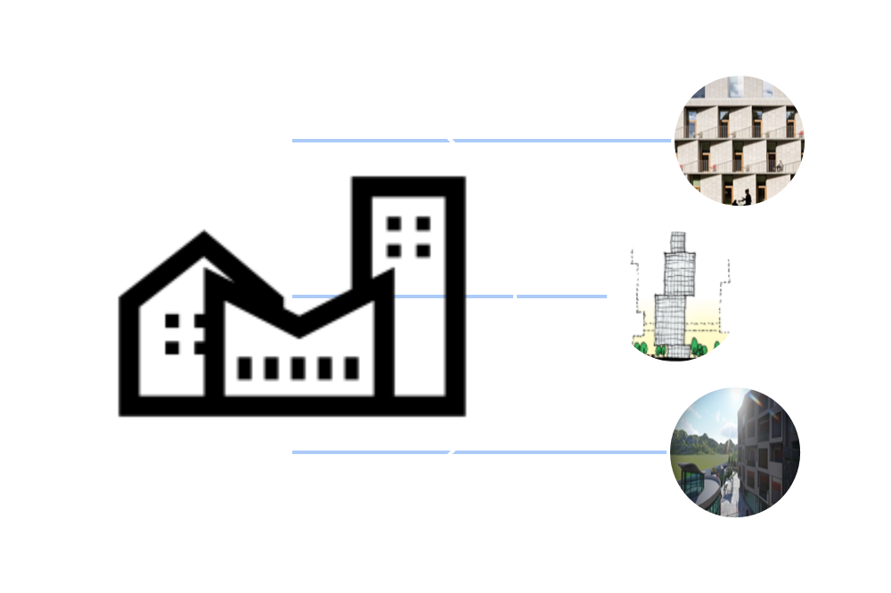
Architectural Design

Slide 8
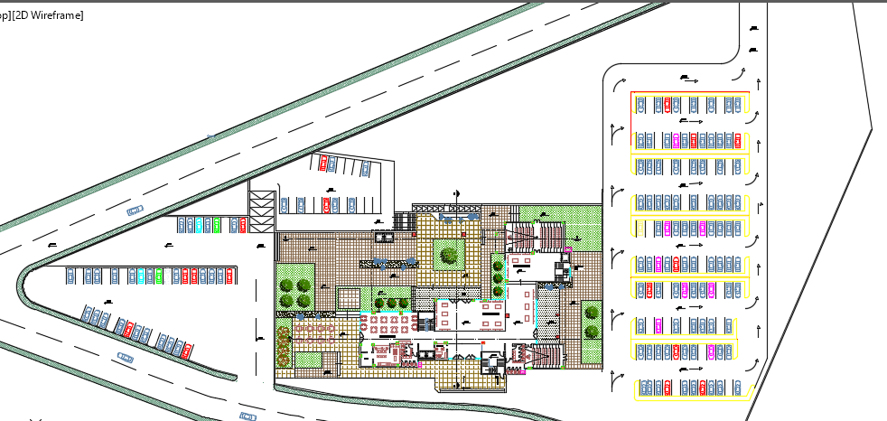
Site plan :

Slide 9
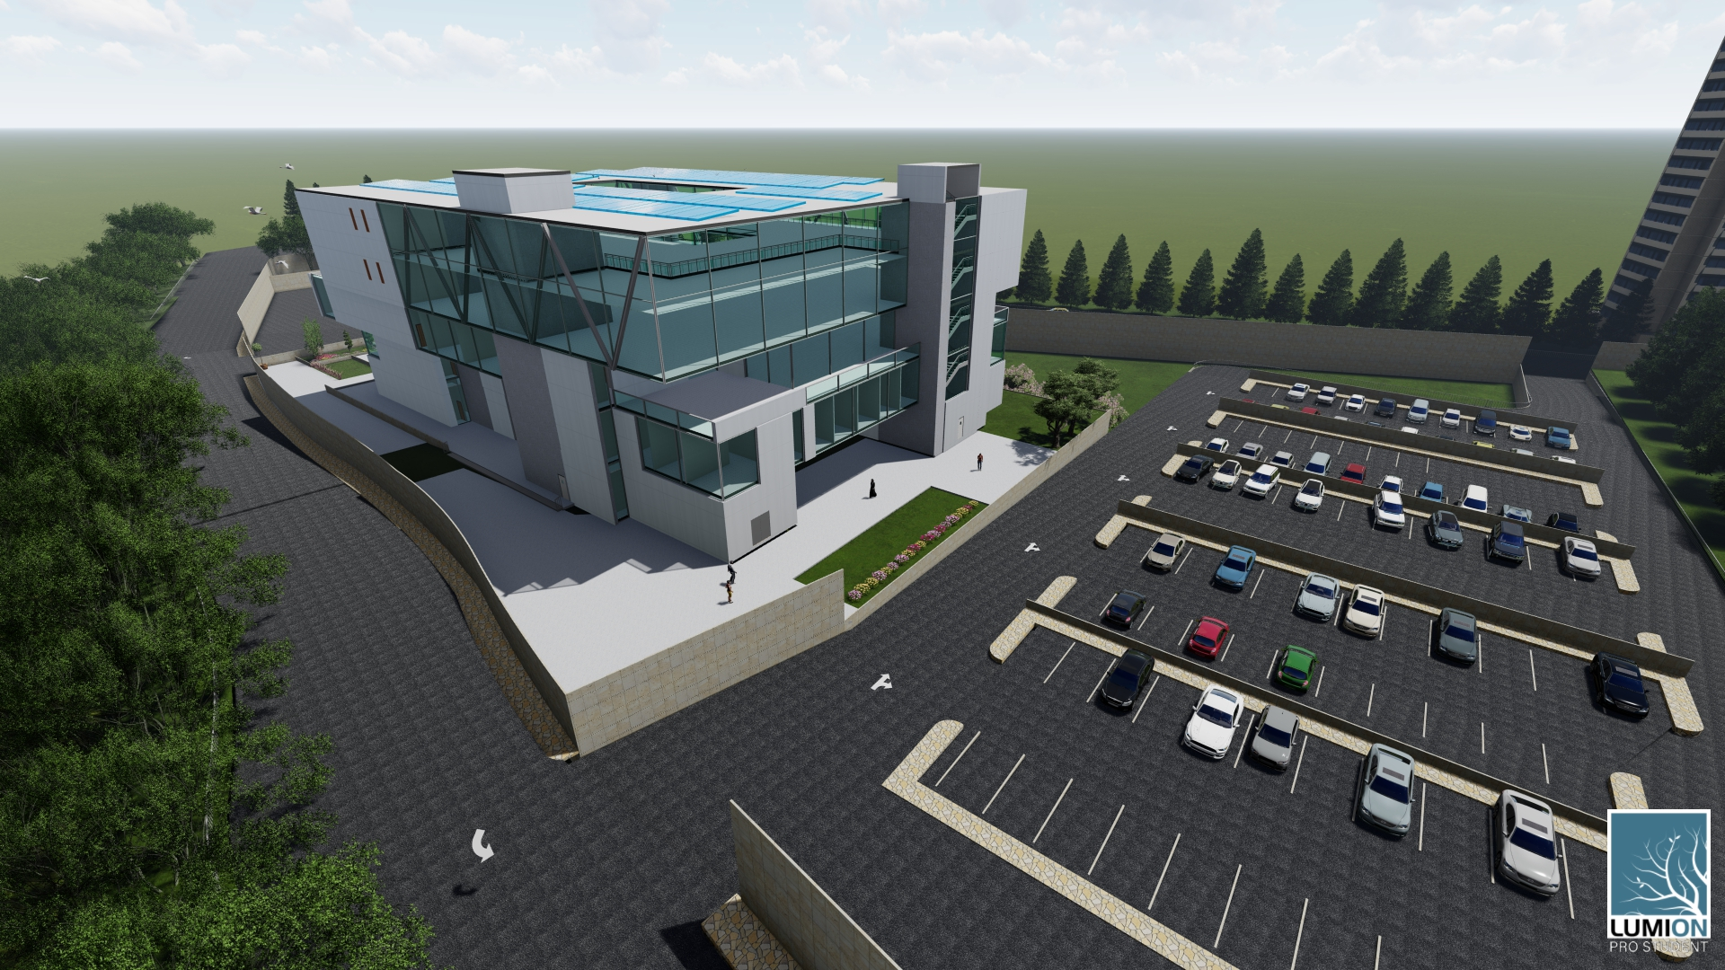
Architectural Design
Site :

Slide 10
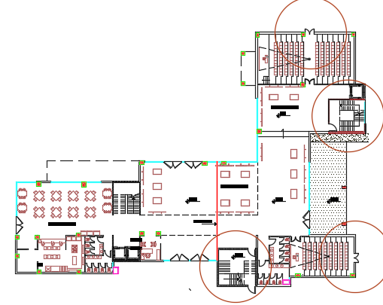
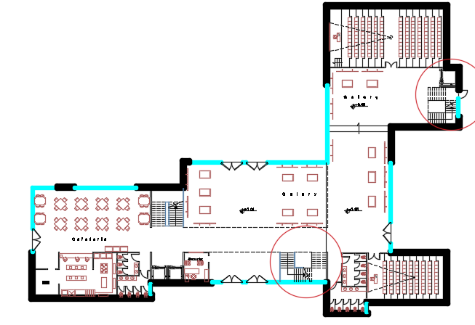
GROUND FLOOR
AFTER
BEFORE

Slide 11
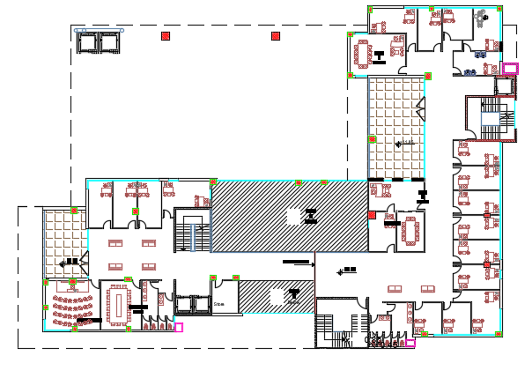
First floor :

Slide 12
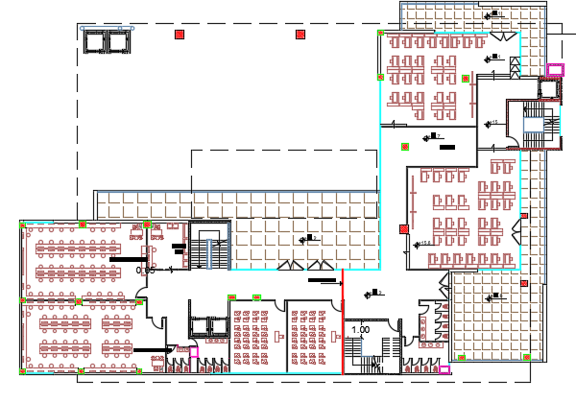
Second floor :

Slide 13
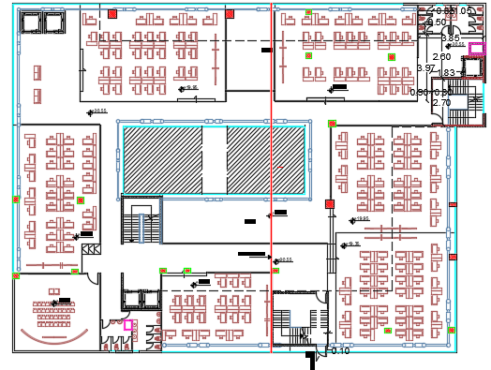
Third floor

Slide 14
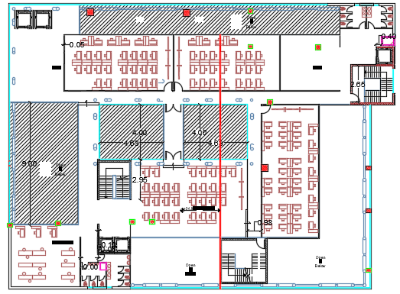
Fourth floor

Slide 15
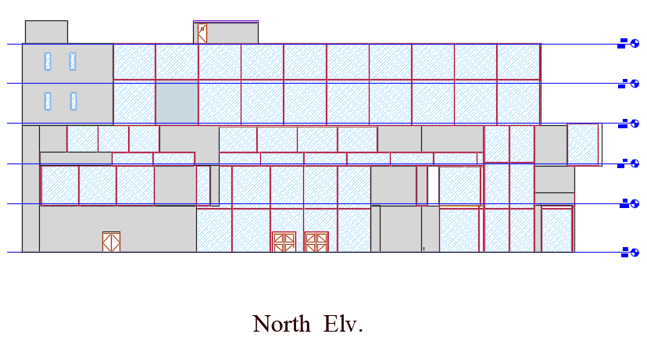
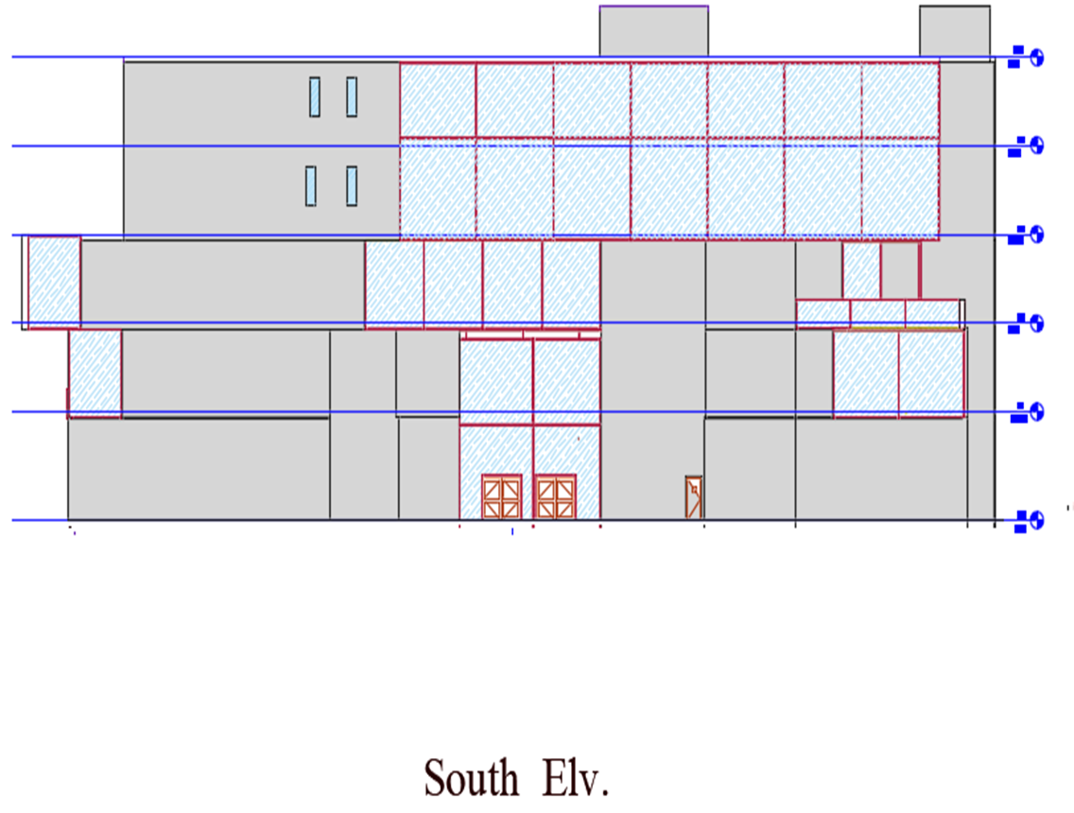
Architectural Design

Slide 16
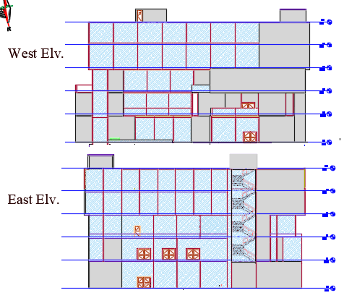
Architectural Design

Slide 17
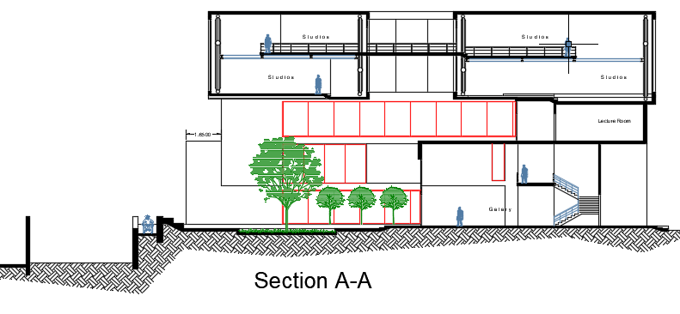
Architectural Design

Slide 18
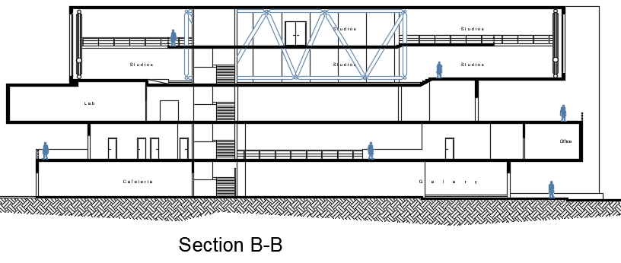
Architectural Design

Slide 19
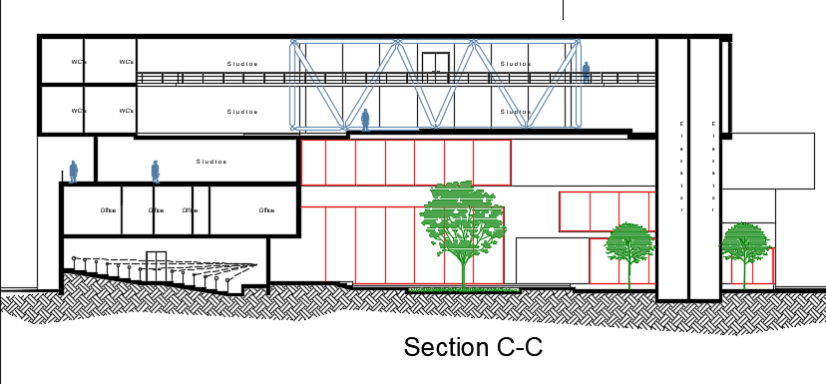
Architectural Design

Slide 20
Structural analysis
Codes
- ACI 318-14
- ASCE 7-10
Material
- Compressive strength ( fʹc ) = 28 MPa
- Yielding strength of steel (fy) = 420 Mpa.
Bearing capacity = 150 kN /m2
Designed load
SID = 4.5 KN/m2
Live load = 5 KN/m2

Slide 21
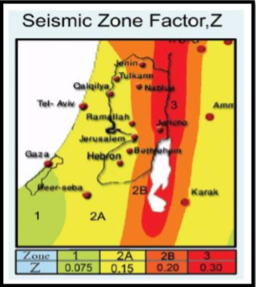
SEISMIC LOAD analysis
The seismic load will be designed according to ASCE 7-10 code, and using response spectrum approach for design, the following steps were taken to design the load:
mass source including 100% of dead and super imposed load and 25% of live loads
a. Seismic zone is 2B (Z=0.2) because the building is on Nablus
*SS = spectral response acceleration parameter at short periods.
Ss = 0.7
*S1 = spectral response acceleration parameter at a period of 1 s.
S1 = 0.18
site classification = SD (stiff soil )
site coefficient Fa and Fv according to Ss and S1
Fa = 1.24
Fv = 2.08

Slide 22
SEISMIC LOAD analysis
Design Spectral Acceleration Parameters
SDs = 1.24*0.7*2/3 = 0.578
SD1= 2.08*0.18*2/3 = 0.25
I = the importance factor = 1
R = the response modiﬁcation factor
R = 6 (special reinforced concrete shear walls )
Design category : D

Slide 23
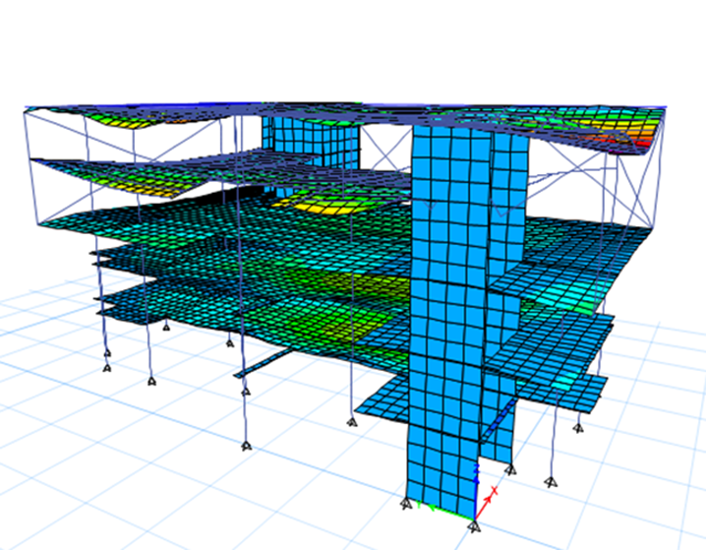
SEISMIC LOAD analysis
Checks
Compatibility check
Equilibrium check
Internal Forces check
Deflection check
Modal mass participation ratio check
20 modes satisfy percentages higher than 90%.
Base shear check
ok
ok
ok
ok
ok
ok

Slide 24
Checks
Drift Check
P delta check
This check is for story stiffness
ok
ok

Slide 25
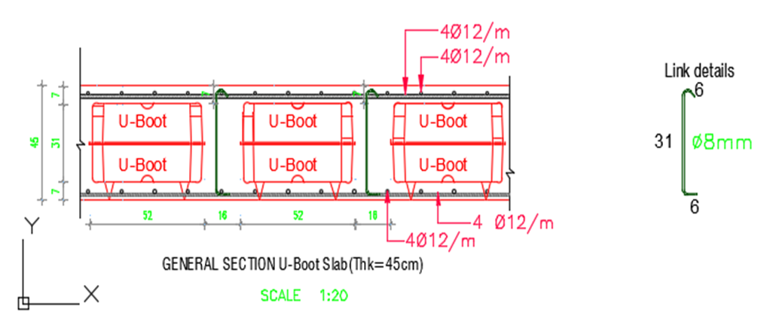
Structural analysis
Slab structural system :
Slab thickness =450mm

Slide 26
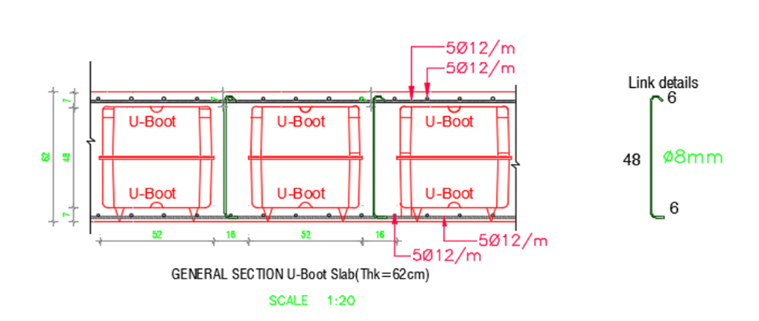
Structural analysis
Slab structural system :
Slab thickness =620mm

Slide 27
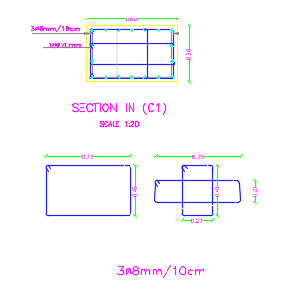
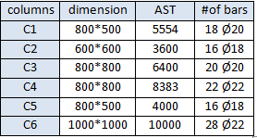
Structural analysis
Columns :

Slide 28
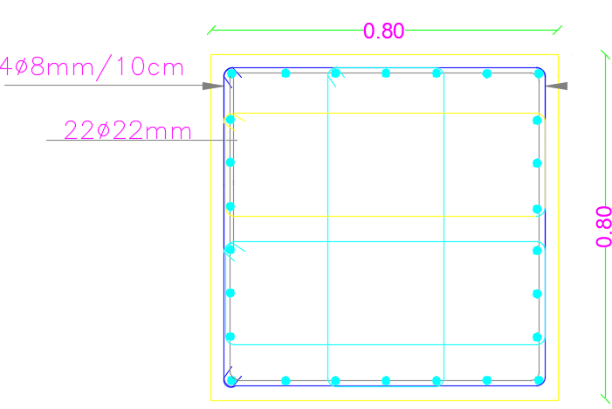
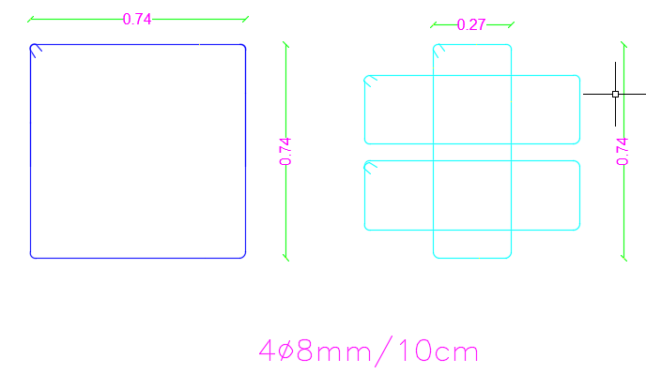
Structural analysis

Slide 29
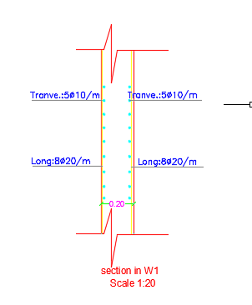
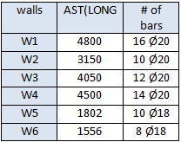
Structural analysis
Shear Wall :

Slide 30
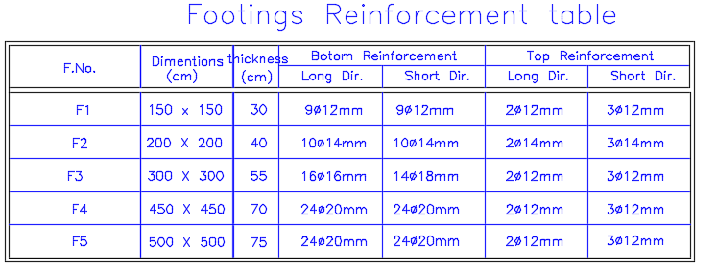
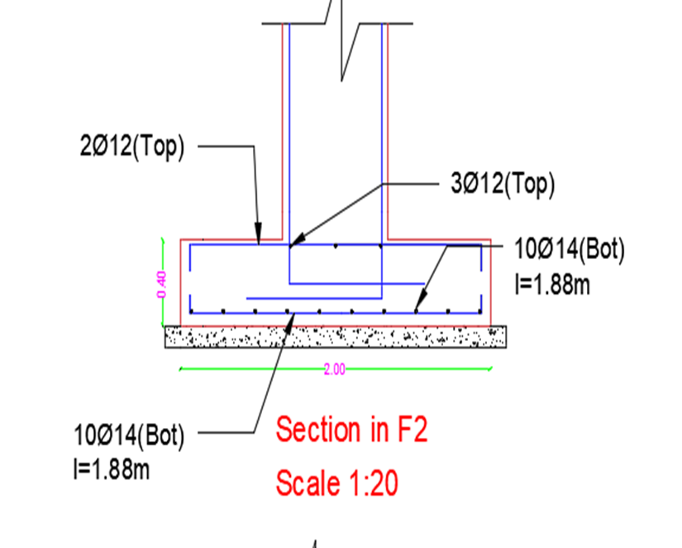
Structural analysis
Footing design :

Slide 31
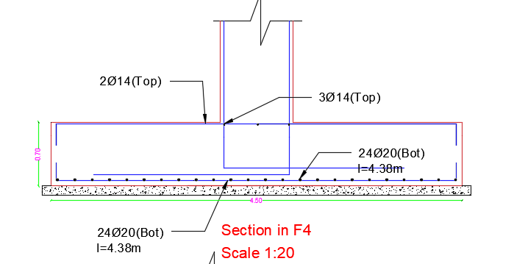
Structural analysis

Slide 32
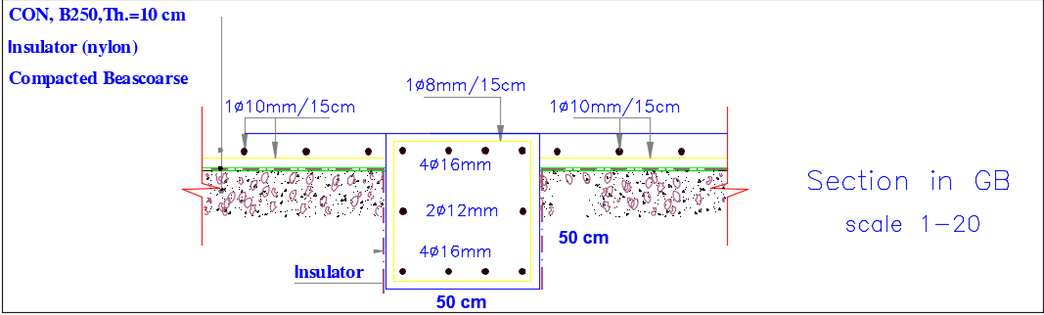
Structural analysis
Tie beams :

Slide 33
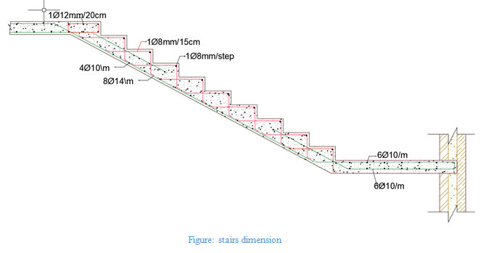
Structural analysis
Stairs :

Slide 34
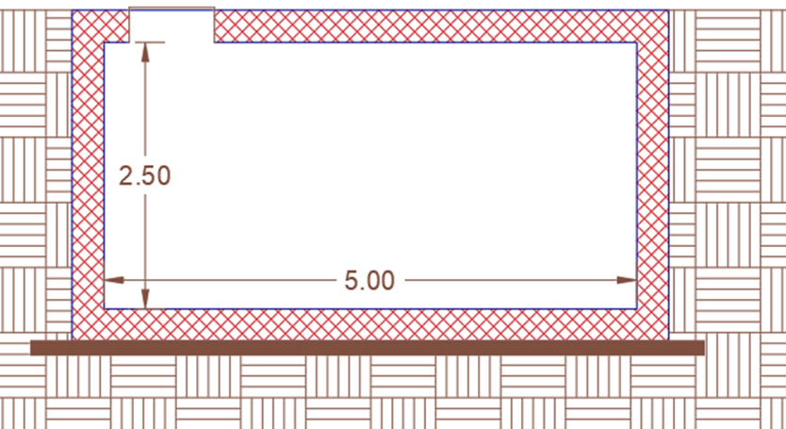
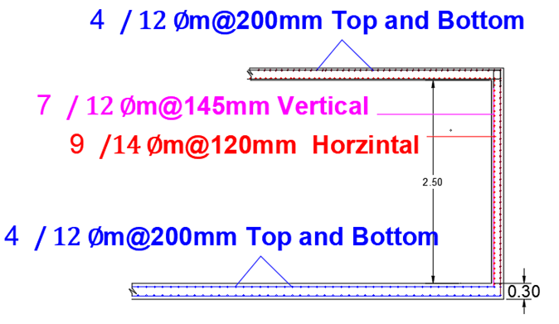
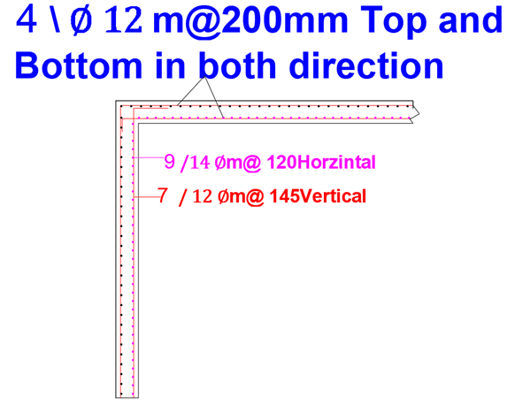
Structural analysis
Water tank:

Slide 35
Structural analysis
Problems and challenges:-
During the analysis of origin in terms of construction emerged a lot of problems and challenges
One of the most important problems that we cant add any column in the site .
So we use inclined columns
Add inclined columns extending from the ground floor to the second floor reduced the cantilever length

Slide 36
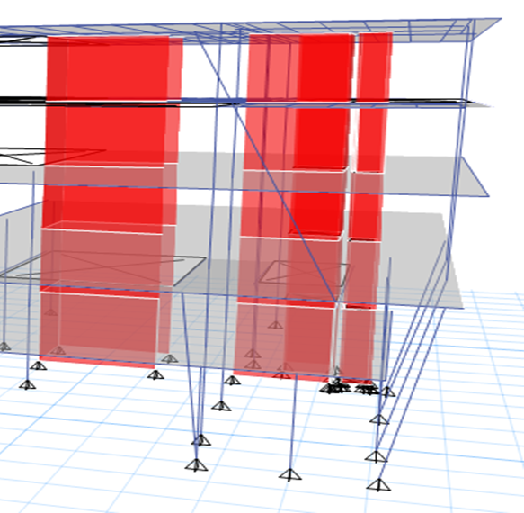
Structural analysis

Slide 37
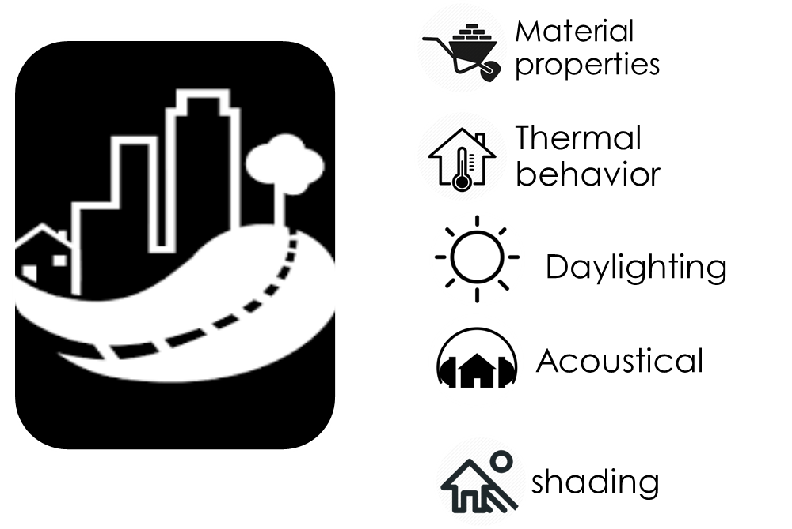
Environmental design

Slide 38
MATERIAL Properties
U-value for Building envelope
U-value(W/m2.K) | Component
0.457 | External Wall
2.097 | Internal Wall
0.344 | Floor
1.530 | Glass

Slide 39
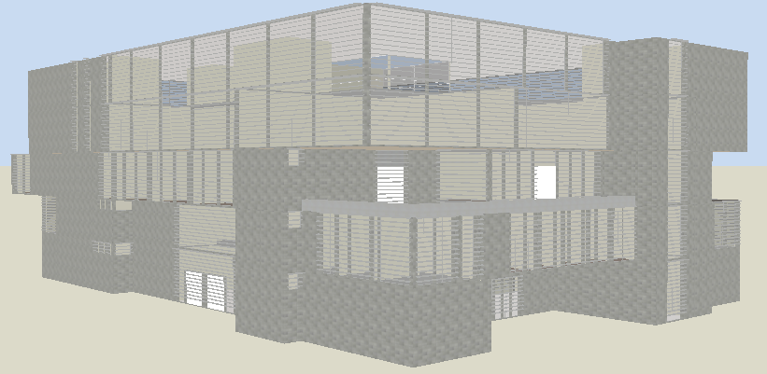
3D Module in Design Builder

Slide 40
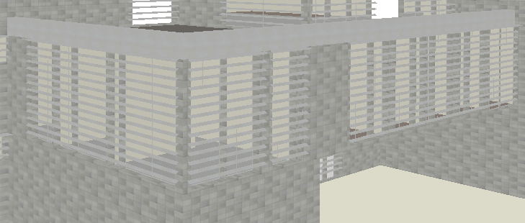
Shading system
Louvers system

Slide 41
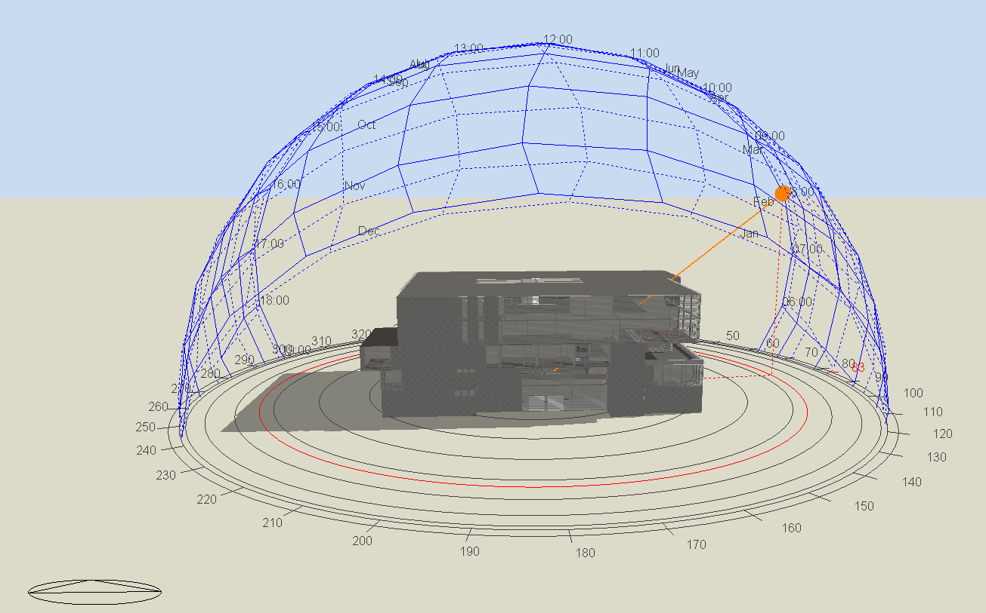
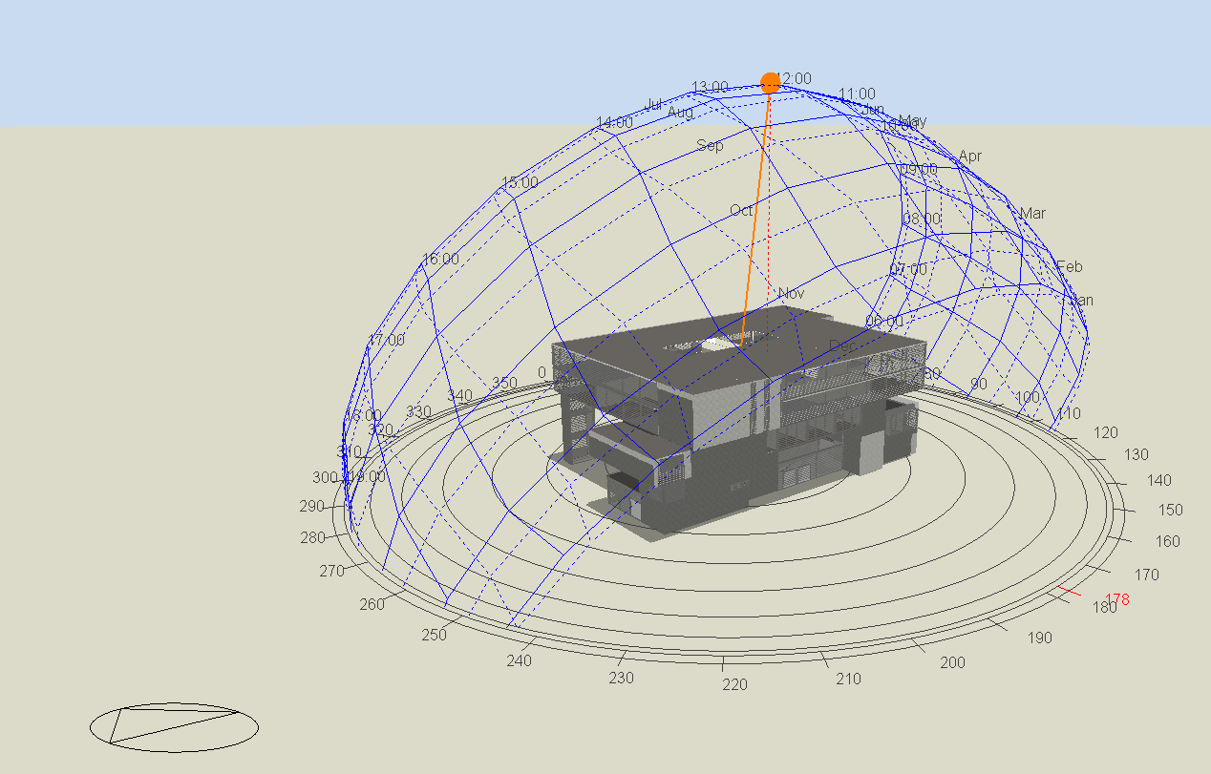
Shading system
In Summer Day
21 June at 8:00 AM
21 June at 12:00 PM

Slide 42
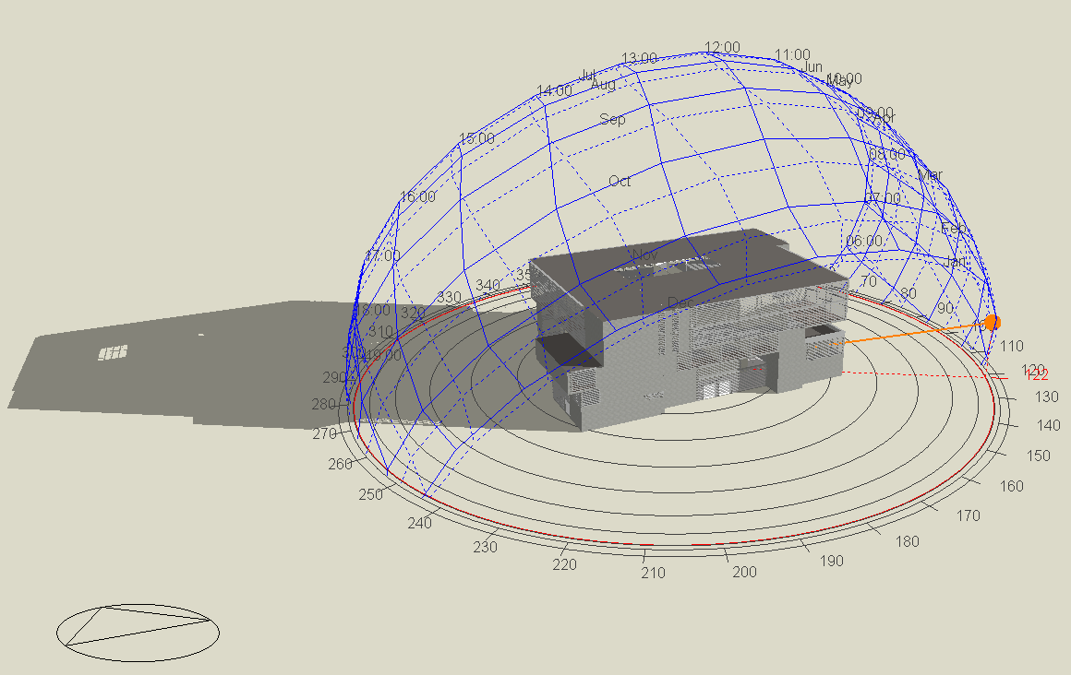
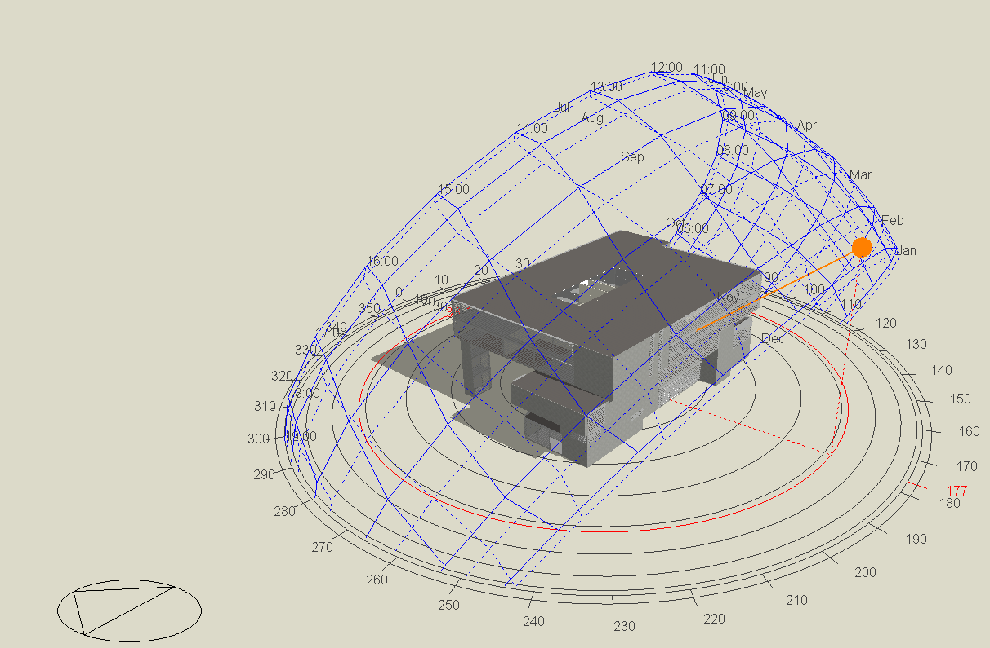
Shading system
In Winter Day
21 January at 8:00 AM
21 January at 12:00 AM

Slide 43
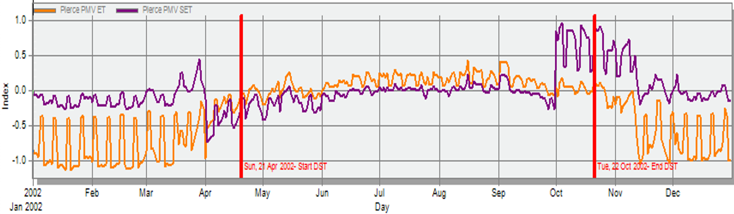
Thermal comfort
Comfort PMV-set

Slide 44
Thermal Design
Heating and cooling loads
  cooling load is 466.1 Kw
  Heating load is 356.6 Kw
Site and source Energy
Energy per conditioned building area[KWh/m2] | Energy per total Building area[KWh/m2] | Total Energy[KWh]
95.94 | 95.94 | 478532.14 | Total site Energy
95.94 | 95.94 | 478532.14 | Net Site Energy
229.95 | 229.95 | 1146925.12 | Total Source Energy
229.95 | 229.95 | 1146925.12 | Net Source Energy

Slide 45
Thermal Design
Comfort set point not met Summery
Facility [Hrs.]
153.50 | Time set point not met during occupied heating
58.00 | Time set point not met during occupied cooling
918.00 | Time not comfortable based on simple ASHREAE 55-2004

Slide 46
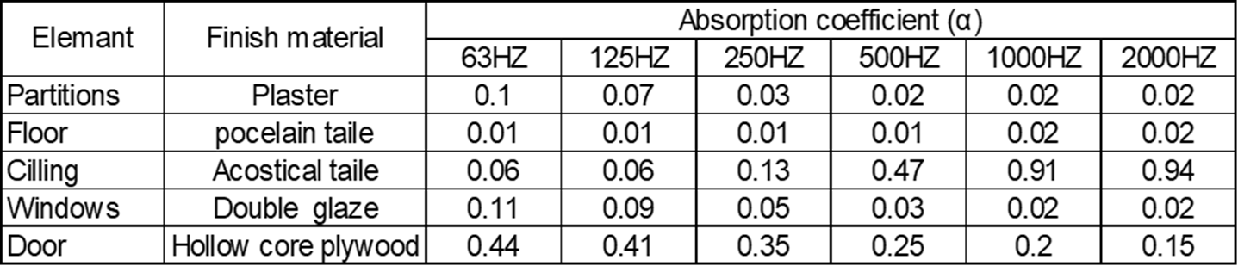
Acoustical design
Absorption coefficient

Slide 47
Acoustical design
Reverberation time {Rt60}
Assessment | Recommended range | Rt60 Range at 500Hz | Volume(m3) | Room
ok | 0.7 – 0.9 | 0.79 | 137.4 | Lecture room
ok | 1.2 – 1.4 | 1.21 | 663.5 | Theater
ok | 0.4 – 0.7 | 0.41 | 592.12 | Computer lab
ok | 0.4 – 0.6 | 0.5 | 65.88 | office

Slide 48
Acoustical design
Sound transmission class [STC]
assessment | STC Value(dB) | Type
Ok | 43 | Classroom wall External
Ok | 47 | Wall between classrooms
Ok | 47 | Wall (Between Classroom and Corridor)
Ok | 55 | Computer lab wall external
Ok | 47 | Office wall external
Ok | 47 | Wall between office and corridor
ok | 55 | External glass wall

Slide 49
Acoustical design
Impact Insulation Class (IIc)
Assessment | IIC (db.) | Type
ok | 58 | floor

Slide 50
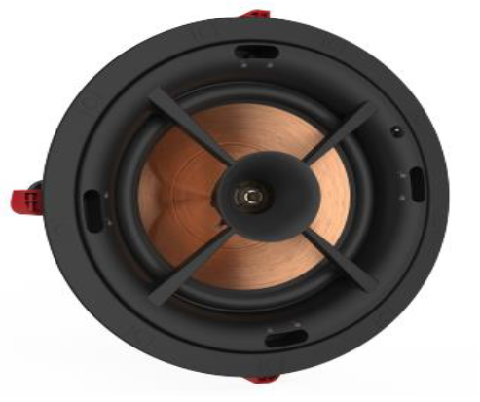
Acoustical design
Loud speakers
  Type used : PRO-10RPC In-ceiling Speakers

Slide 51
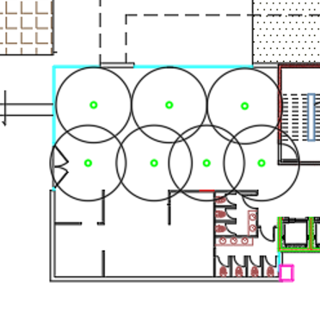
Acoustical design
Speakers distribution in cafeteria

Slide 52
Mechanical design
Water system
Drainage system
Fire Figting
HVAC system
Elevators

Slide 53
Water supply system
System used is underground tank with electrical pump
Total water consumption for building is : 19.2 m3
Fixture unit
Fourth floor | Third floor | Second floor | First floor | Ground floor | floor
50 | 50 | 47 | 30 | 45 | Zone 1
- | - | 52 | 35 | 52 | Zone 2
68 | 68 |  |  | - | Zone 3
118 | 118 | 99 | 65 | 97
Total Fu in building = 497

Slide 54
Water supply system
Pipes Diameter and losses
Zone 3 | Zone 2 | Zone 1
2” | 2” | 2” | Vertical pipe
1.5” | 1.5” | 1.5” | Horizontal pipe
¾” | ¾” | ¾” | Branch pipe
2.35 psi | 5.92 psi | 8.72 psi | Total loss
9.95 psi | 38.2 psi | 38.2 psi | Allowable loss
Ok | Ok | OK | assessment

Slide 55

Water supply system
Water supply system plan {ground floor}

Slide 56
Drainage system
Drainage system diameters
Type of Pipe | Slope | Diameter | Pipe
PVC | 0 % {90} | 4” | Vent
PVC | 1 % | 4” | Drainage
PVC | 0 %{90} | 4” | Stack
PVC | 2 % | 2” | Sewer

Slide 57

Drainage system
Manholes plan

Slide 58

Drainage system
Rain water plan

Slide 59
Hvac Design
Total cooling load is 466 Kw
Total Heating load is 366 K
System used is VRV(variable refrigerant volume) for first three floors
VAV system was used for third and fourth floor

Slide 60

Hvac Design
HVAC system plan (first floor)

Slide 61

Hvac Design
HVAC system plan (third floor)

Slide 62
Elevator design
Required number = 5
Car capacity = 2500 lb.
Car speed 350 fpm
Car passenger capacity = 13 person.

Slide 63
Electrical design
Socket distribution
Artificial lighting

Slide 64

Power for first floor plan

Slide 65
Artificial lighting
The artificial lighting is an important aspect in buildings, it has a major effect on productivity and working in buildings.

Slide 66

Lighting for first floor plan

Slide 67
1. Illuminance
2. Glare
Illuminance standard
Glare standard
Design illuminance(lux) | Recommended illuminance(lux) | area
204 | 150 | Cafeteria
372 | 300 | Theater
488 | 500 | Office
635 | 500 | Drawing room
532 | 400 | Classroom
253 | 100 | Corridor
578 | 300 | Conference room
152 | 100 | bathroom
Area | Recommended illuminance(lux)
Theater | 22
Office | 19
Drawing room | 22
Classroom | 19
Conference room | 19

Slide 68
Uniformity:
It describes the ratio between the minimum and average illuminance, it should be greater than 0.6.
4. Reflection factors
The reflection is defined as the ratio between the luminous flux reflected by the surface and the luminous from the lamp, the reflection factors for surfaces in the building are listed in table
surface | Reflection factor(%)
Walls | 50%
Ceilings | 75%
Floors | 65%

Slide 69
    The firefighting systems that we used:
    1.sprinkler suppression system
    2.fire extinguisher(Co2&Helium) auxiliary system) )3.Hose station

Slide 70

Fire plan for Ground floor

Slide 71
Evacuation plans

Slide 72

Evacuation plan
for Ground floor

Slide 73

Evacuation plan
for First floor

Slide 74

Evacuation plan
for second floor

Slide 75

Evacuation plan
for Third floor

Slide 76

Evacuation plan
for Fourth floor

Slide 77
FOR PV system:
Tilt angle=27
Area available =1800 m²
Initial Cost for PV system.=180,000$
Monthly production =22,500 Kwh
Price per kwh=0.43 NIS

Slide 78
Total Present worth of energy 407566.99 NIS=saving
The payback period =6.6 years
= 6 years&7 month

Slide 79

Pv-distribution plan

Slide 80
Quantity surveying

Slide 81


Slide 82
Quantity surveying
Unit cost (NIS/m2) | Total cost (NIS) | Item
598.22 | 12,276,626.88 | Structural work
61.73 | 1,266,760.40 | Mechanical work
7.20 | 147,680.00 | Electrical work
31.38 | 644,000.00 | Environmental work
698.52 | 14,335,067.28 | Total cost of building

Slide 83
Life cycle cost analysis

Slide 84
Present Value (PV) | Future value | Year
331390.76 | 347960.3 | 1
315610.25 | 347960.3 | 2
300581.19 | 347960.3 | 3
286267.80 | 347960.3 | 4
272636.00 | 347960.3 | 5
259653.33 | 347960.3 | 6
247288.89 | 347960.3 | 7
235513.23 | 347960.3 | 8
224298.31 | 347960.3 | 9
213617.44 | 347960.3 | 10
203445.18 | 347960.3 | 11
193757.32 | 347960.3 | 12
184530.78 | 347960.3 | 13
175743.60 | 347960.3 | 14
167374.85 | 347960.3 | 15
159404.62 | 347960.3 | 16
151813.93 | 347960.3 | 17
144584.69 | 347960.3 | 18
137699.71 | 347960.3 | 19
131142.58 | 347960.3 | 20
124897.69 | 347960.3 | 21
118950.18 | 347960.3 | 22
113285.89 | 347960.3 | 23
107891.32 | 347960.3 | 24
102753.64 | 347960.3 | 25
Life cycle cost analysis for our design
# Annual energy consumption=95 kWh/m²
Annual energy recurring cost
= 95 kWh/m². year *8518 m²* 0. 43 NIS/kWh =347,960.3 NIS

Slide 85
Life cycle cost analysis for our design
# Design and construction cost =14,335,067.28 NIS
# Annual energy recurring cost=347960.3 NIS
# Net present for energy value =4904133.18 NIS
# LCC = Construction cost + PV (Energy cost) =
= 14,335,067.28 +4904133.18
=19,239,200.46 NIS
= 5,419,493.1 $

Slide 86


