Slide 1


Slide 2
Improvement the electrical distribution network
Benefits and advantages of improving the electrical distribution networks
Reduction of power losses.
increasing of voltage levels .
correction of power factor.
increasing the capability of the distribution transformer.

Slide 3
Methods of improvement of distribution electrical networks
1. swing buses
2.transformer taps
3. capacitor banks (compensation)

Slide 4
Tubas Electrical Distribution Network
Electrical Supply :
TUBAS ELECTRICAL NETWORK is provided by Israel Electrical Company (IEC) with two connection point
Sources | Tyaseer | Al zawiah
Capacity | 15 MVA | 5 MVA
Voltages | 33 KV | 33KV
Rated C.B | 300 A | 150 A

Slide 5
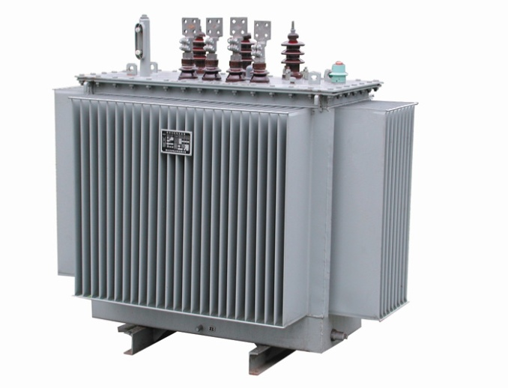
Elements Of The Network :
Distribution Transformers
The network consists of 151 distribution transformer (33∆/0.4Y KV). The transformers range from 50KVA to 630 KVA the following table shows them in details:
Number of transformers | Rating (KVA)
3 | 50
16 | 100
18 | 160
46 | 250
35 | 400
33 | 630

Slide 6
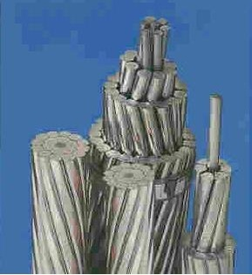
Overhead lines
The conductors used in the network are ACSR with different diameters as the following table:
Cable Name | Cross sectional area (mm²) | R (Ω/Km) | X (Ω/Km) | Nominal Capacity (A)
Ostrich | 150 | 0.19 | 0.28 | 350
Cochin | 110 | 0.25 | 0.29 | 300
Lenghorn | 70 | 0.39 | 0.31 | 180
Aprpcot | 50 | 0.81 | 0.29 | 130

Slide 7
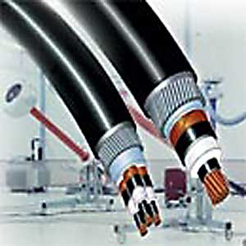
Underground cables
The under ground cables used in the network are XLPE Cu as shown :
Diameter (mm²) | R (Ω/Km) | X (Ω/Km)
95 | 0.41 | 0.121

Slide 8
Problems in The Network :
The P.F is less than 0.92% , this cause penalties and power losses.
There is a voltage drop.
There is power losses.
Over loaded transformer
Over loaded connection point

Slide 9
Analysis of the network
Maximum load case
In first stage of the analysis of tubas network we have to take the maximum load in daily load curve.
Then applied it on ETAB we started the study of this case after we applied the data needed Like load consumption of power and other data.

Slide 10
We have to summarize the results, total generation, demand, loading, percentage of losses, and the total power factor.
The swing current = 326 A
 | MW | MVAR | MVA | % PF
Swing Bus(es): | 16.755 | 7.474 | 18.346 | 91.33 lag.
Generators: | 0.00 | 0.00 | 0.00 | 0.00
Total Demand: | 16.755 | 7.474 | 18.346 | 91.33 lag.
Total Motor Load: | 9.368 | 4.148 | 10.245 | 91.44 lag.
Total Static Load: | 6.760 | 2.245 | 7.123 | 94.9 lag.
Apparent Losses: | 0.627 | 1.081

Slide 11
Bus # | rated(kv) | operating(kv) | operating %
Bus179 | 0.400 | 0.367 | 91.8
Bus180 | 0.400 | 0.375 | 93.7
Bus186 | 0.400 | 0.374 | 93.5
Bus187 | 0.400 | 0.377 | 94.2
Bus189 | 0.400 | 0.379 | 94.6
Bus190 | 0.400 | 0.378 | 94.6
Bus191 | 0.400 | 0.377 | 94.2
Bus196 | 0.400 | 0.376 | 94.0
Bus197 | 0.400 | 0.371 | 92.8
Bus198 | 0.400 | 0.376 | 94.0
Bus199 | 0.400 | 0.374 | 93.5
Bus200 | 0.400 | 0.371 | 92.8
Bus201 | 0.400 | 0.364 | 90.9
Bus202 | 0.400 | 0.373 | 93.1
Bus207 | 0.400 | 0.377 | 94.2
Bus208 | 0.400 | 0.379 | 94.8
Bus209 | 0.400 | 0.379 | 94.7
Bus210 | 0.400 | 0.375 | 93.6

Slide 12
The P.F in the network equals 91.33% and this value causes many problems specially paying banalities and this value must be (0.92-0.95)
The voltages of buses are not acceptable and this voltage will be less when it reaches the consumer
the network have over loaded transformer .
Over loaded connection point .
High losses of power .

Slide 13
The maximum load case improvement
The methods we used to do that are:
Tab changing in the transformers.
Adding capacitors to produce reactive power.
Changing and replace transformer.
Add another connection point .

Slide 14
Improvement the maximum case using taps changing and power factor improving .
In the first part of project this step is done and the result had been taken
The method of tab changing involves changing in the tab ratio on t he transformer but in limiting range which not accede (5%) .
The P.F need to be improved to reduce the penalties on municipalities, reduce the current flows in the network which reduces the losses.
The power factor after the improving must be in the range (0.92- 0.95) lag

Slide 15
Improvement the maximum case using taps changing and power factor improving .
We use this equation to calculate the reactive power needing for this improvement is:
Qc = P (tan cos⁻¹ (p.f old)- tan cos⁻¹ (p.f new))
PF old = 91.33
PF new at least = 92%
Q=16.755*(tan (24.783) – tan (23.074)) = 774 KVAR

Slide 16
Improvement the maximum case using taps changing and power factor improving .
The following table shown the summary .
The swing current = 328 A
 | MW | MVAR | MVA | % PF
Swing Bus(es): | 17.423 | 6.946 | 18.757 | 92.89 lag
Total Demand: | 17.423 | 6.946 | 18.757 | 92.89 lag
Total Motor Load: | 9.368 | 4.148 | 10.245 | 91.44 lag
Total Static Load: | 7.399 | 1.668 | 7.585 | 97.55 lag
Apparent Losses: | 0.656 | 1.131

Slide 17
Bus number | V rated (KV) | Operating %
Bus65 | 0.4 | 97.646
Bus68 | 0.4 | 99.519
Bus69 | 0.4 | 97.426
Bus70 | 0.4 | 97.275
Bus73 | 0.4 | 97.309
Bus179 | 0.4 | 99.029
Bus180 | 0.4 | 99.483
Bus181 | 0.4 | 100.755
Bus182 | 0.4 | 97.209
Bus183 | 0.4 | 97.114
Bus184 | 0.4 | 96.815
Bus185 | 0.4 | 97.207
Bus186 | 0.4 | 99.632
Bus187 | 0.4 | 100.218
Bus188 | 0.4 | 97.264

Slide 18
overloaded transformers
This problem was solved by changing transformers locations where the transformers which are large and the load on them small were changed with small highly loaded transforms
Then another transformers connected in parallel with the left overloaded transformers this will need to buy new transformers.

Slide 19
Transformer | Srated old | Savg | LF old | Srated new | LF new
AAUJ1 | 400 | 402.5 | 1.00625 | 250+250 | 0.644
Serees Western | 250 | 262.48625 | 1.049945 | 400 | 0.4824
Tamoon Albatmah | 160 | 169.23125 | 1.057695 | 250 | 0.5415
Tamoon Almeshmas | 250 | 423.1875 | 1.69275 | 250+250 | 0.6771
Tamoon Alrafeed | 250 | 316.19625 | 1.264785 | 400 | 0.6323
Tamoon jalamet Albatmah | 100 | 125.12 | 1.2512 | 160 | 0.6256
Tamoon first of the town | 250 | 264.18625 | 1.056745 | 160+160 | 0.5885
Tamoon National Security | 160 | 161.1725 | 1.007328 | 250 | 0.4837
Aqaba Eastern | 400 | 439.45875 | 1.098647 | 630 | 0.558
Aqaba Western | 400 | 485.9075 | 1.214769 | 630 | 0.617
Faraa Camp Old Station | 630 | 854.8425 | 1.356893 | 630+400 | 0.6639
wadi alfaraa alhafreia | 250 | 254.46 | 1.01784 | 400 | 0.4614
Wadi alfaraa gas station | 400 | 409.465 | 1.023663 | 630 | 0.5199
Housing | 250 | 261.975 | 1.0479 | 400 | 0.5239
Abu Omar | 400 | 499.61625 | 1.249041 | 630 | 0.6344
Allan Alsood | 250 | 281.54125 | 1.126165 | 250+250 | 0.4504
Almasaeed | 250 | 459.51 | 1.83804 | 630 | 0.5835
Alhawooz | 400 | 476.405 | 1.191013 | 630 | 0.6049
Althoghra | 160 | 163.075 | 1.019219 | 250 | 0.4538
Almghier Marah Alkaras | 100 | 114.276625 | 1.142766 | 160 | 0.5713
Tayaseer Main | 250 | 305.65625 | 1.222625 | 400 | 0.6113
Aljarba Eastern | 160 | 174.8675 | 1.092922 | 250 | 0.5595
Merkeh Abu Omar | 50 | 64.561625 | 1.291233 | 100 | 0.5164

Slide 20
overloaded transformers
The following table shows the transformers which are needed to be bought:
shows the extra transformers left after solving the overloaded transformers problem
Number of transformers | KVA
6 | 630
1 | 250
Number of transformers | KVA
1 | 100
1 | 50

Slide 21
overloaded transformers
Flowing table summarizes the analysis results after changing transformers
The swing current = 327 A
 | MW | MVAR | MVA | % PF
Swing Bus(es): | 17.388 | 6.867 | 18.695 | 93.01 lag
Total Demand: | 17.388 | 6.867 | 18.695 | 93.01 lag
Total Motor Load: | 9.394 | 4.163 | 10.275 | 91.43 lag
Total Static Load: | 7.374 | 1.664 | 7.559 | 97.55 lag
Apparent Losses: | 0.620 | 1.039

Slide 22
Bus number | V_{rated} | Operating (%)
Bus65 | 0.4 | 98.353
Bus68 | 0.4 | 99.519
Bus69 | 0.4 | 97.774
Bus70 | 0.4 | 97.286
Bus73 | 0.4 | 97.322
Bus179 | 0.4 | 101.288
Bus180 | 0.4 | 100.658
Bus181 | 0.4 | 100.769
Bus182 | 0.4 | 97.223
Bus183 | 0.4 | 97.128
Bus184 | 0.4 | 96.829
Bus185 | 0.4 | 97.221
Bus186 | 0.4 | 100.719
Bus187 | 0.4 | 100.234
Bus188 | 0.4 | 97.279

Slide 23
New connection Point
Tubas Electrical Distribution Company (TEDCO) is planning to add new connection point for the company in Zawya area.
This connection point is 5MVA rated.
And circuit breaker is 150A

Slide 24
New connection Point
The following table shows the results summary after the new connection point
The swing current = 325 A
 | MW | MVAR | MVA | % PF
Swing Bus(es): | 17.430 | 6.622 | 18.646 | 93.48 lag
Swing bus (1): | 12.865 | 4.920 | 13.77 | 93.4 lag
Swing bus (2): | 4.565 | 1.702 | 4.872 | 93.7lag
Total Demand: | 17.430 | 6.622 | 18.646 | 93.48 lag
Total Motor Load: | 9.394 | 4.163 | 10.275 | 91.43 lag
Total Static Load: | 7.599 | 1.712 | 7.790 | 97.55 lag
Apparent Losses: | 0.437 | 0.747

Slide 25
Bus | V_{rated} | Operating (%)
Bus65 | 0.4 | 98.484
Bus68 | 0.4 | 99.519
Bus69 | 0.4 | 98.241
Bus70 | 0.4 | 97.853
Bus73 | 0.4 | 97.991
Bus179 | 0.4 | 102.013
Bus180 | 0.4 | 101.362
Bus181 | 0.4 | 101.475
Bus182 | 0.4 | 97.905
Bus183 | 0.4 | 97.81
Bus184 | 0.4 | 97.515
Bus185 | 0.4 | 97.962
Bus186 | 0.4 | 101.609
Bus187 | 0.4 | 101.211
Bus188 | 0.4 | 98.211

Slide 26
Improving the network with the new connection point
As before the improvement is done by tap changing and adding capacitor banks.
Now all buses are operating over 100% voltages. This will make the voltages reach to the consumer with fewer losses.

Slide 27
Improving the network with the new connection point
The results of the improving are summarized in the following table
The swing current = 322A
 | MW | MVAR | MVA | % PF
Swing Bus(es): | 17.454 | 6.558 | 18.645 | 93.61 lag.
Swing bus (1): | 12.665 | 4.820 | 13.97 | 93.35 lag
Swing bus (2): | 4.765 | 1.802 | 4.572 | 93.82lag
Total Demand: | 17.454 | 6.558 | 18.645 | 93.61 lag
Total Motor Load: | 9.394 | 4.163 | 10.275 | 91.43 lag
Total Static Load: | 7.624 | 1.650 | 7.801 | 97.74 lag
Apparent Losses: | 0.435 | 0.744

Slide 28
Bus number | V_{rated} | Operating (%)
Bus65 | 0.4 | 101.454
Bus68 | 0.4 | 102
Bus69 | 0.4 | 100.73
Bus70 | 0.4 | 100.853
Bus73 | 0.4 | 100.45
Bus179 | 0.4 | 102.03
Bus180 | 0.4 | 101.38
Bus181 | 0.4 | 101.5
Bus182 | 0.4 | 100.37
Bus183 | 0.4 | 100.28
Bus184 | 0.4 | 100.969
Bus185 | 0.4 | 100.43
Bus186 | 0.4 | 101.63
Bus187 | 0.4 | 101.23
Bus188 | 0.4 | 100.71

Slide 29
We note that :
When we improve the not work the losses in the network decrease and the total current decrease.
Losses before improvement = 627 kW.
Losses after improvement =435 kW.
Total current in origin case =326 A
Total current after voltage improvement= 322A

Slide 30
Minimum Case
In the minimum load case the load is assumed to be half the maximum load
The network analysis in this case shows the results in the following table
The swing current =166 A
 | MW | MVAR | MVA | % PF
Swing Bus(es): | 8.381 | 3.480 | 9.675 | 92.36 lag
Total Demand: | 8.381 | 3.480 | 9.675 | 92.36 lag
Total Motor Load: | 4.699 | 2.082 | 5.140 | 91.43 lag
Total Static Load: | 3.529 | 1.132 | 3.706 | 95.22 lag
Apparent Losses: | 0.153 | 0.265

Slide 31
Bus number | V_{rated} | Operating (%)
Bus65 | 0.400 | 98.454
Bus68 | 0.400 | 99.760
Bus69 | 0.400 | 98.284
Bus70 | 0.400 | 98.666
Bus73 | 0.400 | 98.682
Bus179 | 0.400 | 96.900
Bus180 | 0.400 | 97.504
Bus181 | 0.400 | 98.063
Bus182 | 0.400 | 98.635
Bus183 | 0.400 | 98.589
Bus184 | 0.400 | 98.367
Bus185 | 0.400 | 98.631
Bus186 | 0.400 | 97.630
Bus187 | 0.400 | 97.785
Bus188 | 0.400 | 98.303

Slide 32
Minimum Case
Now taking the taps fixed as in the maximum load case
the results shows that all the buses have good voltage level
and the power factor is in the range so no need to add capacitor banks for this case
so the capacitor banks used in the network are all regulated.

Slide 33
Minimum Case
The following table shows the analysis summary with the taps changed
The swing current = 165 A
 | MW | MVAR | MVA | % PF
Swing Bus(es): | 8.720 | 3.614 | 9.439 | 92.38 lag
Total Demand: | 8.720 | 3.614 | 9.439 | 92.38 lag
Total Motor Load: | 4.699 | 2.082 | 5.140 | 91.43 lag
Total Static Load: | 3.855 | 1.244 | 4.051 | 95.17 lag
Apparent Losses: | 0.166 | 0.287

Slide 34
Bus number | V_{rated} | Operating (%)
Bus65 | 0.400 | 98.445
Bus68 | 0.400 | 99.760
Bus69 | 0.400 | 98.251
Bus70 | 0.400 | 98.626
Bus73 | 0.400 | 101.099
Bus179 | 0.400 | 101.654
Bus180 | 0.400 | 102.194
Bus181 | 0.400 | 102.842
Bus182 | 0.400 | 98.582
Bus183 | 0.400 | 98.534
Bus184 | 0.400 | 98.318
Bus185 | 0.400 | 98.581
Bus186 | 0.400 | 102.434
Bus187 | 0.400 | 102.598
Bus188 | 0.400 | 98.247

Slide 35
Minimum Load Study After The Connection Point And Solving Overloaded Transformers Problem
After solving overloaded transformers problem in maximum case
as seen before some transformers were changed and new transformers connected in parallel with some of overloaded transformers.
Also the new connection point is connected to the network.

Slide 36
Minimum Load Study After The Connection Point And Solving Overloaded Transformers Problem
The results for minimum load study in this case are shown in the following table
The swing current = 163 A
 | MW | MVAR | MVA | % PF
Swing Bus(es): | 8.738 | 3.541 | 9.428 | 92.68 lag
Swing bus (1): | 6.157 | 2.524 | 6.654 | 92.52lag
Swing bus (2): | 2.581 | 1.017 | 2.774 | 93.03lag
Total Demand: | 8.738 | 3.541 | 9.428 | 92.68 lag
Total Motor Load: | 4.699 | 2.082 | 5.140 | 91.43 lag
Total Static Load: | 3.928 | 1.270 | 4.128 | 95.15 lag
Apparent Losses: | 0.111 | 0.189

Slide 37
Bus | V_{rated} | Operating (%)
Bus65 | 0.400 | 99.003
Bus68 | 0.400 | 99.760
Bus69 | 0.400 | 98.819
Bus70 | 0.400 | 98.920
Bus73 | 0.400 | 101.456
Bus179 | 0.400 | 103.328
Bus180 | 0.400 | 103.158
Bus181 | 0.400 | 103.214
Bus182 | 0.400 | 98.938
Bus183 | 0.400 | 98.890
Bus184 | 0.400 | 98.675
Bus185 | 0.400 | 98.967
Bus186 | 0.400 | 103.300
Bus187 | 0.400 | 103.105
Bus188 | 0.400 | 98.728

Slide 38
Final improving as with the fixed tab
It is noticed that the voltages and the power factor in this case are good
so no need to add new capacitor banks to the network in this case
therefore all capacitor banks connected are regulated. Also it can be seen that the losses decreased.

Slide 39
Final improving as with the fixed tab
The final results for the minimum load case are summarized in the following table:
The swing current = 164 A
 | MW | MVAR | MVA | % PF
Swing Bus(es): | 8.755 | 3.548 | 9.447 | 92.68 lag
Swing bus (1): | 6.167 | 2.526 | 6.666 | 92.51lag
Swing bus (2): | 2.588 | 1.018 | 2.781 | 93.1lag
Total Demand: | 8.755 | 3.548 | 9.447 | 92.68 lag
Total Motor Load: | 4.699 | 2.082 | 5.140 | 91.43 lag
Total Static Load: | 3.945 | 1.276 | 4.146 | 95.15 lag
Apparent Losses: | 0.111 | 0.190

Slide 40
Bus | V_{rated} | Operating (%)
Bus65 | 0.400 | 101.435
Bus68 | 0.400 | 102.252
Bus69 | 0.400 | 101.283
Bus70 | 0.400 | 101.388
Bus73 | 0.400 | 101.455
Bus179 | 0.400 | 103.327
Bus180 | 0.400 | 103.157
Bus181 | 0.400 | 103.212
Bus182 | 0.400 | 101.409
Bus183 | 0.400 | 101.360
Bus184 | 0.400 | 101.136
Bus185 | 0.400 | 101.439
Bus186 | 0.400 | 103.299
Bus187 | 0.400 | 103.104
Bus188 | 0.400 | 101.192

Slide 41
When we increase power factor the losses in the network decrease and the total current decrease.
Losses before improvement = 153 KW.
Losses after improvement =111KW.
Total current in origin case =166A
Total current after voltage improvement= 164A

Slide 42
Economical study
While we are improving the power factor of our network, the amount of reactive power which had been added as inserting capacitors is 845kvar
P _{max}=16.755 MW
P _{min}=8.381 MW
Losses before improvement = 0.627 MW
Losses after improvement = 0.435 MW
PF before improvement(MAX) = 91.33%
PF after improvement(MAX) = 93.61%
PF before improvement(MIN)= 92.36%
PF after improvement(MIN)= 92.68%

Slide 43
To find the economical operation of the network we must do the following calculation:
P_{AV} = (P_{max} + P_{min})/2 =(16.755+8.381)/2 = 12.568MW
LF=P_{AV}/P_{max} = 0.748
Total energy per year=P _{max}*LF*total hour per year
= 109786 MWH
Total cost per year=total energy*cost (NIS/KWH)=
=49404.061 M NIS
62.977392 MILLION NIS/YEAR

Slide 44
Saving in penalties of (PF): Table follow shows relation of PF to the penalties:
PF | Penalties
0.92 or more | No penalties
Less than 0.92 to 0.8 | 1%of the total bill for every 0.01 of PF less than 0.92
Less than 0.8 to 0.7 | 1.25%of the total bill for every 0.01 of PF less than 0.92
Less than 0.7 | 1.5%of the total bill for every 0.01 of PF less than 0.92
Penalties=0.01*(0.92-pf)*total bill
=0.01*0.0066*62.977*10⁶
=7620.26 NIS/YEAR

Slide 45
Losses before improvement = 468.996 KW
Energy = power loss × hour/year = 410.8404 × 10⁴ KWH
Total cost=energy × cost = 1848782.232 NIS/YEAR
Losses after improvement = 325.38 KW
Energy= 285.03288 × 10⁴ KWH
Cost of losses= 128.2647 × 10⁴ NIS/YEAR
Saving in cost of losses=cost before improvement-cost after improvement =566134 NIS/YEAR

Slide 46
Total capacitor = 905 KVAR
Cost per KVAR with control circuit = 15JD = 90NIS
Total cost of capacitors= 81450 NIS
Total cost of transformers = 186200 NIS
Total investment cost = 267650 NIS
Total saving=saving in penalties+ saving in losses
= 3876206 NIS
S.P.B.P= (investment) / (saving) =0.69 YEAR
Transformer rated | Number of transformer | cost ($)
630 | 6 | 8200
250 | 1 | 4000

Slide 47
We not that :
If we divide the network to two network depend on the capacity of
connection point the losses is more than the losses on the first network as following
Maximum case
Losses before improvement = 720 kW.
Losses after improvement =531 kW.
Minimum case
Losses before improvement = 180 KW.
Losses after improvement =151 KW
And
S.P.B.P= (investment) / (saving) =1.80 YEAR

Slide 48
Monitoring System
The monitoring system designed for this project consists of the following parts:
Measurement devices.
The remote terminal unit (RTU).
Computer interface

Slide 49
Current Measurement
the supervisor have to know the current in the network
high short circuit currents can cause damages in the system
Then the supervisor can cut the power if the protective devices in the network did not work well.

Slide 50
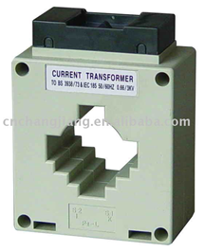
Current Measurement
In our project we choose the current
transformer that converts from
60/5 A this device is MSQ-30
Like any other transformer it has :
primary winding
a magnetic core,
and a secondary winding.
The alternating current flowing in the primary produces a magnetic field in the core
which then induces a current in the secondary winding circuit.

Slide 51
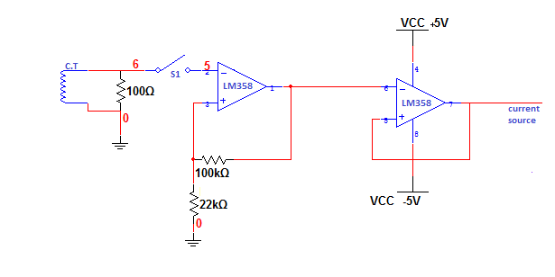
Current Measurement
The current transformer (C.T) gives 4 volts at 10 A amperes flowing in the primary side, then the output voltage of the current transformer
The signal then amplified and inverted by the op-amp (op amp amplification ratio is 100/22 =4.5 )
the buffer is used to
get the signal in its actual shape.
The buffer also do the task of current isolation.

Slide 52
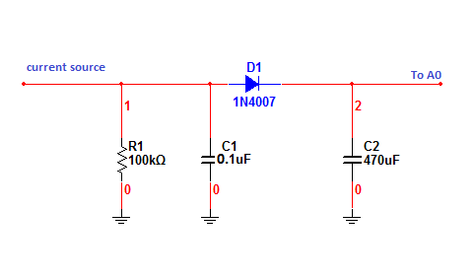
Current Measurement
a rectifier circuit is used to take the peak of the voltage
The low pass filter is to remove the high frequencies.
The diode is to cut the negative half wave of the voltage signal.
The capacitor is to smooth the output DC signal.

Slide 53
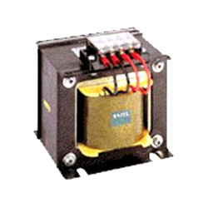
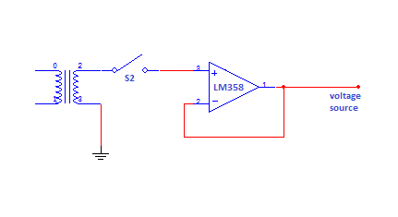
Voltage Measurement
Voltage is another important parameter in the network,
conventional transformer is used here with ration is 230v:6v RMS
And we need a buffer circuit
As shown

Slide 54
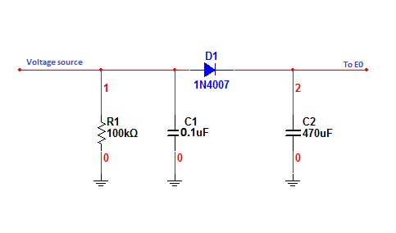
Voltage Measurement
As in the current measurement it is needed to rectify the voltage output signal

Slide 55
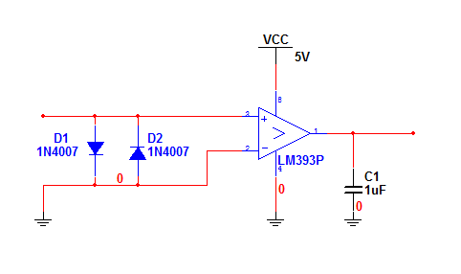
Power Factor Measurement
The power factor is defined as cosine the angle between current and voltage signals.
Here the current and voltage signals will be transform to pulses

Slide 56
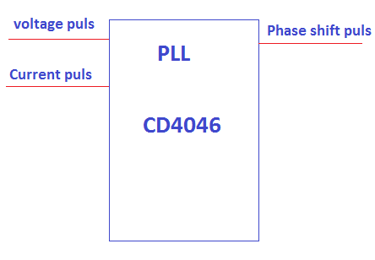
Power Factor Measurement
then they will be injected to PLL (CD4046)
the output of PLL will be the pulse which its width represents the phase shift between the signals.

Slide 57
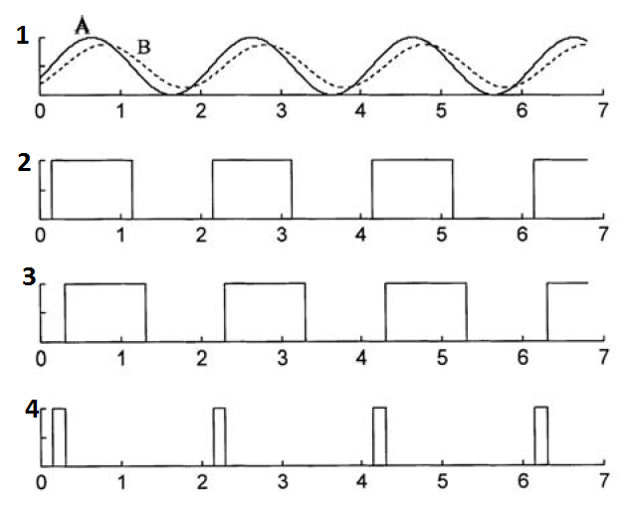
Power Factor Measurement
The following figure shows this operation
1 shows the two signals A and B.
2 shows signal V pulses.
3 shows signal I pulses.
4 shows the output of PLL

Slide 58

Power Factor Measurement
A counter in the microcontroller will count the duration of the phase shift signal.
Then the power factor will be cosine the angle.
P.F = COS

Slide 59
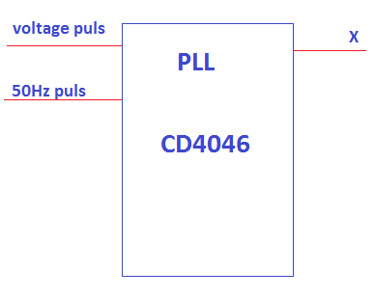
Frequency Measurement
other PLL will be used.
The voltage pulse of amplifying
circuit is the first input
the second input of the PLL will be
a fixed signal with 20ms(i.e. 50Hz)
The output of the PLL will be the
difference between the fixed signal
and the voltage pulses,
the difference duration will be either added or subtracted from the 50Hz.

Slide 60


Frequency Measurement
If Y>20ms(F<50HZ) then,
Else if Y<20ms(F>50HZ) then,

Slide 61
The Remote Terminal Unit (RTU)
The remote terminal unit control and send the data collected from the network process them and send them to the supervision computer.
The microcontroller used in the RTU is PIC16F877A. PIC microcontroller is used because it is :-
simple
available all the time
and cheap

Slide 62
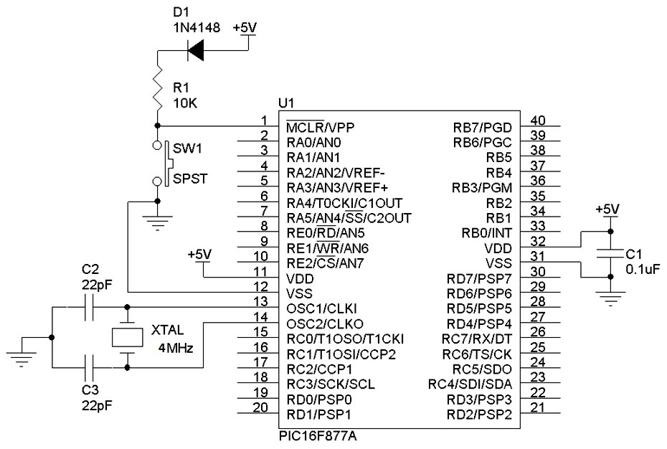
The Remote Terminal Unit (RTU)
The basic circuit for this microcontroller is shown in fig below

Slide 63
The Remote Terminal Unit (RTU)
The data from the measurement devices is not the actual values
multiplied by the factors in the microcontroller to return to their actual value,
then these values will be send to the computer.

Slide 64
The Remote Terminal Unit (RTU)
To connect the microcontroller to the computer MAX232 is used to send the data serially to the computer through RS232. As in the circuit it in figure

Slide 65
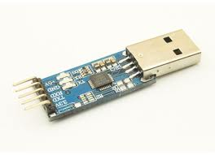
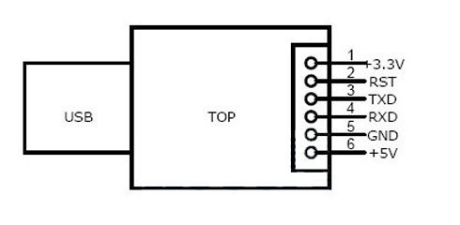
The Remote Terminal Unit (RTU)
Another method To connect the microcontroller to the computer (CP2102) is used to send the data serially to the computer. As in the circuit it in figure
CP2102

Slide 66
video

Slide 67


Slide 68
Thank You

