Slide 1


Slide 2

Healthcare system based IOT

Slide 3
The IdiabSensor Component is responsible for monitoring the glocoze percentage in a patient blood. It includes two modes:
(1) Premeal mode: in this mode the Idiab sensor reads glocoze percentage in a patient blood every 14400s, we will check this value half an hour befor eating. A timer is set in this mode to schedule the reading from the idiab sensor. A message carrying the Idiab value is sent from the output message port of the IdiabSensor component to the in port of the Controller component.
Moreover, if he has eating the food then the state needs will enter the Postmeal mode.
(2) Postmeal mode: in this mode the idiab sensor reads glocoze percentage in a patient blood every 14400 s , we will check this value half an hour after eating . Also in this mode, a timer is set to schedule the reading from the Idiab sensor. A message carrying the idiab value is sent from the output message port of the IdiabSensor component to the in port of the Controller component.
Weight patient component : is responsible to check the weight of patient and sent the value from the output message port of the Weight component to the in port of the Controller component

Slide 4
The Controller component is responsible for receiving sensor data in a simulation and take decisions based on its values. The decisions in this example are related to send a control messages to the patient to take number of dose for patient that must take . In this example, Controller component receives two types of messages from its out ports:
Message contains glocoze percentage in patient blood:
if the received value of Premeal is between 126 and 140 , this component sends through its out port a message to the in port of the Dose Component. This message contains an integer variable (number of dose that patient need). Otherwise, if the received value is more than or equal 500, this component sends through its out port a message to the in port of the Server component ,this message contains a glocoze critical value , and sends through its out port a message to the in port of the Position component ,this message contains a string value (patient position).

Slide 5
if the received value of Postmeal is between 162 and 250 , this component sends through its out port a message to the in port of the Dose Component. This message contains an integer variable (number of dose that patient need). Otherwise, if the received value is more than or equal 500, this component sends through its out port a message to the in port of the Server component ,this message contains a glocoze critical value , and sends through its out port a message to the in port of the Position component ,this message contains a string value (patient position).
Message contains patient weight : we need this value just once , to determine thetotal number of dose that the patient allow to take it every day.
Dose component: is the one responsible for alarm the patient to take dose.

Slide 6
Position component: this component responsible to determine the patient position ,and simultaneously sends through its out port a message to the in port of the Patient family Component and to CloudServer Component.
CloudServer component: this component receives two types of messages from its out ports:
Idiabsensor data , to send this value to doctor to take the first decision to save the patient life as much as possible
Patient position , to send this value to Emergency component to be taken to the hospital.

Slide 7
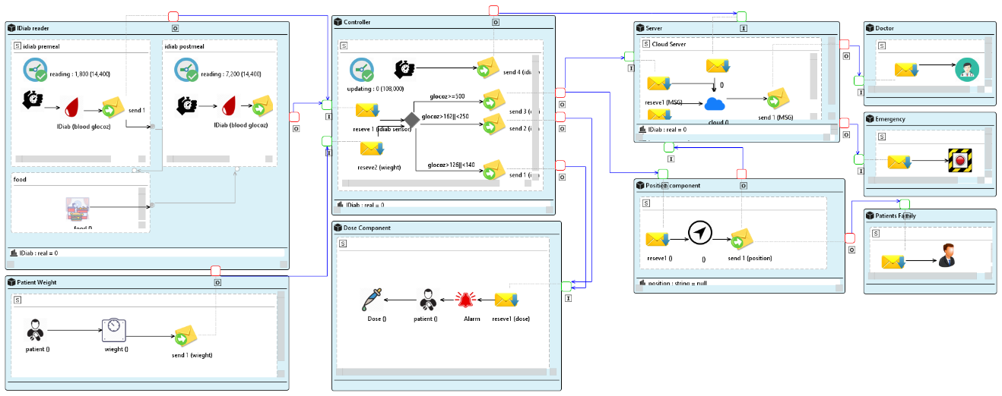

Slide 8
Intraocular pressure (IOP, Glocoma) Case Study
we will simply represent example of Intraocular pressure case study . A simple scenario describes the monitoring of patient eye and IOP level in a patient eye.
Figure 2 shows the SAML model of the CAPS. It is important to note that
this figure is actually a screen-shot of our CAPS tool [20]. From a structural
point of view, the shown SiA-CPS model is composed of four main components;
IOPSensor, Controller, eyeglass Actuator, Doctor, ,and Cloud Server.

Slide 9
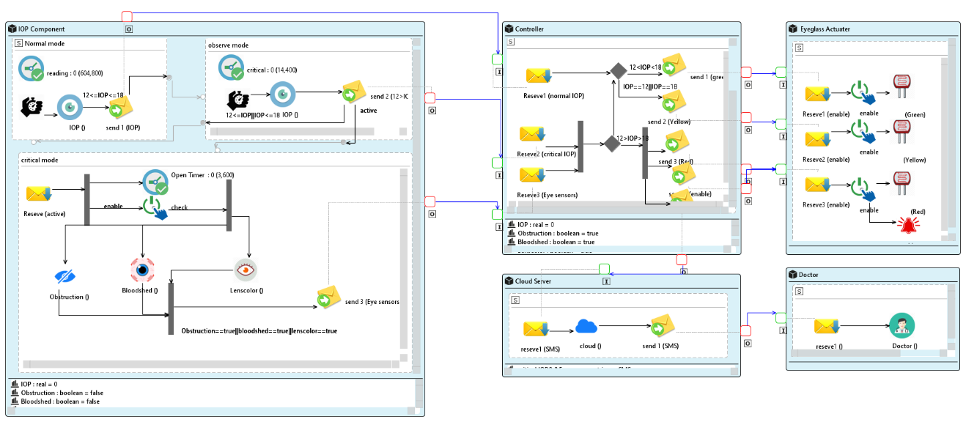

Slide 10

THANKS

