Slide 1
Useful Life of The Artificial Knee Joint
Graduation Project 2
Advisor:
Dr. Iyad Assaf
By:
Wesam Yaqoub
Tayseer Saabneh
Majdi Massaeed
Abdullah Al-Dameri

Slide 2
Outline
Introduction
Methodology
Force and material
Finite element
Rustle and conclusion

Slide 3
Introduction
The Objective for this project is :
develop a three dimensional solid model of artificial knee joint .
study the stresses and the fatigue life of the knee at different flexion angle.
use of finite element analysis for selecting the best biomaterials that can be used in the artificial knee joint components .

Slide 4
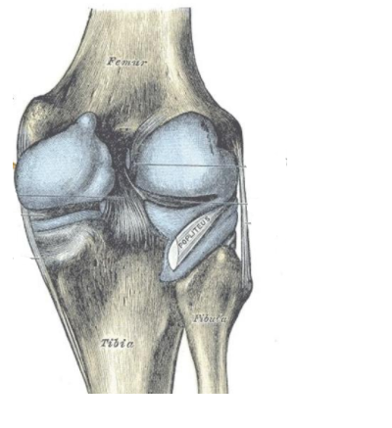
Introduction
What is the knee joint ?
knee joint is complex structure in the human body which undergoes critical loading simultaneously while performing different physical activities such as walking, running, in rotational motion, sitting, static positions ,etc.

Slide 5
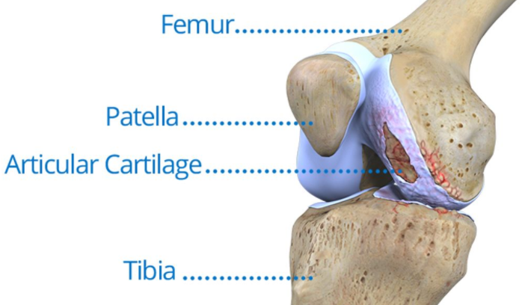
Introduction
The Components of the knee :
Femur : formed by the end of the thighbone
Tibia : the lower leg or shin bone
Patella : is at the front of the knee join

Slide 6
Introduction
History of artificial knee :
Artificial Knee is not a new subject that its an ancient idea developed during the last tow century :
1822 : the first excision joint surgery was performed in London by Anthony White .
1860 : the first knee joint was made from ivory by the German Gluck .
1957 : Gunston was the first used polyethylene against metal in knee replacement .
1974: the artificial knee was developed to be made from cobalt and chrome so that the first success of implant in this year .

Slide 7
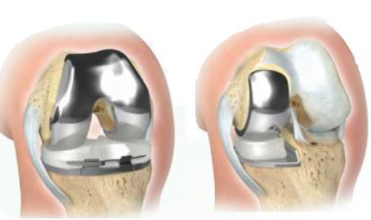
Introduction
Types of Knee Implant :
Total Knee Replacement.
Partial Knee Replacement.

Slide 8
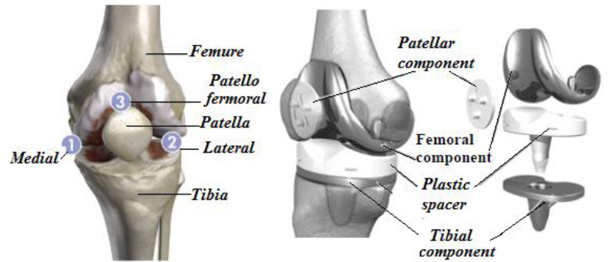
Introduction
TKR Components :

Slide 9
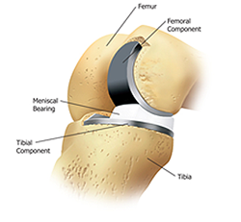
Introduction
PKR Components :

Slide 10
Introduction
Material Requirements
To use materials in a human body it must be considered these points :
Biocompatible and produce minimal rejection .
High Mechanical properties of the material in order to withstand the forces affecting the knee. such as (yield strength, tensile strength, fatigue strength, fracture hardness, and ductility )
Density and cost : recommended to use lightweight components and the cost of these prostheses must be reasonable.
Must be nonmagnetic: used medical diagnostic tool is magnetic resonance imaging ,The presence of any magnetic materials implanted in the patient will disrupt the applied magnetic field .

Slide 11
Introduction
Material used in Artificial Knee:
Typically, titanium ,oxidized zirconium, cobalt-chromium based alloy is used for the femoral and tibial implants .
high molecular weight polyethylene is used for the meniscus plate.

Slide 12
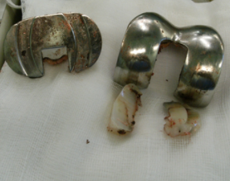
Introduction
The life of artificial knee :
Medicine developed an artificial knee that it work as the original one.
Most of the artificial knee has useful life range between 10 to 20 years
Taking into account the patient age, weight, activity level and overall
health.

Slide 13
Introduction wear of the polyethylene
The wear of the polyethylene part as shown in figure below causes instability leading to the dislocation of the artificial knee, and the long-term sustained movement eventually causes a weariness.
It is necessary to find a suitable solution for the problem of erosion of this piece of
polyethylene and increase its life span and this is the main aim of this research.

Slide 14
Methodology
Studying knee joint in general with its parts, diseases and components.
After that we will discuss the Free body diagram and the relation between forces acts on the Joint to found these forces.
Use finite element software “Solid work” to study the stresses and deformations during different situations.
the fatigue life of the knee could be determined by Fatigue formulas.

Slide 15

Methodology
We choose the solidwork program to make our simulation to create a 3D model
so we could change the material that we choose and see the output stress and deformations so that we use it to obtain the fatigue and see how much it affect the lifetime.

Slide 16
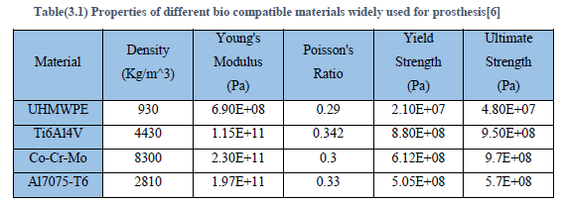
Methodology
To do the analysis , our team used :
Titanium alloy (Ti-6Al-4V) for the femoral and tibial implants
Different material for the meniscus plate. Material properties for these materials are tabulated in table (3.1)

Slide 17
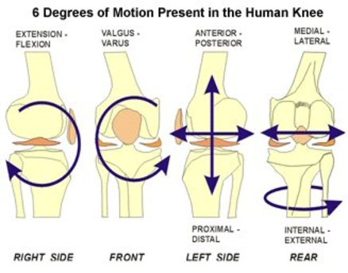
Force Analysis
6-Degree Of Freedom

Slide 18
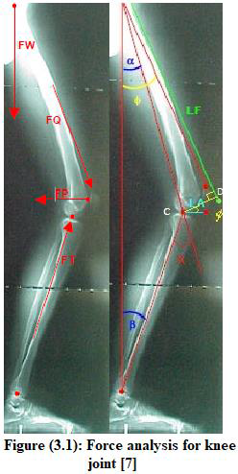



Force Analysis
The next Figure shows the forces and angles acts on knee joint. These forces are FQ, FT, FP and FW where :

Slide 19
Force Analysis
After using relations in the previous slide, and by using trigonometric ,Forces acts on the joint are estimated and tabulated in table below:
situation | X (flexion angle ) | FQ (N) | FT (N) | FP (N) | %BW
Standing | 0 | 2500 | 1641 | 2.4 | 2.8
Walking | 20 | 3448 | 5136.3 | 2353 | 2.6
Stair ascend | 30 | 3635 | 6575 | 7244 | 4.1

Slide 20

Results
These relation was used to determine the fatigue life
Sf =${aN}^{b}$(5.1)
$a =\frac{{(f∗Sut)}^{2}}{Se}$(5.2)
$b=−\frac{1}{3}∗\log\left(\frac{f∗Sut}{Se}\right)$ (5.3)
Where Se = 0.5 Sut(5.4)
$N ={\left(\frac{σrev }{a}\right)}^{\frac{1}{b}}$ (5.5)

Slide 22
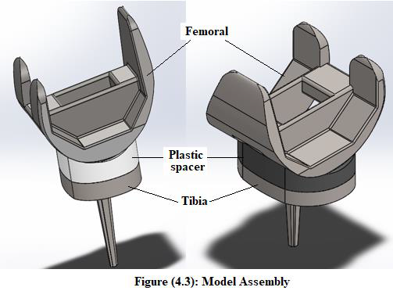
Finite element
Finite-element model development:
A model of 3D synthetic knee is created using Solid Work software for analysis as shown in figure below.

Slide 23
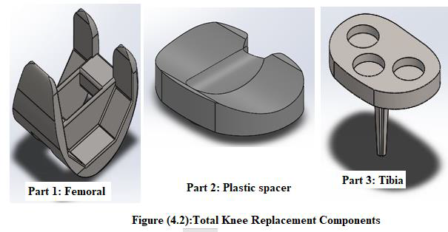
Finite element
knee implant consists of three components , the figure (4.2) show this parts .
Part 1: is metal, attaches to the end of the femur, and is named the femoral implant.
Part 2: is the plastic spacer, acting as the meniscus. This part is named the meniscus plate.
Part 3: is metal and replaced on the top surface of the tibia named the tibial implant.

Slide 24
Finite element
Initial conditions
After drawing the model and by adding mates between parts , the model is ready to act the forces that obtained in different situation to compare the results between them. But initial conditions must be considered to activate the assembly.

Slide 25
Finite element
Initial conditions
Material definition of the model parts:
Femoral Implant and Tibia:
usually made of titanium alloy (Ti-6Al-4V ) and the properties of this metal are available in the Solid Works program.
Meniscus Plate
several materials are used in order to select the best material that can be used in this part. These materials are PE High Density, Titanium alloys, aluminum alloy and Co-Cr-Mo .

Slide 26
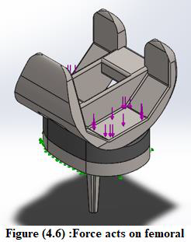
Finite element
Initial conditions
Fixation the tibial part by “Fixed Geometric ”.
Adding Frictions coefficient for Ti6AL4V ( 0.13).

Slide 27
Finite element
For stress if we take the walking situation, the Results we get as shown in the following figures:

Slide 28
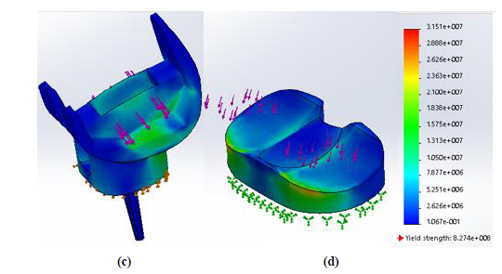
Finite element
Stress
Walking

Slide 29
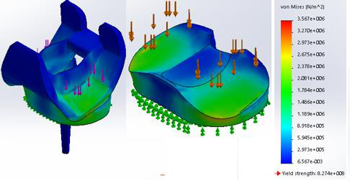
Finite element
Stress
straight ‘‘Standing’’

Slide 30
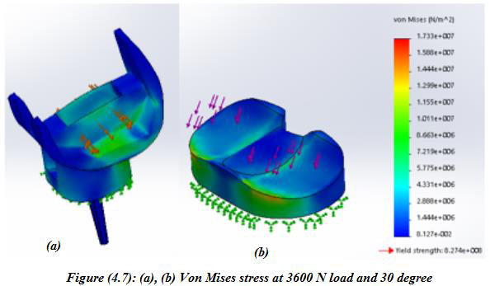
Finite element
Stress
Stair ascend

Slide 31
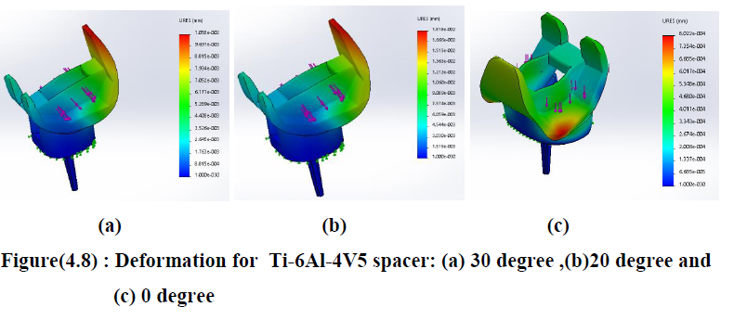
Finite element
Displacement
titanium alloy

Slide 32
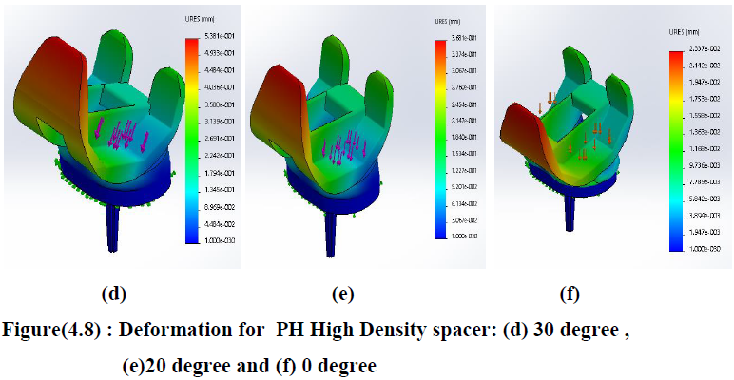
Finite element
Displacement
PH High Density spacer

Slide 33
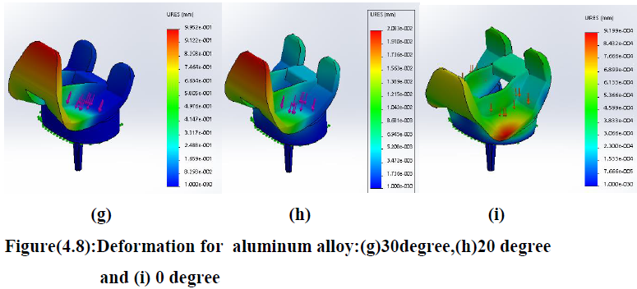
Finite element
Displacement
Aluminum alloy

Slide 34
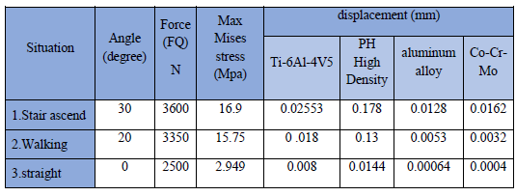
Results
Stress and displacement Results

Slide 35
Results
These relation was used to determine the fatigue life
Sf =${aN}^{b}$(5.1)
$a =\frac{{(f∗Sut)}^{2}}{Se}$(5.2)
$b=−\frac{1}{3}∗\log\left(\frac{f∗Sut}{Se}\right)$ (5.3)
Where Se = 0.5 Sut(5.4)
$N ={\left(\frac{σrev }{a}\right)}^{\frac{1}{b}}$ (5.5)

Slide 36
Results
From the finite element analysis we obtained the stress in different situation to use it and substitutions the values in the previous slide to calculate the fatigue life.
Material | Ultimate tensile strength | Number of cycle |  |  | Number of years
 |  | 2500 N | 3400 N | 3600 N | 2500 | 3400 N | 3600 N
PE High Density | 48 Mpa | 2.76E+08 | 3.19E+08 | 3.21E+08 | 15.45724 | 17.84952 | 17.94004
Titanium alloys | 940 Mpa | 5.47E+09 | 6.31E+09 | 3.19E+08 | 305.9245 | 353.2717 | 355.0632
aluminum alloy | 570 Mpa | 3.28E+09 | 3.79E+09 | 2.76E+08 | 183.5547 | 211.9630 | 213.0379
Cobalt | 235 Mpa | 1.35E+09 | 1.56E+09 | 6.35E+09 | 75.67608 | 87.38827 | 87.83144

Slide 37
Conclusion
titanium is the most material that can live longer but this material does not used due to the resulting friction (metal to metal).
polyethylene is the least material that can continue to work but is the least substance that causes friction and deformation of components.

Slide 38
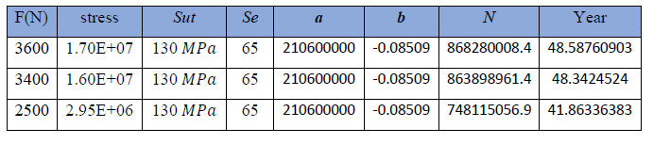
Conclusion
If a material assumed to lived for 40-50 years at the same stress during different situations , by making calculations to find the amount of ultimate tensile strength which will be determined for this material by Excel sheet and trail and error method , table below listed the results we get:

Slide 39
Conclusion
This table shows that a material that has an ultimate tensile strength of 130𝑀𝑃𝑎, it will serve for 40-50 years, and this material is not precisely defined in this project.

