Slide 1
ThTT
The Status of Geography In National
Movement and Conflict Resolution
By:
Yaser M. Al-Najjar , PhD
Professor of Geography and Urban Planning
Framingham State College and Qatar University
3rd Palestinian Geography Conference
Nablus, Palestine
July12-16,2010

Slide 2
Pr
Presentation Contents:
The Definition and Importance of Geography
The Five Themes of Geography
Nation Movement Identity Structure
Review of Palestinian People and History
Conflict Resolution Structure
Conclusion and Recommendations
1
Notes:
Presentation Contents:

Slide 3
The Five Themes of Geography
The five themes of geography were created in 1984 by the National Council for Geographic Education and the Association of American Geographers to facilitate and organize the teaching of geography and analyzing issues spatially.
1. Location: Map the spatial distribution of the four contents of identity structure. The spatial distribution maps will serve as base documents in the negotiation process and contribute to solid resolutions to the conflict.
2. Place: Place describes the human and physical characteristics of a location. These geographical characteristics influence and localize every content of identity. Also, should be taking into considerations in conflict resolution proposals .
3. Human-Environment Interaction: This theme considers how humans adapt to and modify the environment (Determinism , Possibilism ,Perceptualism , and Human Modifier schools of Thoughts). Thus, we observe the effects of this interaction on the contents of identity, and on the living functions of cultural groups.
4. Movement: This theme studies movement and migration. Thus, we review the spatial diffusion of nations and invaders of Palestine since the 14th century B.C..
5. Region: Regions have some sort of characteristic that unifies the area. Regions can be formal, functional, or vernacular.
Formal regions are those that are designated by official boundaries, such as cities, states, counties, and countries.
Functional regions are defined by their connections.
Vernacular regions are perceived regions. They have no formal boundaries but are understood in our mental maps of the world.

Slide 4
National Identity Structures
Religion
History
Language
Spatial Dimension of National Identity/Geography
Ethnicity

Slide 5
Nations/Groups That Lived in Palestine (in chronological order)
Natufians (14th Century B.C.)
Canaanites (2600 B.C.)
Amorites (2600 B.C.)
Yebusians (2600 B.C.)
Phoenicians (2600 B.C.)
Palestinians ( 2600 B.C.)
Hixus (1400 B.C.)
Pharoes (1300 B.C.)
Israelites (1200 B.C.)
Assyrians (722 B.C.)
Babylonians (597 B.C.)
Persians (539 B.C.)
Greek (332 B.C.)
Nabatians (323 B.C.)
Salujics /Greek (167 B.C.)
Romans (63 B.C.)
Tadmorians (60 B.C.)
Byzantines (395)
Persians (614)
Romans (628)
21. Arab Muslims (636)
22. Talonians (868)
23. Karameta (905)
24. Akhshadians (933)
25. Fatimites (969)
26. Salujics (1067)
27. Crusaders/ Faranja (1085)
28. Modern Islamic Era/ Zinckies (1145)
29. Ayubids (1182)
30. Mamlukes (1264)
31. Ottoman (1300)
32. French/Napoleon (1799)
33. Zionists immigration supported by Britain and France (late 1800s)
34. British Mandate (1916)
35. The creation of Israel/Palestinian Nakba (1948)
The unique observation about these data is the fact that the native population never totally left their home land

Slide 6
Historical Chronology of the Palestinian Biblical National Identity
Abraham’s journey to Canaan
Assyrians break free from Babylonian rule
Israelites entered and controlled parts of Canaan
2000 B.C.
1500 B.C.
1350 B.C.
1250 B.C.
1200 B.C.
1100 B.C.
Moses brings Israelites the Ten Commandments
Saul chosen as the 1st King of the Israelites

Slide 7
King Solomon dies. The 12 tribes break into 2 groups forming the Kingdom of Israel in the north, and the Kingdom of Judah in the south.
King David unites the 12 tribes and entered Jerusalem
1000 B.C.
900 B.C.
722 B.C.
David’s son Solomon became the King and builds a temple
Assyrians conquer Babylon
Assyrians conquer the Kingdom of Israel. The 10 tribes of Israel are forced to move to other lands. They mix with other cultures and disappear. They are now referred to as the 10 lost tribes.

Slide 8
Babylonians conquer Jerusalem. Nebuchadnezzar burns down the temple in Jerusalem about 586 B.C.. Jews were taken to Babylon as slaves. (This is referred to as the Diaspora, the scattering of Jews around the World.
Conquered cities rebel against Assyria
650 B.C.
600 B.C.
597 B.C.
539 B.C.
B.C.A.D.
70 A.D.
Judah is captured by the Babylonians. Many of its leading citizens are taken to Babylon.
The Persians conquer Babylon and the Jews are allowed to return to Judah. Jews build 2nd Temple in 515 B.C.
The Romans destroy the 2nd Temple.

Slide 9
Ethnicity Structure in Palestine
Adam & Eve
Abel
Cain
Seth
Lamech
Noah
Shem
Japheth
Ham
Abraham
Cush
Mizraim
Phut
Canaan
Issac
Ishmael
Jacob
Esau
Napitali
Dan
Benjamin
Joseph
Issachar
Reuben
Simon
Zebulun
Levi
Judah
Gad
Asher

Slide 10
Ethnicity Structure in Palestine (cont.)
Canaan
Zidon
Heath
Jebusit
Amorite
Girgasite
Havite
Arkite
Sinite
Arvadite
Zamarite
Hamathite
Sidonians
Phoenicians

Slide 11
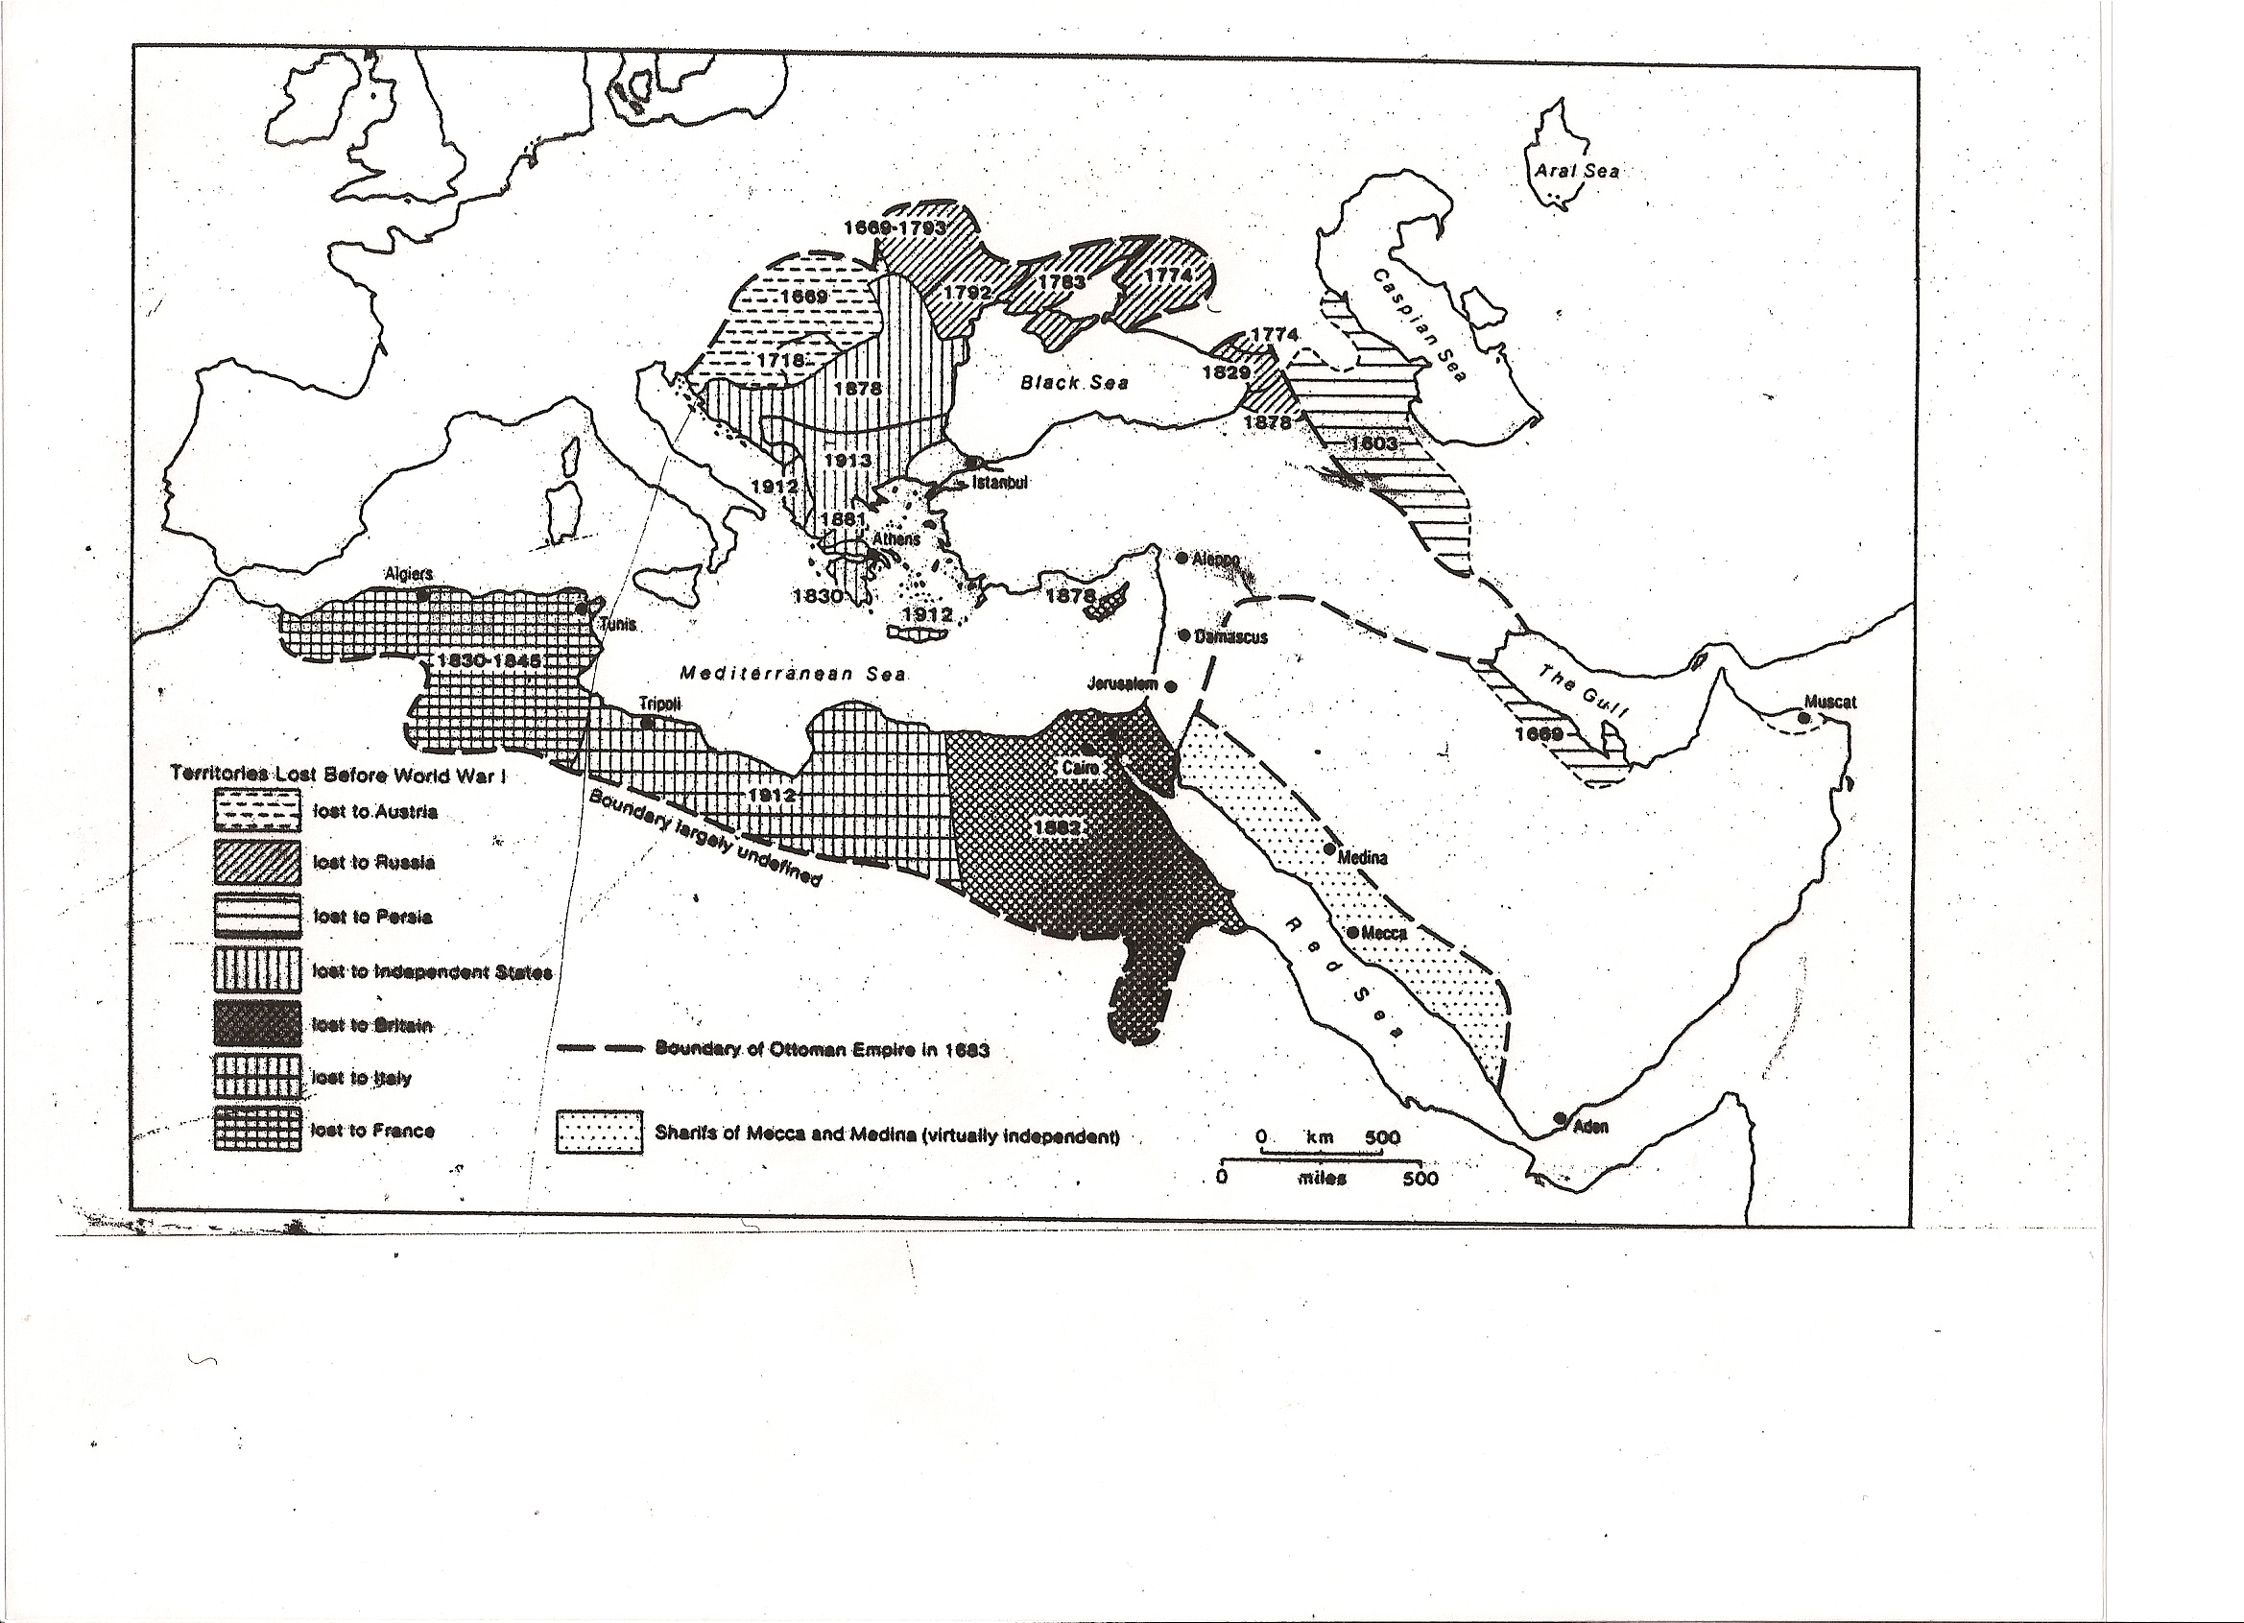
Territorial Land Before World War I

Slide 12
Conflict Resolution Structure
Power: Military
Political
Economical
Demography
Communication Skills:
Language
Charisma
Propaganda
Media
Interest and Connectivity: Local
Regional
International
Spatial Dimension of Conflict Resolutions
Historical Facts: Archeology
Landmarks

Slide 13
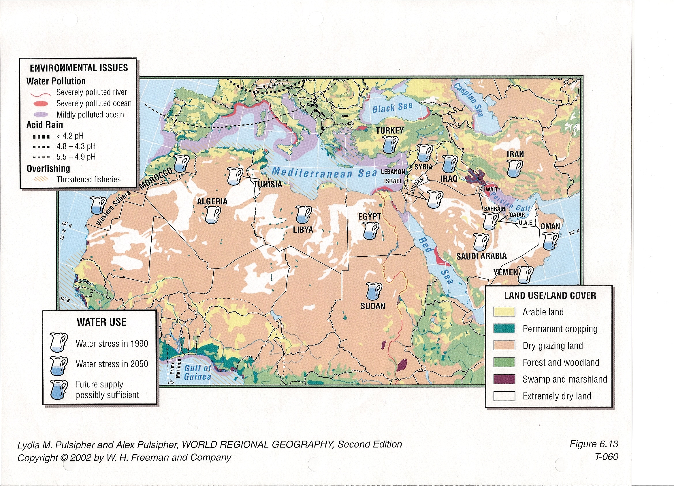
Resources and Consumption Behaviors

Slide 14
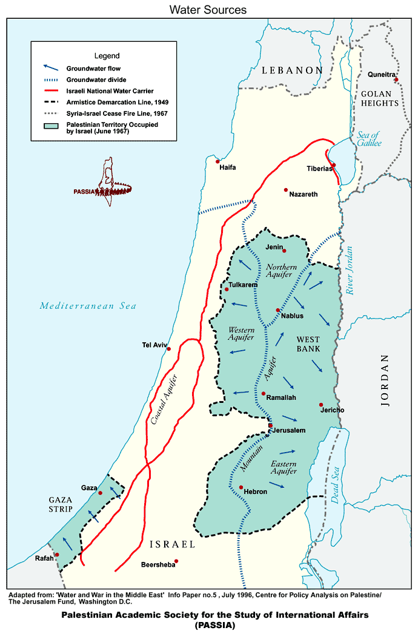
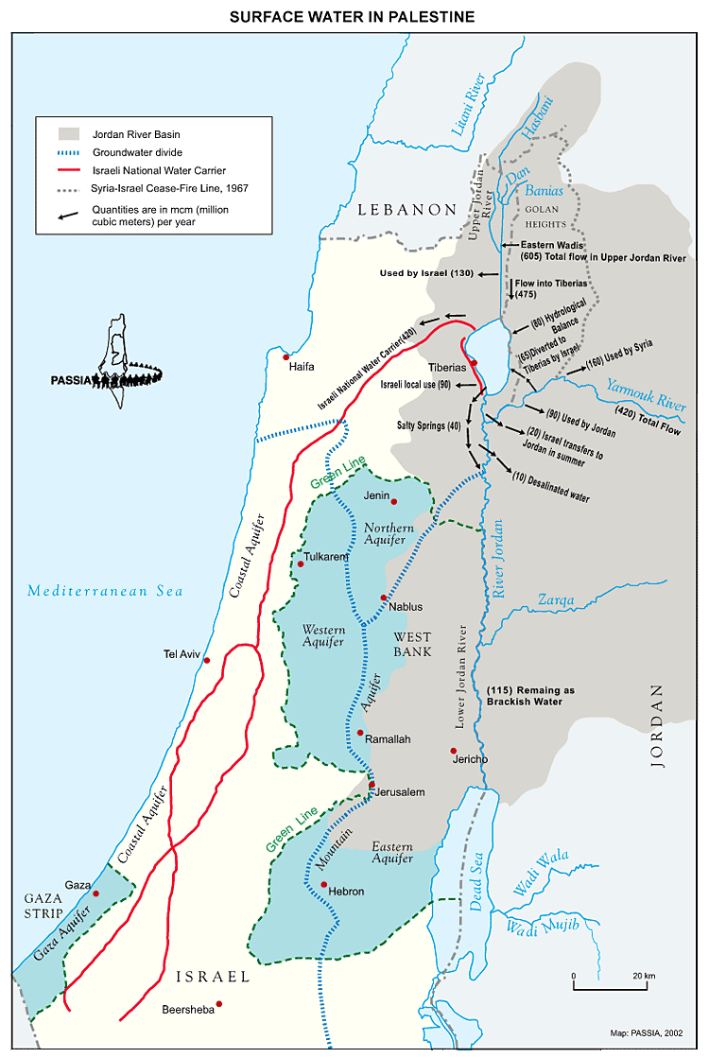

Slide 15
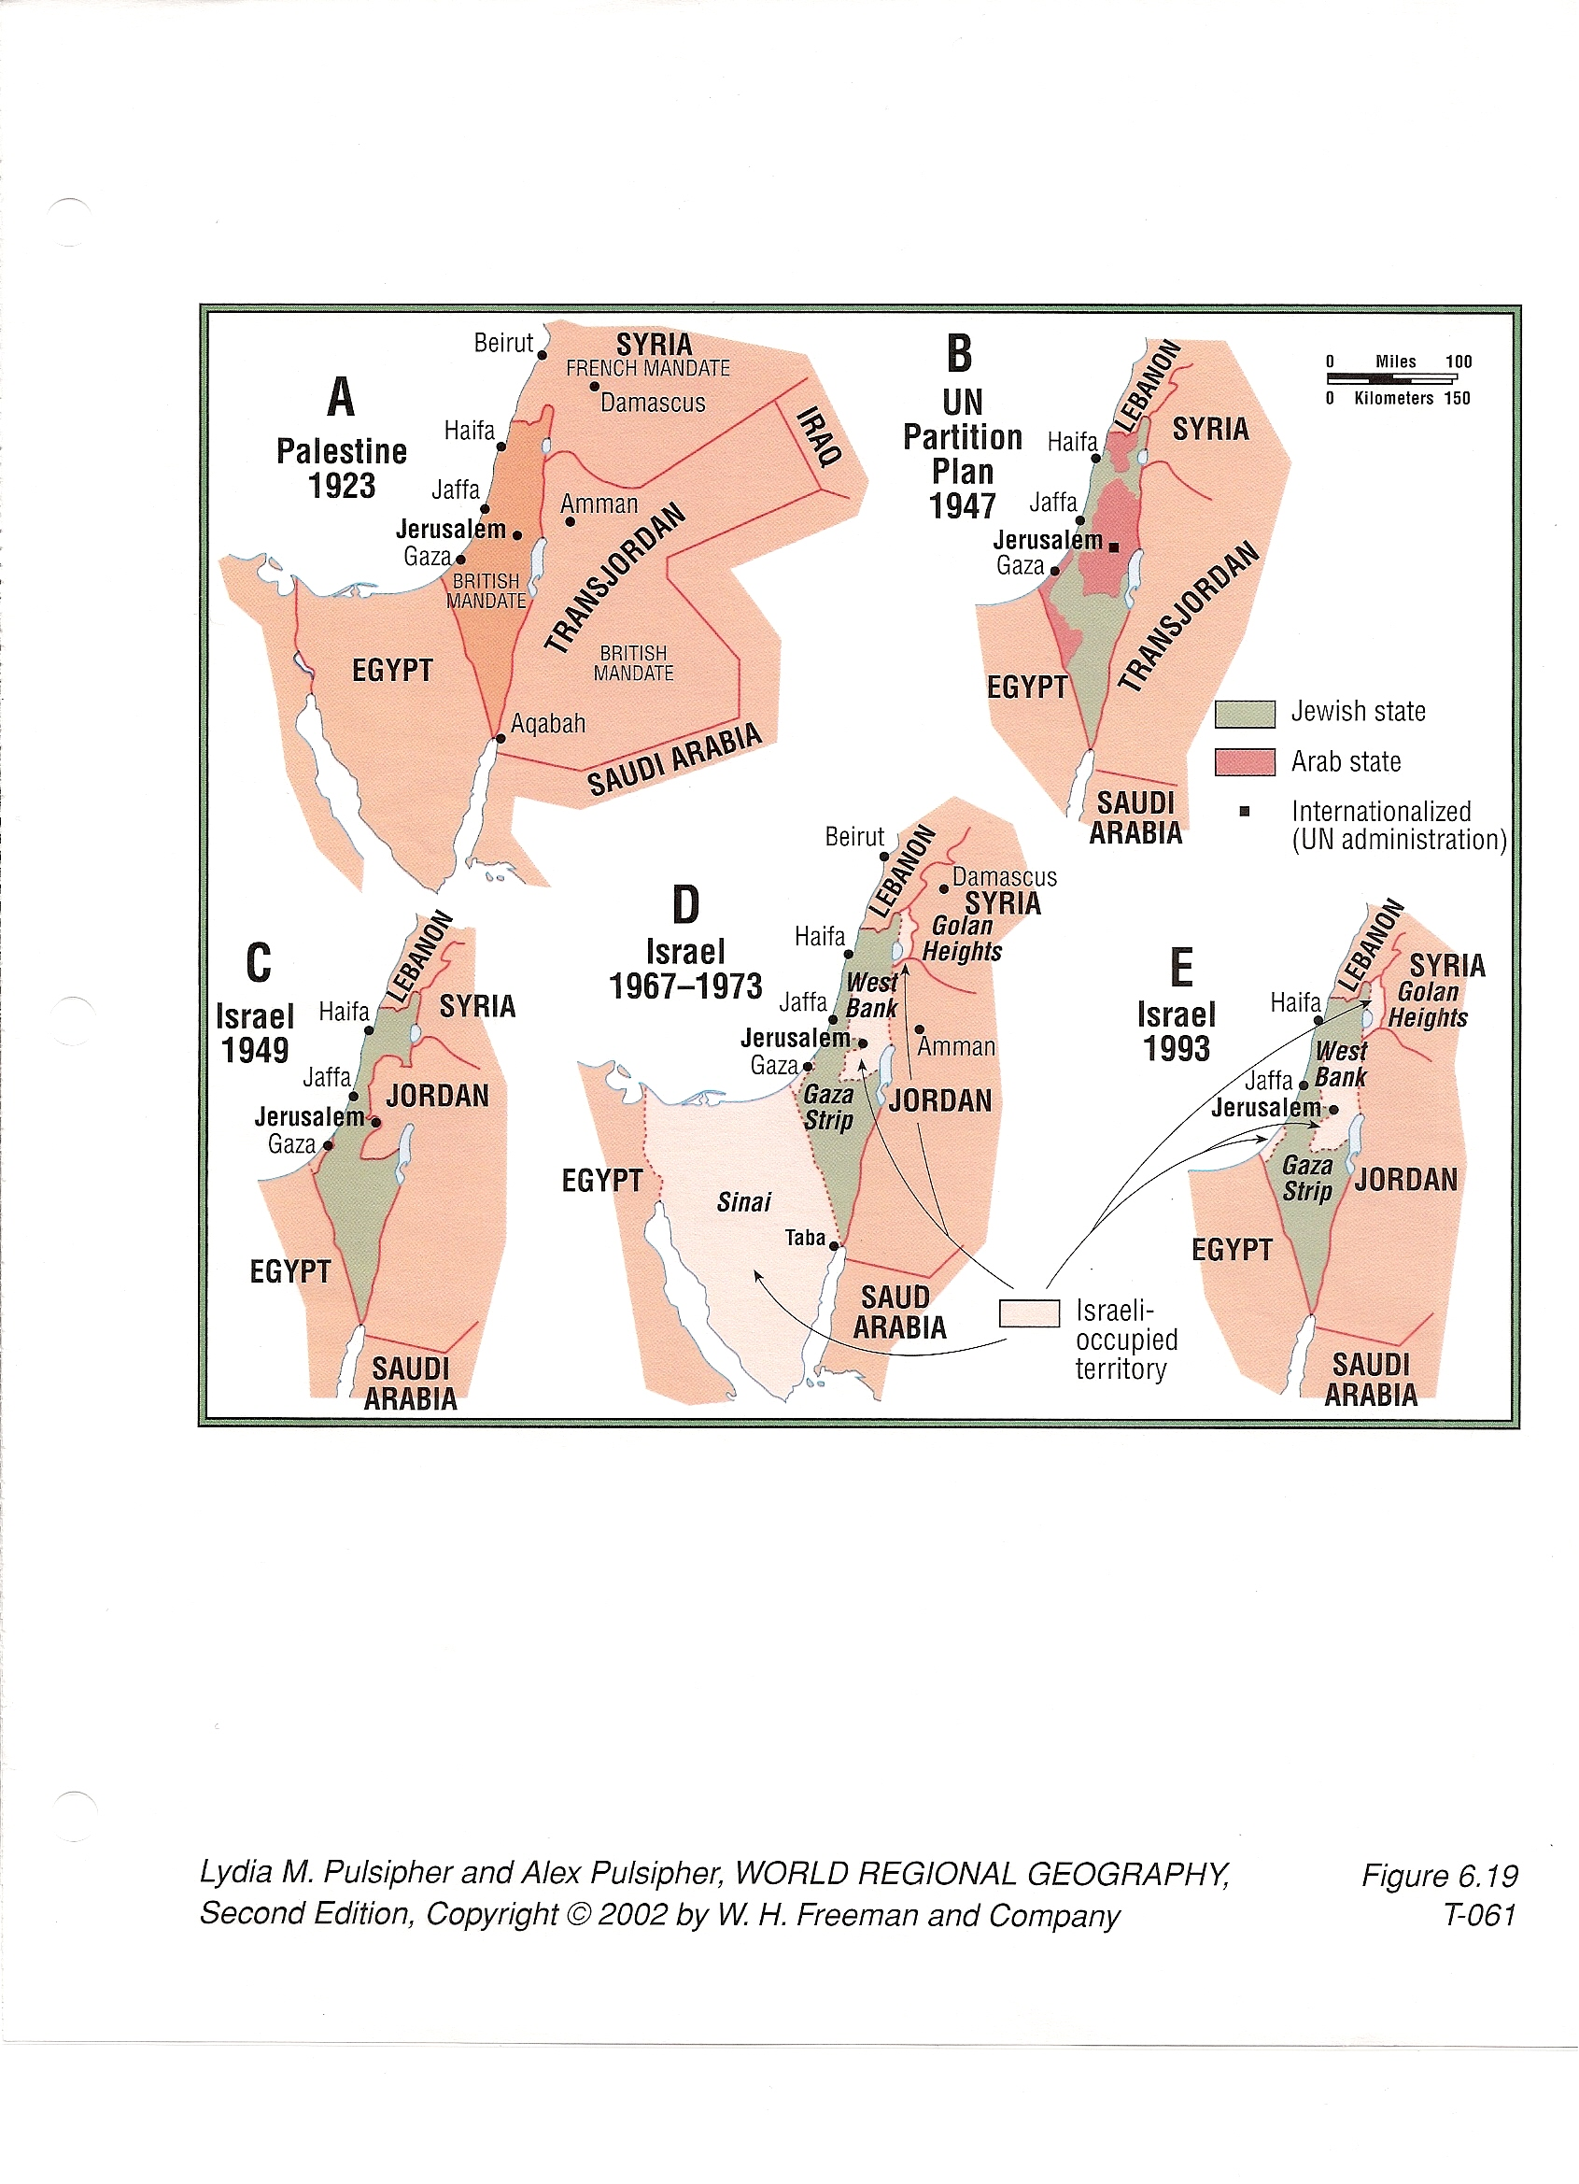
Zionist Intrusion Into Palestine

Slide 16
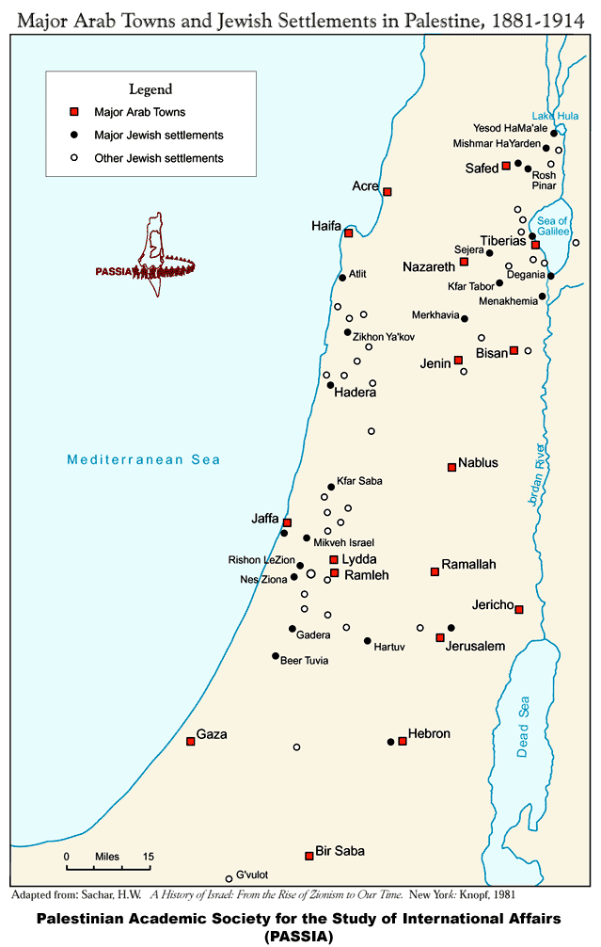
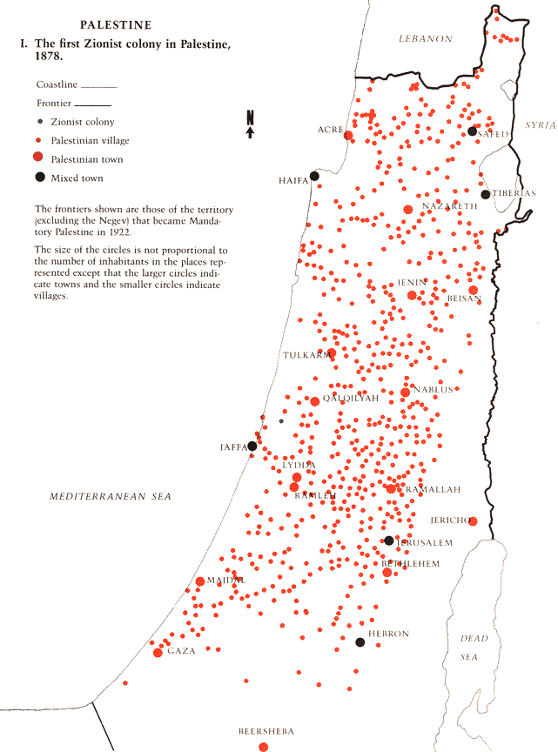

Slide 17
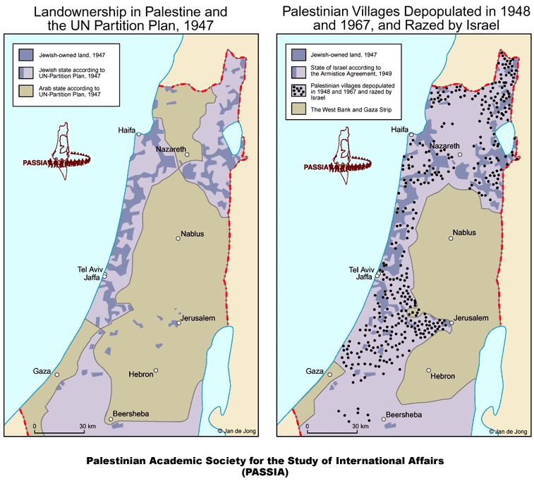
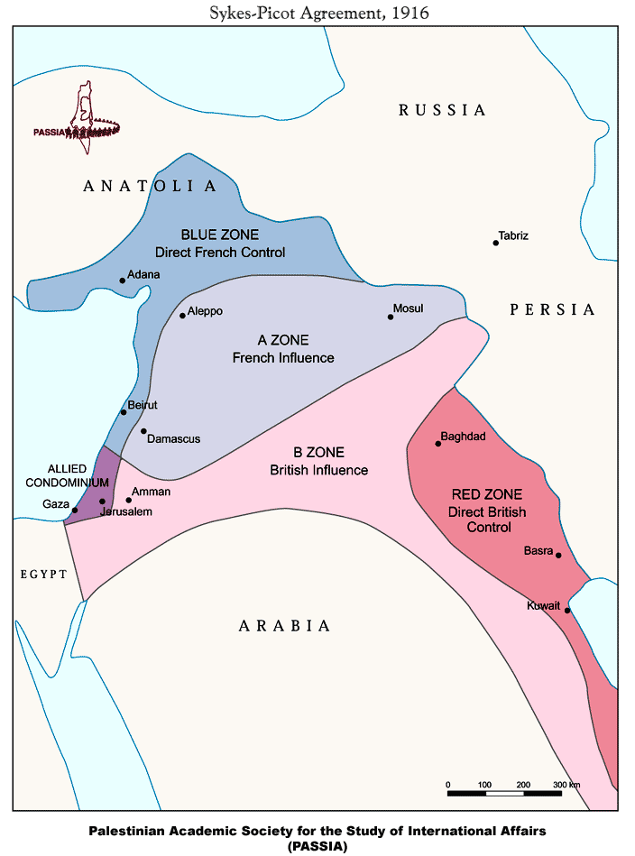

Slide 18
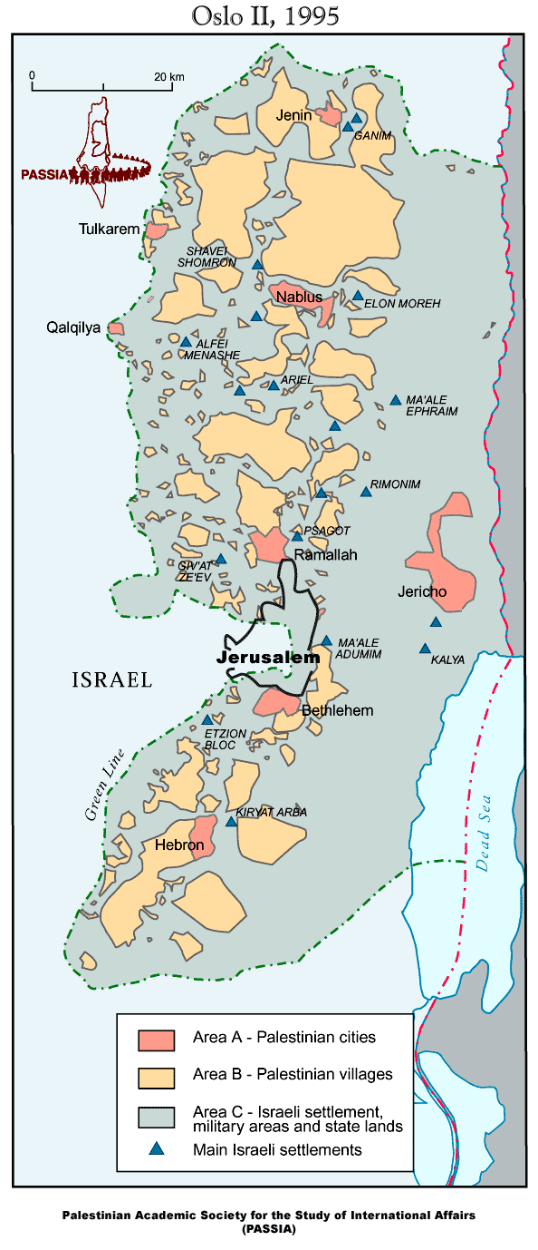
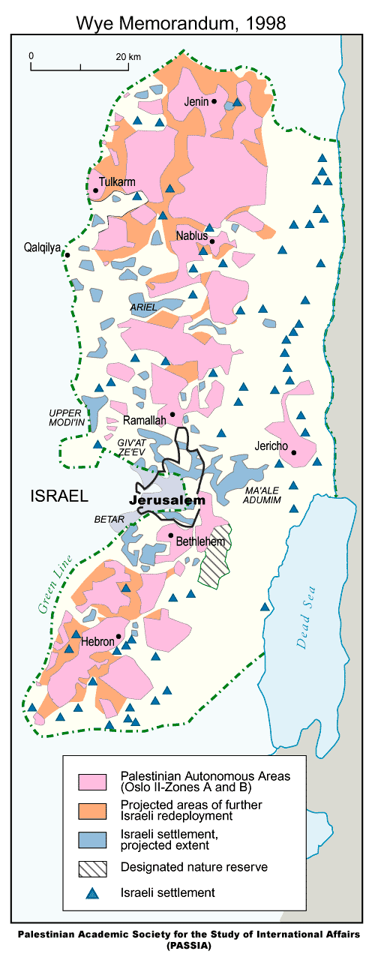
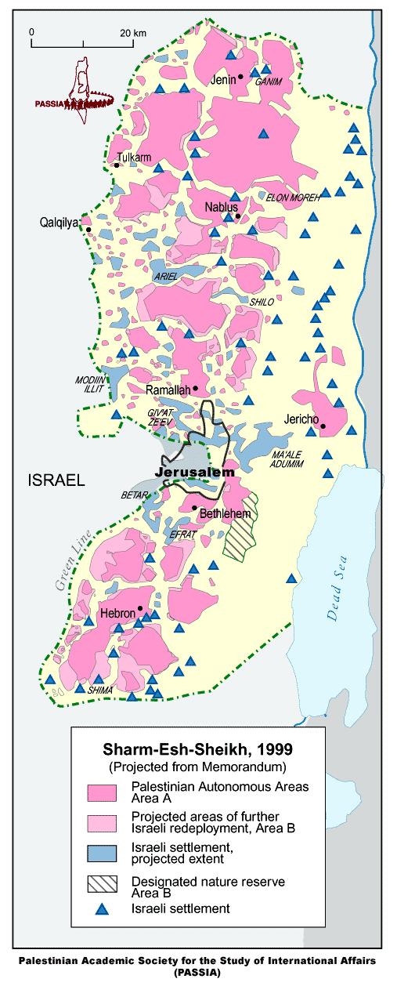
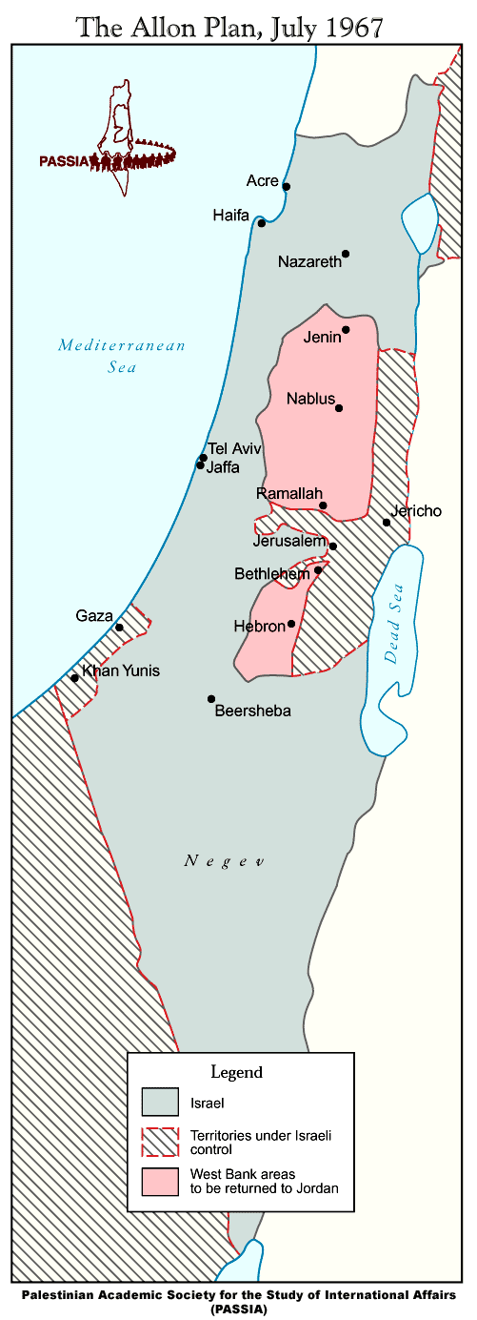
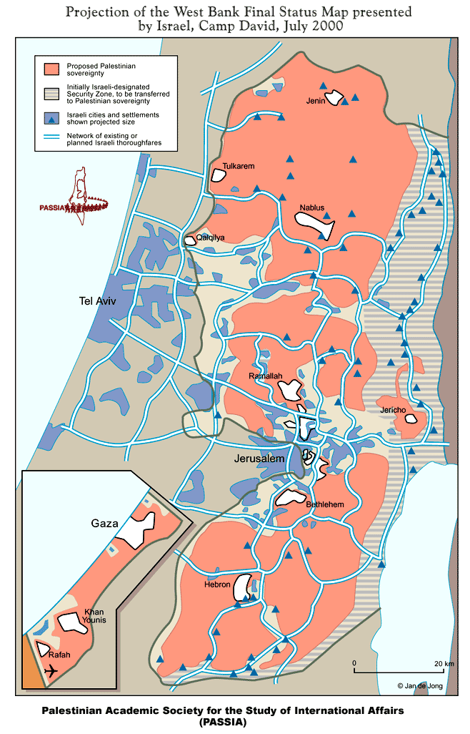
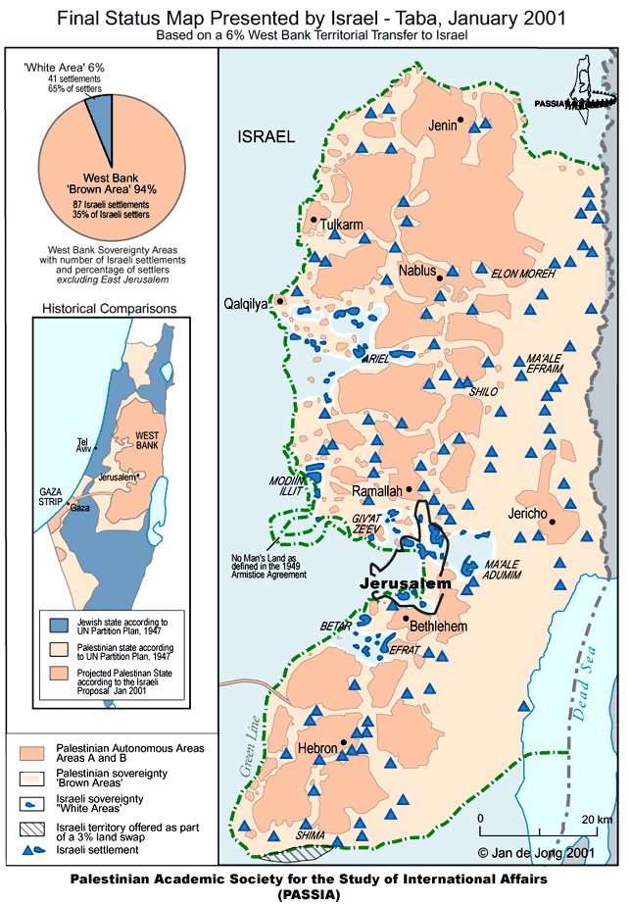
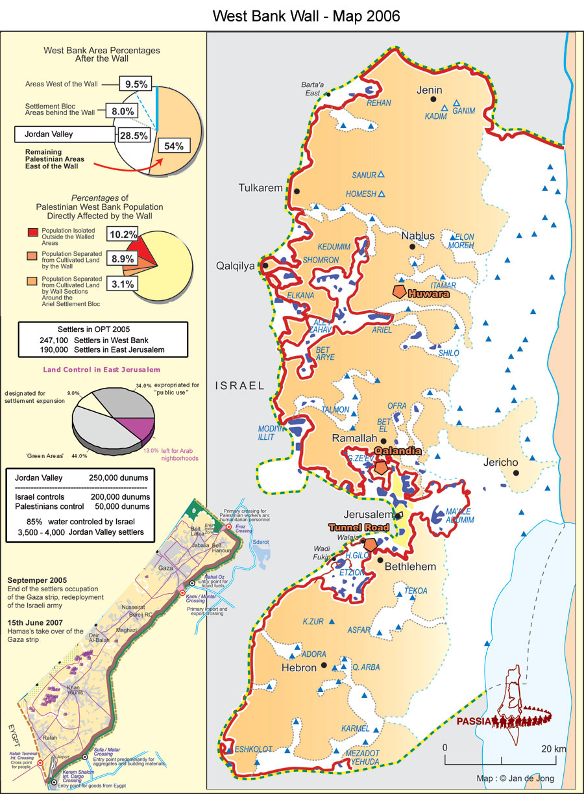

Slide 19
Goals of these Plans as indicated by these maps:
1. Maximization of Israeli security.
2. Minimizing the inclusion of Arab inhabitants.
3. Annexation of the strategically important and sparsely
populated Jordan Valley.
4. Consolidation of the Jerusalem corridor.
5. Cantonization of the rest of the West Bank and Gaza Strip.
Result:
No viable Palestinian State. Instead Palestinians can have autonomy type of Palestinian self-administration territories and economic peace by which Palestinian Territories will supply cheap labor to Israeli low payment jobs and become a consumption market to Israeli products. .

Slide 20
C
Conclusion and Recommendations
Geography Curriculum
Research and Publication
Community Involvement
Active Association for Geographers
Notes:
Geography Curriculium

