Slide 1

Faculty of Engineering & Information Technology
Department of Civil Engineering
Preparing BOQ for residential Villa
Prepared by: Amjad Sewadi
Abdullah Qoqa
Submitted to: Eng. Hussein AbuZant

Slide 2
Outline
Introduction
Methodology
Work Breakdown Structure (WBS)
Quantity Surveying
Structural surveying
Sub Structure
Super Structure
Finishes Surveying
Tiling
Plastering & Painting
Partitions

Slide 3
Outline
Stone
Brick Works
Marble Panel for Windows
Marble for kitchen
Closets for kitchen
Doors & Windows
Guardrails for Stairs
Sanitary Units
Electric Units
Bill of Quantities (BOQ)

Slide 4
Introduction
The project is a residential Villa consisting of only one story (ground floor only ), located at Bani Zaid village in Ramallah and al Birah governorate, the area of the ground floor is 222m² , and the area of the stair case is 22m²
The project site is divided into two parts, the first part has a level of -0.85m which the building will be located on, and the other part has a level of -1.85m which represents the main street and the private street, also it includes a parking for the cars.
The Following Figure Represents a General View Of The Project Site And The Building :

Slide 5
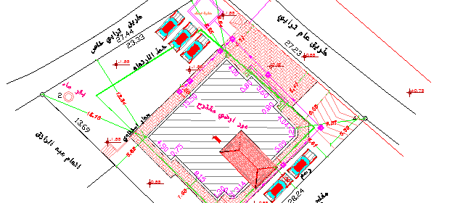

Slide 6
Methodology
Project Break Down Structure into Small Work Packages
Summarizng Relevant Information for Each Work Package
Determining the Method of Estimation of Quantities for Each Work Package
Finding the Cost Considering the Common Cost in The Palestinian Market of Construction Works
Summing Up Information to Find The Total Quantites and Costs

Slide 7
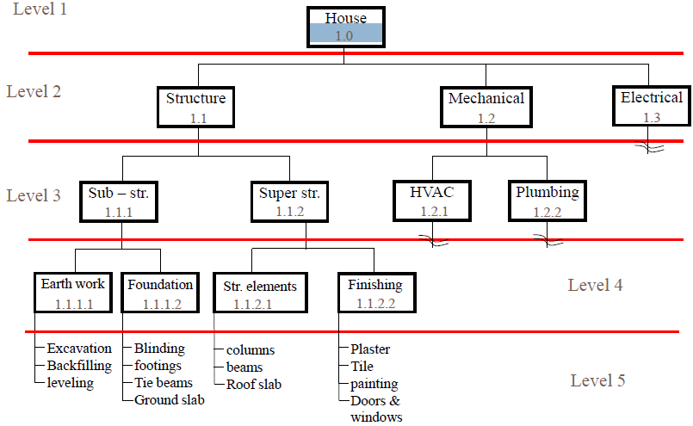
Work Breakdown Structure

Slide 8
Sub-Structure Quantity Surveying
The Sub-Structure includes all thing under ground slab level including:
Excavations
Backfilling
Footings
Columns Necks
Tie Beams

Slide 9
Excavations
The excavation process is only for footings with total height of 1.5 m to embed the footings under ground to save them and we need 0.5 m allowance around footing for masons free moving
After finish calculation for volume of excavations we have to multiply with factor to convert from bank volume to loose volume and this factor equal 1.25
The following table represents the volume of soil to be excavated
Footing Name | Number of Footings | Length (m) | Width (m) | Length of Excavations (m) | Width of Excavations (m) | Thickness of Footing (m) | Depth of Excavation (m) | Volume of Excavation (m³)
F1 | 4 | 2.2 | 2 | 3.2 | 3 | 0.4 | 1.5 | 57.6
F2 | 6 | 2 | 1.8 | 3 | 2.8 | 0.4 | 1.5 | 75.6
F3 | 5 | 1.4 | 1.4 | 2.4 | 2.4 | 0.4 | 1.5 | 43.2
F4 | 5 | 1.2 | 1.2 | 2.2 | 2.2 | 0.4 | 1.5 | 36.3
F5 | 1 | 0.8 | 0.8 | 1.8 | 1.8 | 0.4 | 1.5 | 4.86
TOTAL BANK VOLUME OF EXCAVATIONS (m³) |  |  |  |  |  |  |  | 217.56
TOTAL LOOSE VOLUME OF EXCAVATIONS (m³) |  |  |  |  |  |  |  | 271.95

Slide 10
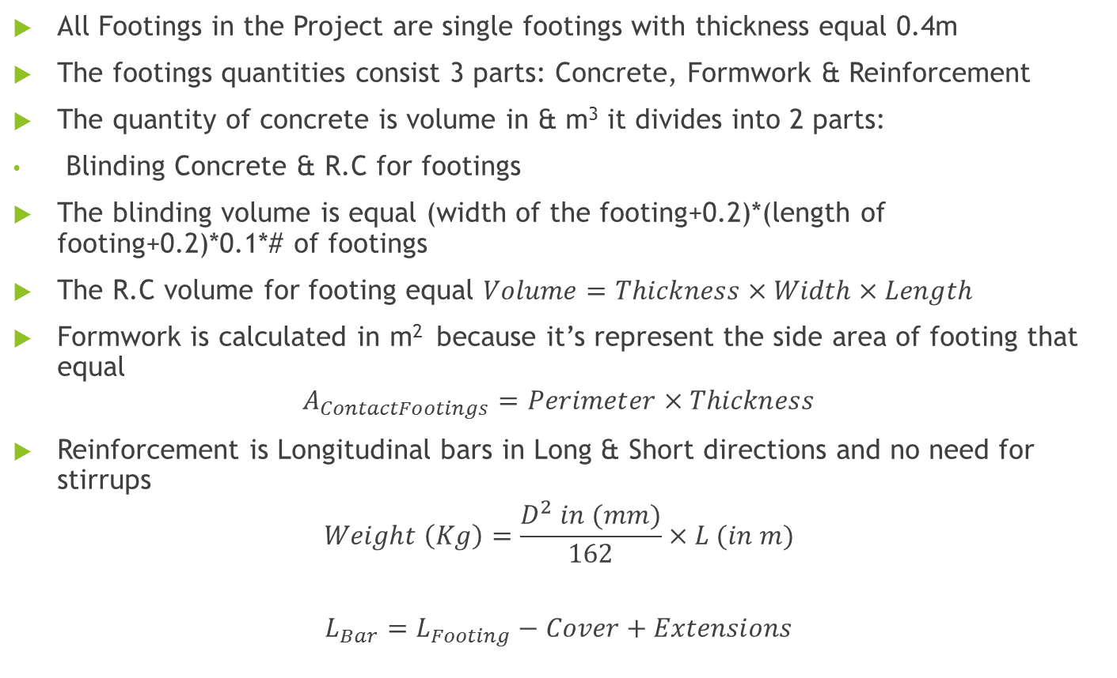
Footings
All Footings in the Project are single footings with thickness equal 0.4m
The footings quantities consist 3 parts: Concrete, Formwork & Reinforcement
The quantity of concrete is volume in & m³ it divides into 2 parts:
Blinding Concrete & R.C for footings
The blinding volume is equal (width of the footing+0.2)*(length of footing+0.2)*0.1*# of footings
The R.C volume for footing equal $Volume=Thickness×Width×Length$
Formwork is calculated in m² because it’s represent the side area of footing that equal
$$A_{ContactFootings}=Perimeter×Thickness$$
Reinforcement is Longitudinal bars in Long & Short directions and no need for stirrups
$$Weight \left(Kg\right)=\frac{D^{2} in (mm)}{162}×L (in m)$$
$$L_{Bar}=L_{Footing}−Cover+Extensions$$

Slide 11
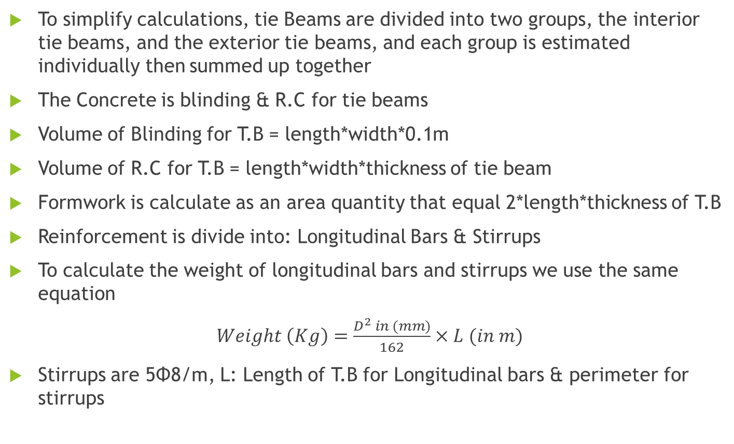
Tie Beams
To simplify calculations, tie Beams are divided into two groups, the interior tie beams, and the exterior tie beams, and each group is estimated individually then summed up together
The Concrete is blinding & R.C for tie beams
Volume of Blinding for T.B = length*width*0.1m
Volume of R.C for T.B = length*width*thickness of tie beam
Formwork is calculate as an area quantity that equal 2*length*thickness of T.B
Reinforcement is divide into: Longitudinal Bars & Stirrups
To calculate the weight of longitudinal bars and stirrups we use the same equation
$Weight \left(Kg\right)=\frac{D^{2} in (mm)}{162}×L (in m)$
Stirrups are 5Φ8/m, L: Length of T.B for Longitudinal bars & perimeter for stirrups

Slide 12
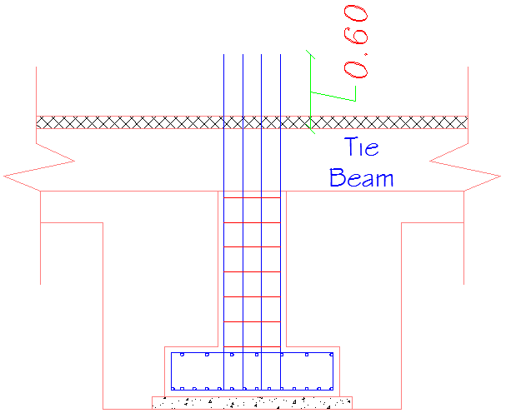
Columns Necks
The Column neck is the part of column that is below tie beam level and start from the top of footing, but the Longitudinal bars Length start from the bottom of the footing and extend 60cm above tie beam as in the following figure

Slide 13
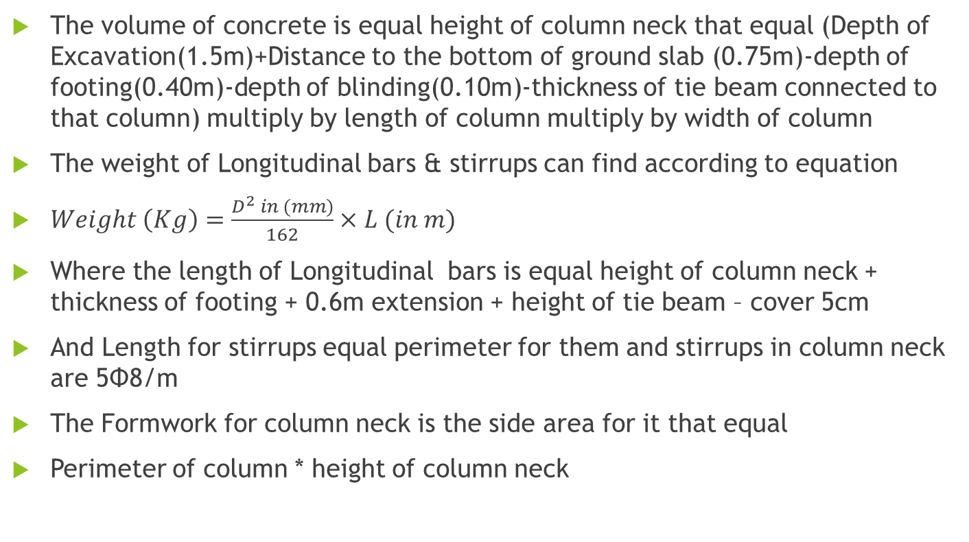
Columns Necks
The volume of concrete is equal height of column neck that equal (Depth of Excavation(1.5m)+Distance to the bottom of ground slab (0.75m)-depth of footing(0.40m)-depth of blinding(0.10m)-thickness of tie beam connected to that column) multiply by length of column multiply by width of column
The weight of Longitudinal bars & stirrups can find according to equation
$Weight \left(Kg\right)=\frac{D^{2} in (mm)}{162}×L (in m)$
Where the length of Longitudinal bars is equal height of column neck + thickness of footing + 0.6m extension + height of tie beam – cover 5cm
And Length for stirrups equal perimeter for them and stirrups in column neck are 5Φ8/m
The Formwork for column neck is the side area for it that equal
Perimeter of column * height of column neck

Slide 14
Backfilling
We divide backfilling to two stages: first stage is from blinding of footing to the bottom of tie beam and second stage from top of T.B to the bottom of ground slab
In the first stage we can calculate volume of backfilling using this equation
The Volume of Backfill = (V of Excavations) – (V of Footing and Blinding) – (V of Column Necks to -0.85 Level)
Where V of Excavations equal 217.56 m³
Volume of footing and Blinding equal 22.74+7.11= 29.75 m²
Height of Column Neck to Level of (-0.85) = Depth _{Excavation} – Thickness _{Footing & Blinding} = 1.5 – ( 0.4 + 0.1 ) = 1m
Volume of Column Necks = 0.2 x 0.55 x 1 x 20 + 0.2 x 0.2 x 1 = 2.24m³
Volume Of Backfilling Of Stage 1 ( Level -0.85 ) = 217.56–29.85–2.24 = 185.47m³

Slide 15

Backfilling
In the second stage of backfilling after construction of tie beam we can use this equation to find the volume
$V_{Backfill}=A_{Building}×h_{Backfill}−V_{TB\&Blind}$
V = 222 * (0.85-0.1) – 27.88 = 138.62 m³
Total Compacted volume for backfilling equal 185.47 + 138.62 = 324.09 m³
Total Loose volume for backfilling equal 324.09 * 1.39 = 450.5 m³

Slide 16
Super-Structure Quantity Surveying
The Super structure quantity survey include all work after finish the second stage of backfilling which includes
Ground slab
Columns
Beams
Top Slab
Staircase
Finishes

Slide 17
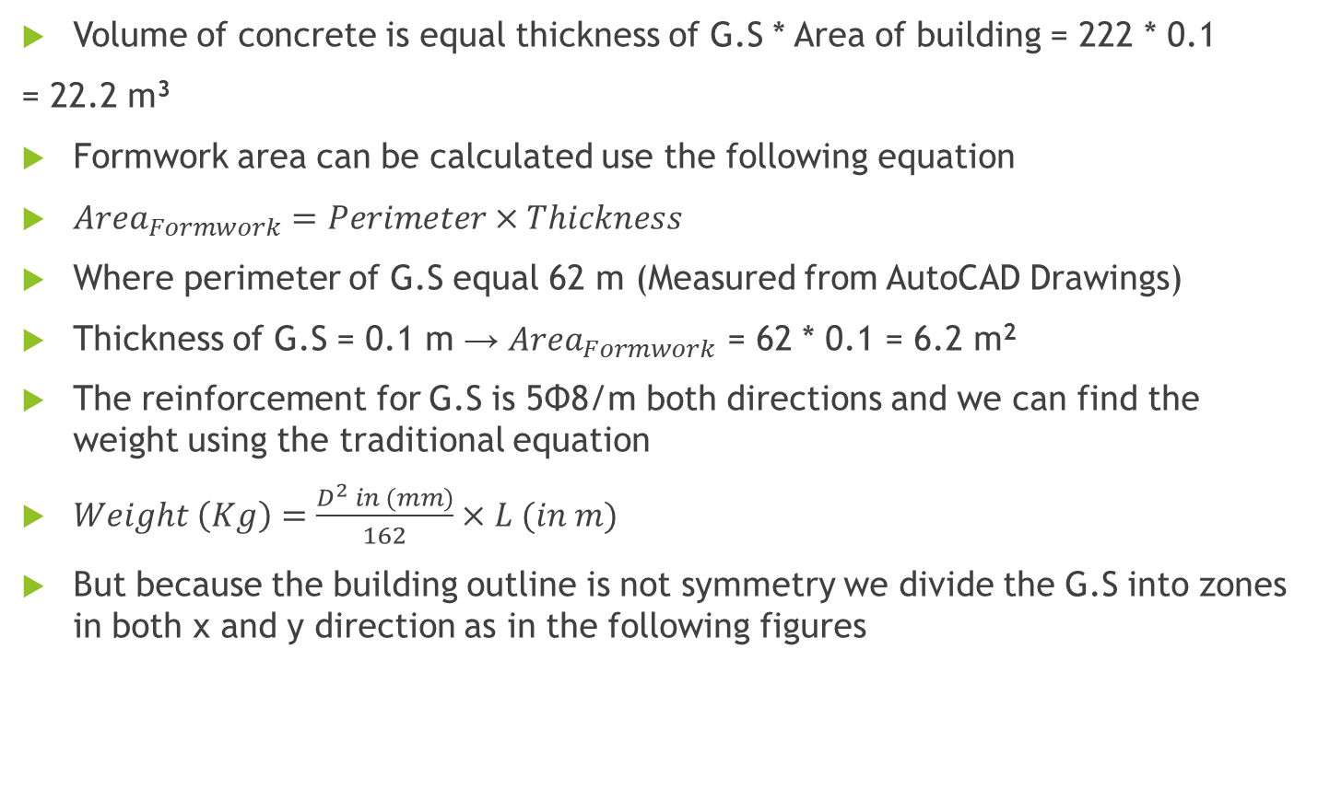
Ground slab
Volume of concrete is equal thickness of G.S * Area of building = 222 * 0.1
= 22.2 m³
Formwork area can be calculated use the following equation
${Area}_{Formwork}=Perimeter×Thickness$
Where perimeter of G.S equal 62 m (Measured from AutoCAD Drawings)
Thickness of G.S = 0.1 m → ${Area}_{Formwork}$ = 62 * 0.1 = 6.2 m²
The reinforcement for G.S is 5Φ8/m both directions and we can find the weight using the traditional equation
$Weight \left(Kg\right)=\frac{D^{2} in (mm)}{162}×L (in m)$
But because the building outline is not symmetry we divide the G.S into zones in both x and y direction as in the following figures

Slide 18
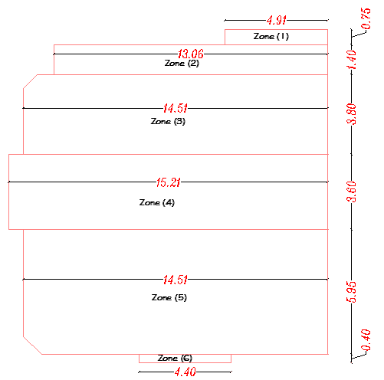
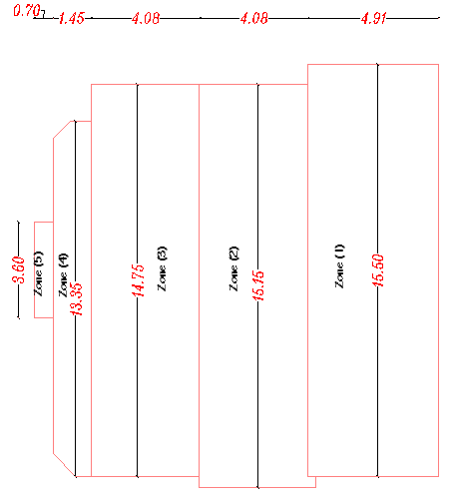
Reinforcement of G.S

Slide 19
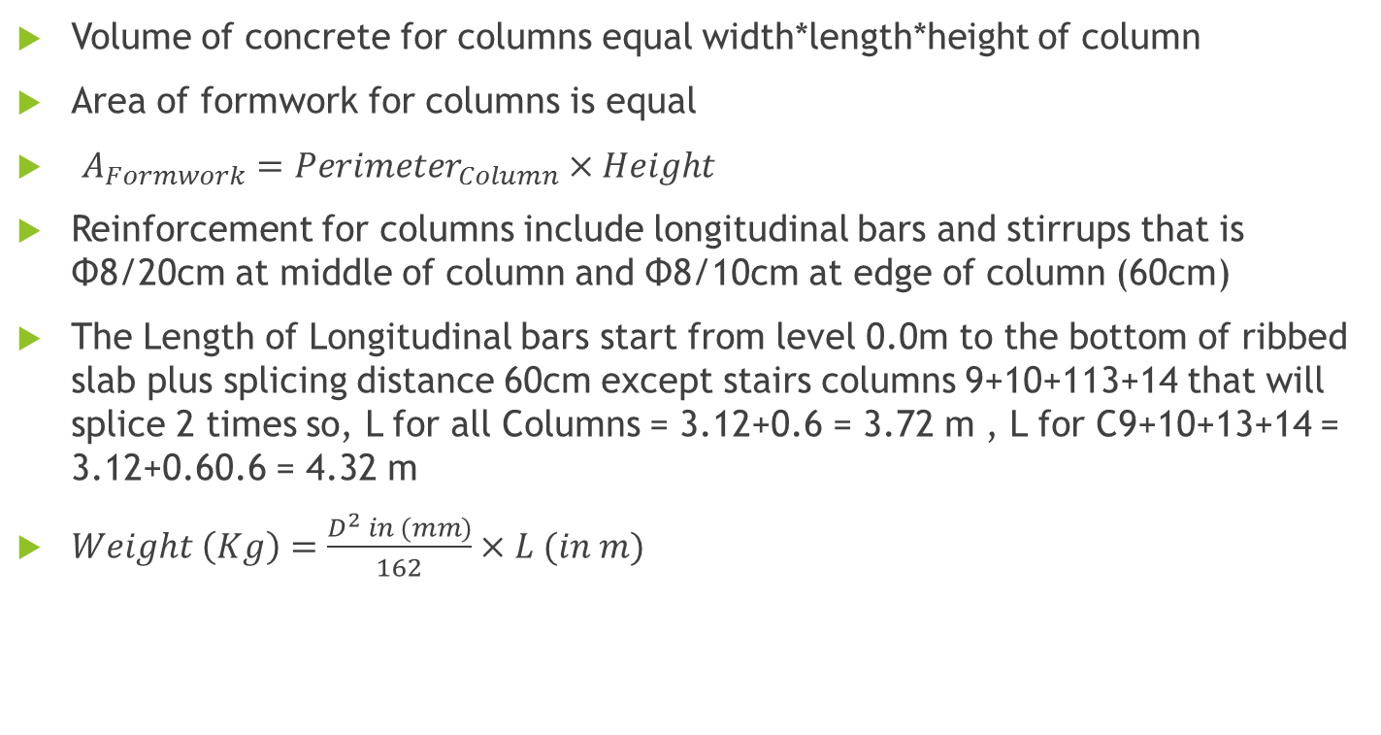
Columns
Volume of concrete for columns equal width*length*height of column
Area of formwork for columns is equal
$A_{Formwork}={Perimeter}_{Column}×Height$
Reinforcement for columns include longitudinal bars and stirrups that is Φ8/20cm at middle of column and Φ8/10cm at edge of column (60cm)
The Length of Longitudinal bars start from level 0.0m to the bottom of ribbed slab plus splicing distance 60cm except stairs columns 9+10+113+14 that will splice 2 times so, L for all Columns = 3.12+0.6 = 3.72 m , L for C9+10+13+14 = 3.12+0.60.6 = 4.32 m
$Weight \left(Kg\right)=\frac{D^{2} in (mm)}{162}×L (in m)$

Slide 20
Beams
All beams are hidden beams and have the same thickness of the slab ( 25cm )
Formwork of this kind of beams is the same formwork for the slab, NO special formwork is needed for this kind of beams since they are hidden, but if they were dropped, they need special formwork
The Reinforcement of Beams consist of the following parts :
Continuous Bottom Bars, this type of bars are continuous across all the length of the beams.
Top Bars, these bars are continuous through the length of the beam, and they have a splicing distance of 1.2m from both sides
Bottom Bended Bars, the bars are bended at a distance of 70cm from the face of the support, and also, the bars are spliced at a distance of 1.2m from both sides of the beam
Volume of Concrete for the beam equal (depth*width*length)

Slide 21
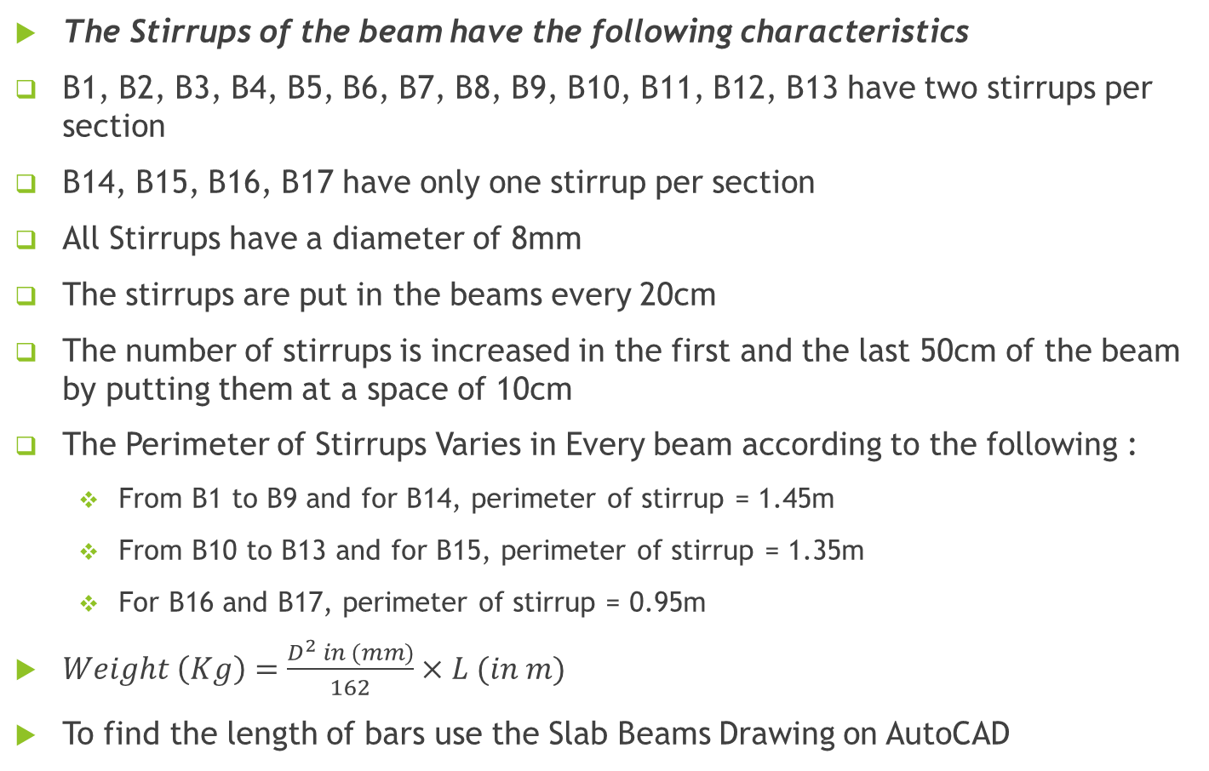
Beams
The Stirrups of the beam have the following characteristics
B1, B2, B3, B4, B5, B6, B7, B8, B9, B10, B11, B12, B13 have two stirrups per section
B14, B15, B16, B17 have only one stirrup per section
All Stirrups have a diameter of 8mm
The stirrups are put in the beams every 20cm
The number of stirrups is increased in the first and the last 50cm of the beam by putting them at a space of 10cm
The Perimeter of Stirrups Varies in Every beam according to the following :
  From B1 to B9 and for B14, perimeter of stirrup = 1.45m
  From B10 to B13 and for B15, perimeter of stirrup = 1.35m
  For B16 and B17, perimeter of stirrup = 0.95m
$Weight \left(Kg\right)=\frac{D^{2} in (mm)}{162}×L (in m)$
To find the length of bars use the Slab Beams Drawing on AutoCAD

Slide 22
Ribbed Slab
The type of the slab is one way ribbed slab which contains cement blocks to reduce its weight, cost, and to provide better isolation.
Block Dimensions are as follows :
  Thickness = 17cm
  Width = 25cm
  Length = 40cm
The Volume of concrete required for the Slab includes the volume required for beams, since the beams are hidden and they are part of the slab’s concrete.
Formwork of The Slab is The External Stone Layer ( مدماك الصبة )
The following figure shows the number of Blocks in each zone of the ribbed Slab

Slide 23
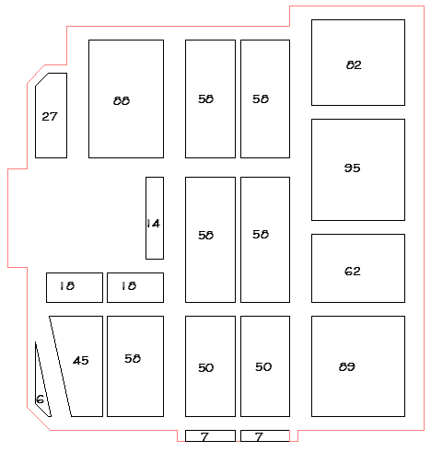
Ribbed Slab

Slide 24
Ribbed Slab
Number of Blocks =82+95+62+89+2x(58+58+50+7)+88+14+18+18+45+58+6+27 = 948
Slab Thickness = 0.25m
Volume of a Block = 0.4 x 0.22 x 0.17 = 0.017m³
Total Volume of Blocks = 948 x 0.017 = 16.116m³
Area of Ribbed Slab = Total Area of Floor – Area of Staircase = 222-22 = 200m²
Volume of Concrete Required = Thickness _{Slab} x Area – Volume _{Blocks}
= 0.25 x 200 -16.116= 33.884m³
Reinforcement for ribbed Slab consist of 3 items: Longitudinal bars, Shrinkage steel and stirrups
Longitudinal bars are 2Φ12 or Φ12 and Φ14
Shrinkage Steel are mesh with Φ8/25cm both sides
Stirrups are 4Φ8/m with 30cm perimeter length

Slide 25
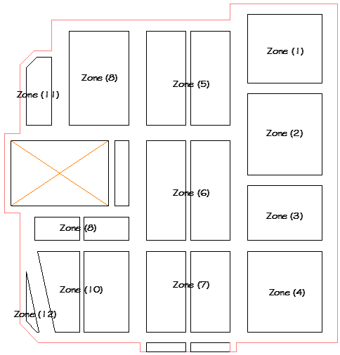
Ribbed Slab
To simplify the weight estimate for the main longitudinal bars in the ribs, the slab is divided to several zones as shown in the following figure :

Slide 26
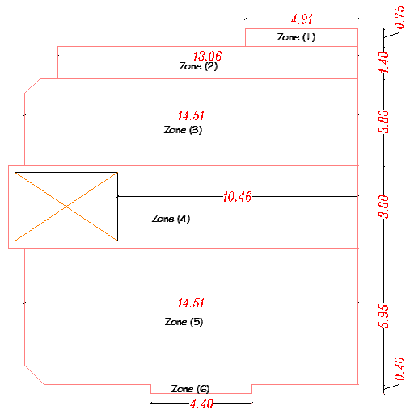
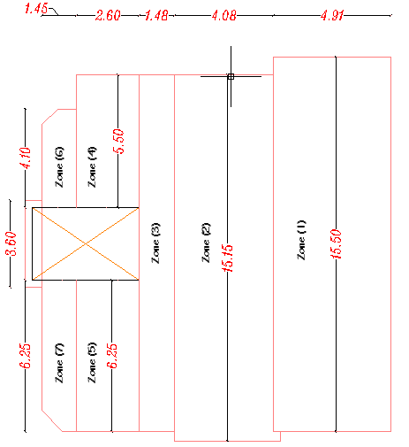
Ribbed Slab
To Simplify The Estimation Of Weight For The Shrinkage Steel, we divide the slabs to zones in both x and y direction as following figures

Slide 27
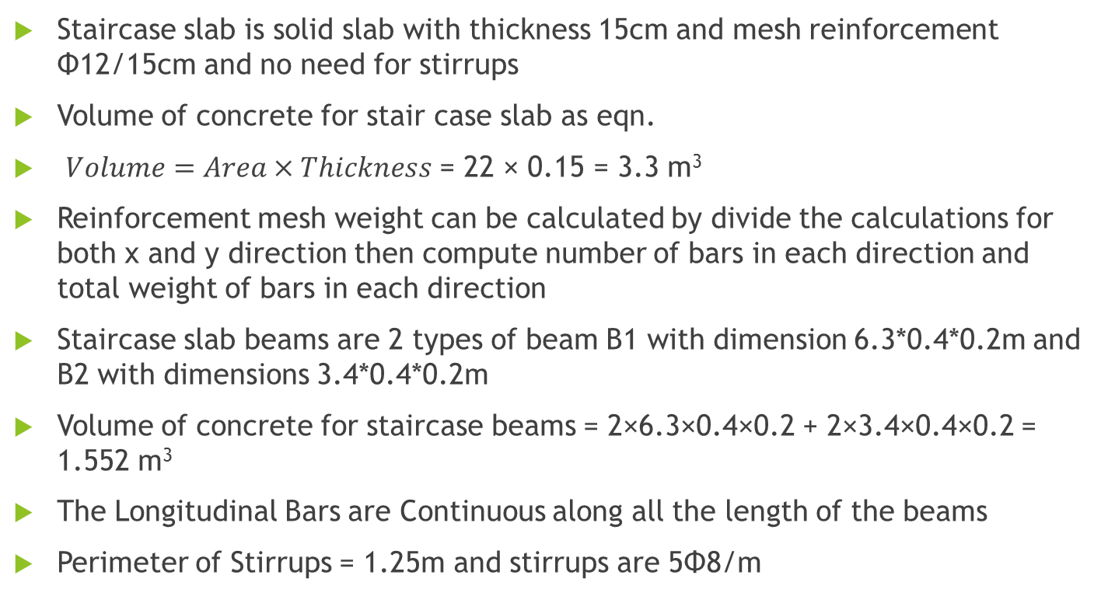
Staircase
Staircase slab is solid slab with thickness 15cm and mesh reinforcement Φ12/15cm and no need for stirrups
Volume of concrete for stair case slab as eqn.
$Volume=Area×Thickness$ = 22 × 0.15 = 3.3 m³
Reinforcement mesh weight can be calculated by divide the calculations for both x and y direction then compute number of bars in each direction and total weight of bars in each direction
Staircase slab beams are 2 types of beam B1 with dimension 6.3*0.4*0.2m and B2 with dimensions 3.4*0.4*0.2m
Volume of concrete for staircase beams = 2×6.3×0.4×0.2 + 2×3.4×0.4×0.2 = 1.552 m³
The Longitudinal Bars are Continuous along all the length of the beams
Perimeter of Stirrups = 1.25m and stirrups are 5Φ8/m

Slide 28
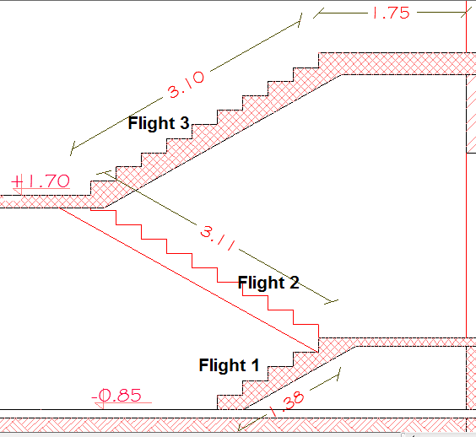
Staircase
Staircase flights are 3 shown in the following figure
Volume of Concrete equal (side area of flight*1.4m + volume of Landing)
Longitudinal bars are 7Φ14/m, Transverse bars are Φ14/20cm in the landing and under one bar under each riser and stirrups are 5Φ8/m
Formwork covers all sides of the staircase flight, and the bottom area is measured directly from AutoCAD drawings of the design

Slide 29
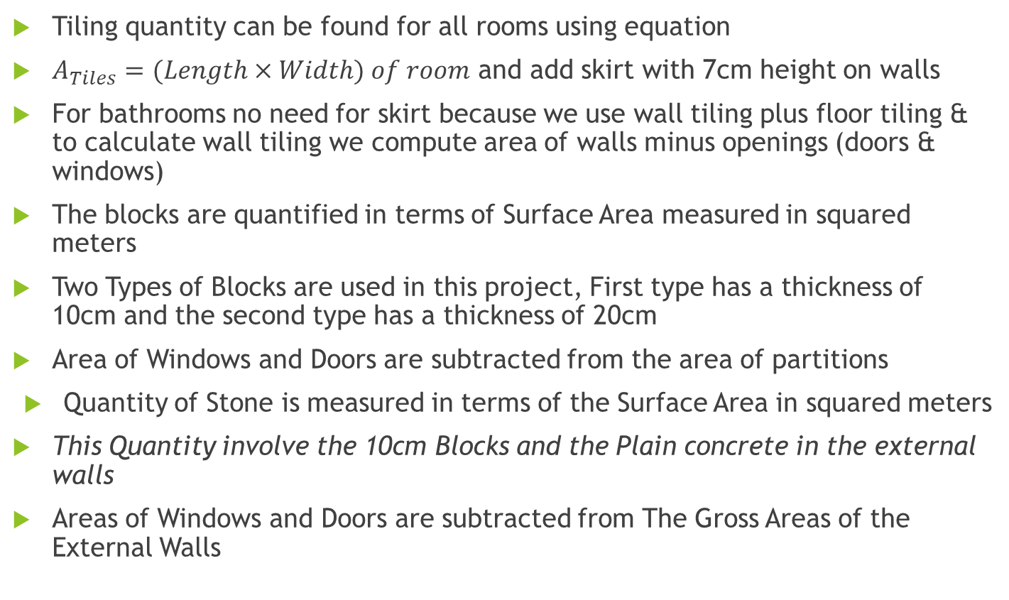
Finishes
Tiling quantity can be found for all rooms using equation
$A_{Tiles}=(Length×Width) of room$ and add skirt with 7cm height on walls
For bathrooms no need for skirt because we use wall tiling plus floor tiling & to calculate wall tiling we compute area of walls minus openings (doors & windows)
The blocks are quantified in terms of Surface Area measured in squared meters
Two Types of Blocks are used in this project, First type has a thickness of 10cm and the second type has a thickness of 20cm
Area of Windows and Doors are subtracted from the area of partitions
Quantity of Stone is measured in terms of the Surface Area in squared meters
This Quantity involve the 10cm Blocks and the Plain concrete in the external walls
Areas of Windows and Doors are subtracted from The Gross Areas of the External Walls

Slide 30
Finishes
The Ceiling of all the floor will be plastered and painted
All the rooms walls and partitions will be plastered and painted
The Walls and Partitions of Bathrooms will not be plastered and painted since it will be covered by ceramic tiles
The height of the tile skirt was subtracted from the height of walls to be accurate
The quantity of brickwork is measured in terms of the Total Surface Area
Dimensions are measured from the Drawings of the project
Brickwork only cover the staircase
The measured area is the total area, NOT the projected one

Slide 31
Bill of quantities (BOQ)
Total Volume of Concrete For All The Project = 120.1 m3
Total Weight for All Steel Reinforcement of The Project = 10755 (Kg)
Factor Concrete Volume to Reinforcement Weight = 1 : 90
Bill of quantities is prepared by consultant to make cost estimate for owner for the total project and it is important for bidding phase to put the prices on it by contractors and take the least cost to make the project and it is important to put a nearby costs by consultant to avoid “Unbalanced Bid” by contractors in bid phase
We make the BOQ in NIS currency and use local costs of the construction materials in Palestine with high quality and tests before buying them and this is responsibility by site engineer to watch delivery process and make tests during construction phase especially for concrete to ensure that within specifications to avoid any failure

Slide 32
الخلاصة العامة للكميات
رقم الجدول | الوصف | المجموع بالشيكل
1 | اعمال الهدم والازالة والطمم والاسفلت | 18,720
2 | أعمال الخرسانة. | 168,050
3 | أعمال الطوب و الحجر | 116,330
4 | أعمال القصارة. | 19,300
5 | أعمال البلاط و الرخام. | 30,465
6 | اعمال الدهان ومدات الميلان والعزل | 15,320
7 | اعمال المنجور. | 13,200
8 | الأعمال المعدنية و الألمنيوم وفواصل التمدد | 27,700
9 | الأعمال الصحية. | 16,165
10 | الأعمال الكهربائية. | 9,645
 | مجموع جداول الكميات | 434,895

