Slide 1

Operations improvement at aeco
Prepared by:
Ro’a Omar Barham
Hala Nabil Demaidi
Rand Omar Ghannam
Isra Abdalsalam Haj Hamad

Slide 2







Introduction
Problem Statement
Objectives
OUTLINE
Methodology
Results & Analysis
Conclusion
Recommendation

Slide 3




Introduction
Arab Eastern Company AECO was established in 1990
AECO company is located in the industrial area of Nablus city
The total area of the factory is 8000 m2, it includes 3 production lines.
AECO includes 90 workers in the 2 shifts

Slide 4

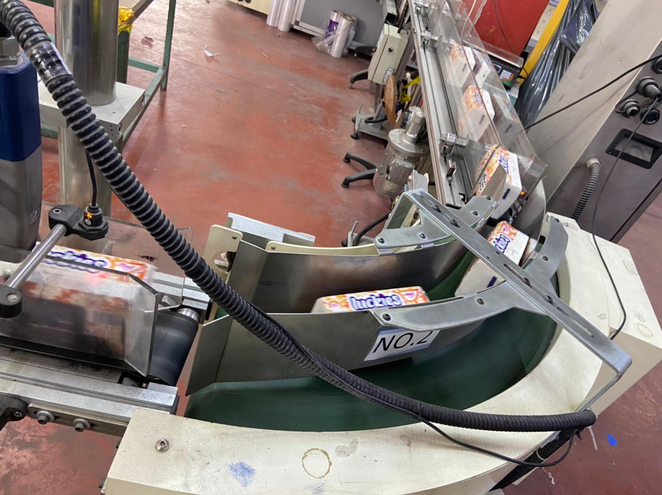
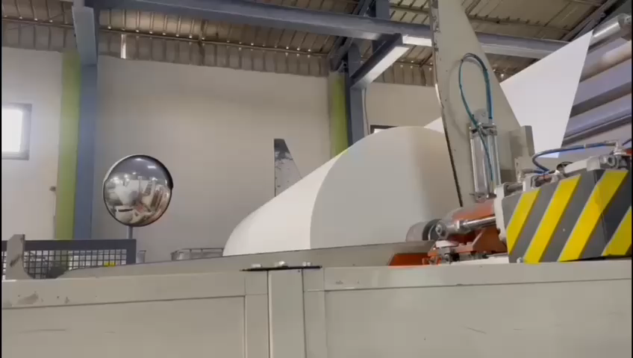
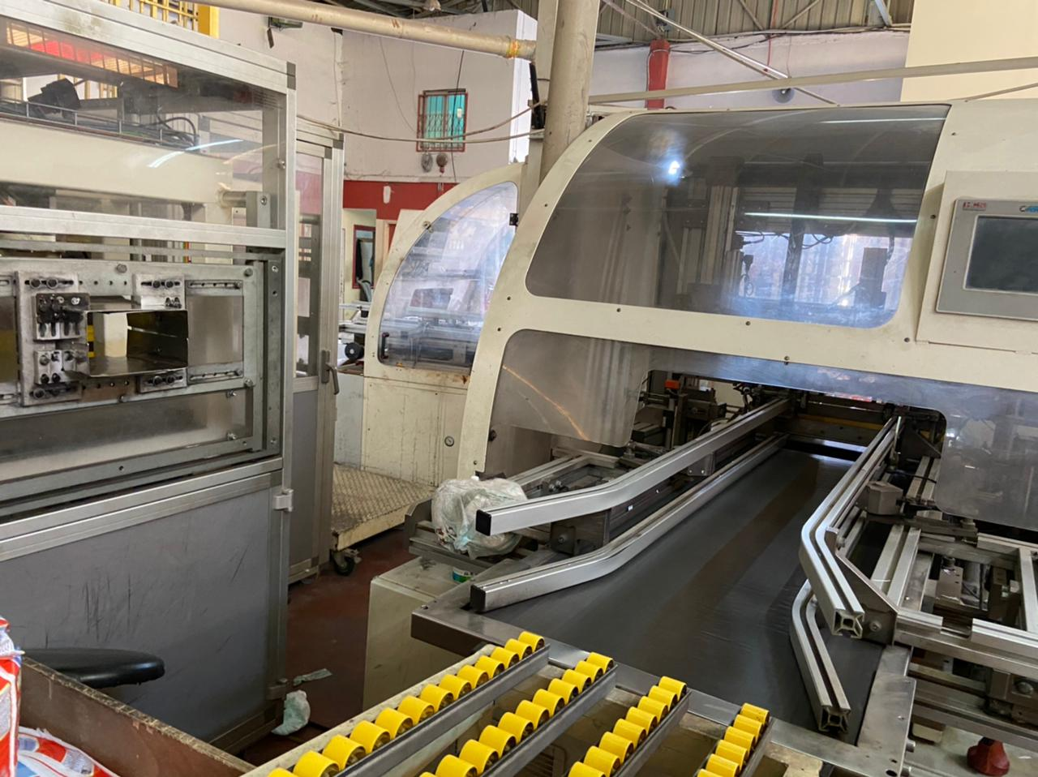
Introduction
Soft tissues
production line
Toilet & kitchen production line
Diapers production line

Slide 5







Inventory Management
Order Fulfilment
06
01
Quality
05
Problem Statement
02
Production Planning
04
03
Safety and Ergonomics
Preventive Maintenance

Slide 6
Objectives
1
2
3
4
5
Improve communication between departments
Improve maintenance
Enhance inventory
management
Improve safety
Improve quality system

Slide 7

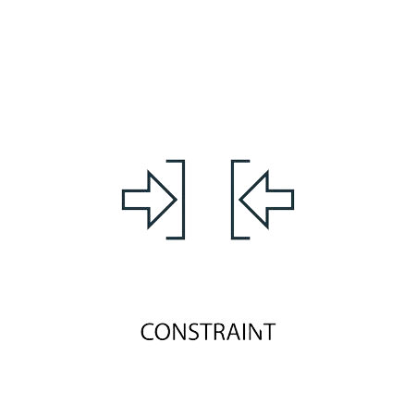



Methodology
Apply what we have studied in previous courses to solve AECO problems
5
Search on theoretical background & previous work
4
3
Identify constraints
Data collection and studying the current situation
1
2
Identify the main problems

Slide 8






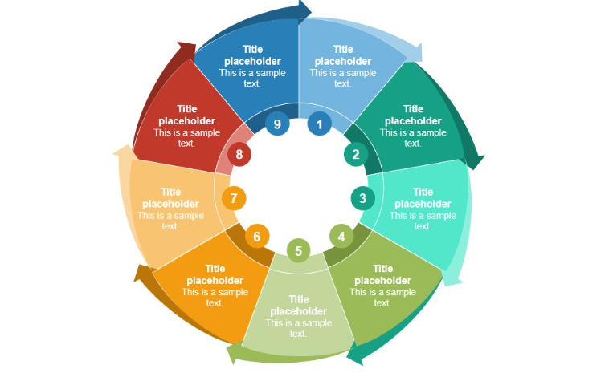
Results & Analysis
Quality
Control
Products list
Order fulfillment process
Safety
Current Situation Study
Inventory Management
Flow operation chart
Communication between departments
Factory departments
Production planning

Slide 9

Results & Analysis
Results & Analysis
1
Sales forecasting
Julia Premium
Extra lucky soft
Linda extra
Our Goal is:
Minimum Mean Absolute Deviation
Minimum Mean Squared Deviation

Slide 10

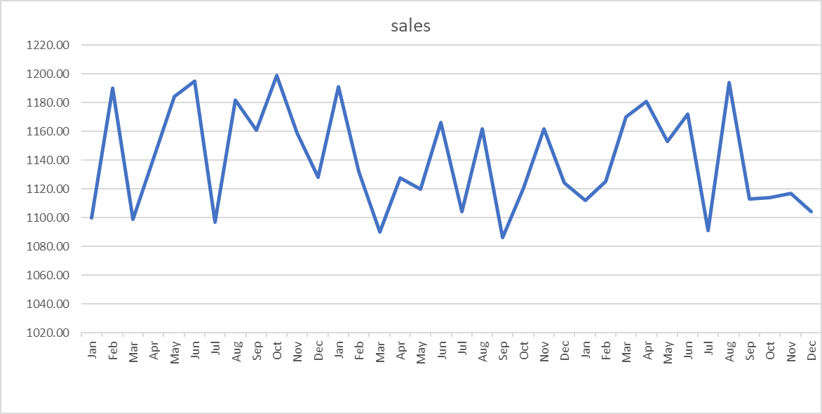
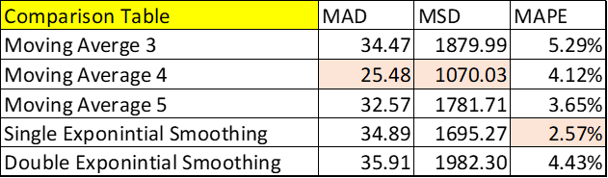
1
Sales forecasting
Julia Premium
Julia Premium
Julia Premium pattern Analysis

Slide 11

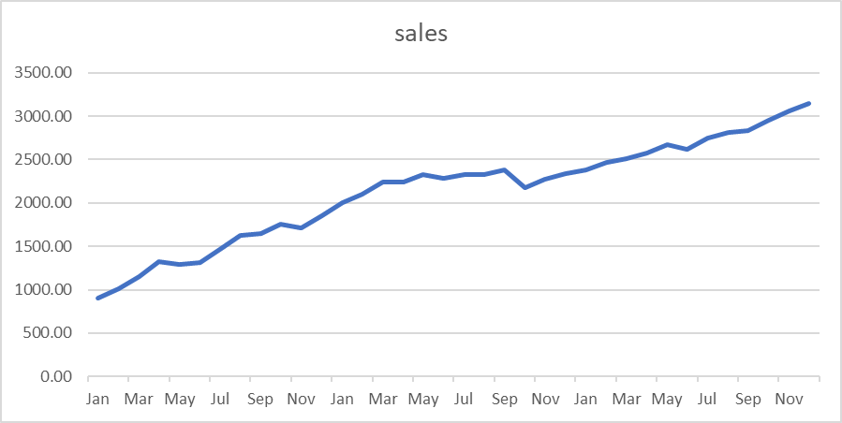
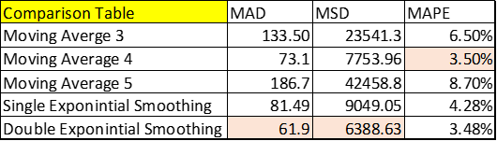
1
Sales forecasting
Linda extra
Linda Extra pattern analysis

Slide 12

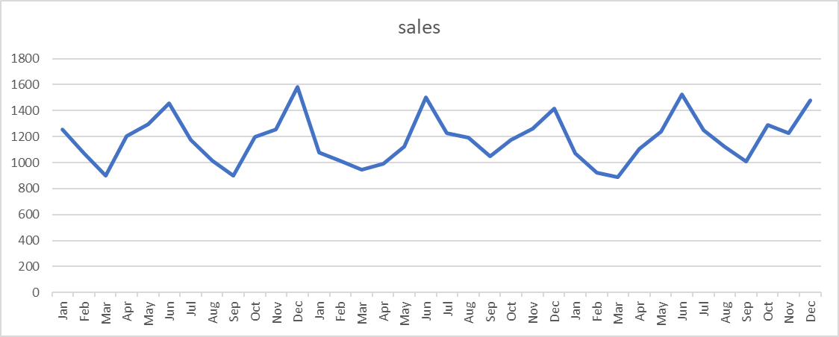
1
Sales forecasting
Extra lucky soft
Extra Lucky soft pattern analysis

Slide 13
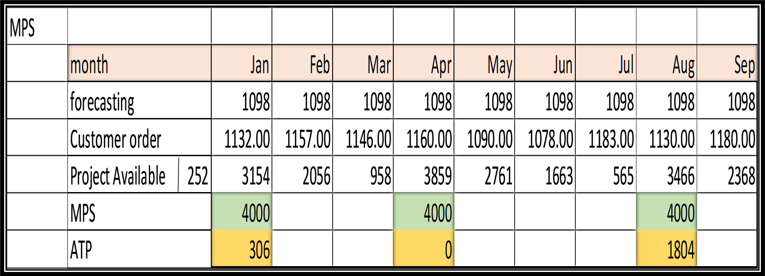
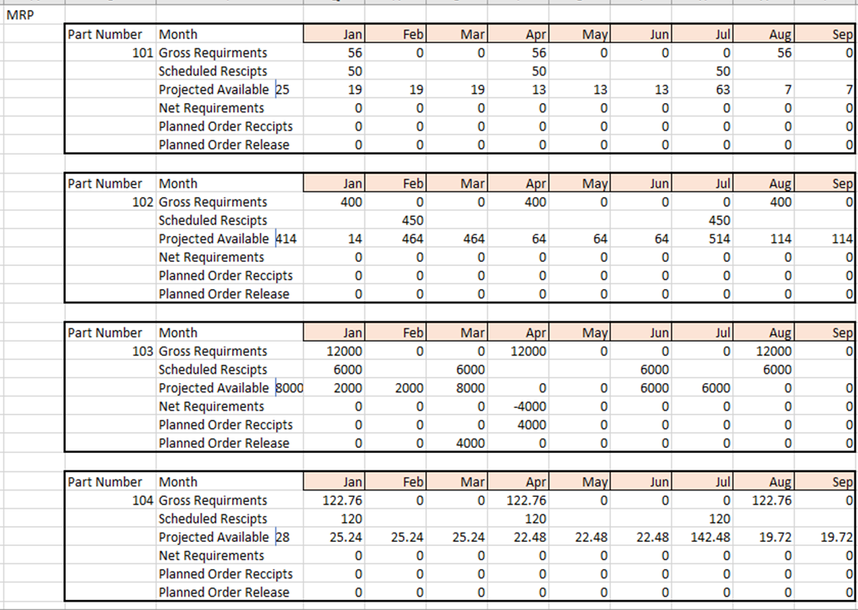
Results & Analysis
Results & Analysis
2
2
Production Planning
Production Planning
Master Production
Planning
Material Requirment
Planning
Julia
Premium

Slide 14
Results & Analysis
3
Maintenance System
Failure mode and effect analysis, does evaluate each problem related to maintenance.
We have studied main repeated maintenance problems at AECO.
The PRN number is an indicator on how much serious this problem.
Severity
Occurrence
Detection
FEMA

Slide 15
3
Maintenance System

Slide 16
3
MTBF: Mean time between failure
MMTR: Mean time to repair
Maintenance System
The 4 main problems have been chosen, and make a comparison between current and predicted MTTR, MTBF and RPN
Process Step/Input
SEVERITY
OCCURRENCE
DETECTION
Risk Priority Number (RPN)
SEVERITY
OCCURRENCE
DETECTION
Risk Priority Number (RPN)
MTBF
MTTR
Action Recommended
MTTR
RPN
MTBF

Slide 17
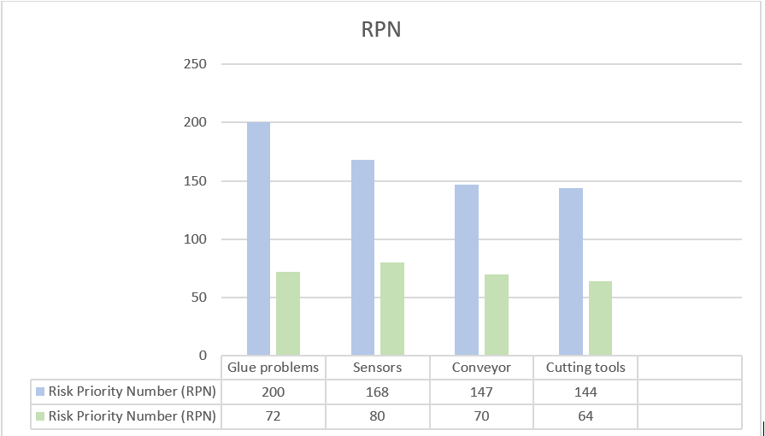
3
Maintenance System
RPN

Slide 18
Results & Analysis
Inventory and warehouses management
4
Safety stock and reorder point
01
02
ABC classification
identification of the products
05
03
Warehouse design
04
Material Handling

Slide 19
Inventory and warehouses management
4
Safety stock and reorder point
01
1- Safety stock and reorder point for final products
2- Safety stock and reorder point for raw materials
Product name | Monthly Usage | max monthly usage | avg. Lead time (month) | Max Lead time | reorder point | safety stock
جوليا بريميوم مضغوط 18ابيض ثلاث طبقات | 1138 | 1199 | 0.108874 | 0.114317 | 137.0665 | 13.16827

Slide 20
Inventory and warehouses management
4
ABC classification
02
% of items
% of overall value
A | 28.57143% | 73.87641%
B | 31.42857% | 20.86172%
C | 40% | 5.261873%

Slide 21
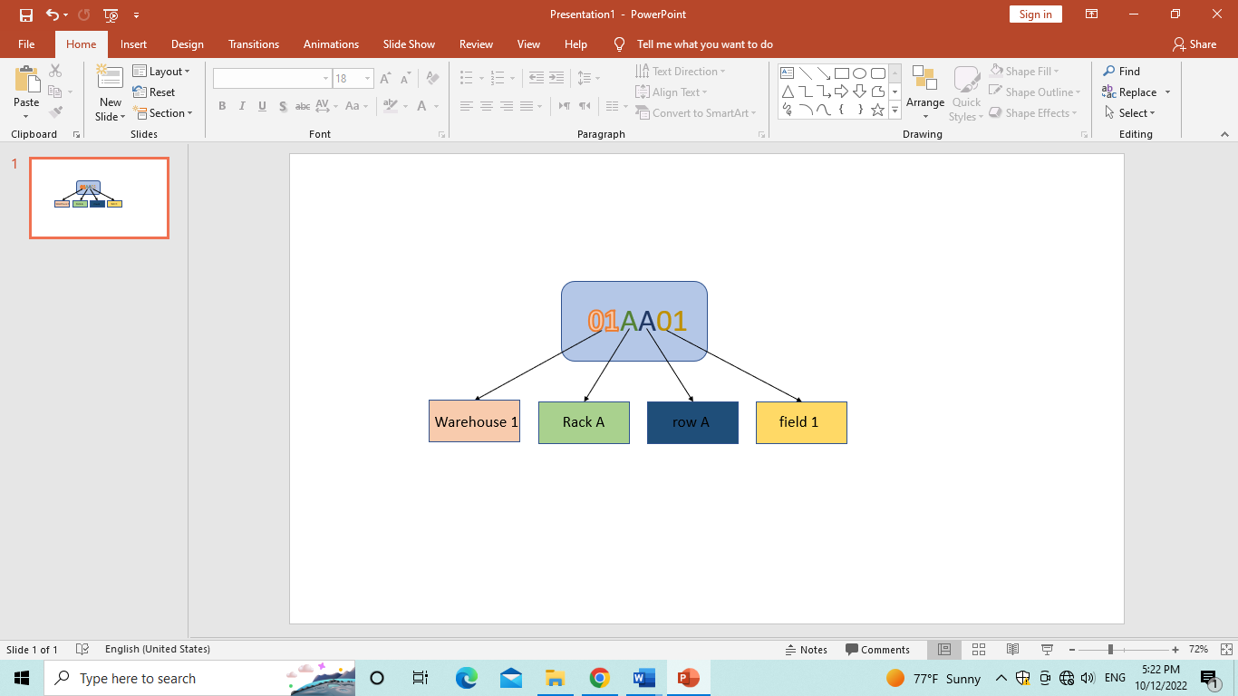
Inventory and warehouses management
4
Identification of the products
( Item coding )
03

Slide 22
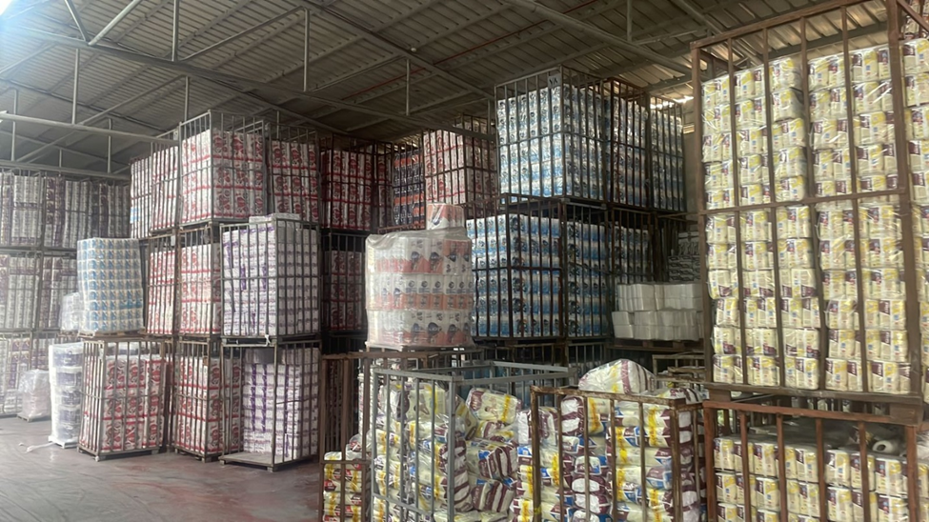
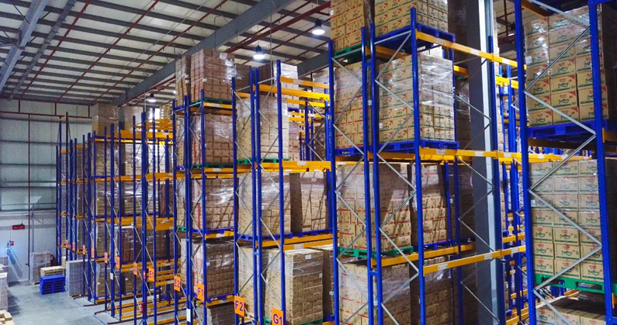
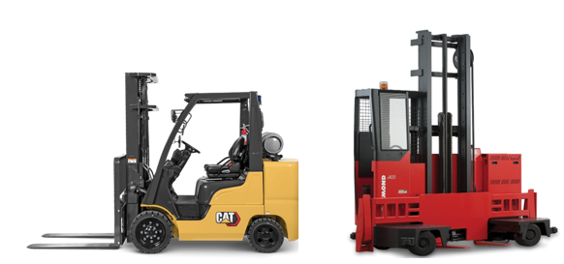
Inventory and warehouses management
4
Warehouse design
04

Slide 23
Inventory and warehouses management
4
Warehouse design
old storage method
04

Slide 24
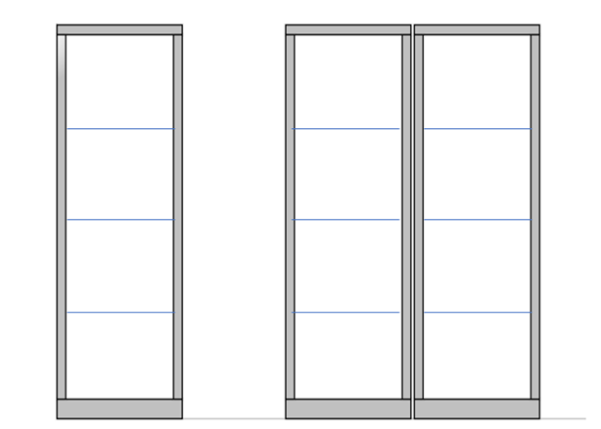
Inventory and warehouses management
4
Warehouse design
Pallet racking storage system
04

Slide 25
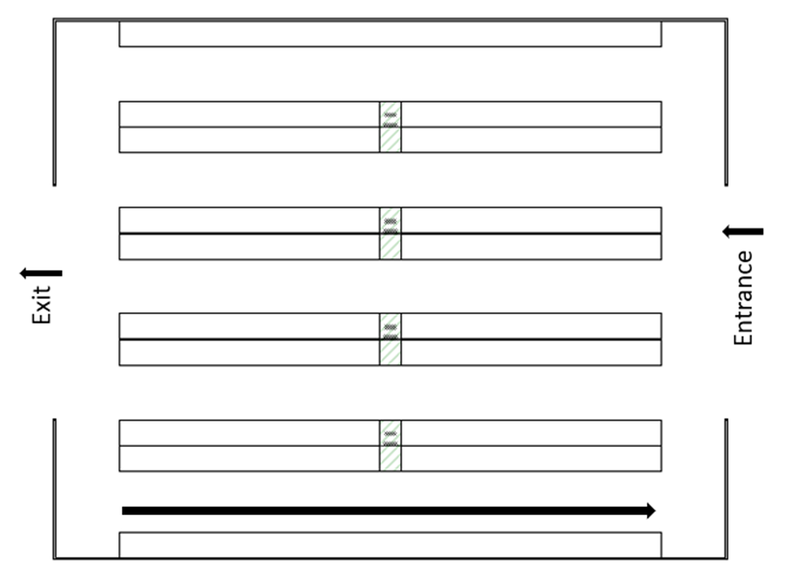
Inventory and warehouses management
4
Warehouse design
new layout of the warehouse
04

Slide 26
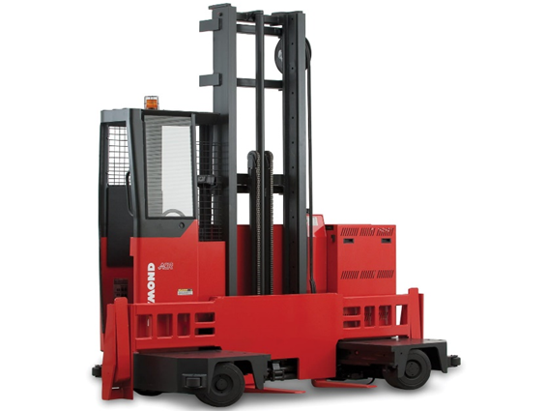
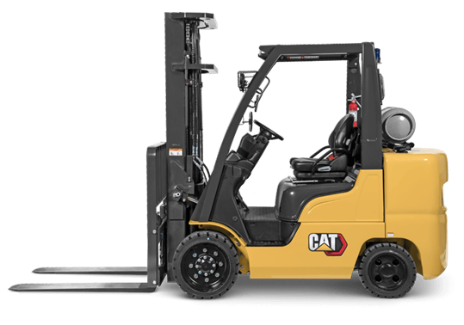
Inventory and warehouses management
4
Material Handling
05
The old forklift
The new forklift

Slide 27

Results & Analysis
5
Safety System
Objectives for increasing safety
1
2
3
Reduce Risks
Reducing Injuries and Injury-Related Costs
Improving Employee Morale and Performance

Slide 28
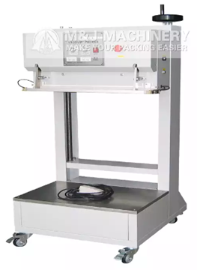
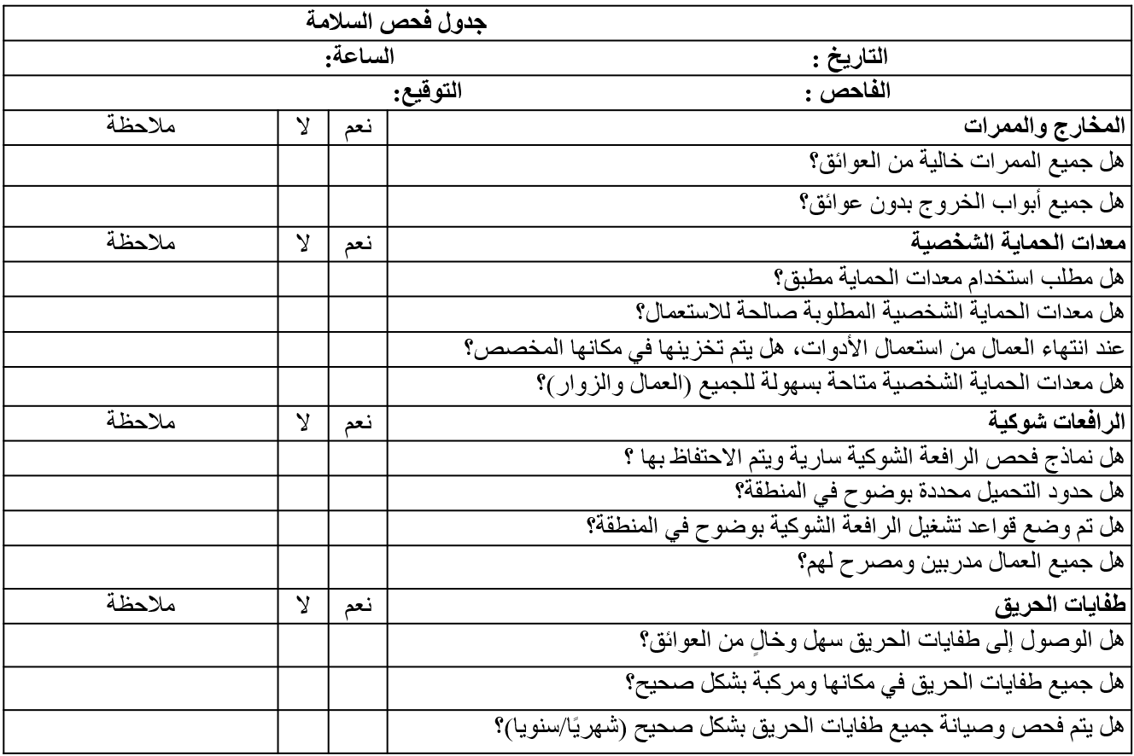
5
Safety System
Dust Accumulation
Effectiveness
of Fire Systems
Machine Noise
Muscle Fatigue
Increase the number of suction cups so that the sum of the capacity of suction cups is 8572.35.
Providing masks
Buying a welding machine
Use the safety inspection form.
Providing hearing protection tools.

Slide 29
5
Safety System
Safety Types:
Building Safety
Human Safety
Product Safety
Machine Safety
Fire safety
Emergency exist and Corridors
Ventilation
Ergonomic
Personal protective equipment
Material handling
Materials handling
Cleanliness
Carrying out preventive maintenance of the machine

Slide 30
5
Safety System
Rules and Guidelines
Follow Electrical Safety Rules
Inform the supervisor of any danger
09
01
Smoking is only permitted in designated smoking area.
08
Periodic Inspection of
Firefighting Systems
02
07
Use the prescribed personal protective equipment
Use seat belts while using
any vehicle.
03
06
Keep work areas clean and do not block emergency exits.
Only authorized persons
repair or modify the machines.
05
04
Do not open the door of the machine until it stopped.

Slide 31

Results & Analysis
6
Quality System
1
2
In Process Record
Raw Materials
Form
3
Procedures
Heat Map
4

Slide 32
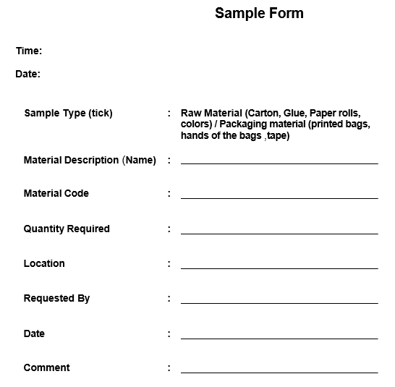
6
Quality System
Quality Form for the Raw Material, which is more accurate to track and test the raw material.

Slide 33
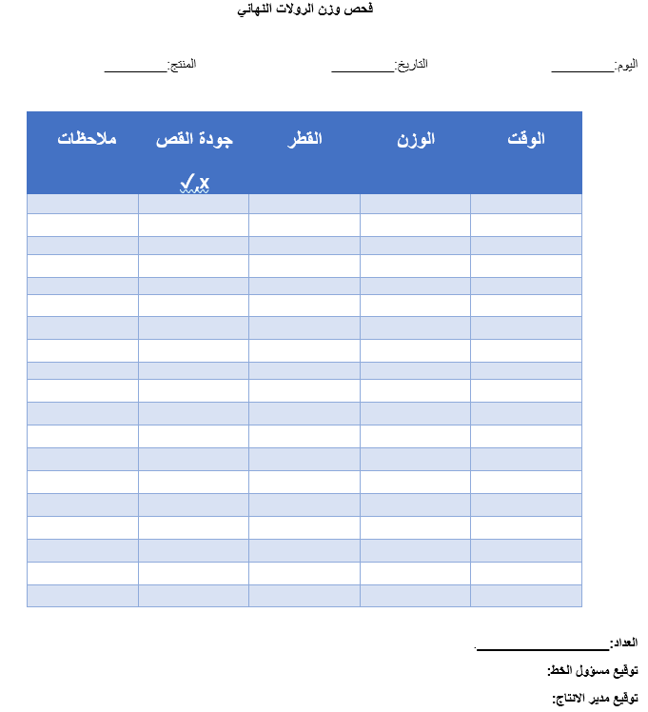
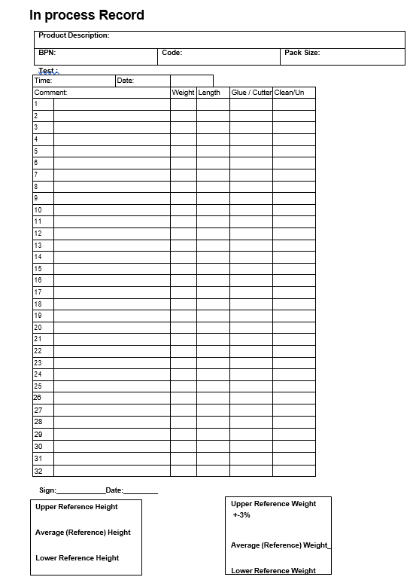
6
Quality System
In Process Record, before and after Improvement.

Slide 34
Randomly Vs. Calculated Sample size
6
Quality System
Randomly Vs. Calculated Sample size
YES
Calculated sample size
Sample Size:
n = N * [Z² * p * (1-p)/e²] / [N – 1 + (Z² * p * (1-p)/e²)]
By using this formula :
They must take 17 rolls/30 minutes
NO
Random size
They used to take 3 rolls/30minutes
Notes:
© Copyright PresentationGO.com – The free PowerPoint and Google Slides template library

Slide 35
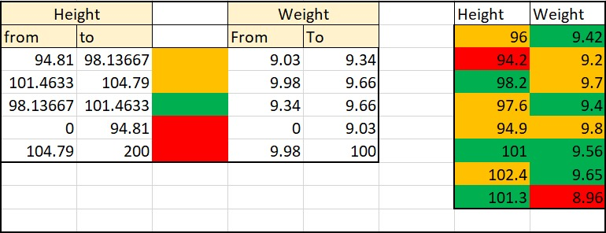
6
Quality System
Heat Map shows the allowance the height of the rolls must be within these averages
Weight
Height
Weight
Height

Slide 36


6
Quality System
After discussing one of the main topics with the heads we came up with these procedures to help the company employ more employees easily.
SUPPLIER EVALUATION PROCEDURE
UNSUITABLE MATERIAL AND CONTROL OF MANUFACTURING PROCEDURE

Slide 37
Conclusion
The use of item cards, reorder point, safety stock and the new layout of the store facilitates the process of storing, entering, and removing goods.
01
Not all the products will have the same forecasting method.
04
05
02
Documented maintenance would help the factory to prevent the failure in the machine and do preventive actions.
05
Using the quality forms will help the company to have more qualified processes and final products.
03
Production planning would help solving the problem of miscommunication between the departments.
06
Apply safety form to ensure reducing injuries that workers may be exposed.

Slide 38





Recommendations
Focus on increasing the sales for the products, which have a stationary pattern
Implement the forecasting methods
Apply reorder point and safety stock
Implement the MPS/MRP
Follow up with the maintenance system and do preventive maintenance in time
.
.

Slide 39

Recommendations
Apply ABC classification
Using the new layout of the warehouse
Follow up with the safety recommendation
07
09
08
10
Use the item number to facilitate the storage process
Implement the quality forms and procedures
.
.

Slide 40

WELCOME!
Thank You
Any questions?

Slide 42
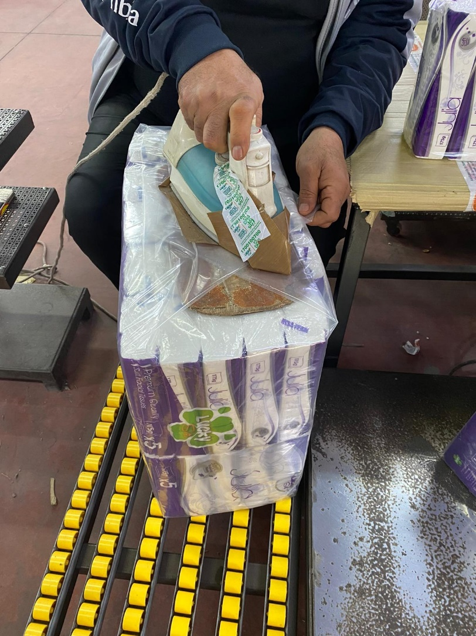

Slide 43
Safety form

Slide 44
2
Production Planning

Slide 45
2
Production Planning
Paper Roll

Slide 46
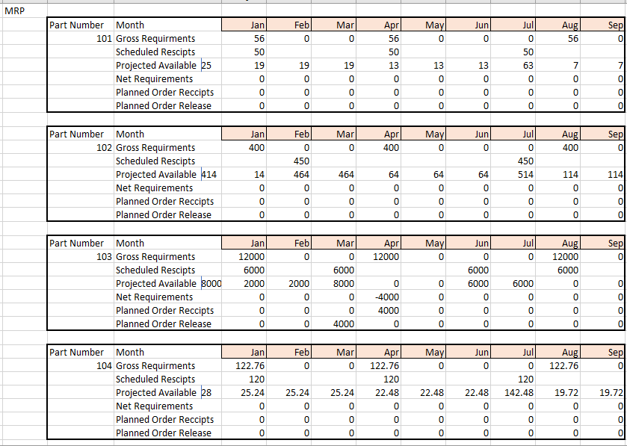
2
Production Planning

Slide 47
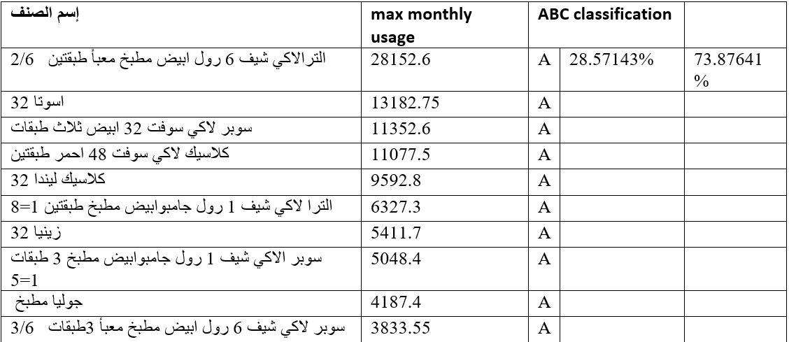
Inventory and warehouses management
5
04

Slide 48
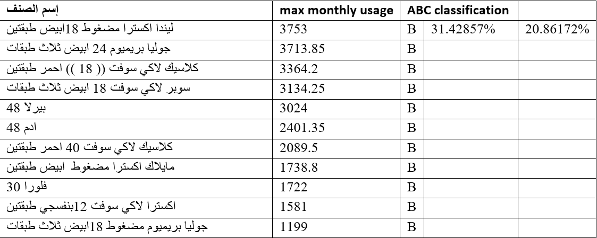
Inventory and warehouses management
5
04

Slide 49
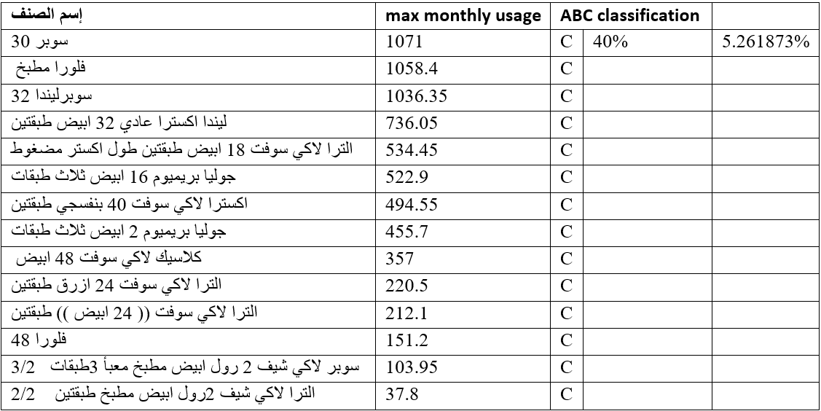
Inventory and warehouses management
5
04

