Slide 1

Graduation Project 2
SUSTAINABLE PERFORMANCE INTEGRATION FOR BUSINESSMEN FORUM BUILDING'S
Prepared By :
Ahmad AWWAD
Othman DARIYAH
Tariq SHEHAB
Supervised By : Eng. Wala OMAR

Slide 2
Outline
Site description & Analysis
Architectural design
Environmental design
Structural design
Mechanical design
Electrical design
Quantity survey and cost
Conclusion

Slide 3
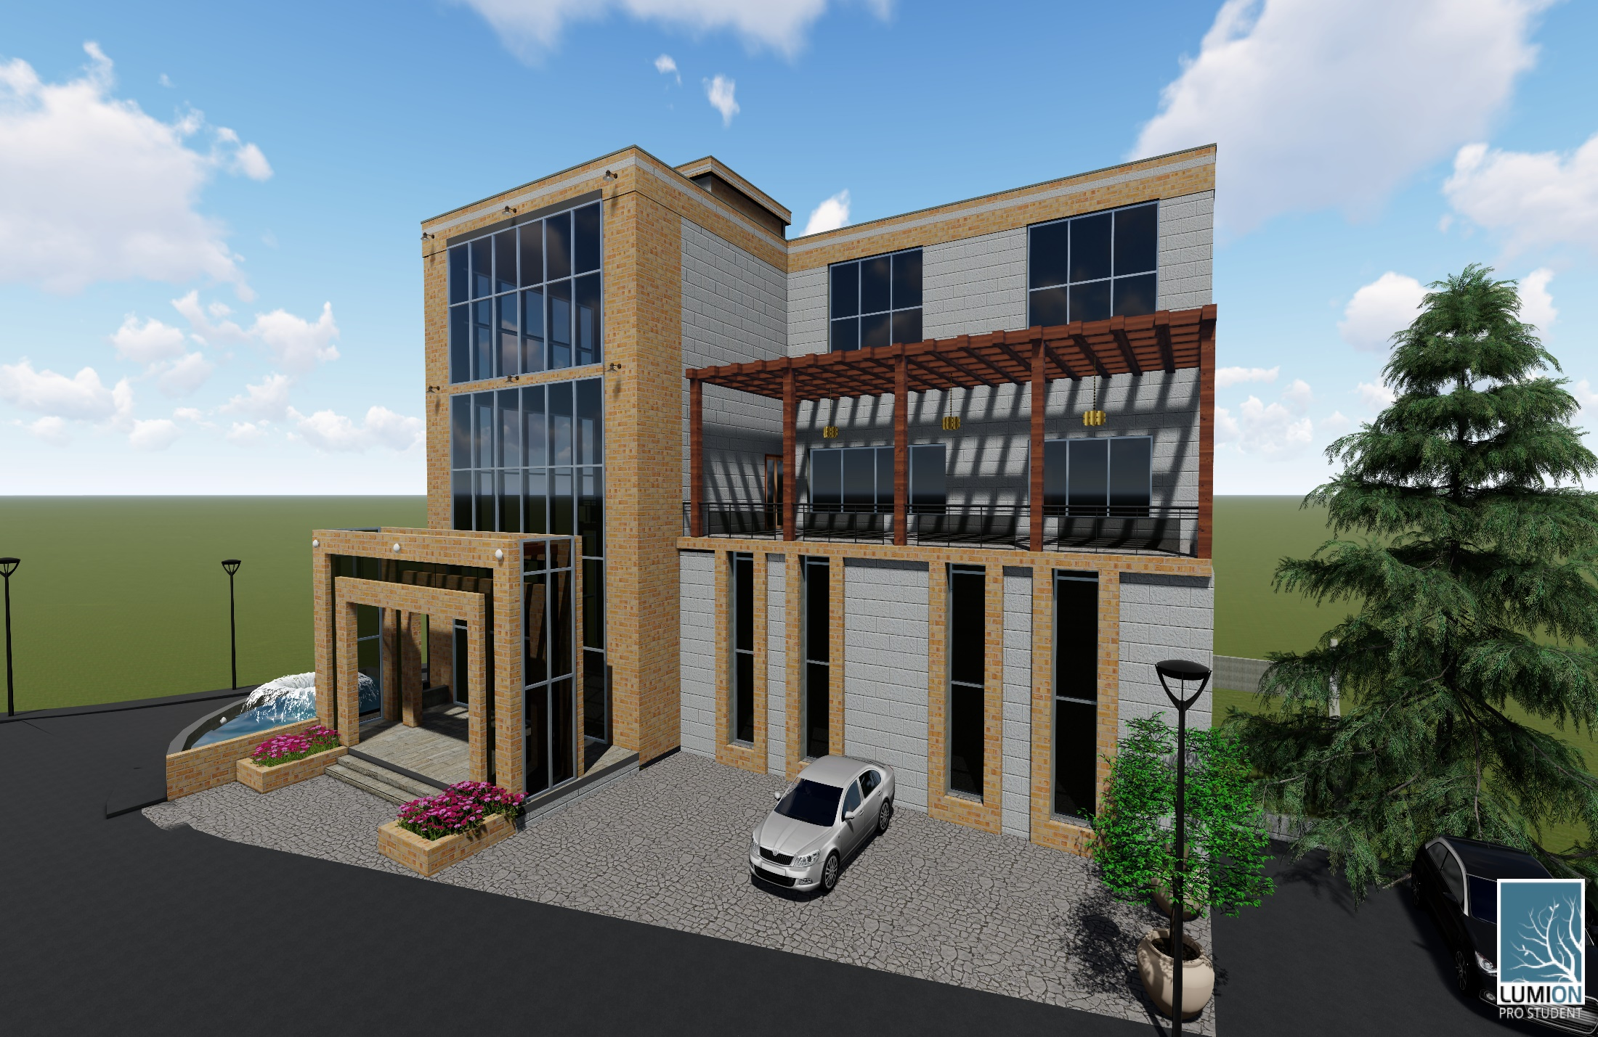
Introduction
Nablus Businessmen forum.

Slide 4
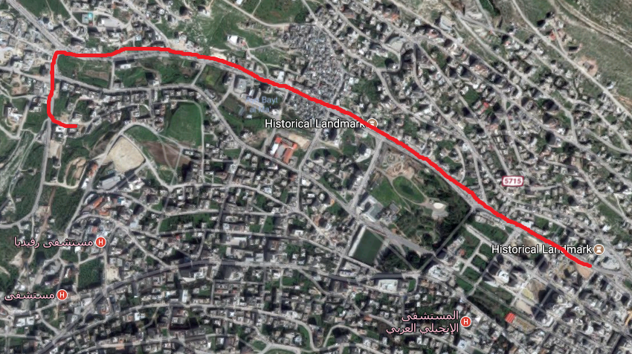
Site analysis
N

Slide 5
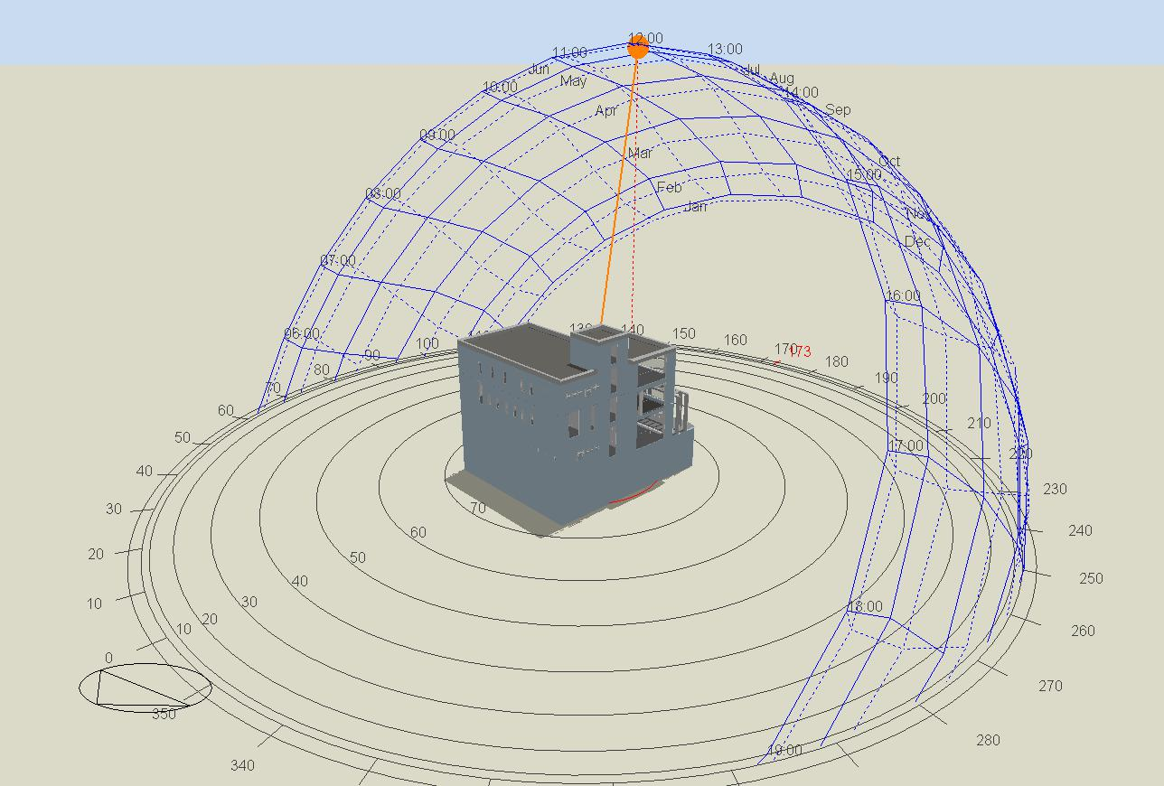
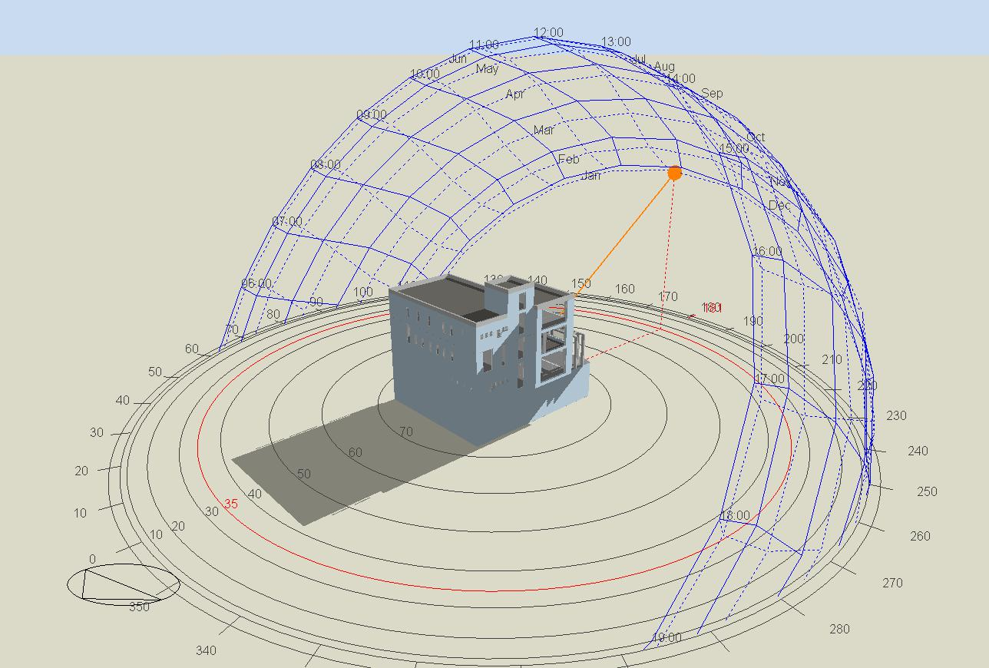
Sun Path & Shading
12 pm in June
12 pm in December

Slide 6
Architectural design
Site Plan
Basements
Ground Floor
First Floor
Second floor

Slide 7
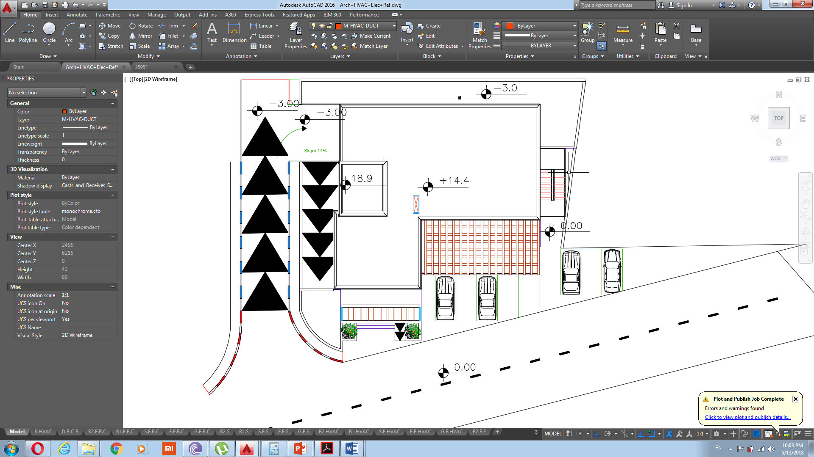
Site Plan
N

Slide 8
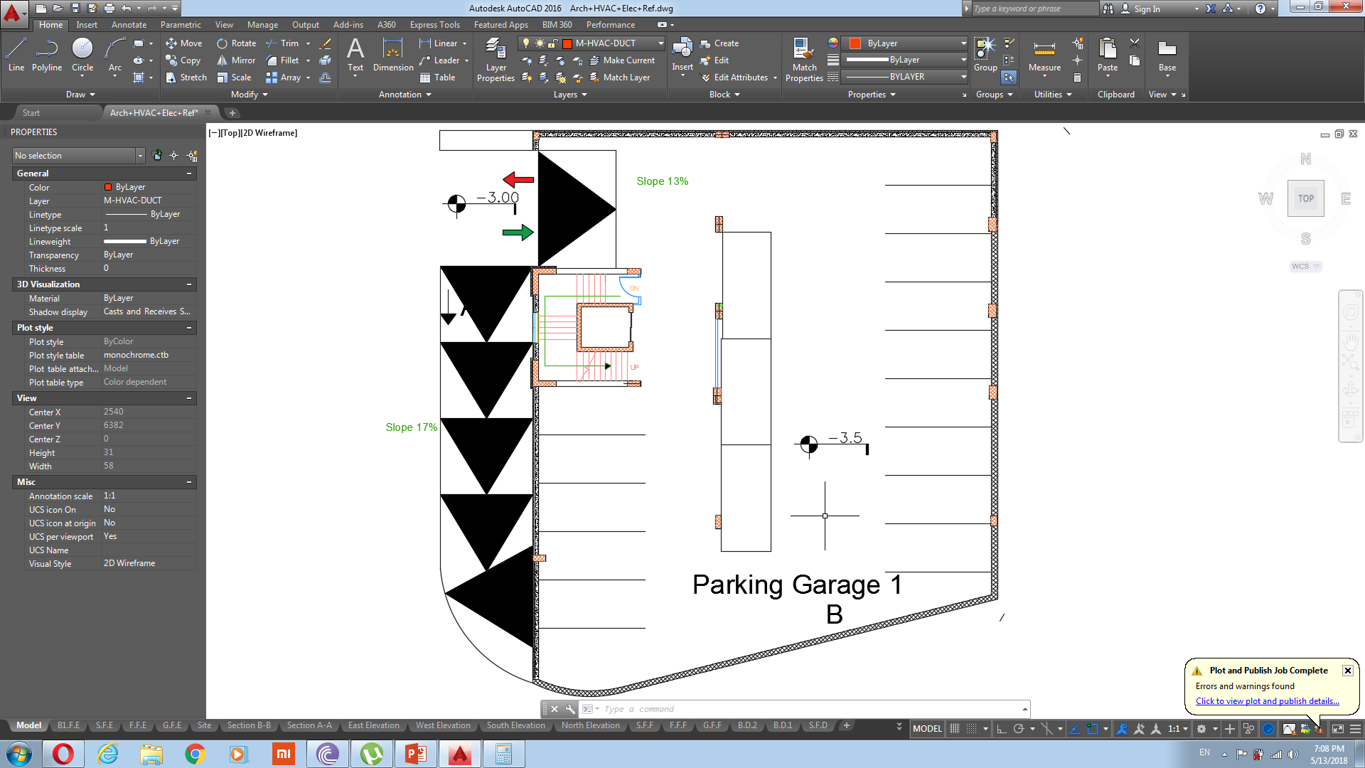
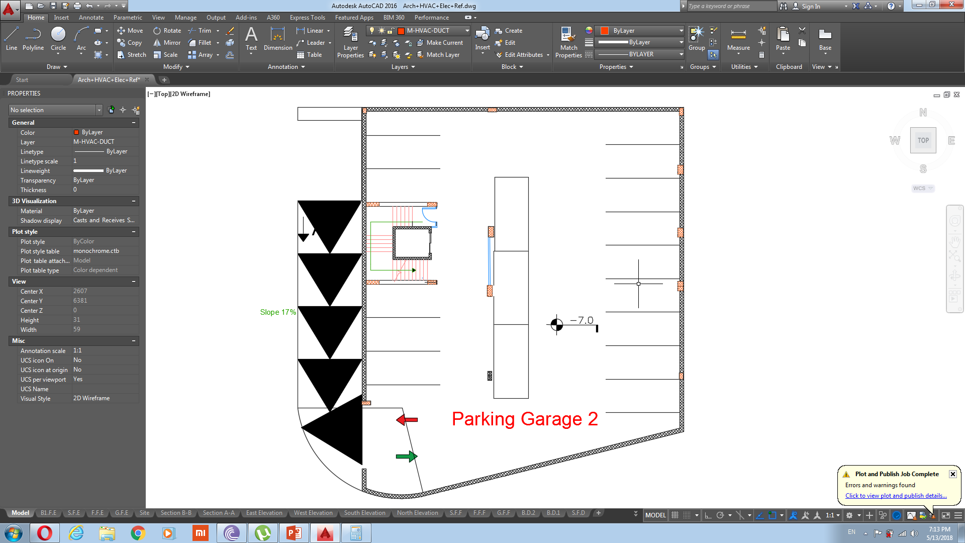
Basements
N
First basement floor
second basement floor
About 650 $m^{2}$ and capacity for 18 cars for each basement floor.

Slide 9
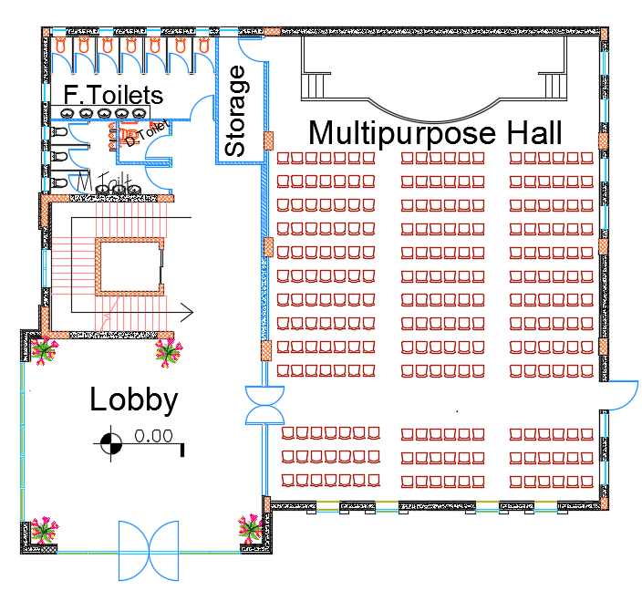

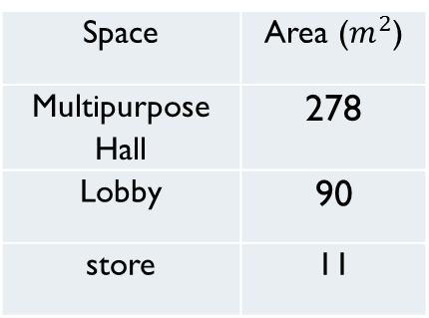
Ground Floor
Total area = 518 $m^{2}$
Space | Area ($m^{2}$)
Multipurpose Hall | 278
Lobby | 90
store | 11
Expected Number of
Audience
210
Schedule
Afternoon & Evening Time

Slide 10
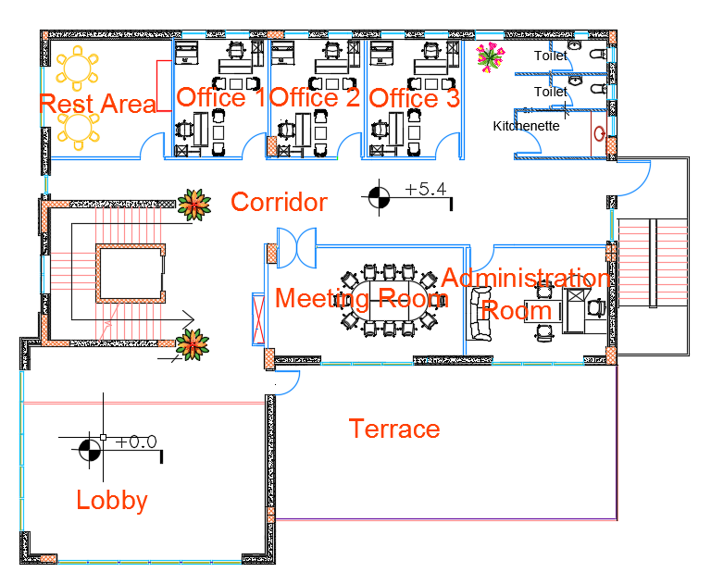


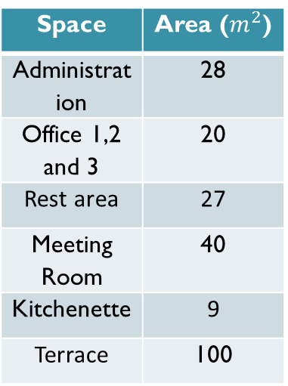
First Floor
Total area = 518 $m^{2}$
Space | Area ($m^{2}$)
Administration | 28
Office 1,2 and 3 | 20
Rest area | 27
Meeting Room | 40
Kitchenette | 9
Terrace | 100
Total area = 518 $m^{2}$
Expected Occupancy
8-11
Schedule
8 Working hours
(9 am-5 pm)

Slide 11
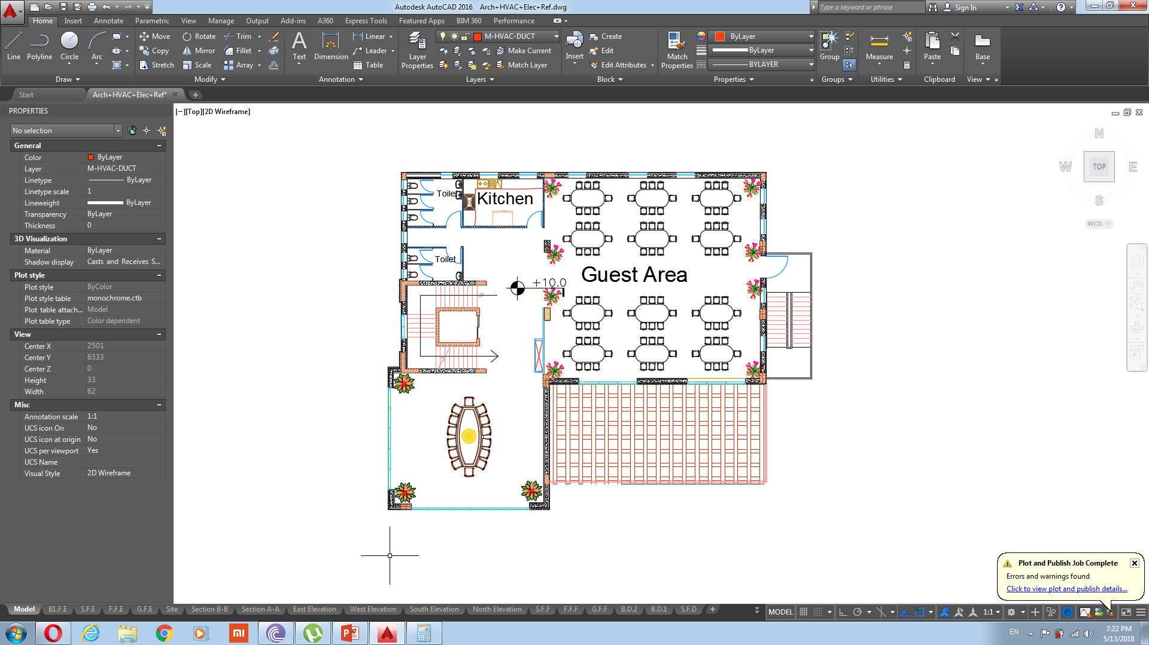
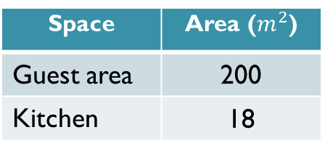

second Floor
Total area = 418 $m^{2}$
Space | Area ($m^{2}$)
Guest area | 200
Kitchen | 18
Expected Number of
Users
100
Schedule
At Evening Time

Slide 12
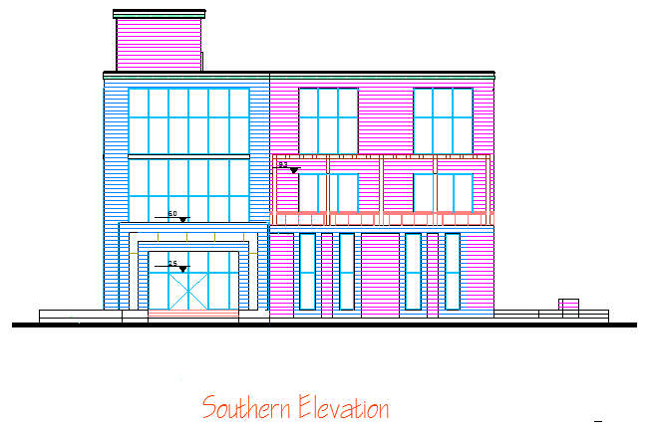
Southern Elevation

Slide 13
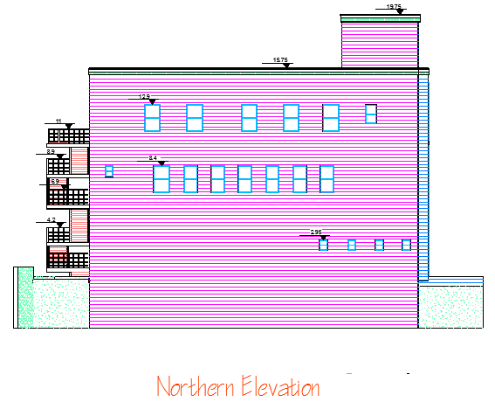
Northern Elevation

Slide 14
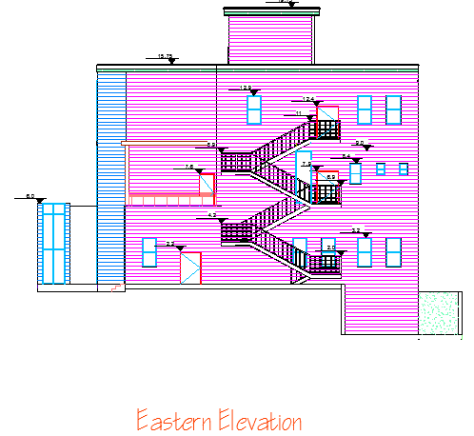
Eastern Elevation

Slide 15
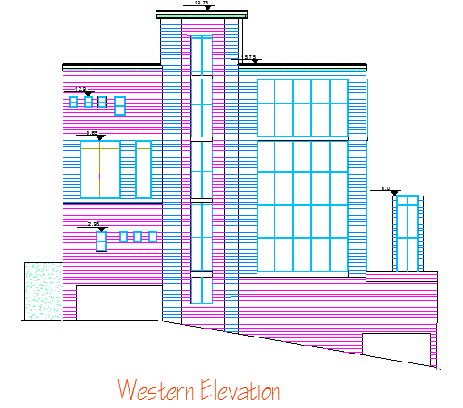
Western Elevation

Slide 16
Comparison
The comparison between the old design and our design for the ground floor
 | The current design | Our design
lobby | Lobby with an area of 40 m² is not enough for 255 people | Lobby with an area of 90 m² is enough for 210 people
Toilets | There are not enough number of toilets for men and women, and there are no urinals | There are enough number of toilets for men and women, and there are urinals
Toilet for the disabled | There is no toilet for the disabled | There is a toilet for the disabled
Store | There is no storage area for excessive chairs and the stage equipment’s | here is a storage area for excessive chairs and the stage equipment’s

Slide 17
Comparison
In the current design, there are 15 parking spaces only .
In our design, the basement floors designed as garages with capacity 35 cars, and in outside the building and within the boundaries of the building land, there are 7 parking spaces.
Total = 42 parking spaces.
In the current design, the view of the terrace was mainly north, but on the north side the view was blocked because of a building from the north.
In our design, we change the location of terrace to the south side with view to the south and east.
In the current design, there is excessive areas for offices and the meeting room, and there is no rest area.

Slide 18
Environmental Design
Thermal design.
Natural Lighting.
Acoustic Design.

Slide 19
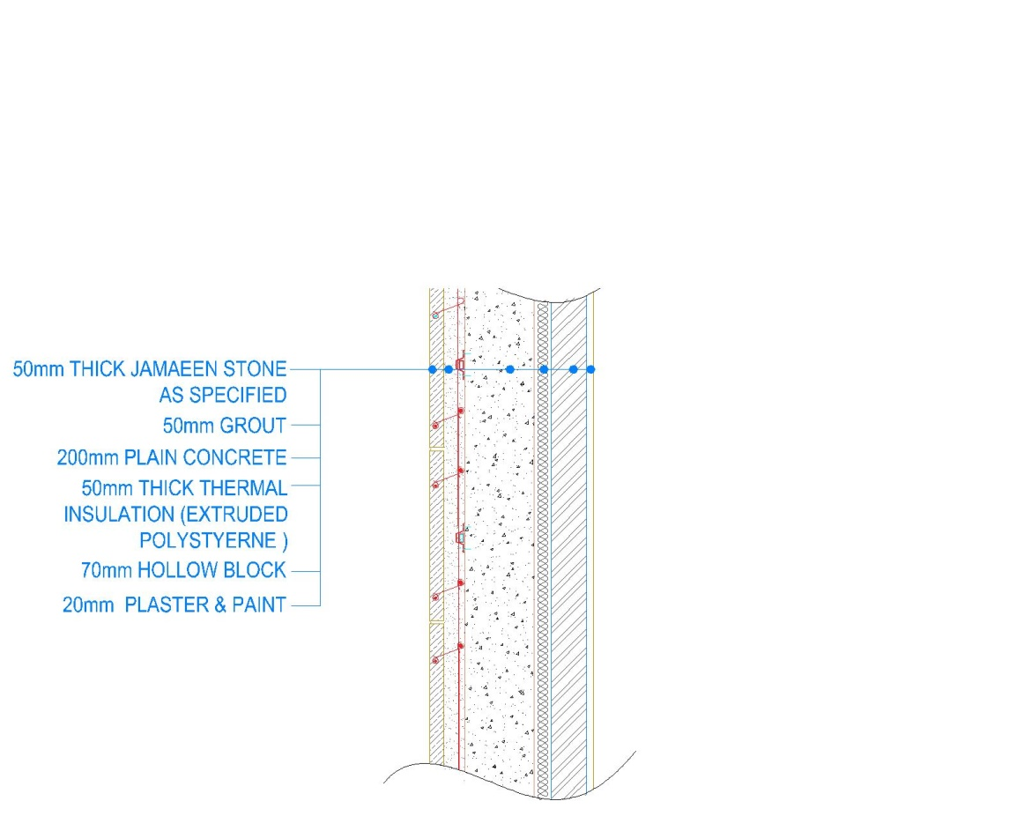
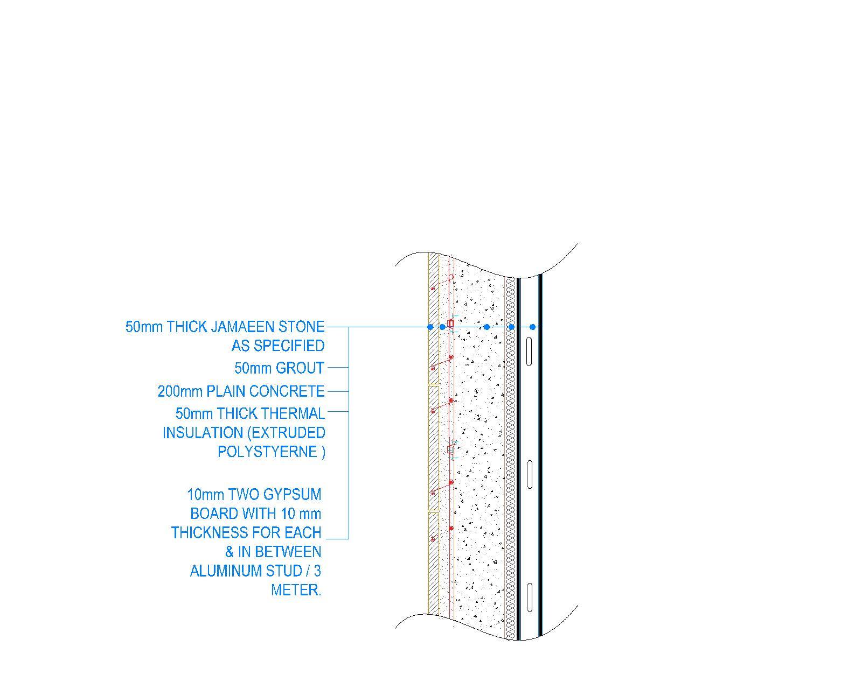

Thermal
Two types of Exterior Wall (1,2)
1
2
Both almost have the U value
U-Value = 0.49 W/$m^{2}$.K

Slide 20
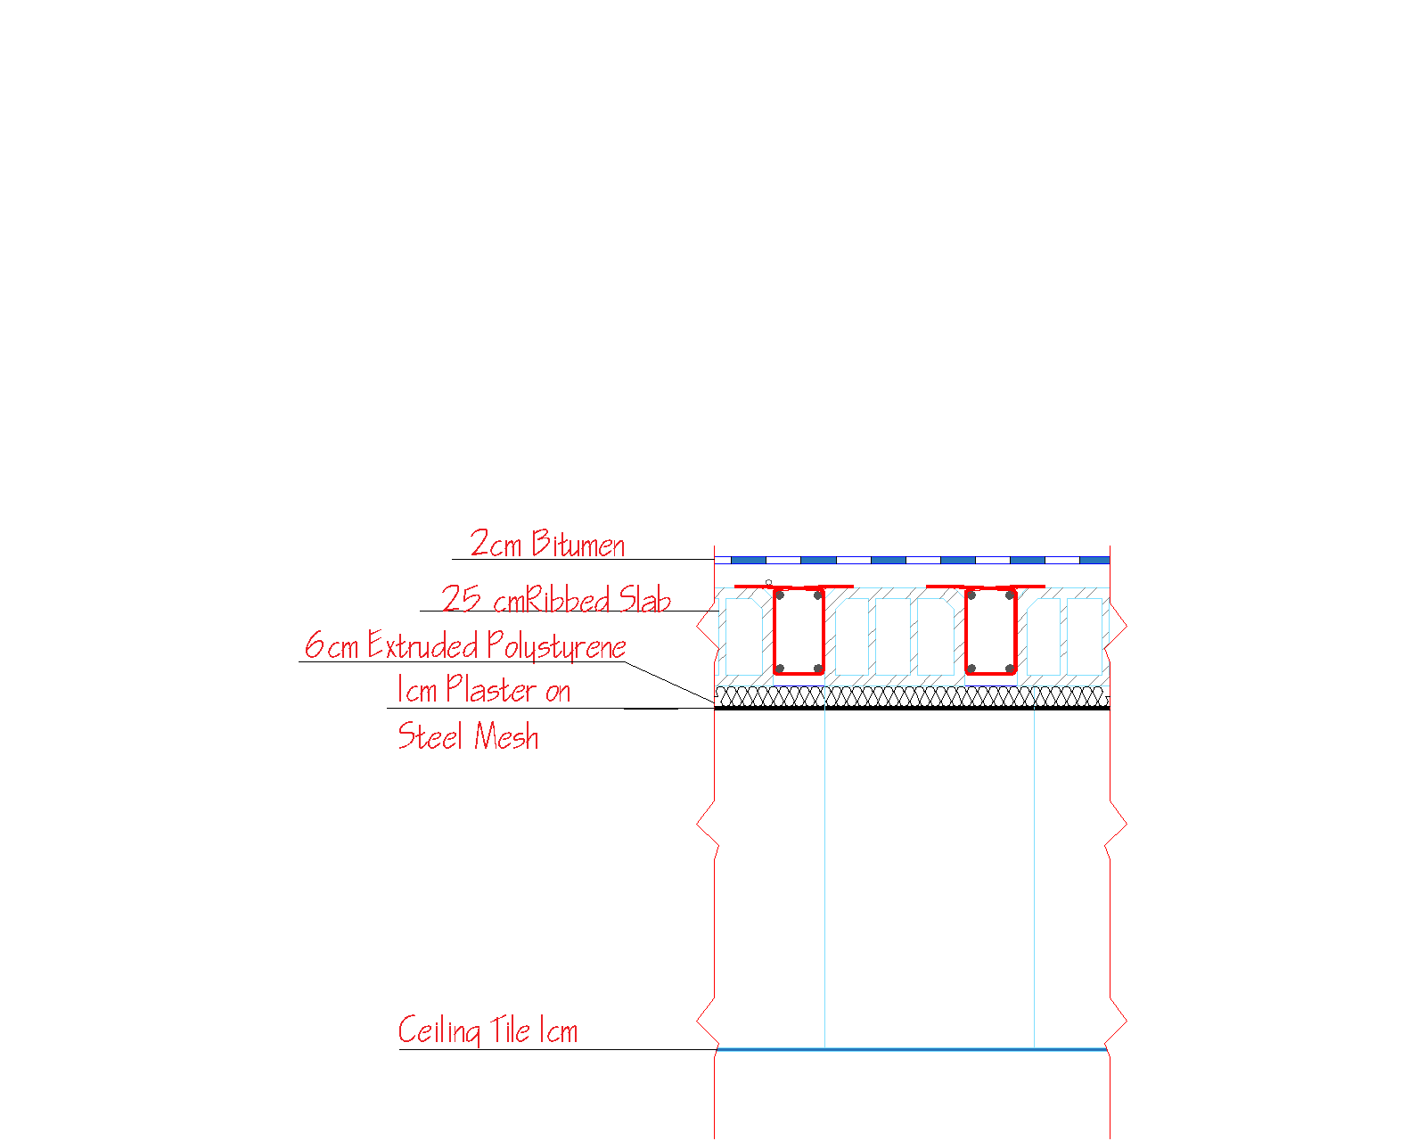


Thermal
Exterior Slab
Glazing
Double grey 3mm/13mm argon LOE (low emittance glass).
U-Value= 1.49W/$m^{2}$.K.
U-Value= 0.39W/$m^{2}$.K.

Slide 21
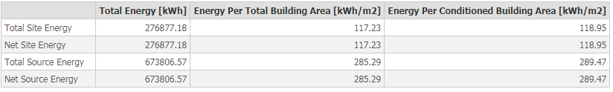
Design Builder Results

Slide 22
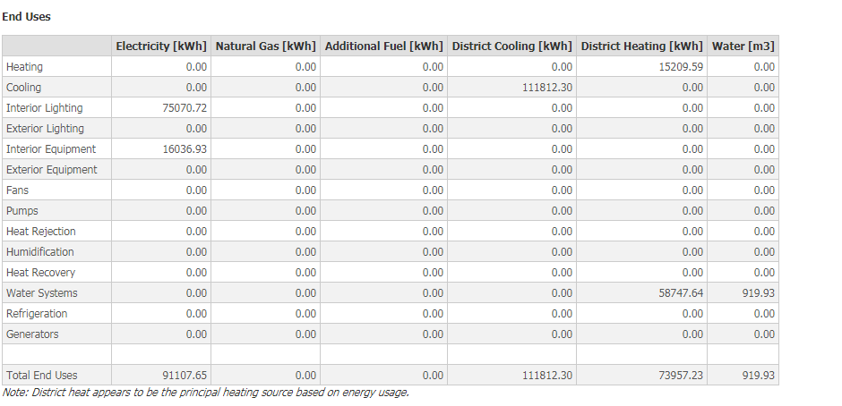
Design Builder Results

Slide 23
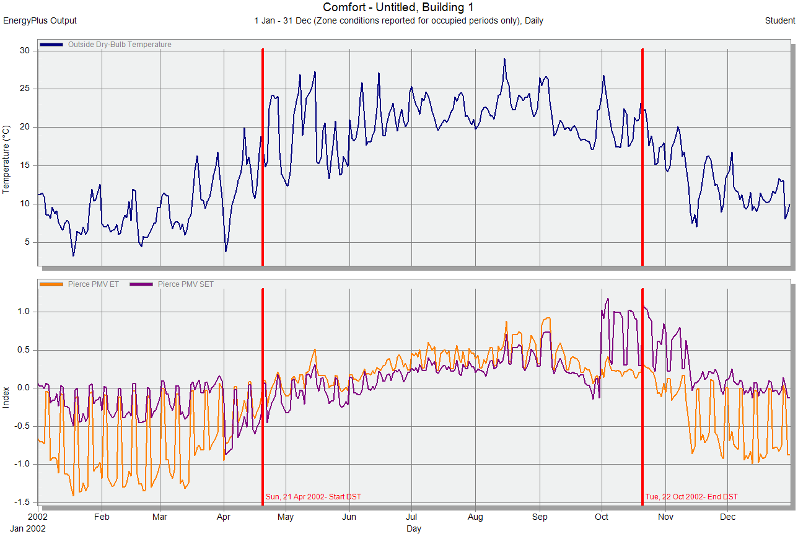
Design Builder Results

Slide 24
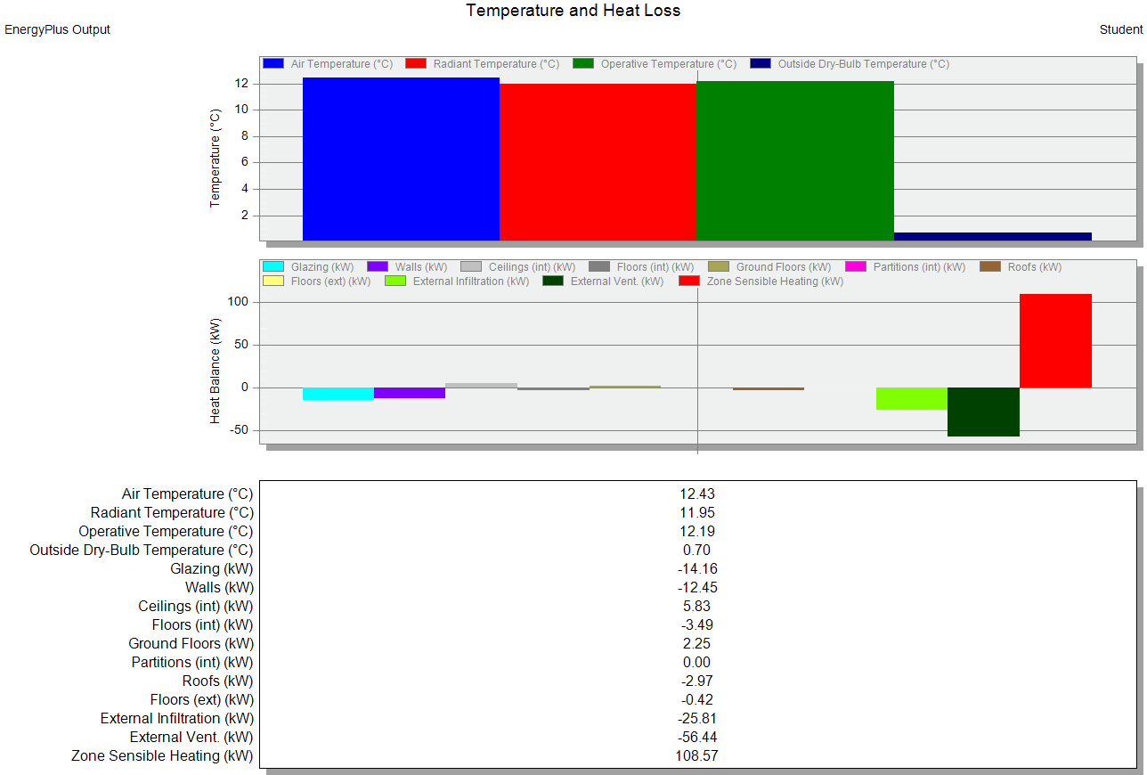
Design Builder Results

Slide 25
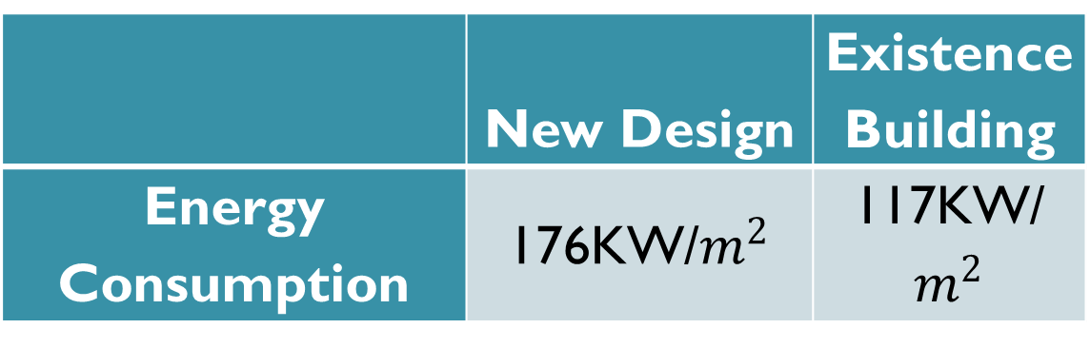
Comparison
Big difference between the energy consumption of the existing and the new design is noted.
 | New Design | Existence Building
Energy Consumption | 176KW/$m^{2}$ | 117KW/$m^{2}$

Slide 26
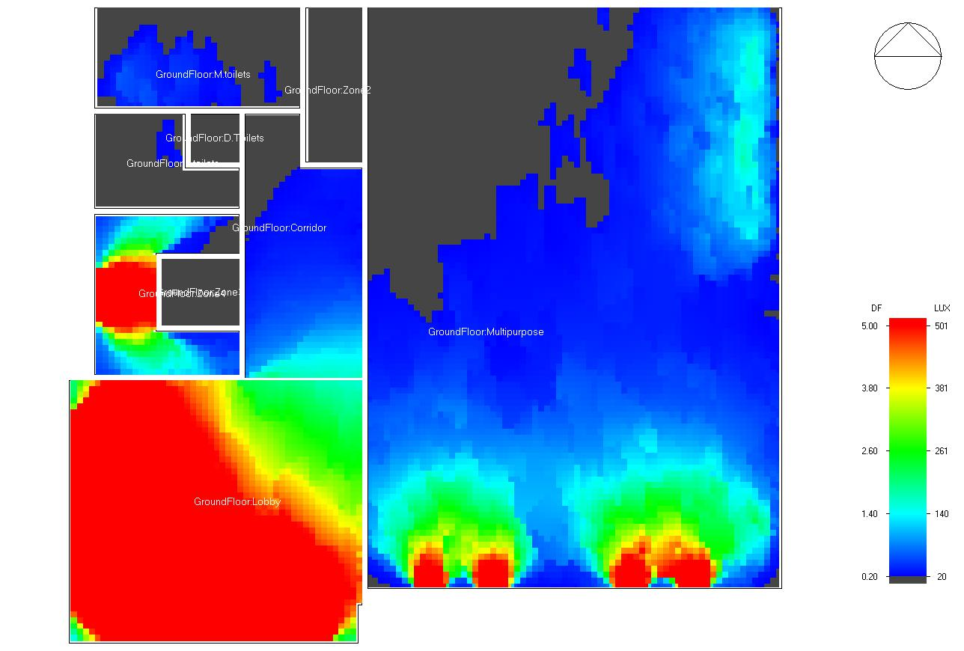
Natural Lighting
Ground Floor
Space | DF% | DF% Required | DF% Min | Comparison
Lobby | 8.11 | 2 | 0.6 | Within
Multipurpose | 0.81 | 2 | 0.6 | Within
Corridor | 1.36 | 2 | 0.6 | Within
Stair | 2 | 2 | 0.6 | Within

Slide 27
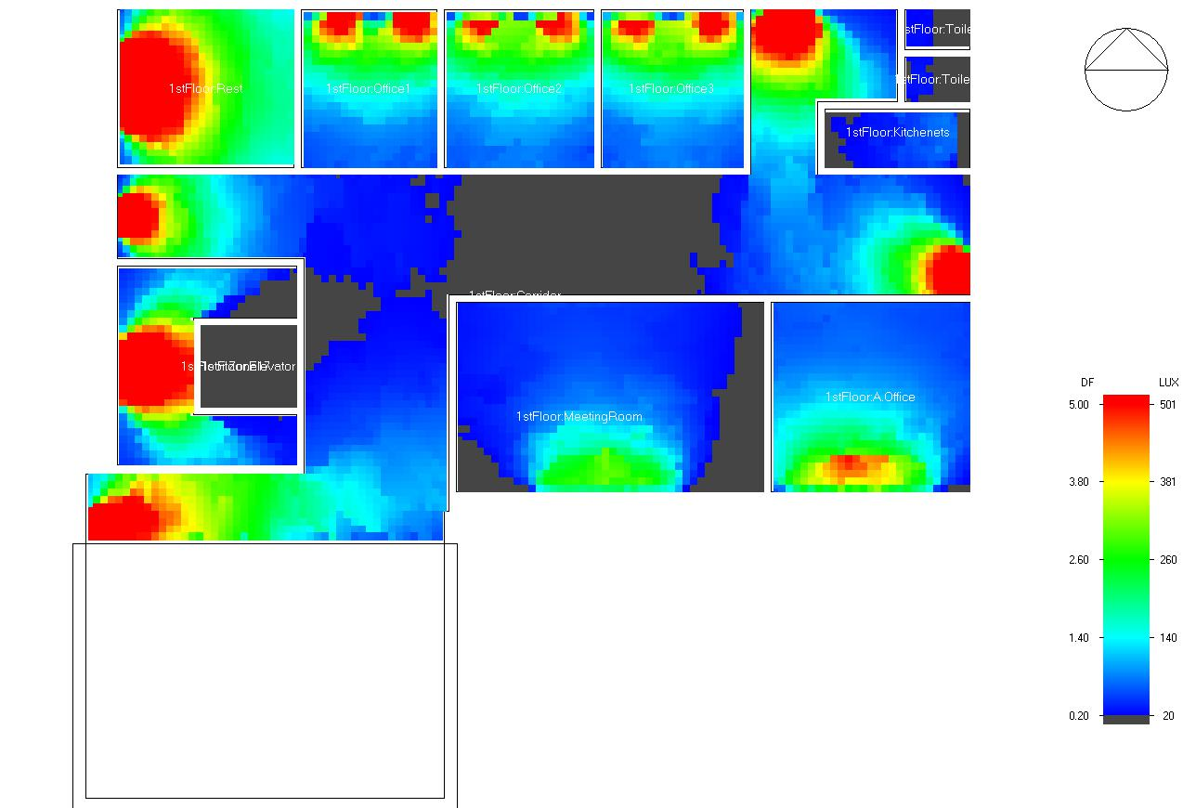
Natural Lighting
First Floor
Space | Average Daylight Factor (%) | DF% Required | DF% Required | Comparison
Office 3 | 1.87 | 4 | 1.6 | Within
Corridor | 1.44 | 2 | 0.6 | Within
Meeting Room | 0.9 | 2 | 0.8 | Within
Administration Office | 1.31 | 4 | 1.6 | Within
Office 2 | 1.76 | 4 | 1.6 | Within
Office 1 | 1.9 | 4 | 1.6 | Within
rest | 3.88 | 2 | 0.6 | Within
Kitchenettes | 0.36 | 2 | 0.6 | Not

Slide 28
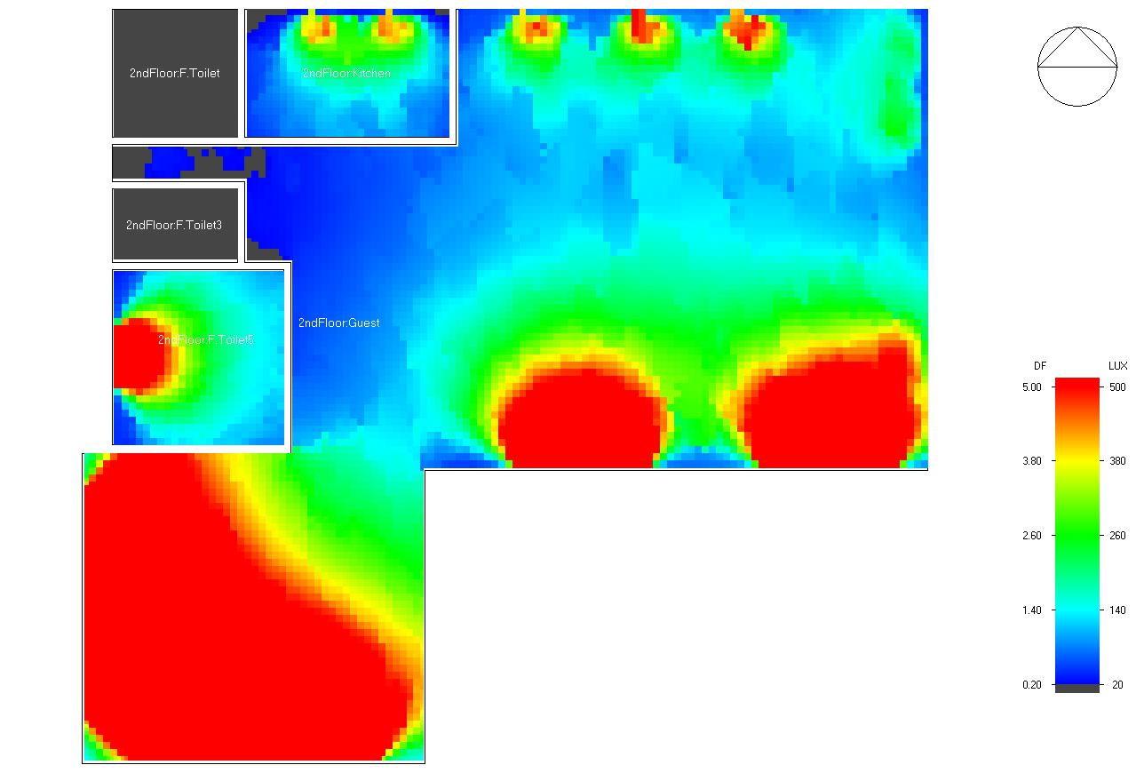
Natural Lighting
Second Floor
Block | Average Daylight Factor (%) | DF% Required | DF% Required | Comparison
Guest | 3.88 | 2 | 0.6 | Within
Kitchen | 1.5 | 2 | 0.6 | Within

Slide 29
Comparison
Space | DF% existing design | DF% New design | DF% Required | DF% Minimum
Multipurpose | 0.39 | 0.81 | 1 | 0.6
Lobby | 5.37 | 8.11 | 2 | 0.6
Office (avg.) | 0.2 | 1.84 | 4 | 1.6
Administration Office | 1.29 | 1.31 | 4 | 1.6
Meeting Room | 0.96 | 0.9 | 2 | 0.8
Guest | 2.14 | 3.88 | 2 | 0.6
Kitchen | 2.97 | 1.5 | 2 | 0.6

Slide 30
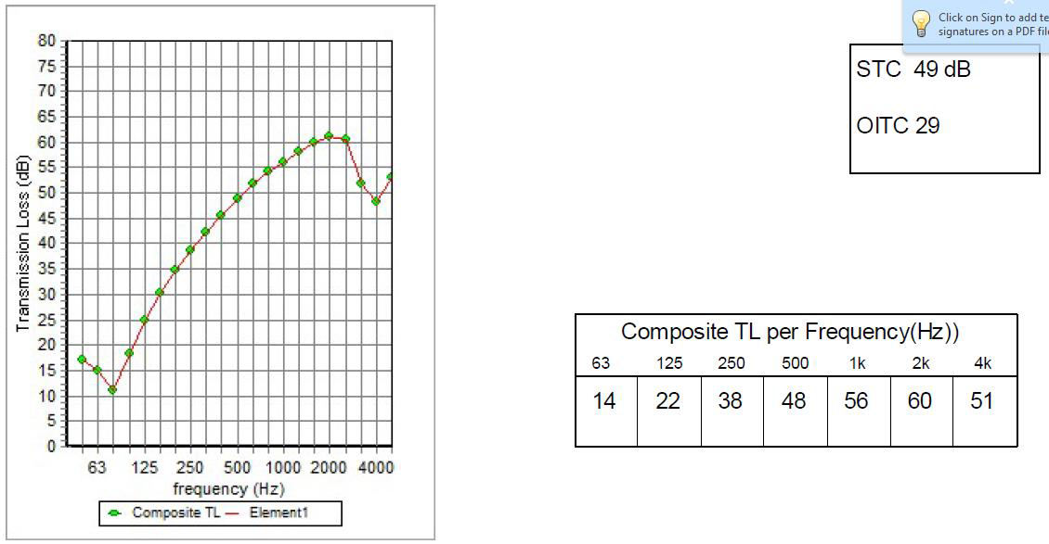
Acoustical Design
Sound Transmission Class (STC)
Internal Partition

Slide 31
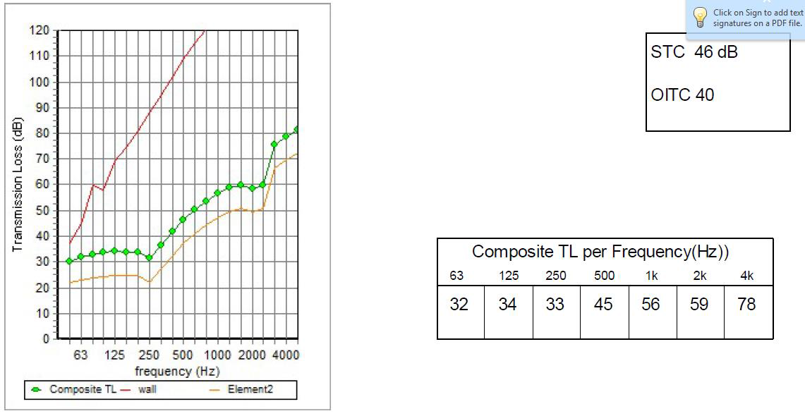
Acoustical Design
Sound Transmission Class (STC)
External Wall

Slide 32
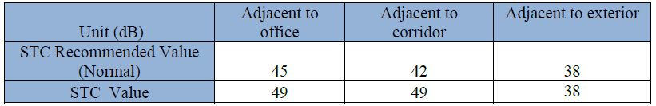
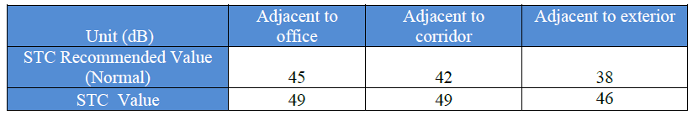
Acoustical Design
Sound Transmission Class (STC)
Offices:-
Meeting Room :
STC values within the recommended.

Slide 33
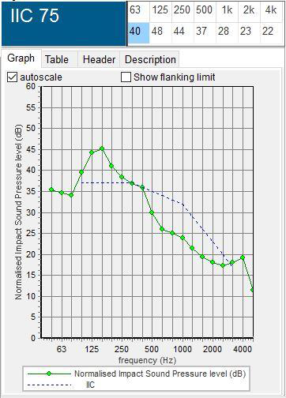
Acoustical Design
Impact insulation class (IIC)
Slab 25 cm
The recommended IIC = 50 db.
75>50 within.

Slide 34
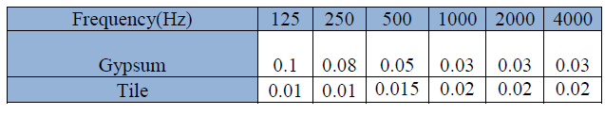
Acoustical Design
Reverberation Time (RT60)
Finishes

Slide 35
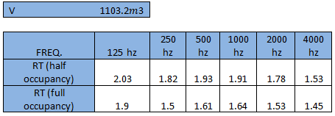
Acoustical Design
Reverberation Time (RT60)
Multipurpose
Recommended (1.4-1.9) at 500-1000Hz
Most suitable analysis equation: Sabine

Slide 36
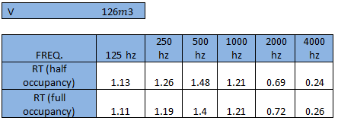
Acoustical Design
Reverberation Time (RT60)
Meeting Room
Recommended (0.6-1.9) at 500-1000Hz
Most suitable analysis equation: Sabine

Slide 37
Structural Design:
Codes and Standards:
ACI 318-14 for reinforced concrete design.
UBC-97 for seismic design and its load combinations.

Slide 38
Structural Design:
Material :
concrete fc = 40 Mpa were used for foundation & columns. concrete fc = 24 Mpa for slabs & beams.
Reinforcement steel Fy = 420 Mpa.
Soil bearing capacity = 250KN/m²

Slide 39
Structural Design:
Loads
Dead load.
Super imposed dead load =3.5 kN/m² .
Live load = 5 kN/m²
Seismic load .

Slide 40
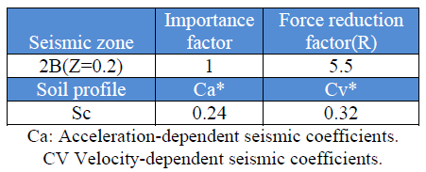
Structural Design:
Seismic design

Slide 41
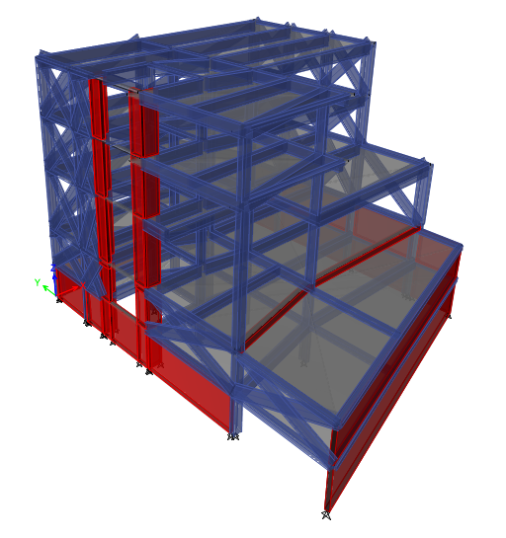
Structural Design:
Model in ETABS program

Slide 42
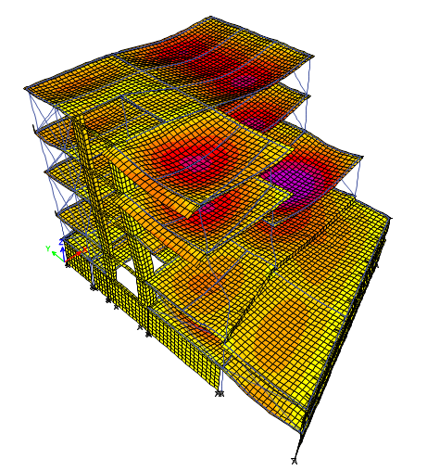
Structural Design:
Checks:
Compatibility check.

Slide 43
Structural Design:
Checks:
Equilibrium check
load case | ETABS | HAND | Error | OK (<5%)
Dead | 23,915.21 | 22,766.937 | 5% | OK
Live | 12,386.79 | 12,341.5 | 1.72% | OK
SID | 12,685.24 | 12,907.25 | 0.36% | OK

Slide 44
Structural Design:
Checks:
Internal forces checks
All columns and beams that checked, the difference between ETABS and hand calculations was been less than 10%

Slide 45
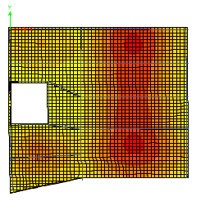
Structural Design:
Checks:
Deflection check. MAX. allowable deflection = 58 mm in beams & 25mm in slab

Slide 46
Structural Design:
Checks:
Period check.
Time period by ETABS equal 0.543 s.
period from hand calc.= 0.49s
T from ETABS = 0.54 s < (1.4 * 0.49) = 0.69s ➔ OK

Slide 47
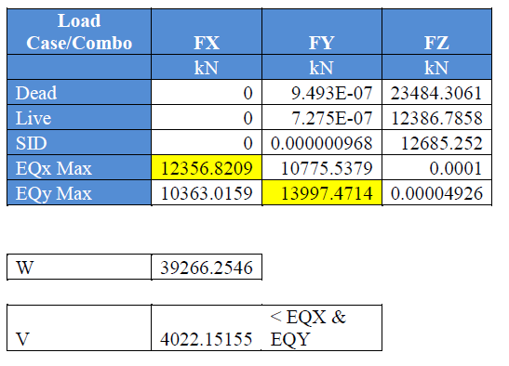
Structural Design:
Checks:
Base shear check

Slide 48
Structural Design:
Checks:
Drift cheek
The critical story is ground floor ΔS = 5mm
Maximum Inelastic Response Displacement
ΔM = .7 * 5.5 * 5 = 19.25mm < The limit = 0.025 * 5500 = 137.5 mm.

Slide 49
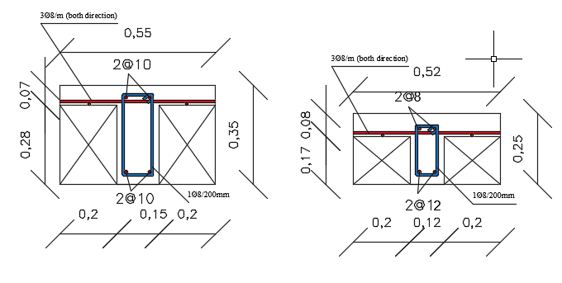
Structural Design:
Slab sections reinforcement :
for b1, b2 & ground floor h = 35 cm
for 1st & 2nd floors h = 25 cm

Slide 50
Structural Design:
Beams Dimensions:
Main beams ( 1m depth & 0.5m width )
Secondary beams is hidden beams with width 0.5m

Slide 51
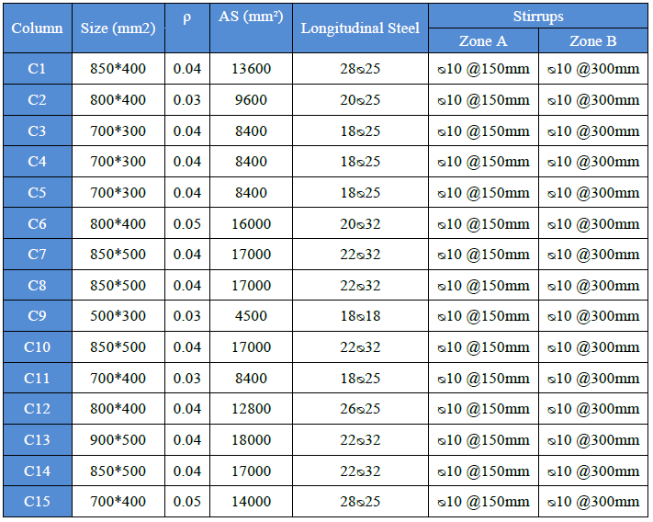
Structural Design:
Columns Dimensions:

Slide 52
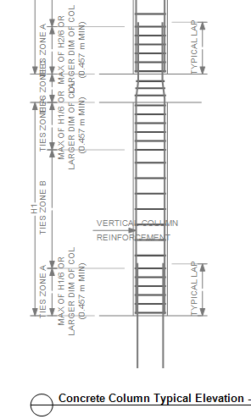
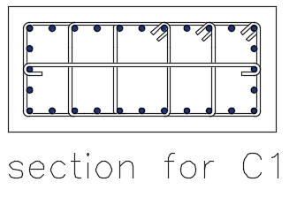
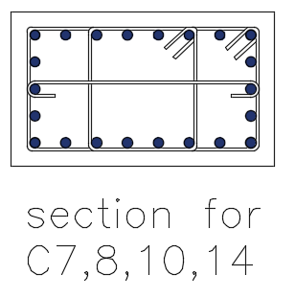
Structural Design:
Columns reinforcement:

Slide 53
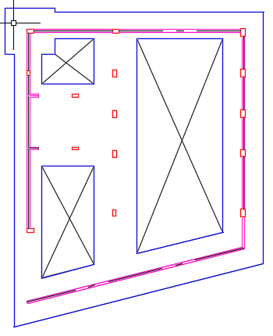
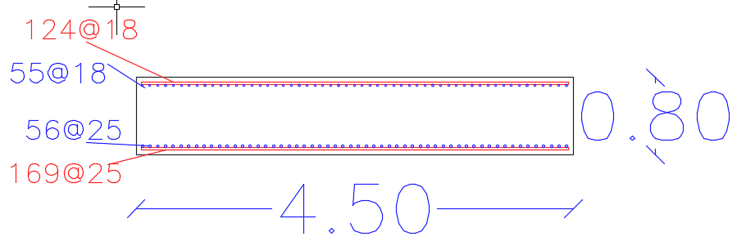
Structural Design:
Footing :

Slide 54
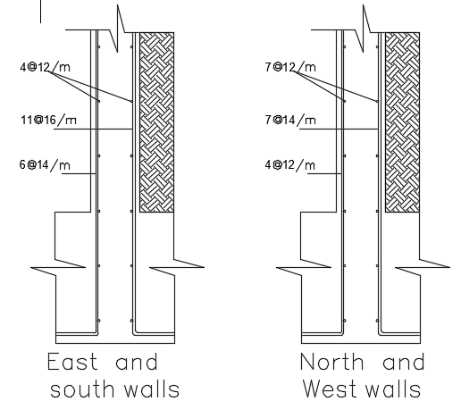
Structural Design:
Basement wall Reinforcements:
H = 30 cm

Slide 55
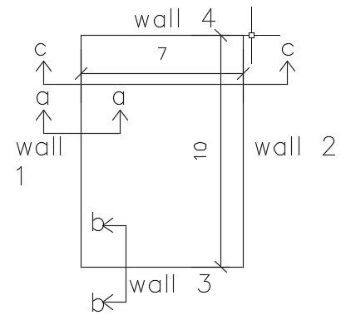

Structural Design:
Water Tank Reinforcements :

Slide 56


Structural Design:
Water Tank Reinforcements :

Slide 57

Structural Design:
Stairs Reinforcements:

Slide 58
Mechanical design
Water Supply System
Drainage System
Fire-fighting System
H-VAC System

Slide 59
Mechanical design
Water Supply System
(water consumption)
Floor | Type | Maximum water consumption
G.F | Flush Toilet | 1764 liter/ day
 | Flus Urinal | 154 liter/ day
 | Lavatories | 600 liter/ day
F.F | Flush Toilet | 97 liter/ day
 | Lavatories | 332 liter/ day
S.F | Flush Toilet | 840 liter/ day
 | Lavatories | 285 liter/ day
 | Kitchen | 1660 liter/ day
Annual consumption for fresh water:
Annual consumption for flush tank
192 m³ /365 days
→ 2.6 m³ /5 days. (In critical case)
66.1 m³ /year
→ 0.91 m³ /5 days → 1 m³ /5 days
The flow required per F.H.S is 379 liters / minute. 5 * 379 * 30 = 56850 liters = 57 m³ (In critical case).

Slide 60

Mechanical design
Water Supply System

Slide 61

First floor water supply system paln

Slide 62

Mechanical design
Drainage System
Storm water :
the annual rainfall rate in Nablus is 600 mm, there are 450 m² of roofs in the building exposed to rainwater.
0.6 * 450 = 270 m³ → 250 m³ usable

Slide 63

Mechanical design
Drainage System

Slide 64

Mechanical design
Drainage System

Slide 65

Mechanical design
fire-fighting System

Slide 66

Mechanical design
means of egress

Slide 67
HVAC Design
We select variable refrigerant volume with separated mechanical ventilation system to be used in the building. VRV system consists of outdoor unit, indoor units, and liquid & gas pipes. With VRT technology.
Separate ventilation system for high occupancy space , Toilets & Garages.

Slide 68
HVAC Design
Colling Load
Floor | Zone | Design Capacity (kW)
 | Lobby | 15.21
Ground Floor | Multipurpose | 58.43
 | Corridor | 6.86
 | Office3 | 1.66
 | Corridor | 24.57
 | Meeting Room | 5.26
 | Administration Office | 2.59
1stFloor | Office2 | 1.75
 | Office1 | 1.69
 | Rest | 3.32
 | Kitchenettes | 0.56
 | Guest | 40.67
2ndFloor | Kitchen | 1.76
Total |  | 164.67

Slide 69
HVAC Design
Heating Load
Floor | Zone | Design Capacity (kW)
 | Lobby | 9.73
Ground Floor | Multipurpose | 45.17
 | Corridor | 6.21
 | Office 3 | 1.66
 | Corridor | 17.92
1stFloor | Meeting Room | 6.06
 | Administration Office | 2.64
 | Office 2 | 1.72
 | Office 1 | 1.68
 | rest | 4.1
 | Kitchenettes | 0.54
2ndFloor | Guest | 35.37
 | Kitchen | 1.1
Total |  | 133.9

Slide 70


Out door unit design

Slide 71



Indoor unit design

Slide 72


High Occupancy spaces ventilation system

Slide 73

Ground flor HVAC Plan

Slide 74

First floor HVAC Plan

Slide 75

Second floor HVAC Plan

Slide 76

Garages Ventilation system

Slide 77

Basement 1 HVAC Plan

Slide 78

Basement 2 HVAC Plan

Slide 79
Electrical Design
Wiring Connections & Socket distributions.
Artificial Lighting

Slide 80

Ground Floor lighting wiring connections plan
Electrical Design

Slide 81

Ground Floor Sockets Plan
Electrical Design

Slide 82

Electrical Design
Ground Floor Circuit Breaker

Slide 83


Electrical design
Artificial lighting
multipurpose hall
 | E (lux) | U | MAX UGR
Stage area | 520 > 500 | 0.72 > 0.6 | 18.4 < 19
Seating area | 363 > 300 | 0.58 < 0.6 | 18.8 < 19

Slide 84



Electrical design
Artificial lighting
Offices and meeting room
 | E (lux) | U | MAX UGR
Table surface | 528 > 500 | 0.73 > 0.6 | 17.6 < 19
Surrounding | 439 > 300 | 0.60 = 0.6 | 17.6 < 19

Slide 85


Electrical design
Artificial lighting
Garages
 | E (lux) | U | MAX UGR
Stage area | 219 > 200 | 0.43> 0.4 | 24.5 < 25

Slide 86

Cost Analysis

Slide 87
Conclusion
1. Improvement in building functionality & Highlight the building.
2. Improvement in building thermal behavior.
3. Improvement in acoustical design.
4. Structural seismic design.
4. Use of rain water.
5.Efficient firefighting systems & egress plans.
6. Efficient HVAC system.
7. Design takes into account people with special needs by providing ramps & elevator.
8. Electrical lighting wiring take into account natural lighting.

Slide 88
THANK YOU

