Slide 1

An-Najah National University
Telecommunications Engineering Department
Smart Glass Window
Submitted by:
Amr Ishtyeh Rafah Nairat
Yousef Shmlawi
Supervisor: Dr. Haneen Al-Autt

Slide 2
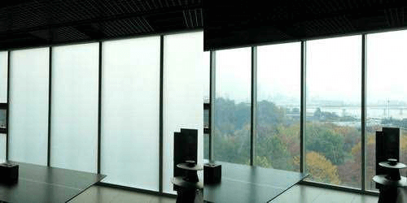

Slide 3
Outlines:
Abstract.
Goal.
Hypotheses.
Procedures.
Materials.
Types of Smart Glass
Block Diagram
Flow Chart
Market Segmentation
Smart Glass Window Circuits
Results.
Conclusion.
Future research.

Slide 4
Abstract
The "Smart Glass Window" project introduces an innovative solution to enhance energy efficiency in homes by managing heat flow through intelligent tint adjustments. It combines an electrochromic window with ambient light and temperature sensors, controlled by an Arduino Uno.

Slide 5
Goal.
The "Smart Glass Window" project aims to revolutionize construction by creating an intelligent window system that enhances privacy, sustainability, and energy efficiency. It caters to diverse settings, from residential spaces to offices and hospitals, contributing to eco-friendly and privacy-centric structures.

Slide 6
Hypotheses.
The integration of dynamic tinting in windows based on ambient conditions will significantly reduce the need for artificial heating and cooling

Slide 7
Procedures.
Install ambient light and temperature sensors.
Connect sensors to an Arduino Uno microcontroller.
Integrate the microcontroller with the electrochromic window.

Slide 8
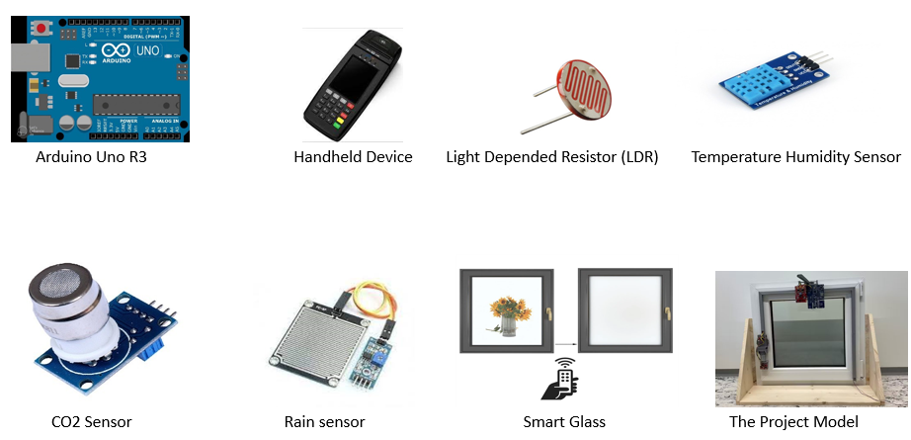
Materials.

Slide 9
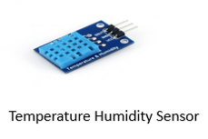
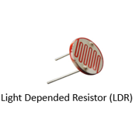
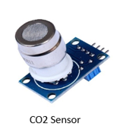
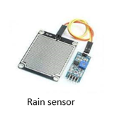
We calculated the initial cost of the project by calculating the cost of the parts used (360) Shekels.
Notes:
يمكن انو نشيلها

Slide 10
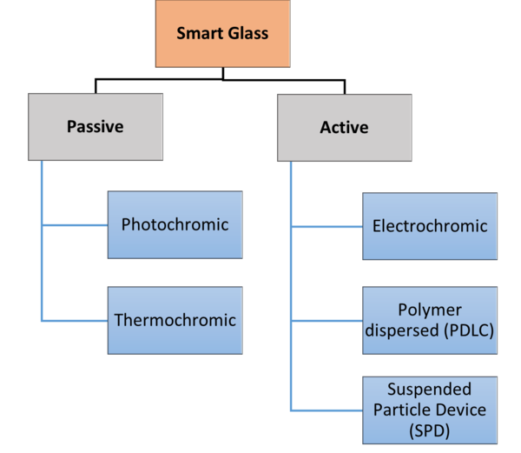
Types Of Smart Glass.

Slide 11
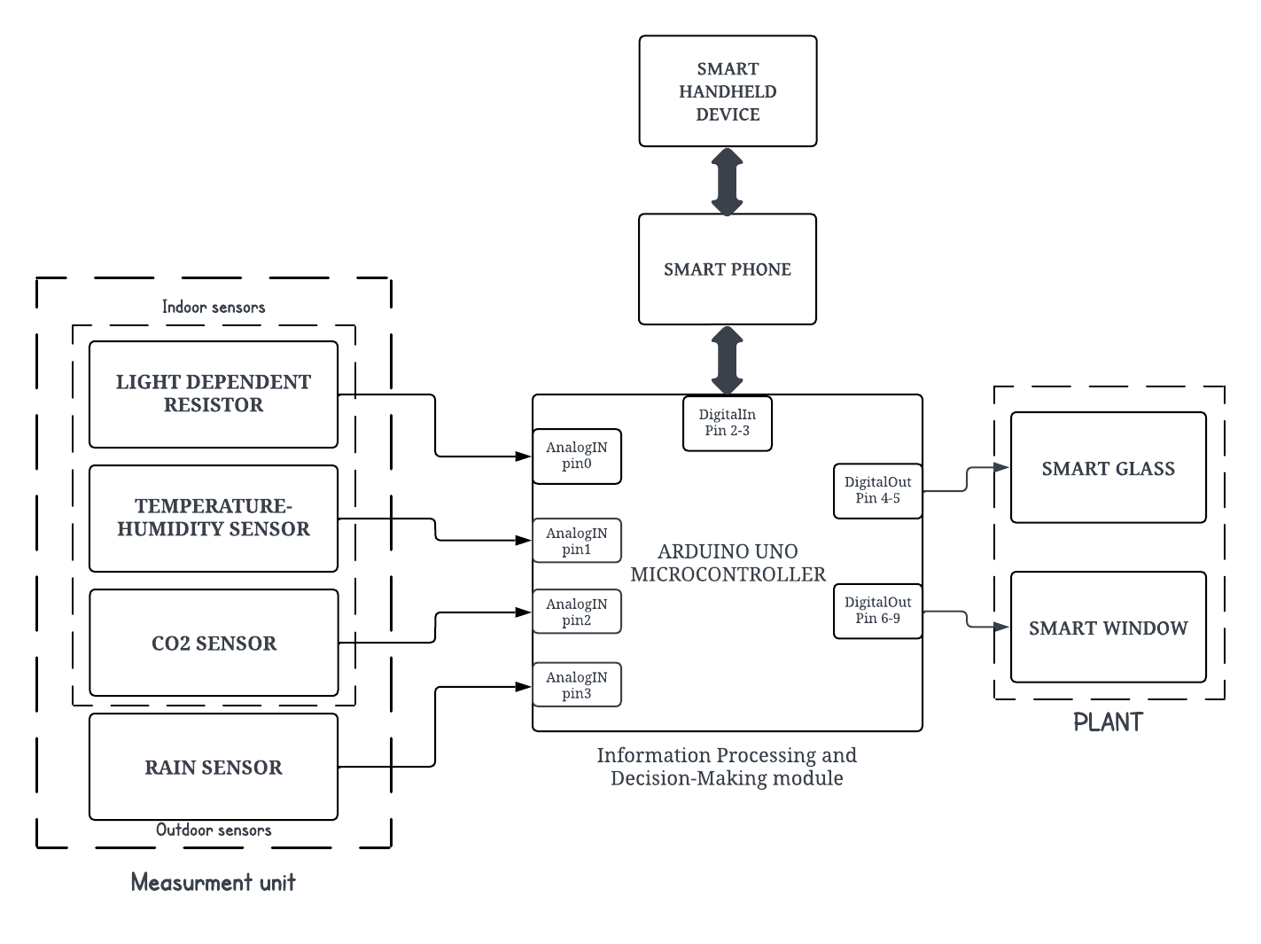
Block Diagram.

Slide 12
Block Description.
The block diagram illustrates a sophisticated system powered by an Arduino UNO microcontroller, integrating a diverse range of sensors and devices tailored for both indoor and outdoor applications.

Slide 13
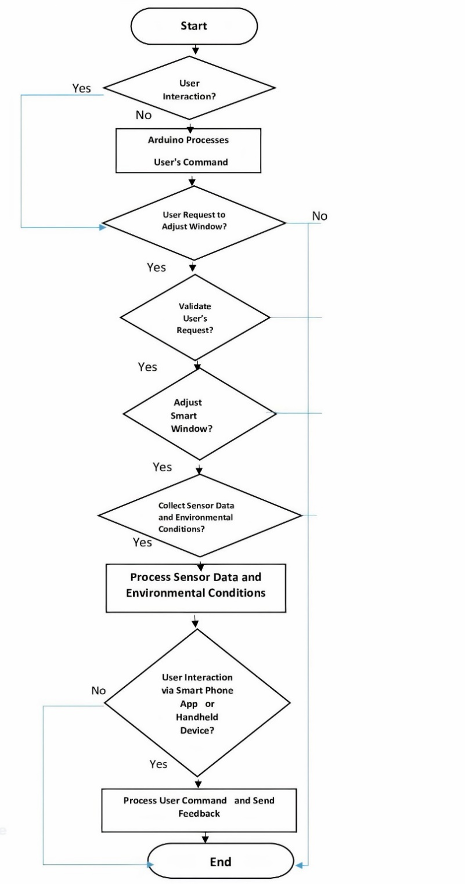
Flow Chart.

Slide 14
Flow Chart Cont.
Beginning with environmental data collection, sensors monitor light and temperature. The Arduino Uno analyzes this data and triggers commands to adjust the electrochromic window tint. This iterative process guarantees real-time adaptation, optimizing energy efficiency and elevating indoor comfort.

Slide 15
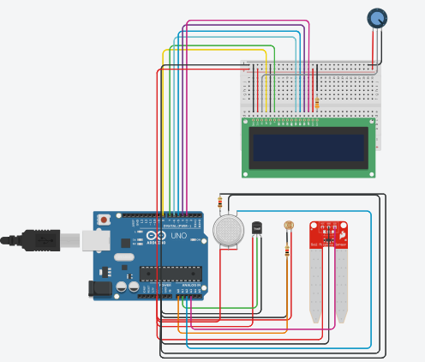
Smart Window Circuits.

Slide 16
Results.
When the circuit is powered on and the Arduino runs the appropriate code, each sensor's reading is displayed on the LCD. The display likely updates at regular intervals, showing real-time sensor data. The layout on the LCD is arranged to show the readings in an organized manner, with labels for each sensor's data for easy reading.

Slide 17
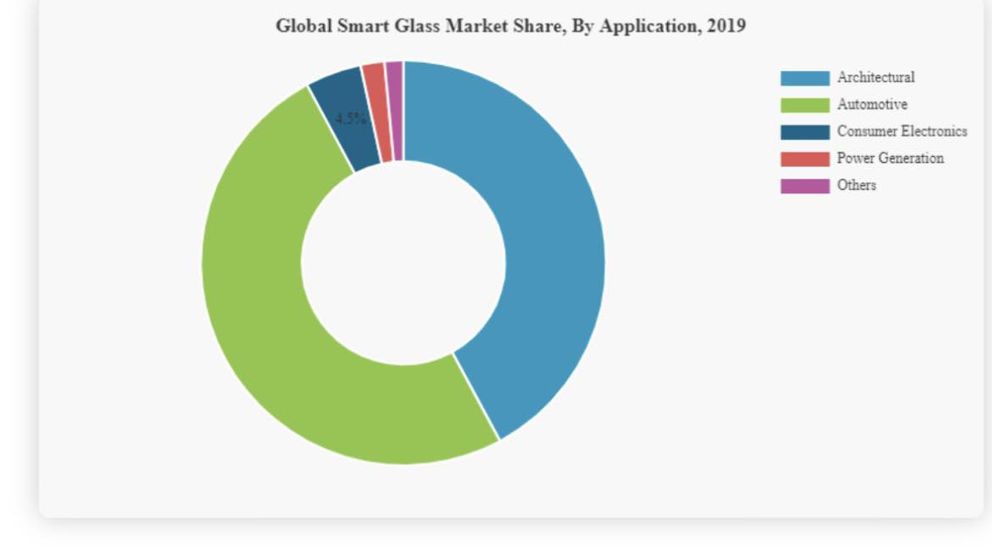
Market Segmentation.
By Applications: Applications span architectural, automotive, aircraft, consumer electronics, and other sectors.

Slide 18
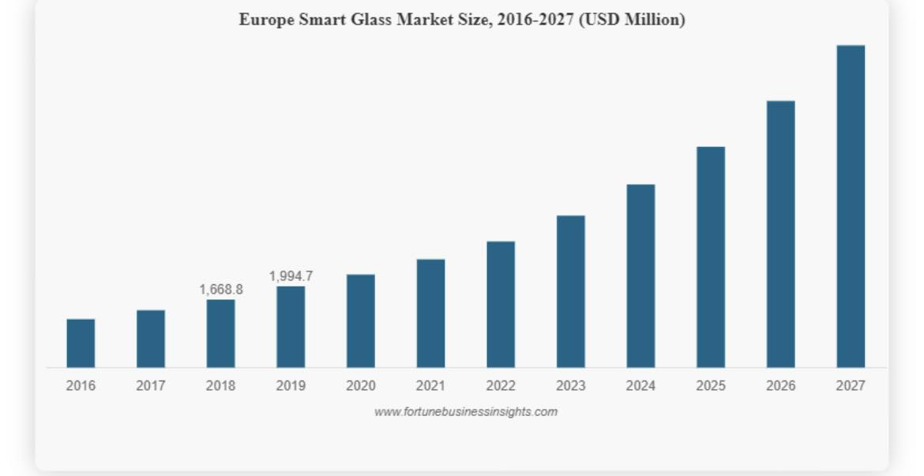
Market Segmentation cont.
By Regions: North America and Europe are mature markets, while Asia Pacific shows the fastest growth. Opportunities are also identified in the Middle East, Africa, and Latin America.

Slide 19
Future research.
Integration of Additional Sensors.
User Experience Studies.
Cost-Effective Materials.

Slide 20
Conclusions
Our project has demonstrated considerable success in creating an intelligent and responsive system for smart windows.
The integration of advanced technologies, coupled with the adaptability and efficiency improvements, opens doors to diverse applications.

Slide 21
Any Recommendations?

Slide 22


