Slide 1

بسم الله الرحمن الرحيم
Water supply services Management
for tubas governorate
Prepared by
Ameen Khabass Ameer qab
Qasim Bsharat Laith thaher
Supervisor
Dr. Anan Jayyousi

Slide 2
Content
Objective
Overview of Tubas Governorate
Future population
Consumption rates
Future demand, supply and water gap
Gap reduction
Long-term solutions
Packages of investment plan
Bardala water distribution network

Slide 3
Objectives
Analyze the current water situation of Tubas Governorate
Estimate the water gap in the future
Discuss probable solutions to cover the gap
Suggest an investment plan
Design a network for one un-served locality

Slide 4
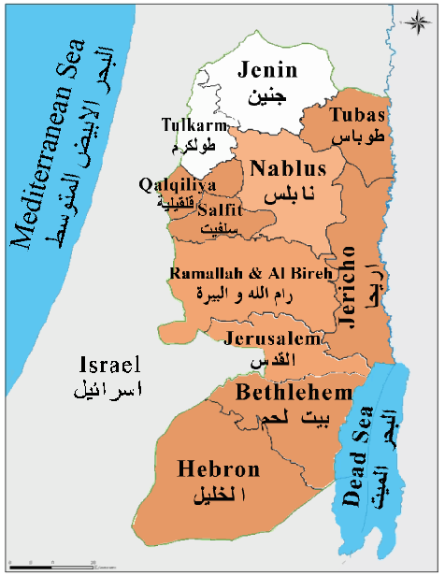
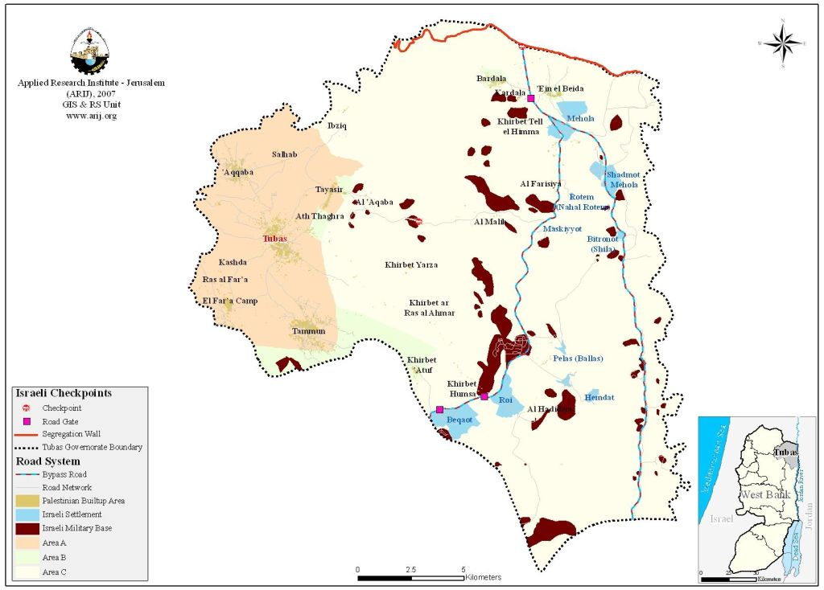
Overview of Tubas Governorate
Location

Slide 5
Overview of Tubas Governorate
Land Use
Classification | Area (km²) | Percentage
Palestinian Built-up Area | 6.2 | 1.7
Israeli Colony | 7.7 | 2.1
Israeli Military Base | 15.8 | 4.3
Arable Land | 99.3 | 27.1
Permanent Crops | 70.5 | 19.3
Heterogeneous Agriculture | 1.9 | 0.5
Mine, Dump & Construction Sites | 0 | 0
Forest | 2.4 | 0.7
Open Space | 30.2 | 8.3
Shrub and/or herbaceous vegetation association | 12.5 | 3.4
Pastures | 119.6 | 32.7
Total | 366 | 100

Slide 6
Overview of Tubas Governorate
Topography
Max. elevation is 548 AMSL and min elevation is 182 BMSL.

Slide 7
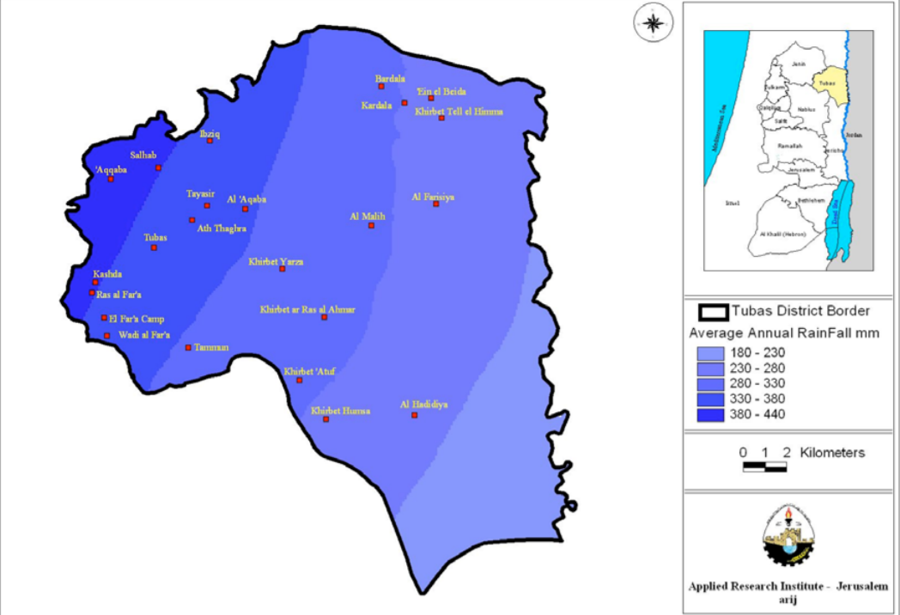
Overview of Tubas Governorate
Climate
Avg. rainfall depth is 329 mm

Slide 8
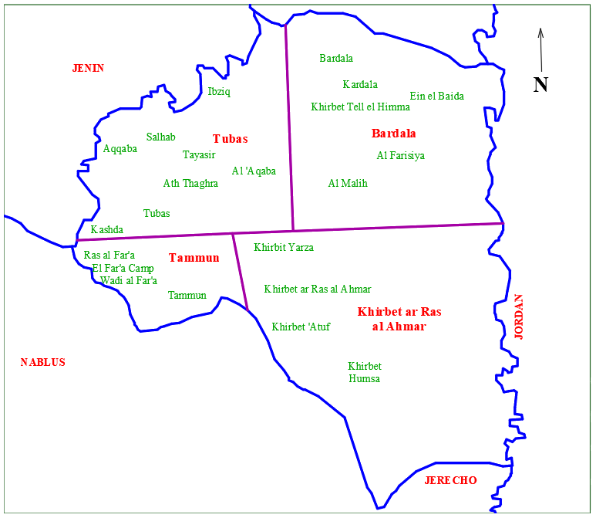
Future Population
Clusters

Slide 9
Future Population
r = 3.2 %
Cluster | Cluster Name | 2016 | Short Term (2020) | Intermediate Term (2025) | Long Term (2035)
1 | Bardala | 4,825 | 5,477 | 6,417 | 8,809
2 | Tubas | 34,807 | 39,512 | 46,298 | 63,566
3 | Tammun | 26,527 | 30,113 | 35,285 | 48,445
4 | Khirbet ar Ras al Ahmar | 694 | 788 | 922 | 1,265
Total |  | 66,853 | 75,890 | 88,922 | 122,085

Slide 10
Consumption Rate -Urban-
Target year |  |  | 2016 | 2020 | 2025 | 2035
Urban | Domestic consumption | Rate (L/c/d) | 66 | 75 | 90 | 120
 |  | Ratio of M&I (%) | 79 | 79 | 79 | 79
 | Public consumption | Rate (L/c/d) | 7 | 8 | 10 | 14
 |  | Ratio of M&I (%) | 8 | 8 | 8.5 | 9
 | Livestock consumption | Rate (L/c/d) | 5 | 5 | 5 | 5
 |  | Ratio of M&I (%) | 6 | 5.5 | 4.5 | 3.5
 | Industrial consumption | Rate (L/c/d) | 6 | 7 | 9 | 13
 |  | Ratio of M&I (%) | 7 | 7.5 | 8 | 8.5
 | Total M&I consumption Rate (L/c/d) |  | 84 | 95 | 114 | 152
 | Physical losses (%) |  | 29 | 25 | 15 | 15
 | Total demand Rate (L/c/d) |  | 118 | 127 | 134 | 179

Slide 11
Consumption Rate -Rural served-
Target year |  |  | 2016 | 2020 | 2025 | 2035
Rural Served | Domestic consumption | Rate (L/c/d) | 50 | 65 | 80 | 110
 |  | Ratio of M&I (%) | 79 | 79 | 79 | 79
 | Public consumption | Rate (L/c/d) | 3 | 4 | 5 | 6
 |  | Ratio of M&I (%) | 5 | 5 | 4.5 | 4.5
 | Livestock consumption | Rate (L/c/d) | 6 | 9 | 11 | 16
 |  | Ratio of M&I (%) | 10 | 10.5 | 11 | 11.5
 | Industrial consumption | Rate (L/c/d) | 4 | 5 | 6 | 7
 |  | Ratio of M&I (%) | 6 | 5.5 | 5.5 | 5
 | Total M&I consumption Rate (L/c/d) |  | 63 | 82 | 101 | 139
 | Physical losses (%) |  | 29 | 25 | 15 | 15
 | Total demand Rate (L/c/d) |  | 89 | 110 | 119 | 164

Slide 12
Consumption Rate -rural unserved-
Target year |  |  | 2016 | 2020 | 2025 | 2035
Rural Unserved | Domestic consumption | Rate (L/c/d) | 30 | 45 | 70 | 100
 |  | Ratio of M&I % | 79 | 79 | 79 | 79
 | Public consumption | Rate (L/c/d) | 2 | 3 | 5 | 6
 |  | Ratio of M&I % | 6 | 6 | 5.5 | 5
 | Livestock consumption | Rate (L/c/d) | 4 | 6 | 10 | 15
 |  | Ratio of M&I % | 10 | 11 | 11.5 | 12
 | Industrial consumption | Rate (L/c/d) | 2 | 2 | 4 | 5
 |  | Ratio of M&I % | 5 | 4 | 4 | 4
 | Total M&I consumption rate |  | 38 | 57 | 89 | 127
 | physical losses (%) |  | 5 | 5 | 15 | 15
 | Total demand rate (L/c/d) |  | 40 | 60 | 104 | 149

Slide 13
Future demand
(Unit: 1000 m³)
Cluster | Cluster name | Short Term (2020) | Intermediate Term (2025) | Long Term (2035)
1 | Bardala | 328.6 | 667.4 | 1,312.5
2 | Tubas | 4,687.3 | 5,912.3 | 1,0978.0
3 | Tammun | 3,312.4 | 4,199.0 | 7,945.0
4 | Khirbet ar Ras al Ahmar | 60.1 | 100.4 | 194.7
Total |  | 8,388.4 | 10,879.1 | 20,430.2

Slide 14
Water supply
Water Resource |  | Quantity (Million m³/year)
Pumping from groundwater wells | Domestic | 1.4
 | Agricultural | 1.3
Discharge of springs water |  | 0.9
Purchasing from Israeli water company (Mekorot) |  | 5.4
Cluster | Cluster name | Supply
1 | Bardala | 151
2 | Tubas | 1,402
3 | Tammun | 825
4 | Khirbet ar Ras al Ahmar | 22
(Unit: 1000 m³)

Slide 15
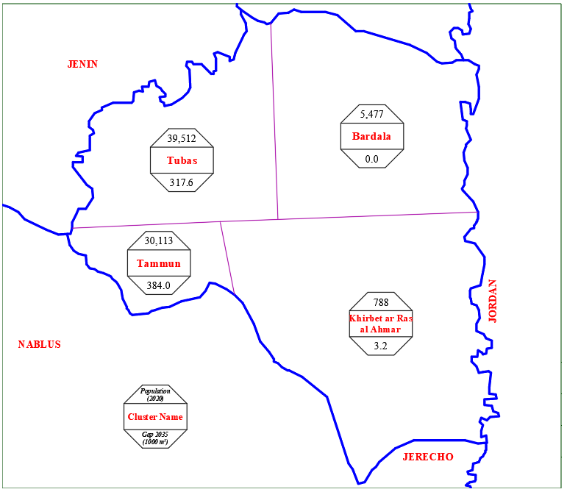
Future Water Gap (2020)
Gap = Demand – Supply
Total Gap = 704.8*10³ m³

Slide 16
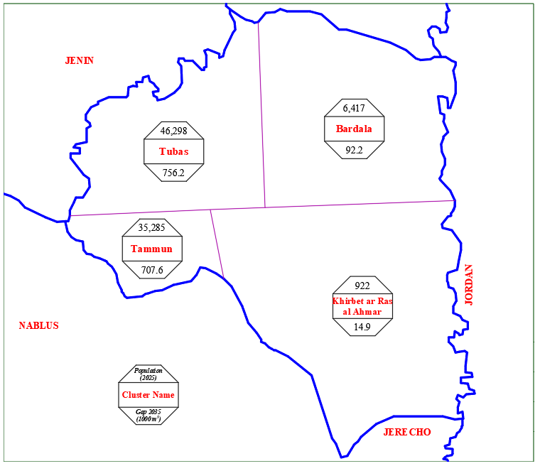
Future Water Gap (2025)
Total Gap = 1,570.8*10³ m³

Slide 17
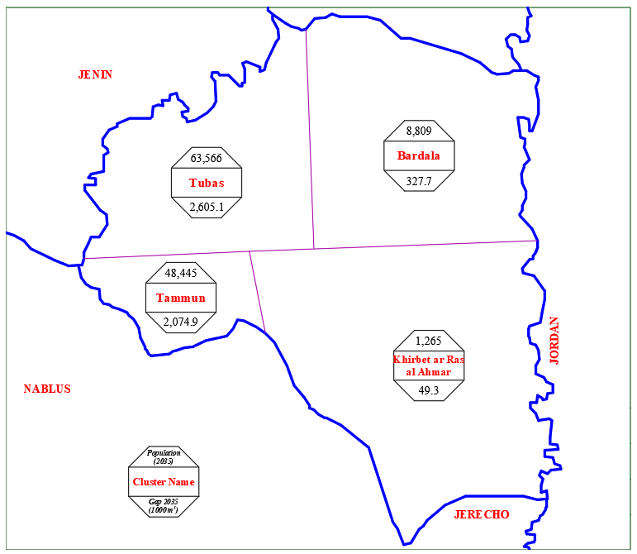
Future Water Gap (2035)
Total Gap = 5,057.0*10³ m³

Slide 18
Gap reduction
Near future solutions:
Loss reduction program
Rainwater harvesting
Long-term solutions:
Utilizing Groundwater
Utilizing Jordan River
Development of Non-Conventional Water Resources

Slide 19
Loss reduction program
Our aim is to decrease the loss by 5%
Cluster | Cluster name | Water saved (1000 m³)
1 | Bardala | 0.0
2 | Tubas | 68.1
3 | Tammun | 41.3
4 | Khirbet ar Ras al Ahmar | 0.4
Total |  | 109.8

Slide 20
Rainwater harvesting
Avg. family size is 5.6 capita.
No. of floor in each building is 2 floors
Each floor contain 2 apartments.
Avg. area of each apartment is 150 m².
Avg. annual rainfall is 329 mm.
The rainwater collecting percentage 80%.

Slide 21
Rainwater harvesting
(Unit: 1000 m³)
Cluster | Cluster name | 2020 | 2025 | 2035
1 | Bardala | 2.3 | 5.6 | 14
2 | Tubas | 16.6 | 40.5 | 101.4
3 | Tammun | 12.6 | 30.9 | 2.7
4 | Khirbet ar Ras al Ahmar | 0.3 | 0.8 | 2
Total |  | 31.8 | 77.8 | 120.1

Slide 22
Remaining gap
(Unit: 1000 m³)
Cluster | Cluster name | 2020 | 2025 | 2035
1 | Bardala | 0.0 | 86.6 | 313.6
2 | Tubas | 233.5 | 647.6 | 2,435.7
3 | Tammun | 330.1 | 635.5 | 1,956.4
4 | Khirbet ar Ras al Ahmar | 2.7 | 13.7 | 46.9
Total |  | 566.4 | 1,383.4 | 4,752.6

Slide 23
Long-Term Solutions
Utilizing Groundwater
Tubas governorate is located over the Eastern and the North-Eastern Aquifers
The most important development options for improving water quantities
Utilizing Jordan River
The Palestinian portion of Jordan river water is 250 Mcm/year
Surface water needs treatment

Slide 24
Long-Term Solutions
Non-Conventional Water Resources
Water harvesting of seasonal floods
Tubas Governorate characterized by low rainfall rates and high temperatures
Can be used in irrigation and feeding groundwater
Wastewater Treatment
Sewerage networks are not available
Treated wastewater can be used for agricultural uses

Slide 25
Utilizing Groundwater
The remaining gap is 4.75 Mcm/year in year 2035
According to PWA, there are 8 location for proposed new wells
New well is 300m depth and produces 1.00 Mcm/year

Slide 26
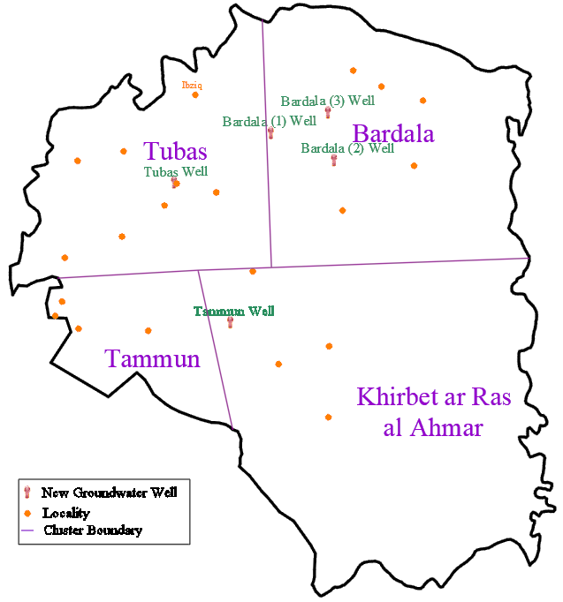
New Groundwater wells

Slide 27
Packages of investment plan
Based on estimated future water demand, Different projects will be implemented to cover this demand
Package components will vary according to the required action

Slide 28
Packages of investment plan
Determine the diameter of transmission pipeline using continuity equation
Q = V * A
The head loss in transmission pipelines is calculated using the following equation
H_{L} = 0.01 L
The pump head calculated using Energy Conservation principle (Bernoulli Equation)
H_{P} = ∆Z + H_{L}

Slide 29
Packages of investment plan
The pumps power calculated by using following equation.
γ : Specific weight of water ( 9810 N/m³).
µ : Pump efficiency (assumed to be 75%).
Coding
WS- (first two latter of cluster name) C/ (package number)

Slide 30
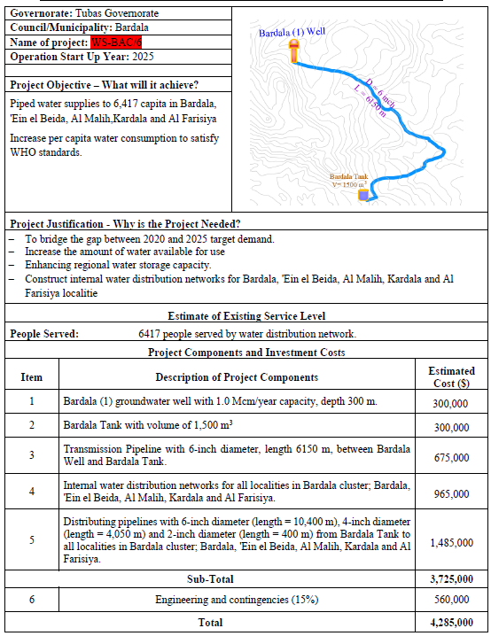
Sample of proposed Packages

Slide 31
Cash flow of investment plan

Slide 32
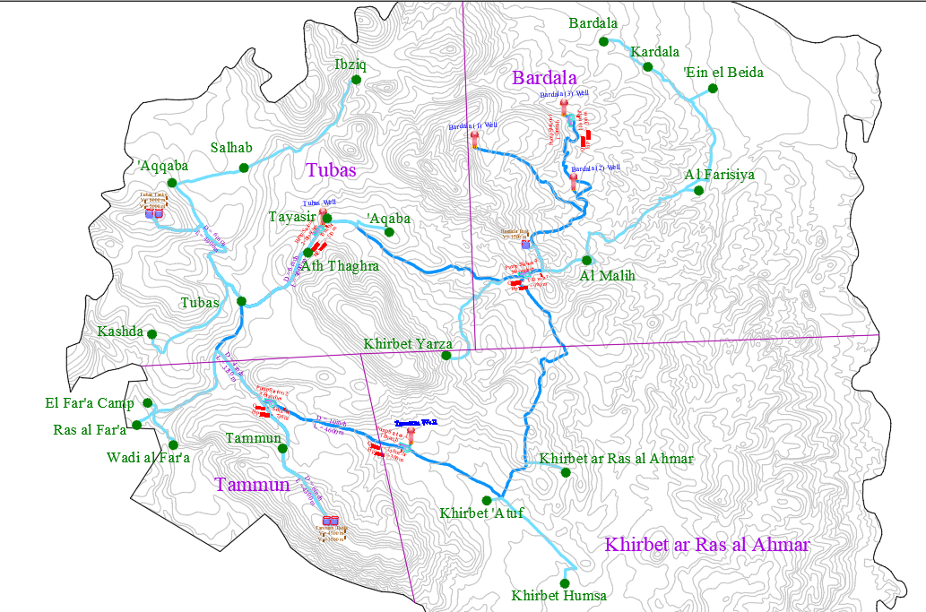
Cash flow of investment plan

Slide 33
Bardala water distribution network
Bardala is located 13 km northeast of Tubas city.
The total area is 20,000 dunums (4 % of the Tubas Governorate area)
Built-up area = 480 dunums
Agricultural area = 10,000 dunums
Confiscated area = 400 dunums

Slide 34
Bardala water distribution network
Population
Bardala represents only about 3.3% of Tubas Governorate in 2035.
r = 3.2 %
Year | 2007 | 2016 | 2020 | 2025 | 2035
Population (capita) | 1,637 | 2177 | 2,471 | 2,895 | 3,974

Slide 35
Bardala water distribution network
Design Parameters:
Assumed head at the beginning = 140 m H₂O
The design period is 19 years until 2035.
Maximum daily factor = 1.8
Average daily demand =100 L/c.d
Ductile iron pipes with Hazen-Williams coefficient (C_{HW} = 130).
Min diameter = 1 inch.

Slide 36
Bardala water distribution network
Demand calculation
The proposed daily water demand in the year of 2035 will be 100 L/c.d
The total demand
Demand definition
Using demand area and theisen polygon method

Slide 37
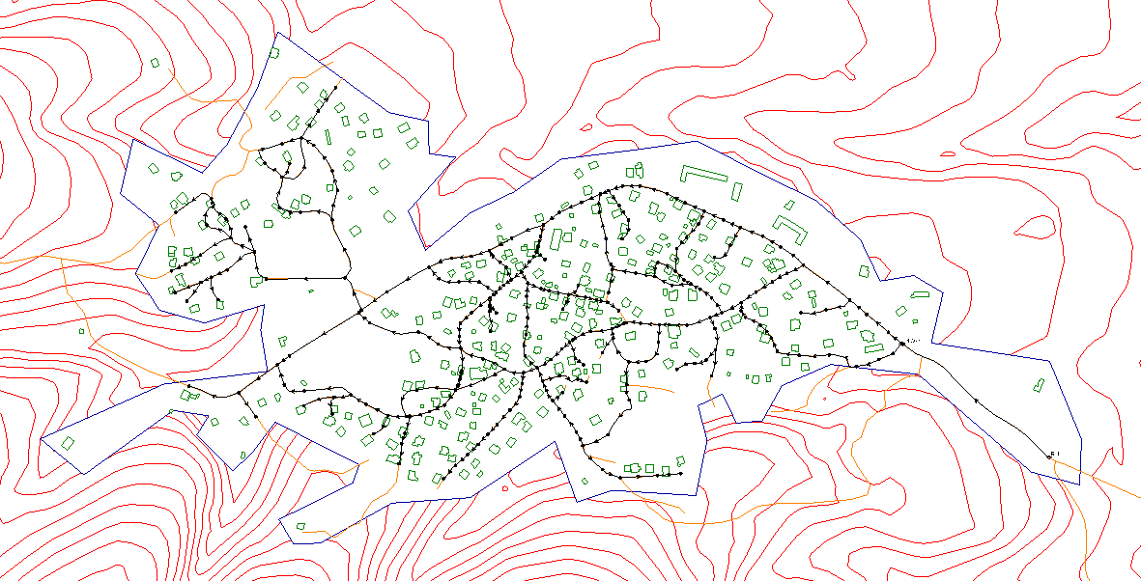
Bardala water distribution network
Network layout

Slide 38
Bardala water distribution network
Results
Parameter | Max. Value | Min. Value | Note
Demand | 2.82 m3/hr | 0.02 m3/hr | ــــــــــــــــــــــــ
Pressure | 95 m H₂O | 20 m H₂O | We used pressure reducing valve at the beginning of the network
Velocity | 1.52 m/s | 0.032 m/s | It's less the 0.3 m/s but it’s accepted since the network is used for drinking water and it's more than 0.01 m/s
Diameter (in) | Total Length (m)
4.0 | 979
2.0 | 3726
1.0 | 3244
Total | 7949

Slide 39
Conclusion
The population of Tubas Governorate will become about 120,000 capita in 2035
The gap of water is about 5 Mcm/year in year 2035
To bridge this gap:
0.23 Mcm/year from near-future solutions
4.77 Mcm/year from long-term solutions
The total investment cost is 26 million dollar
The average investment per year around 1.53 Million$/year

Slide 40
