Slide 1
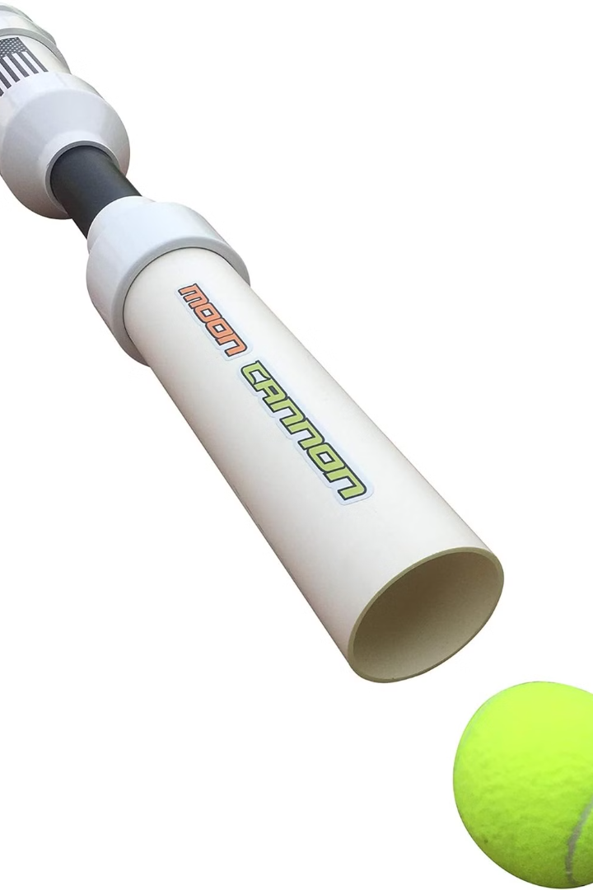
Ping Pong Hitter
By : Manar Sadaqa
Sama Shawa

Slide 2
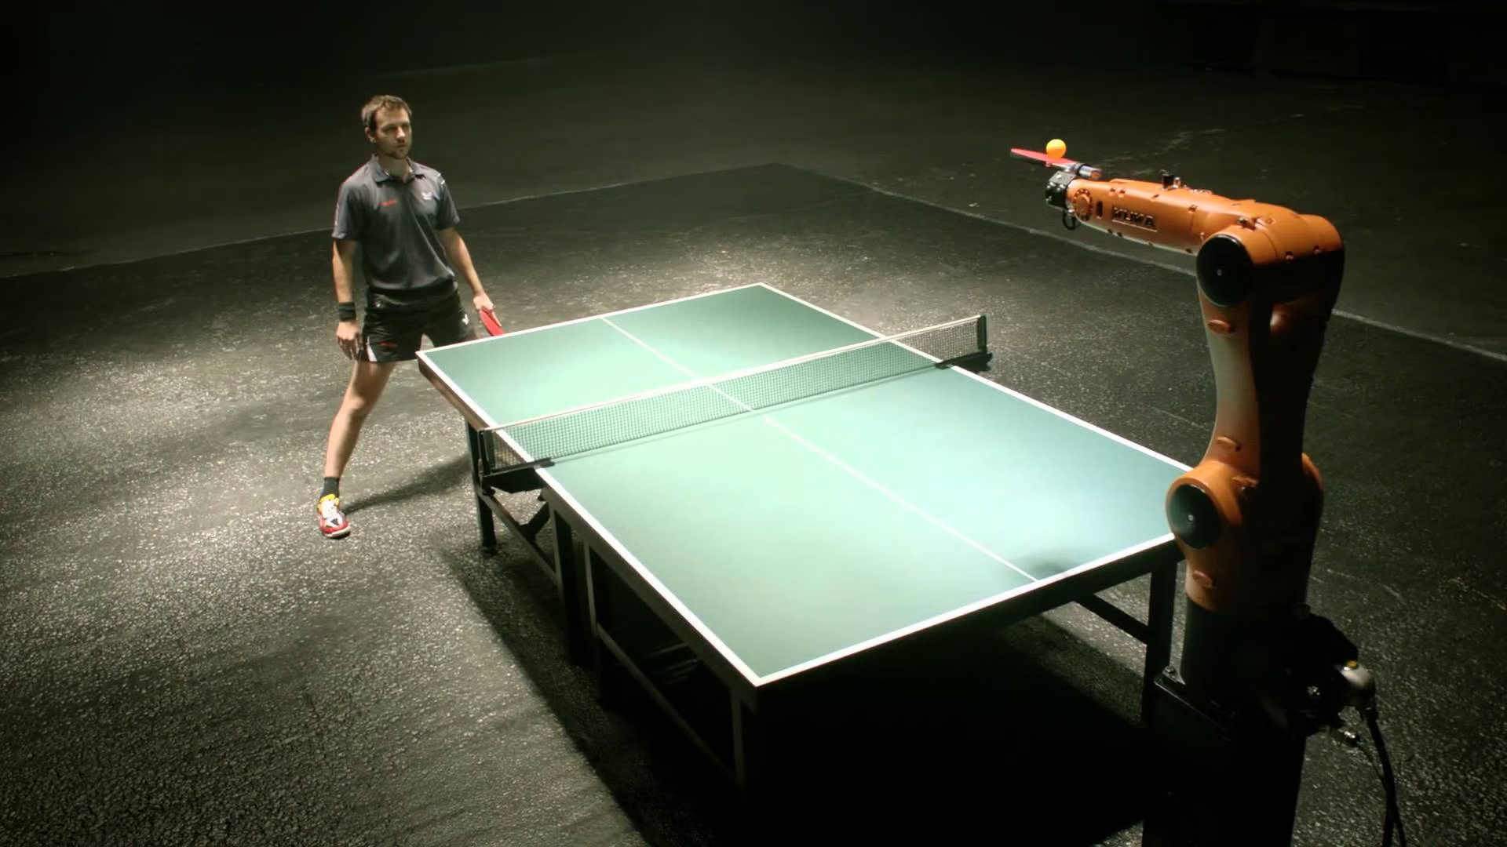
Outline
Introduction
1
2
Objective
Features
3
4
Process
Constants & Challenges
5
6
Future Work

Slide 3
introduction
Problem
Solution
A problem is the difficulty of finding a coach with excellent qualifications who can spend a long time training the player
The solution was that the hitter was a substitute for the player's partner, and the sensors were a substitute for the coach monitoring the player's scores and the camera was used to show whether the player hit the ball or not

Slide 4
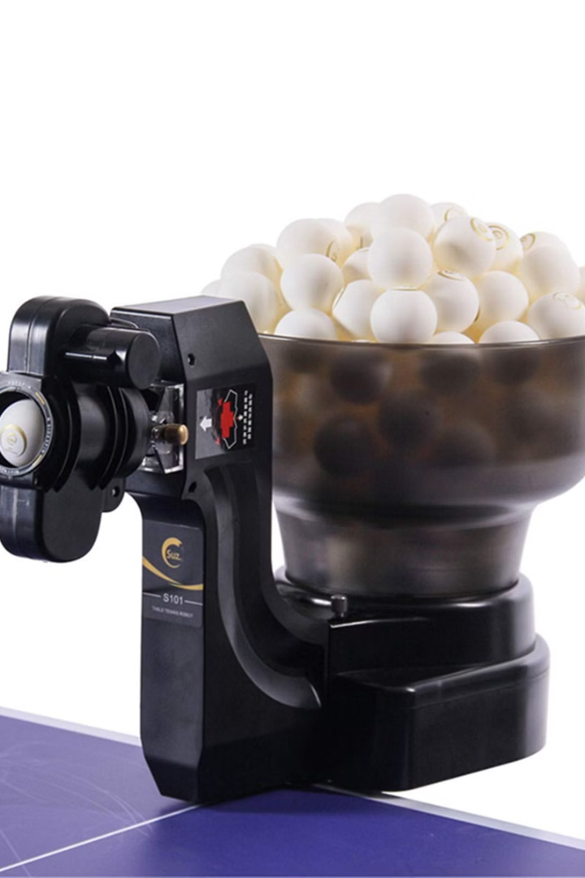
objective
The objective of our project is to introduce robotics into the sports field and implement automation to replace players in ping pong.

Slide 5



Features
Automated Ball Throwing
Camera
Sensor-Based Feedback

Slide 6
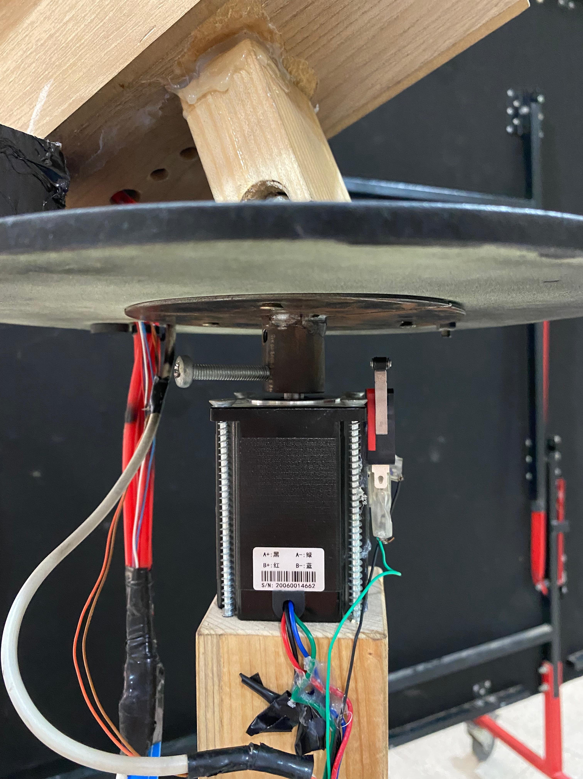
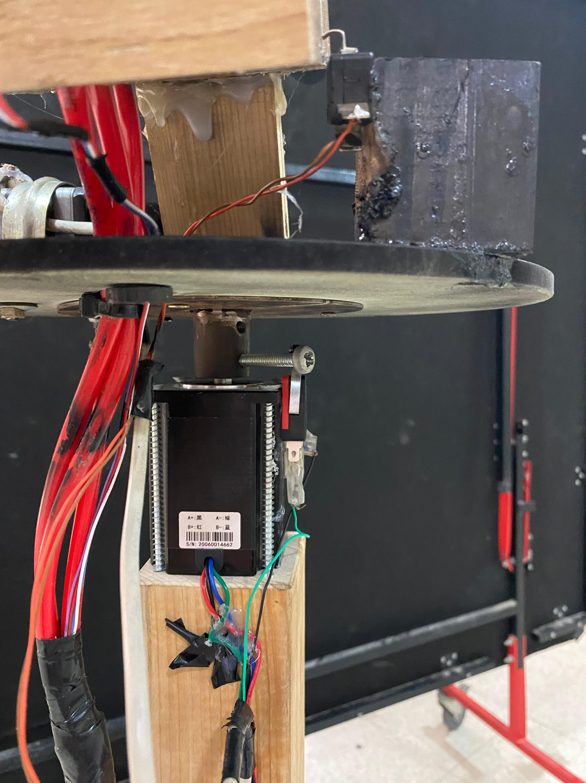
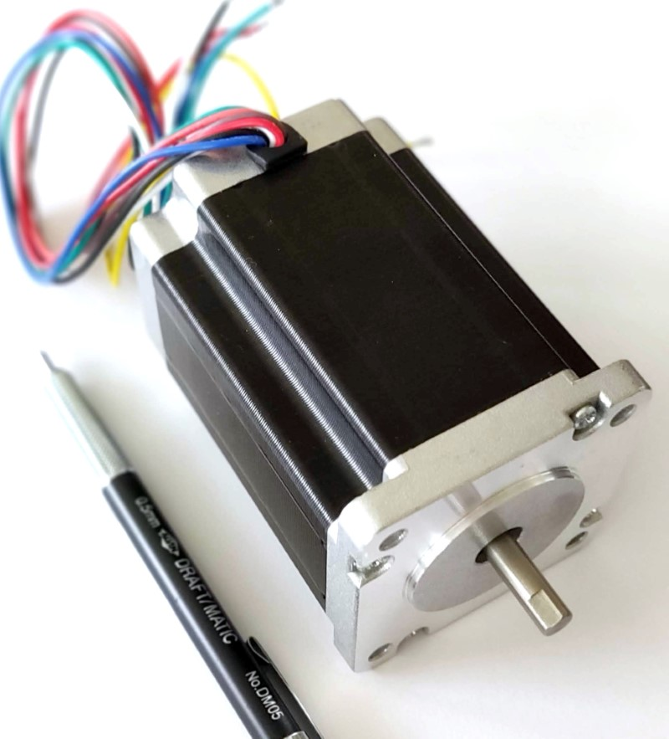
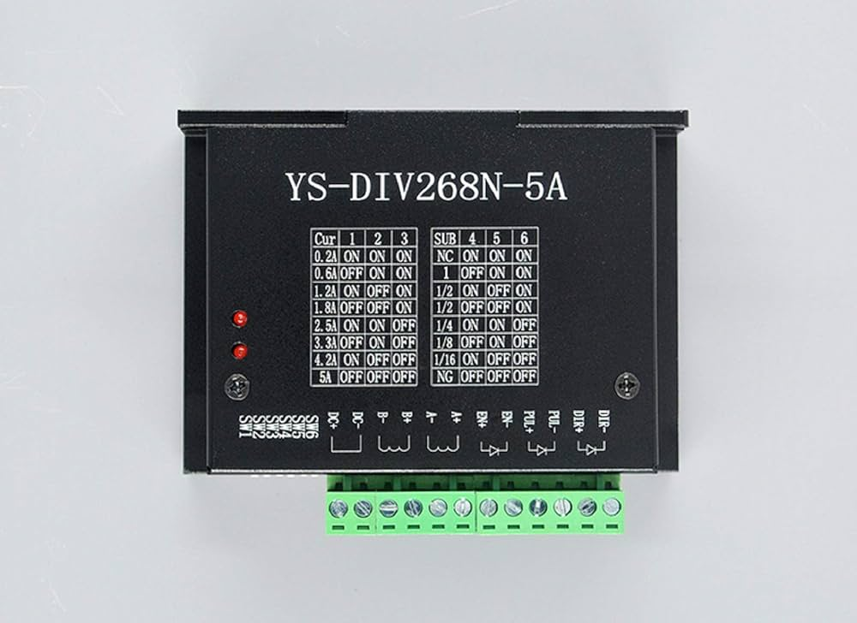
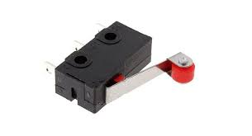
Process

Slide 7
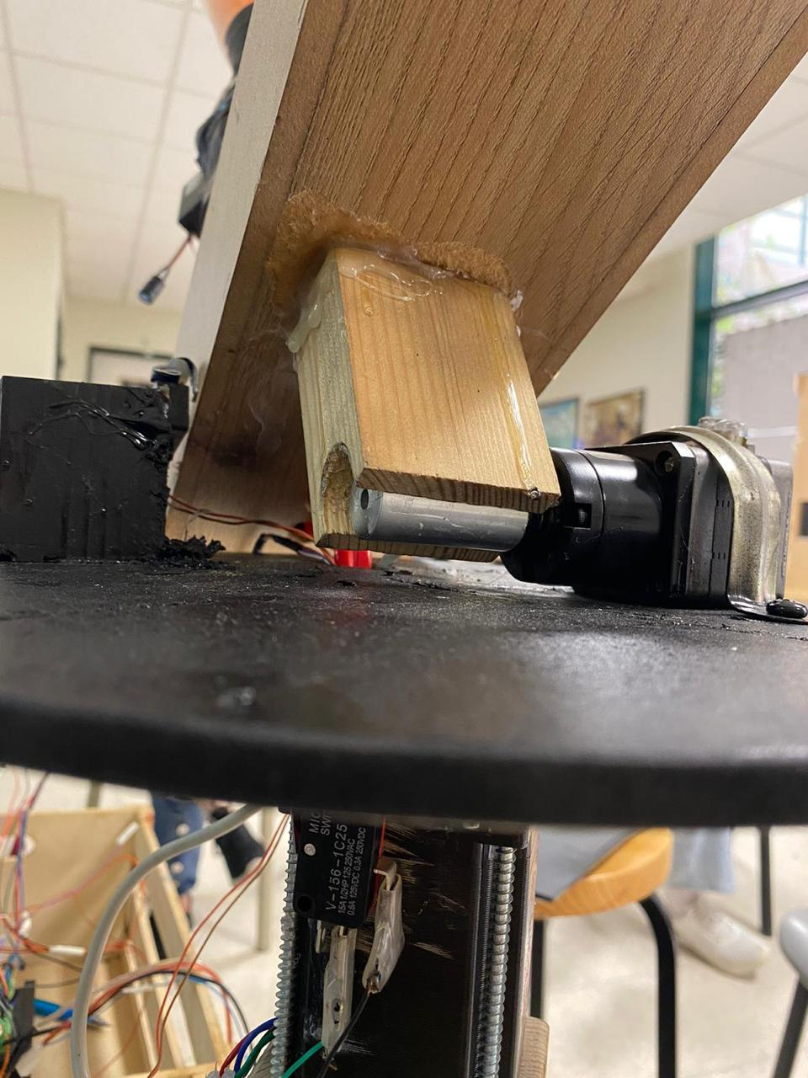
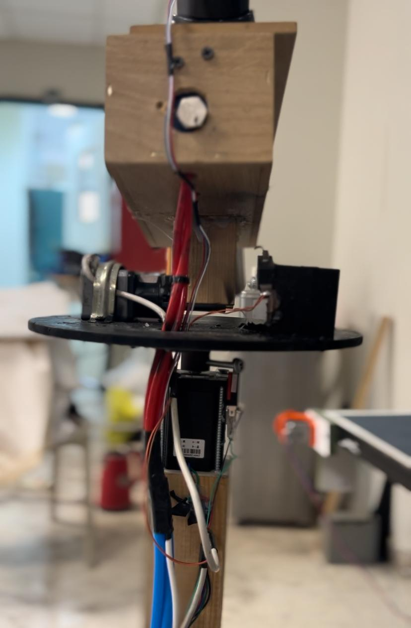
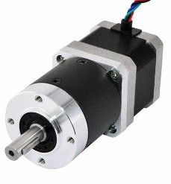
Process Cont.

Slide 8
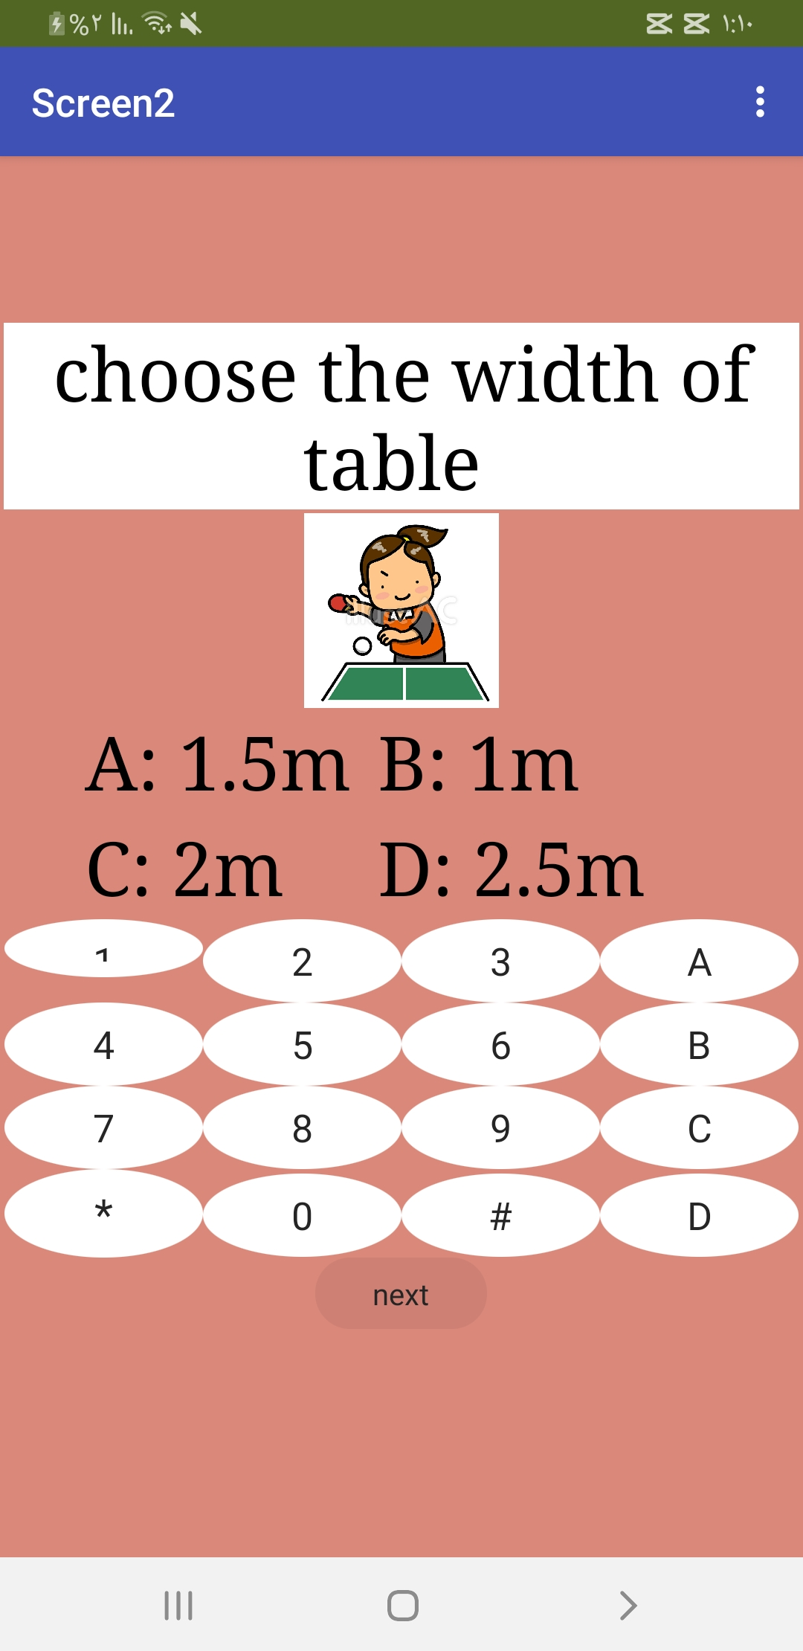
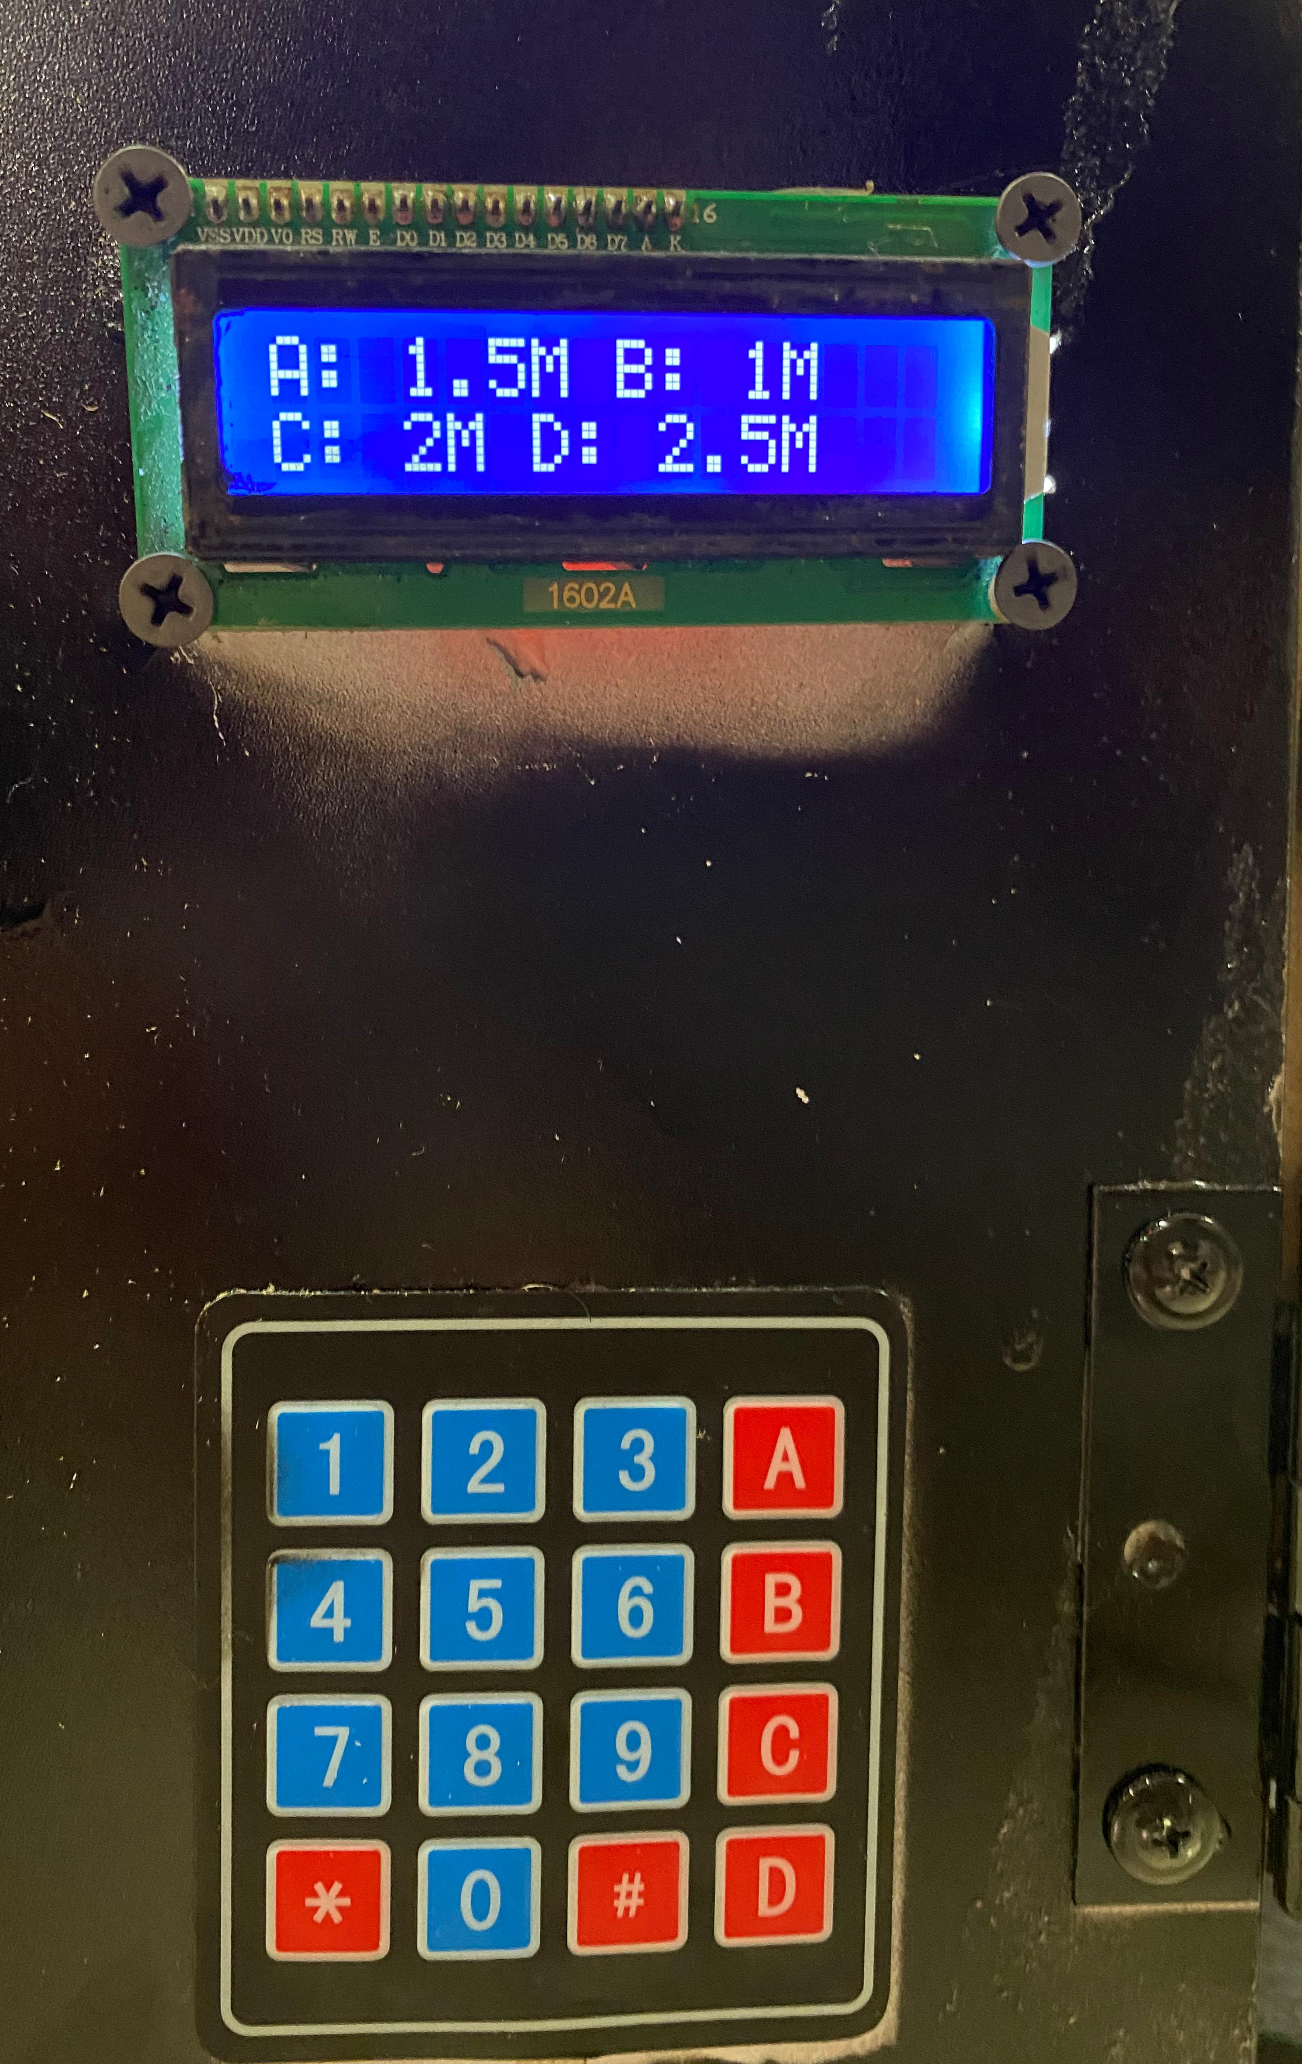
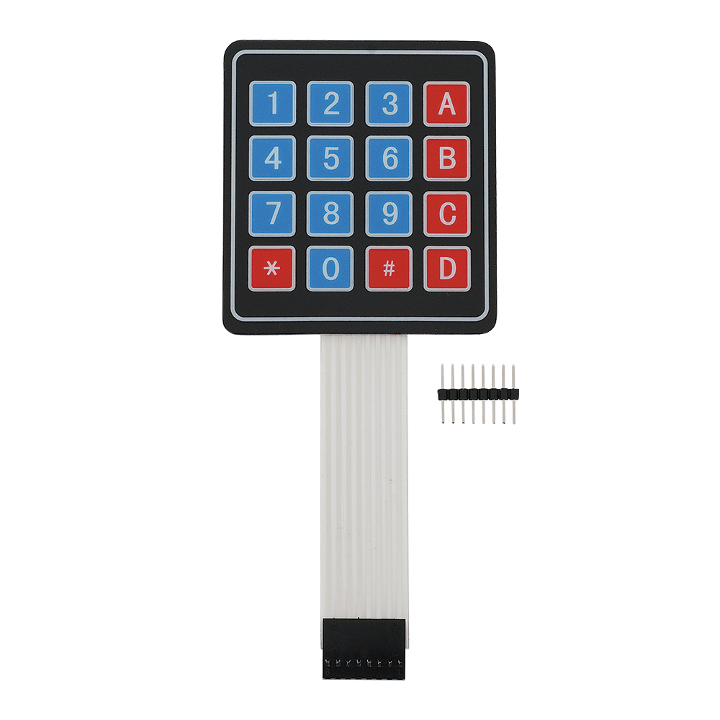
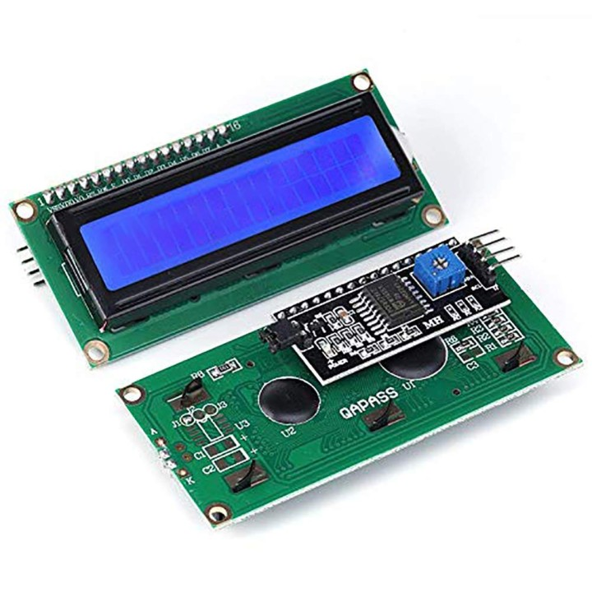
Process Cont.
Select table width

Slide 9
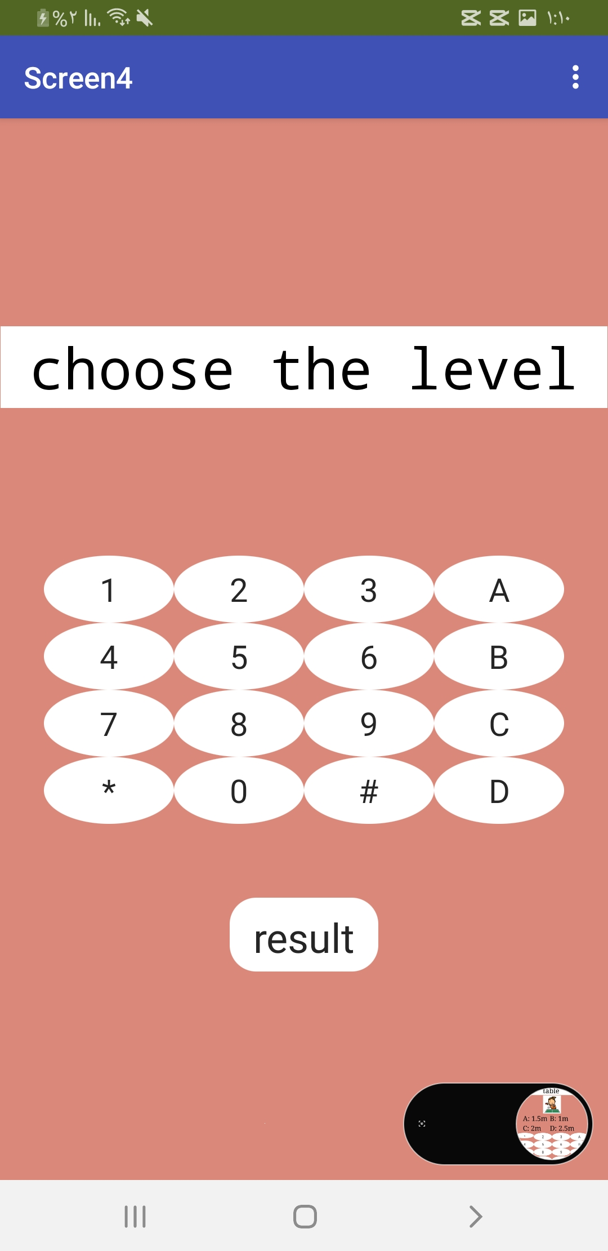
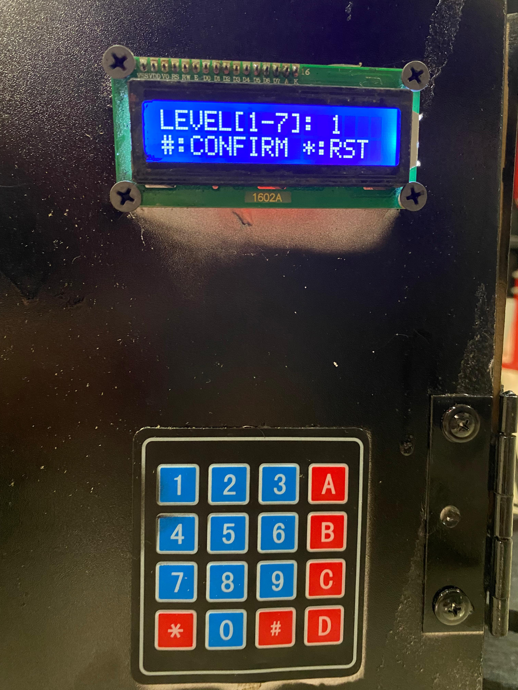
Process Cont.
Select ball
hitting force

Slide 10
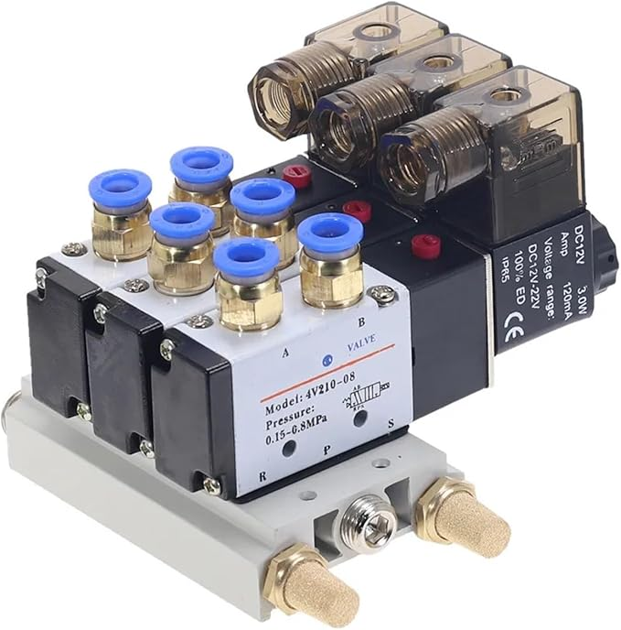
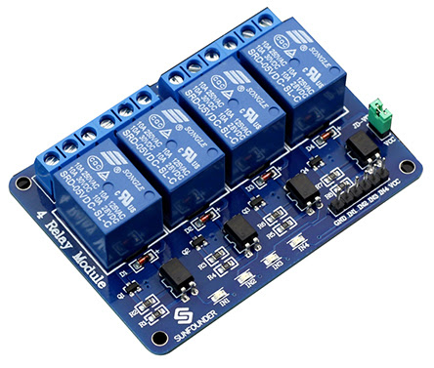
Process Cont.

Slide 11
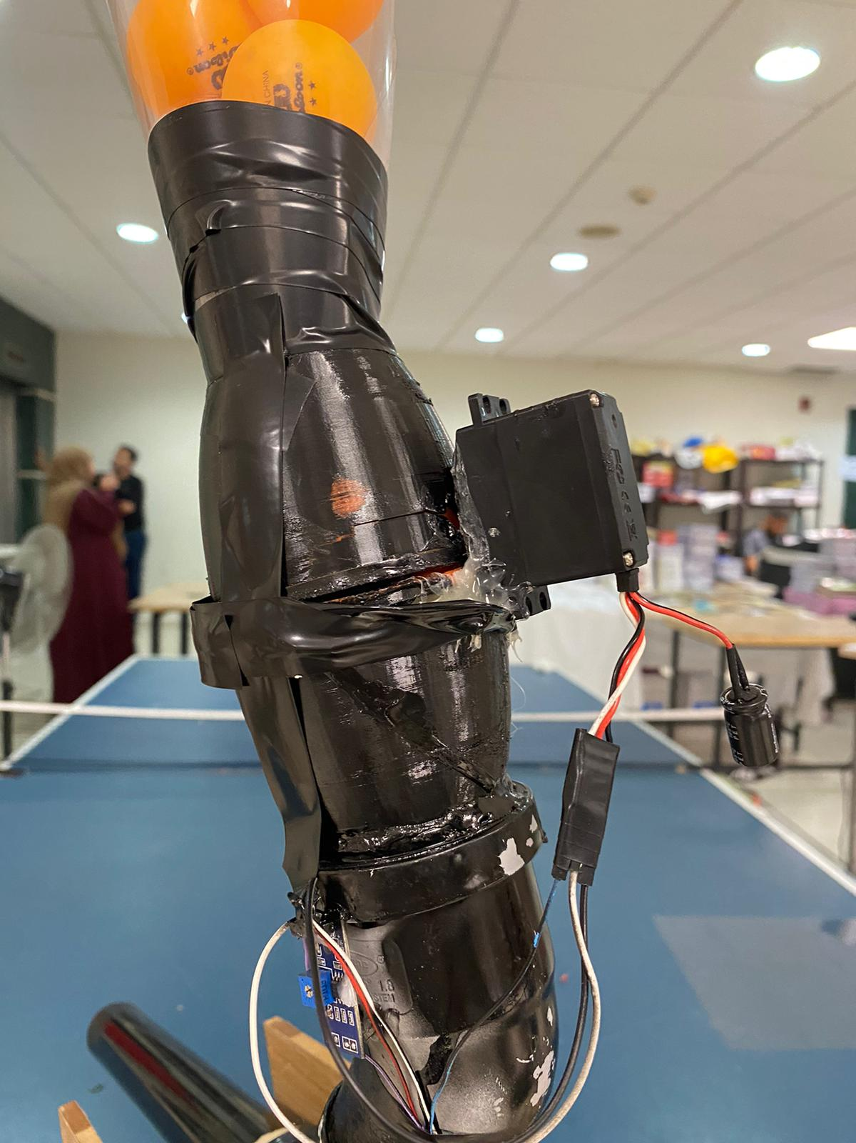
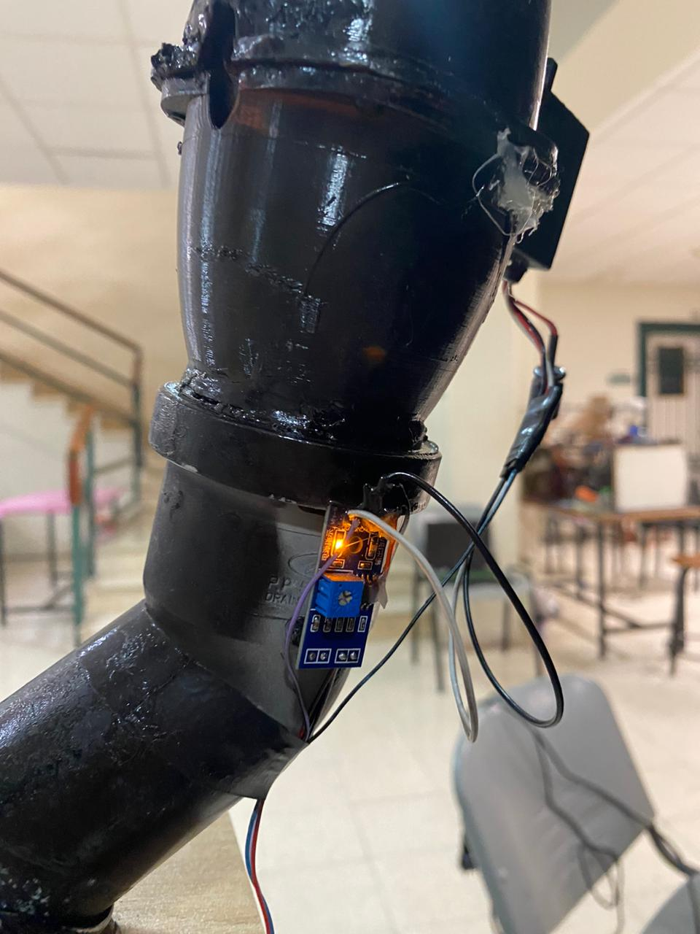
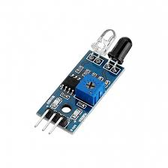
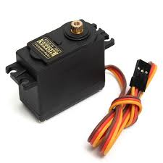
Process Cont.

Slide 12
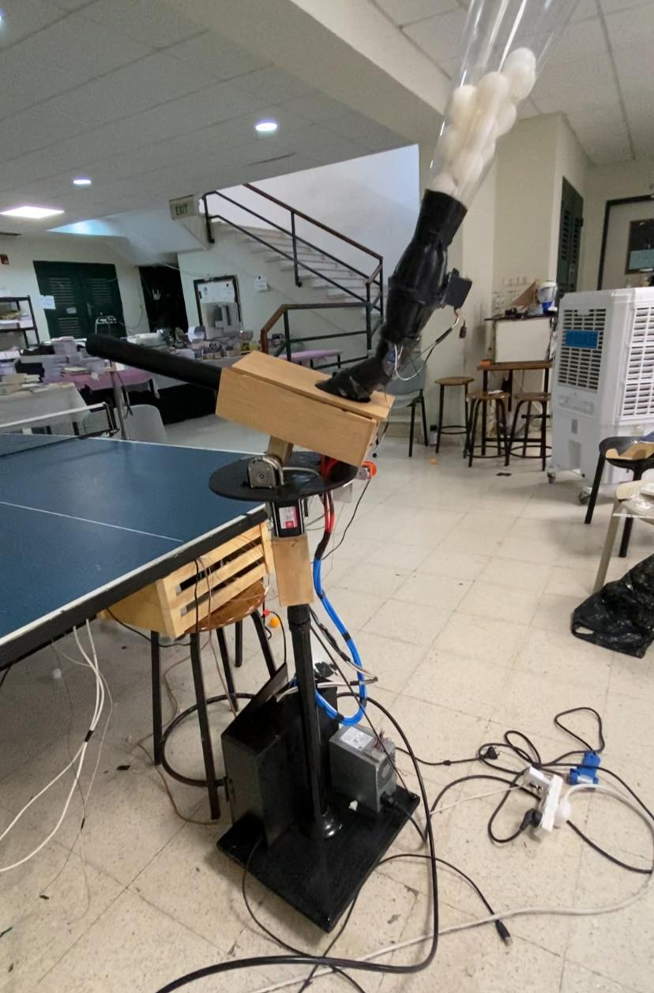
Process Cont.

Slide 13
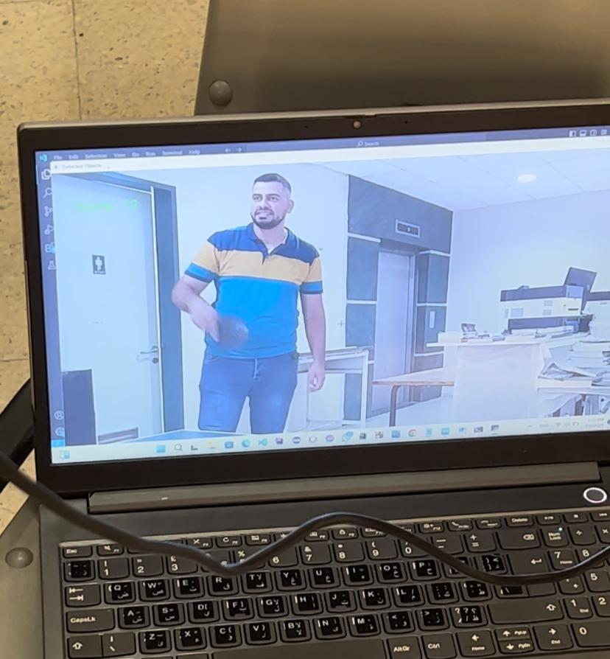
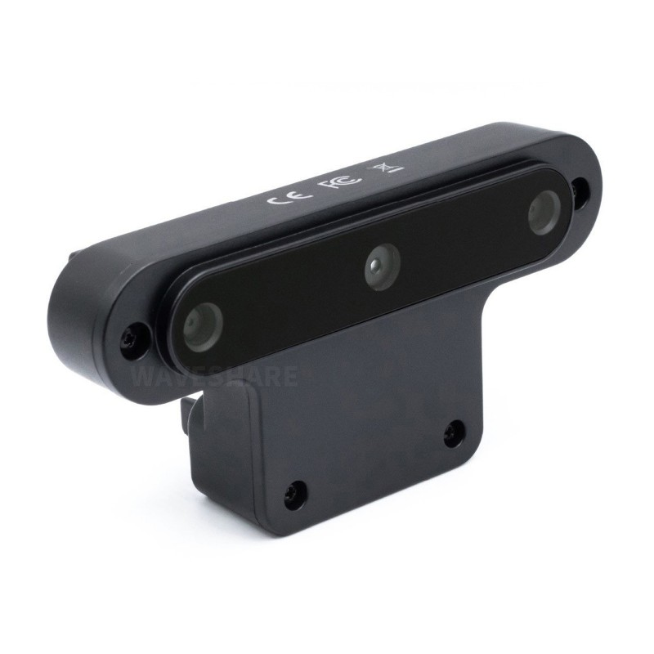
Process Cont.

Slide 14
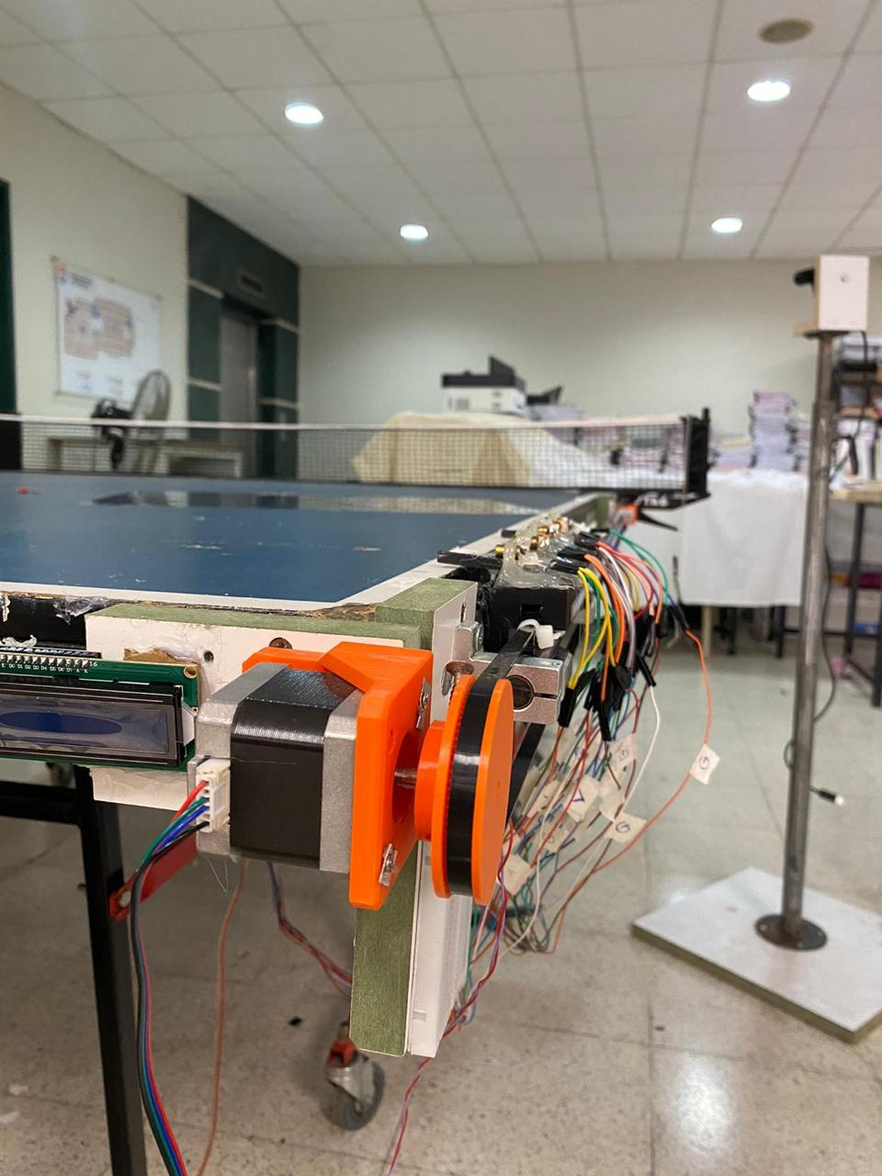
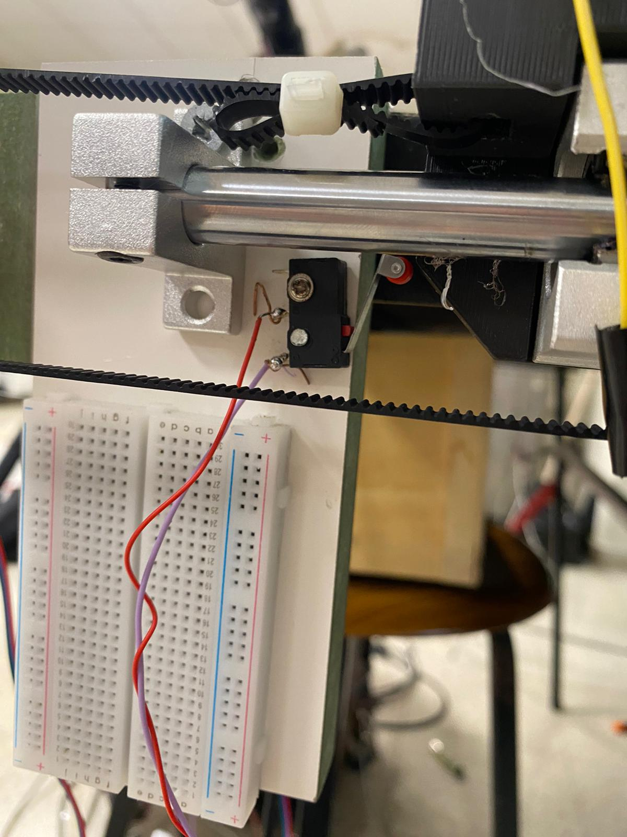
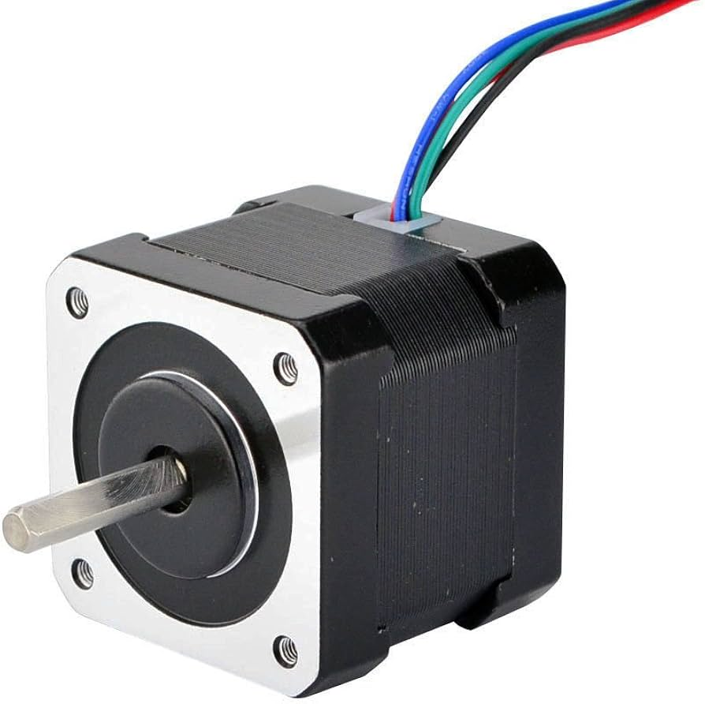
Process Cont.

Slide 15
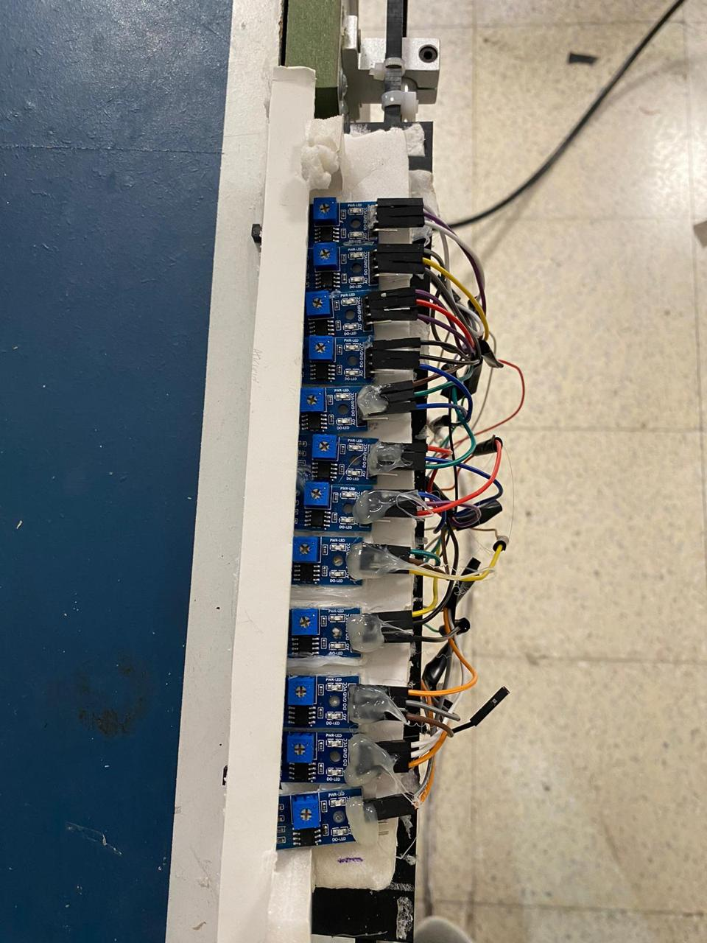
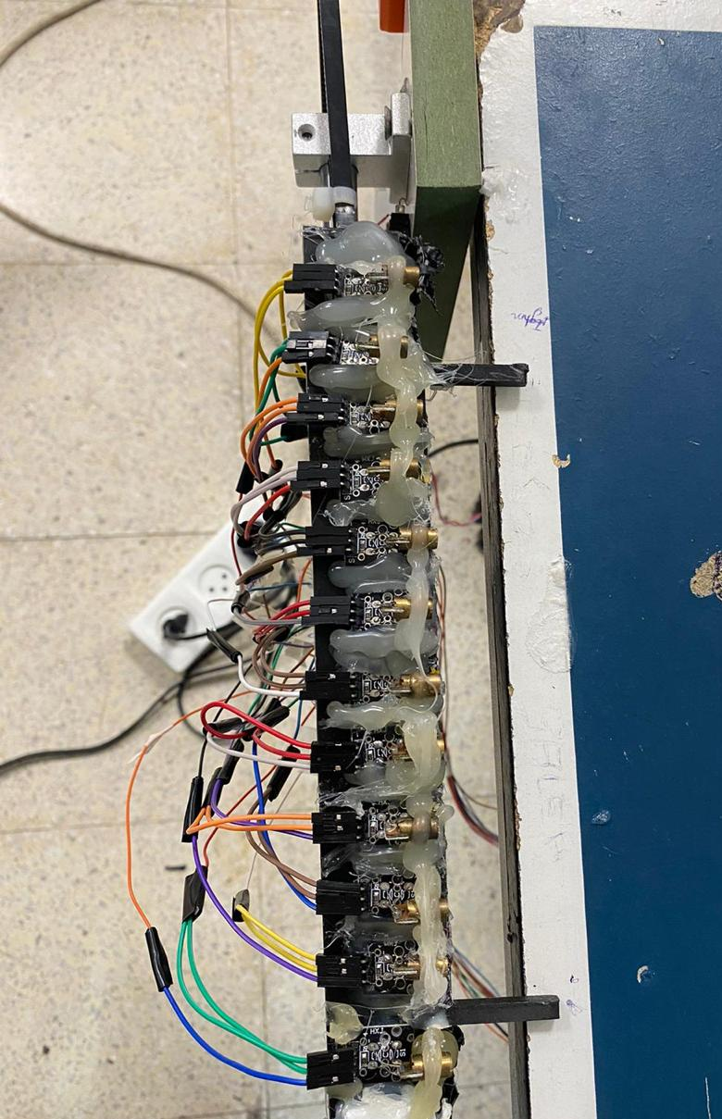
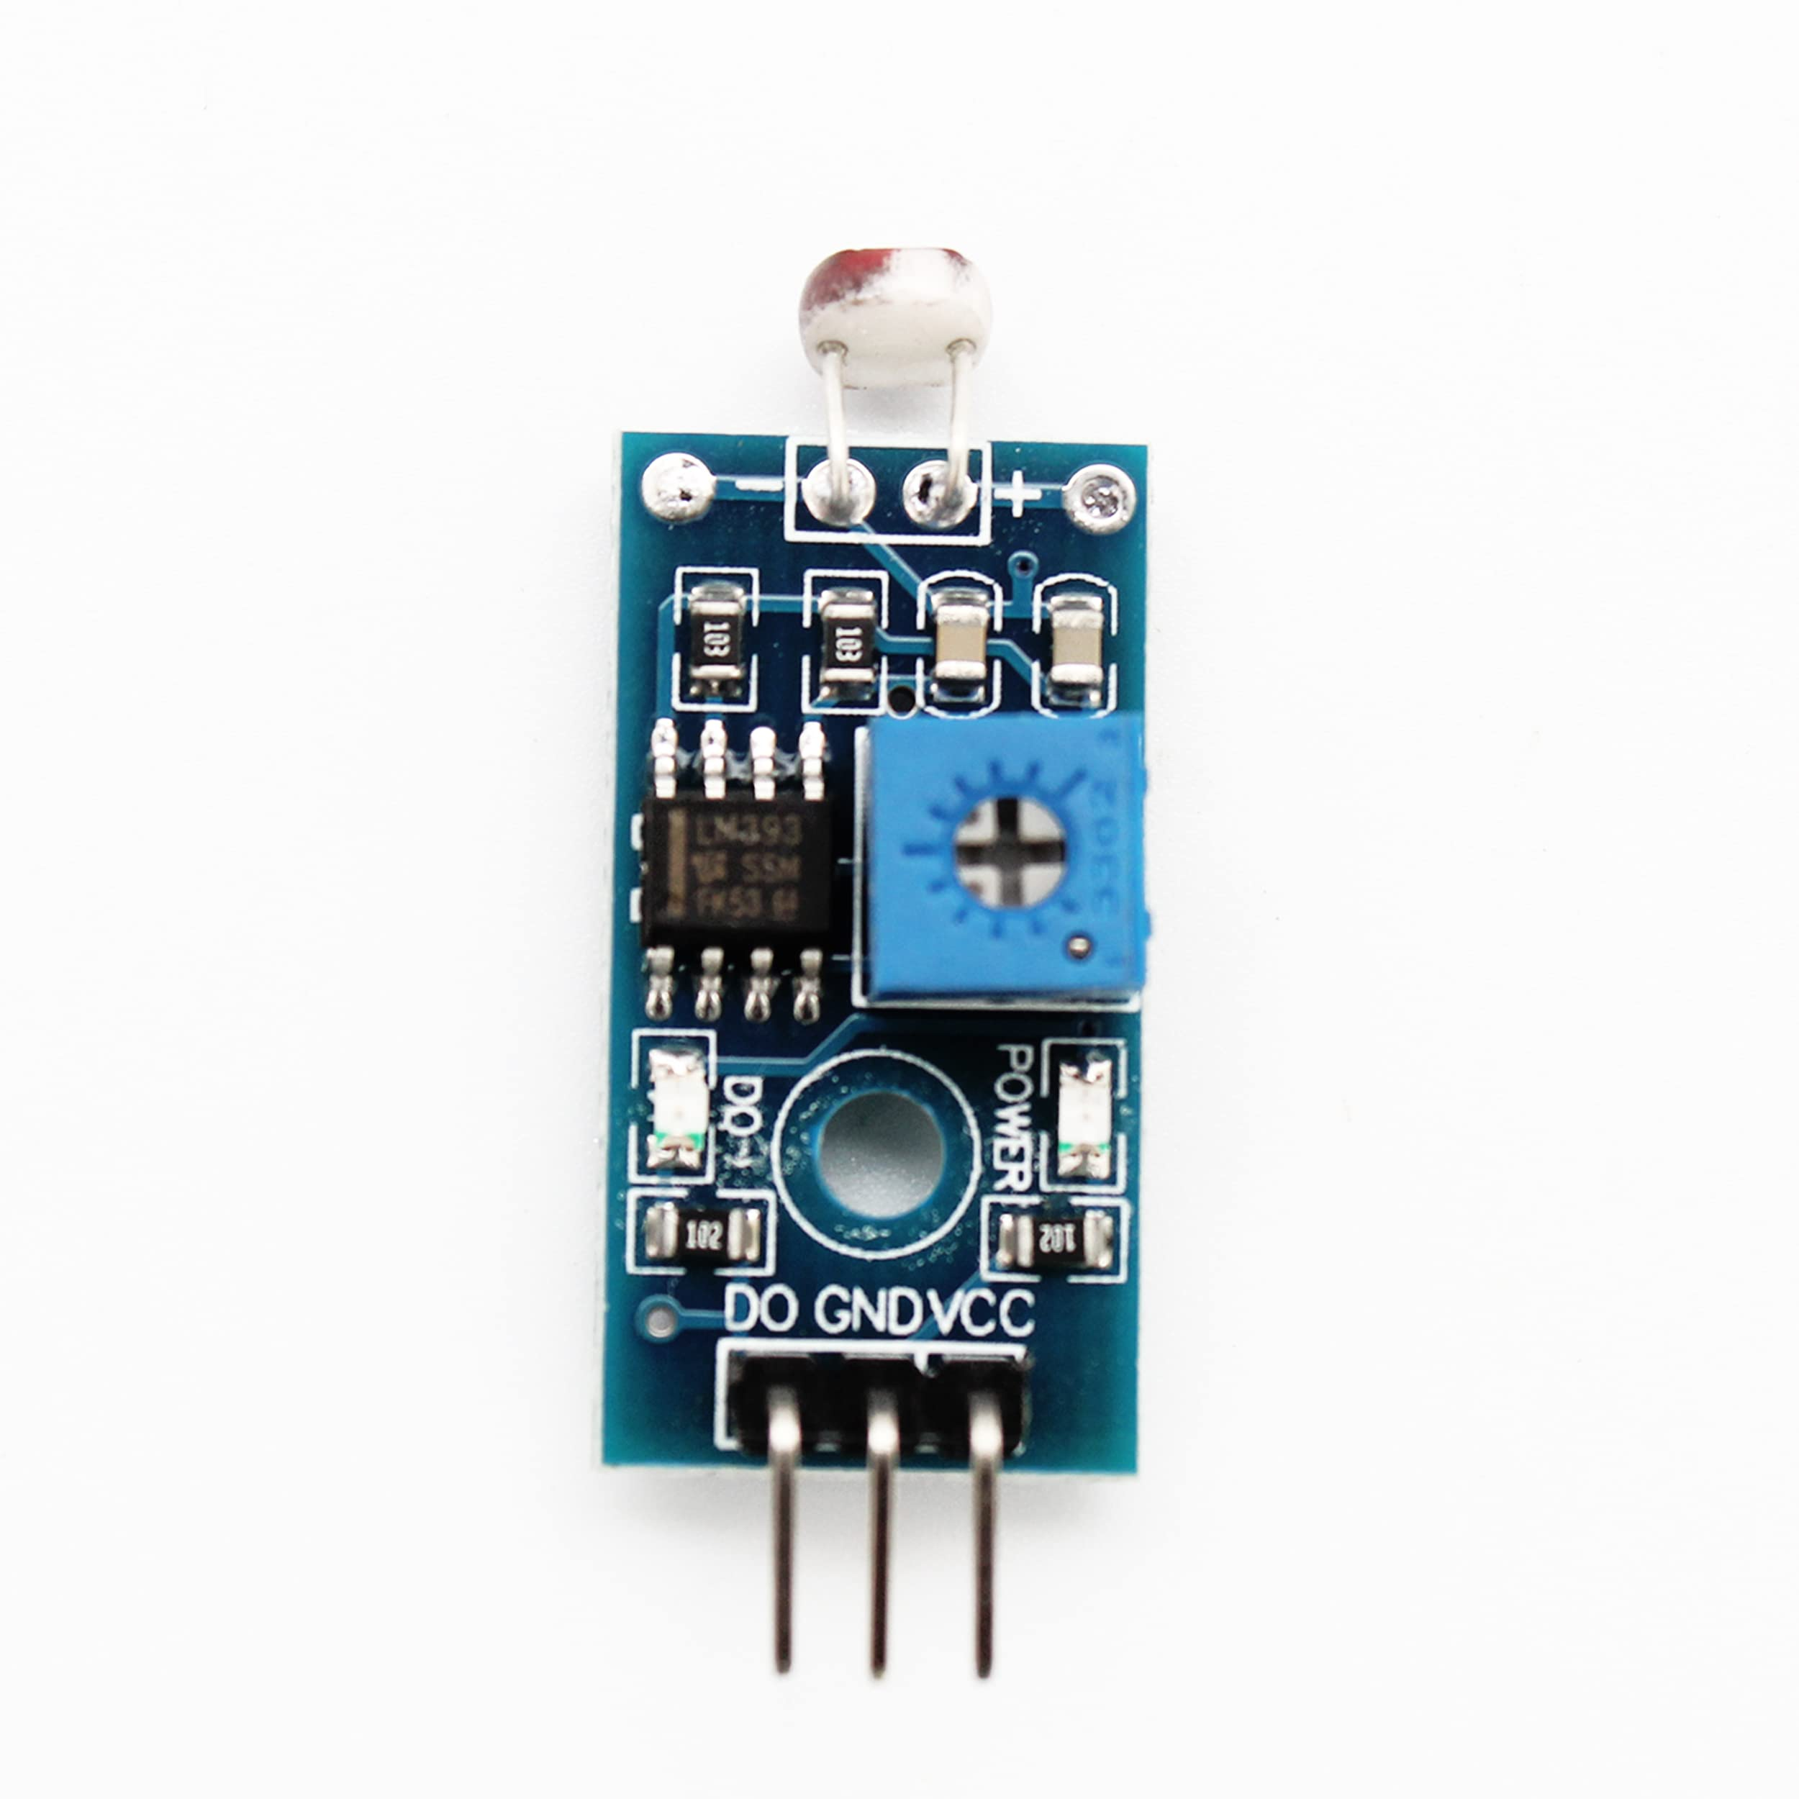
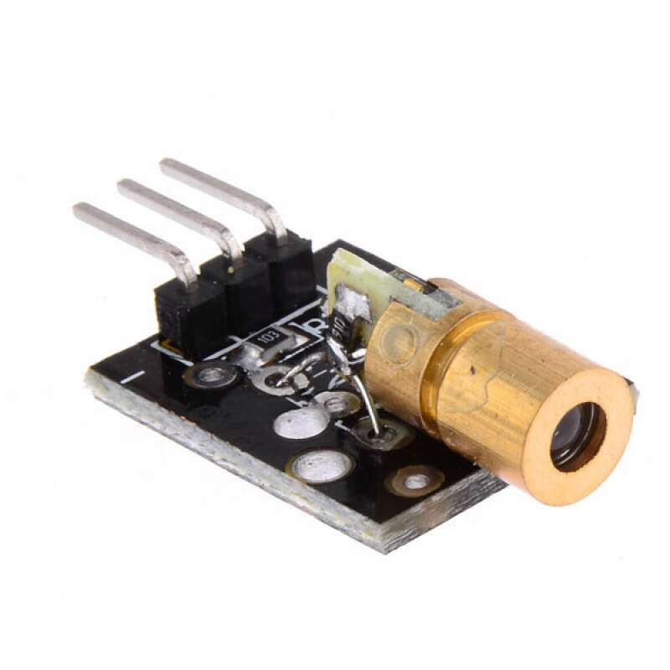
Process Cont.

Slide 16
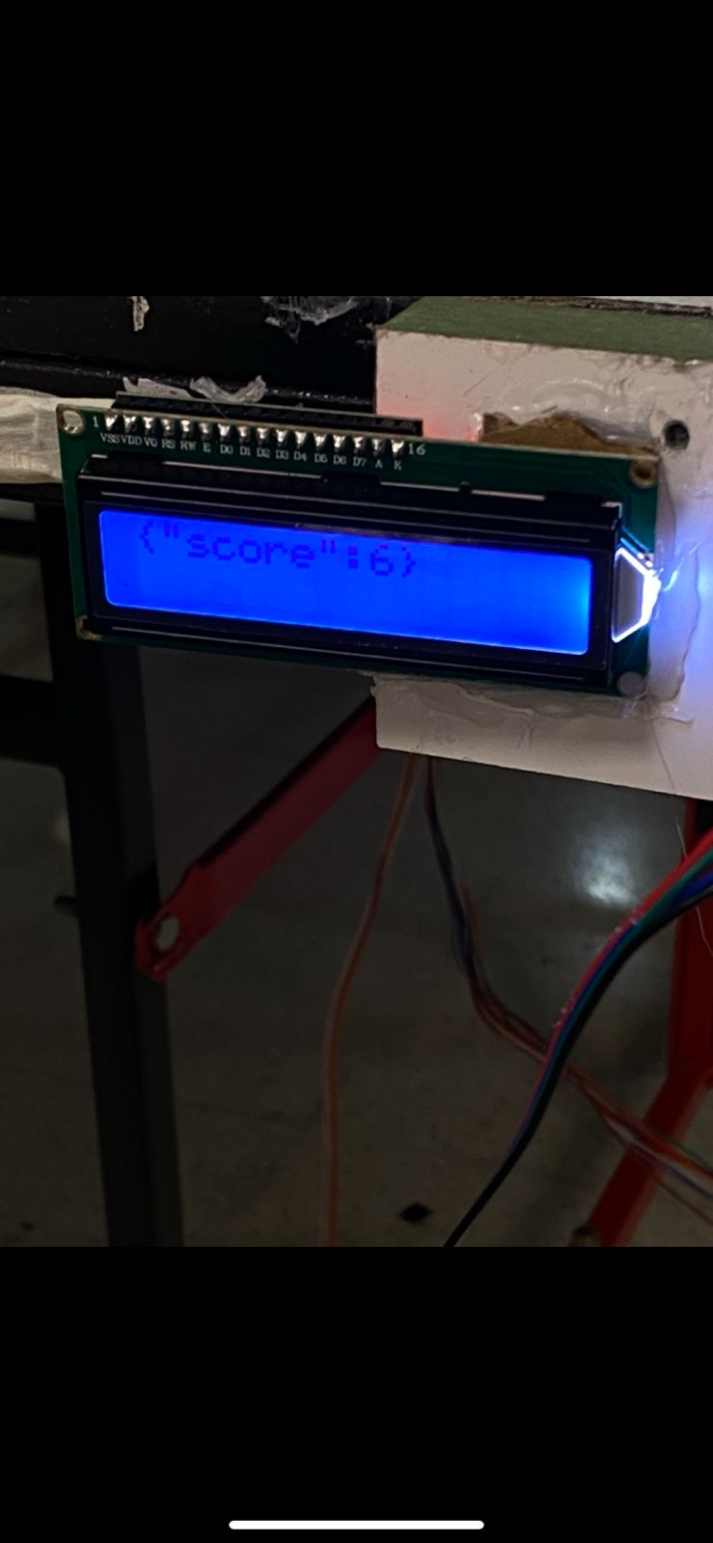
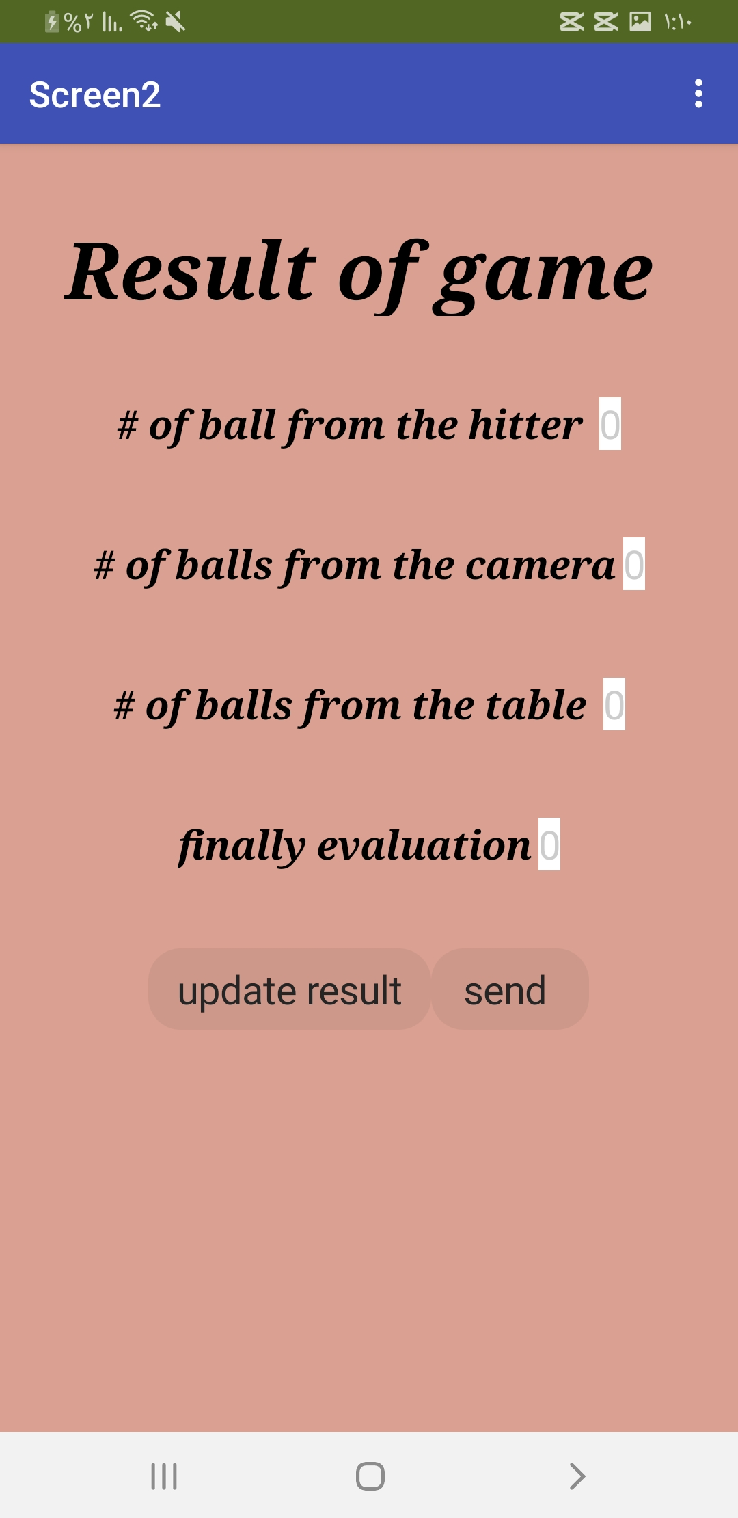
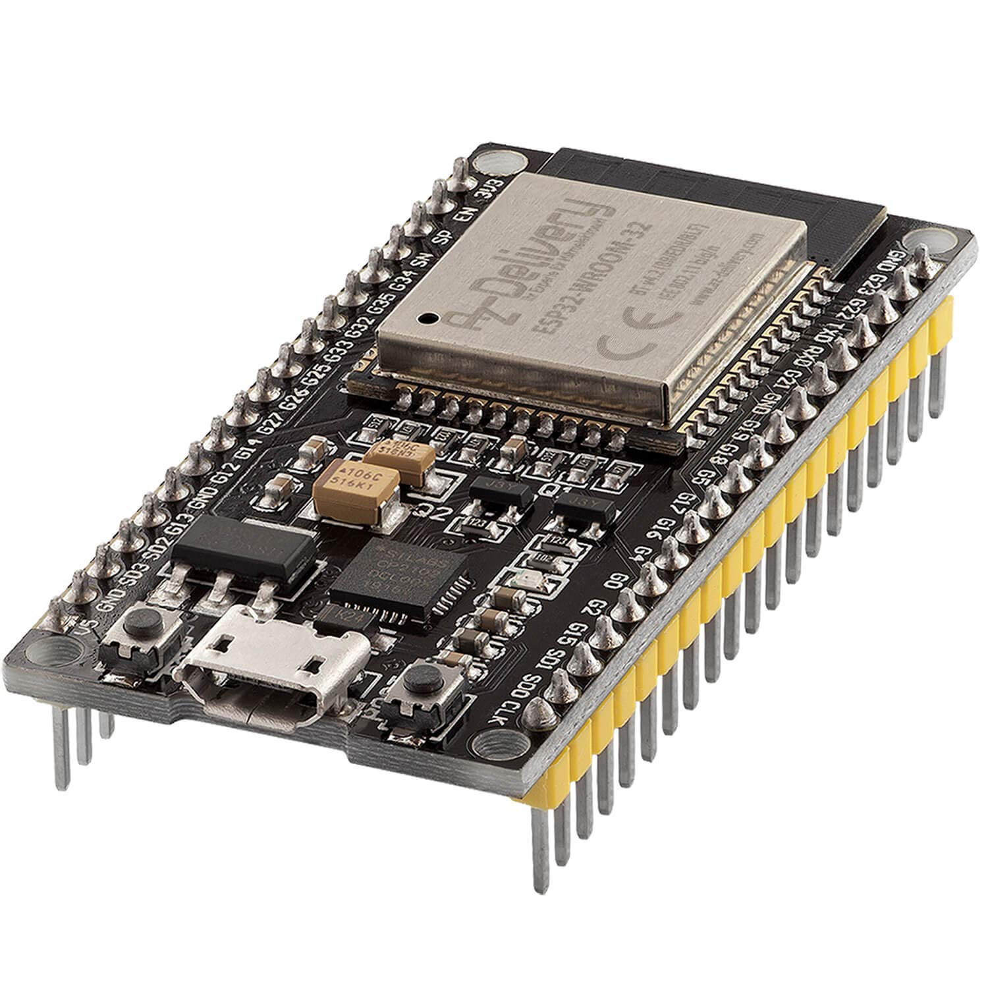
Process Cont.

Slide 17
Constraint & challenges
—
—
—
—
magnetic sensor
load of stepper motor
laser calibration
detection of camera
—
—
—
—
accuracy
tool damage
project design
cost

Slide 18
Future Work
Top Spin
Data-Driven Performance Analytics
1
2
3
Accuracy

Slide 19
Thanks !

