Slide 1

An-Najah National University
Graduation Project II Presentation
Design of a Wastewater Collection Network for Siris Village
By Students:
Ali Abu Hatab – Reg. No: 11925931
Mohammad Mahmoud – Reg. No: 11925767
Anas Wathifi – Reg. No: 11820968
Under supervision of:
Dr. Mohammad N. Almasri
Fall / 2023

Slide 2
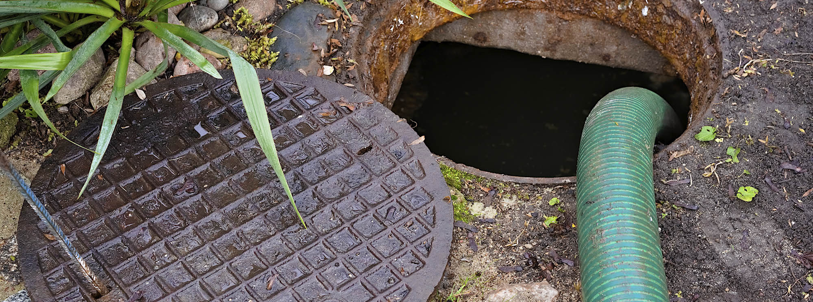

Introduction
Water is essential for our daily use, and water consumption leads to generate wastewater.
Wastewater should to be disposed safely, otherwise it will make a lot environmental issues.
Wastewater is mainly generated by the industrial , commercial and domestic sources.
Siris like other Palestinian villages, depends on Cesspits and Septic Tanks to git rid of wastewater.

Slide 3
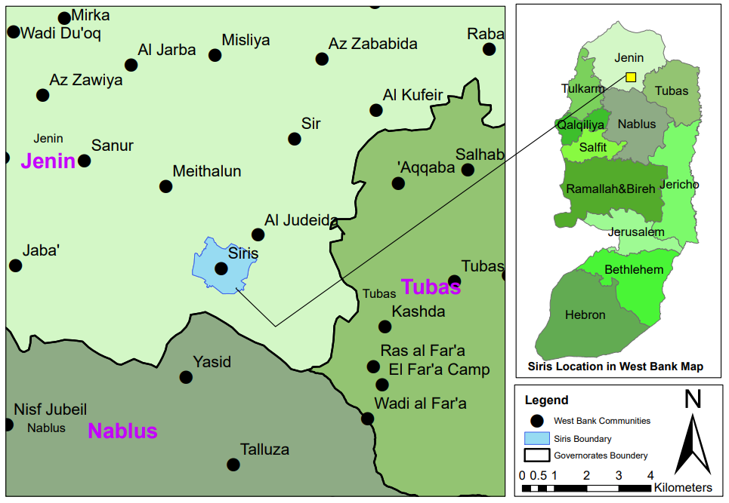
DESCRIPTION OF THE STUDY AREA
THE STUDY AREA OVERVIEW :
Siris is one of the oldest villages in Jenin Governorate.
It is located in the north of the West Bank, part of Jenin in the south.

Slide 4

DESCRIPTION OF THE STUDY AREA
SIRIS LANDS
The total administrative area of the village in 2017 is estimated to 12495 donums.
of which about 2500 donums are the territory of state.
7500 donums are planted with olives.
About 1500 donums are flat lands.
The rest is used for facilities.

Slide 5
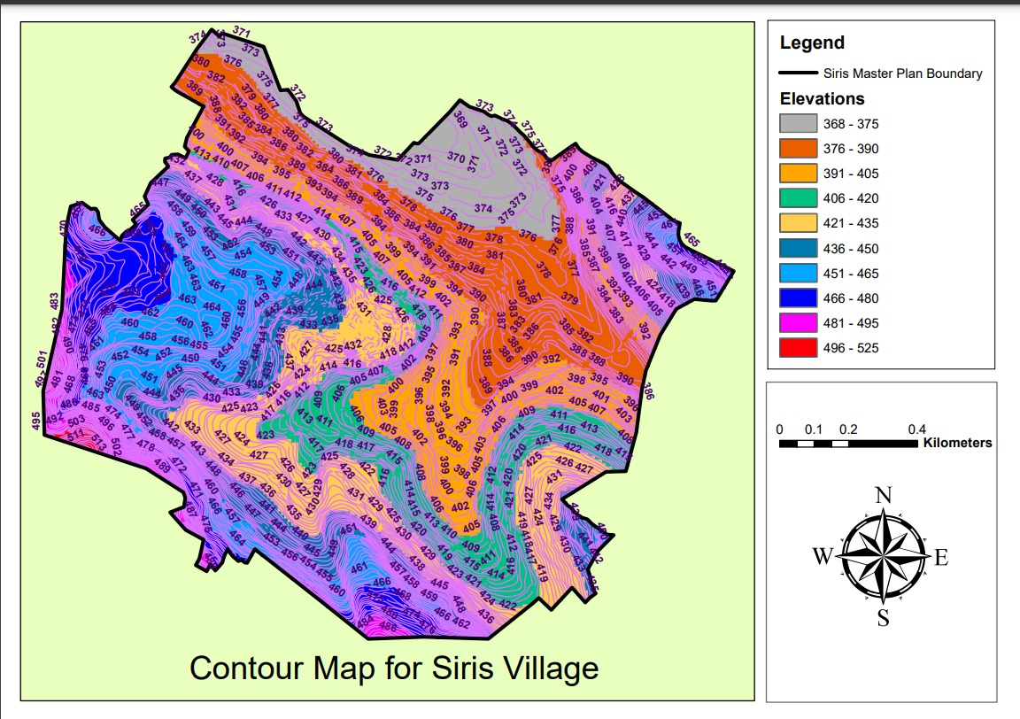
DESCRIPTION OF THE STUDY AREA
TOPOGRAPHY
The ground elevations range from 368m to 516m above sea level.

Slide 6
DESCRIPTION OF THE STUDY AREA
WATER SUPPLY
  Siris, Al-Judeida, and Meithalun are supplied with a pump through a water network that was established in 2011 by digging a well with a production capacity of 200 m3/hour, and another pump for Masliyah, Jarba, and Sair.
  The area is located within the Marj Sanur watershed, the northeastern basin.

Slide 7
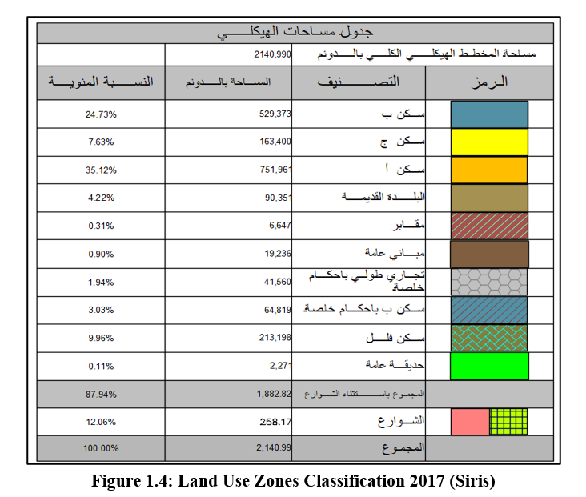
DESCRIPTION OF THE STUDY AREA
SIRIS LAND USE ZONES

Slide 8
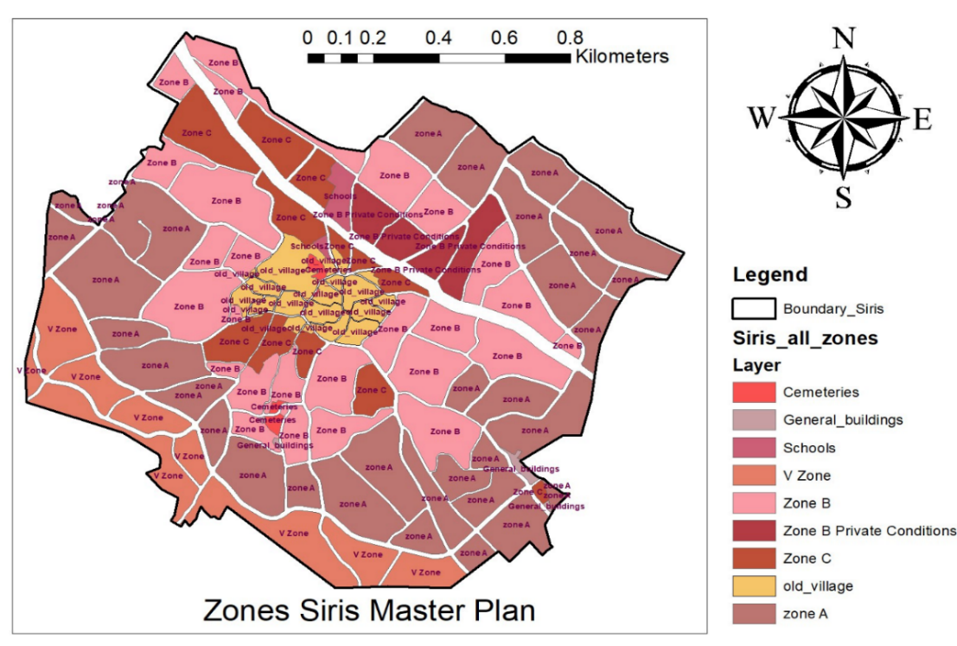
DESCRIPTION OF THE STUDY AREA
LAND USE ZONES DISTRIBUTION

Slide 9
Problem Definition
The expansion of Siris village population increased water consumption resulting in more wastewater generation.
Seeping the wastewater from cesspits into the ground water.
Besides, the high disposal costs and bad odors involved.
All of this making the necessary to design a wastewater collection network.

Slide 10
Objectives
Design a wastewater collection network for Siris Village using SewerCAD Software.
To estimate the unit load on Manholes
To estimate the total cost for the designed network .
To Determine the outfall locations.

Slide 11
Methodology
Project Idea
Study Area Selection
Data Collection
Analysis & Assessment- Excel
SewerCAD Modeling
Export Layout Shapefile To SewerCAD Software
Drawing WWCN Layout Using ArcMap Software
Yes
Model Run & Design
Layout Need Adjustment ?
No
Final Report
Conclusion & Recommendations
Cost Estimation

Slide 12
Generated Wastewater Flow Rate & Design Period

Slide 13
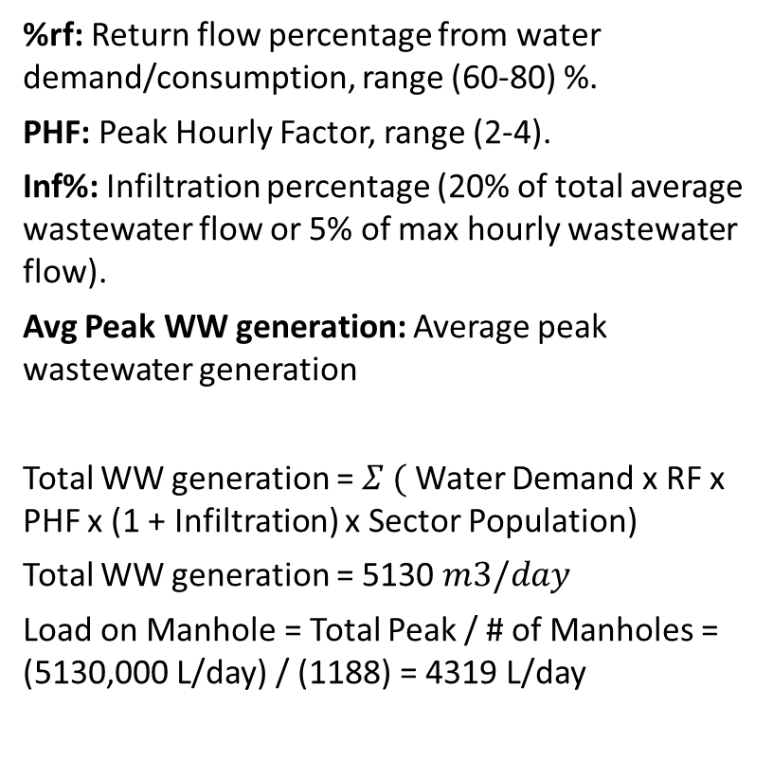
Generated Wastewater Flow Rate & Design Period
%rf: Return flow percentage from water demand/consumption, range (60-80) %.
PHF: Peak Hourly Factor, range (2-4).
Inf%: Infiltration percentage (20% of total average wastewater flow or 5% of max hourly wastewater flow).
Avg Peak WW generation: Average peak wastewater generation
Total WW generation = $Σ ($Water Demand x RF x PHF x (1 + Infiltration) x Sector Population)
Total WW generation = 5130 $m3/day$
Load on Manhole = Total Peak / # of Manholes = (5130,000 L/day) / (1188) = 4319 L/day

Slide 14
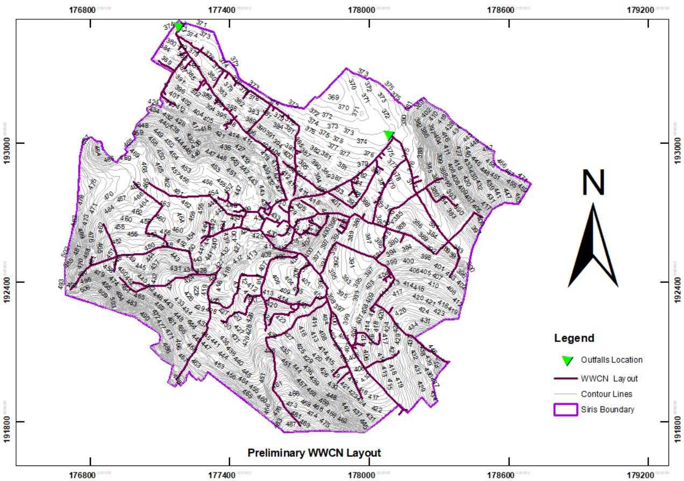
Preliminary Layout

Slide 15
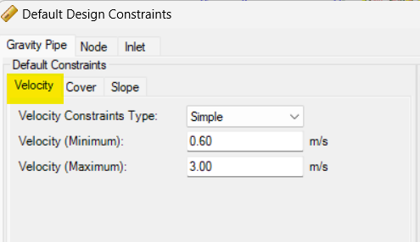
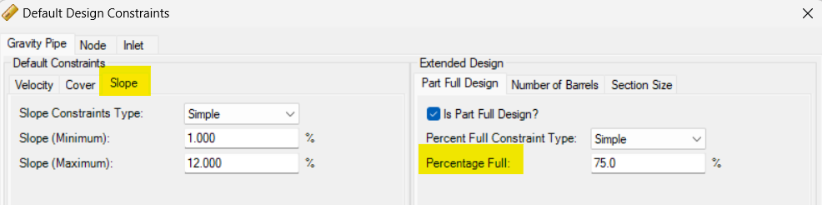
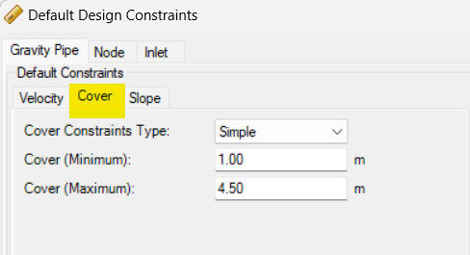

SewerCAD Modeling
Inputting Criteria
Cover depth (1-4.5 m).
Velocity (0.6 - 3 m/s).
Slope (1 % - 12 %).
Conduit partially full system (75 %).
Minimum sewer diameters (not less than 8 inch).

Slide 16
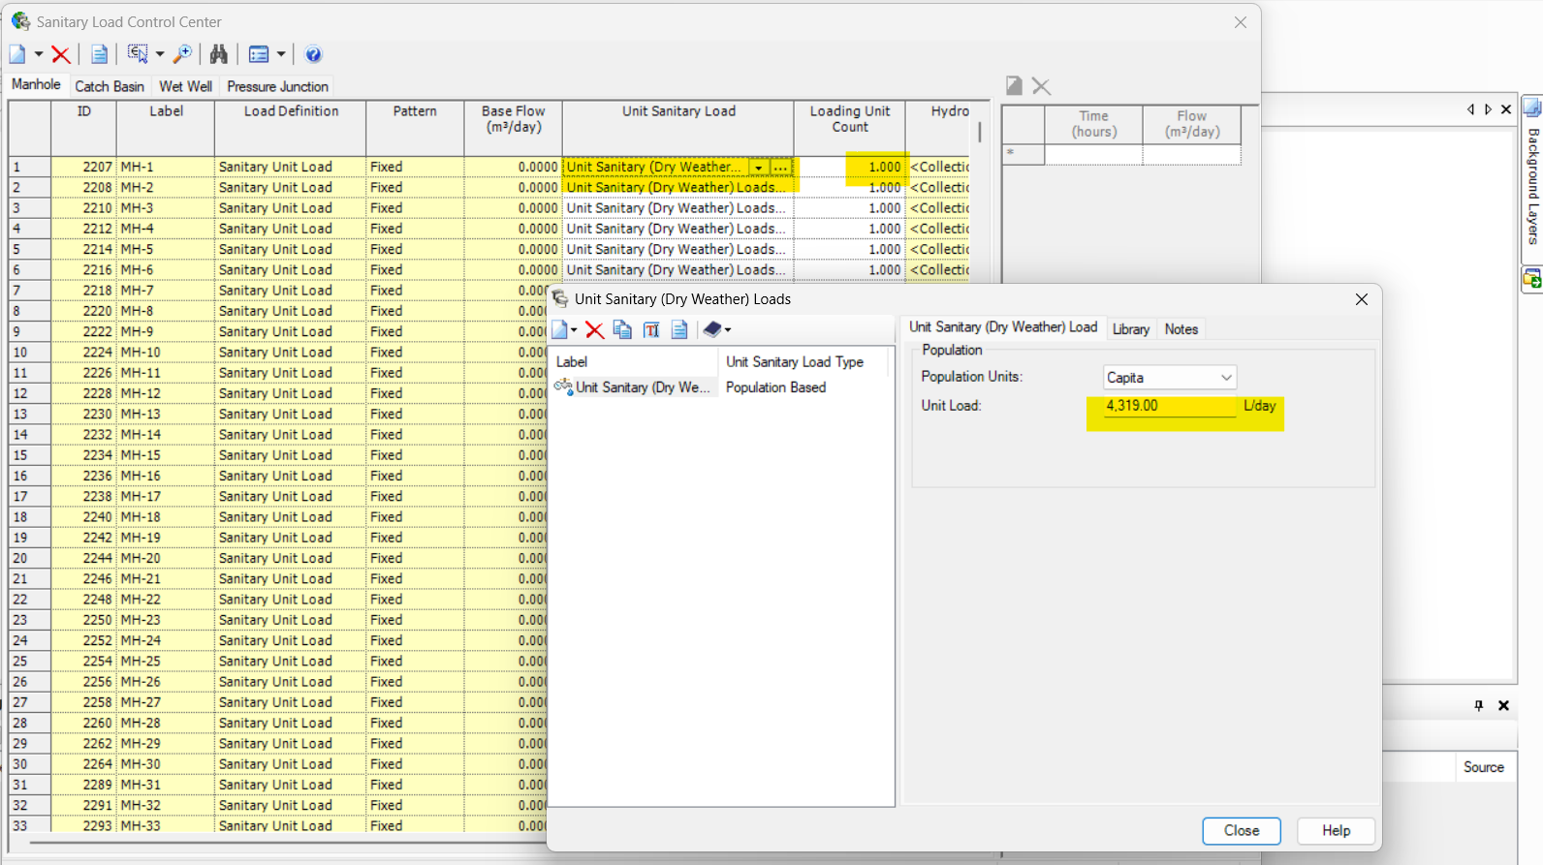
SewerCAD Modeling
Uniform Load on Manholes
Load on Manhole = Total Peak / # of Manholes = (5130,000 L/day) / (1188) = 4319 L/day

Slide 17
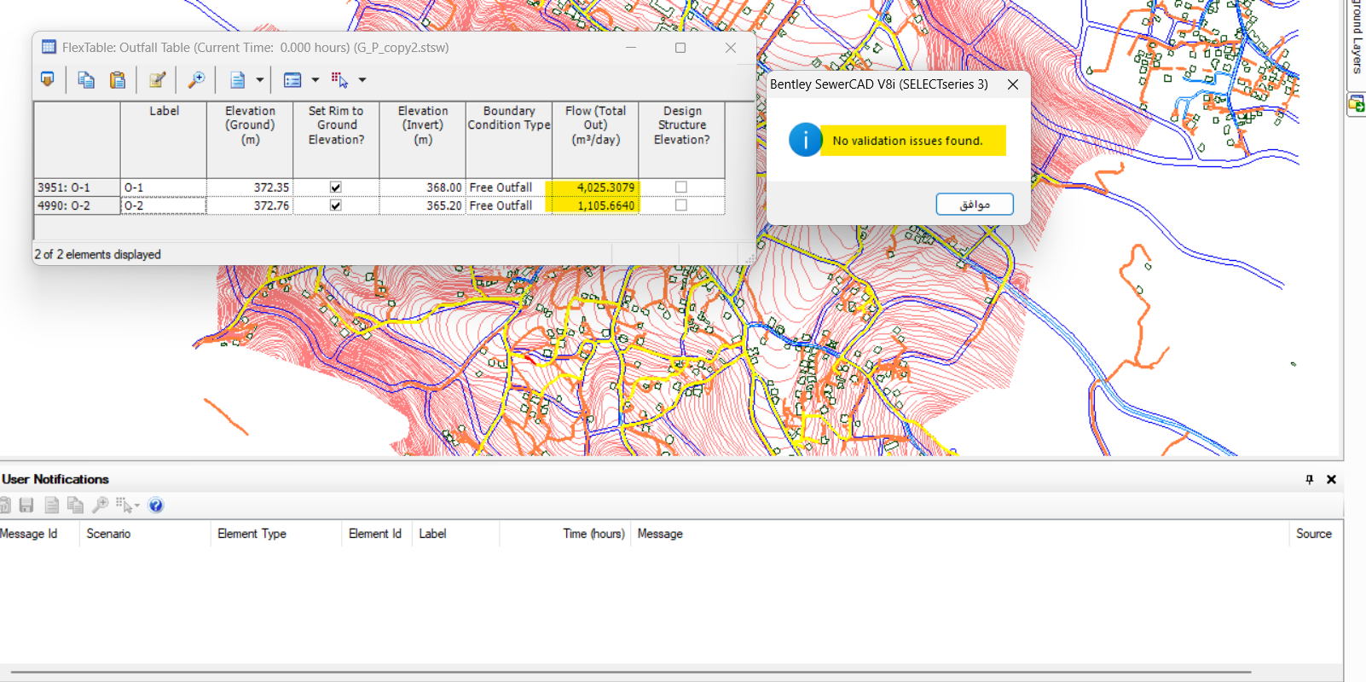
SewerCAD Modeling
Validation
Load on Manhole = Total Peak / # of Manholes = (5130,000 L/day) / (1188) = 4319 L/day

Slide 18
Design Material
We used PVC (Poly Vinyl Chloride) because of many reasons:
It's existing in Palestine local market, in addition to
Light weight; so high workability
Long lifespan
Low cost
Chemical resistance

Slide 19
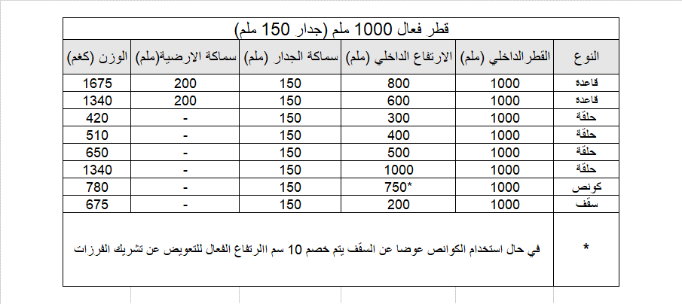
Design of Manholes
Manholes are used to connect pipes at roads inter sections, change in slopes, the following figure shows the Manholes components and its properties:

Slide 20
ANALYSIS AND DESIGN
  Determining manhole locations
There are several considerations to know the manholes location:
The distance between manholes within the range (30-50) m. Depend on the country maintenance capacity, in Palestine we take it 30m maximum distance.
Manhole must be located at each intersection of roads.
When there is a change in slope.
When there is a change in diameter.

Slide 21
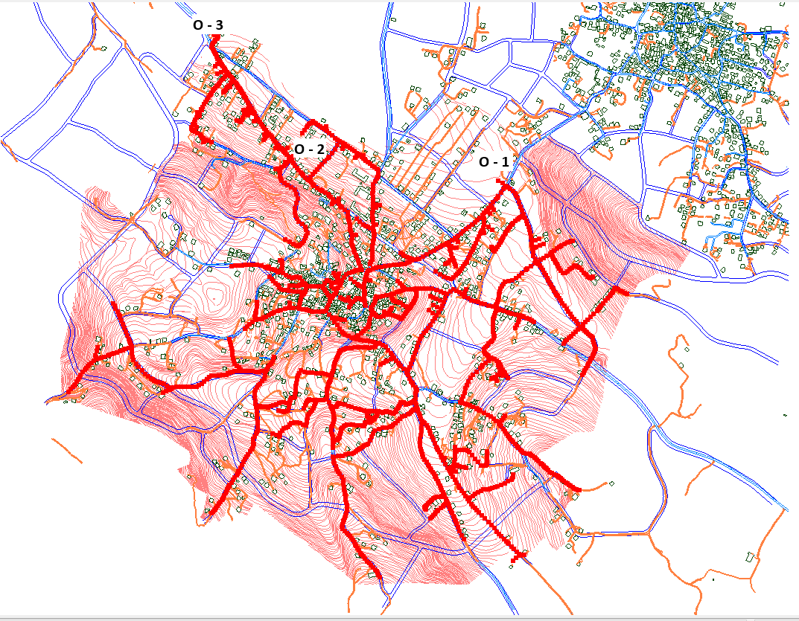
ANALYSIS AND DESIGN
  Draw wastewater collection network
Due to the topography nature in Siris we divided the network into three parts of three outfalls.

Slide 22
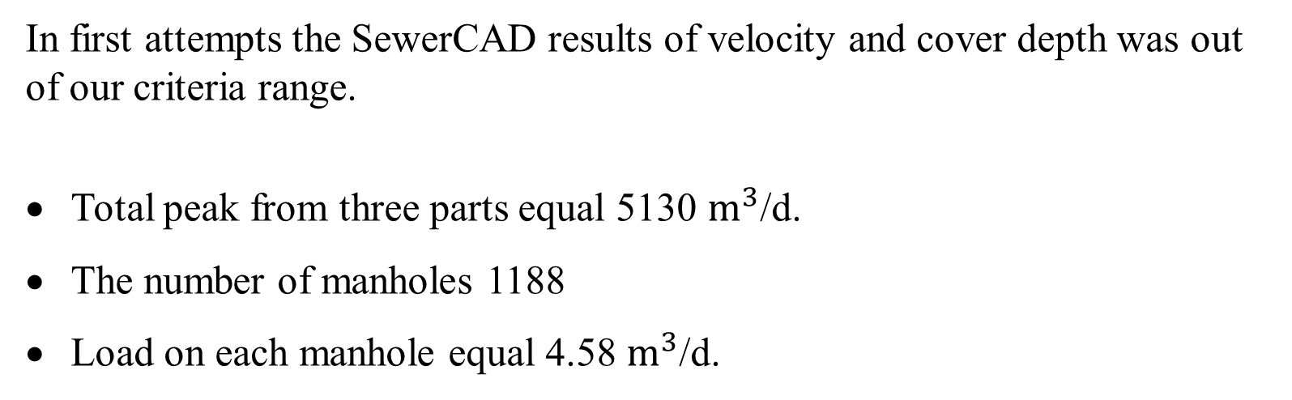
ANALYSIS AND DESIGN
  First attempts in SewerCAD
In first attempts the SewerCAD results of velocity and cover depth was out of our criteria range.
Total peak from three parts equal 5130 $m^{3}$/d.
The number of manholes 1188
Load on each manhole equal 4.58 $m^{3}$/d.

Slide 23
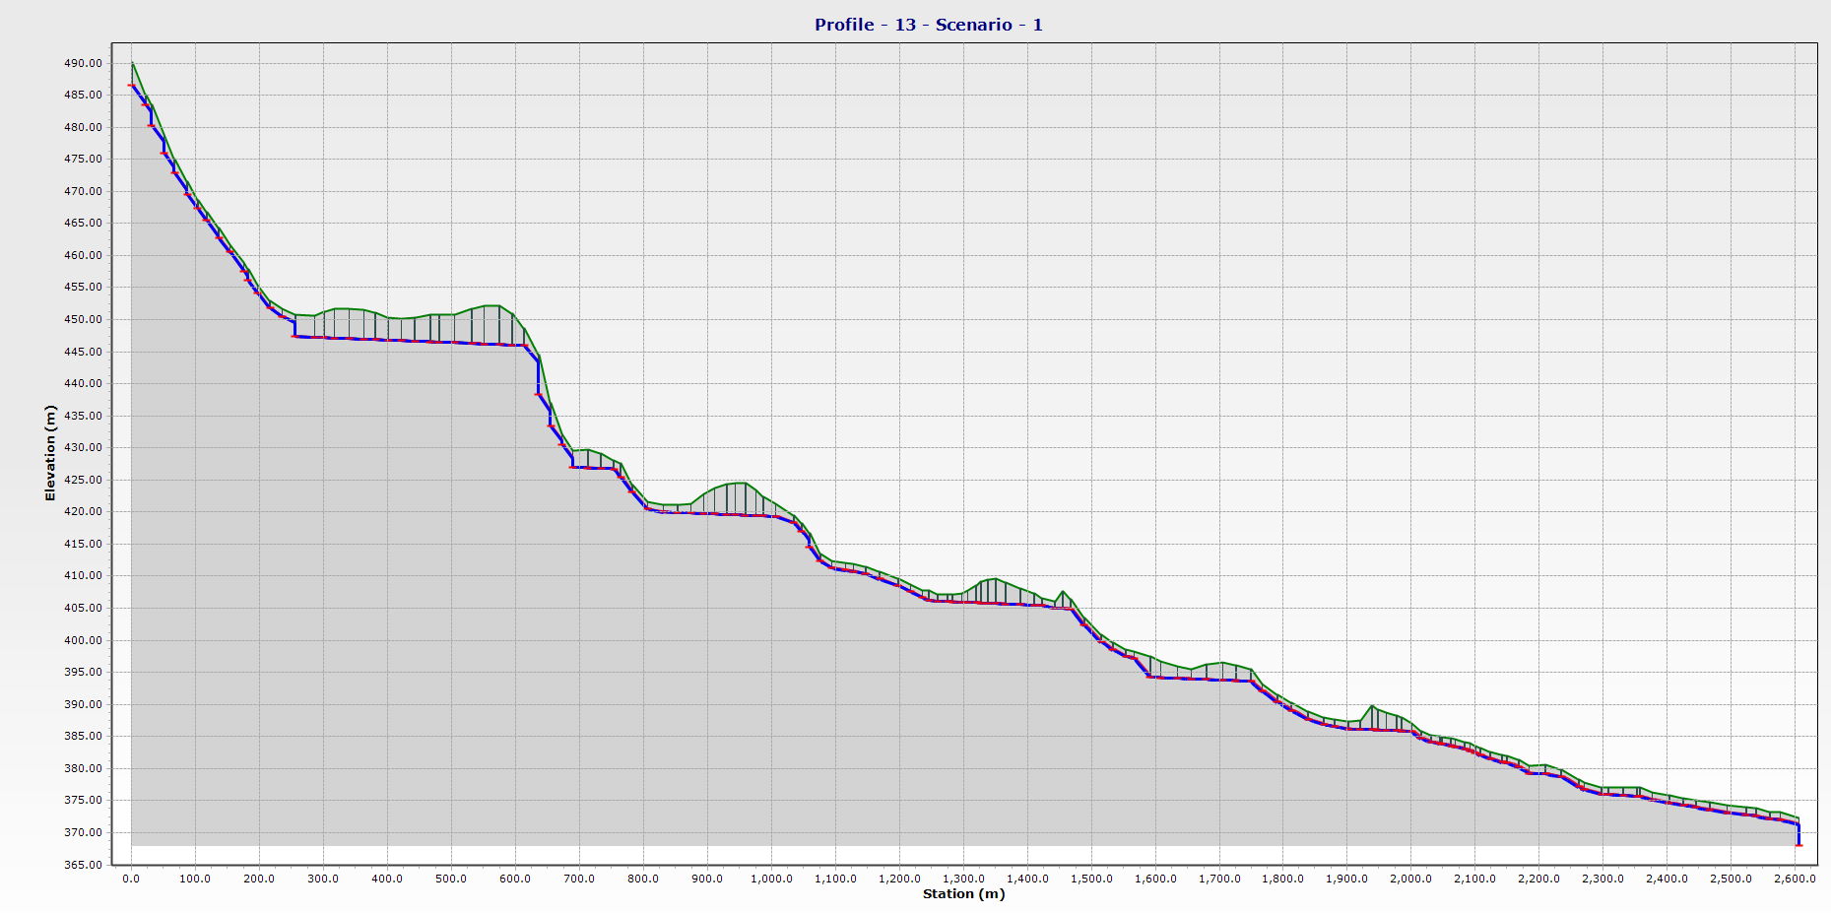
ANALYSIS AND DESIGN
  First attempts in SewerCAD
Profile A ends with O-1 in the network in the initial trails:

Slide 24
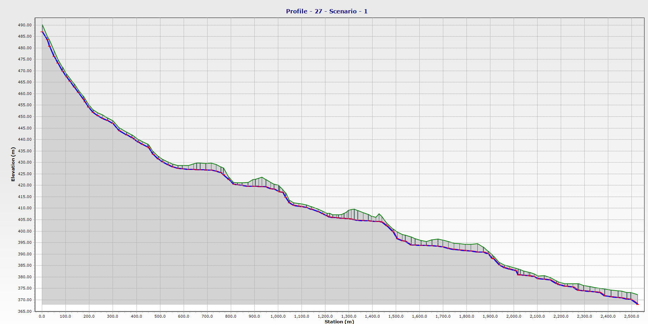
ANALYSIS AND DESIGN
  Final attempt in SewerCAD
Profile A ends with outfall O- 1 in the network after final design:

Slide 25
ANALYSIS AND DESIGN
  Problem Identification
Four issues contributed to complications in the sewer network design:
Low Flow at Network Start: The flow within the beginning segments of the network was insufficient, resulting in reduced velocity. SewerCAD compensated for this by increasing the conduit slopes, inadvertently causing an excessive cover depth at these starting points.
Flat Terrain Influence:. This terrain characteristic, combined with the software's adjustments for velocity, led to increased cover depths of up to 12 meters, particularly towards the end of these conduits.
High Slope Terrain: The slop in mountain areas is relatively high.
Adverse Slopes: at some stations through pipe lines the streets were having an adverse slope.

Slide 26
ANALYSIS AND DESIGN
  Implemented Solutions
To address these challenges, a multi-faceted approach was adopted:
New Paths: We changes some paths in the network to minimize the issues related to cover depth because of the flat terrains.
Drop Manholes: We used drop manholes in the mountain regions to minimize the slope and to keep the cover sequence within the criteria.
Disconnect lines: We disconnect some lines at some regions especially in the middle of the village, because there was a lot of adverse slopes and topography variation that would make problems in mainly in the cover depths.

Slide 27
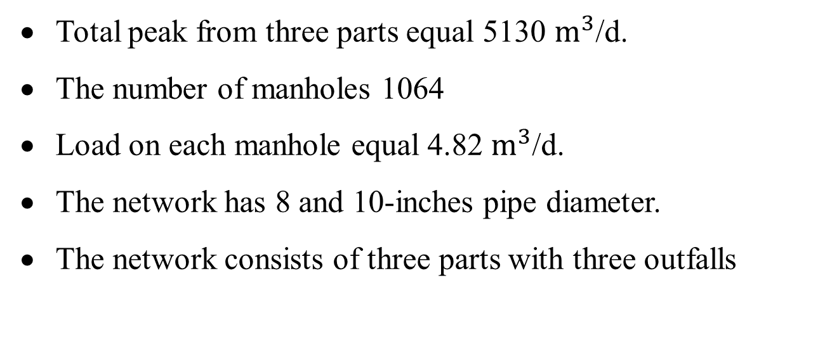
DESIGN & RESULTS
  Final attempt in SewerCAD
After make different changes in the layout and pipelines, we finally reach ed the following results:
Total peak from three parts equal 5130 $m^{3}$/d.
The number of manholes 1064
Load on each manhole equal 4.82 $m^{3}$/d.
The network has 8 and 10-inches pipe diameter.
The network consists of three parts with three outfalls

Slide 28
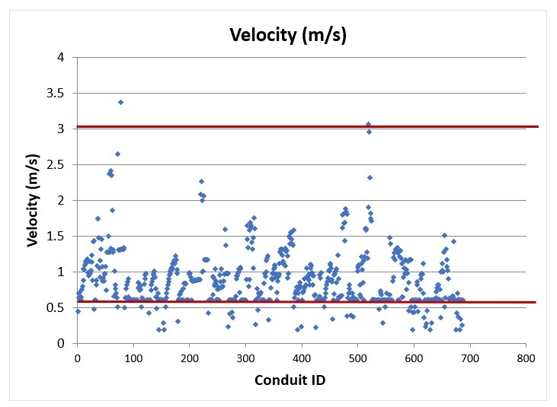
DESIGN & RESULTS

Slide 29
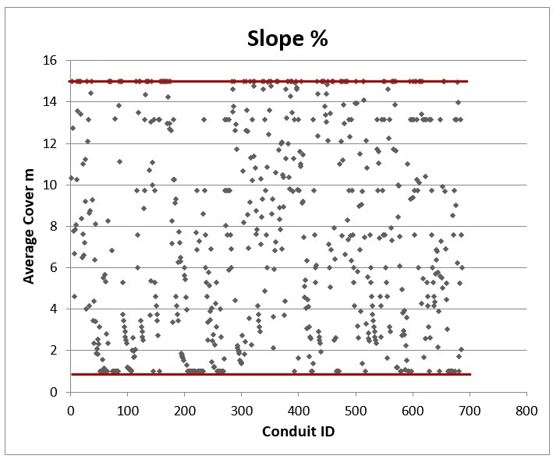
DESIGN & RESULTS

Slide 30
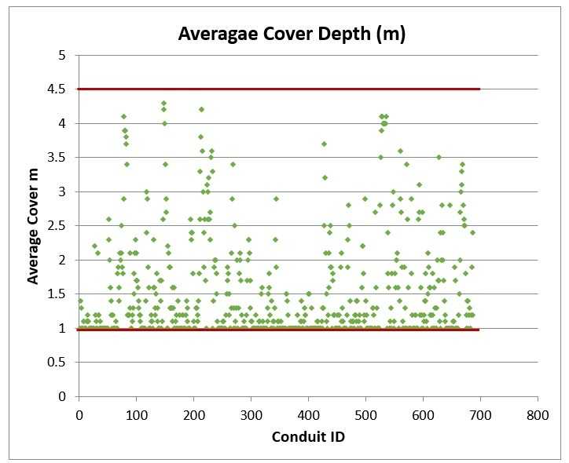
DESIGN & RESULTS

Slide 31
COST ESTIMATION OF THE NETWORK
The main cost drivers of the wastewater collection network:
Manholes
Conduits
Excavation depth
In addition to 16% tax and 20% contractor profit.

Slide 32
COST ESTIMATION OF THE NETWORK
  Methodology of Cost Calculation
The cost calculations were conducted by multiplying the length of each component by its unit cost.
Data derived from an engineer we reached who is working as contractor and takes many projects in Palestine.
Data on conduit length, the number of manholes, average depth of conduits, and depth of manholes were sourced from the final design in SewerCAD.

Slide 33
COST ESTIMATION OF THE NETWORK
Excavation unit price ($)
Depth Start | Depth End | Cost $
0 | 1 | 8.0
1 | 2 | 10.0
2 | 2.5 | 12.0
2.5 | 3 | 14.0
3 | 3.5 | 16.0
3.5 | 4 | 20.0
4 | 4.5 | 24.0
4.5 | 5 | 26.0

Slide 34
COST ESTIMATION OF THE NETWORK
Backfilling unit price ($)
Depth Start | Depth End | Cost $
0 | 2 | 10
2 | 2.5 | 12
2.5 | 3 | 14
3 | 3.5 | 18
3.5 | 4 | 22
4 | 4.5 | 26
4.5 | 5 | 28

Slide 35
COST ESTIMATION OF THE NETWORK
Reinstatement Work
The cost for reinstatement work to return the site to its original condition is $15 per meter
    Pipes and Fittings
The unit price for supplying, delivering, and installing pipes and fittings is $22 per meter. and it is including the labor cost.

Slide 36
COST ESTIMATION OF THE NETWORK
Manholes
Component / Work | Unit Price $
Base 0.6 | 200
Ring 0.4 | 100
Floor 0.2 | 150
Ring 0.3 | 85
Ring 0.5 | 125
Base 0.8 | 260
Cone 0.75 | 315
Cast Iron Rim (1 m Diameter) | 200
Excavation, Labor work and Backfilling | 115

Slide 37
COST ESTIMATION OF THE NETWORK
Cost percentages summary
Work Description | % From Total Cost
Pipe Lines Excavation | 4.3%
Pipe Lines Backfilling | 4.4%
Supply and Deliver Pipes and Fittings | 15.3%
Asphalt Reinstatement | 14.3%
Pipes Installation - Labor Work | 5.7%
Supply, and Deliver Manholes | 48.7%
Manholes Excavation, Labor Installation and Backfilling | 7.2%
Total Percentage % | 100.0%

Slide 38
COST ESTIMATION OF THE NETWORK
Pipes work
Backfilling cost ($) | Excavation cost ($) | Backfilling unit price ($) | Excavation Unit Price ($) | Quantity (Depth) (m) | Depth (m)
45800 | 45800 | 10 | 10 | 4580 | up to 2
8868 | 8868 | 12 | 12 | 739 | 2.0 - 2.5
5082 | 5082 | 14 | 14 | 363 | 2.5 - 3.0
5256 | 4672 | 18 | 16 | 292 | 3.0 - 3.5
3806 | 3460 | 22 | 20 | 173 | 3.5 - 4.0
3952 | 3648 | 26 | 24 | 152 | 4.0 - 4.5
1484 | 1378 | 28 | 26 | 53 | 4.5 - 5.0
74,248 | 72,908 |  |  | 6352 | Sum

Slide 39
COST ESTIMATION OF THE NETWORK
Asphalt Reinstatement / Supply, Install and Deliver Pipes and fittings
Cost ($) | Unit price ($) | Quantity
244260 | 15 | 16284 | Asphalt Reinstatement (m)
97704 | 6 | 16284 | Pipes install labor work
256832 | 16 | 16052 | Supply, and Deliver Pipes and fittings (8 in)
4408 | 19 | 232 | Supply, and Deliver Pipes and fittings (10 in)
603204 |  |  | Sum
750,360 |  |  | Total Cost of Pipes Work $

Slide 40
COST ESTIMATION OF THE NETWORK
Manhole's work
 |  | Cost ($) | Unit price ($) | Quantity | Component / Work
 |  | 125800 | 200 | 629 | Base 0.6m
 |  | 72600 | 100 | 726 | Ring 0.4m
 |  | 115350 | 150 | 769 | Floor 0.2m
 |  | 27540 | 85 | 324 | Ring 0.3m
 |  | 70625 | 125 | 565 | Ring 0.5m
 |  | 112840 | 260 | 434 | Base 0.8m
 |  | 92610 | 315 | 294 | Cone 0.75m
16% | Tax | 212600 | 200 | 1063 | Cast Iron Rim (1 m)
20% | Profit | 122245 | 115 | 1063 | Excavation, Labor work and Backfilling
2,215,495 | Total Network cost ($) | 952,210 |  |  | Total Cost of Manholes Work $
143 | Total Network cost/m ($)

Slide 41
COST ESTIMATION OF THE NETWORK
Pipe Lengths (m)
8 Inches | 10 Inches
16,052 | 231.9

Slide 42
COST ESTIMATION OF THE NETWORK

Slide 43
CONCLUSIONS
The network cost is high at $2,215,495 or 143 $/ m length, this is due to complex topography, a lot of intersections, a lot of variations in slopes, thus large quantity of manholes, and the cost of manhole components (ring, base, floor, and cone) is relatively high, which make up 48.7% of the total cost.
There are three outfalls of the study area .
The final model for three zones has conduits 1063 and 1064 manholes of one-meter diameter.
The Network has an 8in of total length 16052m and 10in of total length 213.9 m PVC pipe diameter.

Slide 44
RECOMMENDATIONS
Our recommendation is to implement the Siris project, which involves studying the feasibility of applying the same project idea to all neighboring villages. The goal is to collect wastewater from all these villages and direct it to a single outfall in the northwest.
It is highly recommended to prevent pollution, illness, and other problems associated with wastewater gathering, a wastewater treatment plant must be constructed.

Slide 45


