Slide 1


Graduation project ( 2 )
July 5th, 2020
Students:
Eng. Omair Zanabeet
Eng. Khalil Odetallah
Eng. Amer Omair
AN-NAJAH NATIONAL UNIVERSITY (NNU)
Faculty of Engineering & Information Technology
Presented in partial fulfillment of the requirements for
Bachelor degree in Mechanical Engineering
Supervisor : Eng. Ramez Alkhaldi

Slide 3
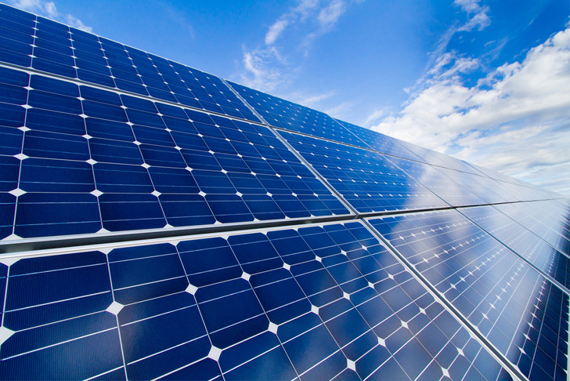
The effect of cooling on the solar PV performance

Slide 4
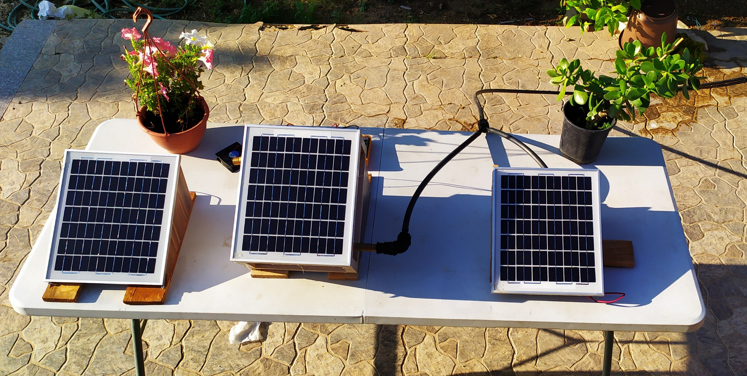

Slide 5
What is Pv cell ?
6
1
5
2
4
3

Slide 6
Introduction
Recent and estimated capacity in all world (G_{wp})
Year _end | 2014 | 2015 | 2016 | 2017 | 2018 | 2019 | 2020
Cumulative | 178.4 | 229.3 | 306.5 | 403.3 | 512 | 633 | 770
Annual new | 40.1 | 59.9 | 76.8 | 99 | 109 | 121 | 121-154
Cumulative growth | 28% | 29% | 32% | 32% | 27% | 24%

Slide 7
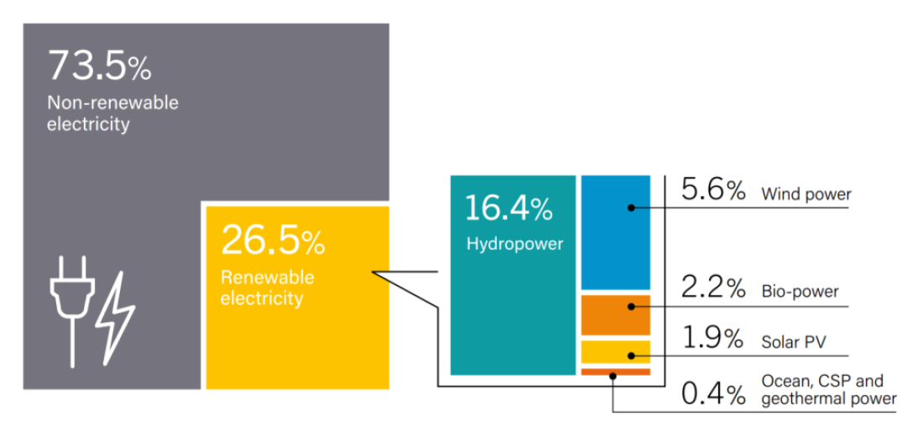
The percentage of the renewable electricity using at the end of 2017

Slide 8
Solar Energy Advantages
Saves you money
After the initial investment has been recovered, the energy from the sun is practically FREE.
Environment friendly
Solar Energy is clean, renewable (unlike gas, oil and coal), sustainable and helping to protect our environment. As we see previously ,it does no pollute air.
Low/ no maintenance
Solar Energy systems are virtually maintenance free and will last for decades.

Slide 9
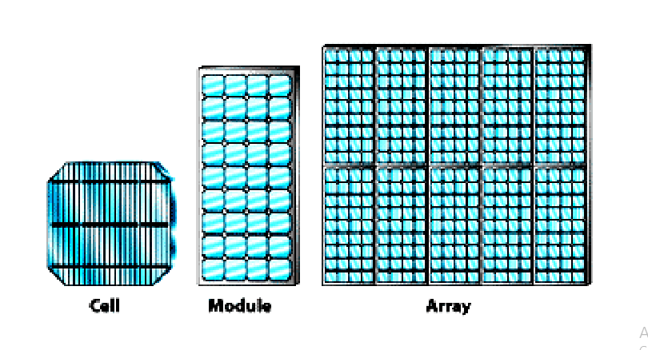
Solar panel (or) solar array (or) Solar module
The solar panel (or) solar array is the interconnection of number of solar module to get efficient power.
• A solar module consists of number of interconnected solar cells.
• These interconnected cells embedded between two glass plate to protect from the bad whether.
• Since absorption area of module is high, more energy can be produced.

Slide 10
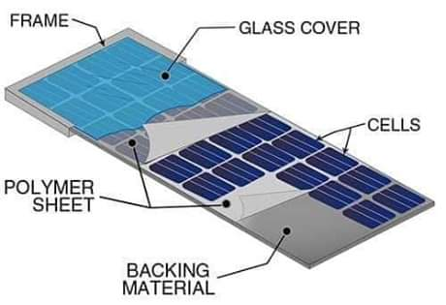
The internal structure of the PV cells
Frame
Glass cover
Polymer sheet
Cells
Backing material

Slide 11
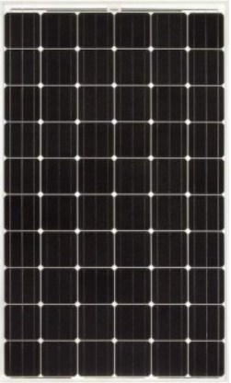
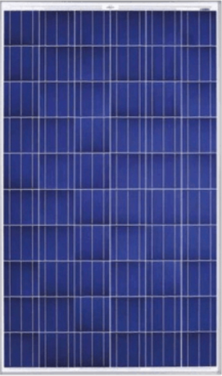
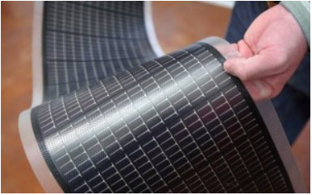
Types of Solar cell
1
Mono-crystalline silicon
2
Poly-crystalline silicon
3
The film

Slide 12
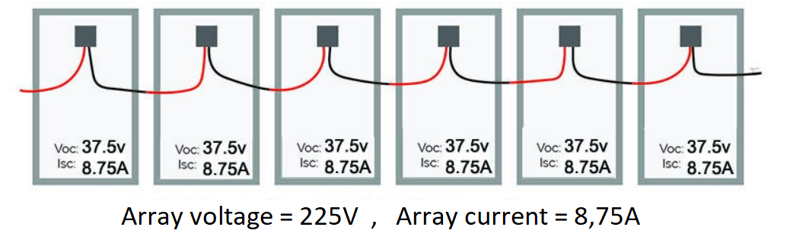
How to connect the solar panel array
1. Series connection

Slide 13
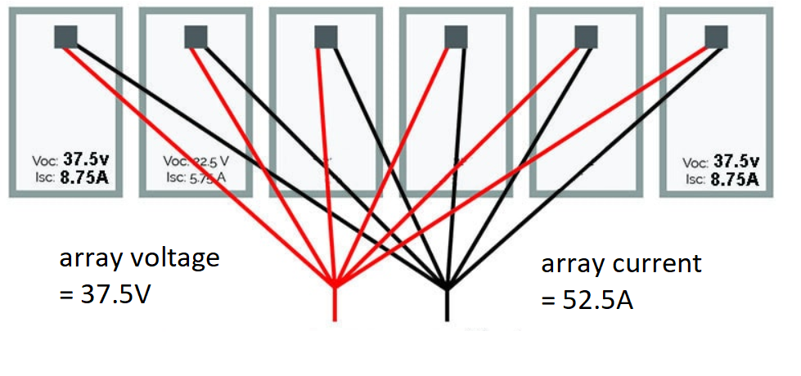
2. parallel connection

Slide 14
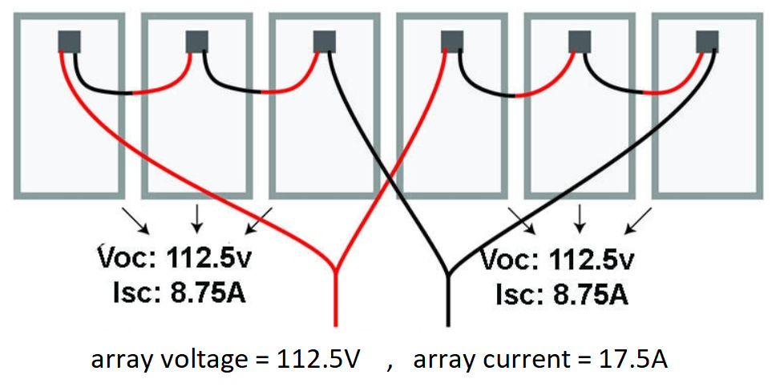
3. combined connection

Slide 15
Solar cell problems
Dust :
The dust is conceded from the one of the main problems that can the solar cells suffered from , and that cause of its direct impact on the absorption of the fallen radiations , because the accumulation of dust atoms and accumulation on the glass surface of the cell prevent the arrival of sunlight to the silicon ions inside the cell , which leads to the lack of the activation capacity of the electrons and their inability to convert the fallen rays into electricity adequately
Temperature :
the rise in temperature above the specified rate of the cell directly reduces the efficiency of the cell so that each rise in temperature by one degree leads to reduce efficiency by an estimated of (0.25%-0.45%) , This percentage is considered high if it continues under the influence of high temperatures.

Slide 16
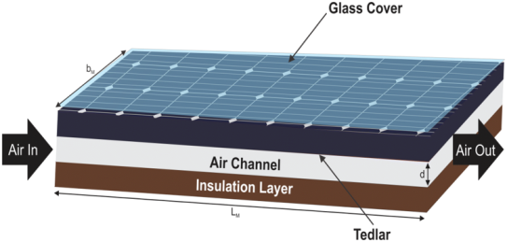
Solar cell cooling methods
1
Air cooling
2
Water cooling

Slide 17
Objective of the project
What we aims to do to get rid of temperature problem ?
After reviewing the effect of high temperature on the efficiency of the cell, it was worked to provide the cells with a water cooling system to ensure the preservation of the temperature and prevent its rise to the extent that affects the value of efficiency.
Various designs have been put in place to eliminate these problems
Our project Divided to three parts :
Standard cell
Backward heat extraction by using fluid circulation
Addition of a water box in the rear of the cell

Slide 18
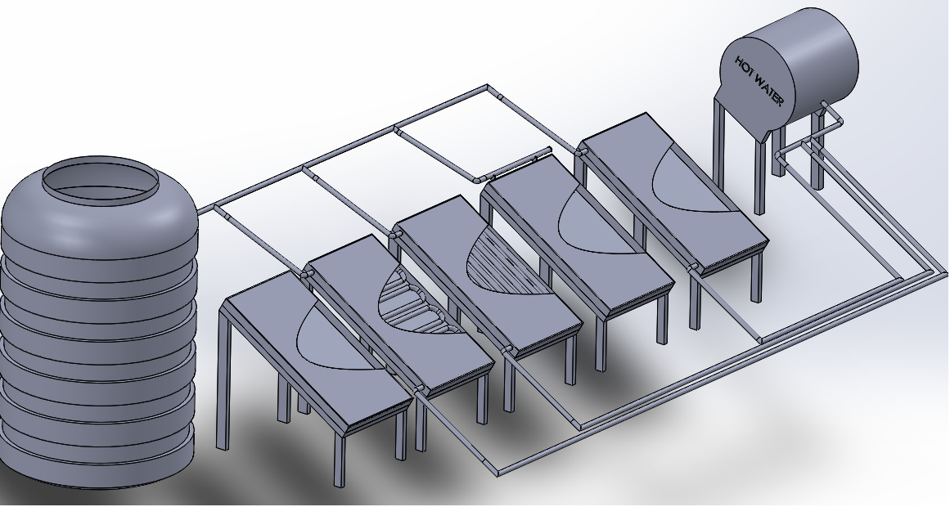
Solid-work design

Slide 19
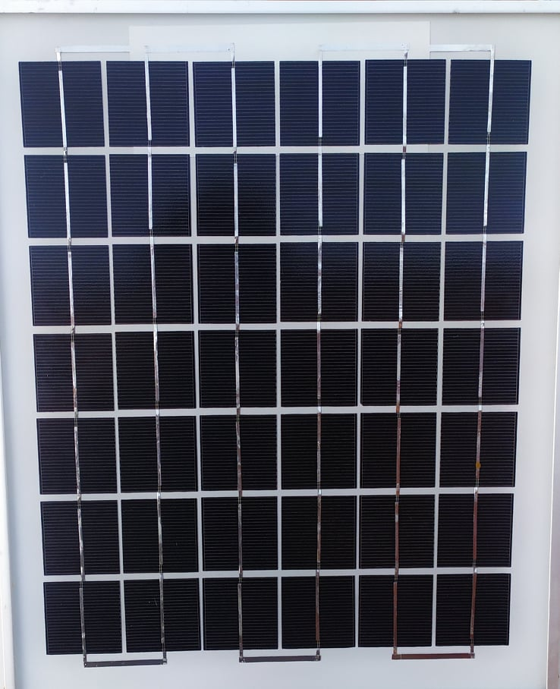
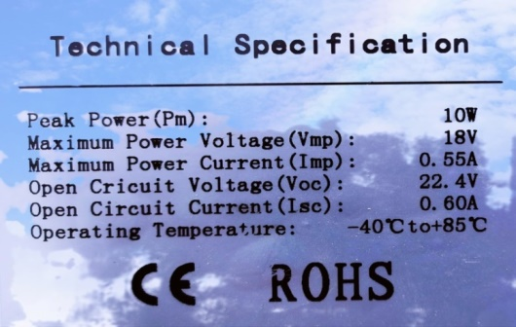
1. Standard cell

Slide 20
Objective of standard cell
The importance of the primary cell lies in studying the ideal angles for fixing the solar cell, where three cells of the same type were installed and each of them was installed at a different angle, namely:
So that was taken reading of: the voltages and current, including calculating the electrical power of each.
The study was carried out over three different days, taking into account the climatic conditions for a single day.
The importance of the cell was also important in the process of studying the effect of the water cooling system on the solar cells, so that the process of comparing the values ​​that were taken for each of the cells equipped with the cooling system with the basic values ​​of the basic cell.

Slide 21
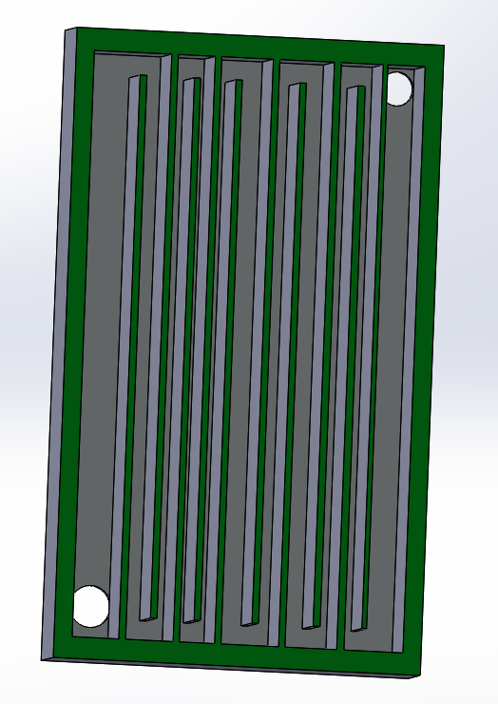

2. Backward heat extraction by using fluid circulation

Slide 22
Objective of the cell :
The main principle used in this system is the process of adding background paths to the solar cell, allowing water to move with the direction of the tracks laid, the goal of adding these paths is to allow water to stay as long as possible and is in contact with the surface of the cell, allowing heat to move as far as possible from the surface The cell into the water entering it.
Aluminium sheets were used in making the tracks laid in addition to making sure the cell was closed from the back by an aluminium plate and insulating materials in order to reduce the chance of rising from the water temperature due to the sunlight on the back of the cell, that is, the heat exchange is limited to the water temperature Inlet and cell surface temperature.

Slide 23
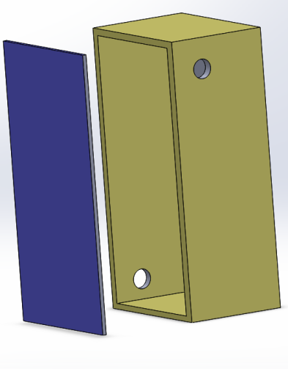
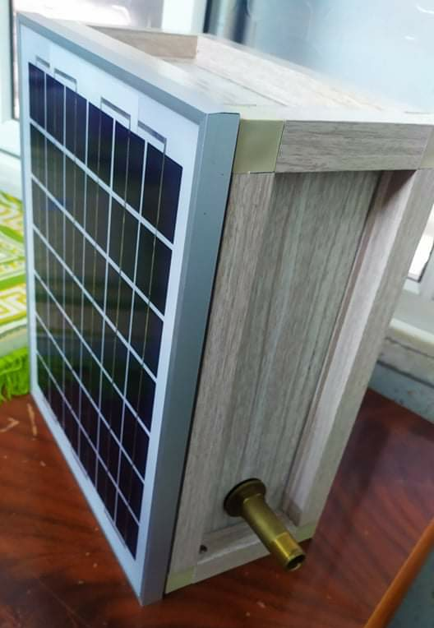
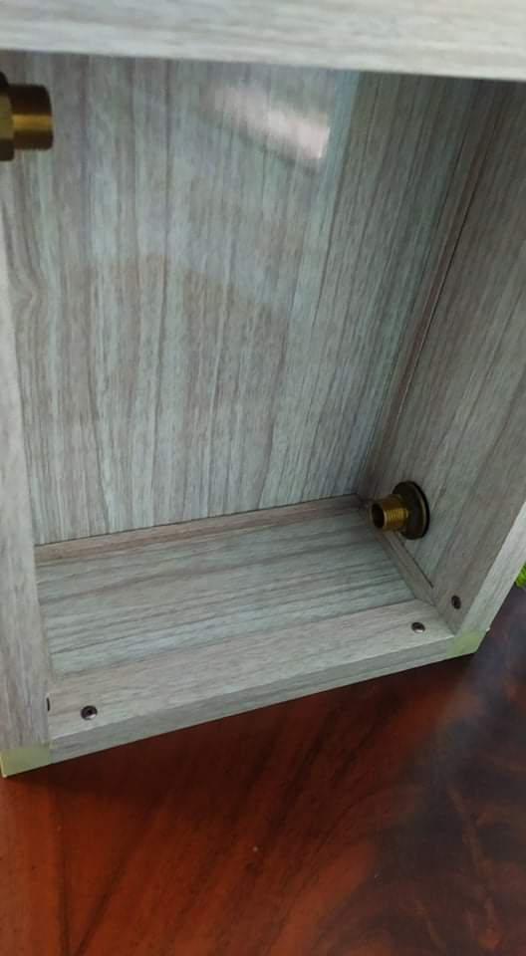
3. Addition of a water box in the rear of the cell

Slide 24
Objective of the cell :
The principle of the box is the process of adding an aluminium box to the back of the cell, which is completely immersed in the water entering it so that it comes in contact with the back surface of the cell at the same time, which allows water to stay in contact with the cell surface long enough to effectively cool the cell .

Slide 25

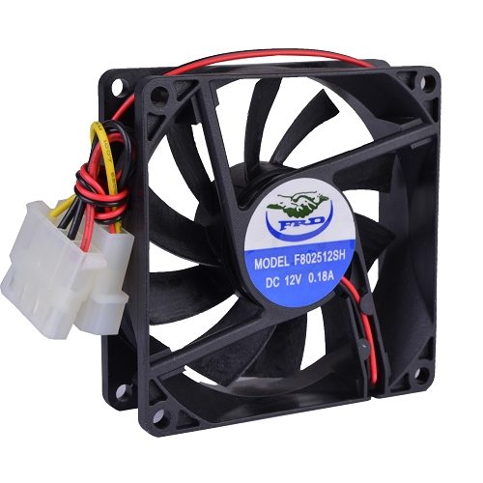
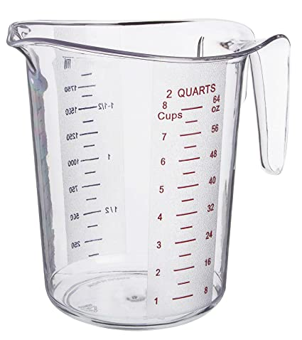
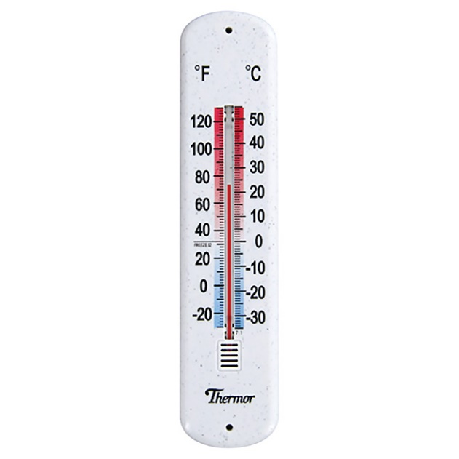
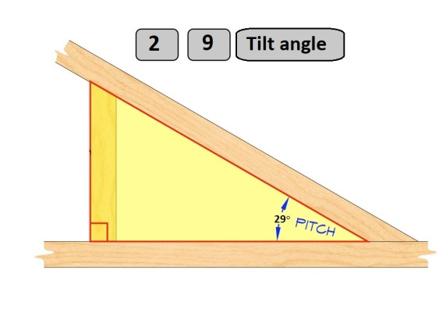
Main component
Multi-meter
Load
Measuring cup
Wooden stand
Thermometer

Slide 26
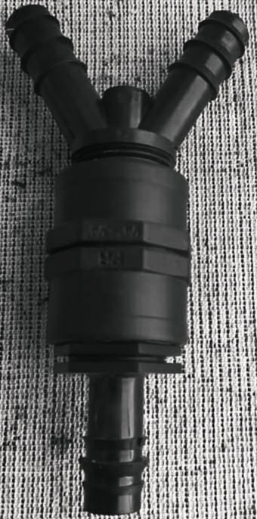
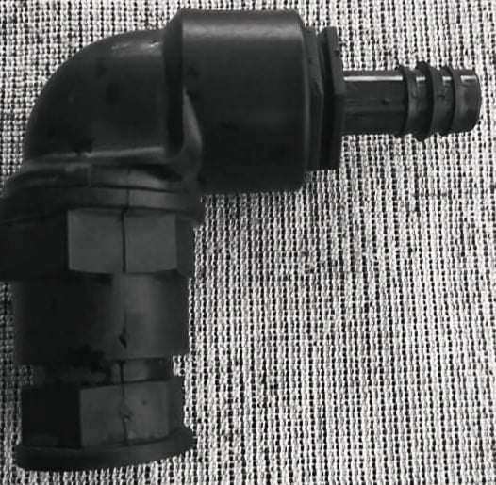
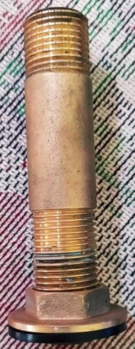
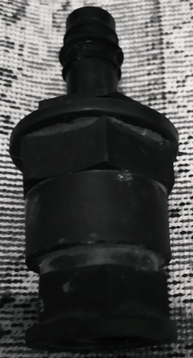
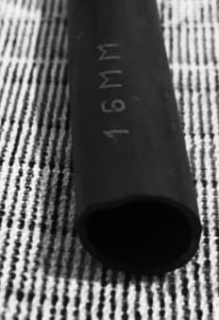
Pipe and fitting
Y-connection
½ inch elbow fit
1/2 inch inlet fit
Fitting transition from 1/2 to 3/4
16mm pipe

Slide 27
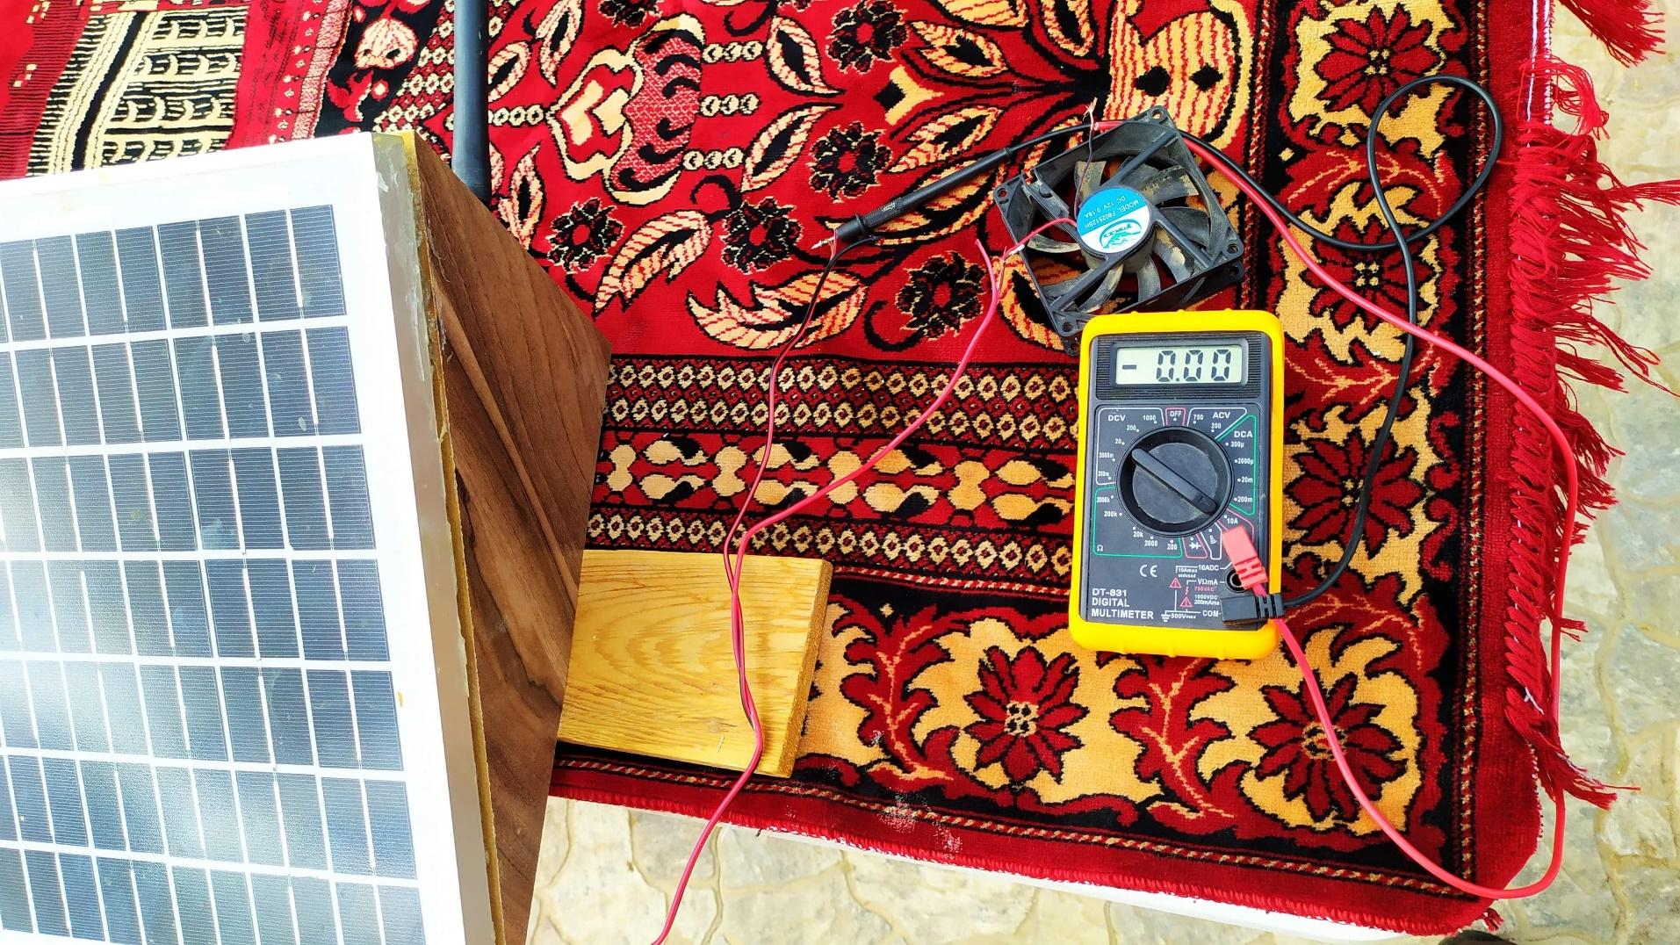
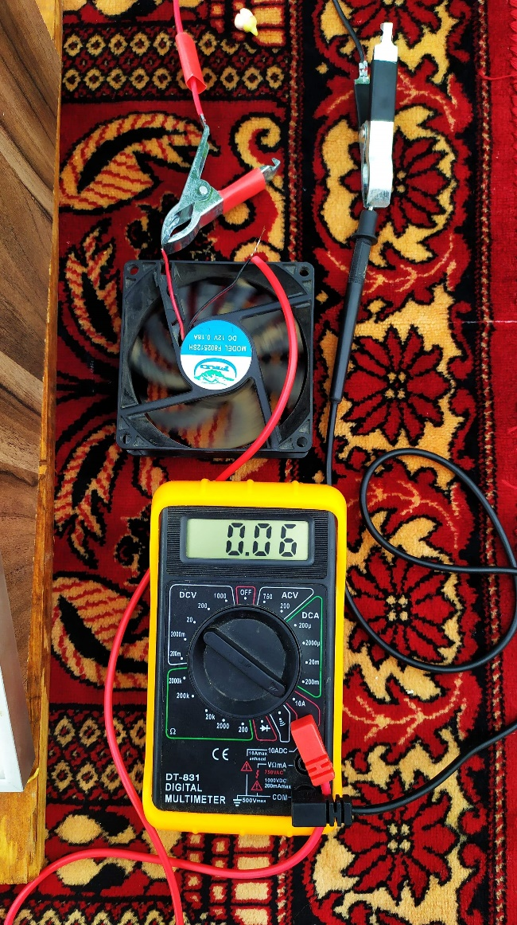
Full connection

Slide 28
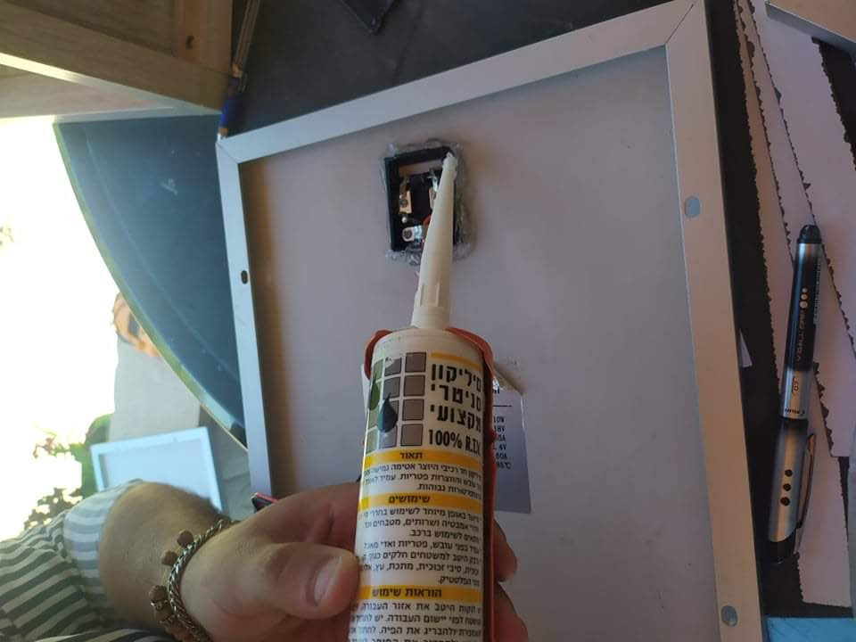
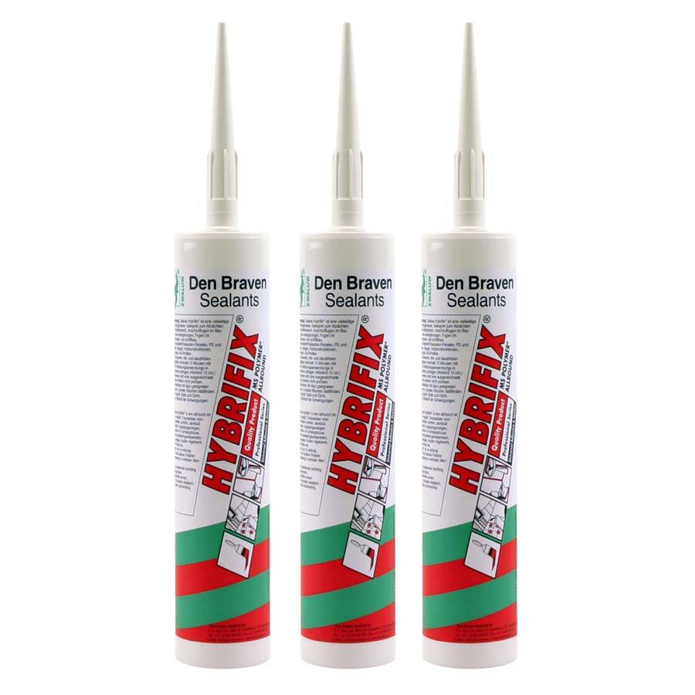
Insulation

Slide 29

Practical process

Slide 30
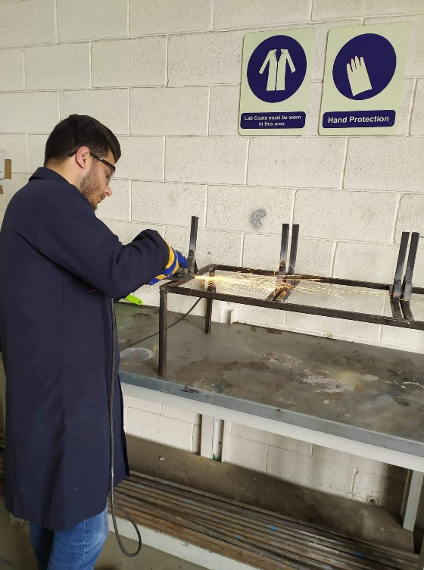
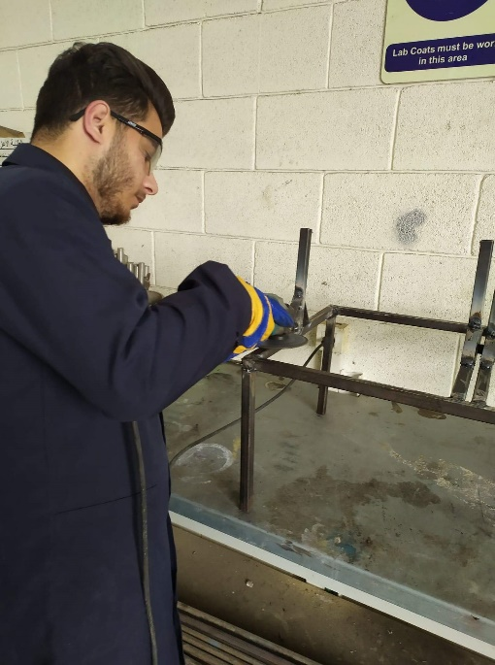
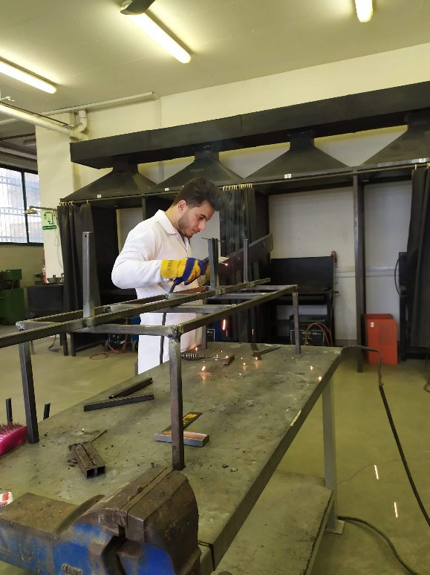
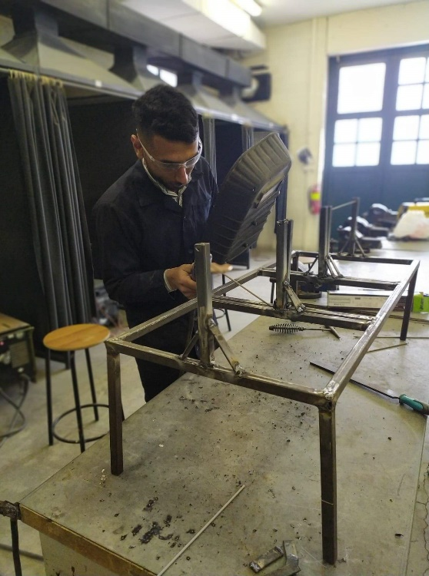

Slide 31
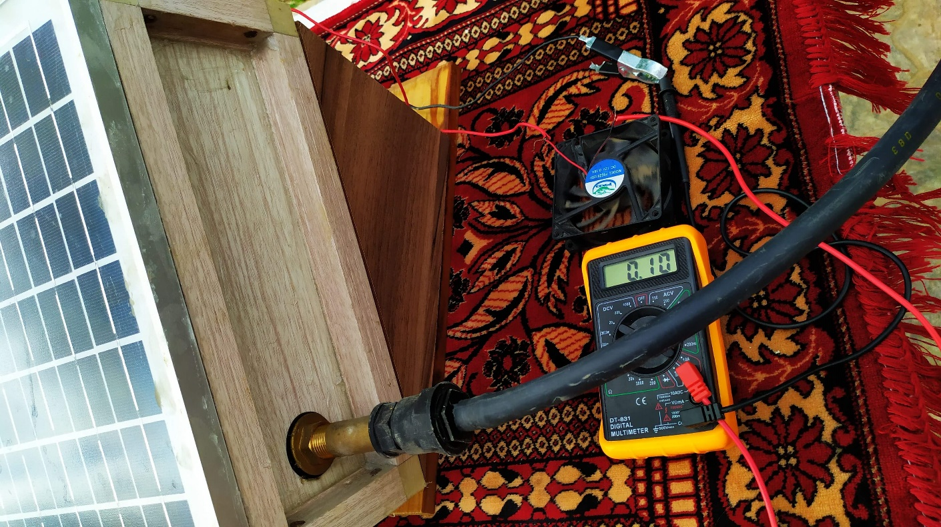
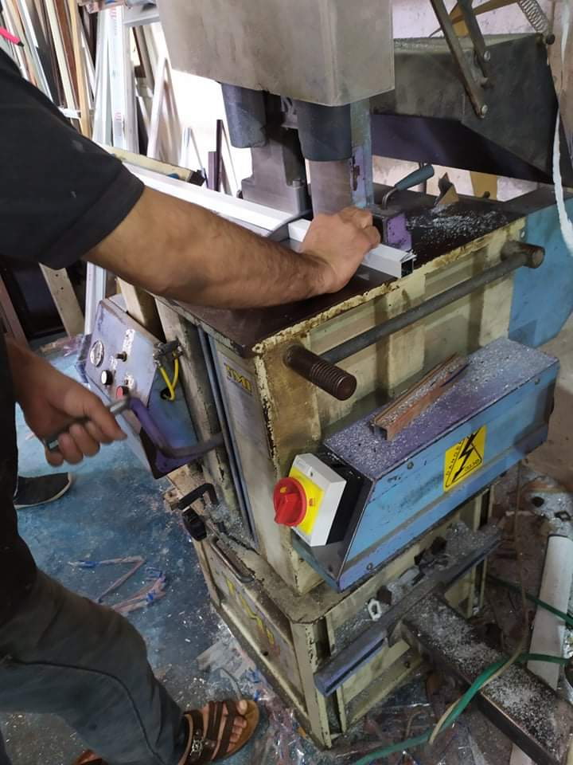
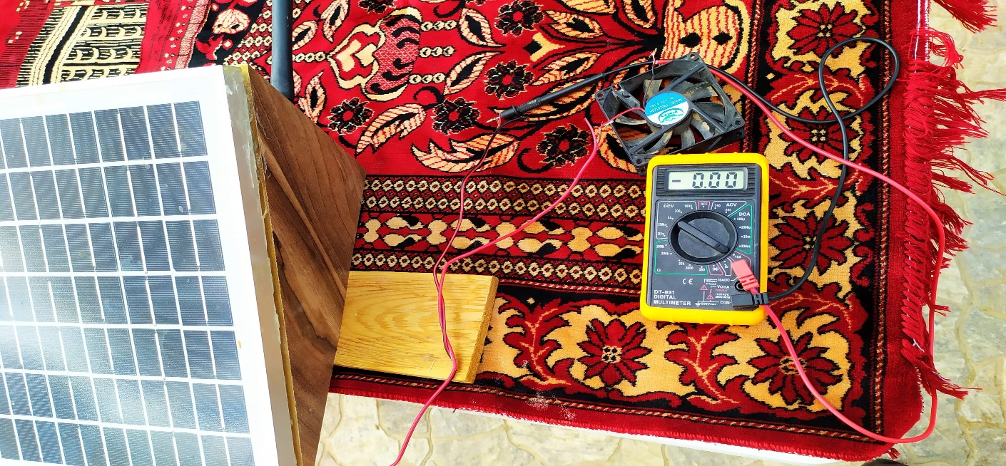
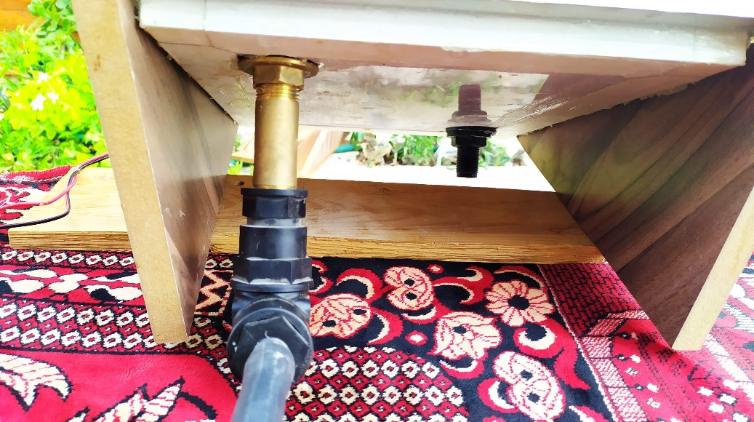

Slide 32
Results
Optimum tilt angle study results :
Day : Sunday date : 14/6/2020
Hours ( pm ) | Θ = 25 |  |  | Θ = 29 |  |  | Θ = 40
 | V | A | P | V | A | P | V | A | P
12:00 | 25.3 | 0.23 | 5.819 | 27 | 0.26 | 7.02 | 25 | 0.24 | 6
12:10 | 30.4 | 0.24 | 7.296 | 32.1 | 0.28 | 8.988 | 32 | 0.26 | 8.32
12:20 | 24.7 | 0.21 | 5.187 | 26.7 | 0.24 | 6.408 | 25.3 | 0.24 | 6.072
12:30 | 25.8 | 0.2 | 5.16 | 27.3 | 0.22 | 6.006 | 26.7 | 0.22 | 5.874
12:40 | 29.3 | 0.28 | 8.204 | 30.8 | 0.29 | 8.932 | 29.1 | 0.27 | 7.857
12:50 | 31.4 | 0.31 | 9.734 | 31.7 | 0.31 | 9.827 | 30.6 | 0.3 | 9.18
1:00 | 27.6 | 0.27 | 7.452 | 30.5 | 0.3 | 9.15 | 28.2 | 0.31 | 8.742
1:30 | 30.2 | 0.28 | 8.456 | 32.3 | 0.32 | 10.336 | 32 | 0.28 | 8.96
2:00 | 29.7 | 0.25 | 7.425 | 31.4 | 0.28 | 8.792 | 30.1 | 0.26 | 7.826
2:30 | 26.6 | 0.24 | 6.384 | 29.7 | 0.27 | 8.019 | 28.9 | 0.25 | 7.225

Slide 33
Efficiency calculation results :
Day : Sunday date :14.6.2020
Power electrical (P_{elec}) |  |  | Power input (P_{in}) | Efficiency ( )
Θ = 25 | Θ = 29 | Θ = 40 |  | Θ = 25 | Θ = 29 | Θ = 40
5.819 | 7.02 | 6 | 62.0165 | 0.09383 | 0.113196 | 0.096748
7.296 | 8.988 | 8.32 | 62.0165 | 0.117646 | 0.144929 | 0.134158
5.187 | 6.408 | 6.072 | 62.0165 | 0.083639 | 0.103327 | 0.097909
5.16 | 6.006 | 5.874 | 62.0165 | 0.083204 | 0.096845 | 0.094717
8.204 | 8.932 | 7.857 | 62.0165 | 0.132287 | 0.144026 | 0.126692
9.734 | 9.827 | 9.18 | 62.0165 | 0.156958 | 0.158458 | 0.148025
7.452 | 9.15 | 8.742 | 62.0165 | 0.120162 | 0.147541 | 0.140962
8.456 | 10.336 | 8.96 | 62.0165 | 0.136351 | 0.166665 | 0.144478
7.425 | 8.792 | 7.826 | 62.0165 | 0.119726 | 0.141769 | 0.126192
6.384 | 8.019 | 7.225 | 62.0165 | 0.10294 | 0.129304 | 0.116501

Slide 34
Conditions :
Day: Sunday date :14/6/2020
Condition | Symbols | Value
Temperature | T(℃) | 27-21
Humidity |  | 57%
Wind speed | V(km/h) | 15
Atm. Pressure | P (hpa) | 1006
Cell area | A( ) | 1015
Flow rate | Q(L/s) | 0.208
Position |  | 32.3,35.0

Slide 35
Average efficiency of Tilt angle :
Tilt angle | Average Efficiency ( )
Θ = 25 | 0.114674
Θ = 29 | 0.134606
Θ = 40 | 0.122638

Slide 36
Results of the designs applied to the cells for the first day :
Day : Wednesday date : 17.6.2020
 | Volt (V) |  |  | Current (A) |  |  | Power (W)
Hours | standard | box | circulation | standard | box | circulation | standard | box | circulation
1:20 | 25.5 | 26.3 | 26.8 | 0.27 | 0.31 | 0.32 | 6.885 | 8.153 | 8.576
1:50 | 59.3 | 60.3 | 62.1 | 0.28 | 0.32 | 0.35 | 16.604 | 19.296 | 21.735
2:20 | 60.3 | 61.5 | 62.5 | 0.27 | 0.29 | 0.31 | 16.281 | 17.835 | 19.375
2:50 | 51.5 | 53.2 | 54.1 | 0.26 | 0.3 | 0.33 | 13.39 | 15.96 | 17.853
3:40 | 48 | 49.7 | 51.3 | 0.26 | 0.3 | 0.31 | 12.48 | 14.91 | 15.903

Slide 37






Conditions :
Day: Wednesday date :17.6.2020
Condition | Symbols | Value
Temperature | T(℃) | 31-33
Humidity |  | 55%
Wind speed | V(km/h) | 18
Atm. Pressure | P (hpa) | 1012
Cell area | A( ) | 1015
Flow rate | Q(L/s) | 0.20
Position |  | 32.3,35.0

Slide 38
Flow rate calculation :

Slide 39
Results for calculation the efficiency for the previous tables :

Slide 40
Average efficiency of previous table :

Slide 41
Results of the designs applied to the cells for the first day :

Slide 42
Conditions :

Slide 43
Flow rate calculation :

Slide 44
Results for calculation the efficiency for the previous tables :

Slide 45
Average efficiency of previous table :

Slide 46
Results of the designs applied to the cells for the first day :

Slide 47
Conditions :

Slide 48
Flow rate calculation :

Slide 49
Results for calculation the efficiency for the previous tables :

Slide 50
Average efficiency of previous table :

Slide 51
Results of the designs applied to the cells for the first day :

Slide 52
Conditions :

Slide 53


Flow rate calculation :

Slide 54
Results for calculation the efficiency for the previous tables :

Slide 55
Average efficiency of previous table :

Slide 56
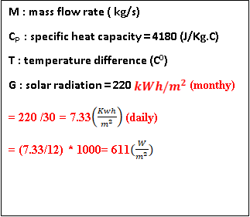
Calculation equations :

Slide 57
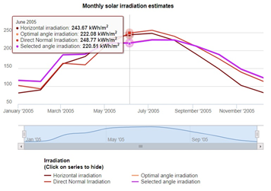
Positions :

Slide 58
Sample of calculations for the tilt-angel practical study:
For 14/6/2020 at 12:00 pm

Slide 59
Sample of calculations for the designs applied to the cells :
For 17 /6/2020 at 3:40 Pm

