Slide 1

Graduation Project II
Structural Analysis and Design of multi-functional building in Nablus city -Palestine.
An-Najah National University
Faculty of Engineering
Civil Engineering Department
جامعة النجاح الوطنية
كلية الهندسة ونكنولوجيا المعلومات
By
Abdul-Aziz Al-Kharraz
Ahmad Khasati
Mjd Salameh
Ekrayem Boshnaq
Under supervision of: Dr.Mahmoud Dwaikat.

Slide 2
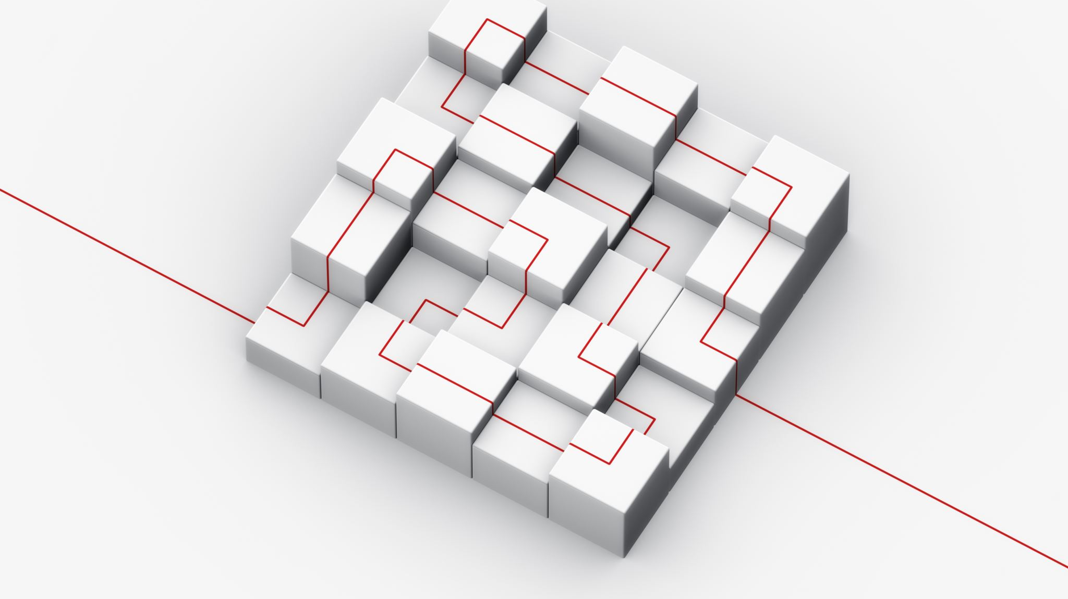
Outline :
1. General Description
2. Preliminary Design
3.Three-Dimensional Modeling and Analysis
4.Design
5.Footing

Slide 3
General Description

Slide 4
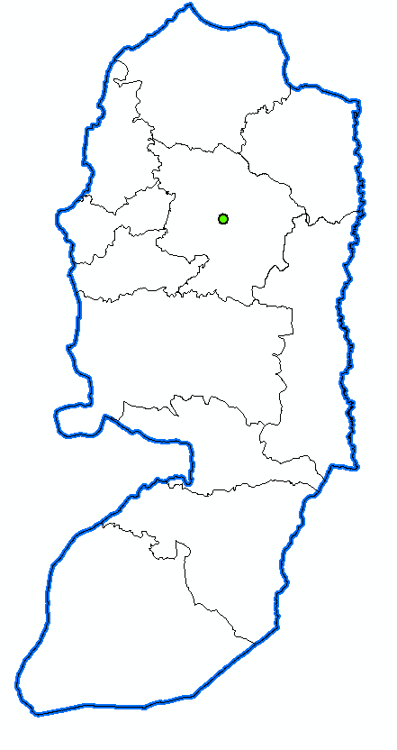

General Description
Location
It is located in Nablus – Palestine, and the coordinates of the project according to the global coordinate system WGS are 32°13′35″N, 35°15′52″E. Location elevation (site level) is +657m AMSL (above mean sea level). Soil Type white limestone (γ = 23.652), very hard to solid and The allowable bearing is 470 KN/m2 (4.7 Kg/cm2).

Slide 5
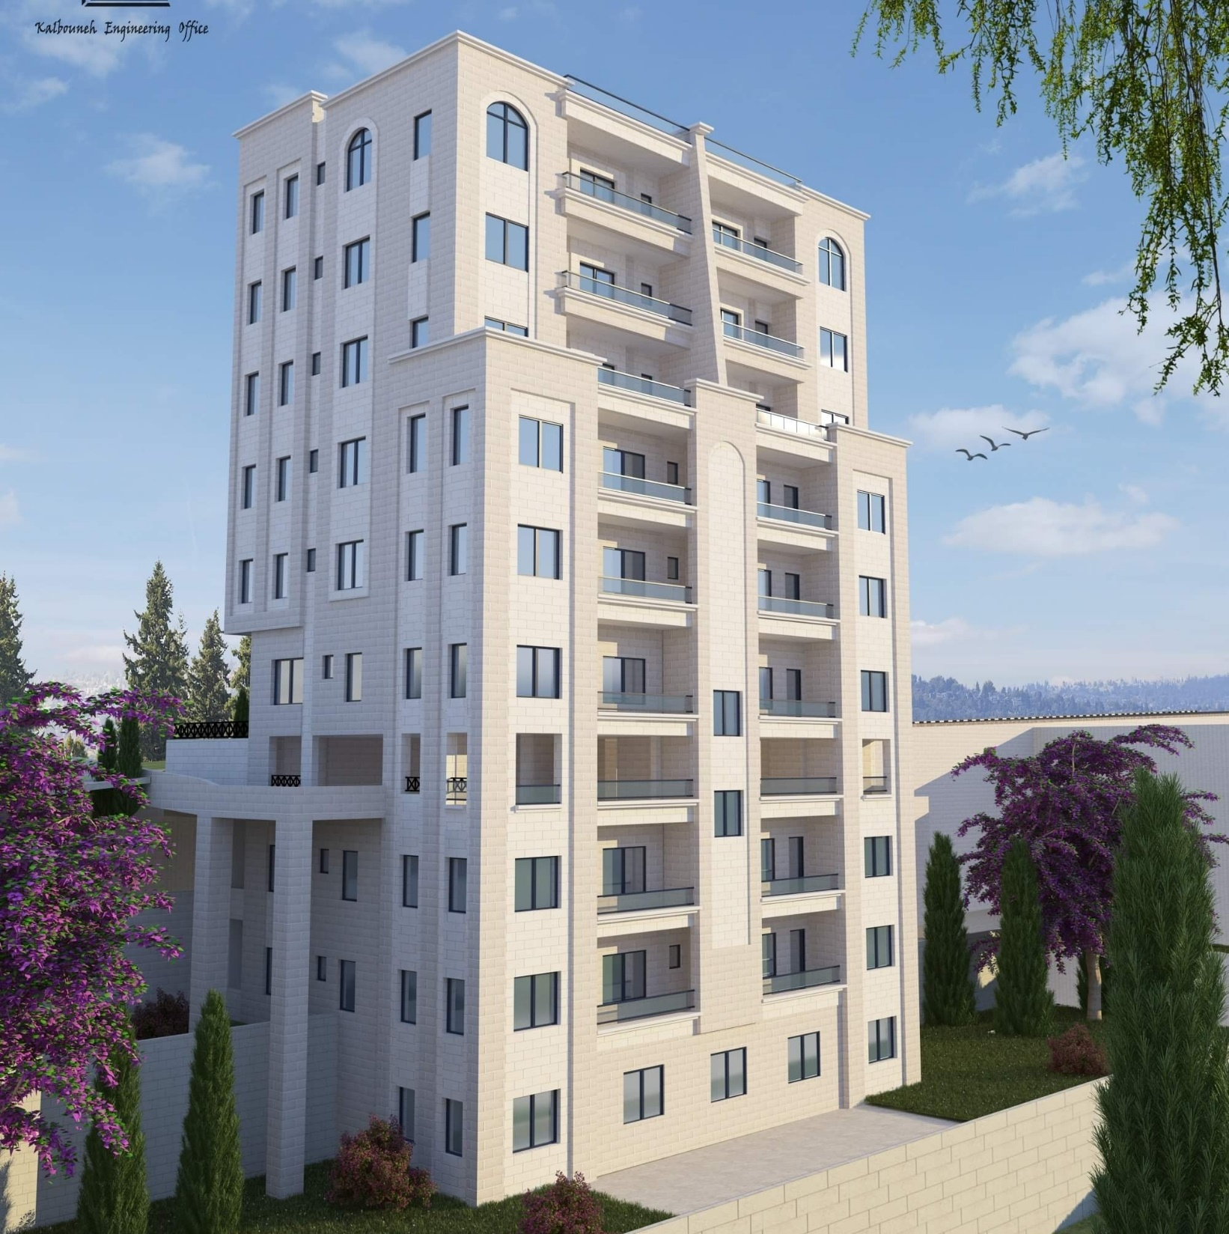

Slide 6
General Description
Assumptions
All supports are Pin supporter in the 3D.
As for the external walls, part of them are made of glass walls and the other part are stone walls, and they are added as dead loads on the external beams.
The slab system is two-way ribbed slab.
In preliminary design chapter, a quick preliminary was performed, so the thicknesses of retaining and shear walls were taken from architectural plans.
Seven checks were made include compatibility check, equilibrium check, stress-strain check, time period, base shear ,story drift , and P-delta.

Slide 7

Architectural
Plans

Slide 8
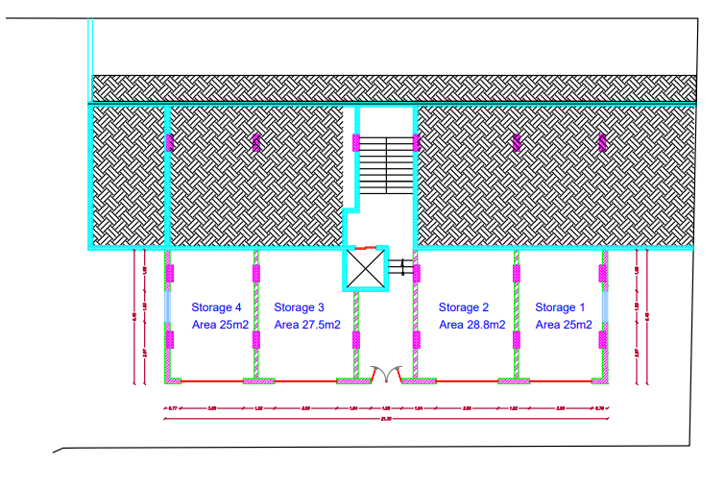
Basement three

Slide 9
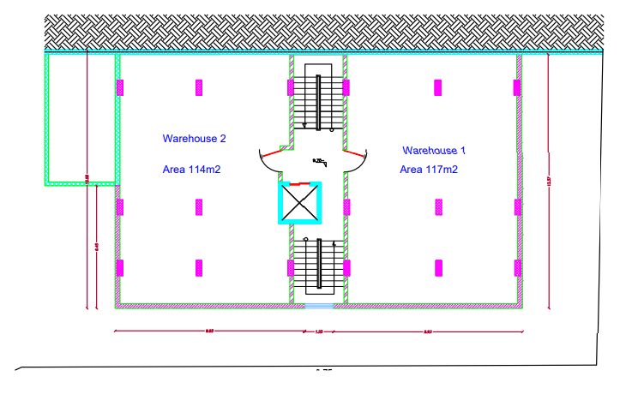
Basement two

Slide 10
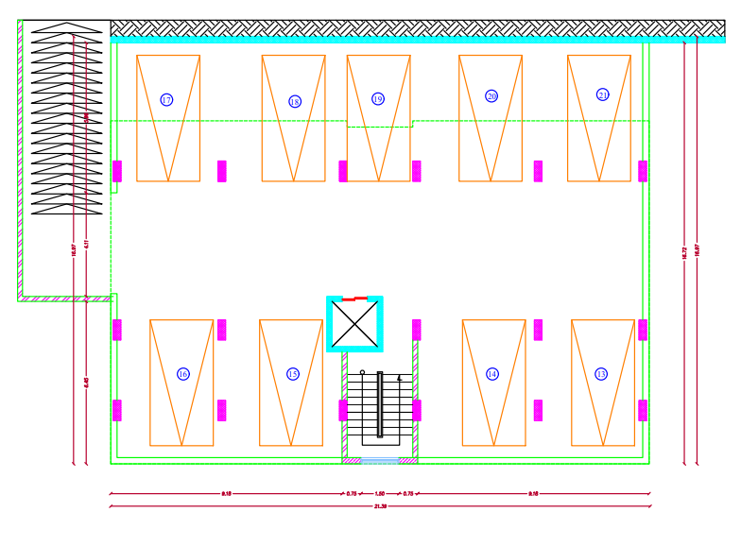
Basement one

Slide 11
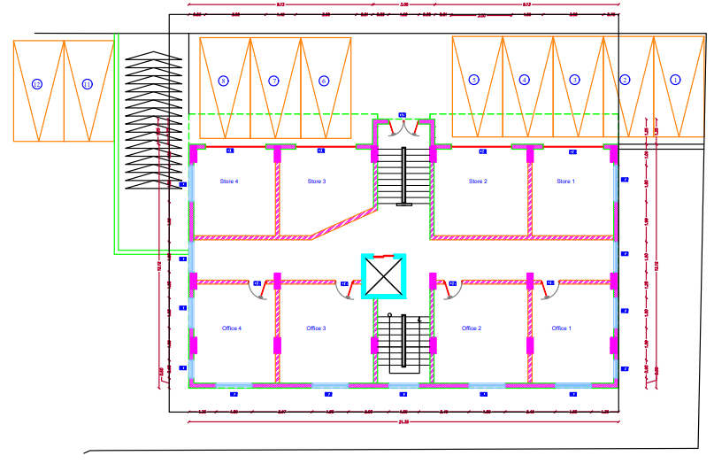
Ground floor

Slide 12
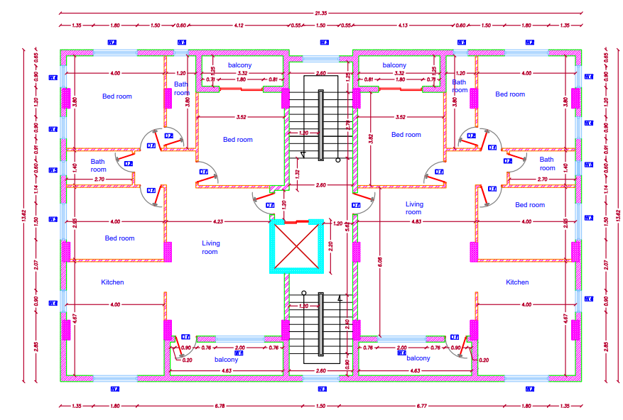
floor
1-7

Slide 13
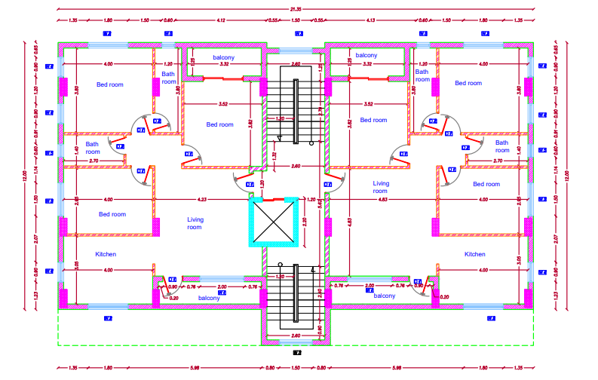
floor
8-11

Slide 14
General Description
Height and Area For Each Floor
Floor Number | Height of each floor (m) | Area of each floor (m²)
B3 | 4.50 | 142
B2 | 4 | 290.5
B1 | 2.75 | 362.5
GF | 4.50 | 290.5
F1-7 | 3 | 290.5
F8-11 | 3 | 260.5

Slide 15
General Description
Codes and Standard.
ASCE 7-16 (American Society of Civil Engineers)
IBC 19 (International Building Code)
ACI 318-19 (American Concrete Institute)

Slide 16
General Description
Load Combinations
Ultimate load combinations:
1.4D
1.2D + 1.6L
1.2D + 1.6L + 0.5(Lr or S or R)
1.2D + 1.6(Lr or S or R) + (1.0L or 0.5W)
1.2D + 1.0W + 1.0L + 0.5(Lr or S or R)
1.2D + 1.0E + 1.0L + 0.2S
0.9D + 1.0W
0.9D + 1.0E
Service load combinations:
D + L
D + 0.75L
D + 0.7E
D + 0.75L + 0.75(0.7E)
0.6D + 0.7E

Slide 17
General Description
Load Combinations
Ultimate load combinations: (lateral load)
1.4D
1.2D + 1.6L
1.29D + L + Ex
1.29D + L - Ex
1.29D + L + Ey
1.29D + L - Ey
0.9D + 1.0Ex
0.9D - 1.0Ex
0.9D + 1.0Ey
0.9D - 1.0Ey

Slide 18
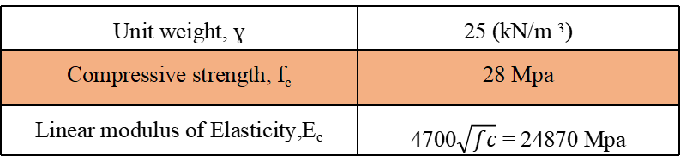
General Description
Construction Materials
Structural Elements
Unit weight, ɣ | 25 (kN/m ³)
Compressive strength, f_{c} | 28 Mpa
Linear modulus of Elasticity,E_{c} | 4700$\sqrt{fc}$ = 24870 Mpa

Slide 19
General Description
Construction Materials.
Non- Structural Elements :
Material | Unit weight ɣ(KN/m³)
Masonry stone | 26
Cement mortar &Plaster | 23
Partition blocks | 12
Filing material aggregate | 14
Glass | 25
Tiles | 26
Ytong Block | 5
Reinforce concrete | 25

Slide 20
General Description
Loads
Gravity loads :
Dead load
Super imposed dead load
Live load
Lateral loads :
Soil load
Seismic load

Slide 21
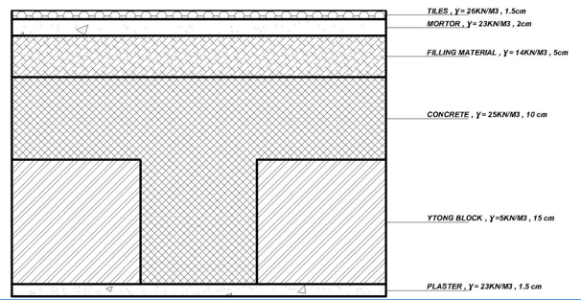
General Description
The floor layers:
Finishing materials weight = Σ (thickness of layer × unit weight for each layer)
Superimposed Dead load calculation
Element | Thickness (cm) | Unit weight (KN/m^3)
Filling | 5 | 14
Mortar | 2 | 23
Tiles | 1.5 | 26
Ytong Block | 17 | 5
Plaster | 1.5 | 23
SD= Tile weight + Mortor weight + Filling weight + Block weight + Plaster weight + SD of Partitions
SD = (0.015×26) + (0.02×23) + (0.05×14) + (0.17×5) + (0.015×23) + 1
= 3.68 KN/m2

Slide 22
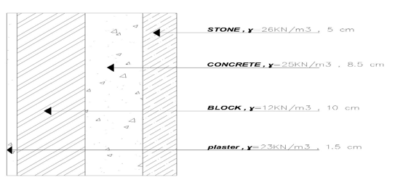
General Description
Exterior wall load
-Stone wall :
SD masonry wall = unit weight × thickness
= (0.05×26) + (0.085×25) + (0.1×12) + (0.015×23)
= 4.97 KN/m²
- Glass wall :
SD glass = ɣ _{glass} × thickness × story height
= 25 × 0.05 ×4
= 5 KN/m

Slide 23
Live Load
Occupancy | Live Load (KN/m² )
B3 (Storage) | 6
B2 (Warehouse) | 6
B1 (Garage) | 1.92
GF (Commercial) | 2.5
F1-11 (Residential) | 2.5

Slide 24
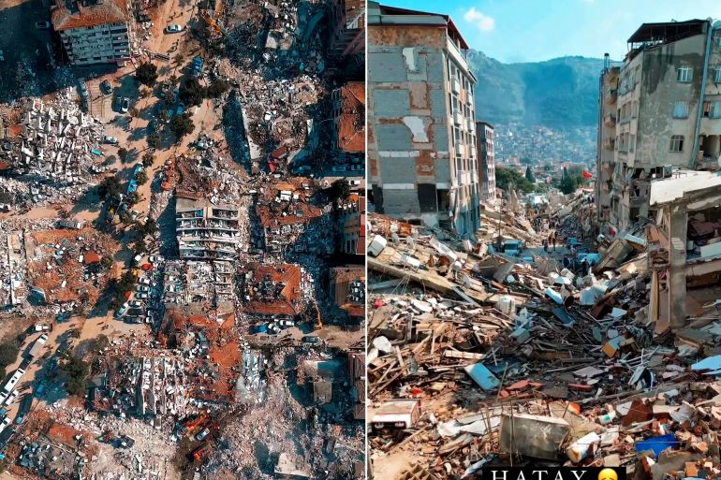
Lateral Load
Seismic loads:

Slide 25
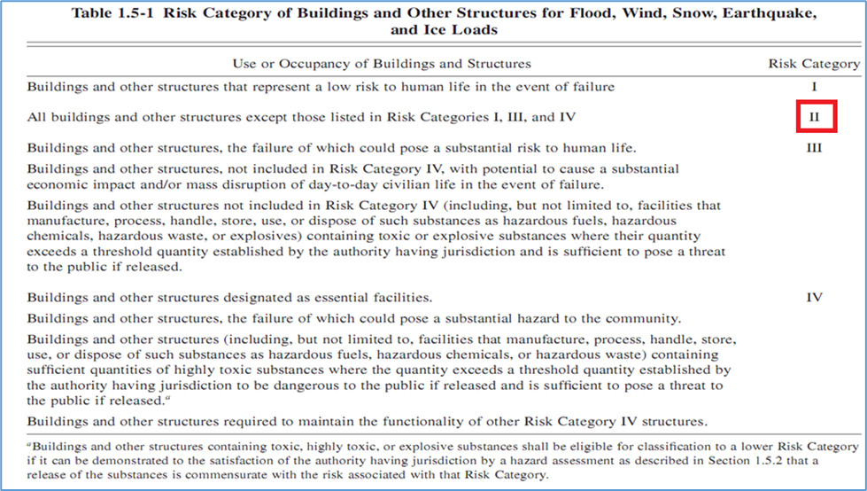
Lateral Load
Seismic loads:
According to ASCE 7-22 code to seismic analysis for this structure:
- Risk category: risk category of the building is II

Slide 26
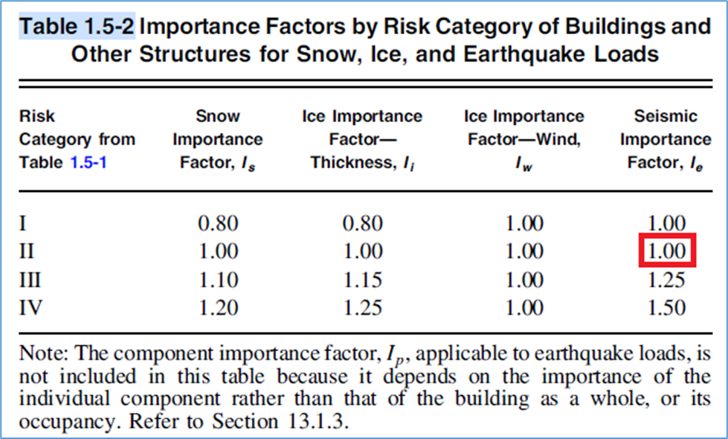
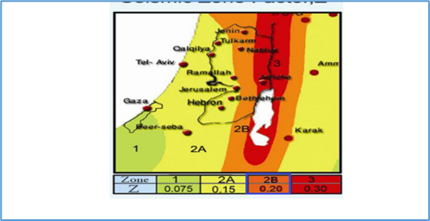

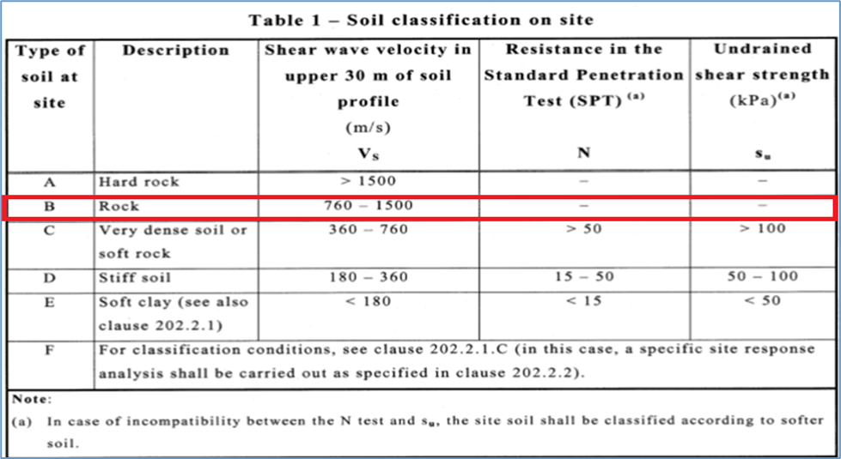
Lateral Load
Importance factor : (Ie) = 1
Zone factor (Z) for Nablus = 0.2
- Mapped acceleration parameters Ss & S1 :
From Palestine seismic map:
Ss= (2.5Z) *1.5= 2.5 *0.2 *1.5 = 0.75
S1 = (1.25Z) *1.5 = (1.25 *0.2) *1.5 = 0.375
Site Class
Site classification is B

Slide 27
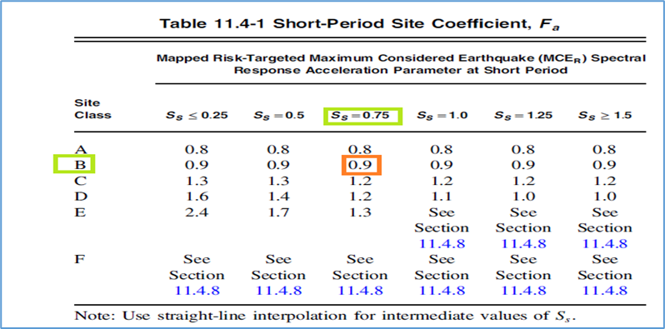
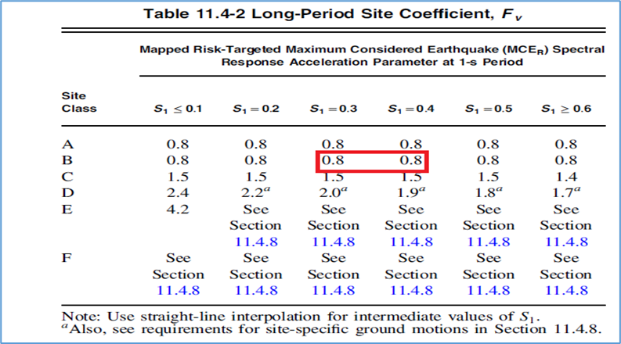
Site Coefficients
- The values of Fa and Fv According to the site class in this project are 0.90 ,0.80 respectively.

Slide 28
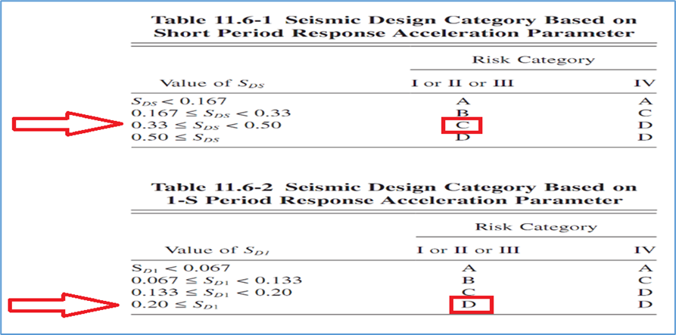
Seismic Design Category
-The maximum considered earthquake Spectral Response Acceleration
Parameters SMS and SM1:
SMS =Fa SS = 0.90 × 0.75 = 0.675
SM1 = Fv S1= 0.80 × 0.375= 0.30
Design spectral acceleration :
S_{DS}= 2 SMS /3 = 2*0.675/3 =0.45
S_{D1}= 2 SM1 /3 =2*0.300/3 =0.20
Seismic Design Category :
Seismic design category D

Slide 29
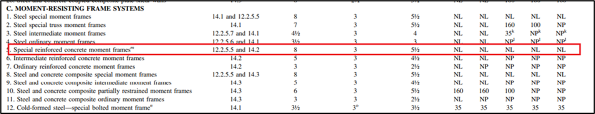
Lateral Force Resisting System
Type of the lateral forces resisting system :
Moment – resisting frame: special reinforced concrete moment frames.
Response Modification Factor (R) = 8
Over-strength Factor (Ω_{o}) = 3
Deflection Amplification Factor (C_{d}) = 5.5

Slide 30
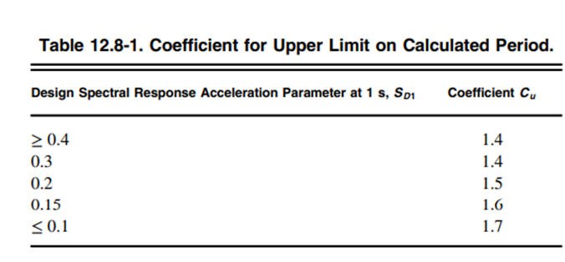
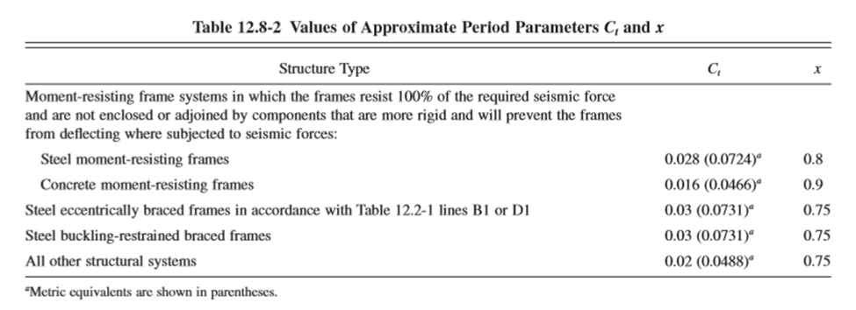
Structural Period
for Moment – resisting frame:
T_{a} = C_{t} h_{n} ^{x} = 0.0466 × 48.75 ^{0.90} = 1.54sec
T from ETABS ≤ T_{a} C_{u}
The period is limited to T_{u} = T_{a} C_{u}= 1.54× 1.5= 2.31sec

Slide 31


General Description
Computer Programs

Slide 32
Structural Preliminary Design

Slide 33
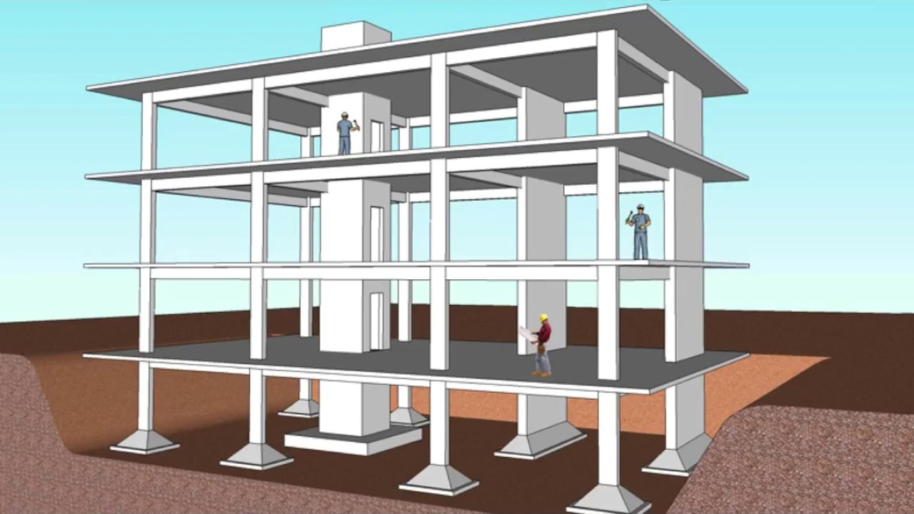
1. Slab System
2.Beam System
3. Column System
4. Wall System
Preliminary Design
Structural Systems for analysis and design

Slide 34

Slab Preliminary dimensions

Slide 35
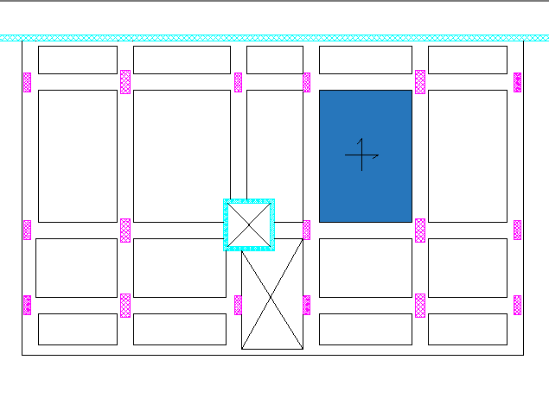
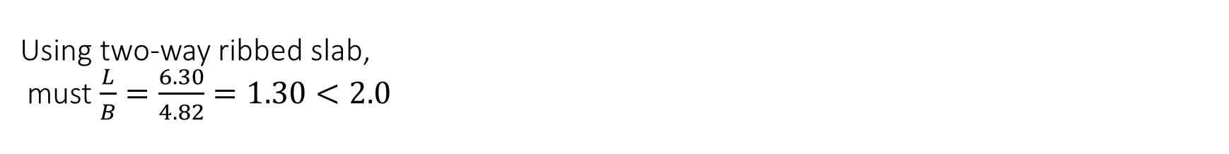
Using two-way ribbed slab, must $\frac{L}{B}=\frac{6.30}{4.82}=1.30<2.0$
Preliminary Design
Slab System
By referring to Table 8.3.1.1 in ACI-318-19:
Thickness = $\frac{L}{33 }∗1.15$ = $\frac{6.30}{33}∗1.15$ = 0.21954 m
h = 250mm

Slide 36

Preliminary Design
Slab System
Check Slab for shear
$$Vu=Wu\left(\frac{l}{2}−\frac{B}{2}−d\right)$$
$$∅Vc=∅\frac{1}{6}\sqrt{fc } bw∗d$$
Vu =14.13 kN/m
ØVc= 20.83 kN/m
Vu < ØVc ----> Ok

Slide 37
Beams Layout

Slide 38
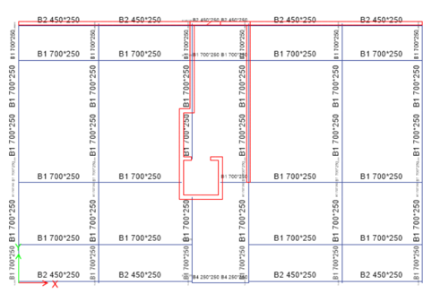
Preliminary Design
Beam Layout

Slide 39
Preliminary Design
Beam System
Beam number | Height (mm) | Width (mm)
B1 | 250 | 700
B2 | 250 | 450
B3 | 250 | 300
B4 | 250 | 250

Slide 40
Column Layout

Slide 41
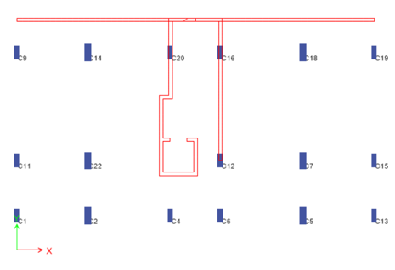

Slide 42
Preliminary Design
Column System
Column | Type | Dimension
C1 | R | 800*300
C2 | R | 1000*400
R: Rectangular column

Slide 43
Wall Layout

Slide 44
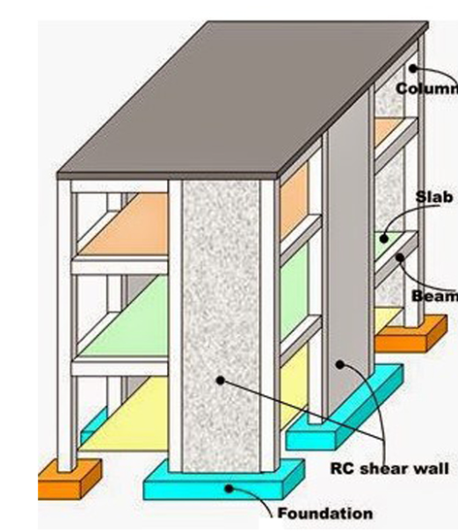
Preliminary Design
Wall System
Types of walls in this structure will be used:
1.Basement retaining walls
2. Elevators and staircase walls. (Shear walls).
From architectural plans, elevators and staircase walls have an initial thickness equal to 200 mm , retaining walls have an initial thickness equal to 300 mm
Wall name | Wall thickness (mm)
Wall 1 | 200
Wall 2 | 300

Slide 45
3D-Modeling and Analysis

Slide 46
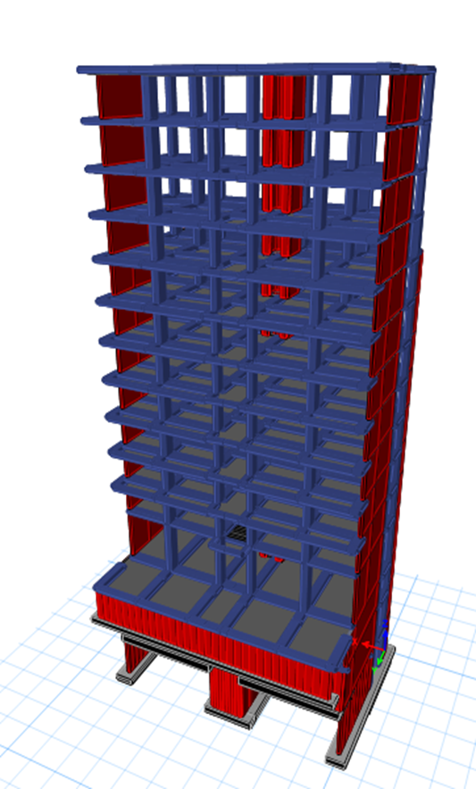
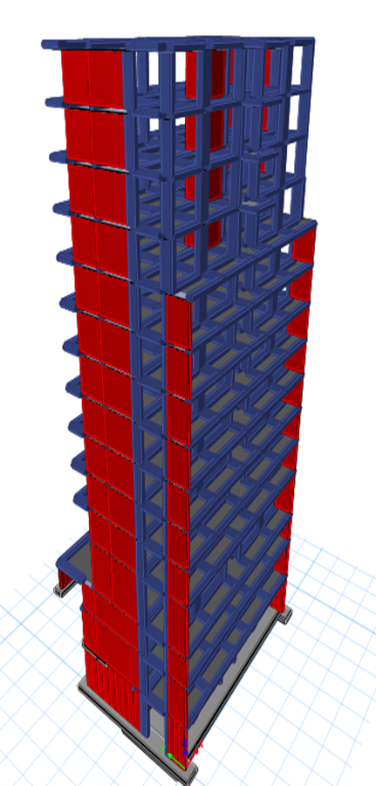
3D-Modeling and Analysis

Slide 47
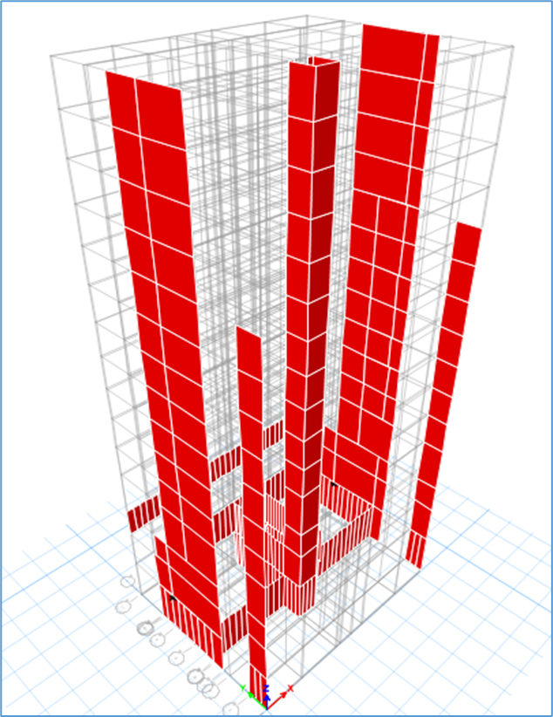
3D-Modeling and Analysis

Slide 48

Verification of Structural Analysis

Slide 49
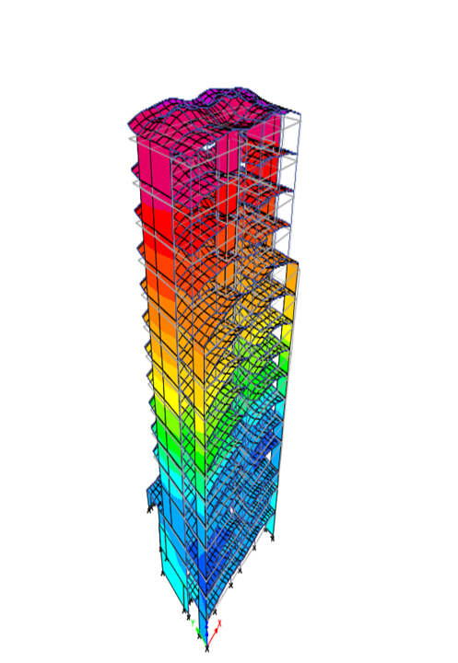
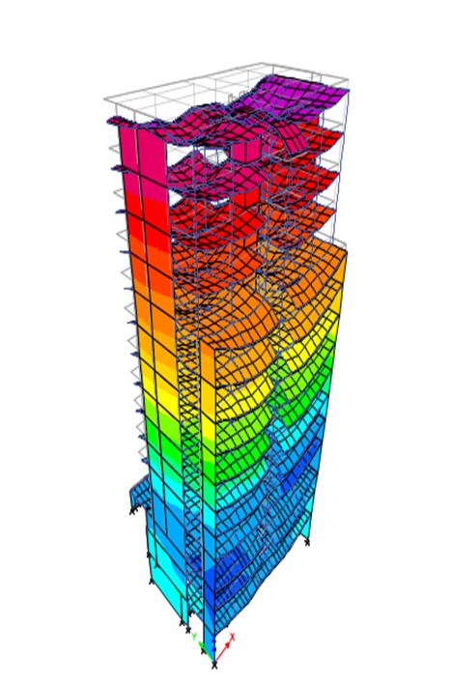
3D-Modeling and Analysis
Compatibility Check

Slide 50
3D-Modeling and Analysis
Equilibrium Check
1.Dead Load.
1.1.Beam weight.
1.2.Columns weight

Slide 51
3D-Modeling and Analysis
Equilibrium Check
1.3.Slab weight.

Slide 52
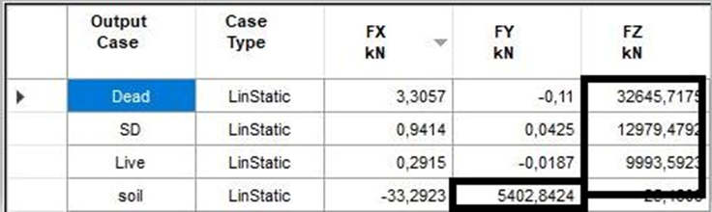
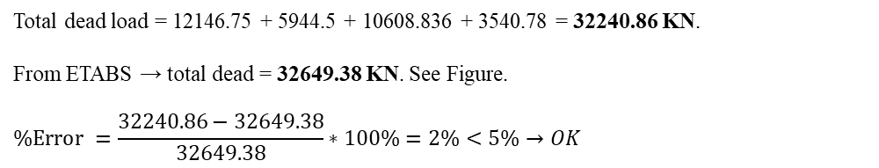
3D-Modeling and Analysis
Equilibrium Check
1.4.Shear wall weight.
Total dead load = 12146.75 + 5944.5 + 10608.836 + 3540.78 = 32240.86 KN.
From ETABS → total dead = 32649.38 KN. See Figure.
$$\%Error =\frac{32240.86−32649.38}{32649.38}∗100\%=2\%<5\%→OK$$

Slide 53
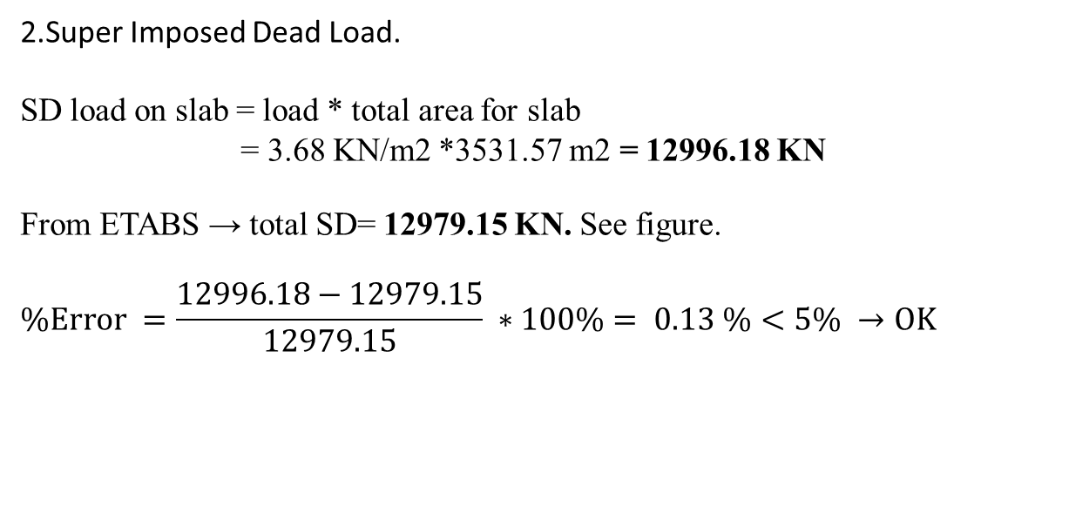
3D-Modeling and Analysis
Equilibrium Check
2.Super Imposed Dead Load.
SD load on slab = load * total area for slab
= 3.68 KN/m2 *3531.57 m2 = 12996.18 KN
From ETABS → total SD= 12979.15 KN. See figure.
$$\%Error =\frac{12996.18−12979.15}{12979.15} ∗100\%= 0.13 \%<5\% →OK$$

Slide 54
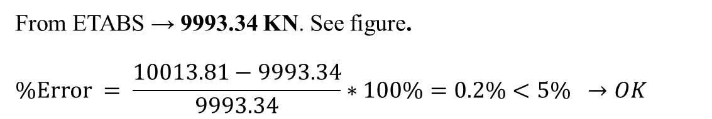
3D-Modeling and Analysis
Equilibrium Check
3.Live Load.
From ETABS → 9993.34 KN. See figure.
$$\%Error = \frac{10013.81−9993.34}{9993.34}∗100\%=0.2\%<5\% →OK$$

Slide 55
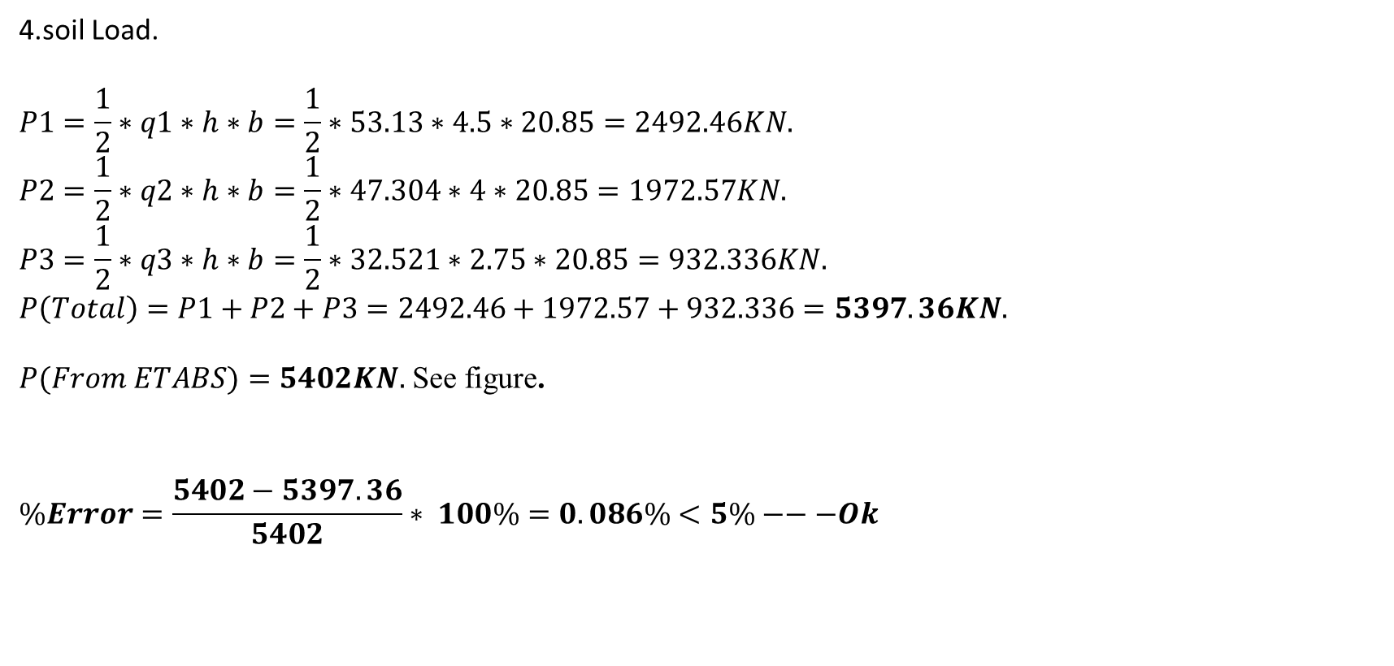
3D-Modeling and Analysis
Equilibrium Check
4.soil Load.
$$P1=\frac{1}{2}∗q1∗h∗b=\frac{1}{2}∗53.13∗4.5∗20.85=2492.46KN.$$
$$P2=\frac{1}{2}∗q2∗h∗b=\frac{1}{2}∗47.304∗4∗20.85=1972.57KN.$$
$$P3=\frac{1}{2}∗q3∗h∗b=\frac{1}{2}∗32.521∗2.75∗20.85=932.336KN.$$
$$P\left(Total\right)=P1+P2+P3=2492.46+1972.57+932.336=5397.36KN.$$
$P(From ETABS)=5402KN.$ See figure.
$$\%Error=\frac{5402−5397.36}{5402}∗ 100\%=0.086\%<5\%−−−Ok$$

Slide 56
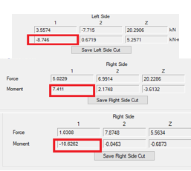
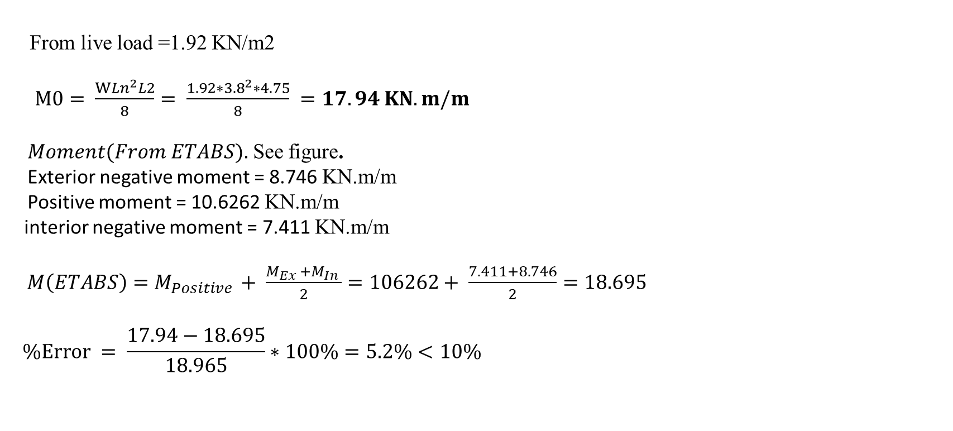
3D-Modeling and Analysis
Stress Strain Load
From live load =1.92 KN/m2
$M0= \frac{W{Ln}^{2}L2}{8}= \frac{1.92∗{3.8}^{2}∗4.75}{8} =17.94 KN.m/m$
$Moment(From ETABS).$ See figure.
Exterior negative moment = 8.746 KN.m/m
Positive moment = 10.6262 KN.m/m
interior negative moment = 7.411 KN.m/m
$M\left(ETABS\right)=M_{Positive }+ \frac{M_{Ex }+M_{In }}{2}=106262+ \frac{7.411+8.746}{2}=18.695$
$$\%Error = \frac{17.94−18.695}{18.965}∗100\%=5.2\%<10\%$$

Slide 57

3D-Modeling and Analysis
Deflection Check
Allowable Deflection = L/240 = $\frac{6.30}{240}∗1000=26.25 mm$
$$Total Deflection =Deflection at the middle− \frac{ΣDeflection at corner}{4}$$
$$Total Deflection =41.1− \frac{\left(20.7+18.01+13.33+20.88\right)}{4}=23mm$$
23 mm < 26.25 mm → ok

Slide 58
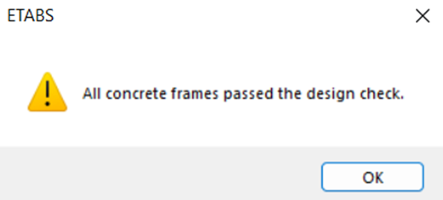
3D-Modeling and Analysis
Verification of the preliminary design

Slide 59
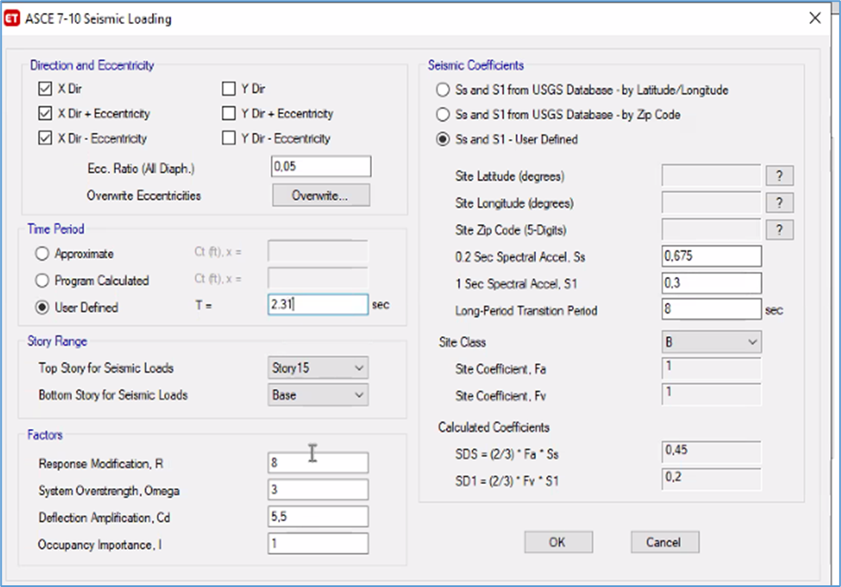
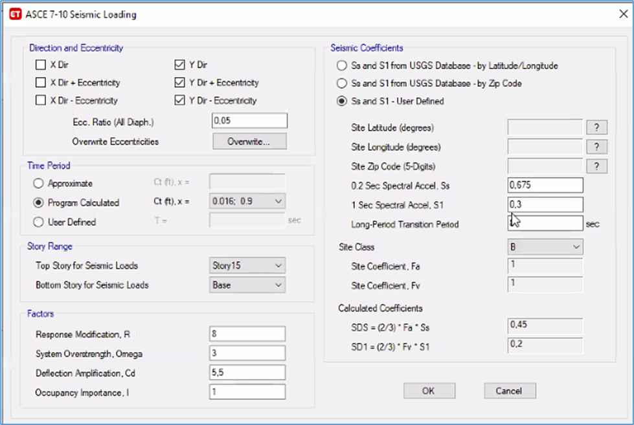
3D-Modeling and Analysis
Seismic Analysis Methods
1.Equivalent lateral force method (ELF).
Seismic loading in X-direction
Seismic loading in Y-direction

Slide 60
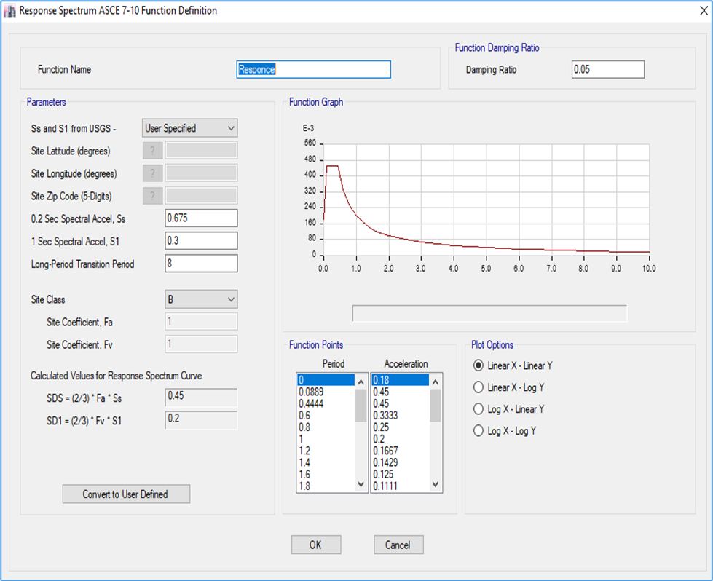
3D-Modeling and Analysis
Seismic Analysis Methods
  2.Modal response spectrum method (MRS).
Definition of MRS in ETABS

Slide 61
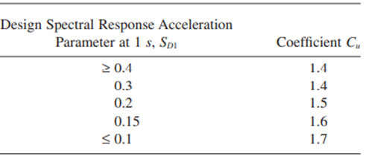
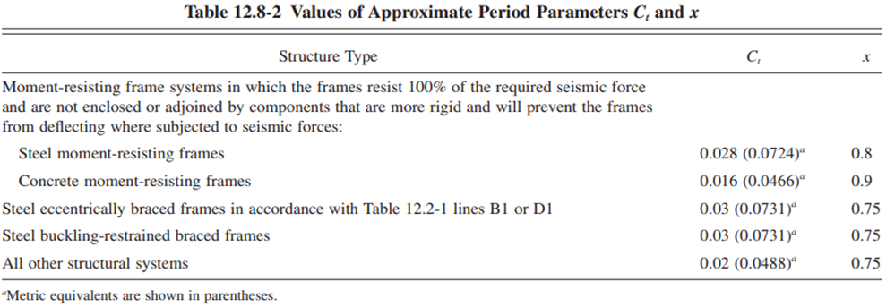
3D-Modeling and Analysis
Period
Ta=Ct* Hn^x
=0.0466*48.75^0.9=1.54 s.
Tu= Ta *Cu =1.54*1.5=2.31s.
→T from Etabs in X direction =2.708s
T Etabs >Tupper ------Take Tupper.
→ T from Etabs in Y direction =1.356s
T Etabs <Tupper ------Take T Etabs.

Slide 62
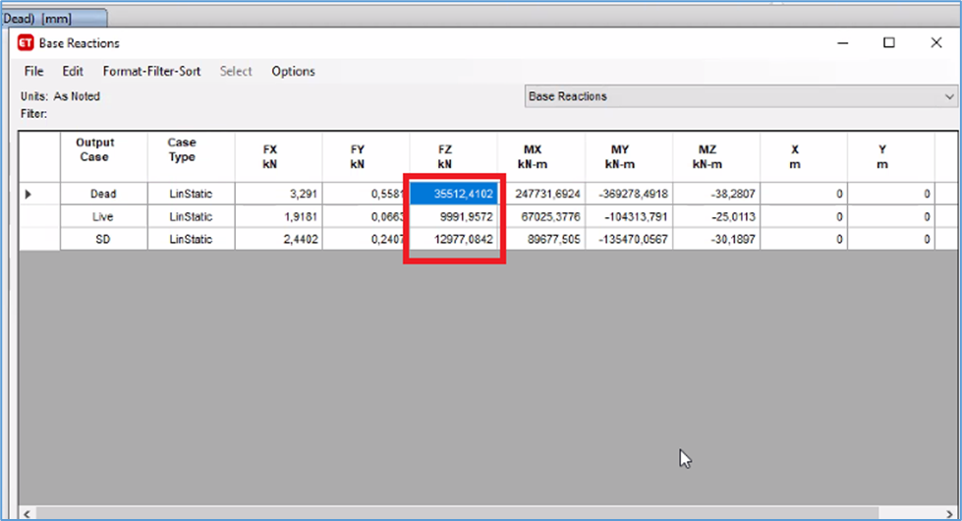
3D-Modeling and Analysis
Base Shear Check
→ V manually = Cs * Building weight
-Where:
V: seismic base shear.
Cs: seismic response coefficient.
W: effective weight.
W = D+ SD+ 0.25 L =35512.41+12977+0.25*9991.95
=50987 Kn.

Slide 63
3D-Modeling and Analysis
Base Shear
Cs=SDS*I/R=0.45*1/8=0.056
Cs min=0.044*SDs*I=0.044*0.45*1=0.0198
Take Cs=0.0198
V=0.0198*50987.39=1009Kn.

Slide 64
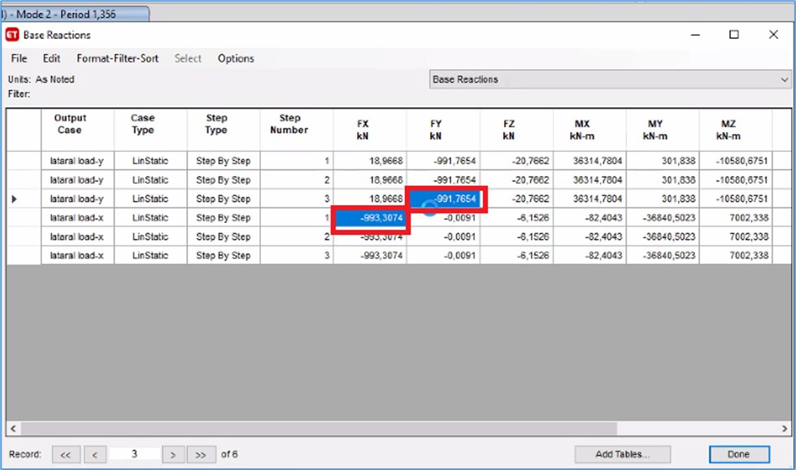

3D-Modeling and Analysis
Base Shear Check
Base shear from Etabs (X direction) = 993.3074 KN
$$\%Error =\frac{993.3074−1009}{1009} ∗100\%=1.58 \%<5\% →OK$$
Base shear from Etabs (Y direction) = 991.7654 KN
$$\%Error =\frac{991.7654−1009}{1009} ∗100\%=1.78 \%<5\% →OK$$

Slide 65

3D-Modeling and Analysis
Response spectrum
The values of dynamic earthquake forces must be approximately equal to the value of earthquake forces in the static method. However, the values were not equal, which led to a change in the scale factor for each of the dynamic earthquake forces in X and Y.
→ Define load case in both directions (Ex and Ey initial)
Factor=9810/R = 9810/8 =1226.25. See figure

Slide 66
3D-Modeling and Analysis
Response spectrum
Check base shear from response compared to ELF:
V(EX)= 369.33 V(ELF-X) =993
modified factor=993/369.33=2.688
Total factor=2.688*1226.25 =3296.16.
→ 0.3Ey must be added to Ex =0.3*1581.86 =474.56.
V(EY)= 763.635 V(ELF-Y) =991
modified factor=991/763.635=1.29
Total factor=1.29*1226.25=1581.86.
→ 0.3Ex must be added to Ey = 0.3*3296.16=988.

Slide 67


3D-Modeling and Analysis

Slide 68

3D-Modeling and Analysis
Story Drift
𝜕𝑥 =𝐶𝑑 ∗ 𝜕𝑥𝑒/𝐼𝑒
The allowable drift = 0.02 hx

Slide 69
3D-Modeling and Analysis
Story Drift
Drift in X-Direction
Story | Delta(elastic) | H | Drift | allowable
15 | 0.001561 | 3 | 0.0085855 | 0.06 | OK
14 | 0.001697 | 3 | 0.0093335 | 0.06 | OK
13 | 0.001802 | 3 | 0.009911 | 0.06 | OK
12 | 0.0105454 | 3 | 0.0579997 | 0.06 | OK
11 | 0.001948 | 3 | 0.010714 | 0.06 | OK
10 | 0.002008 | 3 | 0.011044 | 0.06 | OK
9 | 0.00205 | 3 | 0.011275 | 0.06 | OK
8 | 0.00206 | 3 | 0.01133 | 0.06 | OK
7 | 0.002032 | 3 | 0.011176 | 0.06 | OK
6 | 0.001934 | 3 | 0.010637 | 0.06 | OK
5 | 0.001771 | 3 | 0.0097405 | 0.06 | OK
4 | 0.001249 | 4.5 | 0.0068695 | 0.09 | OK
3 | 0.000272 | 2.75 | 0.001496 | 0.055 | OK
2 | 8.70E-05 | 4 | 0.0004785 | 0.08 | OK
1 | 2.10E-05 | 4.5 | 0.0001155 | 0.09 | OK

Slide 70
3D-Modeling and Analysis
Story Drift
Drift in Y-Direction
Story | Delta(elastic) | H | Drift | allowable
15 | 0.000579 | 3 | 0.0031845 | 0.06 | OK
14 | 0.000585 | 3 | 0.0032175 | 0.06 | OK
13 | 0.000587 | 3 | 0.0032285 | 0.06 | OK
12 | 0.003981 | 3 | 0.0218955 | 0.06 | OK
11 | 0.000571 | 3 | 0.0031405 | 0.06 | OK
10 | 0.000558 | 3 | 0.003069 | 0.06 | OK
9 | 0.000536 | 3 | 0.002948 | 0.06 | OK
8 | 0.000506 | 3 | 0.002783 | 0.06 | OK
7 | 0.000468 | 3 | 0.002574 | 0.06 | OK
6 | 0.00042 | 3 | 0.00231 | 0.06 | OK
5 | 0.00036 | 3 | 0.00198 | 0.06 | OK
4 | 0.000264 | 4.5 | 0.001452 | 0.09 | OK
3 | 0.000243 | 2.75 | 0.0013365 | 0.055 | OK
2 | 6.50E-05 | 4 | 0.0003575 | 0.08 | OK
1 | 1.10E-05 | 4.5 | 0.0000605 | 0.09 | OK

Slide 71
3D-Modeling and Analysis
Effect of P-delta
P-Delta in X-Direction
Story | Delta(elastic) | H | P | V | Theta
15 | 0.001561 | 3 | 3630.8094 | 260.3228 | 0.007257264 | OK
14 | 0.001697 | 3 | 6956.9113 | 409.0381 | 0.009620847 | OK
13 | 0.001802 | 3 | 10283.013 | 490.003 | 0.012605358 | OK
12 | 0.0105454 | 3 | 13652.49 | 536.0515 | 0.089525583 | OK
11 | 0.001948 | 3 | 17471.52 | 577.9581 | 0.019629174 | OK
10 | 0.002008 | 3 | 21290.55 | 629.437 | 0.022640034 | OK
9 | 0.00205 | 3 | 25109.58 | 677.5426 | 0.025324183 | OK
8 | 0.00206 | 3 | 28928.61 | 721.0305 | 0.027549892 | OK
7 | 0.002032 | 3 | 32747.64 | 766.185 | 0.028950016 | OK
6 | 0.001934 | 3 | 36566.67 | 827.5974 | 0.028484035 | OK
5 | 0.001771 | 3 | 40385.7 | 903.9142 | 0.026375319 | OK
4 | 0.001249 | 4.5 | 44158.367 | 972.6869 | 0.01260056 | OK
3 | 0.000272 | 2.75 | 48984.728 | 995.69 | 0.004866007 | OK
2 | 8.70E-05 | 4 | 54108.254 | 1348.8225 | 0.000872505 | OK
1 | 2.10E-05 | 4.5 | 58853.95 | 1420.52 | 0.000193346 | OK
𝜃 =𝑃𝑥∗ ∆ / 𝑉𝑥∗ℎ𝑥
The values of θ in X direction less than 0.1neglect effect of P-delta.

Slide 72
3D-Modeling and Analysis
Effect of P-delta
P-Delta in Y-Direction
Story | Delta(elastic) | H | P | V | Theta
15 | 0.000579 | 3 | 3630.8094 | 208.7228 | 0.003357306 | OK
14 | 0.000585 | 3 | 6956.9113 | 356.9285 | 0.003800755 | OK
13 | 0.000587 | 3 | 10283.0132 | 445.5816 | 0.004515543 | OK
12 | 0.003981 | 3 | 13652.4901 | 491.5601 | 0.036855828 | OK
11 | 0.000571 | 3 | 17471.5201 | 521.6355 | 0.006374974 | OK
10 | 0.000558 | 3 | 21290.5501 | 553.349 | 0.0071565 | OK
9 | 0.000536 | 3 | 25109.5801 | 595.7701 | 0.007530161 | OK
8 | 0.000506 | 3 | 28928.6101 | 649.4521 | 0.007512936 | OK
7 | 0.000468 | 3 | 32747.6401 | 713.9394 | 0.007155554 | OK
6 | 0.00042 | 3 | 36566.6701 | 788.7751 | 0.006490233 | OK
5 | 0.00036 | 3 | 40385.7001 | 868.4401 | 0.005580447 | OK
4 | 0.000264 | 4.5 | 44158.3665 | 936.9396 | 0.002764985 | OK
3 | 0.000243 | 2.75 | 48984.7283 | 987.2354 | 0.004384434 | OK
2 | 6.50E-05 | 4 | 54108.2544 | 1003.1682 | 0.000876482 | OK
1 | 1.10E-05 | 4.5 | 58853.95 | 1120.25 | 0.000128422 | OK
𝜃 =𝑃y∗ ∆ / 𝑉y∗ℎy
The values of θ in Y direction less than 0.1neglect effect of P-delta.

Slide 73
Design

Slide 74


Design
Design of Slab
Check for Shear:
Hand Calculation:
$∅Vc=138.90$KN/m
$Vu=35.60$KN/m
From Etabs:
$Vu=38.016$KN/m. See figure.
$Vu$< $∅Vc$ (No need for Shear Reinforcement).
Design of Moment:
    $ρ min$ = 0.0033 , $bw$ = 150 mm
    d= 210 mm
  As,min = $ρ\min{∗b∗d}$
  = 0.0033 * 150 * 210 = 103.95 mm²/m → 2∅12/m

Slide 75

Design
Design of Slab
Design of Moment:
→For positive moment
Let a = $\frac{As∗fy }{0.85∗fc∗bf}$ =$\frac{103.95∗420}{0.85∗28∗550}$ =3.34 mm
∅Mn =∅*As *Fy (d-$\frac{a}{2}$ )
= 0.9*103.95*420*(210- $\frac{3.34}{2}$) *${10}^{−6}$ /0.55
= 14.88 KN.m/m.
→For negative moment
Let a = $\frac{As∗fy }{0.85∗fc∗bw}= \frac{103.95∗420}{0.85∗28∗150}$ =12.22 mm.
∅Mn =∅*As *Fy (d- a/2)
= 0.9*103.95*420*(210- $\frac{12.22}{2}$)*${10}^{−6}$ /0.55
= 14.56 KN.m/m

Slide 76


Design
Design of Slab
Design of Moment:
The moment of slab has been shown
between the ranges of minimum moment as shown in figure:
In x direction, all reinforcement is minimum. See figure:
Take 2∅12 for positive moment and negative moment.

Slide 77


Design
Design of Slab
Design of Moment:
In y-direction, reinforcements for all slab are minimum
except the following panels. See Figures
For panels in figures above for M11, maximum
moment = 35kN.m/m
→For positive moment
∅Mn =∅*As *Fy (d- a/2)
35*0.9 = 0.9*As*420*(210- $\frac{3.34}{2}$)*${10}^{−6}$ /0.55
As = 220mm² → Take 2∅12.
→ For negative moment
∅Mn =∅*As *Fy (d- a/2)
35*0.9 = 0.9*As*420*(210- $\frac{12.22}{2}$)*${10}^{−6}$ /0.55
As= 225 mm² → Take 2∅12.

Slide 78


Design
Design of beam
Beam has been selected in fourd story. See figure:
Beam dimensions = 700 X 250mm.
Effective depth = 215 mm.
Flexural Design:
→ For positive moment = 20.444 KN.m
Where: f’c = 28 MPa, F_{y} = 420 MPa.
$$ρ=\frac{0.85∗fc}{fy}1−\sqrt{1−\frac{2.61∗Mu}{b∗d^{2}∗fc}}$$
$$ρ=\frac{0.85∗28}{420}(1−\sqrt{1−\frac{2.61∗30.397}{700∗{210}^{2}∗28}} )=0.00168$$
𝜌𝑚𝑖𝑛=0.0033
0.0033 > 0.00168 →Take ρ = 0.0033
→ As = ρ *b*d =0.0033*700* 215 = 501 mm²
→ Use 4∅14

Slide 79

Design
Design of beam
Flexural Design:
→ For negative moment = 43.7448 KN.m
Where: f’c = 28 MPa, Fy = 420 MPa.
$$ρ=\frac{0.85∗fc}{fy}(1−\sqrt{1−\frac{2.61∗Mu}{b∗d^{2}∗fc}}$$
$$ρ=\frac{0.85∗28}{420}(1−\sqrt{1−\frac{2.61∗49.776}{700∗{210}^{2}∗28}} )=0.00369$$
𝜌𝑚𝑖𝑛=0.0033
0.0033 < 0.00369 →Take ρ = 0.00369
→ As = ρ *b*d =0.00369*700* 215 = 555 mm²
→ Use 4∅14

Slide 80

Design
Design of beam
Design beam for shear:
First, we will make sure to calculate the strength of the shear :
$V=\frac{mp1+mp2}{Ln}+\frac{Wu∗Ln}{2}$
→As =569 mm² from Etabs .
$$a=\frac{1.25∗As∗Fy}{0.85∗fc∗b}=\frac{1.25∗569∗420}{0.85∗28∗700}=17.93mm$$
$$→mp1=1.25∗As∗fy∗\left(d−\frac{a}{2}\right)=1.25∗569∗420\left(215−\frac{17.93}{2}\right)=61.59Kn.m$$
→As =398mm² from Etabs .
$$a=\frac{1.25∗As∗Fy}{0.85∗fc∗b}=\frac{1.25∗398∗420}{0.85∗28∗700}=12.5mm$$

Slide 81

Design
$$→mp2=1.25∗As∗fy∗\left(d−\frac{a}{2}\right)=1.25∗398∗420\left(215−\frac{12.5}{2}\right)=43.61Kn.m$$
$Vp=\frac{mp1+mp2}{Ln}=\frac{61.59+43.61}{4.48}=23.48 kn.$
$\frac{Wu∗Ln}{2}=\left(1.2+0.2SDs\right)D+L =1.29∗21.9+9.15=37.401 kn$
$→V1=23.48+37.401=61 kn$.
$$→V factored=\left(1.2+0.4SDs\right)D+L+2E$$
=(1.38*21.9)+9.15+(2*3.15) =46 Kn.
→ Vg= 1.2D+1.6L = (12*20.9)+(1.6*9.15) =39 Kn.
→ The value of shear design = the max value of (V1,V factored ,Vg) = 61 Kn.

Slide 82


Design
→The value of V from load case (Dead , Live .E, 1.2D+1.6L). See figure:

Slide 83



Design
→The summary shear details from Etabs. See the figure:

Slide 84


Design
Calculate of Av /s :
$$Vc= \frac{1}{6}∗\sqrt{fc}∗bw∗d /1000$$
$$= \frac{1}{6}∗\sqrt{28}∗700∗\frac{21}{1000}=132.728 KN$$
→∅Vc =99.546 KN.
$$\frac{Av}{s} min=0.35∗\frac{bw}{fyt}=0.35∗\frac{700}{420}=0.583 mm/m$$
Assume Av = 2 * 78.5 = 157 mm2
→ Take S = 270mm
→Smax = d/2 = 107.5 mm
→ on the side beam :
S max = min (d/4,6db,150mm)
= min (215/4,6*10,150)
Take S= 60mm.
→ at the middle beam :
S = d/2=215/2 =107.5mm. → Take S=100mm. See the figure:

Slide 85


Design
Design of columns
Column at grid (5G) has been selected. See figure:
Axial load from ETABS = 4475.81 KN See figure:

Slide 86


Design
Design of columns
Ultimate moment M3 from ETABS = 101.108 KN.m. See figure:
𝜌 𝐹𝑟𝑜𝑚 𝐸𝑇𝐴𝐵𝑆 = 0.01 See figure:

Slide 87



Design
Design of columns
➔ As = 0.01 * 1000 * 400 =4000 mm²
➔ Use 16∅18.
Shear design for the column:
Use Av /s min =$0.583 mm/m$
Assume Av = 2 * 78.5 = 157 mm2
→ S=270mm.
On the side column:
S max = min (b/4, 6db, h/4, Sₒ)
= min (1000/4, 6*18, 400/4, 100)mm.
Take S= 100mm.
at the middle column:
S =6db=6*18=108mm. → Take S=100mm.
→ Distance between reinforcement bars
= ($\frac{100−80}{6})$=153mm > 150mm
→All steel bars must be connected with one stirp

Slide 88

Footing

Slide 89
Footing
This project is a design for some types of footing, which the Mat foundation and Wall Footing
Ultimate load combinations:
1.4D
1.54D
1.2D + 1.6L
1.32D+1.76L
1.1D+1.1L (Service load)

Slide 90

Footing
Mat foundation Layout (AutoCAD drawing): See Figures:
→Allowable bearing capacity of soil = 470 Kn/m²
→All dimensions were assumed and checked on Etabs.
Strip name | Thickness(m)
1 | 0.45
2 | 0.75
3 | 0.45
4 | 0.65
5 | 0.35

Slide 91


Footing
Mat Foundation and Wall footing checks :
Check soil pressure :
The pressure must be less than q allowable =470 kn/m². → Ok. See figure:

Slide 92


Footing
Check Punching shear :
Check punching shear for mat foundation (less than (1) to get a high factor of safety ). OK. See figure:

Slide 93

Footing
Design for Mat Foundation and Wall footing :
Sample calculation:
Strip 1: (h=450mm)
Area of steel (Top in X direction) from Etabs for (Strip1) =Area of steel min
As min = ρ *b*h =0.0018*1000*450=810mm². →(4∅16/m). See figure
→ All stirps the As min > As from Etabs
→ Take As min.

Slide 94
Footing
→Table of steel reinforcing for all stirps: See Table below:
Stirps | Direction(x) Top (As min) | Direction(x) Bottom (As min) | Direction(y) Top (As min) | Direction(y) Bottom (As min)
2 | 1386 mm² (6∅18/m) | 1386 mm² (6∅18/m) | 1386 mm² (6∅18/m) | 1386 mm² (6∅18/m)
3 | 810 mm² (4∅16/m) | 810 mm² (4∅16/m) | 810 mm² (4∅16/m) | 810 mm² (4∅16/m)
4 | 1080 mm² (6∅16/m) | 1080 mm² (6∅16/m) | 1080 mm² (6∅16/m) | 1080 mm² (6∅16/m)
5 | 630 mm² (4∅14/m) | 630 mm² (4∅14/m) | 630 mm² (4∅14/m) | 630 mm² (4∅14/m)

Slide 95


