Slide 1
Uninfected Corona Nurse
Prepared By: Supervisors :
Badawi Wawi Hanal Abuzanat
Mohammed Issam Muhannad Al-Jabie

Slide 2
Outline
Introduction
Methods and Techniques
Constraints
Demo
Future Work

Slide 3
Introduction

Slide 4
Problem
CoronaVirus

Slide 5
Objectives
Save Nurse’s efforts in Deliver things to some destination.
Infection

Slide 6
Methods and Techniques

Slide 7

Line follower

Slide 8


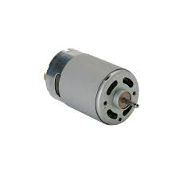
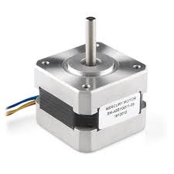
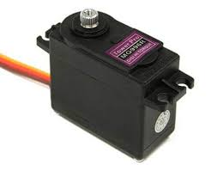
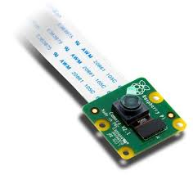
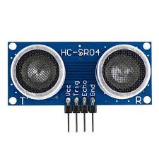
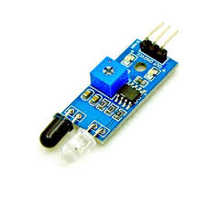
Hardware Components

Slide 9
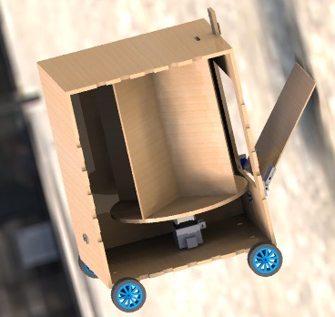
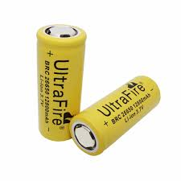
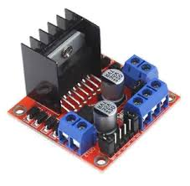
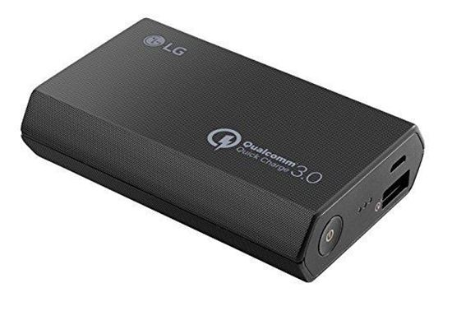
Hardware Components

Slide 10




Programming Languages

Slide 11
Constraints

Slide 12
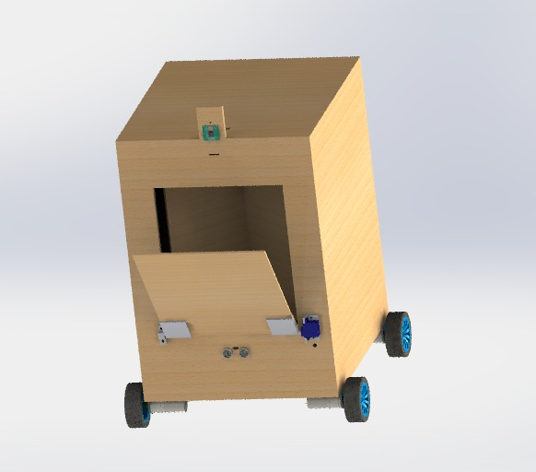
Robot Design

Slide 13
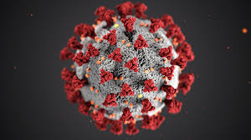
Coronavirus

Slide 14

Price

Slide 15
Demo

Slide 16
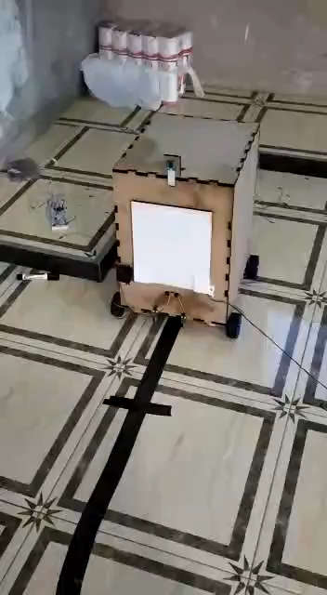

Slide 17
Future Work
temperature sensor
better and more accurate sensors
Less Weight Design
Dynamic start point with AI.
enhance the line follower method by using line mapping
Replace line follower with dynamic navigation.

Slide 18


