Slide 1

Graduation Project (2)
Integrated design of a Directorate of Health
Prepared by :
Batool Fuqha
Fidaa Rawajbeh
Yasmeen Dababat
Supervisor : Dr. Monther Dwaikat.
Notes:
You can safely remove this slide. This slide design was provided by SlideModel.com – You can download more templates, shapes and elements for PowerPoint from http://slidemodel.com/

Slide 2
    Outline
    Introduction.
    Site analysis.
    Architectural design.
    Environmental design.
    Structural design.
    Mechanical design.
    Electrical design.
    Safety.
    Quantity Survey.
Notes:
You can safely remove this slide. This slide design was provided by SlideModel.com – You can download more templates, shapes and elements for PowerPoint from http://slidemodel.com/

Slide 3
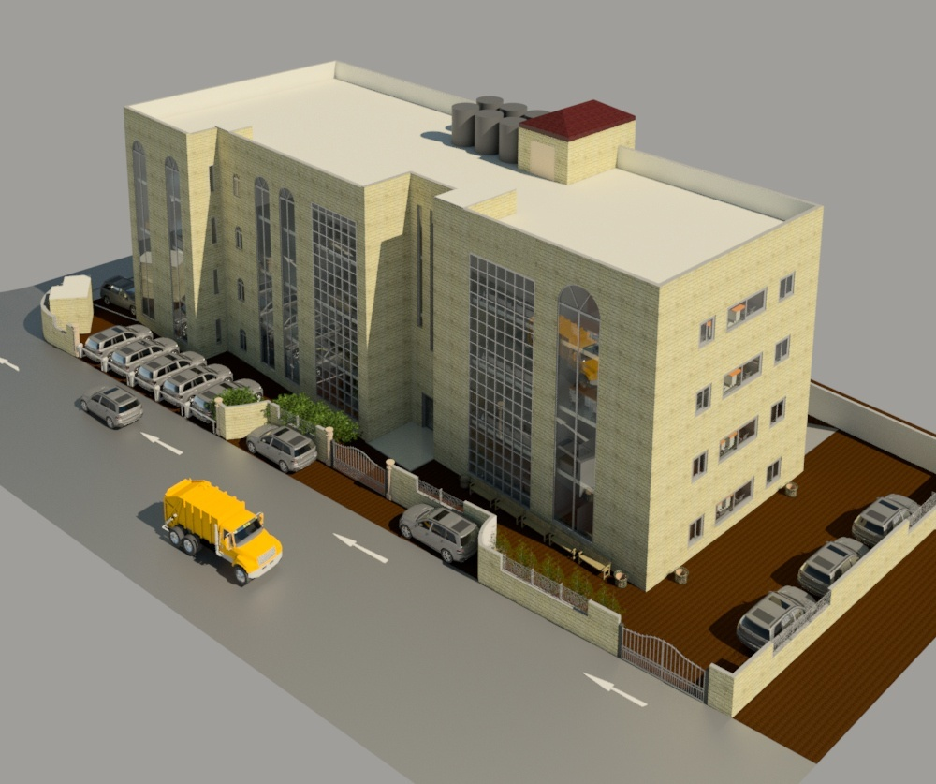
    Introduction
Notes:
You can safely remove this slide. This slide design was provided by SlideModel.com – You can download more templates, shapes and elements for PowerPoint from http://slidemodel.com/

Slide 4
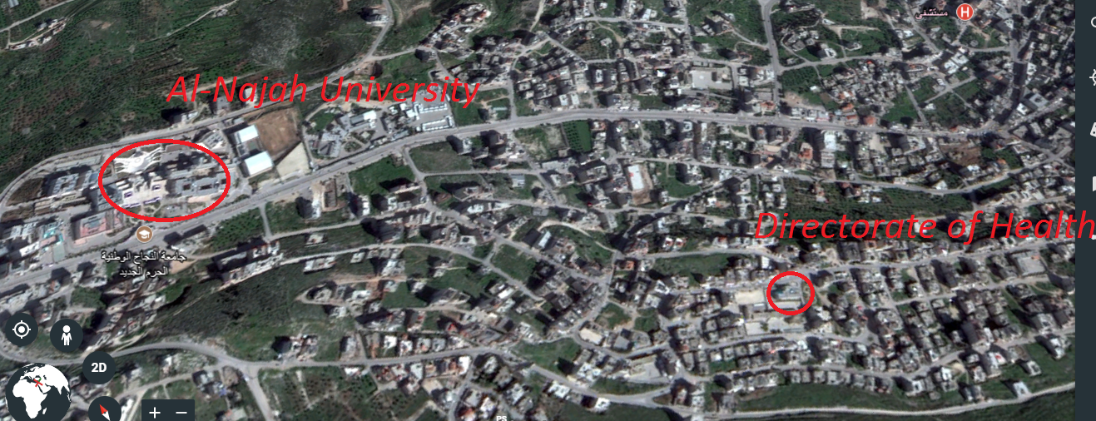
    Site analysis
Al-makhfia, Nablus- Palestine
Location: west of Nablus
Notes:
You can safely remove this slide. This slide design was provided by SlideModel.com – You can download more templates, shapes and elements for PowerPoint from http://slidemodel.com/

Slide 5
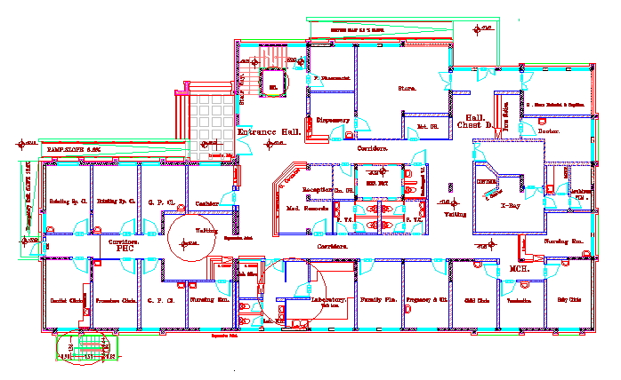
Architectural Design.
Site plan
Ground floor before redesign.

Slide 6
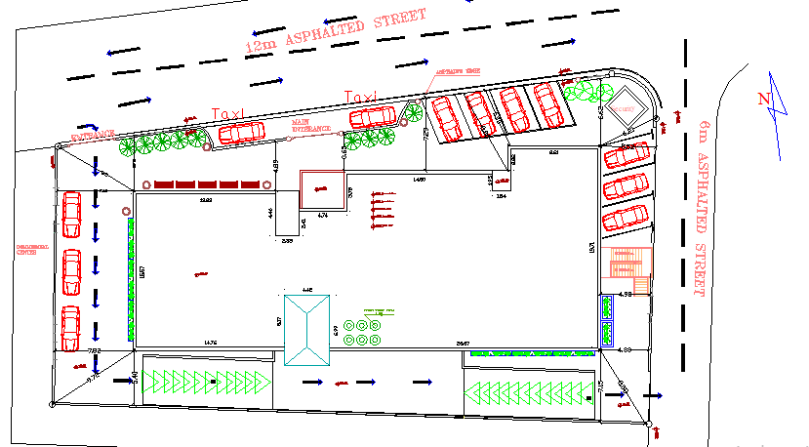
Architectural Design.
Site plan

Slide 7
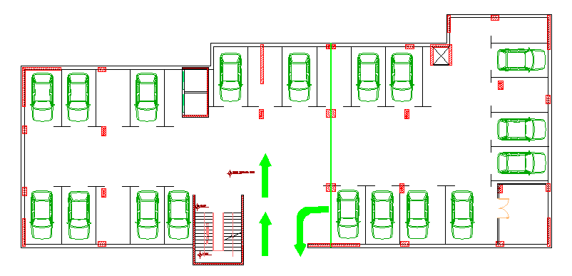
Architectural Design.
Basement floor
827 m²

Slide 8
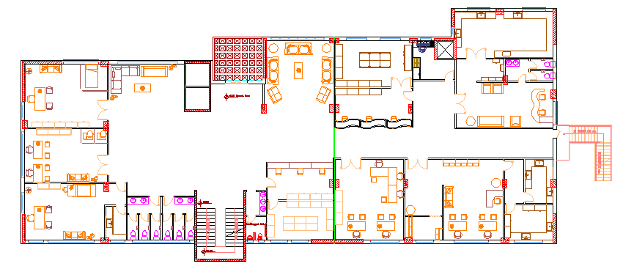
Architectural Design.
Ground floor
811 m²

Slide 9
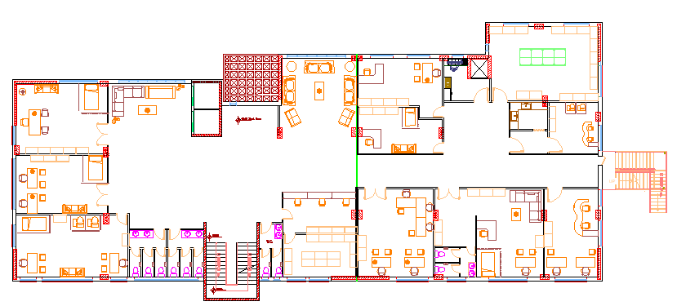
Architectural Design.
First floor

Slide 10
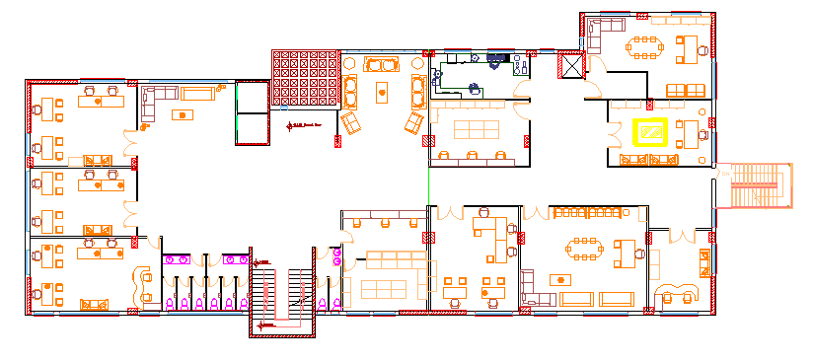
Architectural Design.
Second floor

Slide 11
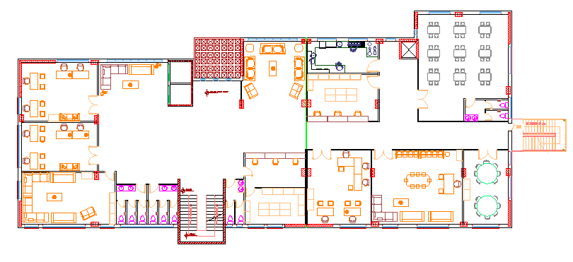
Architectural Design.
Third floor

Slide 12
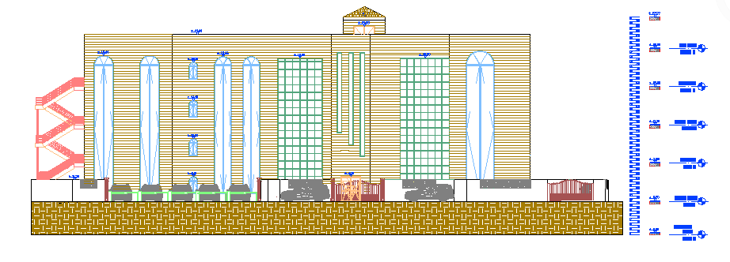
Architectural Design.
Elevations
North Elevation

Slide 13
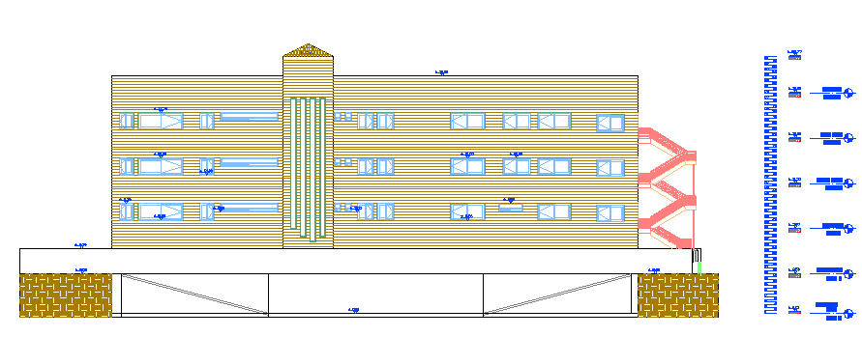
Architectural Design.
Elevations
South Elevation

Slide 14
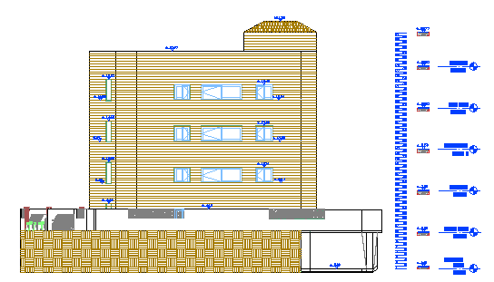
Architectural Design.
  Elevations
West Elevation

Slide 15
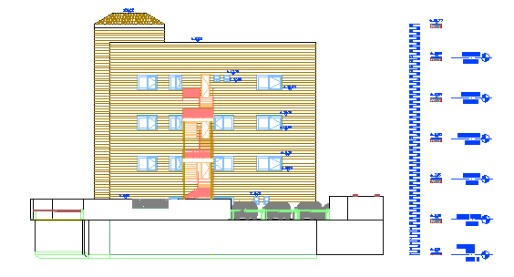
Architectural Design.
Elevations
East Elevation

Slide 16
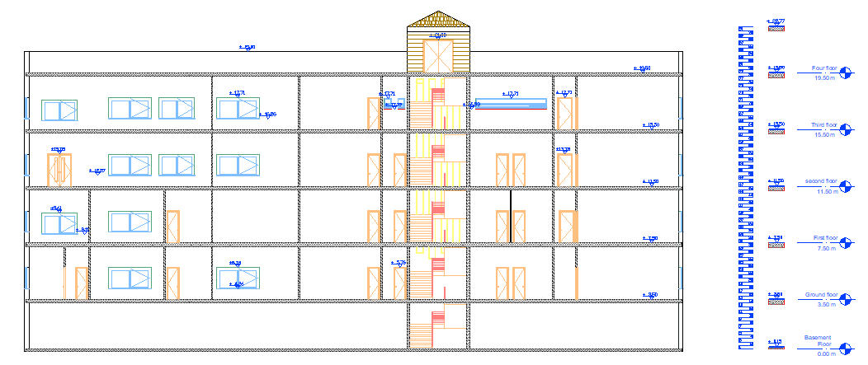
Architectural Design.
Sections
Section A-A

Slide 17
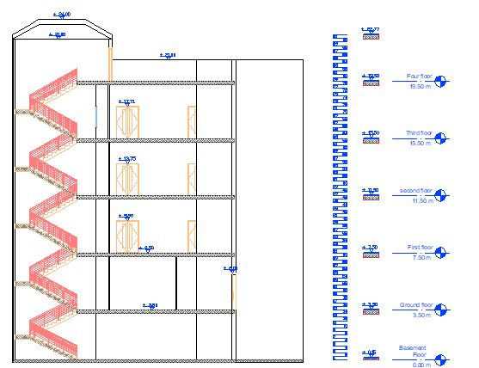
Architectural Design.
Sections
Section B-B

Slide 18
3D Render

Slide 19
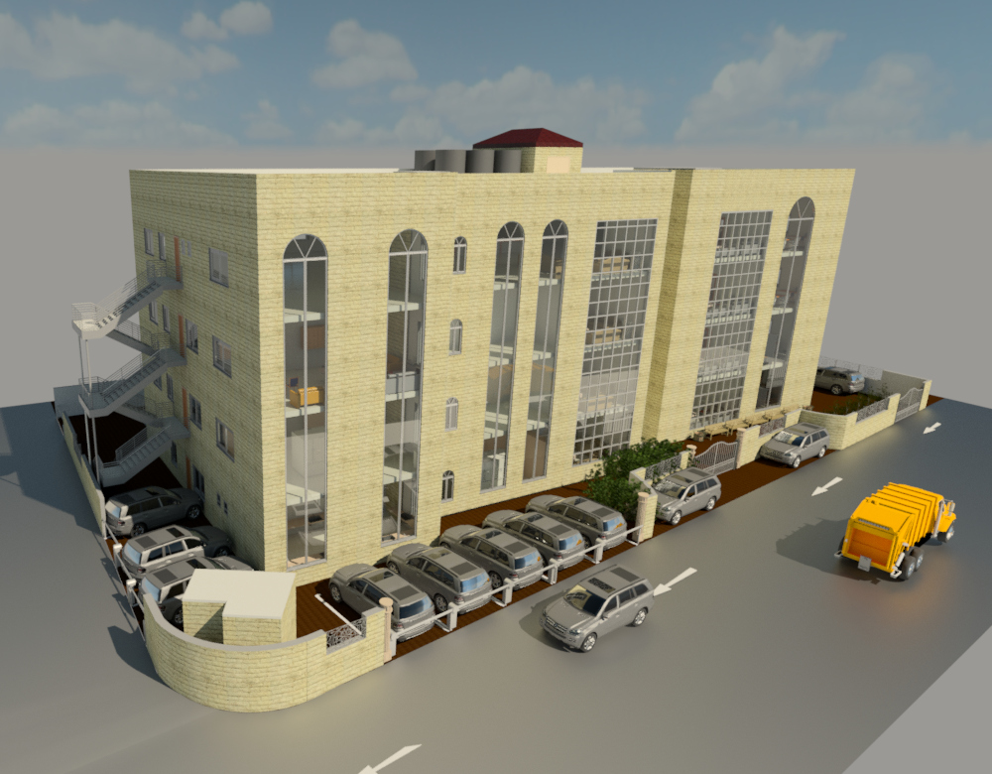
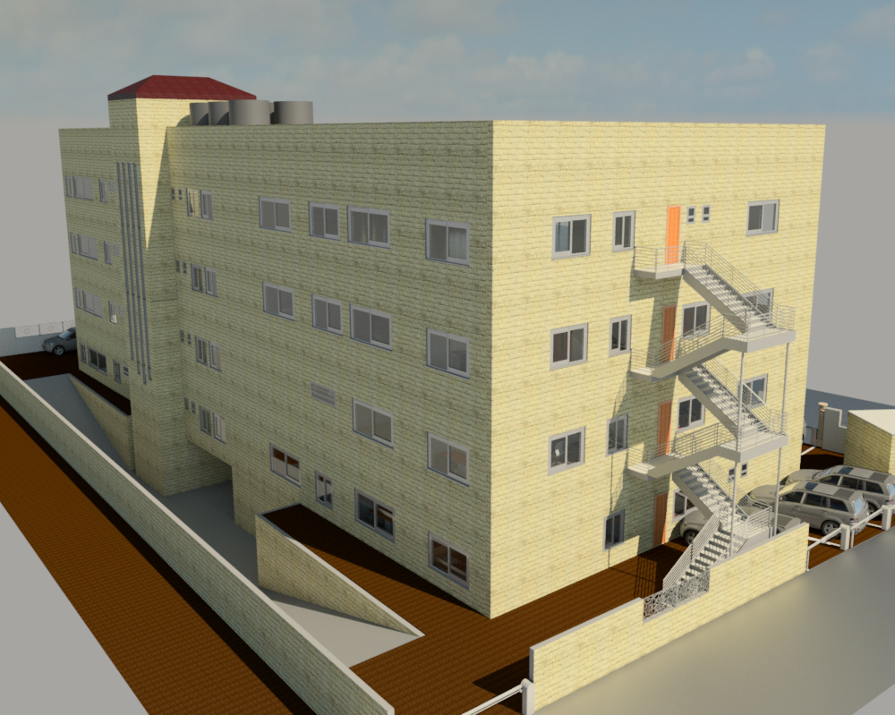
3D Render

Slide 20
4.Environmental design
1-Thermal analysis
2- Acoustical design

Slide 21
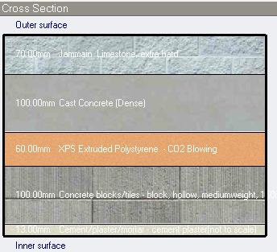
Environmental design
Thermal design
Material used
External wall layers :
7 cm Jammain lime stone
10 cm cast concrete
6 cm XPS Extruded polystyrene
10 cm block
1.3 cm cement plaster
U-value = 0.454 W/m2-k

Slide 22
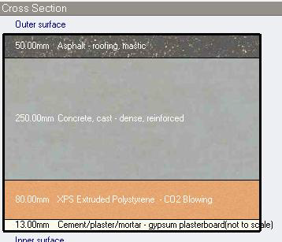
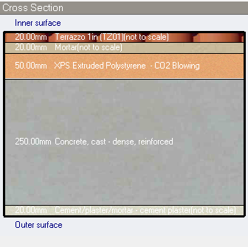
Environmental design
Thermal design
Material used
Flat roof layers :
Internal floor layers:
U-value = 0.372 W/m²-k
U-value = 0.517 W/m²-k

Slide 23
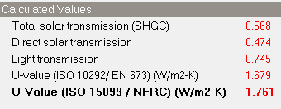
Environmental design
Thermal design
Material used
Glass Prosperities.
Double LoE (e2=0.1) clear glass with 6mm/13 mm Argon gas
U-value = 1.761 W/m2-k

Slide 24
Environmental design
Thermal design
Heating and cooling loads.
Heating design capacity. | 152.5 kW
Cooling design capacity. | 164.02 kW
Site energy

Slide 25
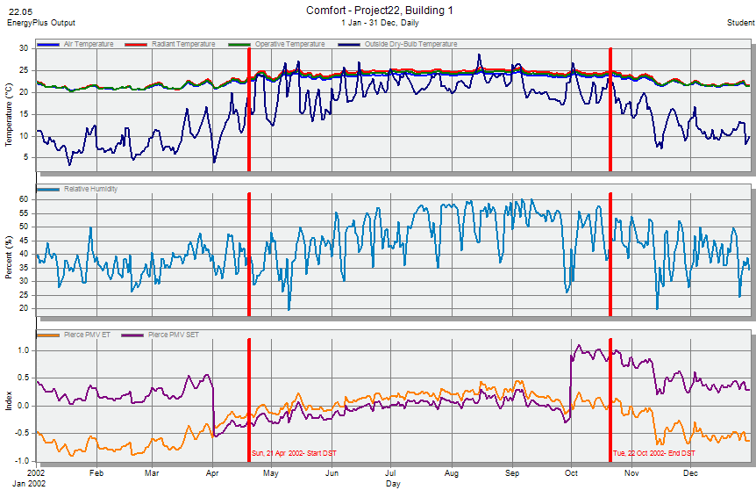
Environmental design
Thermal analysis
Simulation comfort

Slide 26
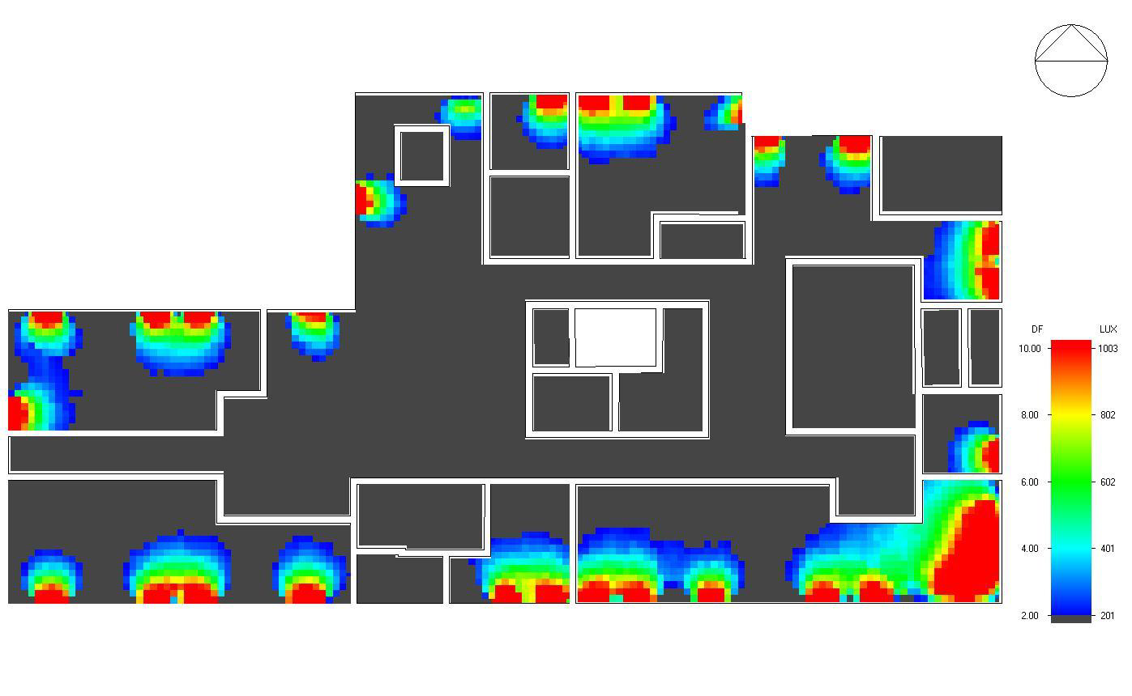
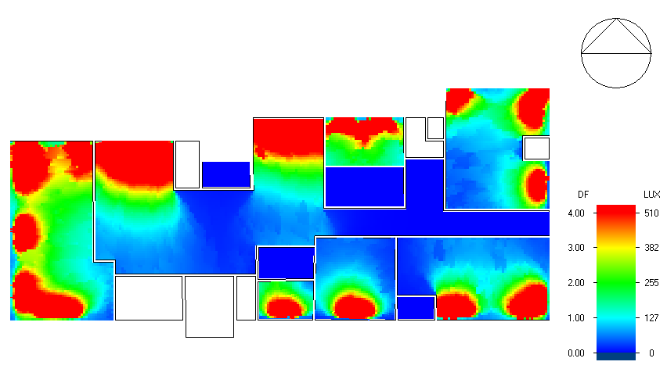
Environmental design
Thermal design
Daylight
Natural daylight analysis.
Room | DF% (After) | DF% (before)
Clinics(G.f) | 3.8 | 2.6
Waiting & circulation area | 2.22 | 0.3
Lab | 2.15 | 3.5
H. school | 3.5 | 2.1
Offices | 4 | 1.6

Slide 27
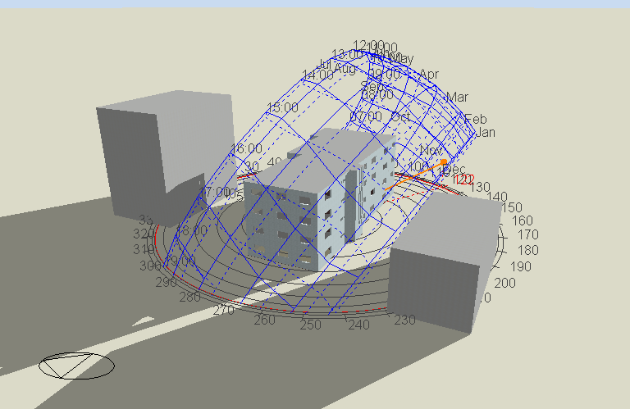
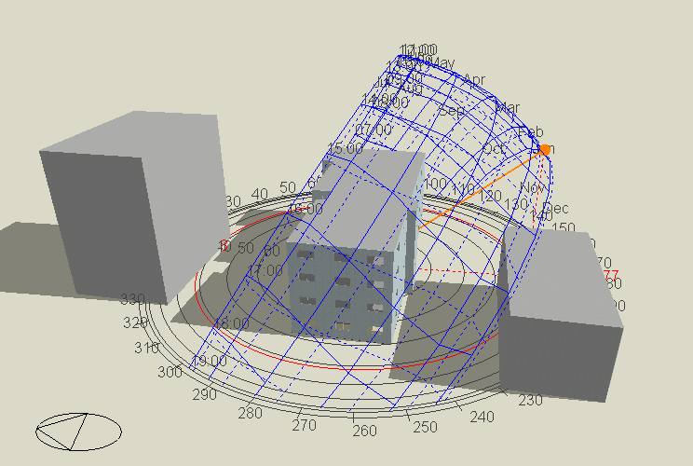
Environmental design
Thermal design
Analysis of shading.
1-Shading in winter (21St/January)
At 8:00 AM. At 12:00 PM.

Slide 28
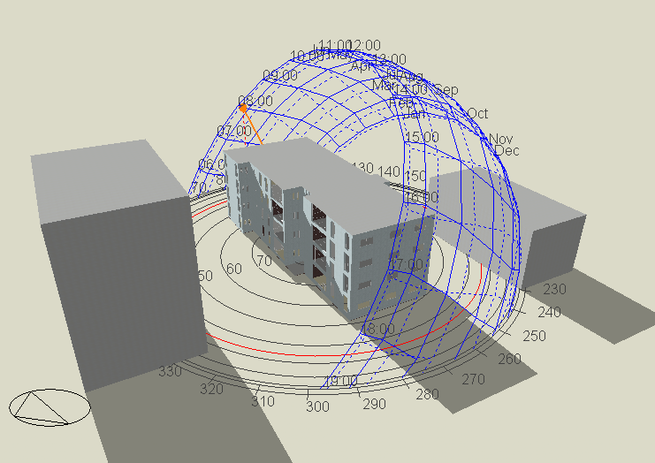
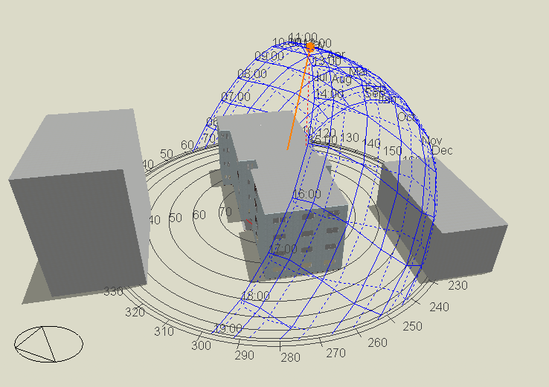
Environmental design
Thermal design
Analysis of shading.
2- Shading in summer (21St/July)
At 8:00 AM. At 12:00 PM.

Slide 29
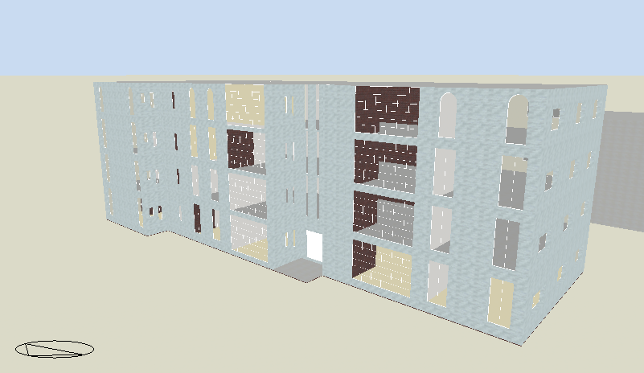
Environmental design
Thermal design
3D model in design builder

Slide 30
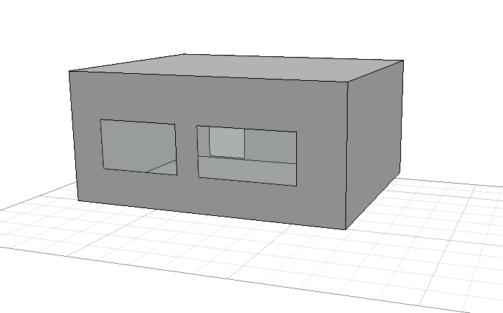
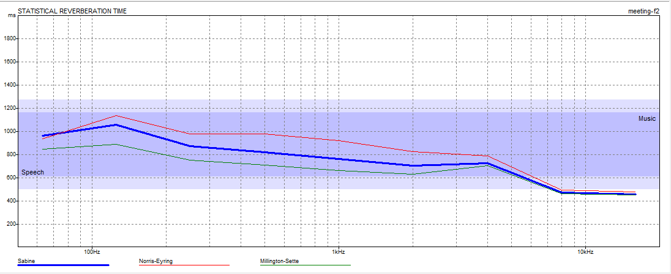
Environmental design
Acoustical design
Reverberation Time (RT60):
Meeting room : The required RT60 (0.6 – 1.0)
FREQ. | TOTAL ABSPT. | SABINE RT60 | NOR-ER RT60 | MIL-SE RT60
63Hz: | 34.796 | 0.96 | 0.93 | 0.85
125Hz: | 30.442 | 1.06 | 1.14 | 0.89
250Hz: | 31.506 | 0.87 | 0.98 | 0.75
500Hz: | 32.648 | 0.82 | 0.98 | 0.71
1kHz: | 34.401 | 0.76 | 0.92 | 0.66
2kHz: | 33.210 | 0.70 | 0.83 | 0.63
4kHz: | 19.391 | 0.73 | 0.79 | 0.71
8kHz: | 18.386 | 0.47 | 0.49 | 0.46
16kHz: | 16.698 | 0.46 | 0.48 | 0.45

Slide 31
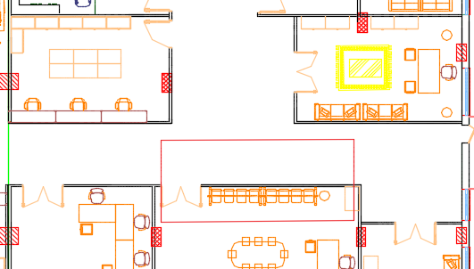
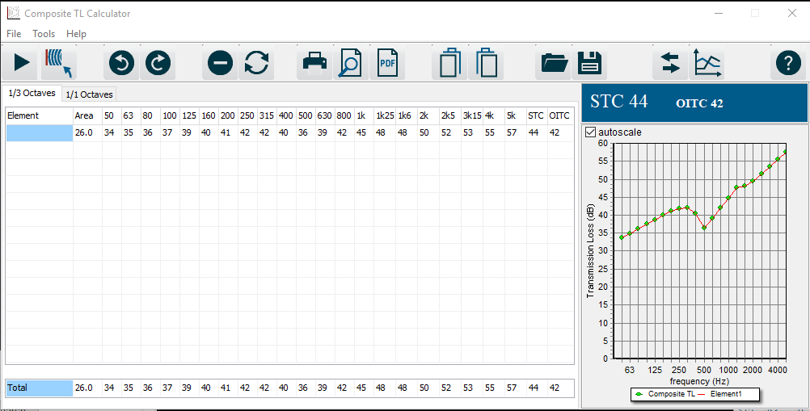
Environmental design
Acoustical design
Sound Transmission Class (STC):
1- meeting room adjacent to corridor : The required STC for the wall is 45dB according to standard and the designed value by using Insul software is 44dB.

Slide 32
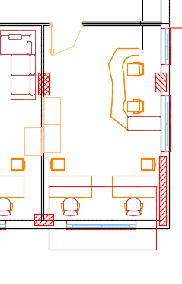
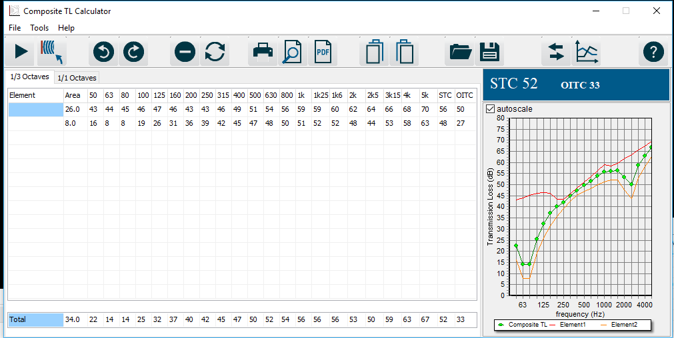
Environmental design
Acoustical design
Sound Transmission Class (STC):
2- Office room with outside.
The required STC for the wall is 50dB according to standard and the designed value by using Insul software is 52dB.

Slide 33
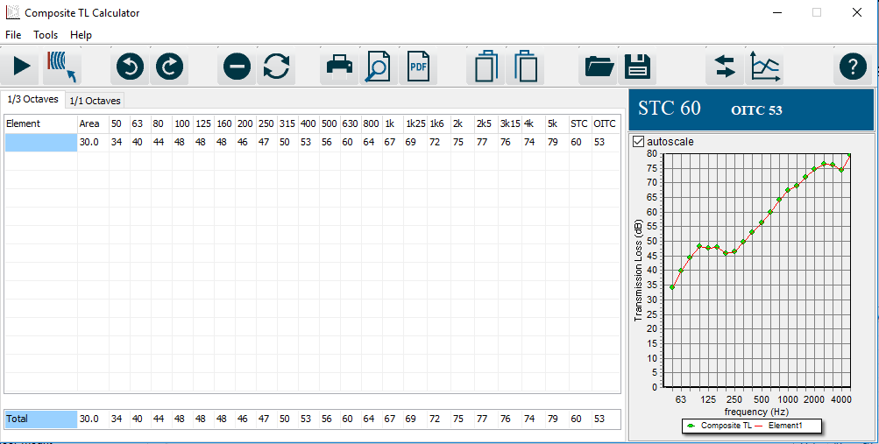
Environmental design
Acoustical design
  Impact Insulation Class(IIC):
Ceiling :the designed value by using Insul software is 53dB.

Slide 34
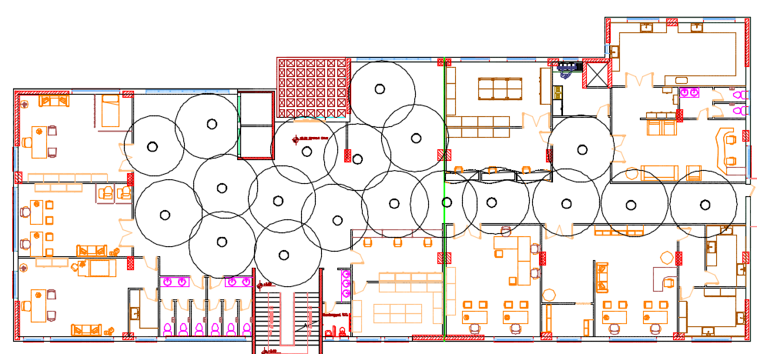
Environmental design
Acoustical design
Loud Speakers:
1- Corridor & Waiting area: We used BT720-4-T47 In-ceiling speakers with 130 coverage angle.

Slide 35
Structural design
The directorate building consisting of 5 floors are made completely of reinforced concrete.
2 blocks.
The directorate has one on ground water tank
Notes:
You can safely remove this slide. This slide design was provided by SlideModel.com – You can download more templates, shapes and elements for PowerPoint from http://slidemodel.com/

Slide 36
Structural design
Codes and Standards:
1
2
3
4
ACI -318-11 for reinforce
concrete structural design.
ACI-350.3-06 for Seismic Design of Liquid Containing Concrete Structures and Commentary
UBC -97 for earthquake design.
ASCE 7 2010 for load combinations
ETABS , SAP , Prokon and hand calculations were used .

Slide 37
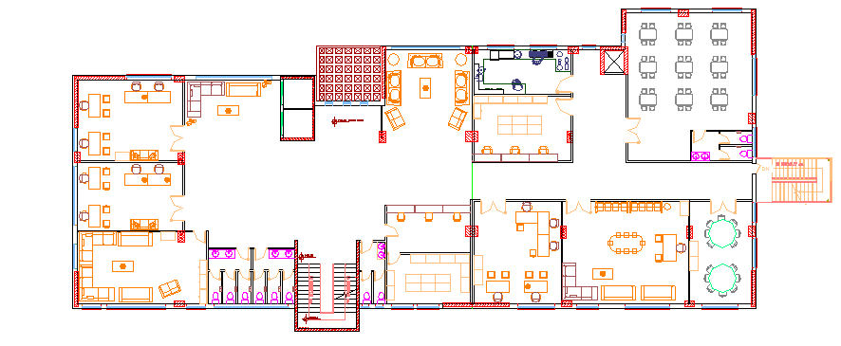
Structural design.
Notes:
You can safely remove this slide. This slide design was provided by SlideModel.com – You can download more templates, shapes and elements for PowerPoint from http://slidemodel.com

Slide 38
Structural design
Design data
Concrete strength,
f’_{c}= 28 Mpa.
1
Steel yield strength F_{y}= 420 Mpa.
2
Bearing capacity for soil
= 250 kN/m²
3

Slide 39
Structural design
Vertical loads :
Live load
SID
( kN/m² )
( kN/m² )
5 kN/m²
3 kN/m²

Slide 40
Structural design
The seismic zone factor. Z=0.2.
Seismic design data :
The soil profile is type SD
The acceleration seismic coefficient Ca= 0.28
Nablus
The velocity seismic coefficient Cv=0.4.
The Seismic importance factor is I=1.5
The structural design type is intermediate, R=5.5

Slide 41
Structural design
Sections dimensions
Structural elements | Dimension
Solid slab | 25 cm thickness
Columns | (40x40) , (40x60) ,(40x80)
Beams | (40x60) , (40x50)
Mat foundation of 1m depth

Slide 42
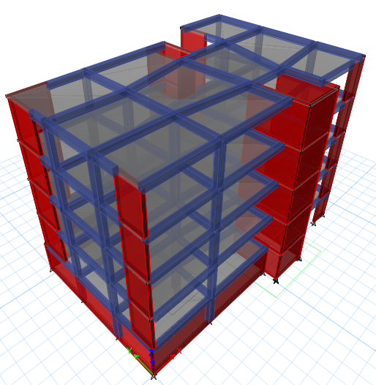
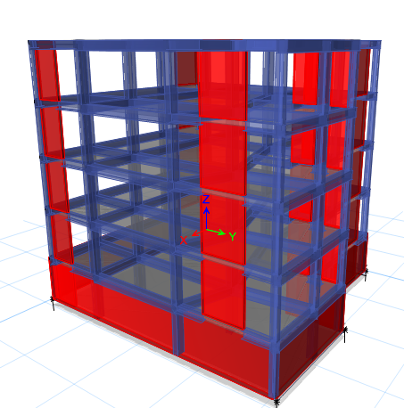
Modeling
Block 2
Block 1

Slide 43
Structural design
Verification of the model
Compatibility check
1
Equilibrium check
2
Internal force check
3

Slide 44
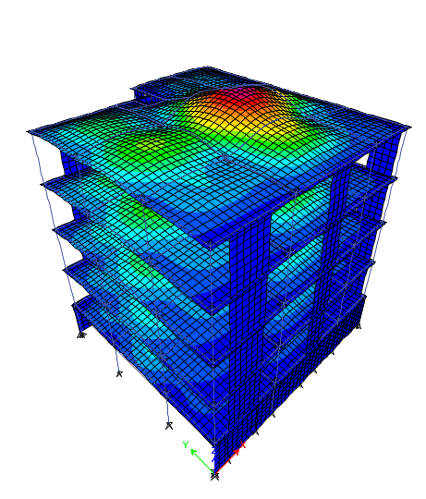
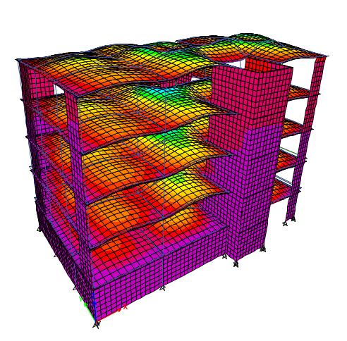
Verification of the model
Block 2
Block 1

Slide 45
Structural design
Verification of the model
Equilibrium check
 | Dead load ( KN ) |  | Live load ( KN ) |  | SID ( KN )
 | Block 1 | Block 2 | Block 1 | Block 2 | Block 1 | Block 2
Manual calculations | 25594 | 22399.9 | 10036 | 9132 | 14771.7 | 5479
ETABs | 24943 | 22146 | 10022 | 8988.8 | 14130 | 5393
% Difference | 2.6 % | 1.14% | 0.14 % | 1.59% | 4.39% | 1.59%

Slide 46
Structural design
Verification of the model
Internal force check
 | Column ( KN ) | Main beam( KN.m ) | Span of slab ( KN.m )
Manual calculations | 4088 | 57.8 | 172.8
ETABs | 3731 | 56.5 | 147.8
% Difference | 9.5% | 5.7% | 16.9%

Slide 47
Dynamic design checks of the model
Drift check
Block 1 →17.4mm < 100mm
Block 2 →22.2mm < 100mm
Period check
Block 1 →0.63 Sec < 0.69Sec
Block 2 → 0.7 Sec → OK
Deflection check
Block 1 → 6.3mm <33mm
Block 2 → 14 mm < 33.6 mm
Base shear check
Block 1 →Y- 7808.8 KN > 7349.6 kN
X- 7409.8 KN >7349.6 kN
Block 2 → Y- 6227.4 KN > 5657 KN
X- 8522.5 KN >5657 kN
Modal participating mass ratio check
Block 1 → 0.95 > 0.90
Block 2 → 0.96 > 0.90

Slide 48
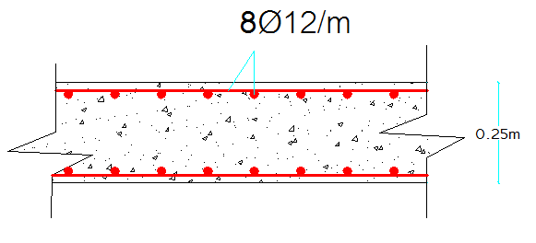
Slab Reinforcement section

Slide 49
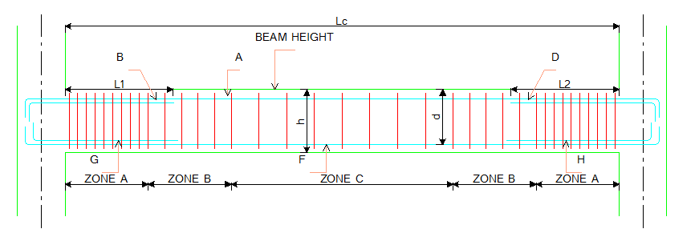
Beam Reinforcement section

Slide 50
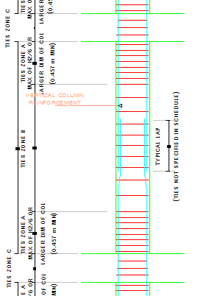
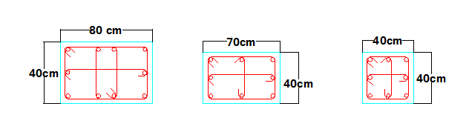
Column Reinforcement section

Slide 51
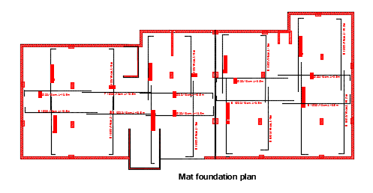
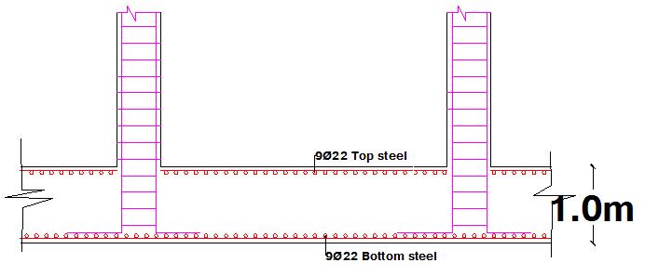
Footing Reinforcement section

Slide 52
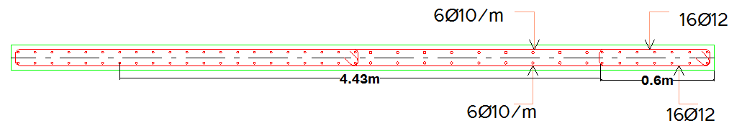
Shear wall reinforcement

Slide 53
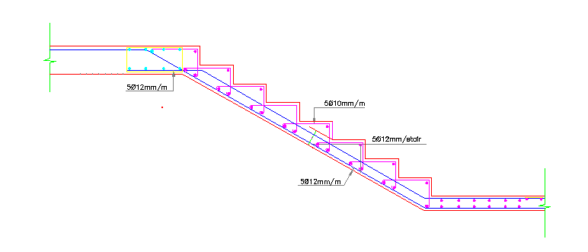
Stairs Reinforcement

Slide 54


Water tank Reinforcement
Vertical section

Slide 55


Retaining wall & Basement wall sections

Slide 56


Retaining wall & Basement wall Reinforcement
Basement wall
Retaining wall

Slide 57
7.Mechanical design.
1-Water supply system 3-HVAC System
2-Drainage System 4-Safety Design

Slide 58


Mechanical design
Water supply distribution:
Diameter | Pipe
2.5 inch | Vertical
2 inch | Horizontal
1 inch | Branch

Slide 59

Mechanical design
Drainage system:
Diameter | DFu | Fixture
4" | 4 | W.C
2" | 1 | Lavatory
2" | 2 | Kitchen sink

Slide 60


Mechanical design
Drainage system:

Slide 61

Mechanical design
HVAC Design:
VRF Design:
VRF system was used for all buildings rooms
Cooling load for building = 164 kW
Outdoor unit was selected from TOSHIBA Company

Slide 62

Mechanical design
HVAC Design:
.
 | Cooling load | Ú(G.F) | Ú(fan coil unit) | #fan coil | Ú(diffuser)
G.F | 43.13KW | 3.314m³/s | 1.415m³/s | 3 | 0.188 m³/s

Slide 63

Mechanical design
HVAC Design:
Duct sizing for longest path (A,B,N,C,D,E,F,G) &branches.
Ducts | ύ | V | Diameter | ΔP/El
A-B | 1.5 | 5 | 0.6 | 0.436
B-N | 1.312 | 4.87 | 0.587 | 0.436
N-C | 0.936 | 4.45 | 0.52 | 0.436
C-D | 0.748 | 4.2 | 0.47 | 0.436
D-E | 0.56 | 3.9 | 0.43 | 0.436
E-F | 0.372 | 3.5 | 0.37 | 0.436
F-G | 0.188 | 2.9 | 0.28 | 0.436

Slide 64


Mechanical design
Safety Design :
1-Warning signs.
.

Slide 65



Mechanical design
Safety Design :
2-Extinguisher & Hose station.
3-Automatic sprinkler system
.

Slide 66
Electrical design
Recommended luminance for spaces::
Function | Recommended lux
Psychiatrics | 500
Corridors | 150
Toilets | 100 - 200
Stores | 50
Meeting room | 500
Children room | 200
Office | 500
Dispensary | 300
Dentistry (chair) | 10000 - 5000

Slide 67

Electrical design
Artificial lighting
General medicine clinic
Surface | Finish material | Reflection factor
Ceiling | Beech, steamed | 80%
Wall | Sandstone tiles | 70%
Floor | Tiles beige | 30%
( kN/m² )
E (lux) = 538 > 500
17.7 < 19 UGR=

Slide 68

Electrical design
General medicine clinic selected luminaires.
( kN/m² )

Slide 69

Electrical design
Artificial lighting
Cafeteria
E (lux) = 351 > 200
19.9 < 22 UGR=
( km² )

Slide 70


Electrical design
Cafeteria selected luminaires.
( km² )

Slide 71

Electrical design
Lighting arrangement
( km² )

Slide 72

Electrical design
Sockets arrangement
( km² )

Slide 73


Electrical design
Circuit breaker branches
( km² )

Slide 74
Quantity Survey:
Stage | Cost
Excavation work & backfilling& disposing | 1,068435 NIS
Structural work | 1,919,118 NIS
Finishing | 2,173,642NIS
Mechanical work | 883,883 NIS
Electrical work | 35,526 NIS
Total project cost | 6,080,538 NIS
Unit cost | 1,470 NIS/m2

Slide 75
The end
Thank you

