Slide 1


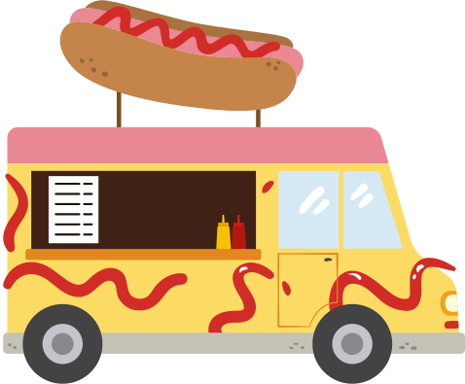

Food Trucks
presented by:
Marah hanini & Leema Abu-Aladel
supervised by :
Dr.Suleiman Abu kharmeh, Dr.Emad Natsheh

Slide 2
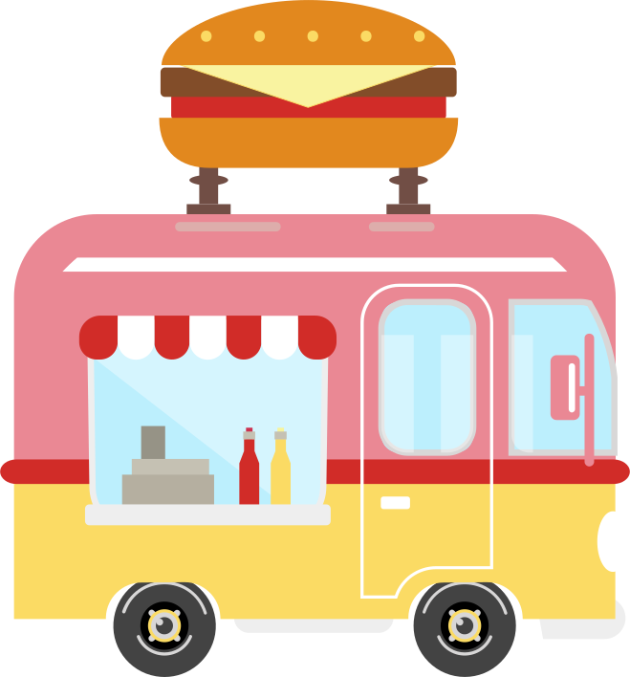
Table of Contents
01
Introduction
02
why FoodTrucks ?
03
used Tools
Features
04
05
Future Work

Slide 3


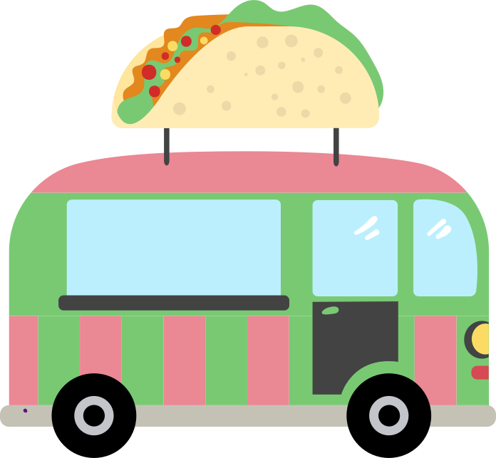
01
Introduction
How the idea come
to our mind ??

Slide 4
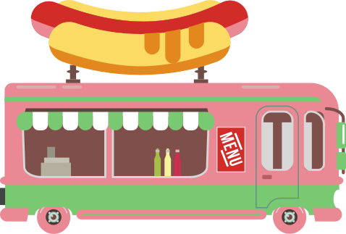
02
why food trucks?

Slide 5

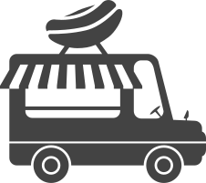
why food trucks?
  🇵🇸 First of its kind in Palestine for food truck discovery & management
  🔗 Connects customers, truck owners, and event
  🍔 Online menu browsing & ordering
  📍 Real-time truck discovery
  🍔 Online menu browsing & ordering
  🤖 AI-powered event planning assistant
  💳 Secure Stripe payment integration
  🎉 Private event booking support
  🧑‍🍳 Supports small food entrepreneurs
Food Trucks

Slide 6



03
Tools

Slide 7








Tools

Slide 8
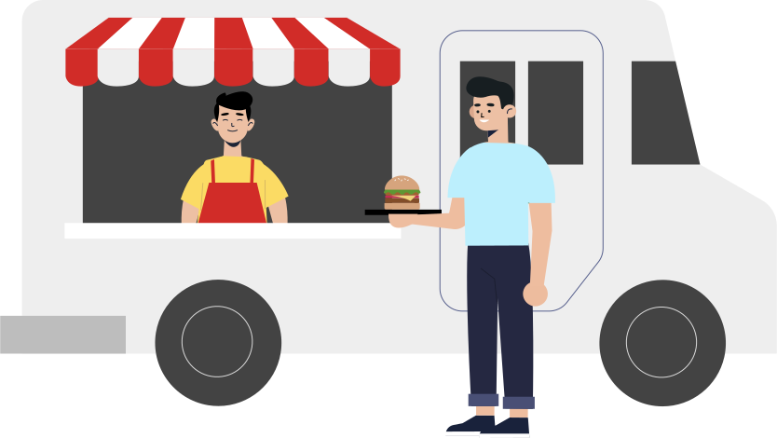
04
FEATURES

Slide 9




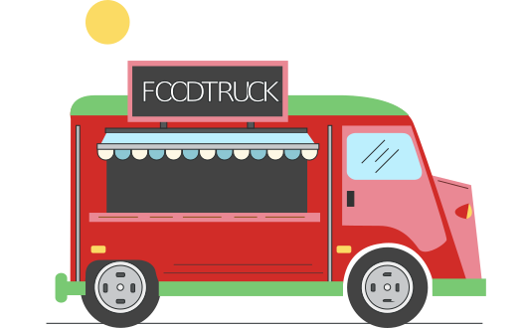
Login and Signup

Slide 10

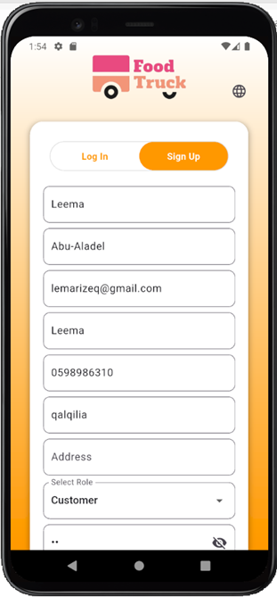
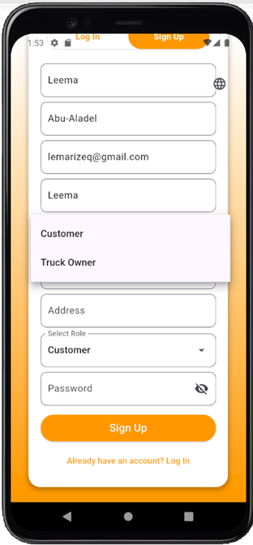
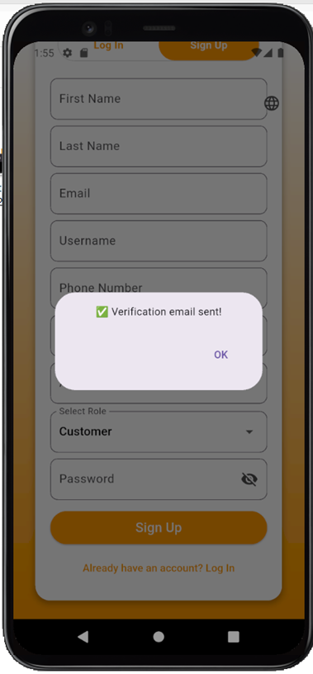
Sign Up Screen

Slide 11
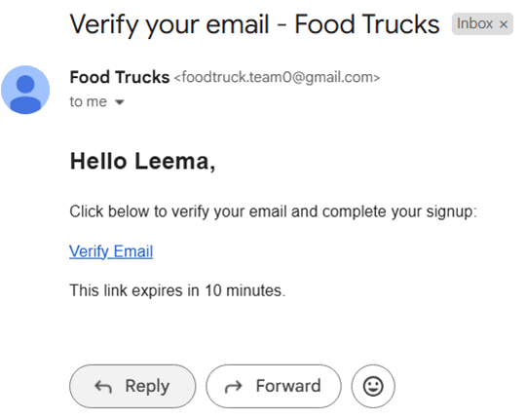
Email Verification Message (Gmail)

Slide 12
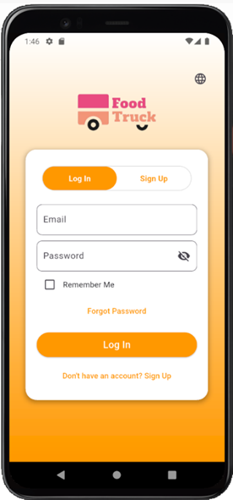
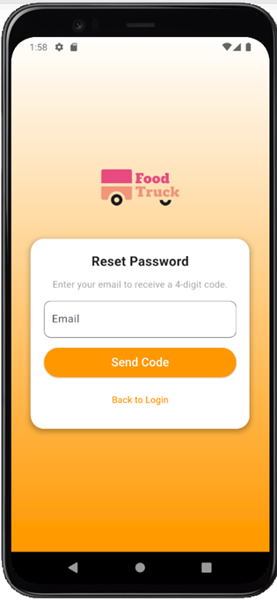
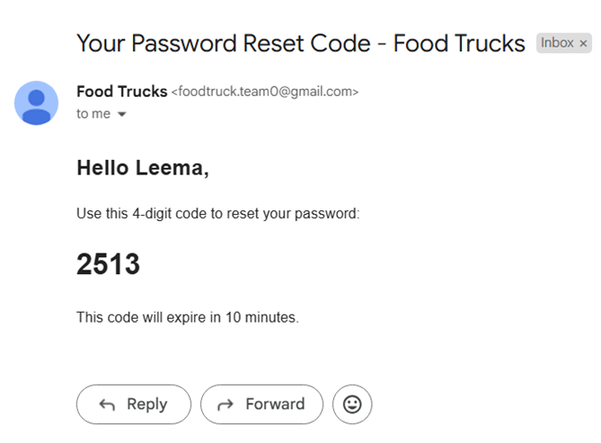
Log In Screen
Reset Password

Slide 13
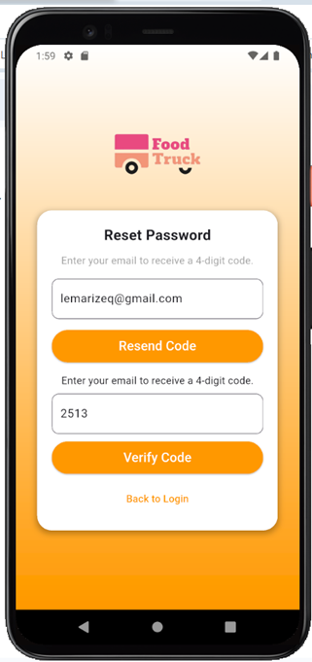
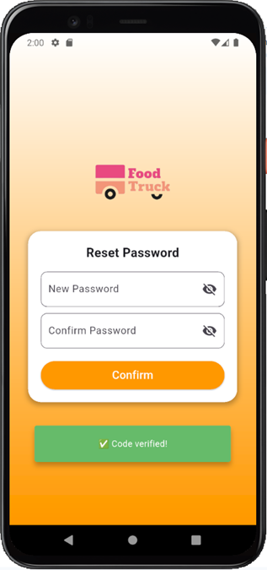
Entering the Verification Code
Setting New Password

Slide 14
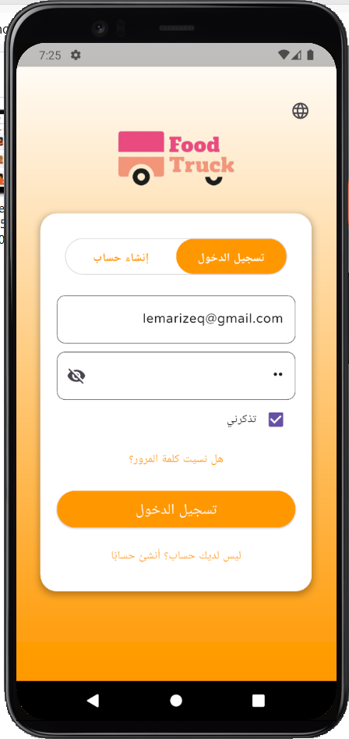
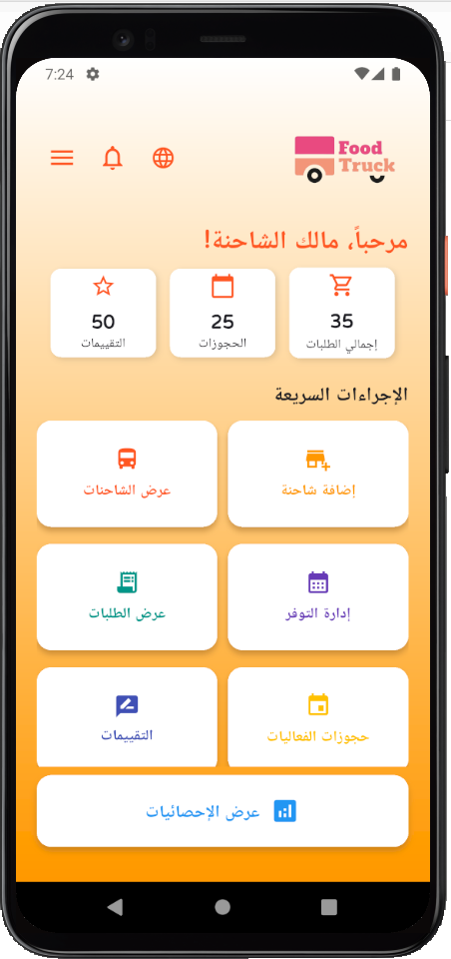
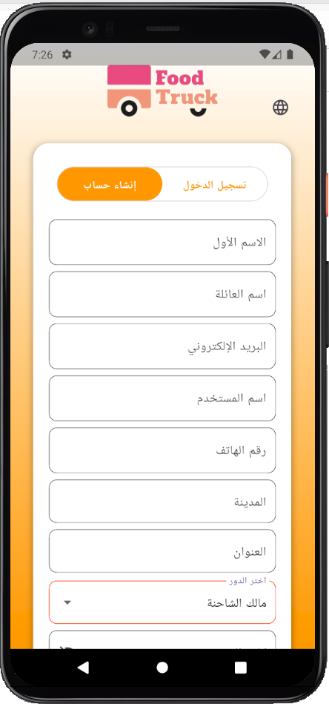
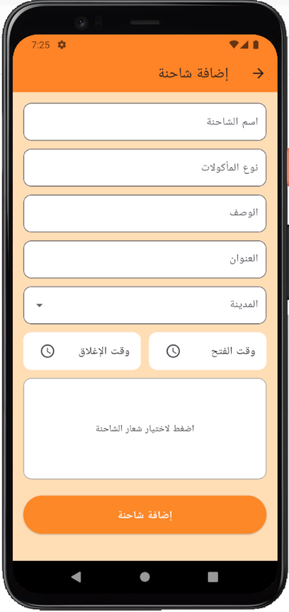
Multi-Language
Support

Slide 15

customer screens

Slide 16
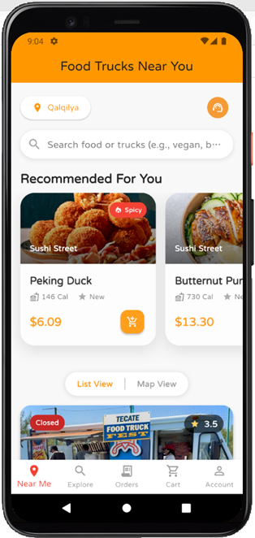
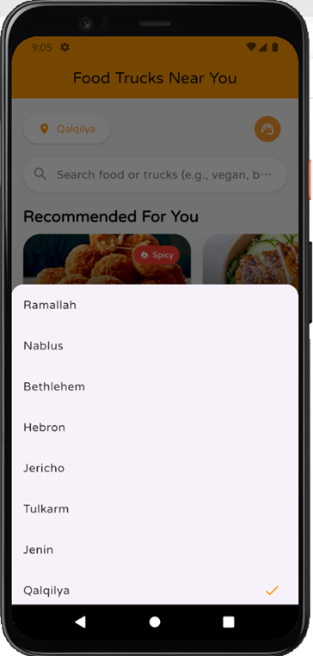
Near Me Page

Slide 17
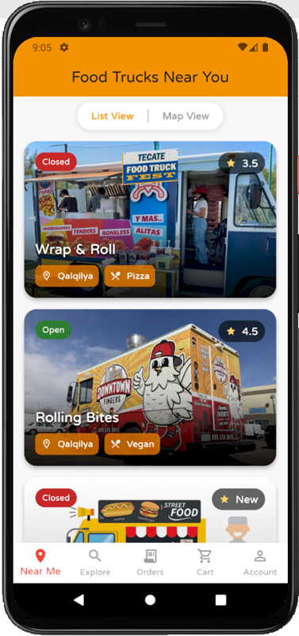
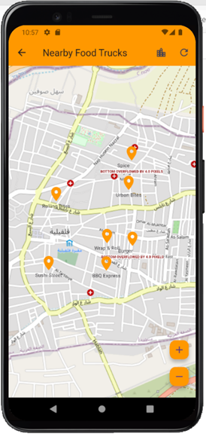
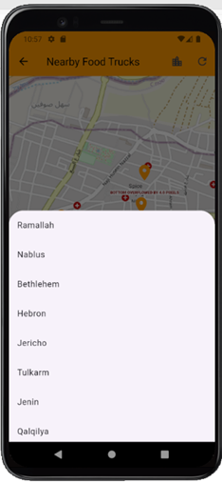
List View
Map View

Slide 18
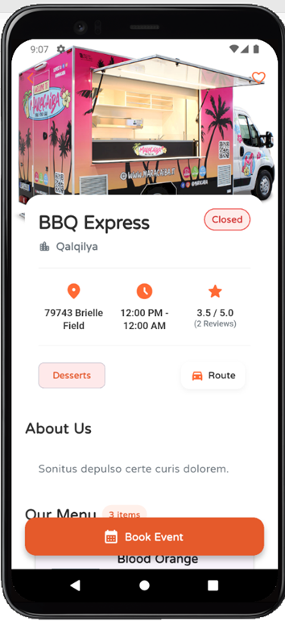
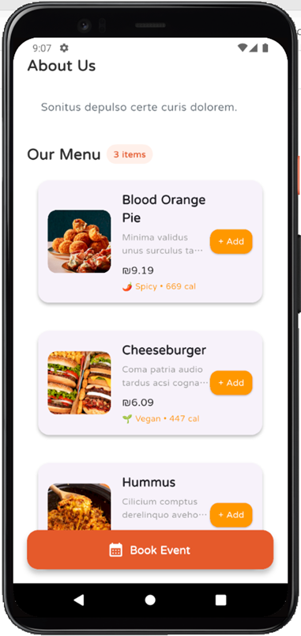
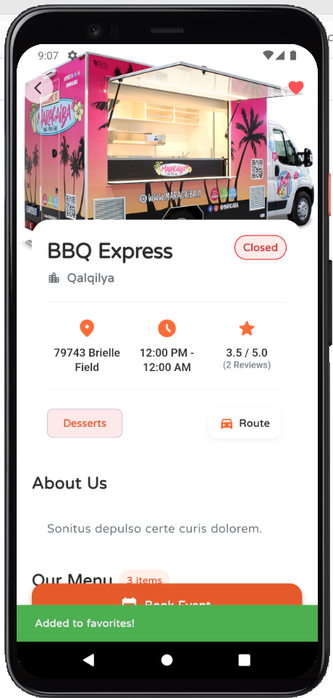
Truck Profile

Slide 19
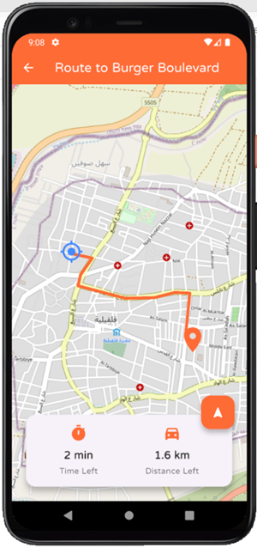
Route to the truck

Slide 20
AI Technologies Used in the Project
1. Large Language Model (LLM):
Used to understand user input, generate natural responses, and handle flexible queries using Google Gemini.
2. Retrieval-Augmented Generation (RAG):
Combines real-time backend data (trucks, menus, orders) with LLM to produce personalized responses.
3. Natural Language Processing (NLP):
Helps with keyword extraction, intent classification, and interpreting natural user language in search and chat.

Slide 21
AI Technologies Used in the Project
4. Sentiment Analysis:
Applied to user reviews to detect positive, neutral, or negative feedback. This helps in generating smarter recommendations and tracking satisfaction.
5. Personalized Recommendation AI:
Uses past orders and review sentiment to suggest menu items that match user preferences and behavior.

Slide 22
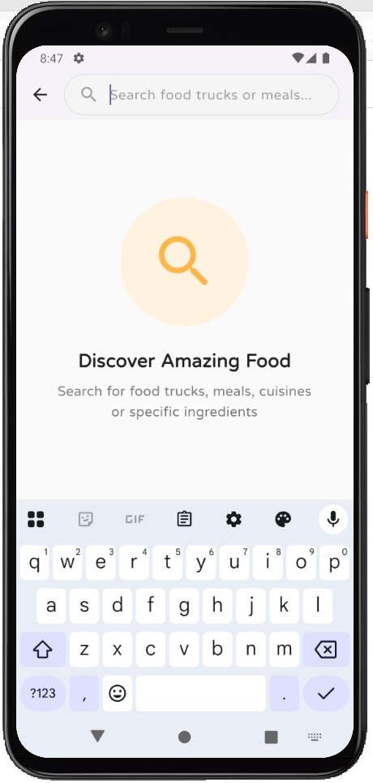
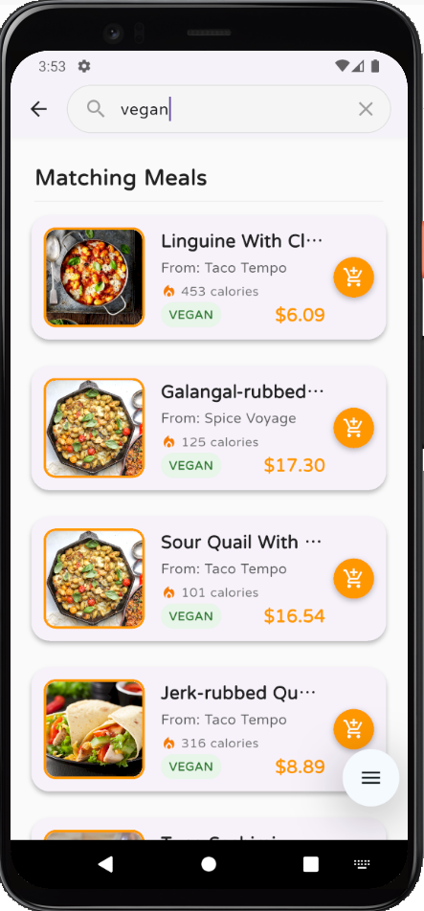
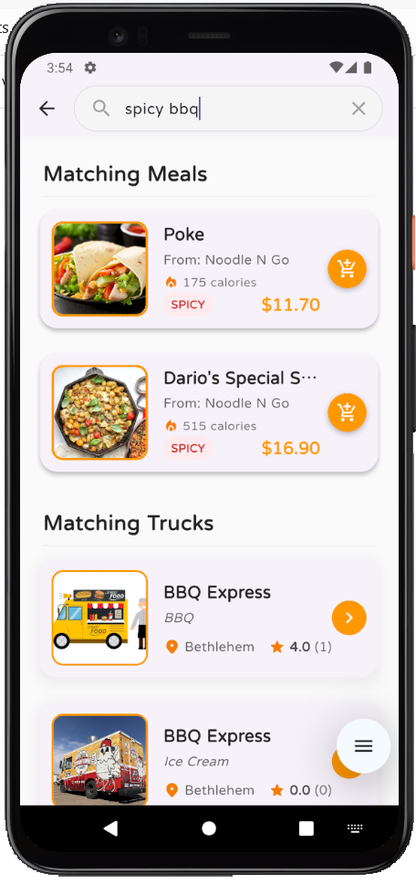
AI-Powered Search Bar

Slide 23
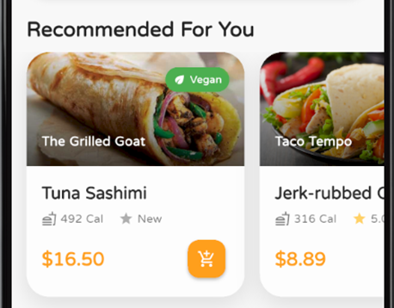
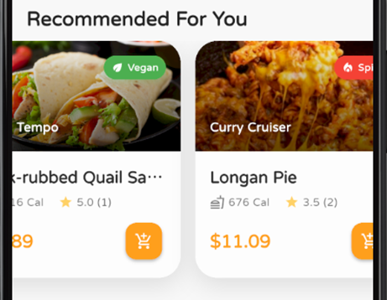
AI-Powered Recommendation system

Slide 24
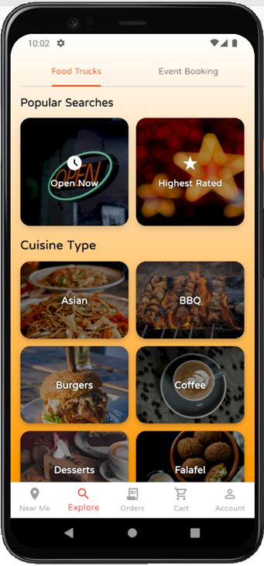
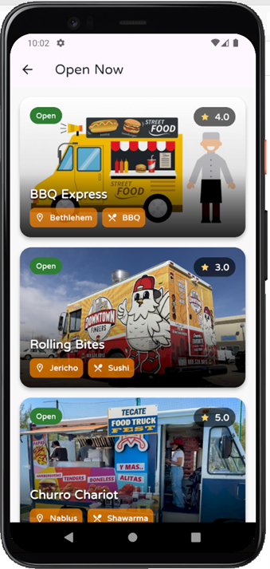
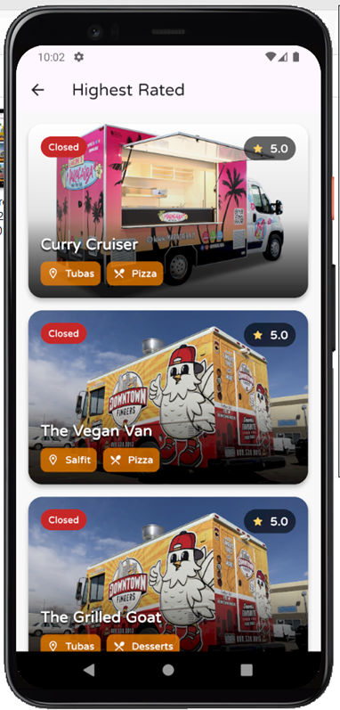
Explore page

Slide 25
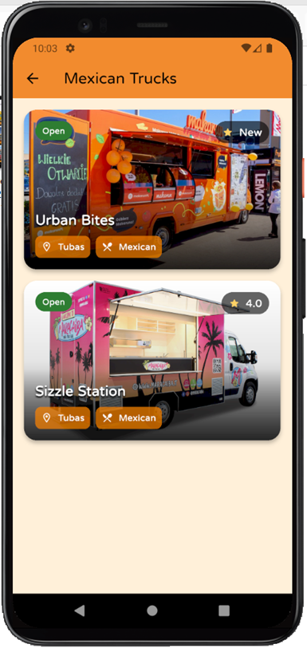
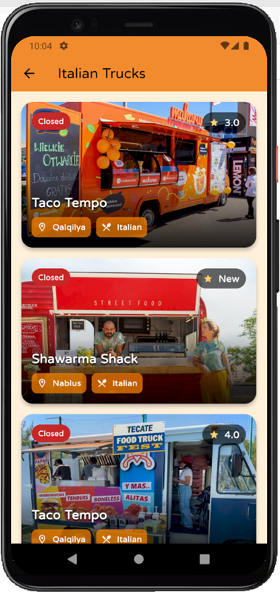
Trucks classified by its cuisine Type

Slide 26
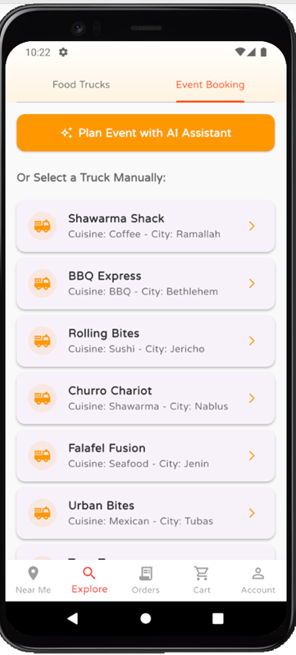
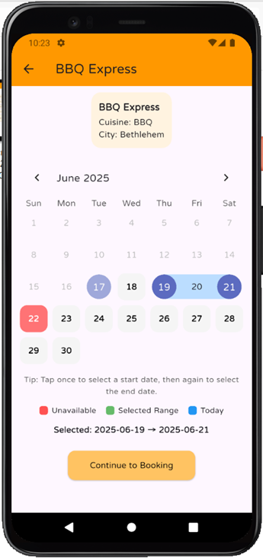
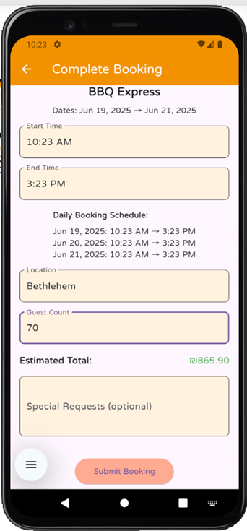
Event Booking

Slide 27
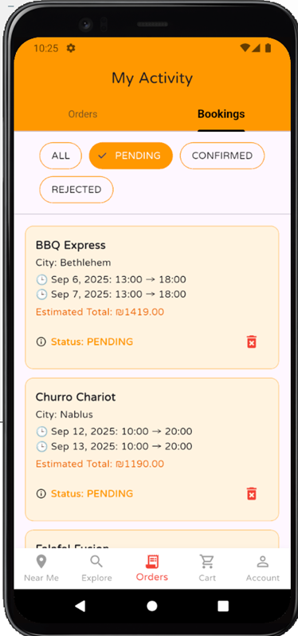
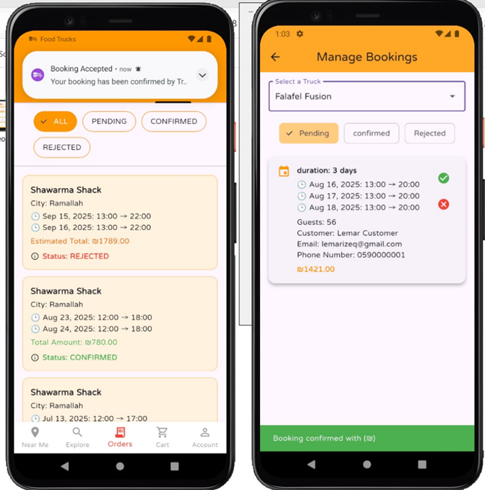
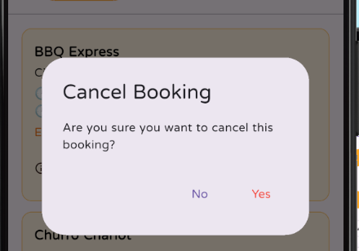
My Activity ( bookings )

Slide 28
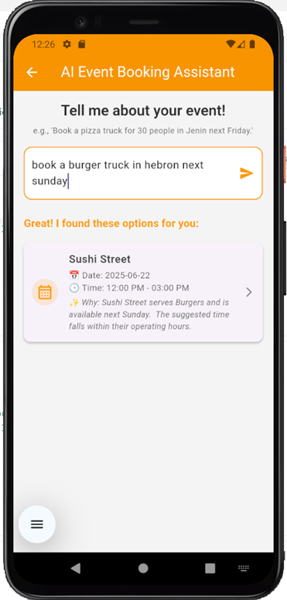
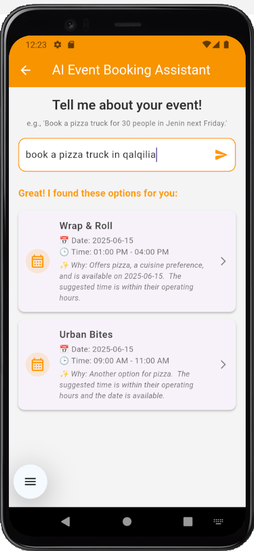
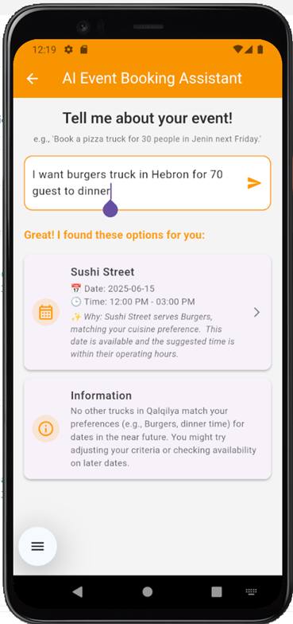
AI-powered booking assistant

Slide 29
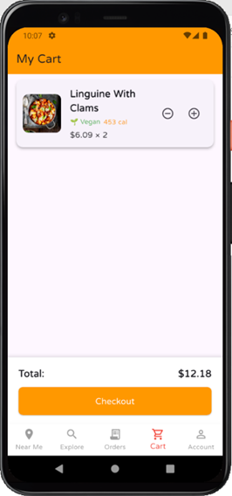
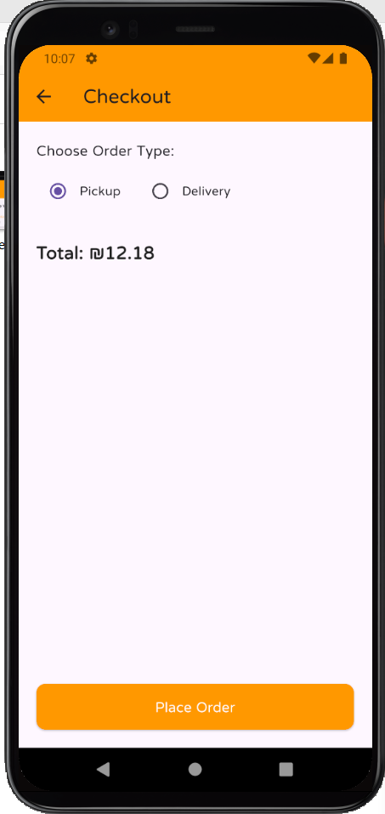

Cart page

Slide 30


Checkout page

Slide 31


Order payment &Confirmation

Slide 32


Order Activity Screen

Slide 33


Order Details Screen

Slide 34



Order status notification

Slide 35


Order Completion

Slide 36




Rate Trucks & items

Slide 37



Chatbot Assistant

Slide 38



Truck Owner
screens

Slide 39


Truck Owner account
&Report Problem
Truck Owner Dashboard

Slide 40



profile page & Report Problem

Slide 41



Add Truck

Slide 42



My Trucks view & Edit Truck

Slide 43


Set Truck Capcity

Slide 44



Menu CRUD

Slide 45


Manage Availability Calendar

Slide 46




Manage Bookings

Slide 47

Event reminder notification

Slide 48




Order Summary

Slide 49



AI-Powered Truck reviews

Slide 50


Truck owner statistics

Slide 51



Truck owner statistics

Slide 52


Admin Panel

Slide 53


Admin Dashboard Overview

Slide 54

User Management Screen

Slide 55

Truck Management Screen

Slide 56

Booking Calendar (month view )

Slide 57

Booking Calendar(day view )

Slide 58

Customer Reviews

Slide 59

Truck reviews

Slide 60


Admin report notification

Slide 61

Reports & problems

Slide 62

report status drop down

Slide 63

Data report screen ( orders and event booking statistics by period )

Slide 64

Data report (event booking statistics by truck )

Slide 65

Data report (average customer Ratings per trucks)

Slide 66

Data report (report submitted per user )

Slide 67

Excel sheet report example

Slide 68

Future Work
  Add dedicated delivery role within the system and enable real-time map tracking for customer orders..
  In-app chat for event coordination between customers and truck owners.
  Loyalty & Rewards Program.
  Improve capacity for owner

Slide 69
Thank You
Any Questions ?

