Slide 1
Drawbot
Hardware Graduation Project

Slide 2
Outlines
Introduction.
Hardware.
Software.
Problems.
Future work

Slide 3
Introduction
What is Drawbot ?
Simply it’s a 2D CNC robot that can draws any thing.
Why Drawbot (a robot for drawing) ?
Advertising, like stores and adv. companies .
Events.

Slide 4
How it works ?
Image
G-Code
GRBL Sender
Controller
Drawbot
Motors

Slide 5
Hardware

Slide 6
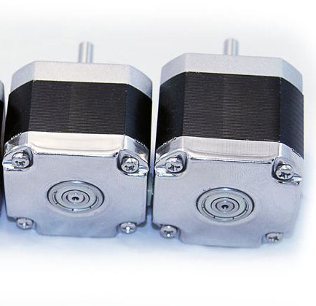
Hardware parts
Stepper motors (X & Y axes)
2x NEMA 17 with 50N.cm for Y-axis. (approx. 2A).
1x NEMA 17 with 30N.cm for X-axis. (approx. 1.3 A)

Slide 7
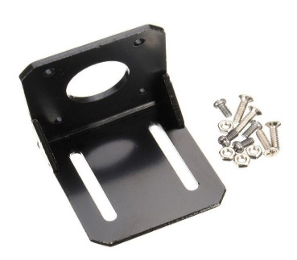
Hardware parts
Nema 17 mounting L Bracket for stepper motor.
Quantity : 2.

Slide 8
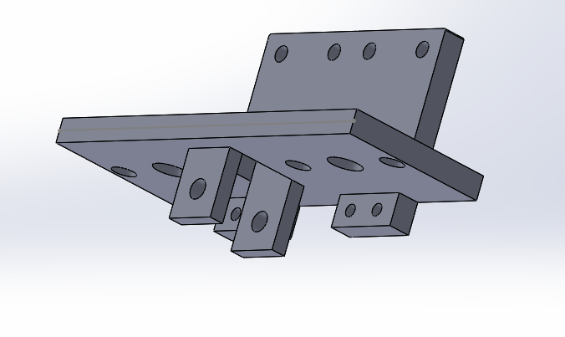
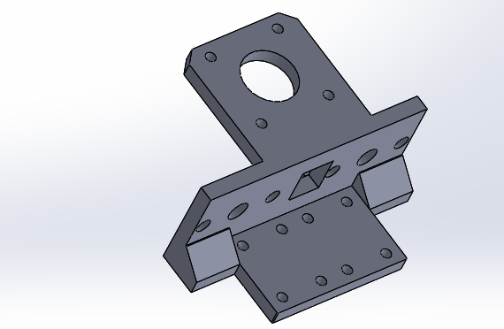
Hardware parts
3D printed module for x-axis

Slide 9
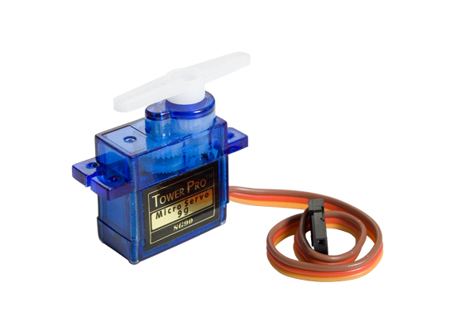
Hardware parts
Servo motor (Z axis)

Slide 10
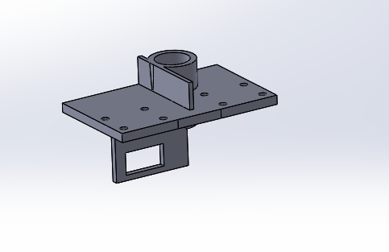
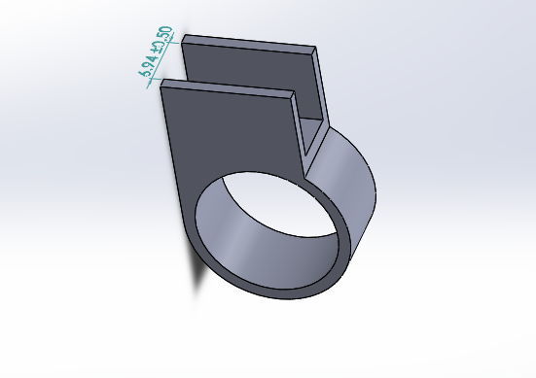
Hardware parts
3D printed module for servo 3D printed module for pin

Slide 11
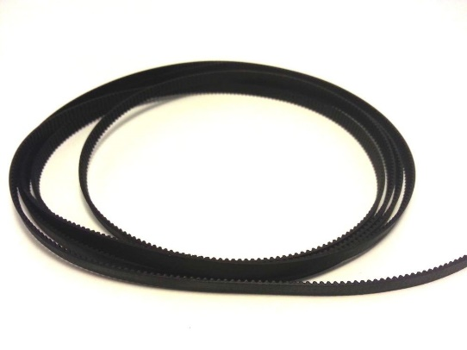
Hardware parts
GT2-6mm open timing belt ,6mm width
Quantity : 3 m.

Slide 12
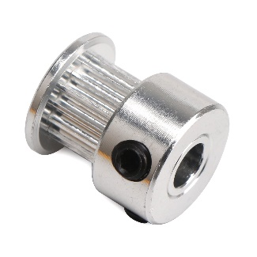
Hardware parts
GT2 Timing Pulley 16 teeth Bore 5mm
Quantity : 6.

Slide 13
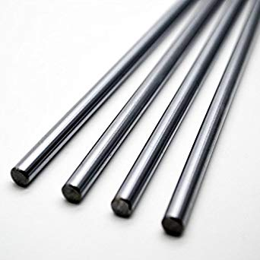
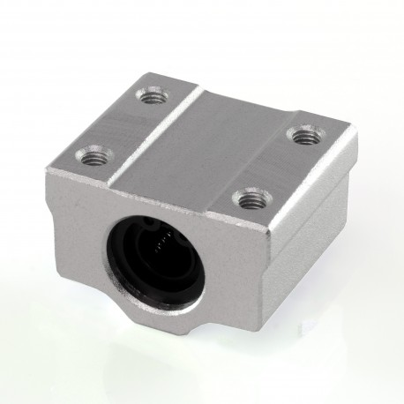
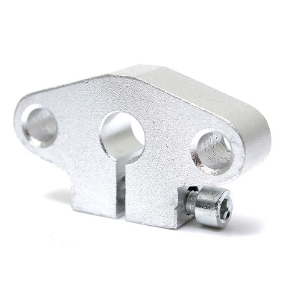
Hardware parts
8mm linear shaft
SHF8 8mm Aluminum Linear Rod Rail Shaft Support
SC8UU 8mm Router Motion Slide Unit Block Bearing
Quantity : 2m.
Quantity : 6.
Quantity : 8.

Slide 14
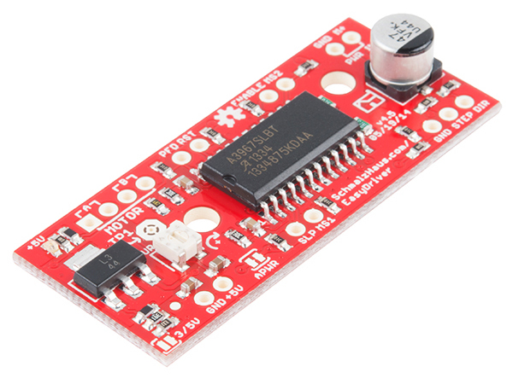
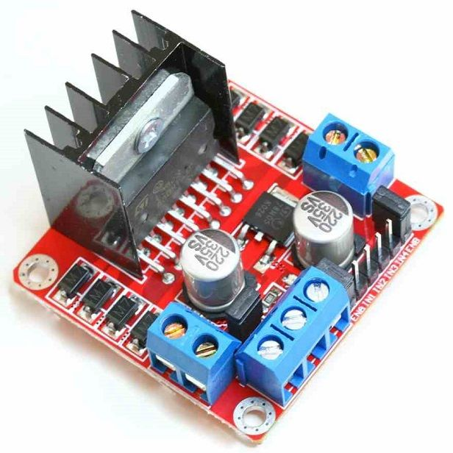
Hardware parts
Easy drivers (A3967)
L298N driver
Quantity : 3.
Quantity : 3.

Slide 15
Software

Slide 16

Software part
Inkscape
It is a professional vector graphics editor for Windows, Mac OS X and Linux. It's free and open source
PC
Image
G-Code

Slide 17
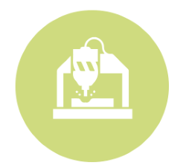
Software part
GrblPanel (G-Code sender)
It is a professional vector graphics editor for Windows, Mac OS X and Linux. It's free and open source
baud rate 115200
PC
Arduino

Slide 18

Software part
Grbl servo firmware
An open source, embedded, high performance g-code-parser and CNC milling controller written in C.
Arduino
X step and direction
G-Code
Y step and direction
Servo angle

Slide 19
Problems

Slide 20
Problems
Weight of X-axis make high load on stepper motors.
Power of stepper motors.
Friction.
Weight of body (MDF wood).

Slide 21
Future work

Slide 22
Future works
Make it light.
Make it scalable.
Communicate wirelessly by mobile App.

Slide 23
Thanks all

