Slide 1

Reducing Ambulances Arrival Time to Patients
An-Najah National University
Information & Computer Science Dept.
Mohammad Eshtayah
Ameer Baghdadi
Jalal Murrar
Amjad Hawash, PhD

Slide 2
Outline
Definition.
Motivation.
Objectives.
Related Work.
Implementation.
Future work.

Slide 3
Definition
Ambulance navigation system is a mobile- and web-based application.
It can be used by people, ambulances, hospitals.
It has has many features.

Slide 4
Motivation
The need to fast reach patients seeking for immediate medical treatment.
Upon the patient delivery, the need to reach the nearest medical center.

Slide 5
Objectives
For patients, Minimizing the time needed to reach ambulance service.
Contact the nearest medical center to prepare the needed medical treatment of the patient.
Track the route of ambulances.

Slide 6
Related Work
A wide range of research on speeding up patient delivery
Classification by methodology
→ Road congestion: (Light signals or change path)
→ Ambulance collection: (Re-distribution of ambulances)
→ Follow the patient's location: (In a fixed or mobile place)
→ Follow-up patient status: (Between the patient and the ambulance or between the ambulance and the hospital)

Slide 7
Implementation.
How does the system work?
1- Android application.
2- Web application.

Slide 8
How does android application work?
Request an ambulance.
Select the nearest ambulance.
Track the ambulance move to the patient.
The patient is delivered to the ambulance.
Track (by ambulance crew) the nearest medical center.

Slide 9
How does web application work?
Medical Centers:
They tracks ambulances heading to them.
They receive patients information while the ambulance on the road.
Upon the medical case, they prepare necessary treatment.

Slide 10
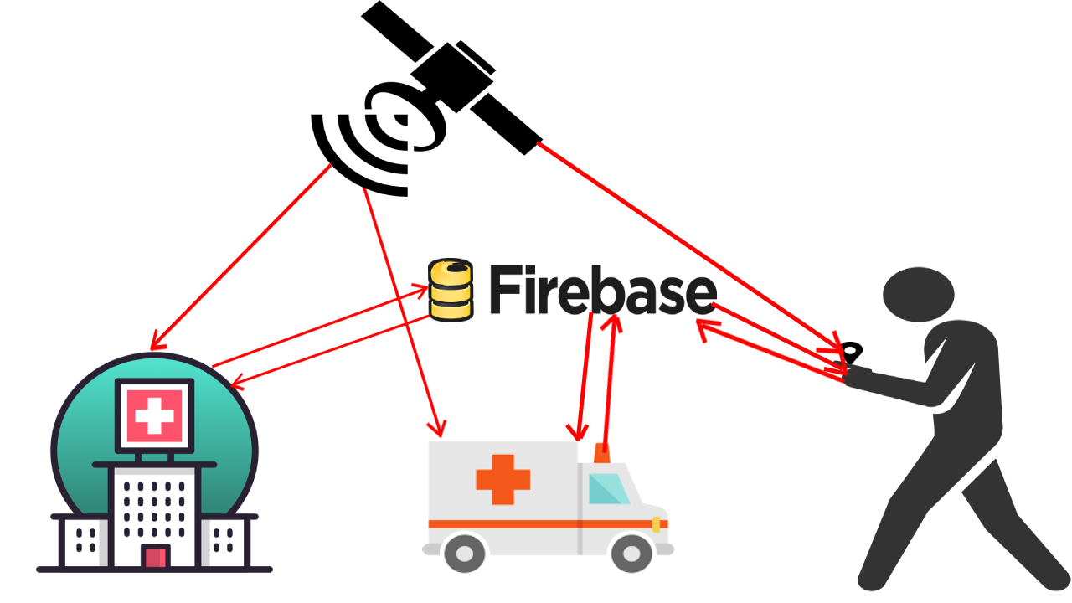
How does system work?

Slide 11
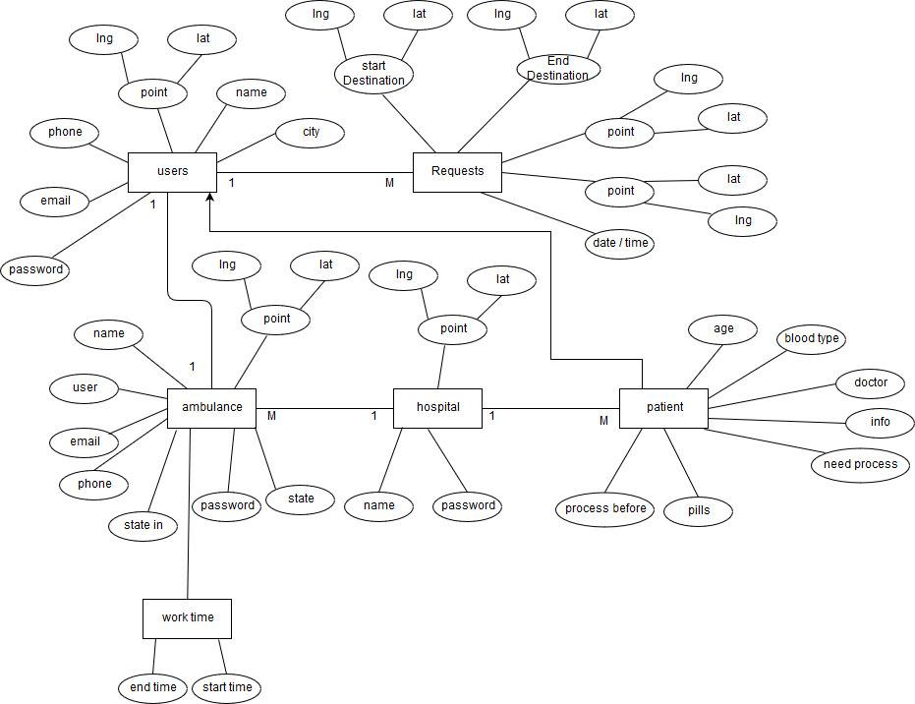
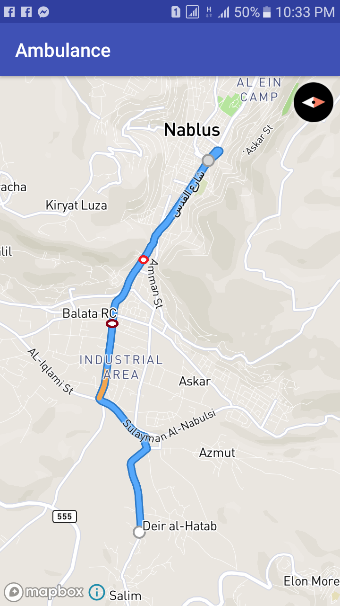
How does system work?

Slide 12
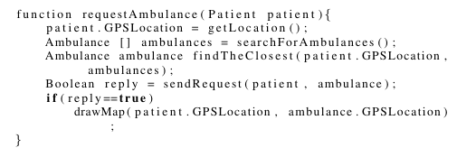
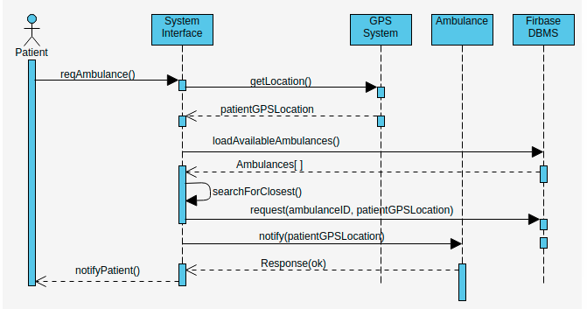
How does system work?

Slide 13
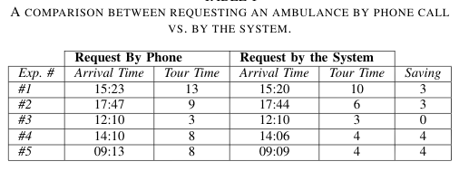
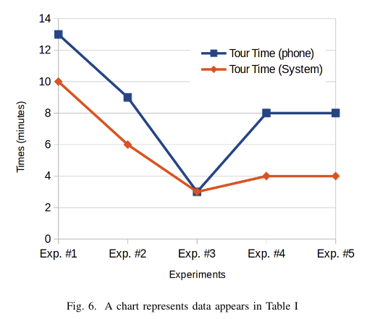
Experimental Results

Slide 14
Future work
  Improve the data exchanged between patients and ambulance crew like voice messages so that the crew could direct patients and/or their relatives for some directive information till the arrival of ambulance.

Slide 15
Thank You
Any Questions?

