Slide 1

(Graduation Project II)
Introducing Early Entrepreneurship Education in Palestine.
Late Primary School Level
An-Najah National University
Faculty of Engineering and Information Technology
Industrial engineering department
Group members:
Asma Jarrar
Haya Jarrar
Ghaidaa Khater
Manar Kabaha
Supervisor Name:
Eng. Suleiman Daifi

Slide 2
Content:
Problem statement
Project description and benefits
Literature review
Development of trainer and trainee guides
Description of guides
Conclusion
Recommendation

Slide 3
Problem statement
  In Palestine, previous studies have shown that there is little to no impact of the school teaching system on the development of entrepreneurial skills, creative thinking and innovation. With the increasing unemployment rate and the ever-growing number of graduates, the need for a generation that is empowered by their ideas and fuelled by creativity is higher than ever.

Slide 4
Project description and benefits
This project is one of the development projects that target members of the community in order to upgrade them in the future and build a prosperous future for them through the development of entrepreneurial thinking. This project targeted school students to facilitate the establishment of the idea of how to be entrepreneurs and what is the role of entrepreneurial thinking in securing a future without unemployment. The first step after research in this project was to develop two guides (trainee and trainer) that introduce and develop entrepreneurial ideas and skills among students through fresh topics and some activities that develop the personality of students and encourage their entrepreneurial thinking, to prepare their mentality to take on a project of their own benefit to them in the future, whether economic, social or humanitarian benefits, or o benefit from these skills in their day to day life.

Slide 5
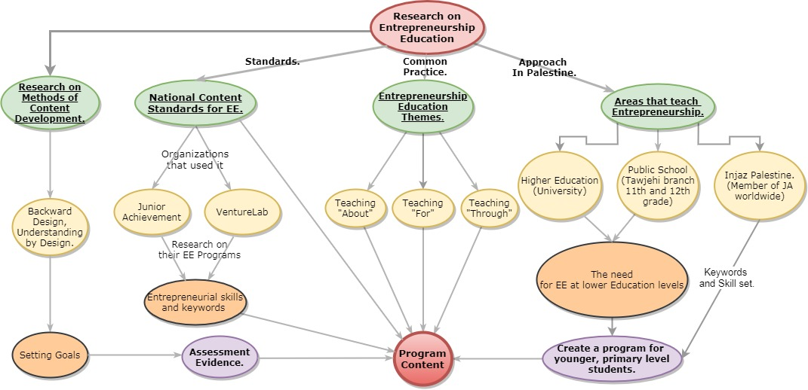
Literature review
Figure 1, Methodology of research

Slide 6
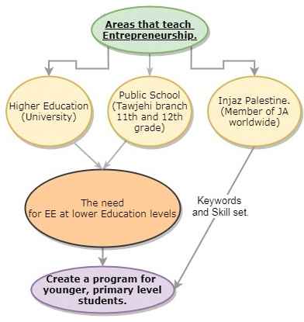
Literature review: approach in Palestine
In Palestine, EE is mainly found in three areas:
Higher education: EE is available as courses in some universities.
Public school system: Tawjehi has an Entrepreneurship and business management branch, and the offer a subject called (small enterprises). (the content is only available for 11 and 12 graders that choose this branch).
Injaz Palestine: a part of JA worldwide, and provide entrepreneurship and vocational education workshops.
Figure 2, EE Teaching approach in Palestine.

Slide 7
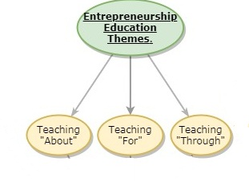
Literature review: ee themes
The common practice is summarized by the three generic themes of EE:
Teaching “about” entrepreneurship programs.
Teaching “for” entrepreneurship programs.
Teaching “through” entrepreneurship programs.
Figure 3, EE themes

Slide 8
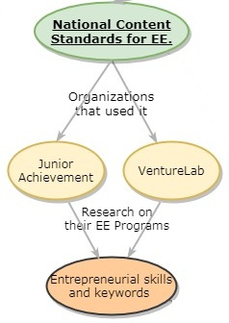
Literature review: Standards
The Consortium for Entrepreneurship Education in Columbus, Ohio, have developed a set of standards for entrepreneurship education, these standards are applied by many programs worldwide
Figure 4, How the National Content Standards for EE were studied

Slide 9
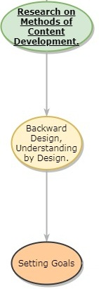
Literature review: backward design
Backward design starts in reverse, taking the desired results, the standards set to accomplish, and targeted goals, to reach performance measures from standards to equip students with the set of skills targeted instead of starting with the teaching activities and how to teach the content. Backward design has three stages:
Clarify desired results.
Determine evidence.
Learning plan.
Figure 5, research on content development methods.

Slide 10


Development of the project
The implementation of work took two directions for introducing two educational materials which are the student guide and teacher/volunteer guide with related additions and enrichment material.
Figure 6&7, trainer and trainee guides.

Slide 11
Development of the project
  The working plan was started with reviewing researches, paper, and case studies related to entrepreneurial education around the targeted age group, which lead to establishing the table of contents. After knowing what topics to include in the material, entrepreneurship education standards were studied to follow in the material writing process, after the material of the two guides was finished, a second look was given to the standard to choose the ones covered in the material, the following table shows the correlation between the material and the Standards.

Slide 12
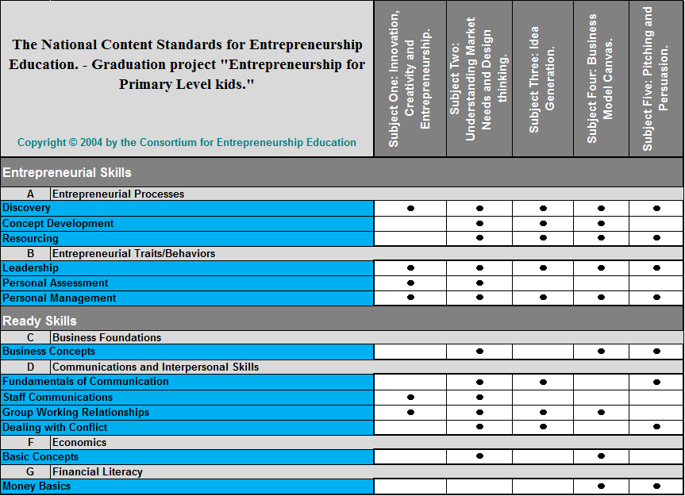
Development of the project: Standards
Table 1, correlation of standards and the content.

Slide 13
Development of the project: design process
  Objectives and desired results of each objective were written to fit the standards, going by the first step of outcome-based education.
  The following task was to determine assessment evidence which was decided to be a set of assessment questions to each subject and suggested activities, the following table shows each assessment activity in each subject, and which of the facets of understanding from UbD do these activities meet.

Slide 14
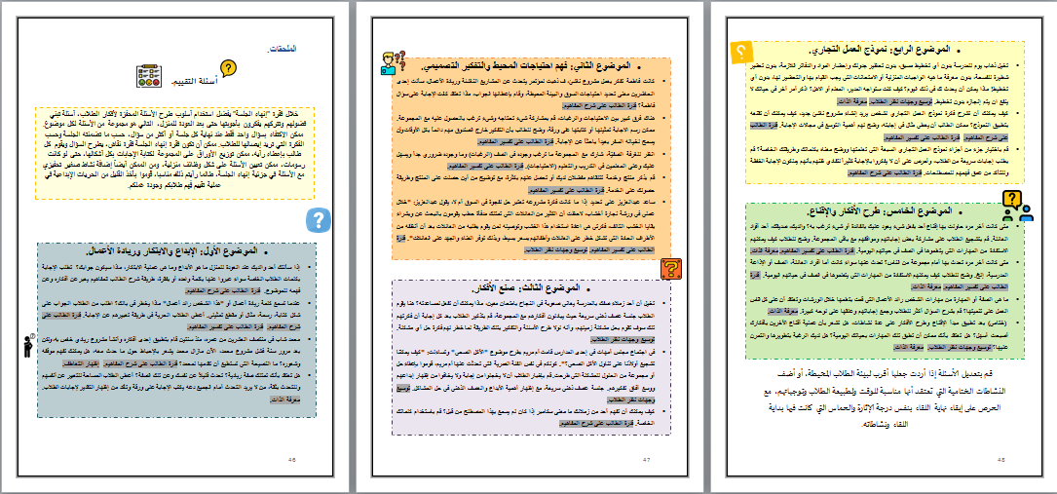
Figure 8, Assessment questions

Slide 15
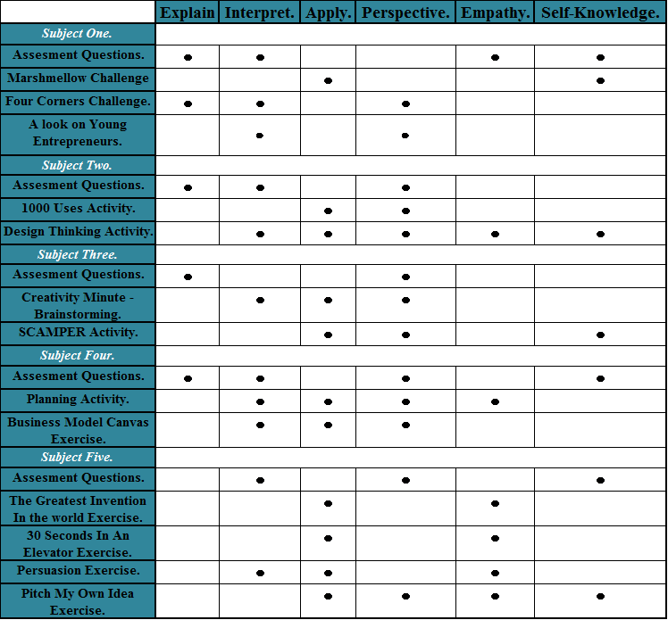
Development of the project: Assessment
Table 2, Understanding Facets Met in each Activity/Section of each Subject.

Slide 16
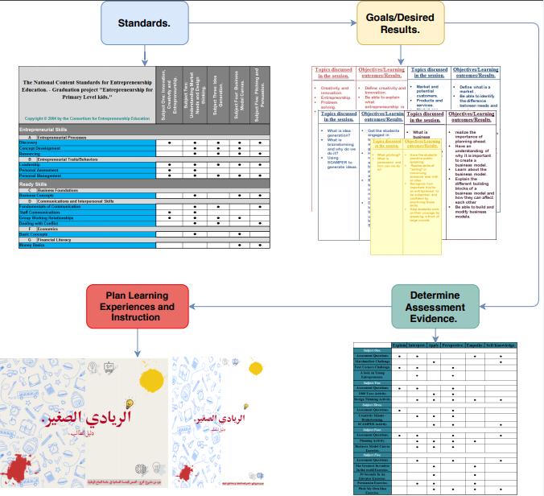
Development of the project: Design process
Figure 9, the process of designing and developing two guides directed at the trainer and the trainee.

Slide 17
Description of guides
Trainee guide: which contains the activities in a simple, smooth and colorful sequence and practical examples which suits the targeted age group, the content is divided into three main sections, the warm-up section, the main activities section, and the wrap-up section.
Trainer guide: is a detailed and rich material designed to open up teacher prospects with a simple and clear view, contains three main sections linked to each topic, these are the introduction, subject preparations, and the activities description.

Slide 18
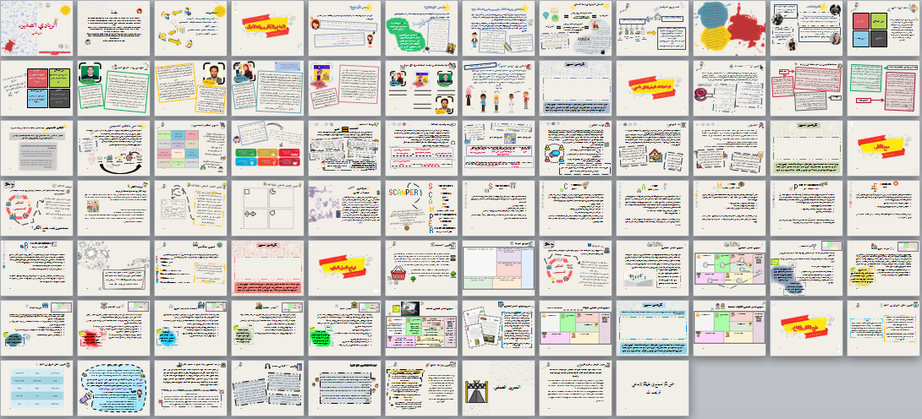

Slide 19
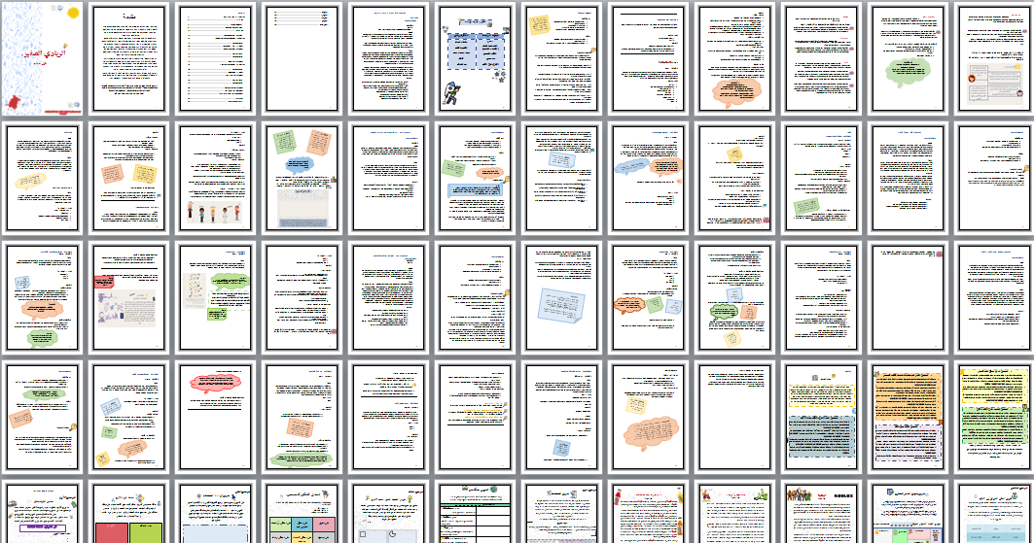

Slide 20
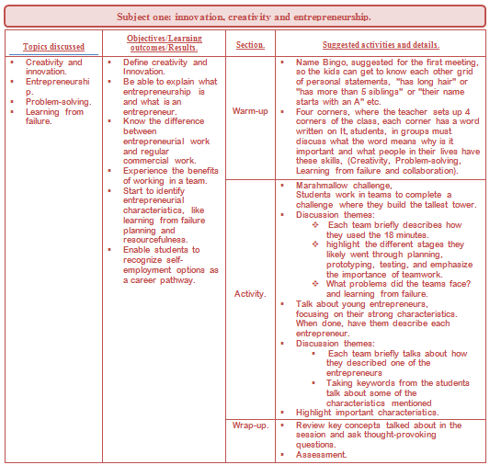
Table 3, Framework of subject one

Slide 21
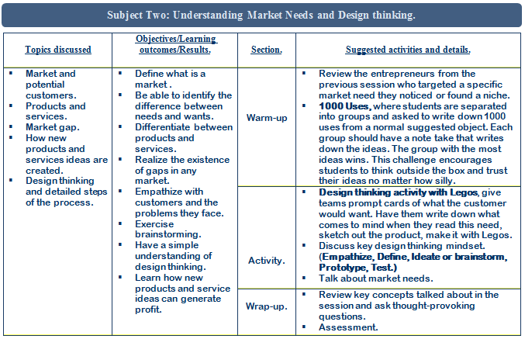
Table 4, Framework of subject two

Slide 22
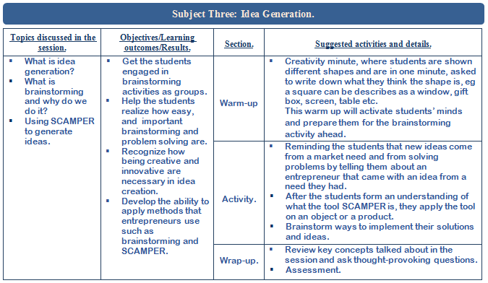
Table 5, Framework of subject three

Slide 23
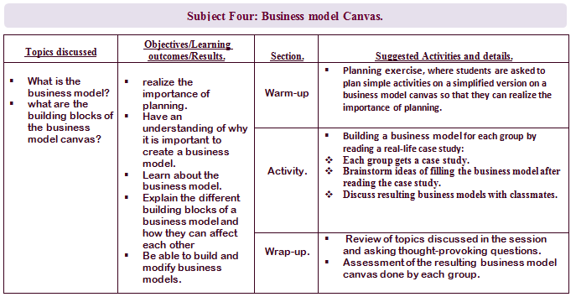
Table 6, Framework of subject four

Slide 24
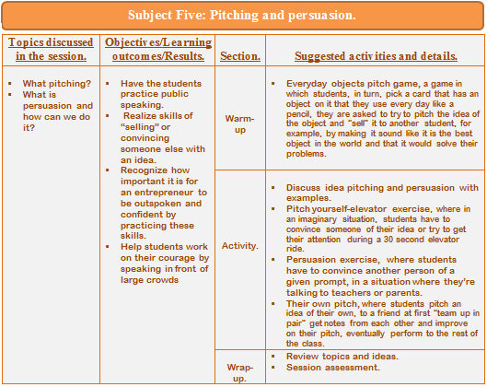
Table 7, Framework of subject five

Slide 25
Conclusion
This project worked on researching current developments in the field of entrepreneurship education leading to the design and development of two guides, one directed at trainees and another directed at trainers, to complement each other in the hope of creating a new and satisfactory learning experience for 11 and 12 years old. Working on the project the research, development, and improvement aimed parts of Industrial Engineering were used to create a better, inclusive, and higher quality learning experience for students.

Slide 26
Recommendation
Continue the research to help the program achieve the best results in the various regions of the West Bank and Gaza Strip, despite the different cultural environment in each region.
Further testing of the designed material is needed to determine the effectiveness of it, and to find out the areas where it can be improved upon, implementation is recommended to start in small groups, singular session workshops while making sure to get the required feedback from participants both on the trainees’ end and the trainers’ end.
When implementing, fully understand the goals of the learning experience and the setting needed to be provided to achieve maximum benefits and get the desired results from students.

Slide 27
THANK YOU
Any Questions?

