Slide 1
Software
The brain of the robot microcontroller which programed with group of instructions to achieve the required tasks.

Slide 2
Operation mode
There are three modes of operation that we provide:
Normal mode
Training mode
Playback Mode

Slide 3
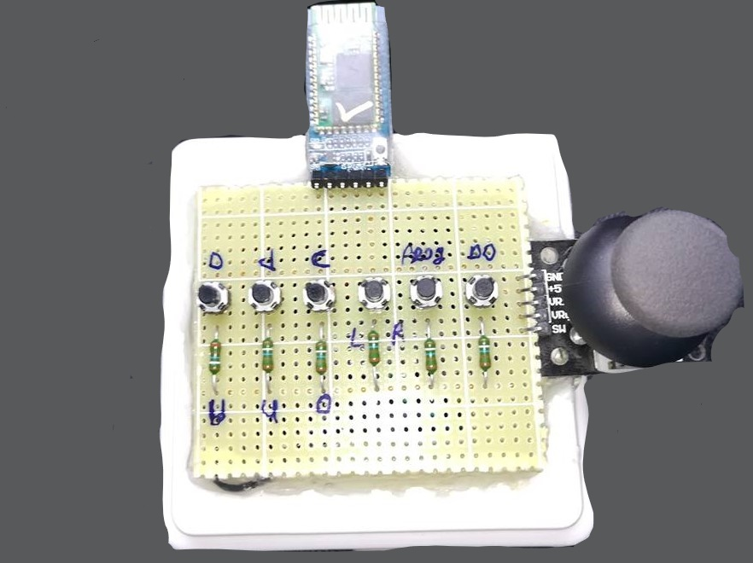
Normal mode

Slide 4
Training mode
Train mode achieved by control the robot arm manually to any desired position
Microcontroller keeps reading analog feedback every 10ms for each servo motor until record play push button pressed or the memory filled

Slide 5
Playback mode
the arm will automatically move from one point to another with the data obtained from the previous training session

