Slide 1
Real Time Health Monitoring and Tracking System using GPS/GSM Technologies
SUPERVISED BY:
Dr. Saed Tarapiah
PREPARED BY:
Orjuwan Damaj, Riham Ghazawi
&Manar Zaid

Slide 2
Outline
Overview
System Idea
System Components
Methodology
Result and Discussion
Recommendations

Slide 3

Overview

Slide 4
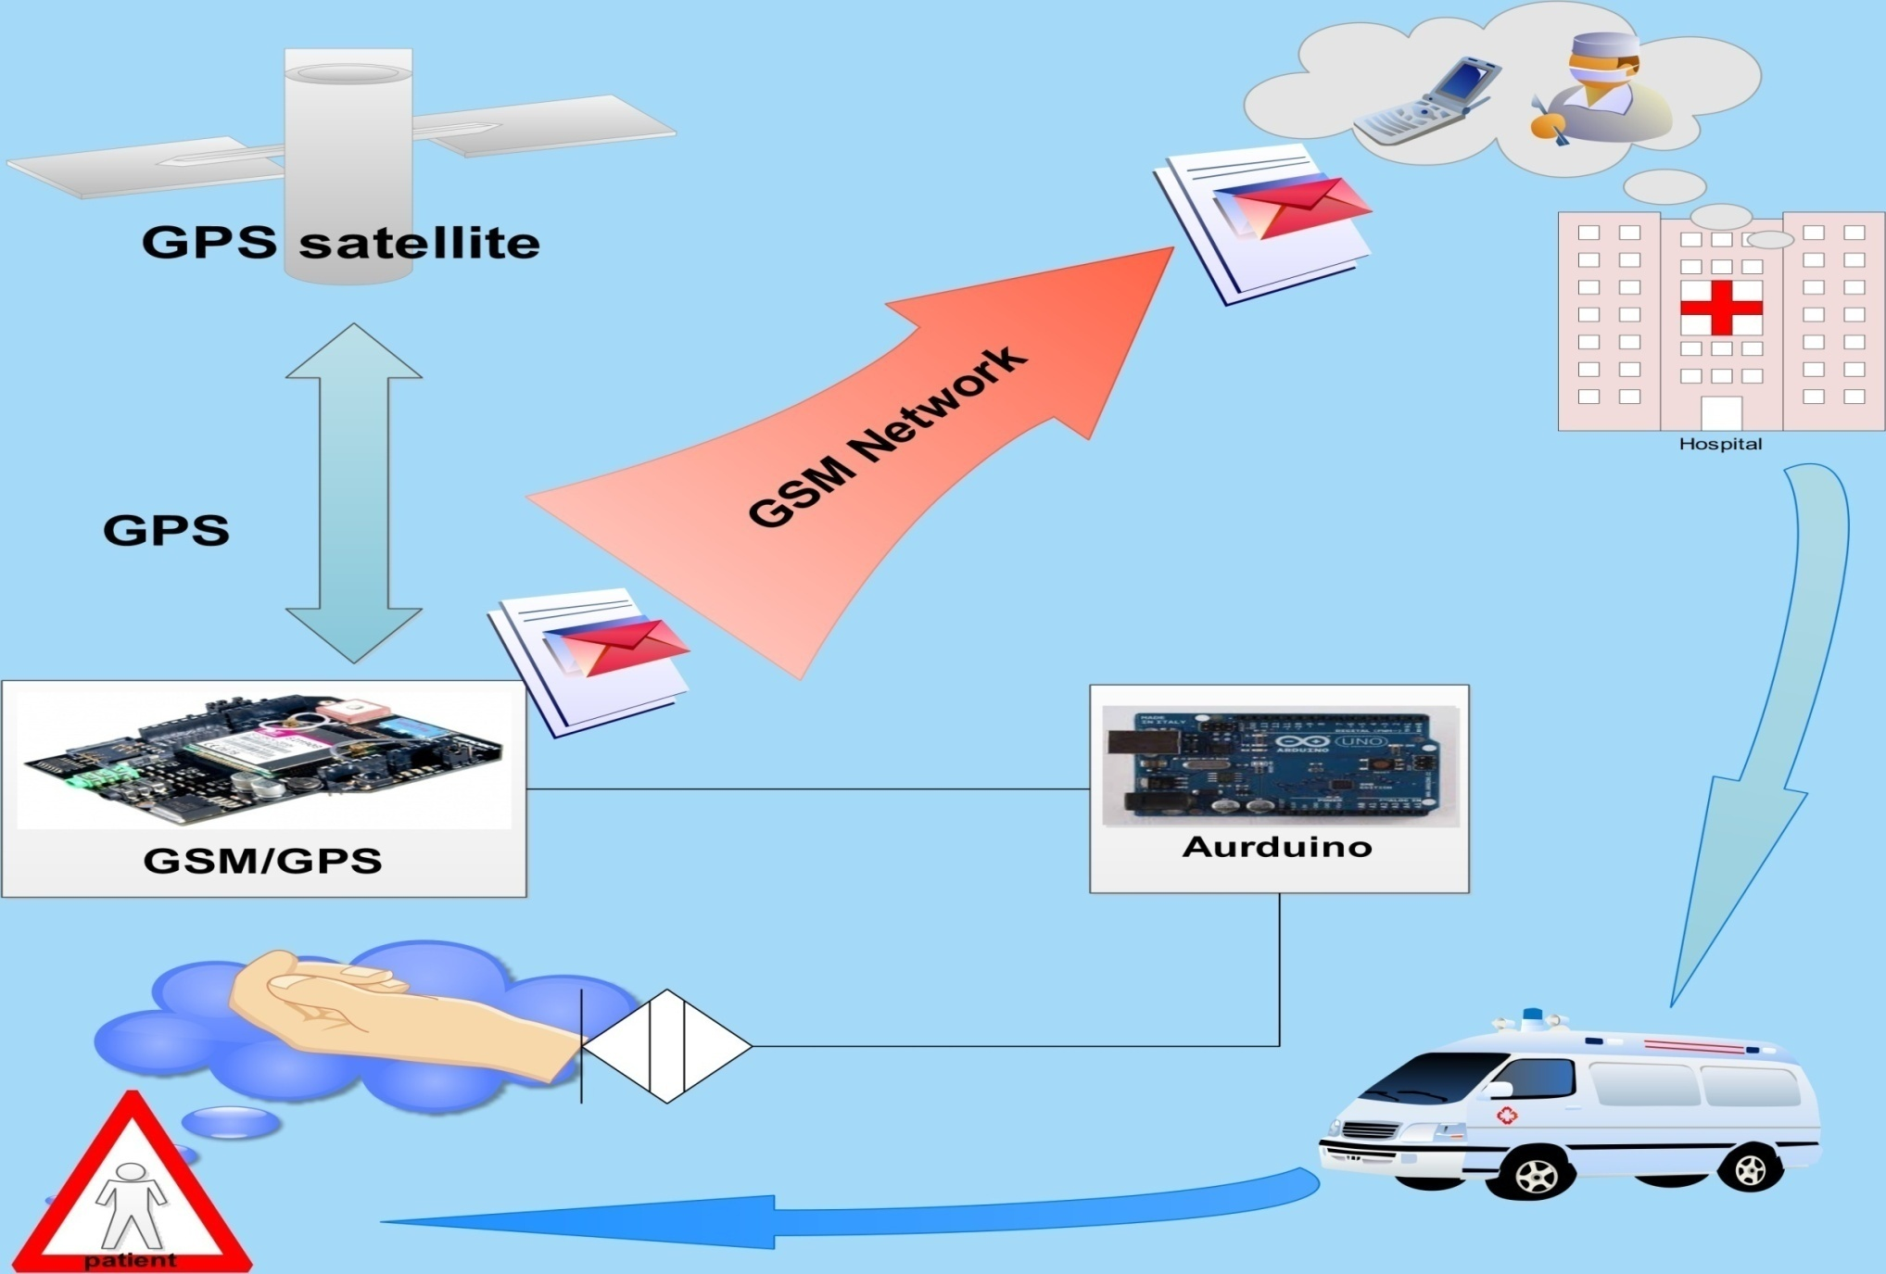

Slide 5
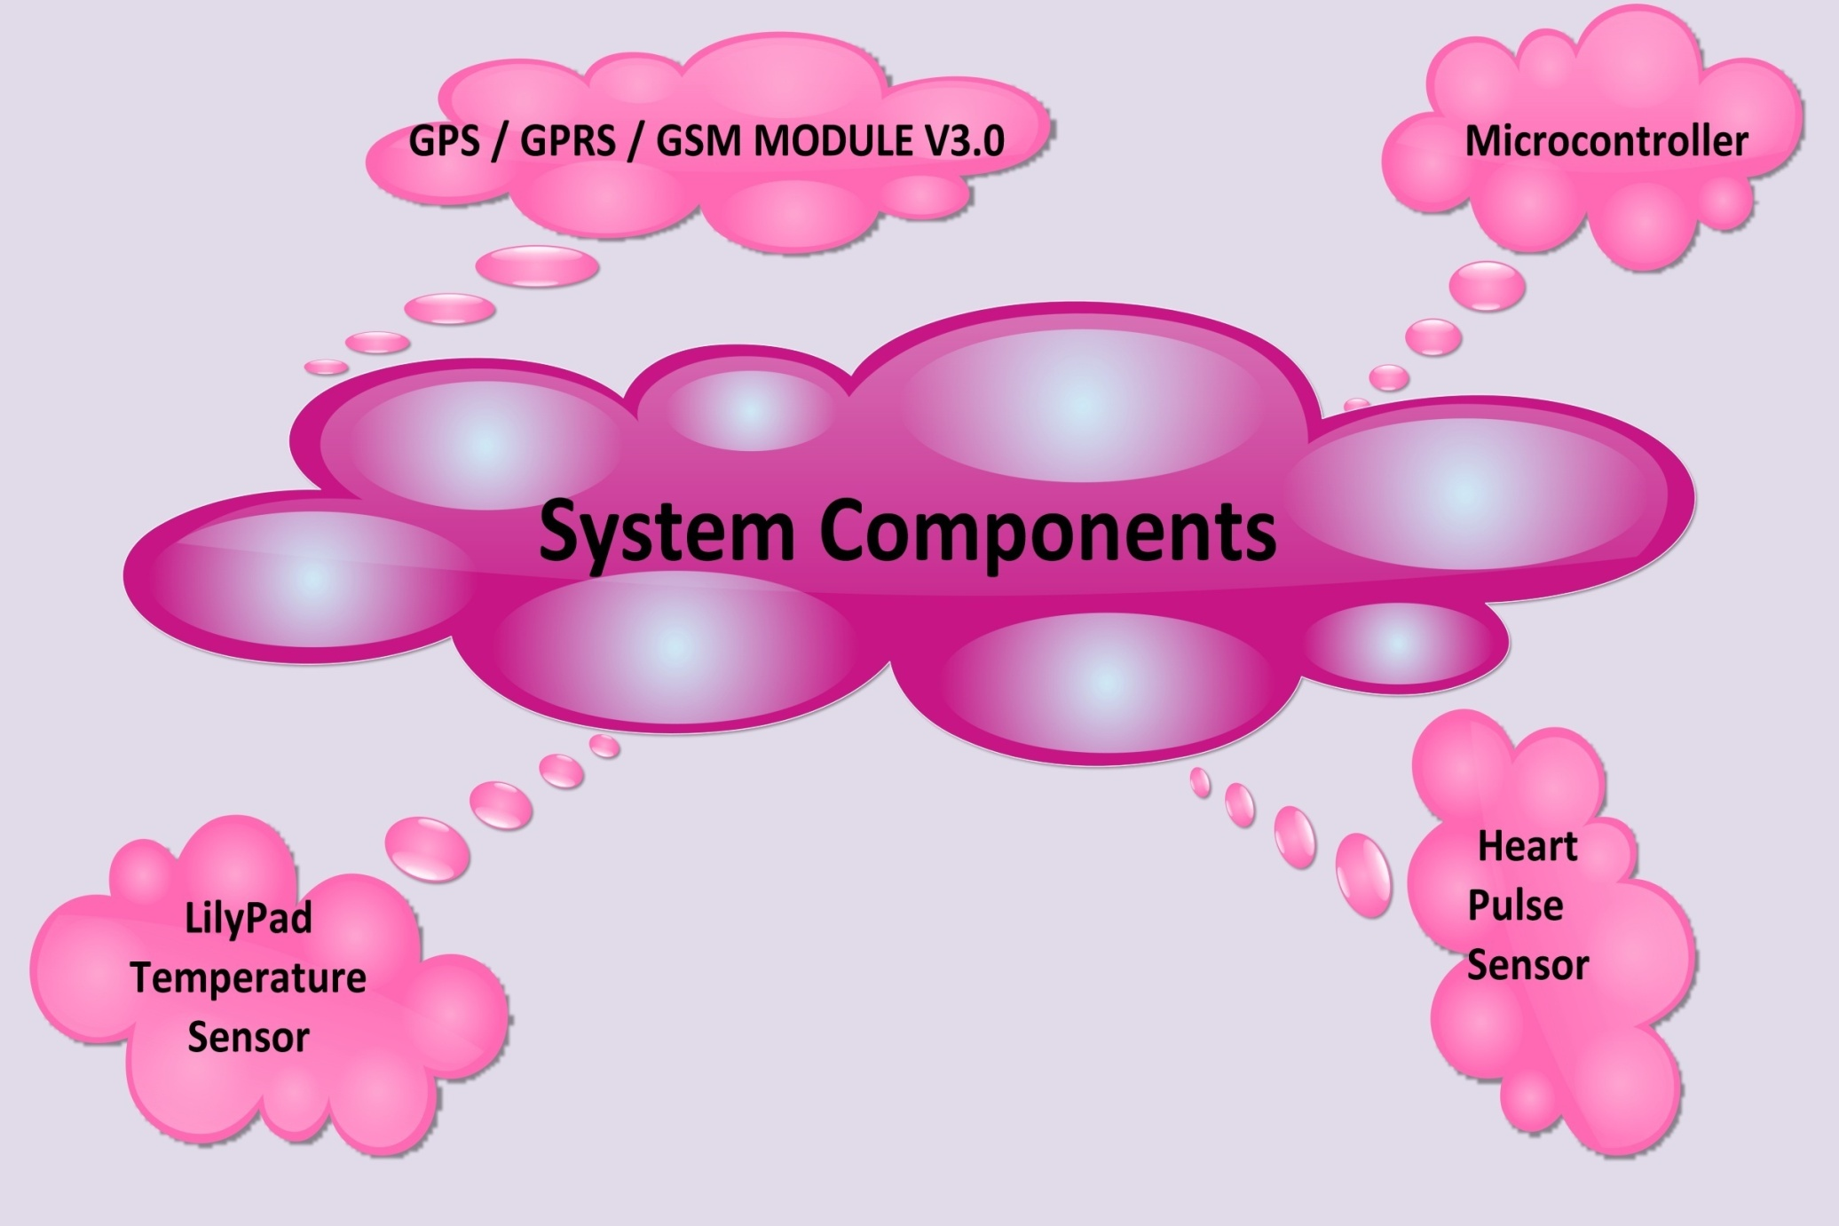

Slide 6
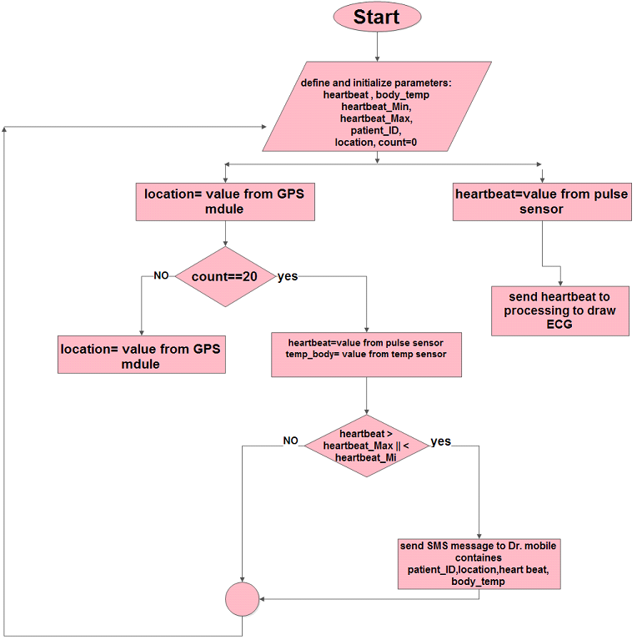

Slide 7
Result and Discussion
System Hardware
The ECG ( two cases )
The GPS Reading
LilyPad Temperature Sensor Reading
The Sent SMS
Google Map Position

Slide 8
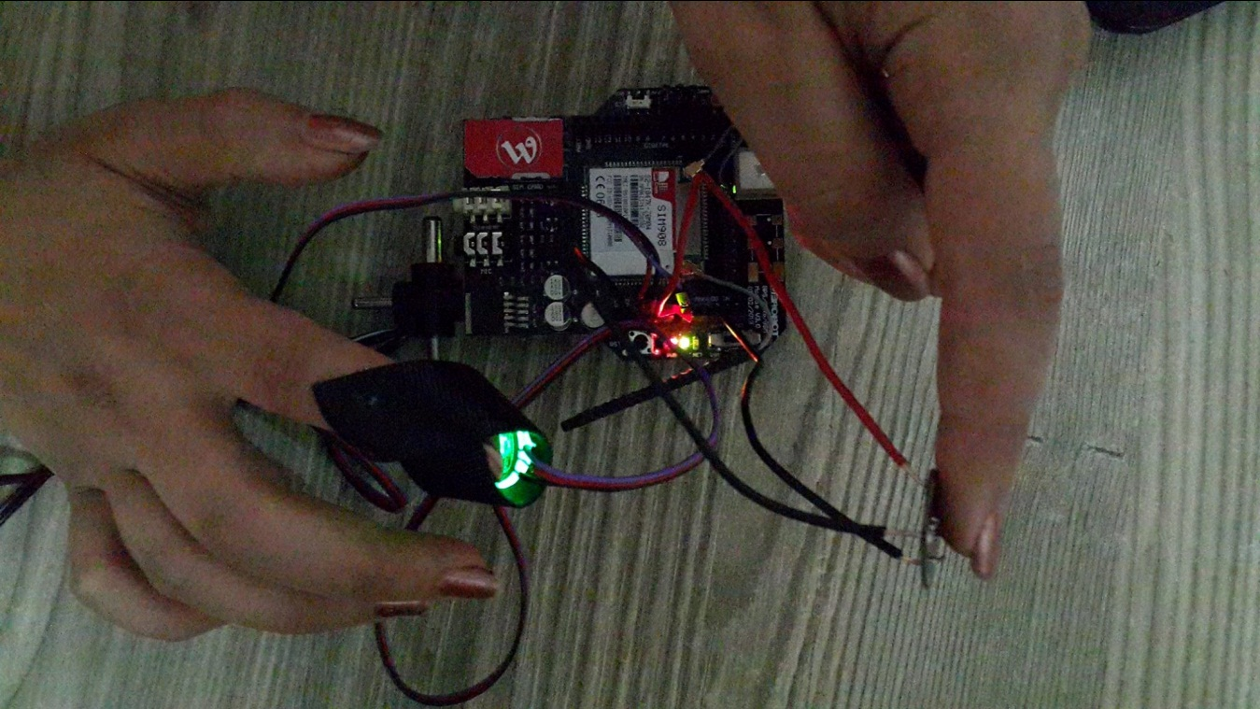
System Hardware

Slide 9
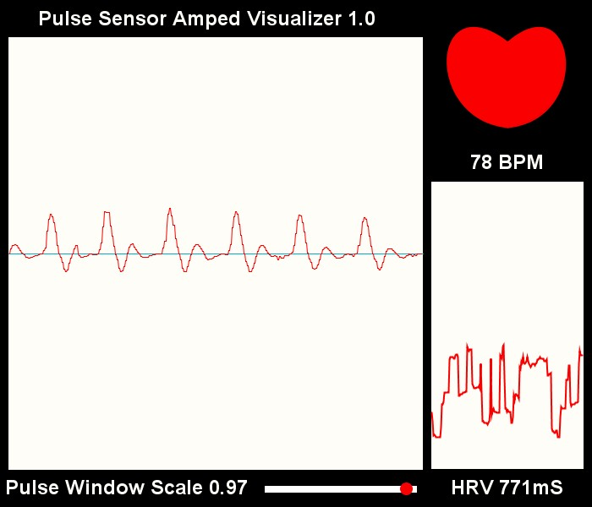
Normal ECG

Slide 10
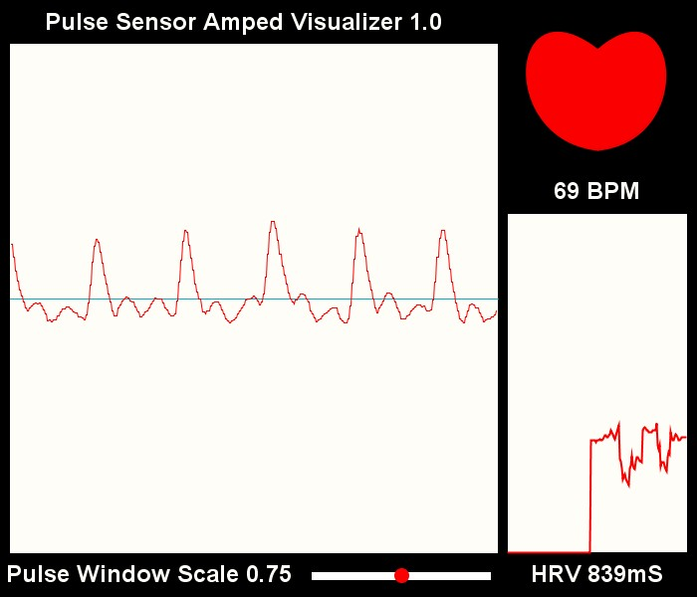
Normal ECG

Slide 11
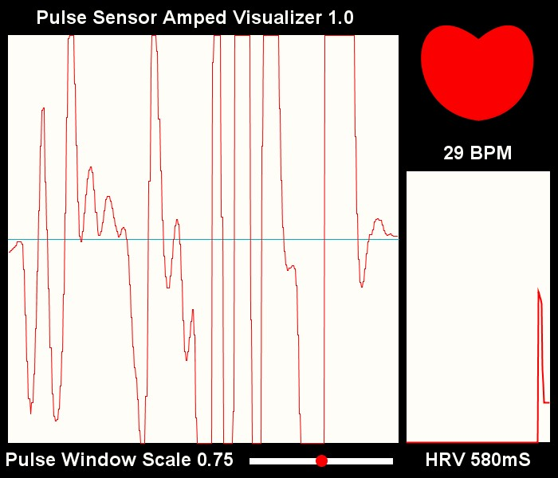

Unconnected Pulse Sensor ECG

Slide 12
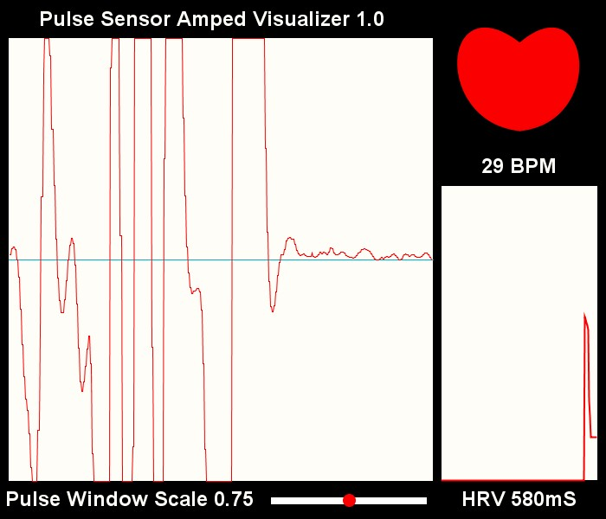

Unconnected Pulse Sensor ECG

Slide 13
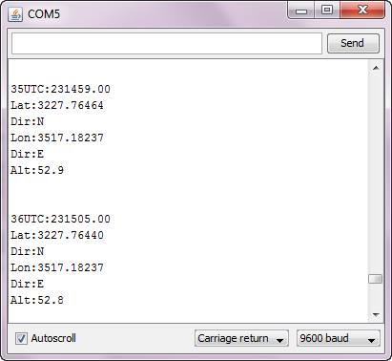
The GPS Reading

Slide 14
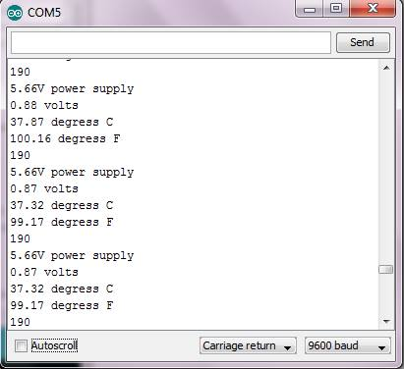
LilyPad Temperature Sensor Reading

Slide 15
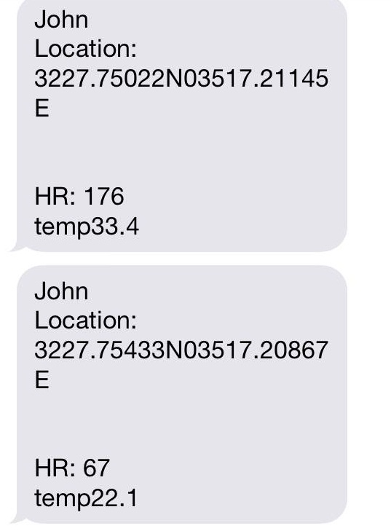
The Sent SMS

Slide 16
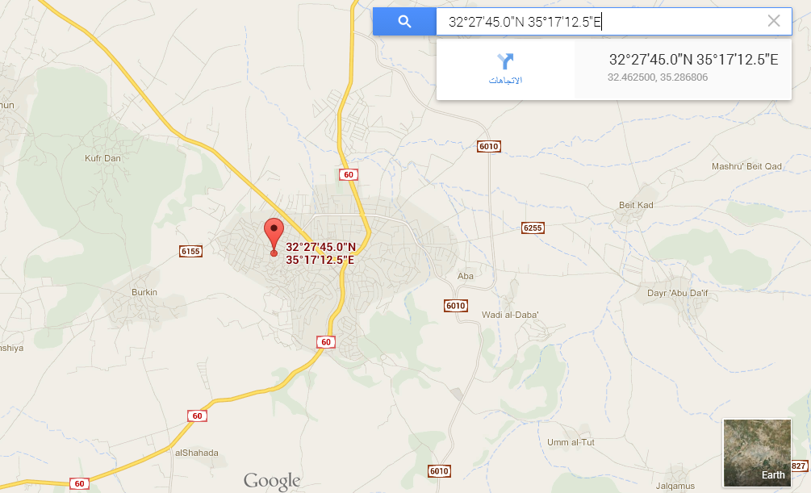
Google Map Position

Slide 17
Recommendations
Android application could be implemented.
Send the name of patient’s position by using server, GPRS, and data structure.
Additional sensors may be added to expand system work filed to include extra illness like Alzheimer's, Diabetes mellitus and Blood pressure.

Slide 18
Economical Feasibility
Model Total cost:
Arduino: 170 NIS
GPS / GPRS / GSM MODULE V3.0: 520 NIS
Pulse Sensor: 135 NIS
LilyPad Temperature Sensor: 25 NIS
The total cost approximately ≈ 850 NIS
Operating cost:
The cost of SMS: 0.25 NIS

Slide 19



Slide 20

THANKS FOR COMING

