Slide 1



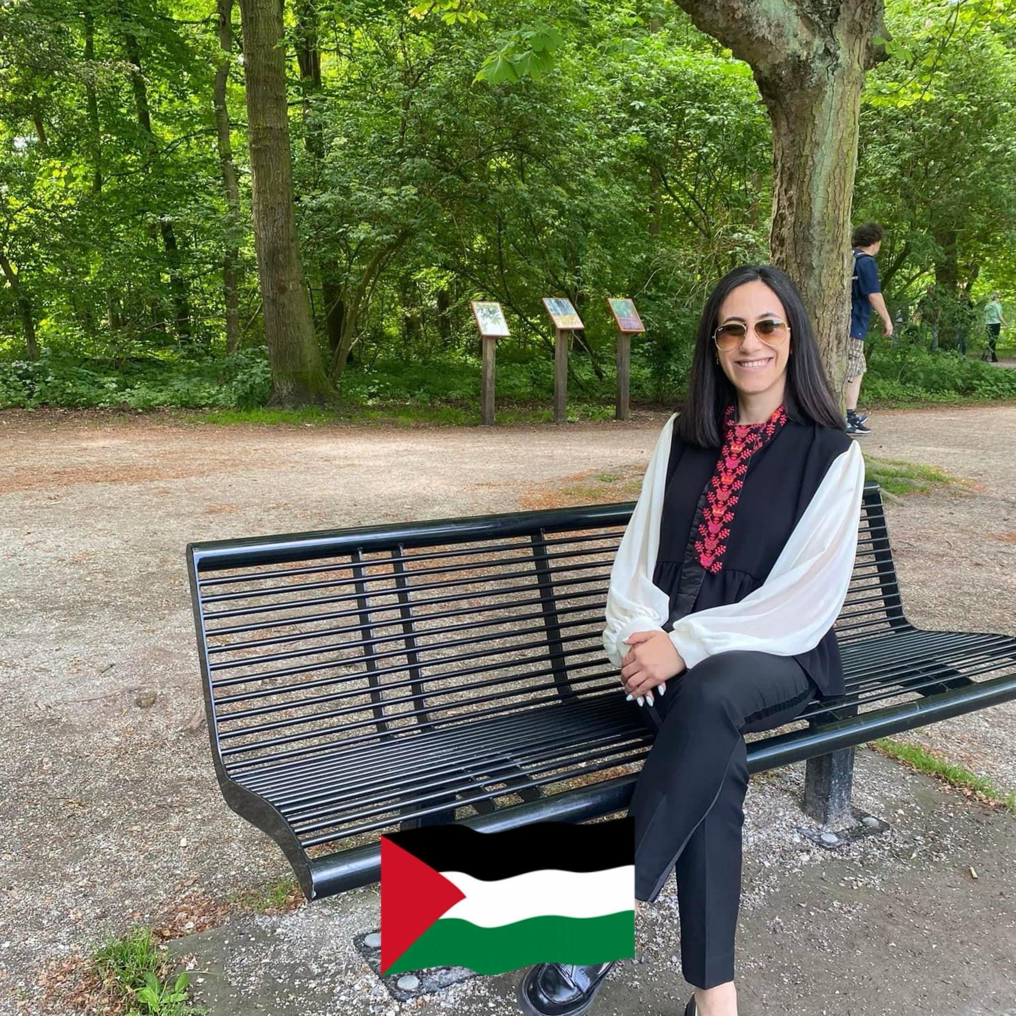
PALESTINIAN CHALETS Application
Welcome to the world of chalet bookings! Our app offers a seamless experience for finding and booking exquisite chalets. With a user-friendly interface and comprehensive features, it's the perfect way to plan your dream getaway.
Amer Zagha
Amr Salman
DR .Mona Demaidi

Slide 2


Features of the App
Extensive Collection
Access a wide range of chalets, each with unique features and amenities to cater to your specific preferences.
Real-Time Availability
Get up-to-date information on chalet availability, ensuring a smooth and efficient booking process.
Advanced Filter Options
Refine your search with filters such as price range, location, and accommodation type for a personalized browsing experience.

Slide 3




User Interface
Intuitive and easy design
Navigating the app is effortless, thanks to its intuitive layout and easy-to-understand interface.
Easy access
The user interface provides easy access to any part of the application you want very quickly
Full of ways to help
Almost every interface contains a search option and provides filtering methods

Slide 4
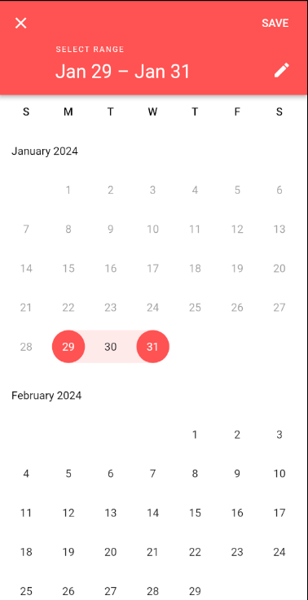
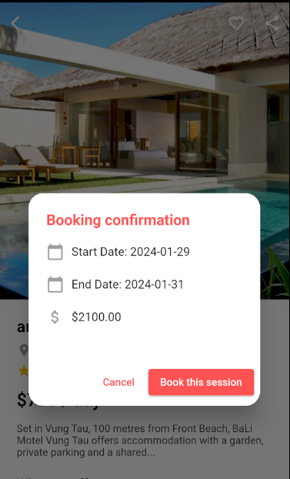
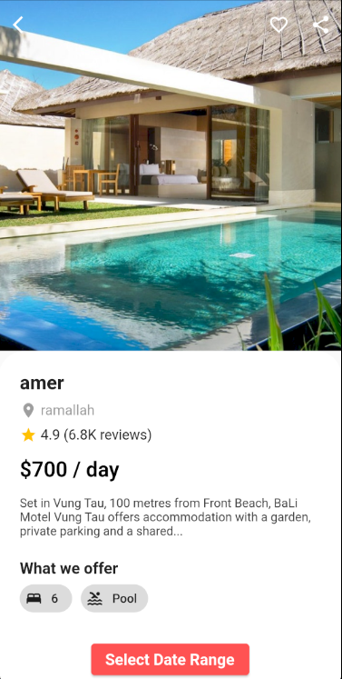
Booking Process
2
3
1
Select
Book
Confirm

Slide 5
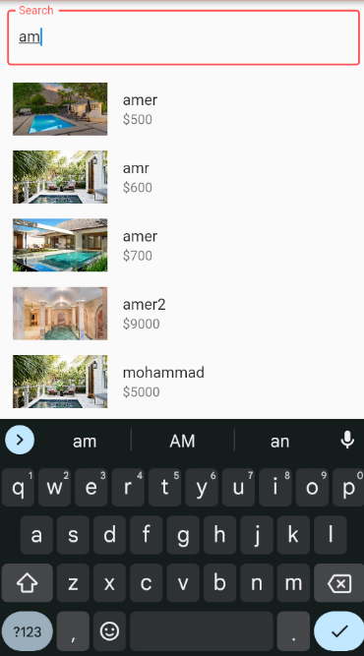
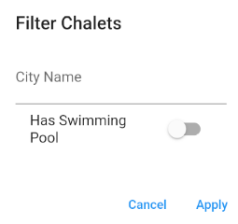
Search and Filter Options
Location-Based Filtering
Chalet – Search method
Set price range filters to find chalets that meet your budget, ensuring a variety of options to choose from.
Filter chalets based on geographical preferences, enabling a tailored search for locations that match your desires.

Slide 6
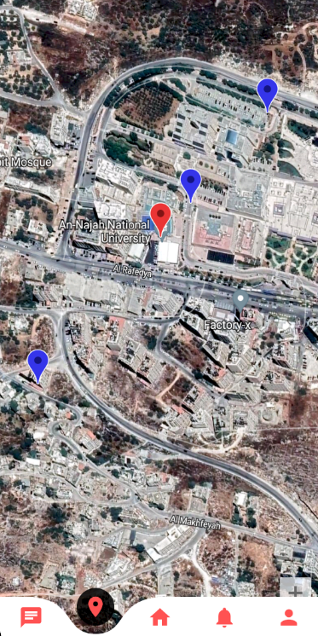
The Map Page
1
Location Showcase
2
Interactive Features
View chalets on a map, allowing for detailed exploration of each location and the surrounding areas before booking.
Interact with the map to view nearby attractions, public transport options, and points of interest, enhancing the Booking planning experience.
3
Zoom and Pan
Use the map's zoom and pan features to get a closer look at chalets and their proximity to local landmarks, beaches, or mountains.

Slide 7
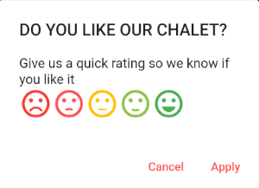

Customer Reviews and Ratings
Comprehensive Feedback
Access in-depth reviews and ratings from previous guests to make informed decisions about your stay.
Generated Photos
View real photos to get an authentic glimpse of chalets before booking.

Slide 8
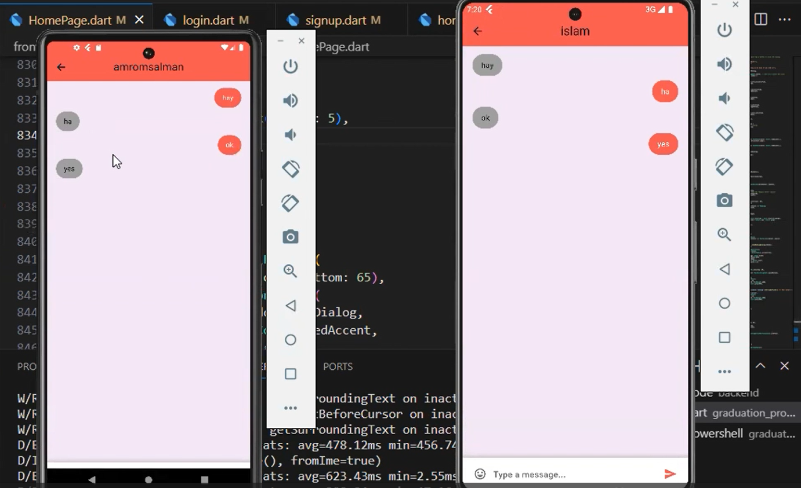
Chat Page on the App
Instant Inquiry
Customized Recommendations
Connect directly with chalet owners for instant responses to your inquiries, ensuring a personalized and efficient communication channel.
Receive personalized chalet recommendations and tailored advice from knowledgeable owners to find the perfect stay.
Booking Assistance
Seek guidance, ask questions, and receive immediate assistance from chalet owners to refine your booking process and address any concerns.

Slide 9

Partnerships with Chalet Owners
1
Expert Collaboration
2
Verified Properties
We've established partnerships with chalet owners to ensure top-quality accommodations and personalized support for our users.
Benefit from access to vetted and verified chalets, offering peace of mind and security during the booking process and stay.
3
Taking a commission of the profits
One of the upcoming plans is to take a 5% commission on every chalet reservation made so that it becomes a profitable project

Slide 10
Future Updates and Enhancements
1
Enhanced Search Filters
Anticipate more refined and detailed search criteria, allowing users to narrow down chalet options based on precise preferences.
2
Augmented Reality Integration
Experience chalets in augmented reality, providing a realistic and immersive preview of accommodations before booking.
3
Smart Recommendations
Benefit from personalized recommendations based on travel history, preferences, and previous bookings, optimizing the selection process.

Slide 11


