Slide 1

Done by:
Siham Khuffash
&
Alaa Yaish
Supervised by:
Dr.Ashraf Armoush

Slide 2
Table of contents
Motivations
EvenYou’s Idea
Project’s goal
Tools And Technologies
Challenges
Future work

Slide 3
Motivations
Distributed attendees and organizers assistants applications problem.
feelings of lost and confused when searching for an event.
Organizer pay a lot to share his events with people by advertisements.
Organizers have to work hard to create an event from a to z.
Increase the percentage of sales in stores.

Slide 4
EvenYou’s idea
User
Organizer
Store
-add events
-edit events
-book all event’s needs
-add items to the menu
- accept/refuse the reservations
-search for events
-join events
-rate & comment
-contact with organizer

Slide 5
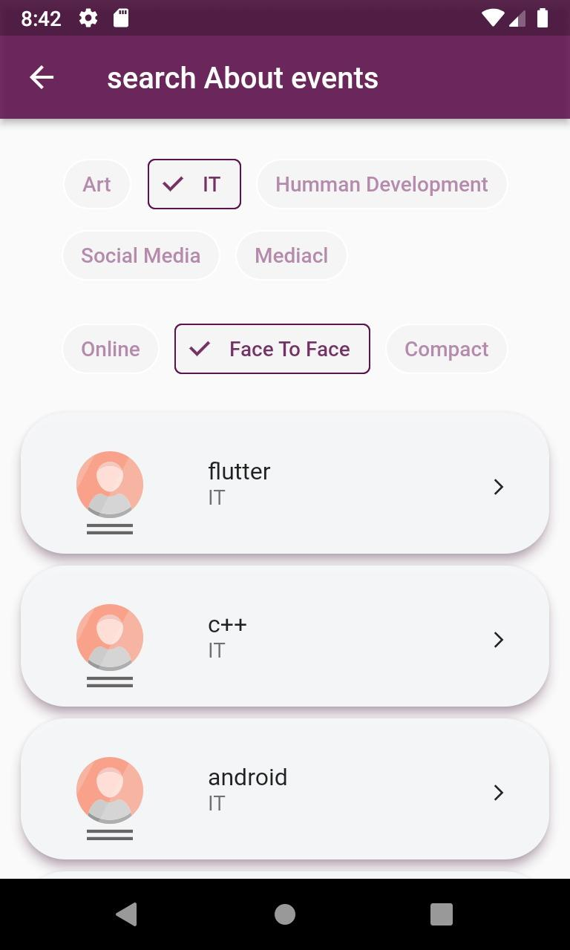
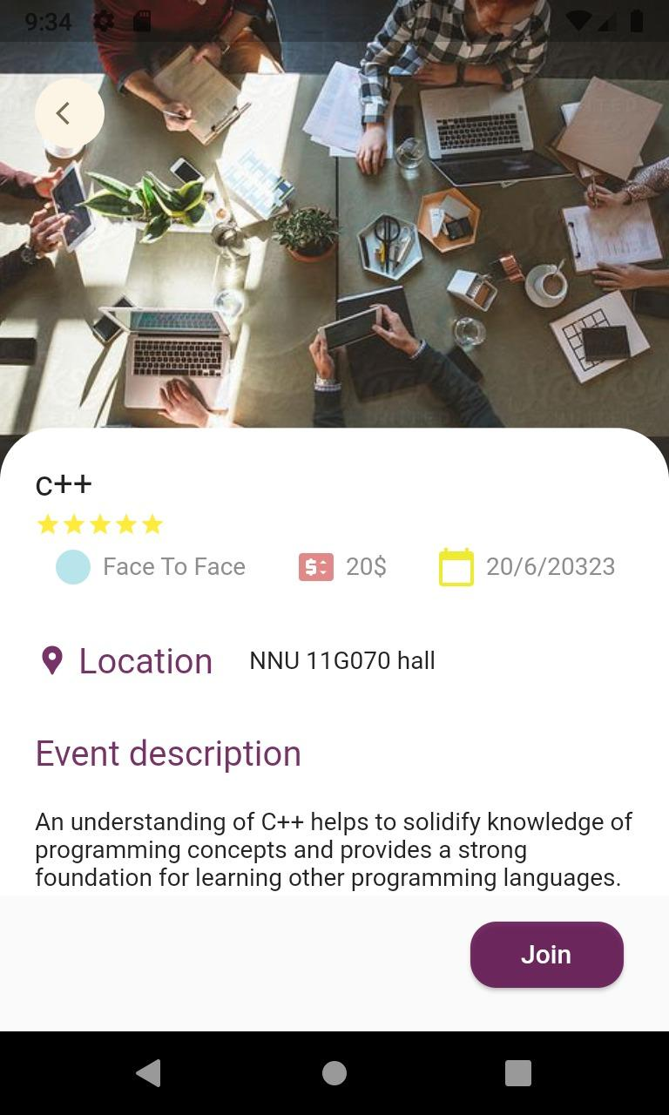
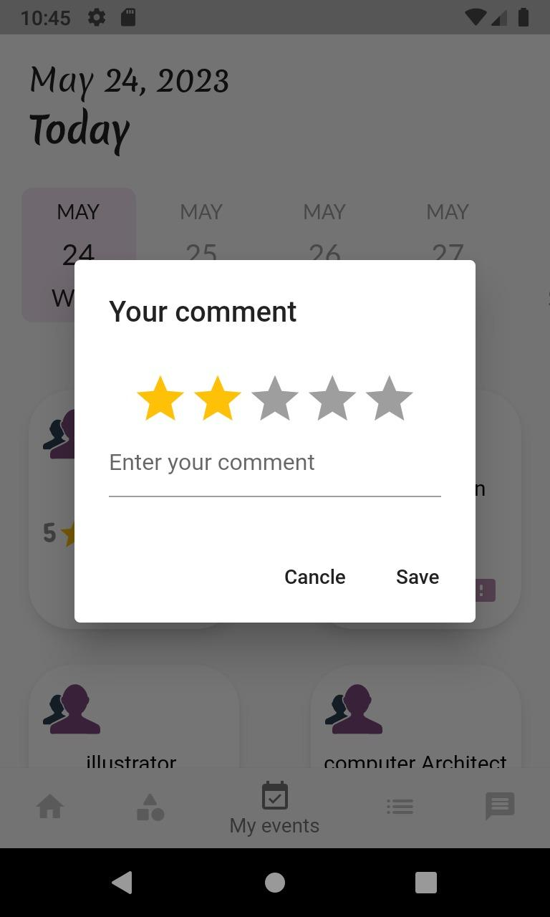
Event attendees

Slide 6
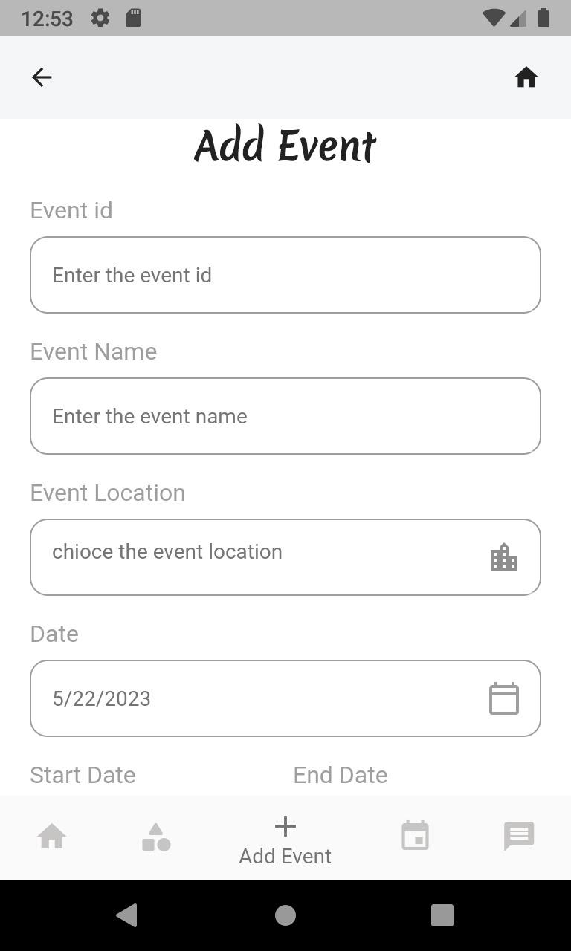
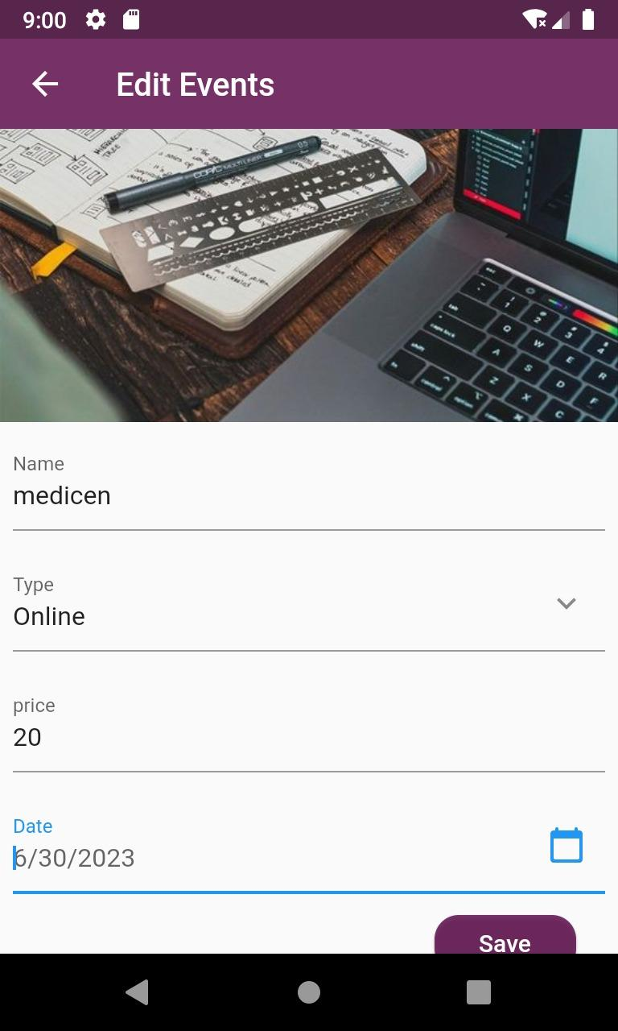
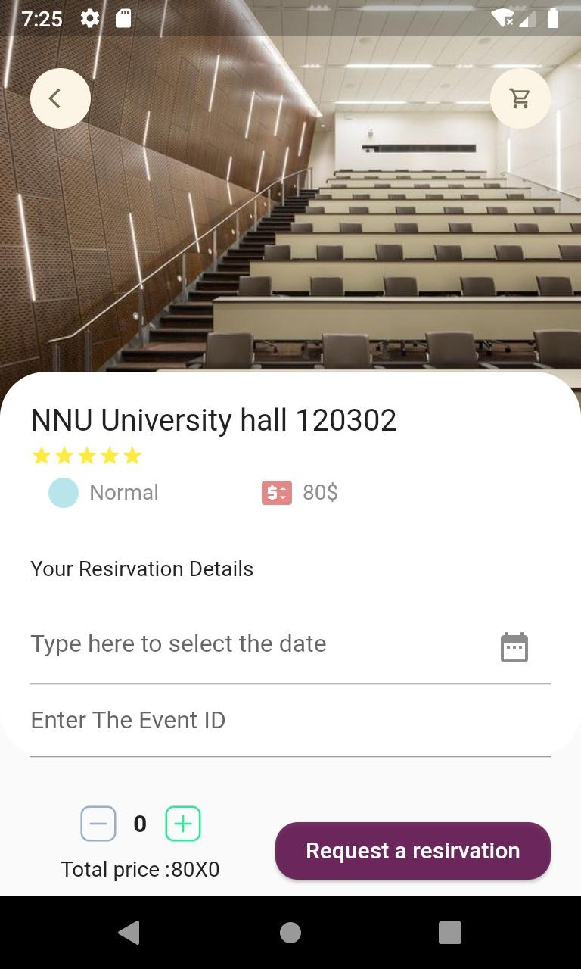
Event organizers

Slide 7
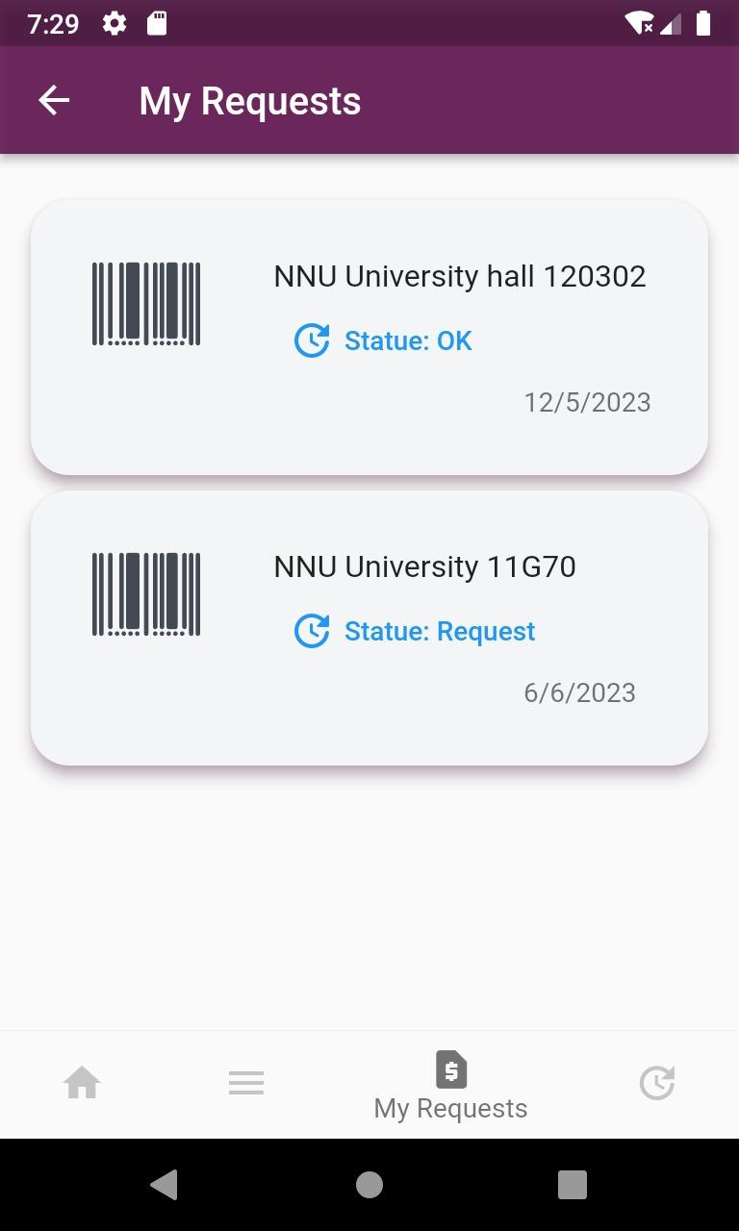
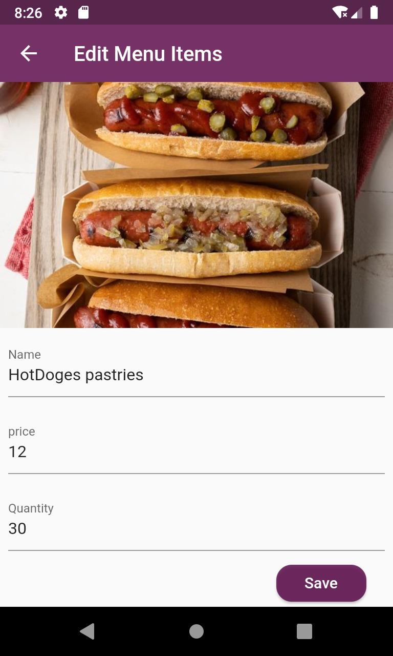
Stores

Slide 8
EvenYou’s Goal
A
Have a user friendly design
B
Helpful and easy to use.
C
Reach out fast to the targetted group
D
to revolutionize the event and stores industry by simplifying event management
E
Increase people ability to learn

Slide 9
Tools & Technologies
Tools
Android studio
MySQL
xampp
phpStore
Visual
Code
Studio

Slide 10
Tools & Technologies
Front end
flutter
API
html
CSS
- For mobile application-
-for the website-
-For the website-

Slide 11
Tools & Technologies
Backend
Database
PHP
MYSQL

Slide 12
Challenges
New languages!
1
Back
2
Front
Emulator
3

Slide 13
Future Work
support multiple languages.
1
4
make users able to create simple events.
2
enhance the chat system.
5
modify the map system.
3
add cards by organizer.

Slide 14
THANK YOU !

