Slide 1
Auto Weighing Machine
Supervisor:
Dr. Hanal Abo Zant
By:
Mustafa Wajdi Saad al deen
Adel Mohammad Halaweh

Slide 2
Outline
01
02
03
Introduction
Motivation
Hardware components
04
05
Challanges
Future work

Slide 3
01
Introduction

Slide 4
The project is about an auto weighing machine which contains a build in balance scale with a runner these parts are the main parts in this project, also this machine contains a database used for tracking the current state of this machine such that it contains the remaning weight from every legumes and the price of every 100g from every legumes type, also this machine provided with a web application that can be used easily from admin to track also the current state of the machine using a user friendly GUI.

Slide 5
02
Motivation

Slide 6
This project has been made to make the weighing process faster and easier from traditional manually process , and also it may be useful from economic side especially for hypermarkets owners because they needs to hire employees to do this process, this machine may be a useful idea to made this process by itself rather than a human.

Slide 7
03
Hardware components

Slide 8
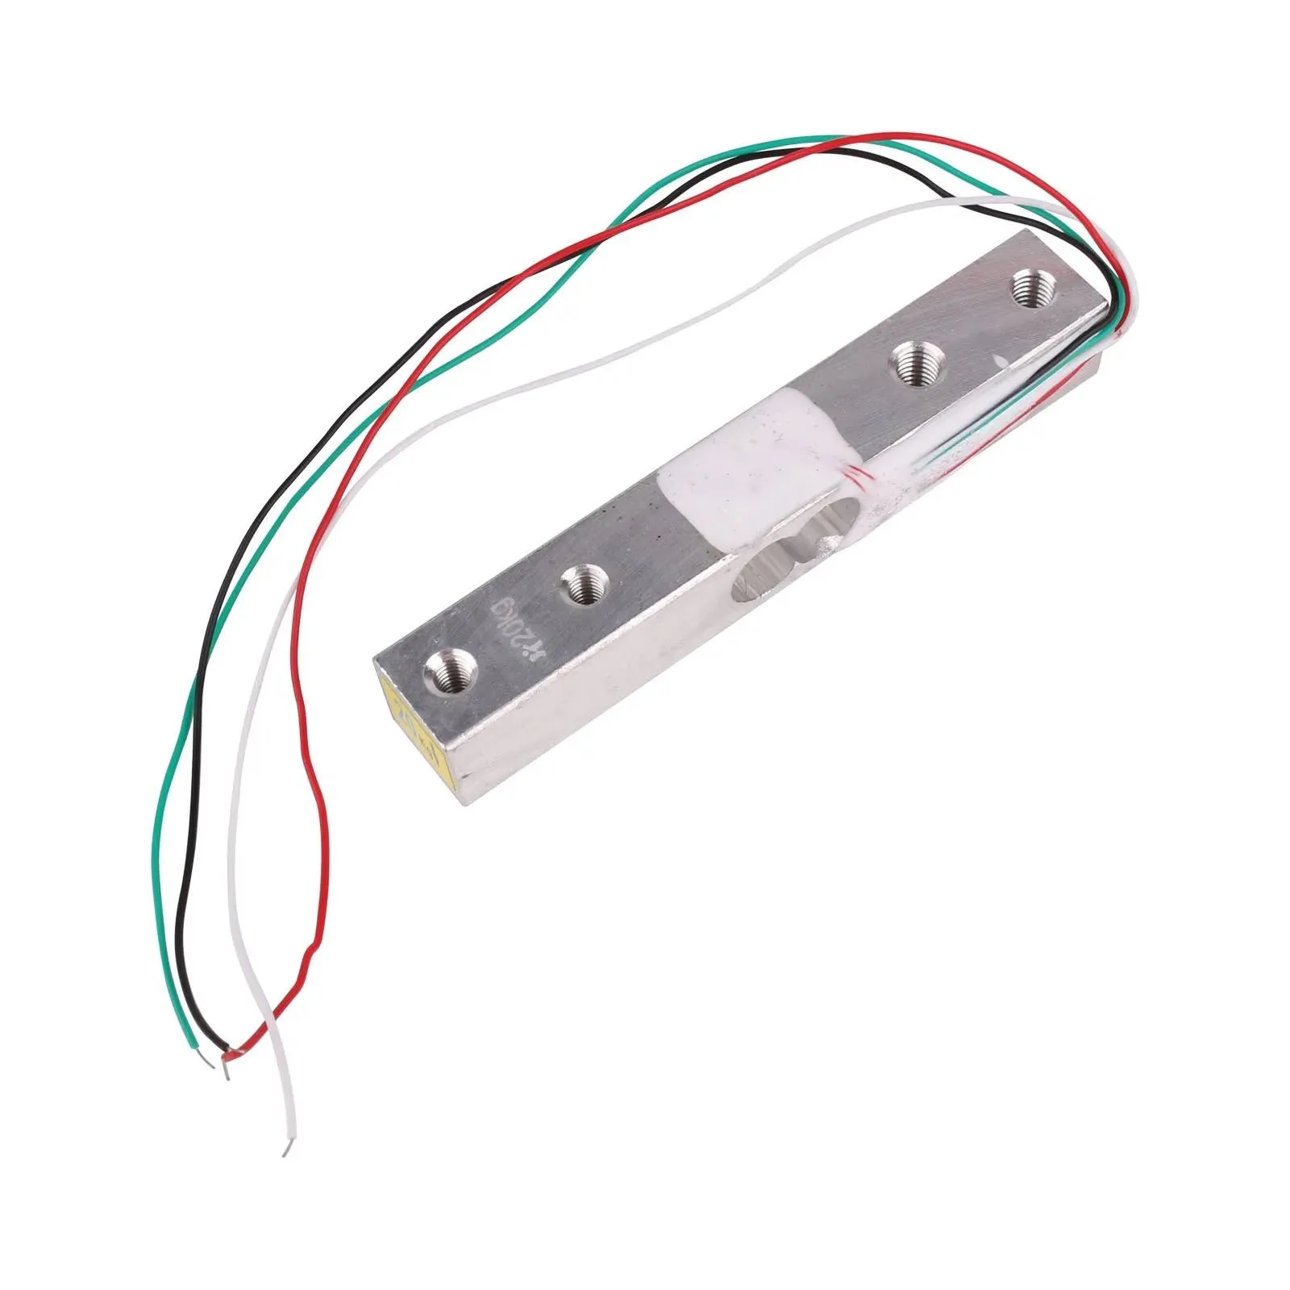
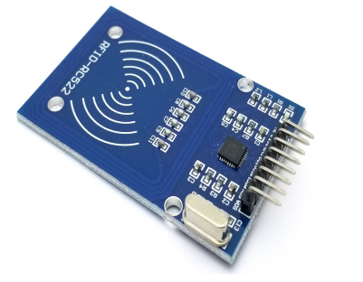
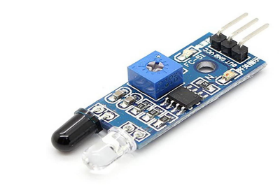
HX711 sensor: RFID: IR sensor:
This sensor has been used to make balance scale which has been used to detect current weight
This components has been used to make selling process , it’s cards has been used as an visa cards
This sensor has been used for object detection, as in this project it has been used for jar detection and also to detect start point

Slide 9
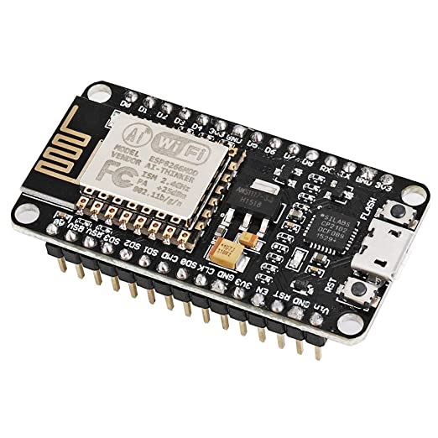
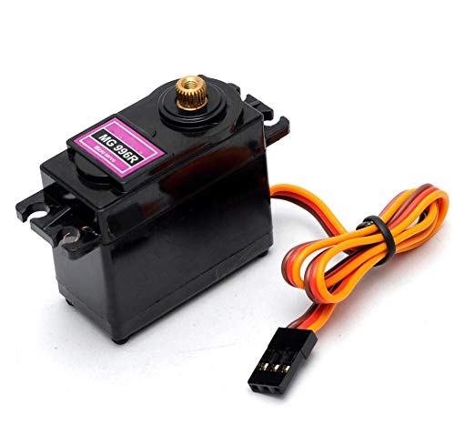
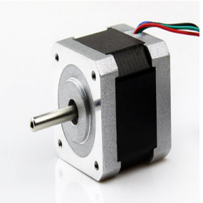
ESP8266: Servo motor: Stepper motor:
It’s main usage is to help arduino to communicate with database
This motor has been used to control filling from bottles
This motor has been used to make runner which has been used to move balance scale from position to another

Slide 10
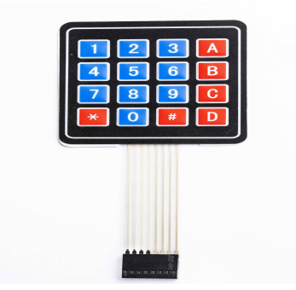
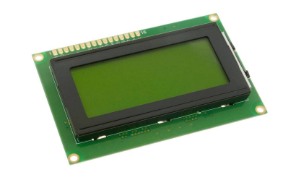
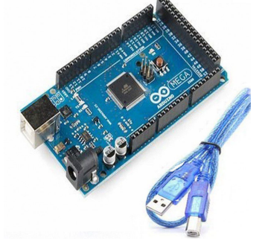
Keypad: LCD : Arduino mega:
This component has been used to enter weight and type
This components has been used to display weight and more things as we will show you

Slide 11
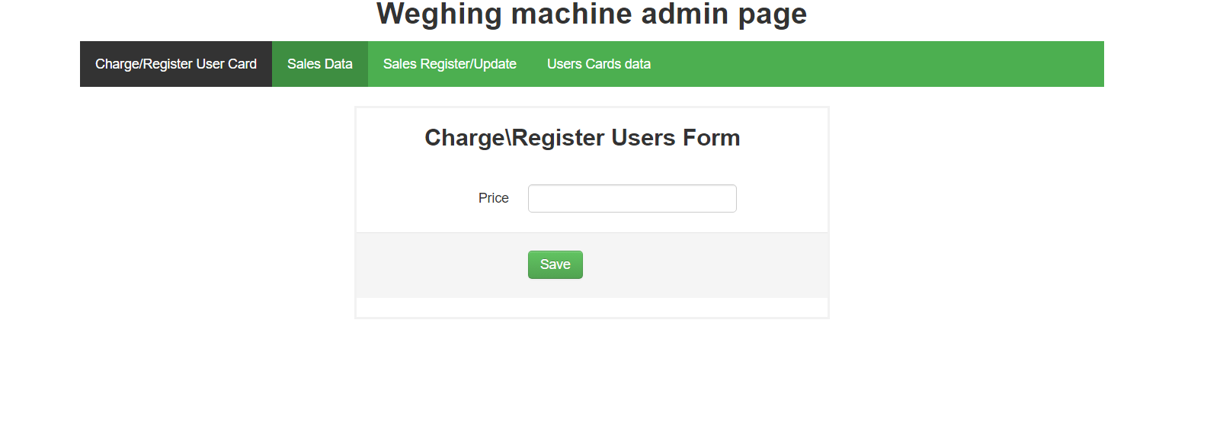
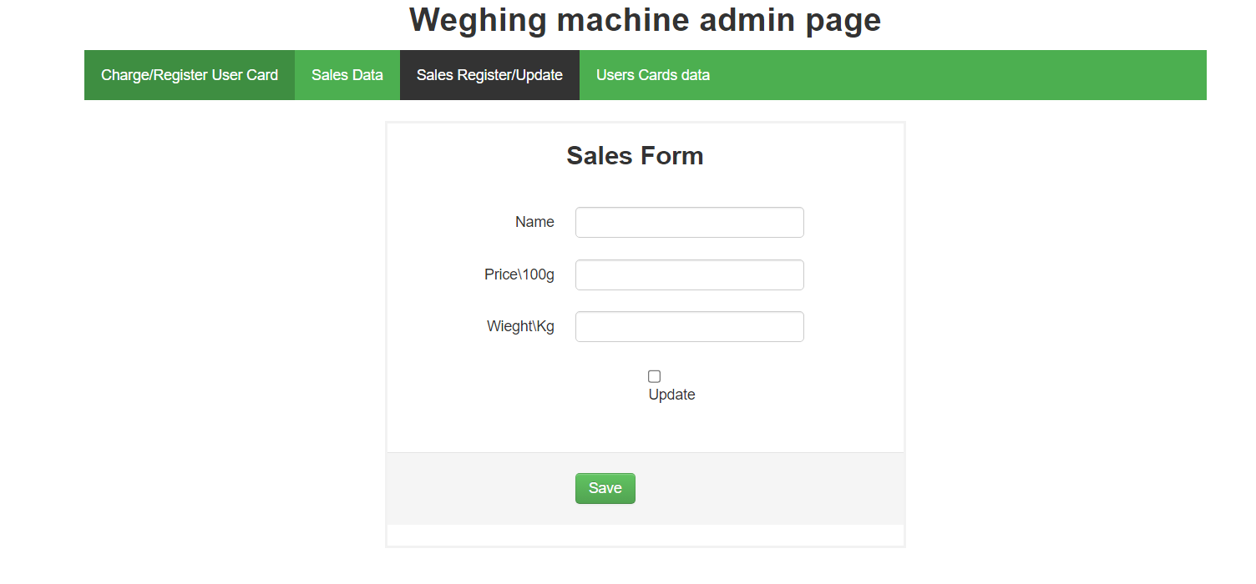
Web application

Slide 12
04
Challanges

Slide 13
1- How to make balance scale and how to make it’s frame to make it’s accuracy high in weighing objects.
2- How to make runner to move balance scale from one position to another
3- Not all components are available in the market

Slide 14
05
Future work

Slide 15
We are planning to make larger so that it will have more types rather than three types and use other components that can have more capacity rather than bottles and also to make it have a user friendly frame and the final thing we wish to make is after buy from this machine it will print a bill to the customer.

Slide 16

Thanks
Do you have any questions?

