Slide 1
A Low Power Boundary Nodes Detection Algorithm for Wireless Sensor Networks
Students:
Ahmad Lhwani
Aws Alawneh
Abed-Alrhman Mosallam
Supervisor:
Dr. Ahmed Awad

Slide 2
OUTLINE
What is a boundary nodes.
Applications and uses of boundary nodes.
Distributed Least Polar-Angle Connected Node (DLPCN) algorithm.
Modified DLPCN algorithm.
Experimental Results.
Simulation Environment.

Slide 3
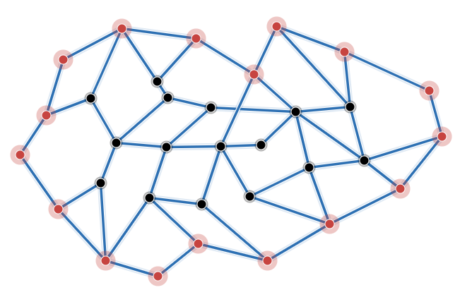
Boundary nodes
A set of nodes located on the boundaries of wireless sensor networks to do some special tasks as shown in Figure (1).
Figure 1. Nodes marked in red color represents boundary nodes.

Slide 4
Applications and uses of boundary nodes.
Help WSN in monitoring because they directly interact with the outside environment, such as events entering or leaving the region.
Monitor boundaries of strategic and sensitive sites (e.g., oil fields or nuclear sites, frontiers of a country, etc.).
Help in routing and management purposes through extracting further information about the WSN structure.
Used for detecting failure nodes in the network.

Slide 5
DLPCN algorithm
DLPCN algorithm is one of the best algorithms for boundary nodes detection, where it finds the minimal set of nodes connected to define the border of WSN.
100% accuracy.
Power consumption is only in the boundary nodes and its neighbors.
Assume there is a virtual node for leader node.
MinFind algorithm: used to choose the leader node.
Figure (2) illustrates an example of how a DLPCN work.

Slide 6
Types of messages used in DLPCN.
There are three types of messages used in DLPCN to determine the boundaries as follow.
  AC: Used to request the coordinates.
  CS: Used to send the coordinates.
    SN: Used to inform a sensor that it is a boundary node.

Slide 7
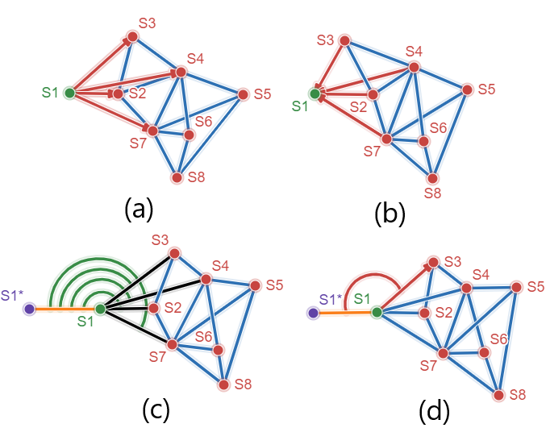
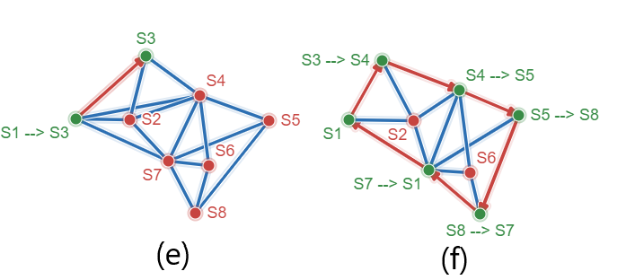
Figure 2. Simple example on DLPCN.

Slide 8
Modified DLPCN algorithm.
There are two modification as follow.
  First: This modification target the exchange messages between the boundary nodes (AC, CS).
  Second: This modification target the CS message between the boundary nodes and its neighbors.

Slide 9
First modification
Mitigation of AC broadcast.
Assume there is a parent for each node except the leader node.
Fixed infinite loop problem.
An infinite loop occurs between two nodes in the network, these nodes have two neighbors or one neighbor only.
Solutions: Each node must check these two conditions.
  If the node has only one neighbor, then it will send SN message to the parent.
  If the node is a boundary and it has only two neighbors, then it will send SN message to the parent.
Figure (3) illustrate the problem.

Slide 10
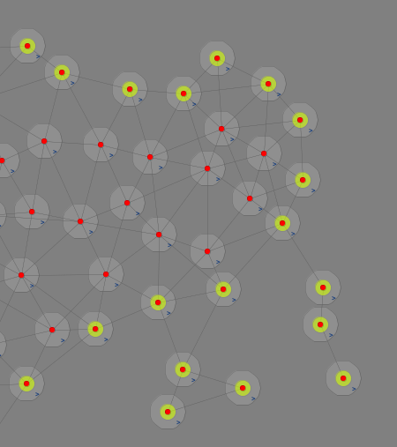
Figure 3. Illustrate the problems that arose from the modifications.

Slide 11
Second modification
Aims to cancel some of CS messages.
Depends on the shape of the network.
The problems that arose of modification:
  Occur infinite loop of waiting due to that some nodes do not receive any CS message (Figure (3)).
  Choose a node is not a boundary node as a boundary node.
  Cut-point problem.
  Receive coordinates from boundary nodes only as a response of AC message.

Slide 12
Solutions
New types of messages additionally to the original messages.
    M: Will be sent by leader node for one time only to the neighbor that has minimum Y coordinates.
    3A: Is used to force nodes to send its coordinates.
    CN: Is used to send coordinates if the node is a boundary.
Each node from inner nodes will check some of conditions to decide if will send its coordinates or not.
  It will check if it is located in the precious and next nodes, also the next node located in the transmission range for the previous node, if this condition is met, then it will not send its coordinates as a response on AC (Figure (4) and Figure (5)).

Slide 13
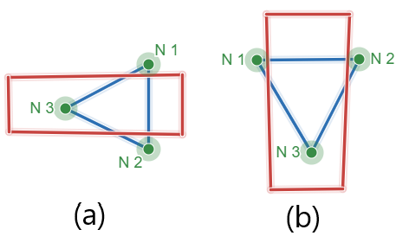
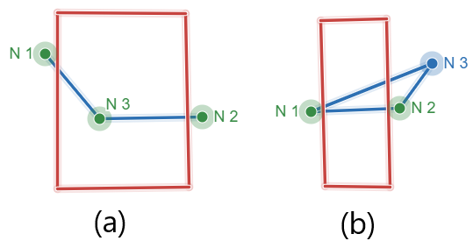
Figure 4. Node 3 will not respond in CS message.
Figure 5. Node 3 will respond in CS message.

Slide 14
Solutions
For boundary nodes, if node send AC and not receive any CS, it will send 3A to all neighbors except the parent (Figure (3)).
Each boundary node will respond of CS message regardless of any other condition.
If the boundary node receive coordinates from a boundary nodes , then it will send broadcast AC message to all neighbors except the parent.

Slide 15
Experimental results
The results are the number of total messages that are exchange in the network (Sent and received), also energy consumption in the whole network.
Figure (6) shows the comparison between the original and modified algorithms in terms of the number of messages for 6 benchmarks.
Figure (7) shows the comparison between the original and modified algorithms in terms of the energy consumption for 6 benchmarks.

Slide 16
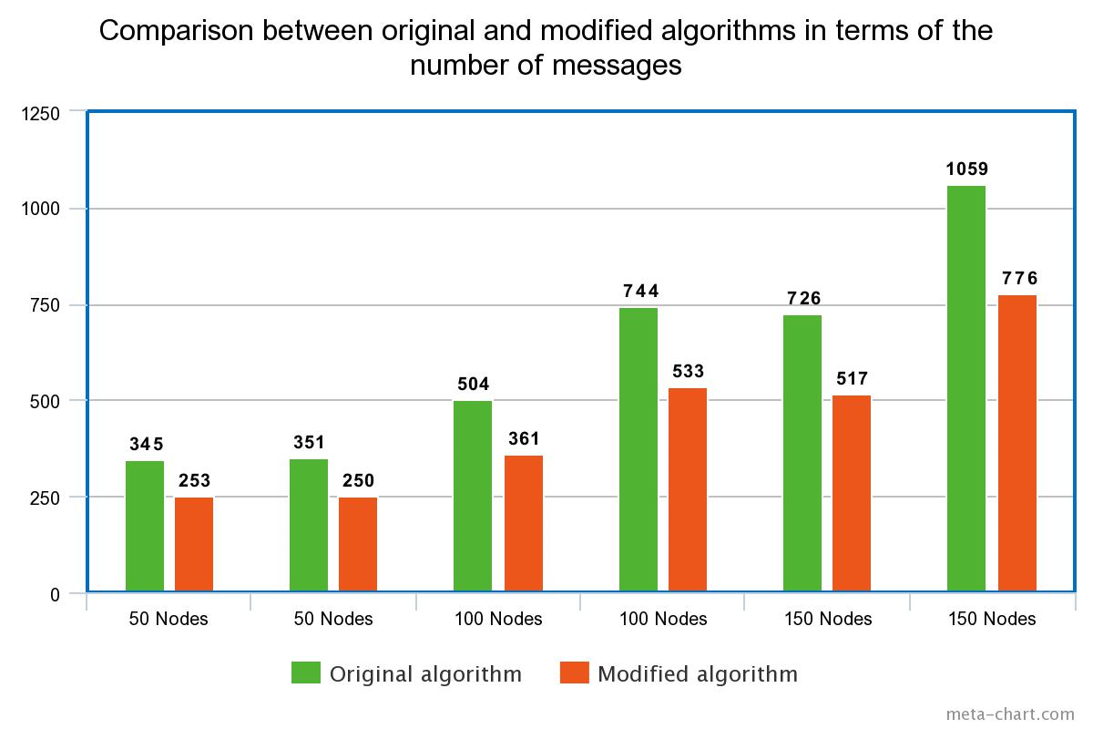
Figure 6. Comparison between original and modified algorithms in terms of
the number of messages.

Slide 17
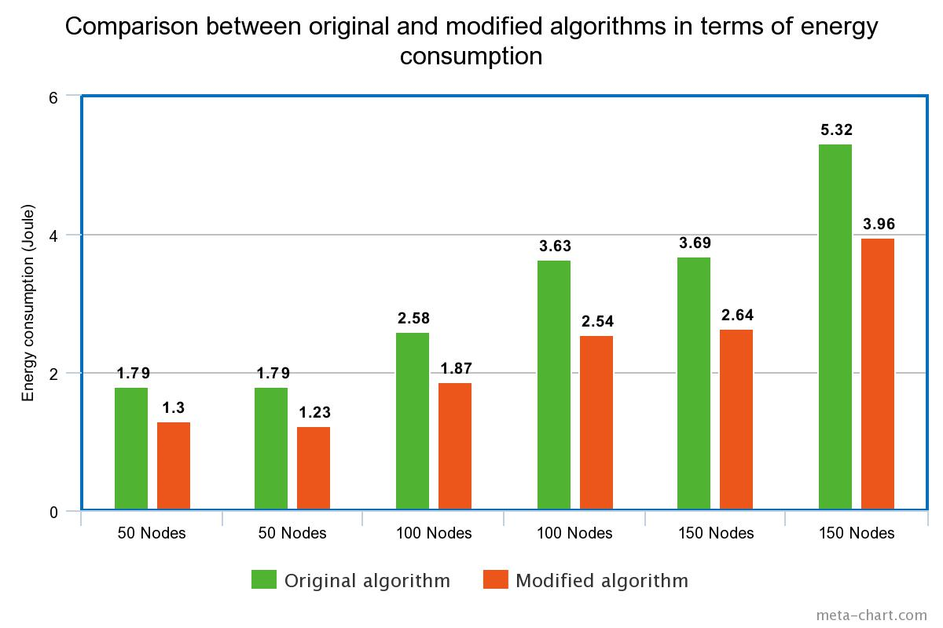
Figure 6. Comparison between original and modified algorithms in terms of
Energy consumption.

Slide 18
Simulation environment
CupCarbon simulator :
model and simulate sensor networks.
discrete event and easy to use.
Provides an environment for a multi-agent simulation.
  allows to run simulations and monitor various events and changes over time
Supports mobility.

