Slide 1
Prepared by:
Esam Fatayer
Amal Obaisi
Haneen Rifai
Supervisor :
Prof . Hamdallah bearat

Slide 2
Effect of heat treatment parameters on distribution of Mg2Si precipitate on the structure and mechanical properties of aluminum alloy 6063

Slide 3
Outlines:
Introduction
Methodology
Sample preparation
Results and discussion
Conclusion

Slide 4
Introduction:
Aluminum Alloys of the 6xxx (Al-Mg-Si system (series are the most widely used for the production of extruded sections, especially the alloy 6063 due to its chemical and physical properties. In these alloys, Mg and Si combine to form the chemical compound Mg₂Si (magnesium-silicide), the primary hardening phase.

Slide 5
The alloy composition of 6063:
Silicon minimum 0.2%, maximum 0.6% by weight Iron no minimum, maximum 0.35% Copper no minimum, maximum 0.10% Manganese no minimum, maximum 0.10% Magnesium minimum 0.45%, maximum 0.9% Chromium no minimum, maximum 0.10% Zinc no minimum, maximum 0.10% Titanium no minimum, maximum 0.10% Other elements no more than 0.05% each, 0.15% total Remainder Aluminum

Slide 6
In the manufacturing, processing starts with a cast billet of 6063 produced by vertical Direct-Chill (VDC) casting system. The billets are then stacked and inserted to the homogenizing furnace to be homogenized at 585°C for 6 hours (3 hours heating and 3 hours soaking time). Then at 585°C these billets are cooled by forced air using large electrical (rapid cooling) fans to produce supersaturated solution .

Slide 7
Homogonizing
Homogenizing is a heat treatment process in which an alloy is taken to an elevated temperature and held at that temperature for relatively long times so that chemical composition is homogeneous everywhere in the work piece .

Slide 8
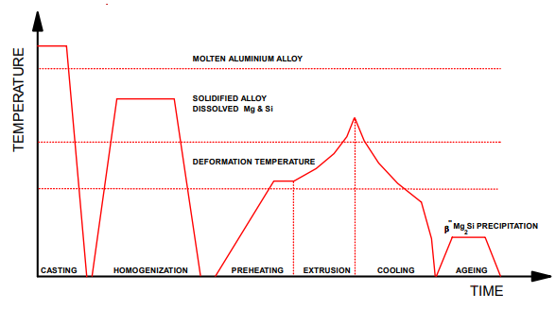

Slide 9
The strength and hardness of some metallic alloys may be enhanced by the formation of extremely small uniformly dispersed particles of a second phase within the matrix. This must be accomplished by appropriate heat treatments.

Slide 10
Methodology:
sample preparation :
The billet was cut in three parts:
1)The beginning of the billet and took No. 3
2) The middle of the billet and its took No.2
3) The end of the billet and its took No. 3

Slide 11
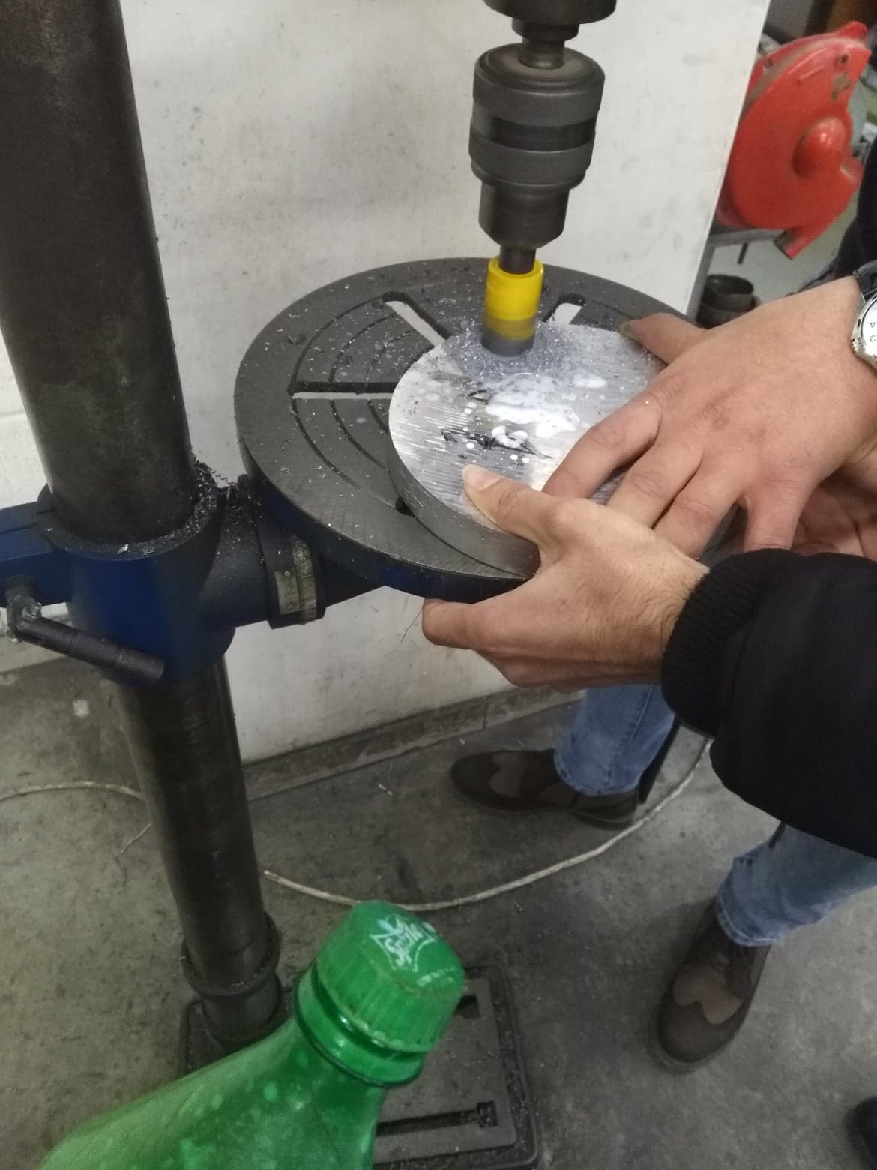
six sample from one strips by using drill with diameter 25mm and 40mm in height to be suitable for metallographic analysis and other tests were cut .

Slide 12
Then samples were grinded with a different sand papers size (320.400.600.1200) by grinding machine to remove any extra pieces and get surface without any notches and then samples was polished with polishing machine to make surface shiny and ready to metallographic study

Slide 13
Preparation for metallographic
Metallographic etchant (10% NaOH) especially designed for AL alloy was used to reveal the Mg2Si precipitates. And then the sample was etched to be prepared for metallographic tested .

Slide 14
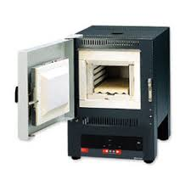
Three temperatures were suggested to work at, namely 585 °C (analogous to that originally used by the industry), 550 °C and 520 °C. Muffle furnace was used to homogenize the strips as well as the metallographic specimens.
Then six samples were taken from each site and VHN was calculated for each samples.

Slide 15
Microstructure was examined by optical microscope. To take image of microstructure and determined the volume fraction of secondary phase.
The sample that was prepared the VHN was done in different location and then the sample was homogenized at temperature at 580C with soaking time 3 hours and then the hardness test was done and the data was collected.
Another samples were homogenized at different temperature 550C and 520C and the hardness test was done and the data was collected.

Slide 16
Results and discussion
  vickers hardness test (VHT)
  as cast H.580 H.550 H.520
VHN | sample
972.4467 | 31
1021.47 | 32
926.8697 | 33
956.8878 | 34
1004.725 | 35
980.3688 | 36
1021.47 | 21
988.3882 | 22
1004.725 | 23
964.6202 | 24
996.5063 | 25
972.4467 | 26
1013.046 | 11
956.8878 | 12
996.5063 | 13
980.3688 | 14
988.3882 | 15
1004.725 | 16
VHN | sample
784.5025 | 331
801.9031 | 332
796.0391 | 333
796.0391 | 334
796.0391 | 335
796.0391 | 336
767.6621 | 221
767.6621 | 222
751.3583 | 223
778.828 | 224
751.3583 | 225
767.6621 | 226
796.0391 | 111
796.0391 | 112
790.2392 | 113
796.0391 | 114
784.5025 | 115
796.0391 | 115
VHN | sample
691.0739 | 1
695.8153 | 2
700.6058 | 3
695.8153 | 4
695.8153 | 5
695.8153 | 6
VHN | sample
835.3439 | 1
864.2853 | 2
819.8892 | 3
801.9031 | 4
807.8321 | 5
819.8892 | 6

Slide 17
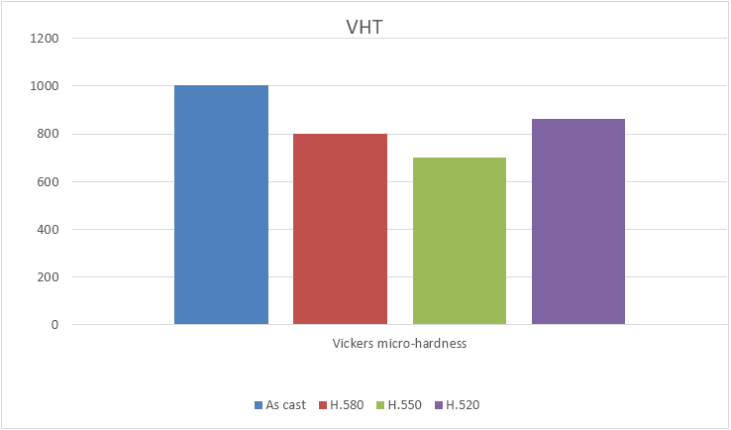
Cont.

Slide 18
Cont.
Figure shows the variation of average Vickers’s micro hardness value for solution treated samples with soaking time 3 hour at various treating temperatures (520,550 and 580 °C). Hardness is also affected by the amount of dissolved second phase particles and consequently, temperature increases the hardness is expected to increase as well .
At 580 °C more particles were dissolved and upon cooling, although part of them remained in solution, resulting in some increase in hardness compared to 550 °C treatment temperatures.
At 520°C maybe the temperature is not enough to dissolve the second phase (Mg2Si) so the average hardness is higher than sample homogenized at 580°C.

Slide 19




Micro-structure
As-cast H.580
H.550 H.520

Slide 20
Cont.
Here that there is some difference in the volume fraction due to the effect at high treating temperature.
the structure of homogenized sample at 550 °C for only 3 h soaking time compared to the structure of homogenized sample at 580 °C for 3h as soaking time. At 550 °C temperature, it is seen that finer and better particle distribution was achieved compared to severe segregation for the 580 °C treatment due to incipient melting. This means that the 580 °C treatments deteriorated the structure and eventually during long soaking time (up to 3 h) the structure brought back into almost similar to the starting (as cast) structure

Slide 21
Cont.
And although see a high amount of flow in all sample that’s led to there is not enough metal purification during smelting.
It could be conclude that more uniform distribution of the (Mg2Si) particles with more or less regular size was achieved in homogenized sample at 550 °C for only 3 h soaking time could be adopted since it gives betters microstructure than that homogenized at 580 °C for the same period (3h).

Slide 22
Conclusion
Homogenization at the temperature 550 °C of for 3h can be recommended for aluminum alloy 6063.
It could be conclude that more uniform distribution of the (Mg2Si) particles with more or less regular size was achieved homogenized structure

Slide 23
Cont.
High hardness number is not recommended for extrusion process.
The homogenization of aluminum alloy billets intended for extrusion is an essential part of the manufacturing process.

Slide 24
Cont.
There is a strong relationship between the heat treatment mode and extrudibility due to distribution of the secondary phases (Mg₂Si).
The size, distribution, and morphology of Mg₂Si particles in Al matrix are influenced by various factors of the processing steps for producing aluminum extrusions.

Slide 25
question time

Slide 26
Thanks
☺

