Slide 1
Human Resources Management System for Small Businesses

Slide 2
BY
Hamed Saleh Hamdan
Mahmoud Adnan Suboh
Supervised :
Dr. Amjad Hawash
Dr.Kamal Irshaid

Slide 3
HRMS
A Human Resource Management System or (HRMS): is a form of HR software that combines a number of systems and processes to ensure the easy management of human resources, business processes and data .

Slide 4
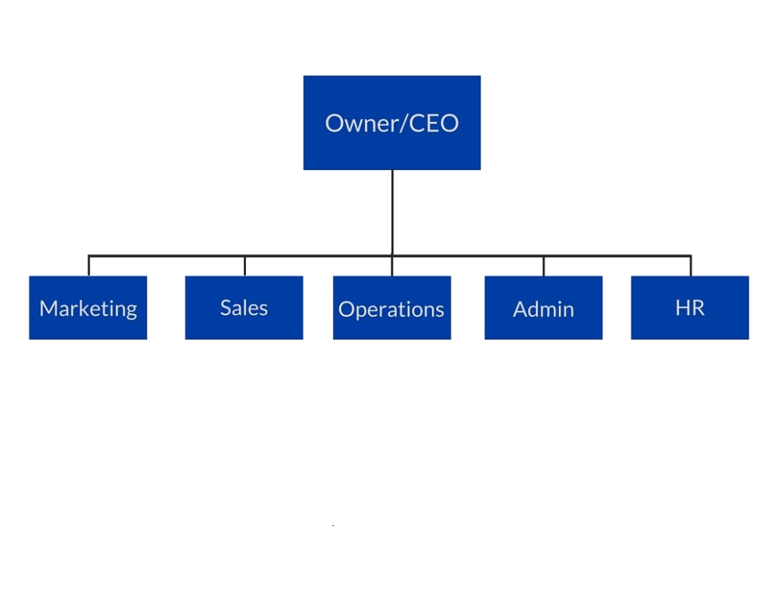
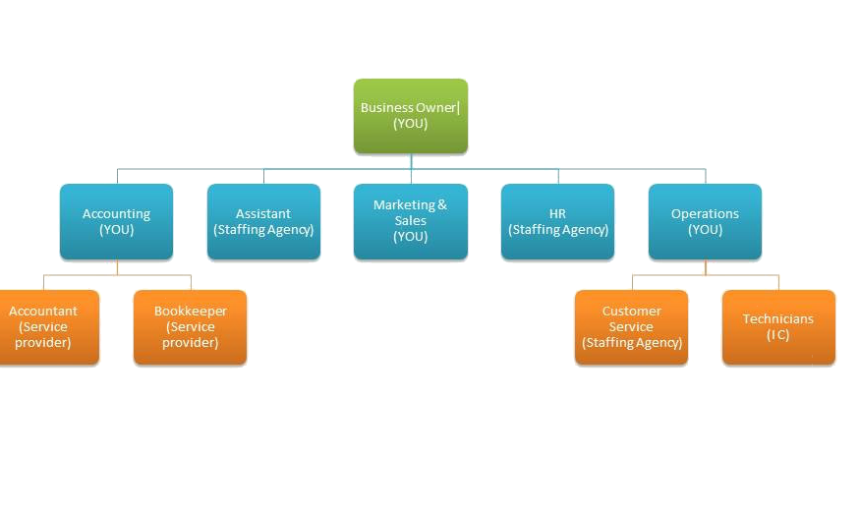
Example of structure of small business

Slide 5
Why we use HRMS in small business ?
Cash Flow Issues
Employee Relations
Hiring Process
commitment of employees
control , supervision and monitoring issue

Slide 6
Project Objective Statement
Financial objective
Organizational Objectives
Management Objectives
Time & attendance management

Slide 7
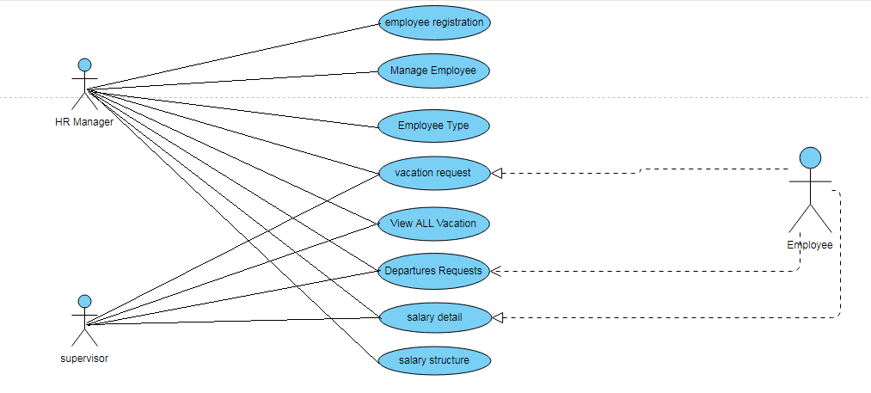
use-cases diagram

Slide 8
Systems that the project handles
Departures Management System :
A Departure system in the project handles all employee departures requests while ensuring smooth functioning of their operations.

Slide 9
Requesting for departures
As an employee :
The employee request Departure and waiting for your reply from your supervisor or HR manager (if supervisor was not present) .

Slide 10
Requesting for departures :
As a Supervisor :
You respond to the department’s employees requests by rejection or acceptance , supervisor can also request Departure and waiting for your reply from HR manager.

Slide 11
As HR Manager :
You respond to the request by rejection or acceptance to employee in case of the absence of the supervisor, and can accept the supervisors departures .

Slide 12
Systems that the project handles
Vacation Management System :
A vacation management system in the project that handles all employee vacation requests while ensuring smooth functioning of their operations.

Slide 13
Requesting for vacation
As an employee :
You request a vacation and waiting for your reply from your supervisor or HR manager (if supervisor was not present) .

Slide 14
Vacation management system
As a supervisor
He respond to the request by rejection or acceptance , supervisor can also request Departure and waiting for your reply from HR manager.

Slide 15
As HR manager
He respond to the request by rejection or acceptance to employee in case of the absence of the supervisor, and can accept the supervisors vacation .

Slide 16
Employee Profile Management System :
HR manager is responsible for adding Employee and updating their profiles .
One of the responsibilities of the HR manager is to determine the supervisors for each employee

Slide 17
Employees Classifications
HR Manager is responsible for adding Employees Classifications by adding job title and salary , to add them to the profile of the employee

Slide 18
Systems that the project handles :
Salary Management System
process refers to the administration of an employee's financial records which includes the salaries, wages, deductions, and net pay .

Slide 19
Salary Management System
HR manager is responsible for create salary cycle to all employee and know total amount of salaries to prepare the financial report .

Slide 20
Questions

