Slide 1


The assessment of Ratalix ERP and Supply Chain “ The Case Study of Bravo”
An-Najah National University
Engineering & IT Faculty
Industrial & System Engineering Department
Prepared By:
Essam Qadri
Supervised By:
Dr. Mohammed Othman

Slide 2

Project Outline
Introduction
Constraints
Methodology
Key Performance Indicators “KPIs”
Summary And Recommendations

Slide 3

INTRODUCTION
Retailing & Bravo Background
Objectives
Problem Statement
Retalix Implementation in bravo
Project Significance
SWOT Analysis
Assessment Policy

Slide 4

OBJECTIVES
Set an Example for Using ERP
Successes , Challenges and Roadblocks
Measure Efficiency , Profitability & Liquidity of Bravo ( Through KPIs)
Judging the Performance to Assess The ERP

Slide 5

ERP “ Retalix” Implementation
In Bravo o
2009
Retalix Initiation
2005
Openning
AccPac

Slide 6

Supply Chain and Retalix Story
In Bravo
IT
Category
Supply Chain
Financial
Marketing
Operations
Human Resources
Safety & Maintenance
Decision Taking

Slide 7

SWOT Analysis
SWOT Analysis
Strengths
Weaknesses
Opportunities
Threats
SOPs
Wizcount integration
Decision Taking
expensive
Resistance
legacy
Professional screening
Integration
HR
Expiration
Safekeeping
Waste elimination
Disruptive Technology
Better Soft wares
Data Sharing
Competitive advantage
Cut offs

Slide 8

Introducing the Assessment Policy
Setting Performance & Financial KPIs
Lack of Data Accessibility
Adopt the Time Series Theory ( The Phases)
Conduct An internal Comparative Study (PEX)
Results, Analysis & Interpretation

Slide 9

Constraints
Lack of Competition
Coordination
Cooperation
Data Accessibility
ERP customization and Benchmarking difficulties
The lack of knowledge in The SCM Field.
Financial and systematic data

Slide 10

METHODOLOGY
Quantitative Data collection
Calculating the KPIs & the Ratios
Validity & Reliability
Qualitative Data
Collection
Adopting Time Series Theory
Data Analysis

Slide 11

Qualitative Data Collection

Slide 12

Data from Departments
Random Customers
Data from stores

Slide 13


Quantitative DATA COLLECTION
Bravo Annual reports
Extracting the Right KPIs
Data Relating to Bravo
Interviews

Slide 14
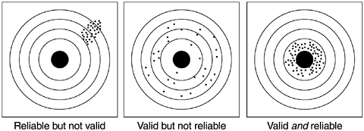
Validity and Reliability

Slide 15

DATA ANALYSIS
Detailed
Excel
sheets
Summary
excel sheets

Slide 16
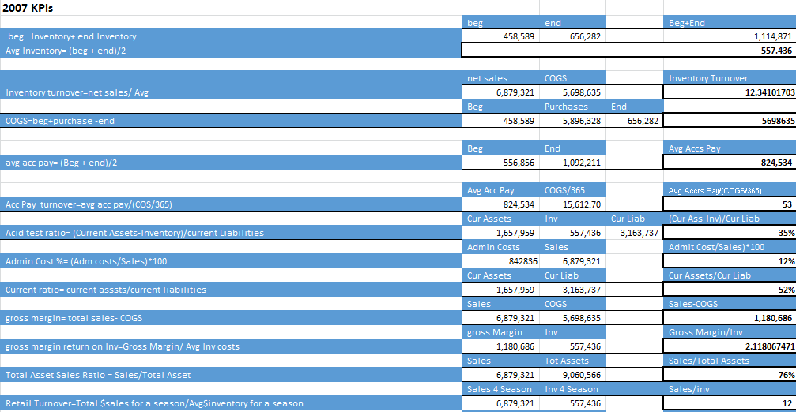
Detailed Excel Sheet

Slide 17
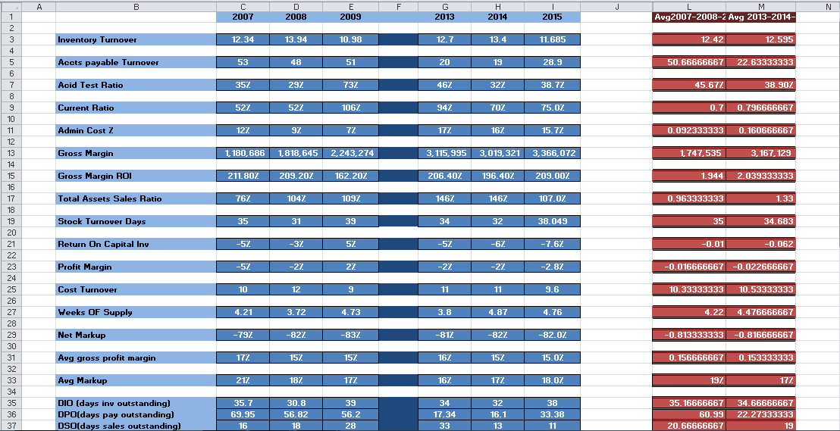
Summary Excel Sheet

Slide 18

Key Performance Indicator “KPI”
KPI is the Value that shows and measures how effectively a company is achieving key business objectives

Slide 19

KPIs and the Relevant Ratios
Profitability & Sustainability Ratios
Leverage & Other Ratios
Operation Efficiency Ratios
Liquidity Ratios

Slide 20

The comparative Study

Slide 21
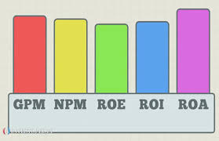
Profitability & Sustainability Ratios
Sales Growth
Return On Assets
Total Assets to Sales Ratio
Average Gross Profit Margin
Sales Per Square Meter

Slide 22
Sales Growth
 | Sales Growth
Phase 1 (2007,2008,2009) | 43.6%
Phase 2 (2013,2014,2015) | 6.6%
it still doesn’t clearly reflect the exact and precise direct indicator of a future growth due to many factors such as exceptional conditions as the occupation as well as others like the constantly changing economic conditions.

Slide 23
Return on Assets
 | Return on Assets (ROA)
Phase 1 (2007,2008,2009) | 0
Phase 2 (2013,2014,2015) | -2.67
The return on assets contributes in determining how efficient the managements is utilizing its assets to generate revenues and earnings , usually the investors notice how the company accomplishes its procedures on converting the money from the invested capital into net income. So the decrease in the ROA means that the market value of the share is decreasing ) which should probably get the shareholders to rethink about their investment.

Slide 24
Total Assets Sales Ratio
 | Total Asset Sales Ratio
Phase 1 (2007,2008,2009) | 0.963
Phase 2 (2013,2014,2015) | 1.33
This ratio is usually existed to describe how efficiently the system utilize its assets to generate Sales and revenues, we can notice that there is a slight increase in the Assets to Sales ratio between the 1st and the 2nd , a deviation of 0.367 is existed between the phases which concludes that bravo isn’t converting assets into sales as effectively as it could do .
This could be connected to the new procedures in improving investment strategies and it could also be relevant to misusage or lack of proper integration between the retalix and the wiz count.

Slide 25
Sales Per Square Meter
 | Sales Per Square Meter
Phase 1 (2007,2008,2009) | 1651
Phase 2 (2013,2014,2015) | 2833
Adequacy of the Layout.
Sales workforce.
Customization of the rented warehouses and stores.

Slide 26
Operational Efficiency Ratios
Accounts Payable Turnover
Accounts Receivable Turnover
Stock Turnover Day
Inventory Turnover
Days Payable Outstanding
Days Sales Outstanding
Cash Conversion Cycle
Operation Profit Margin

Slide 27
Accounts Payable Turnover
 | Accounts payable Turnover
Phase 1 (2007,2008,2009) | 50.6
Phase 2 (2013,2014,2015) | 22.6
the fluctuation between the two phases is totally notices due to right usage of the ERP which used an advanced way of scheduling with the suppliers and the creditors.

Slide 28
Stock turnover Days
 | Stock turnover Day (DIO)
Phase 1 (2007,2008,2009) | 35.1
Phase 2 (2013,2014,2015) | 34.6
, we can notice that that in both phases there is almost a steady stock turnover and this high turnover indicates that stock is being sold rapidly and there is a small portion of unused inventory being stored (storage shortage).

Slide 29
Inventory Turnover
 | Inventory Turnover
Phase 1 (2007,2008,2009) | 12.42
Phase 2 (2013,2014,2015) | 12.595
The Deviation in bravo shows that the ERP didn’t significantly affect the inventory turnover so some recommended notes are stated here:
Better Forecasting, Improved Sales,Reduce the Price , Better inventory Price, Focus on the Top selling Products , Better order management, Eliminate safety stock and old inventory, Reduce Purchase Quantity

Slide 30
Days Payable Outstanding
 | Days Payable Outstanding (DPO)
Phase 1 (2007,2008,2009) | 60.99
Phase 2 (2013,2014,2015) | 22.27
It’s seen that Bravo’s policy for the first phase to pay their creditors took a pattern of high DPO (61 days) which means that bravo held more money on hand .
bravo has definitely stretched down the days to pay their vendors to 22 days so that they can keep their discounts which also means that bravo has enough free cash.

Slide 31
Cash Conversion Cycle
 | Cash Conversion Cycle (CCC)
Phase 1 (2007,2008,2009) | -5
Phase 2 (2013,2014,2015) | 31
The negative number of -5 of the first phase shows that bravo didn’t use to pay its suppliers until bravo receives the payments of the sold goods to its customers. This policy is usually held by the online retailers as they don’t need to pay much holding cost as they don’t keep much inventory.

Slide 32
Operating Profit Margin
 | Operating Profit Margin OPM (EBIT & Revenues)
Phase 1 (2007,2008,2009) | -2.33%
Phase 2 (2013,2014,2015) | -0.33%
The OPT for the 1st phase (-2.33) starts to increase in the 2nd phase to reach (2nd -0.33) which implies a deviation of almost 2% which means the company will start making more money per unit cost of sales.
It’s seen that Bravo so far isn’t considered as profitable as it should be .

Slide 33
Liquidity Ratios
Acid Test Ratio
Current Ratio
Gross Margin Return On investment G.M.R.O.I
Return on Capital Invested

Slide 34
Acid Test Ratio
 | Acid Test Ratio
Phase 1 (2007,2008,2009) | 45.67%
Phase 2 (2013,2014,2015) | 38.90%
It’s financially seen that there is a decrease of 7% of Bravo’s capabilities in its liquidation procedures which is related to dealing with short-term liabilities

Slide 35
Current Ratio
 | Current Ratio
Phase 1 (2007,2008,2009) | 70%
Phase 2 (2013,2014,2015) | 80%
We can notice that there is an increase of 0.1 in phase 2 which means that bravo has been through a procedure of liquidation improvements due to investments ( the new Branch of Nablus)

Slide 36
Gross Margin Return On Investment
 | Gross Margin ROI(G.M.R.O.I)
Phase 1 (2007,2008,2009) | 190%
Phase 2 (2013,2014,2015) | 204%
The G.M.R.O.I is an Inventory profitability evaluation ratio that examines a company’s capacity to transform inventory into cash over the expense of the stock.
The ratios of the Two Phases ( 1st Phase 190% , 2nd Phase 204%) implies an increasing prices of selling the products more than the cost of acquiring those products.

Slide 37
Return on Capital Invested “ Employed
 | Return on Capital Invested (employed)(ROEC)
Phase 1 (2007,2008,2009) | -1%
Phase 2 (2013,2014,2015) | -6%
The ROEC is an essential ratio for detecting profitability , by making a decision of how efficiently and effectively the management has deployed its resources , we can notice that there is a decrease by( -5%)on the second phase , but its somehow related to the new bravo investment branch in Nablus and its shown in the detailed excel sheet but hidden in the average though , as in 2015 there was (-7.6%) ROEC which is considered an increasing ratio above any value over the last 9 studies years

Slide 38
Other Ratios
Weeks OF Supply
Average Markup of the Product Mix

Slide 39
Return on Capital Invested “ Employed
 | Weeks of Supply
Phase 1 (2007,2008,2009) | 4.22
Phase 2 (2013,2014,2015) | 4.47
This indicator shows a clear sustainable process of supplying shipments of bravo of a time series of two different phases with two different input variables, which implies that this slight number deviated leads to a constant supplying procedures

Slide 40
Average Markup of the Product Mix
 | Average Markup of the Product Mix
Phase 1 (2007,2008,2009) | 19%
Phase 2 (2013,2014,2015) | 17%
There markup percentages mean that bravo has altered its pricing policies to a decreasing markups and increasing in production or sales in this situation so it can stay competitive, as a result it decreased almost 2% in the second phase

Slide 41

SUMMARY
and
CONCLUSIONS

Slide 42
Summary
Profitability
Liquidity
Efficiency

Slide 43
Recommendations
Bravo should be More Profitable and increase its liquidity.
Bravo has to increase the net income ,it can be partially done by a purchasing strategy and the brand value.
Redesigning the Stores Layouts.
Workforce Efficiency.
Correctly allocating the cost and the overhead

Slide 44


