Slide 1
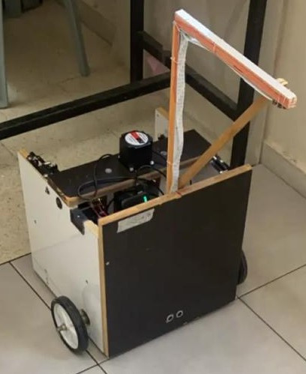


TGFR
Tile Grout Filling Robot
Supervised By: Dr. Raed Al-Qadi
Names:
Yazan Al-Sedih
Bara Al-Sedih
Graduation Project 1 TGFR

Slide 2

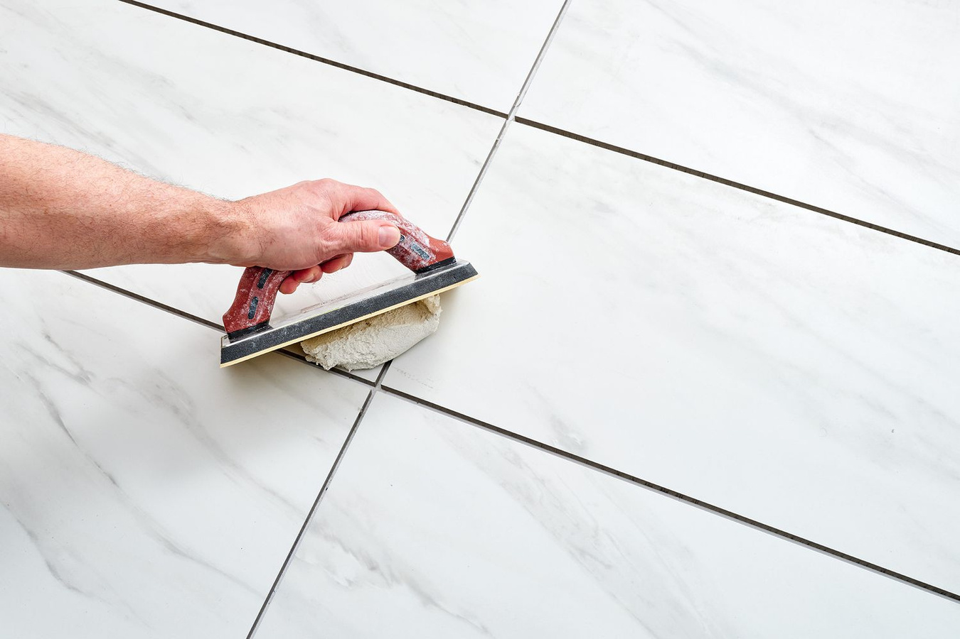

Table of
Contents
01
Introduction
05
Control
02
Design
06
Constraints
03
Components
07
Future Work
04
Features
Graduation Project 2 Table of Contents

Slide 3
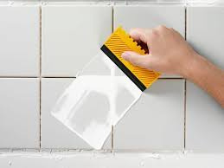
Introduction
Background
Objectives
  Project Inspiration: The need for automated grout filling in tiling projects.
  Project Uniqueness: A robot that performs the task autonomously, reducing human effort.
  Relevance: Targeted at improving the efficiency and accuracy of manual labor.
  Reduce Time and Effort: The robot is designed to automate the grout filling process, saving time.
  Minimize Injuries: The robot eliminates repetitive manual tasks that may cause strain or injury.
  Improve Accuracy: Enhanced precision in applying grout consistently across tiled surfaces.
Graduation Project 3 Introduction

Slide 4
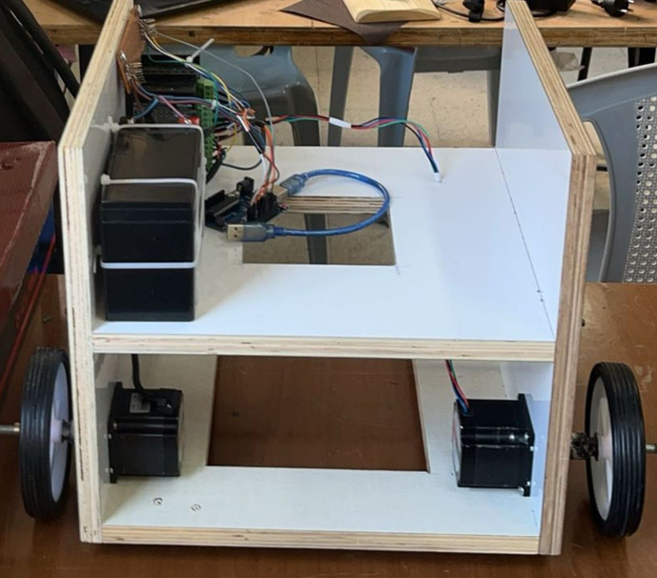
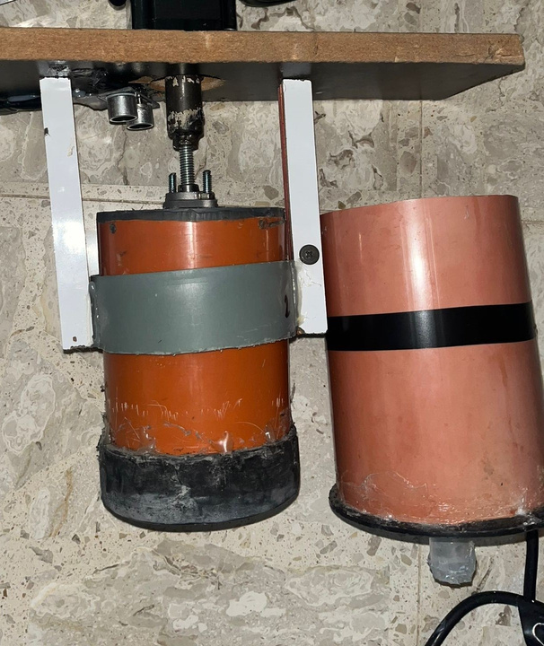
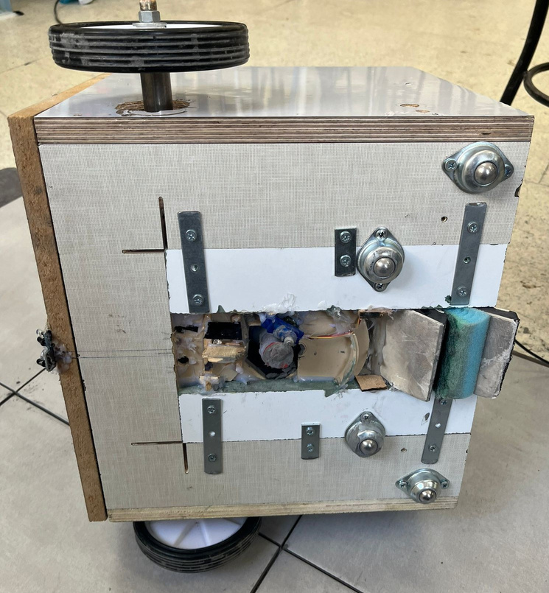
Design
Chassis
Pressing and pushing the grout
Clean the grout
Graduation Project 4 Design

Slide 5
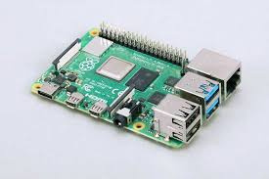
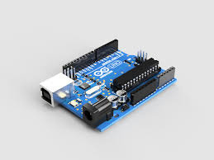
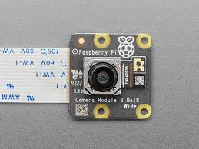
Component
Raspberry Pi Camera Module 3 NoIR
Raspberry Pi 4
Arduino Uno R3
Graduation Project 5 Component

Slide 6
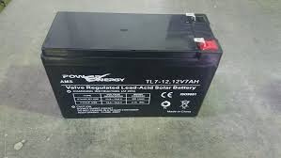
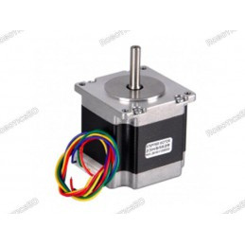
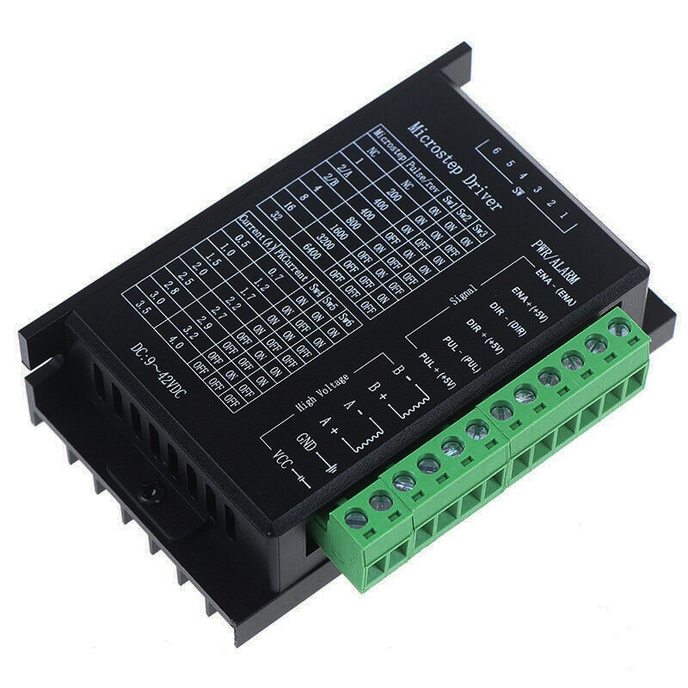
Component
Nema 23 Stepper Motor
Microstep Driver
Battery 12v 7ah
Graduation Project 6 Component

Slide 7
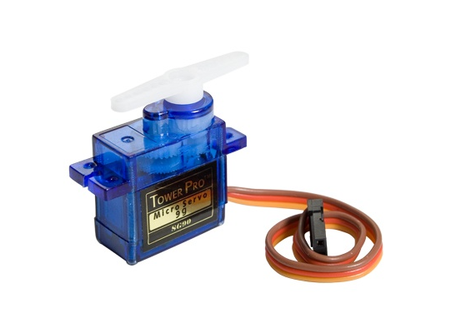
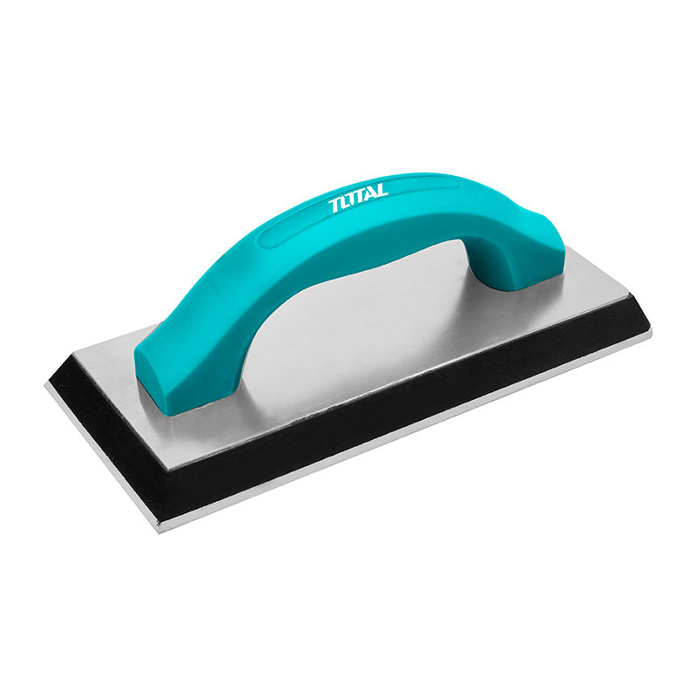
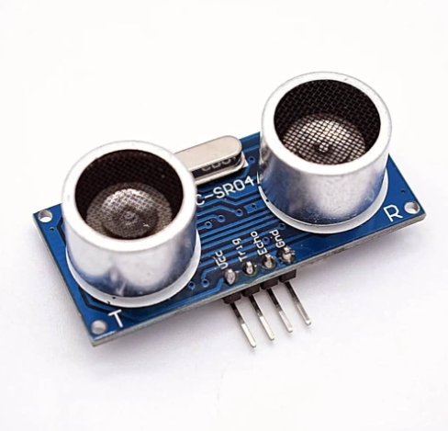
Component
Ultrasonic Sensor
Servo Motor
Grout Float
Graduation Project 7 Component

Slide 8





Features
Control and Flexibility
Accuracy
Mobility
Speed
Using methods and algorithms to complete the process with good accuracy.
Equipped with wheels and sensors, can navigate different tiled surfaces, adjust to varying layouts, and avoid obstacles effectively.
Moves with acceptable speed and precision.
Supports manual and automatic modes.
Graduation Project 8 Features

Slide 9
Control
  Image Processing Algorithm: Identifies the tile edges for accurate grout filling.
  Control System: Commands motor actions based on the tile sizes, and there is also a manual mode.
  Webpage Interface: Enables remote monitoring and both manual and automatic control of the robot.
Graduation Project 9 Control

Slide 10
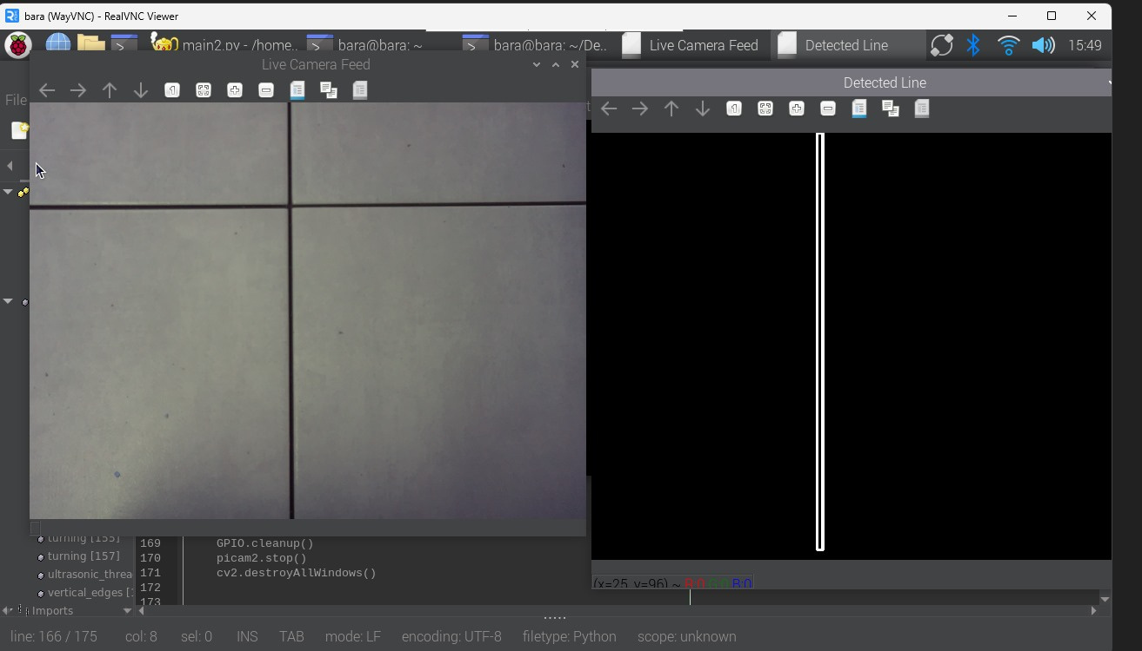
Image Processing
Graduation Project 10 Control

Slide 11
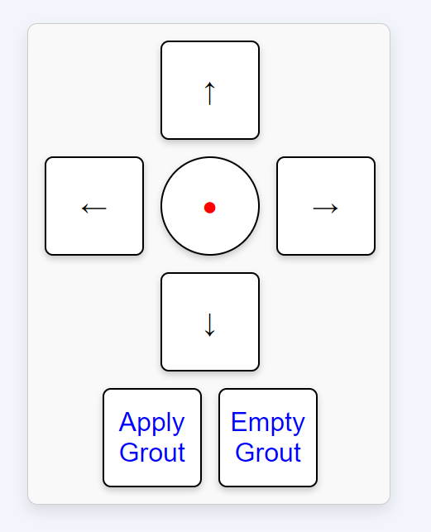
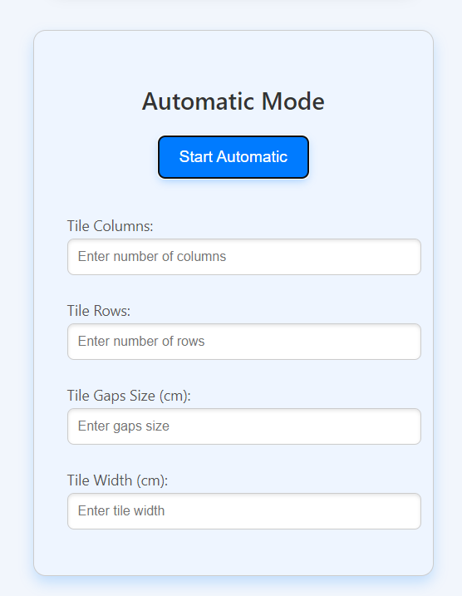
Control System
Graduation Project 10 Control

Slide 12
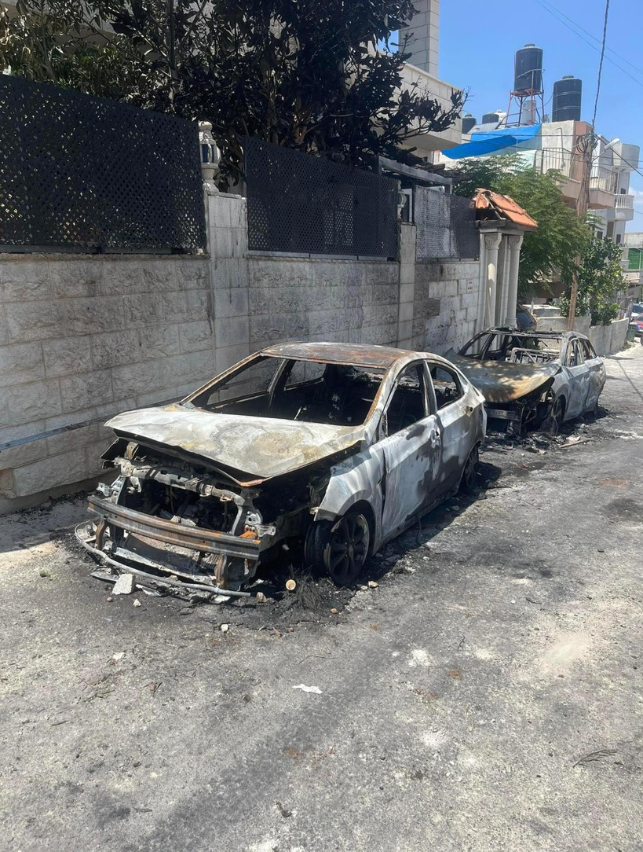

Constraints
01
02
03
Budget and time Limitations
Size and power Constraints
Image Processing Limitations
Graduation Project 11 Constraints

Slide 13
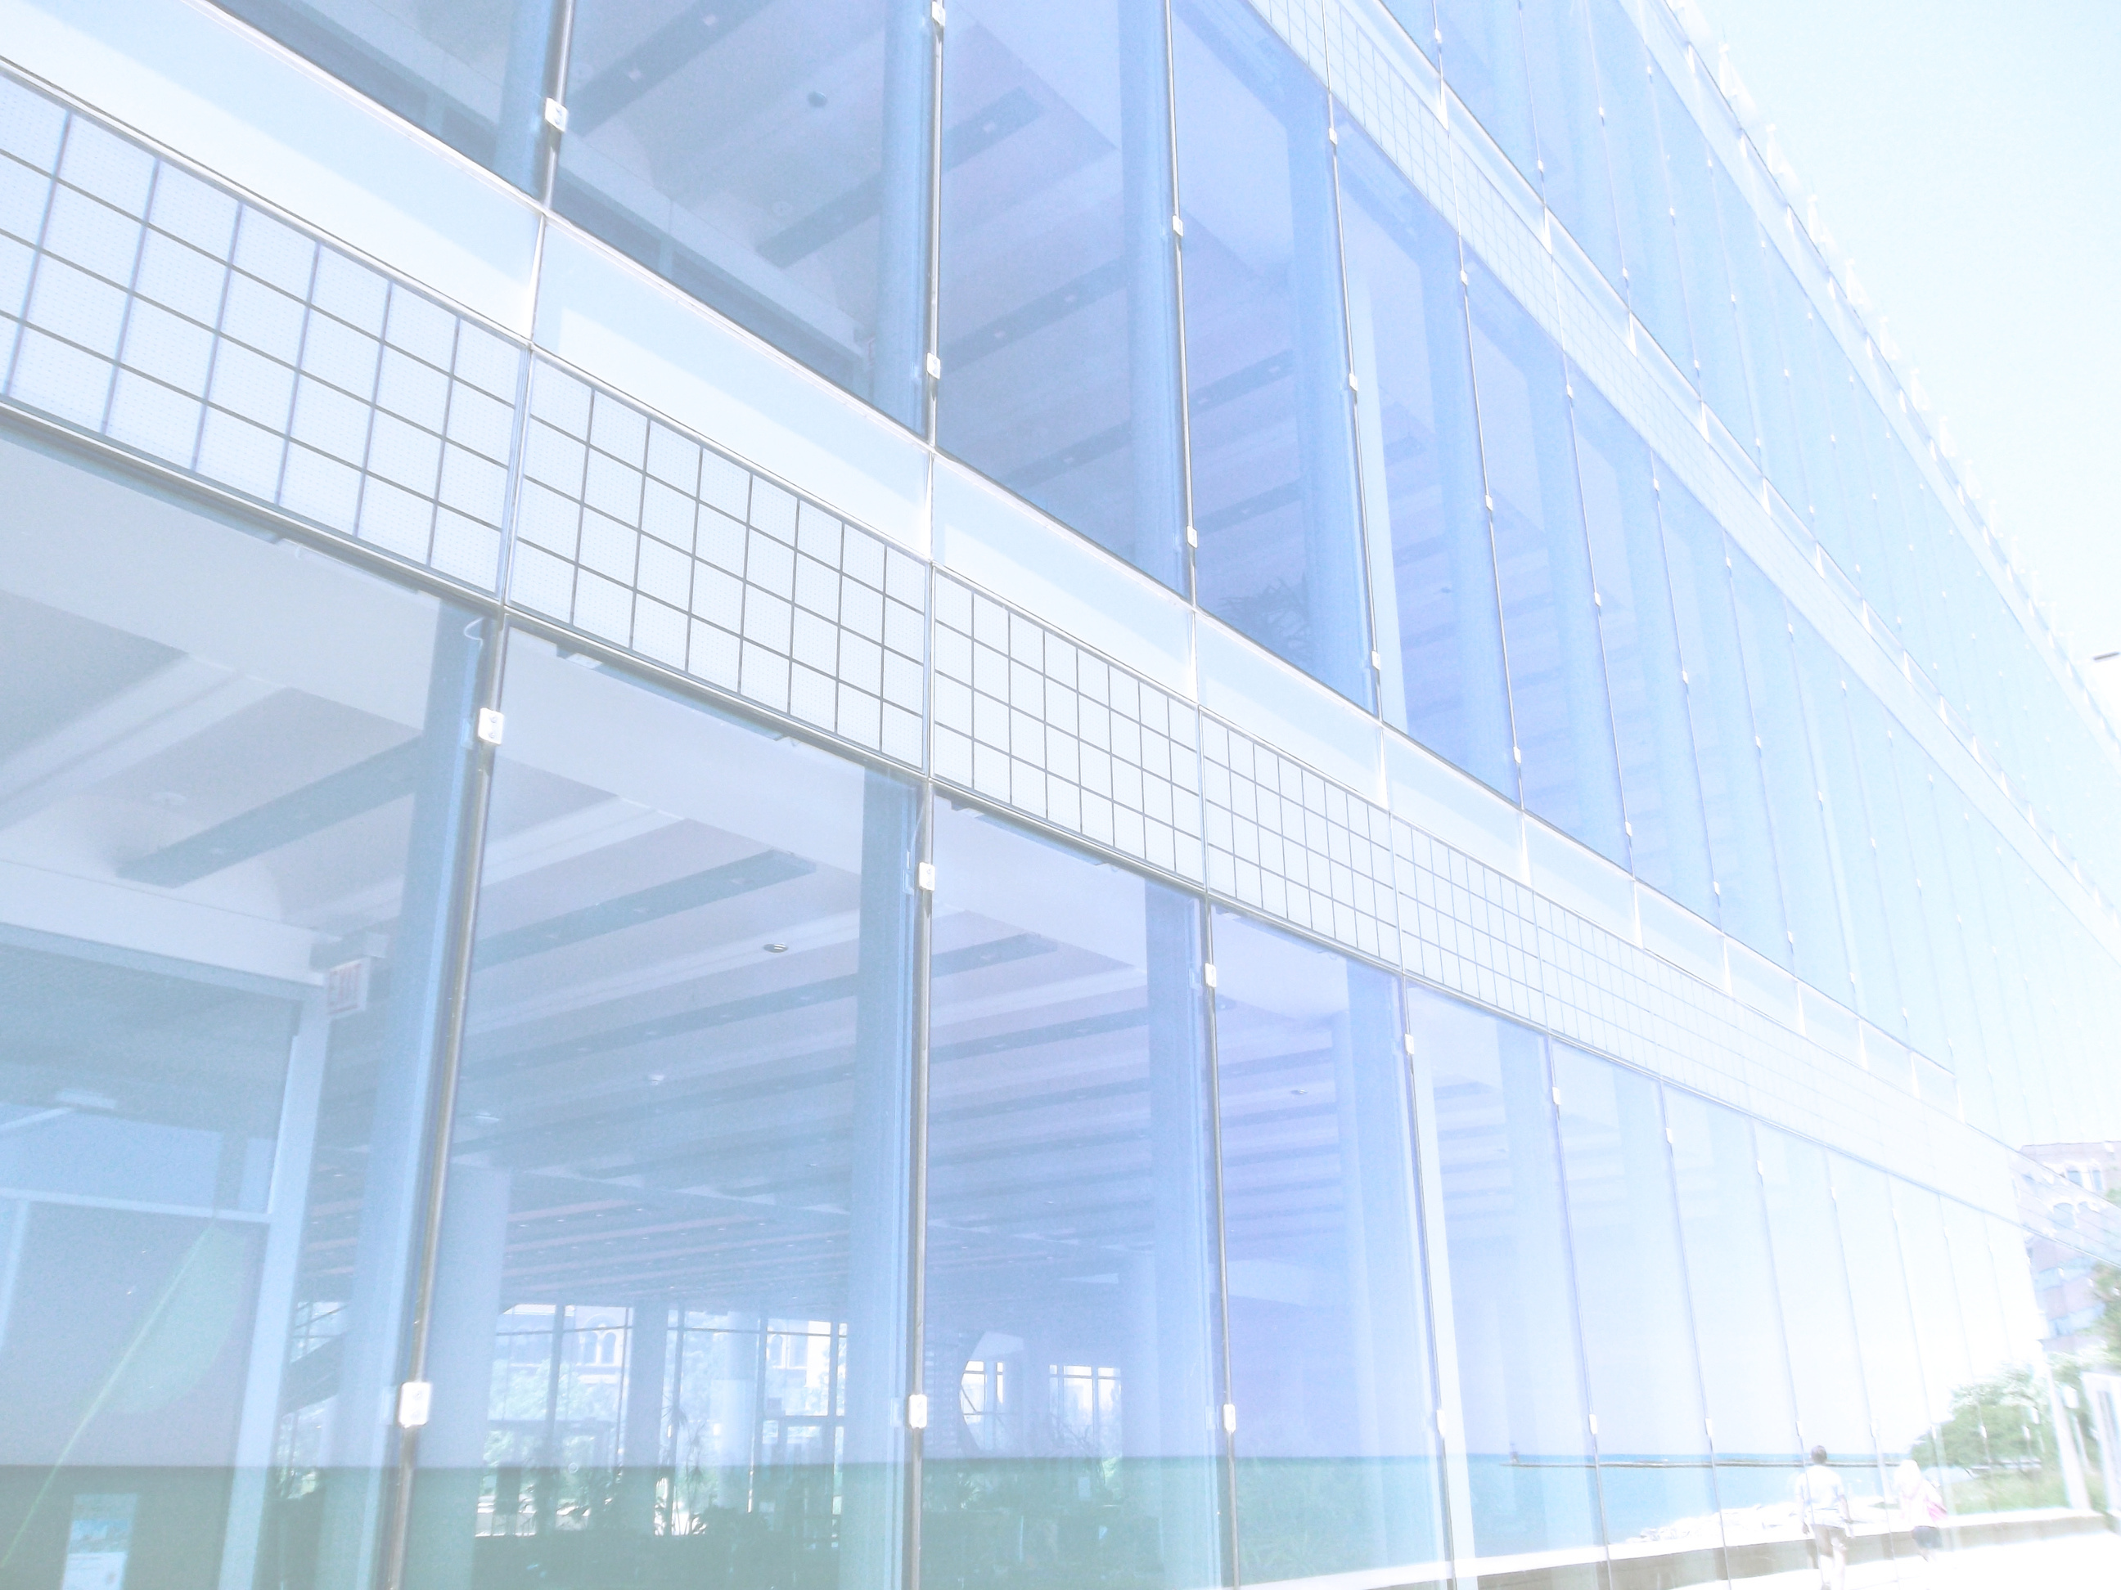

Future work
  Enhancing Speed: Improving motor capabilities for faster operation.
  Increasing Capacity: Expanding the grout container for longer use.
  Cleaning Mechanism: Adding a function to clean excess grout after filling.
  Further Automation: Exploring more advanced AI algorithms for autonomous navigation.
Graduation Project 12 Future work

Slide 14

TGFR
Thank You!
Graduation Project 13 TGFR

