Slide 1

Stocktaking Management System
Taher Dweikat
Ahmed Dweikat
Supervised by Dr. Aladdin Masri

Slide 2
Agenda
Problem Statement
Technologies
Methodology
Quality Factors
Future Work

Slide 3
Problem Statement

Slide 4
Technologies
Android Studio
ASP.Net
DevExpress Components (COTS)
  Common Tools
  Dashboard Designer
HTML & CSS
SQL Database
SHA256
JSON .Net

Slide 5
Methodology
Requirements Analysis
Database
Web Application
Android Mobile Application
Honeywell Barcode Reader (Voyager 1602g)

Slide 6
Requirements Analysis
Studying requirements with Isra Software & Computer Company’s CEO Mr. Husam Dweikat

Slide 7
Database
Microsoft SQL Server Management Studio 2008.
SQL Server Express
Normalized database.
Layer generator.

Slide 8
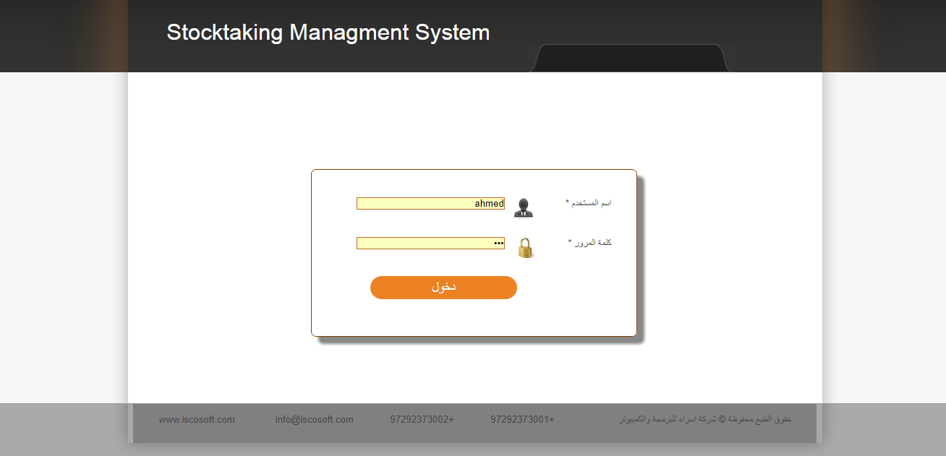
Web Application

Slide 9
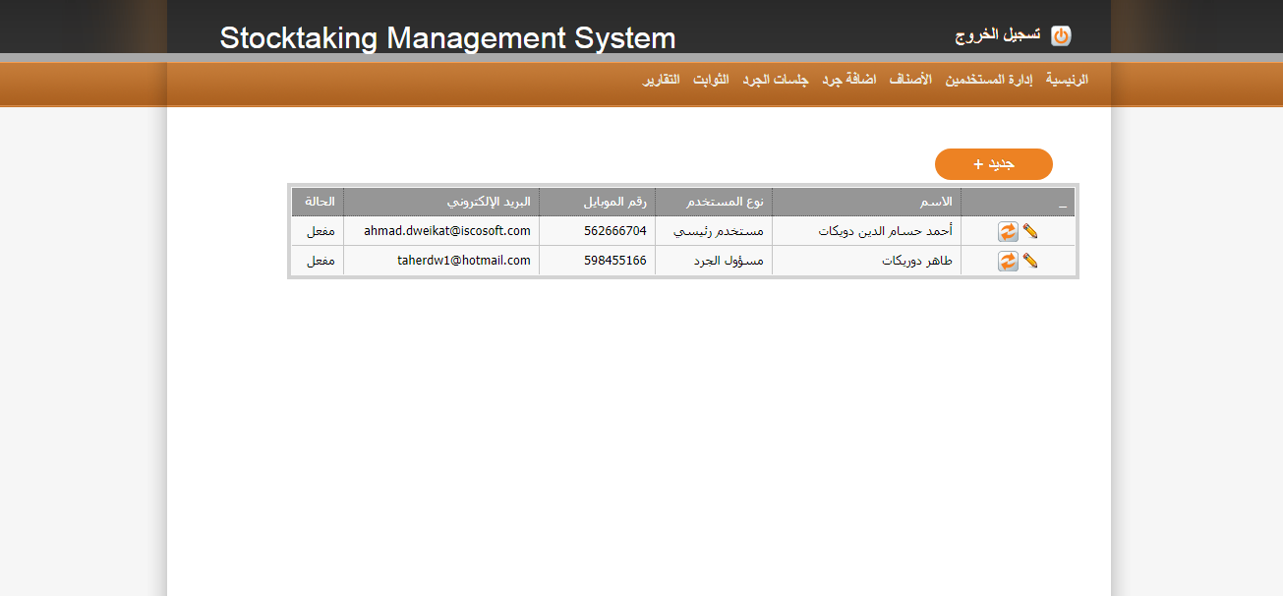

Slide 10
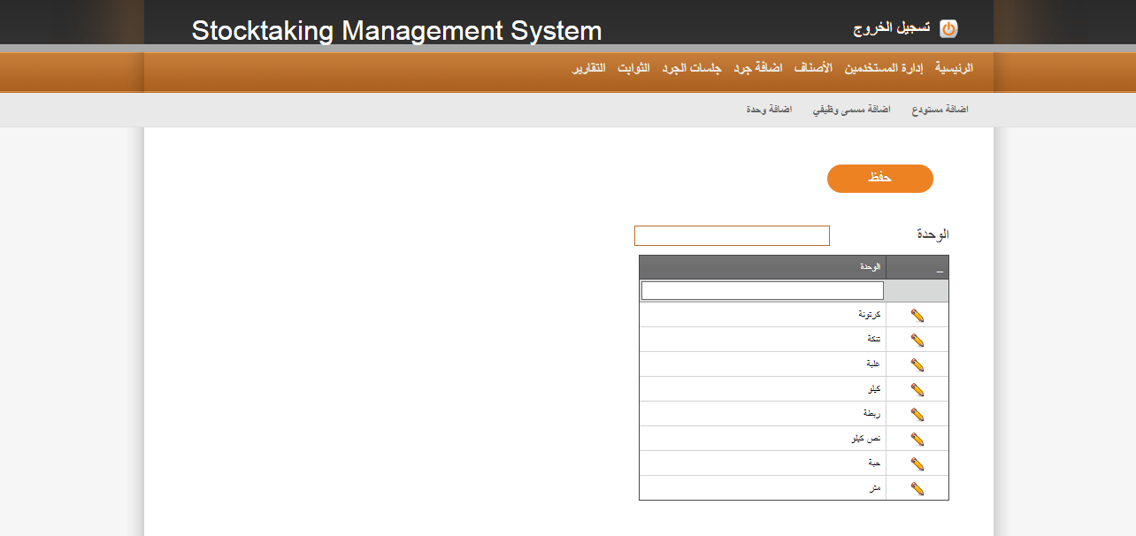

Slide 11
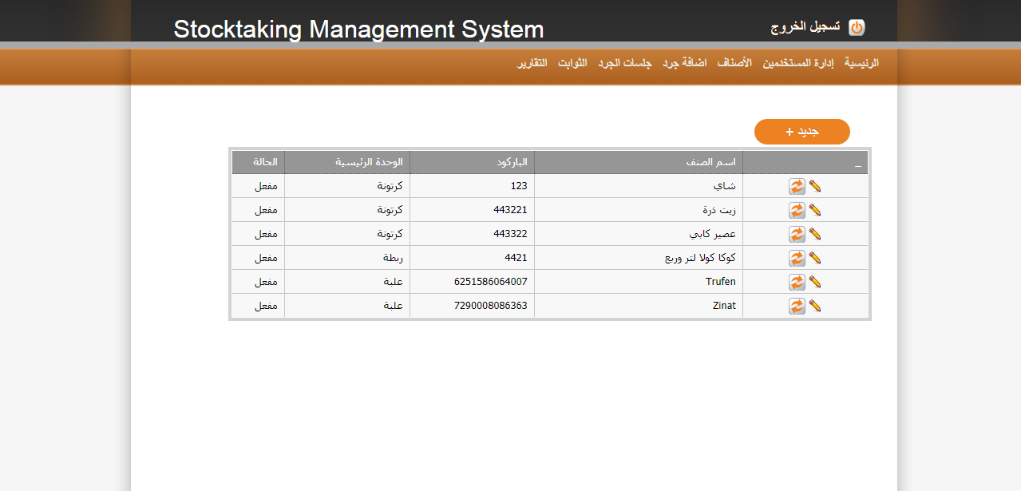

Slide 12
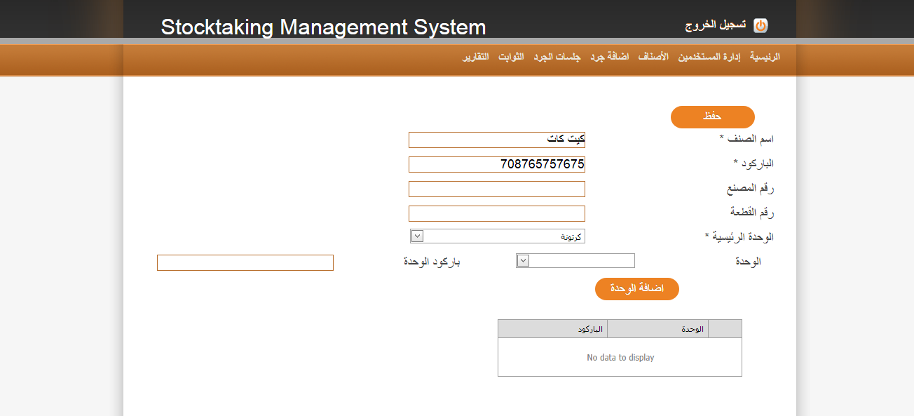

Slide 13
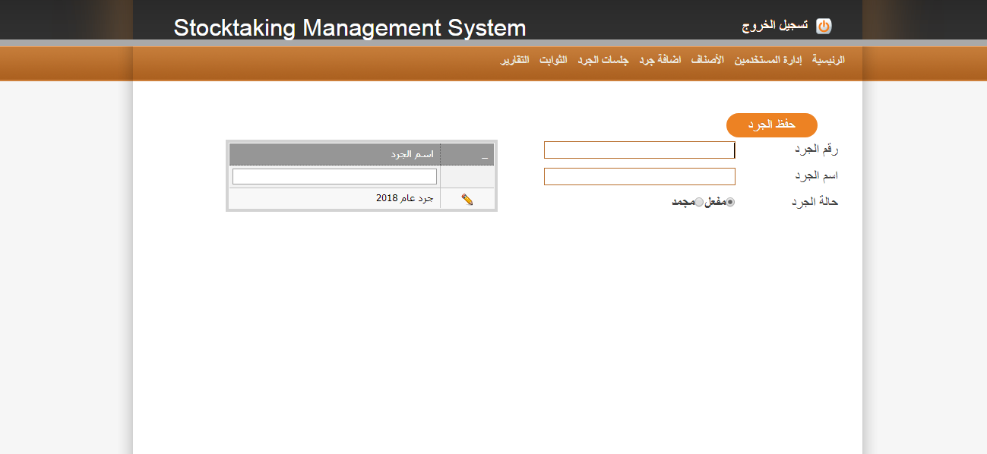

Slide 14
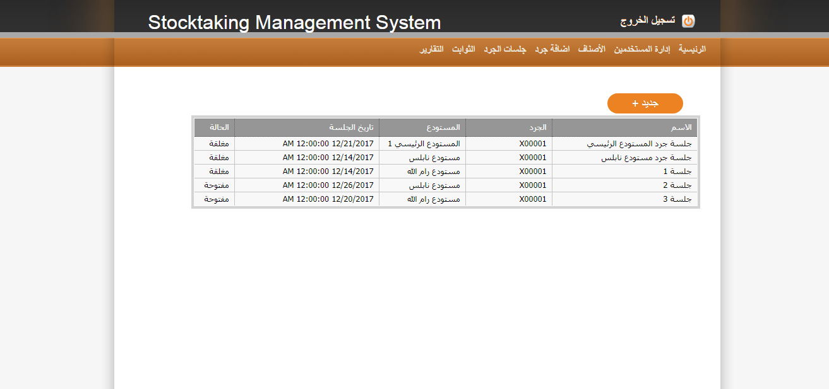

Slide 15
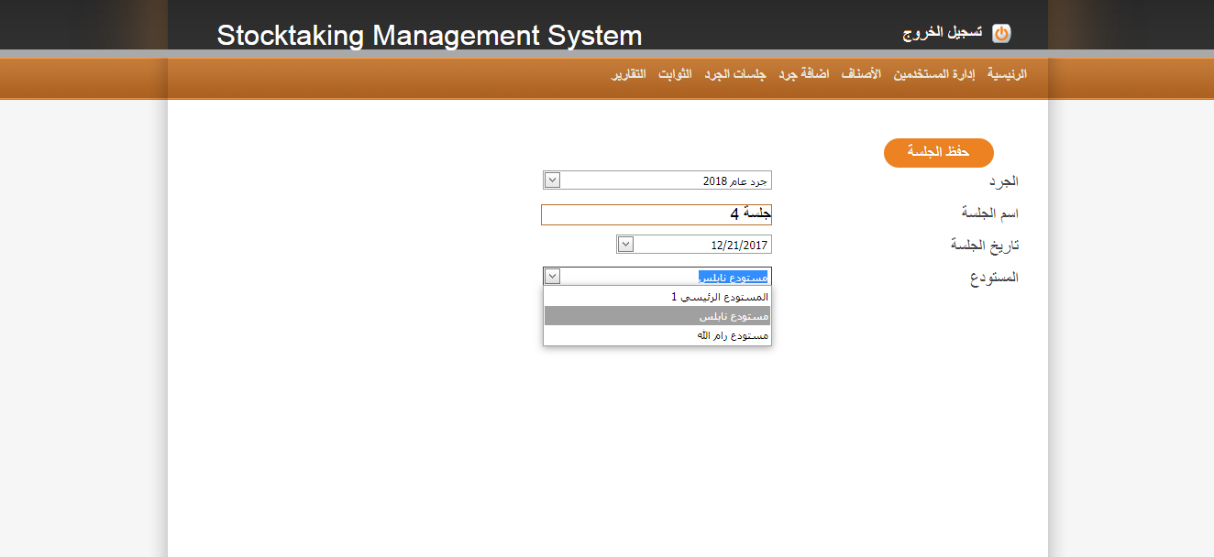

Slide 16
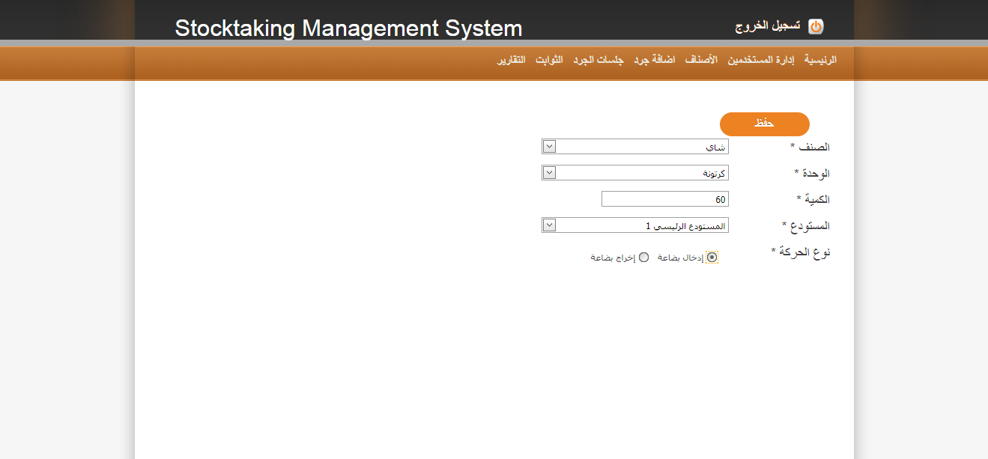

Slide 17
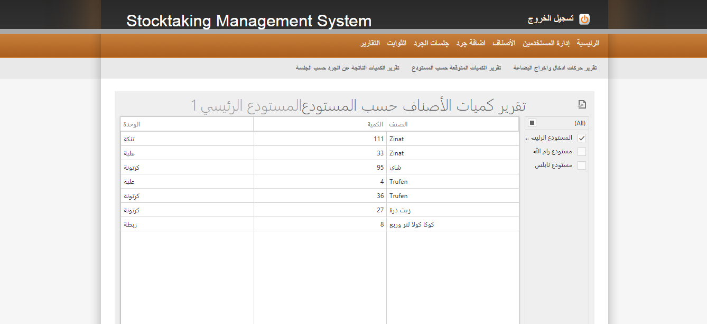

Slide 18
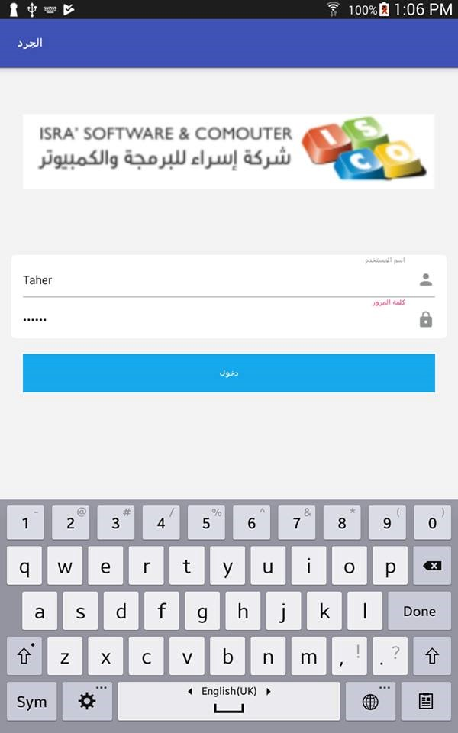
Mobile Android Application

Slide 19
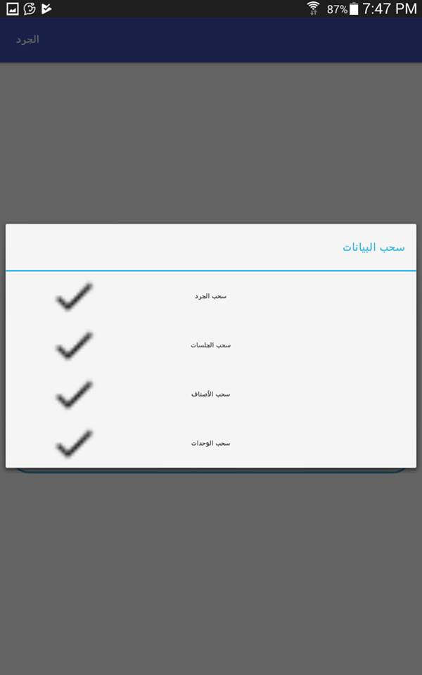
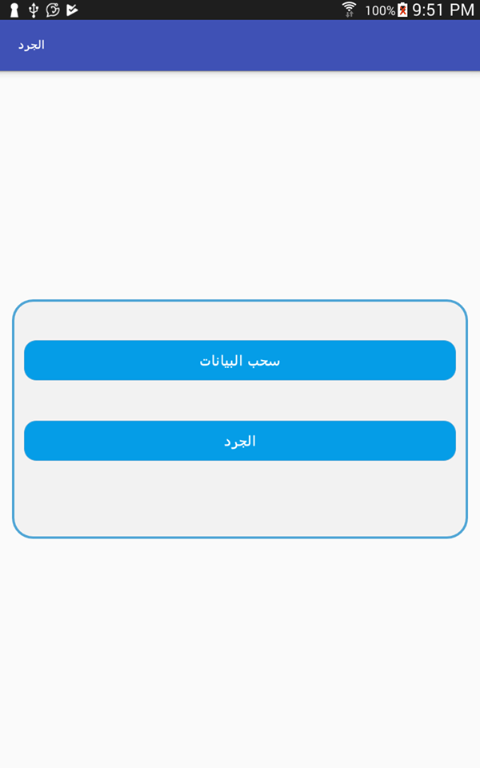

Slide 20
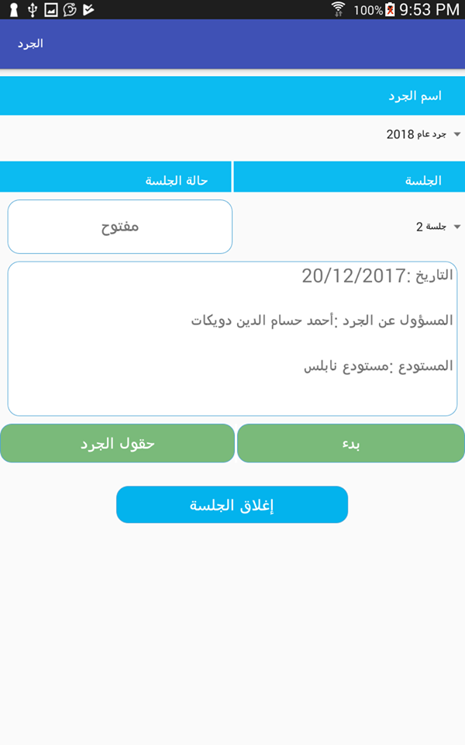

Slide 21
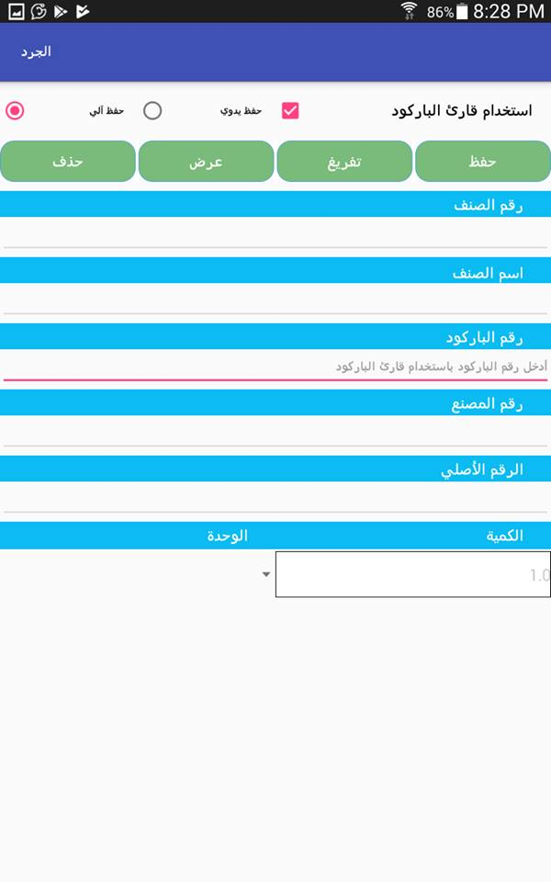
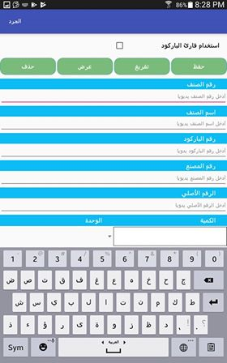

Slide 22
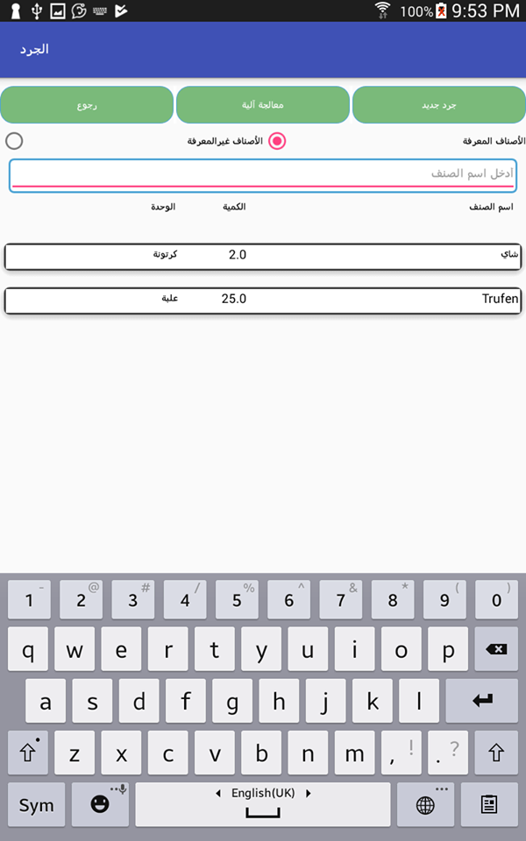

Slide 23
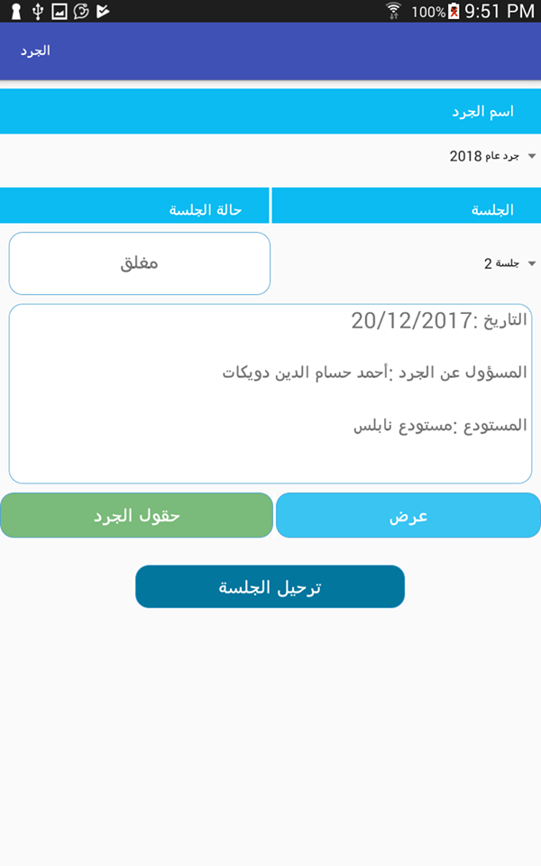

Slide 24
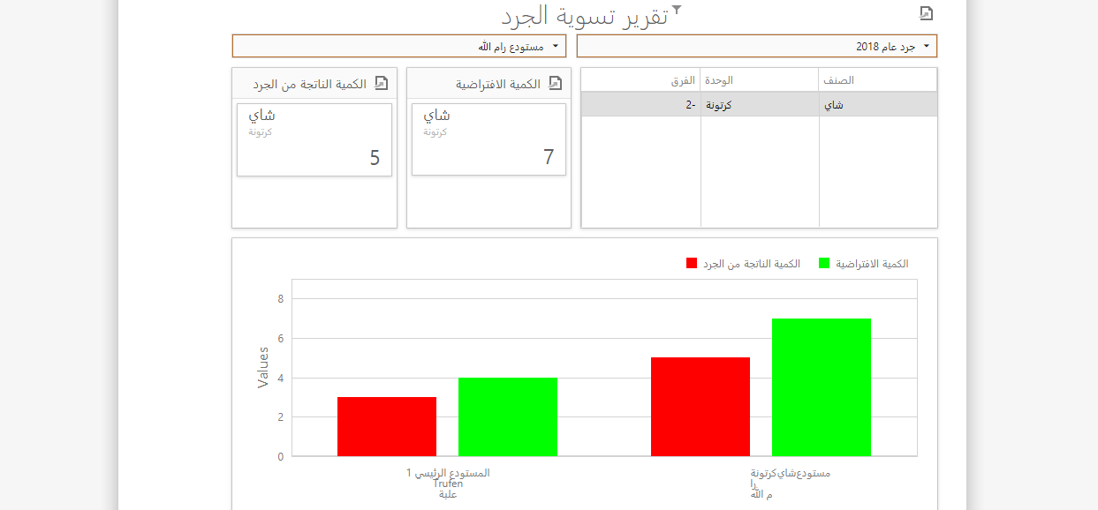

Slide 25
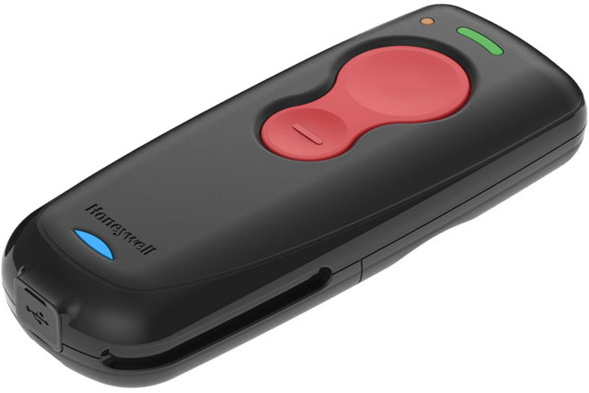
Honeywell Barcode Reader
(Voyager 1602g)

Slide 26
Quality Factors
Usability
Performance
Extendibility
Security

Slide 27
Future Work:
Integration with financial systems such as Shamel.
Export Stock details from Excel.
Add more analytical reports depending on the feedback from the customers.
Apply Bootstrap to our design to make it responsive.

Slide 28
Thank You
Any Questions?

