Slide 1

AN-Najah National University
Building Engineering Department
Graduation Project 2
Re-Design of Nablus Municipality Building
Prepared by : Areen Janem
Sereen Ghanem
We’am Ammar
Supervisor : Dr.Sameh Muna.

Slide 2
Outline:
Introduction.
Site analysis
Architectural design.
Structural design.
Environmental design.
Mechanical design.
Electrical design.
Quantity and survey.

Slide 3
INTRODUCTION:
The Municipality is considered one of the important govermental sectors with financial independence in any country, it defines the boundaries of its area, functions and powers It defines its tasks in carrying out cleaning work, it keepsthe appearance of the city in an acceptable manner, carrying out some health activities, issuing building permits, issuing commercial licenses and monitoring the construction building.

Slide 4
Methodology
Data collection and analysis
Computer Simulation
Environmental aspect
Architectural aspect
Environmental aspect
Structural aspect
Mechanical aspect
Electrical aspect
Design Builder
Electrical aspect
Shadow and sun path
Daylight
DiaLUX
Artificial Lighting
Heating and cooling
Structural Aspect
ETAPS
SAP
Prokon

Slide 5
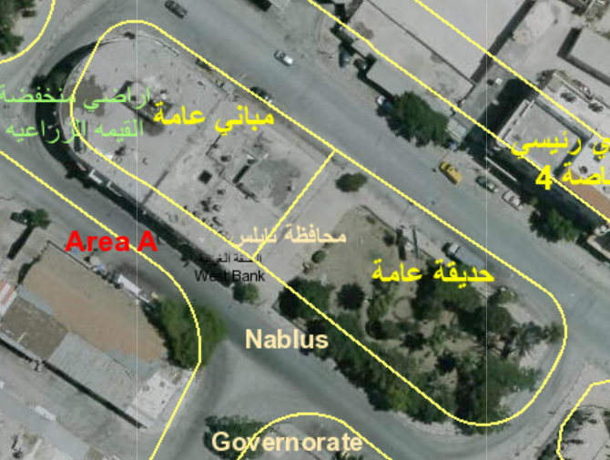
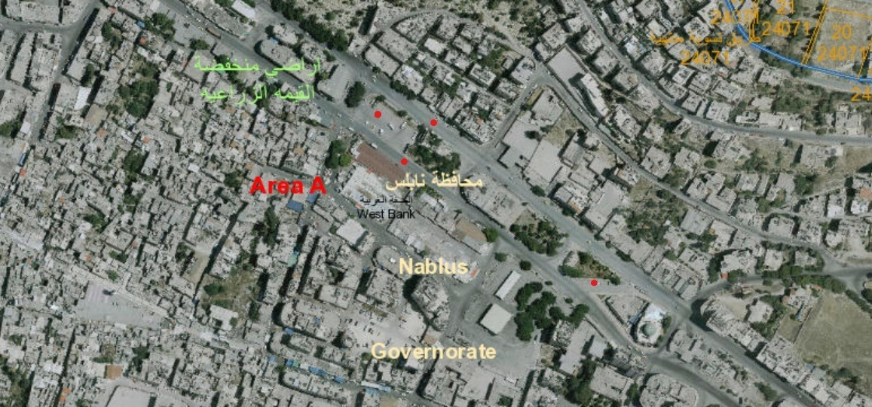
SITE ANALYSIS:
Eastern area of Nablus city map

Slide 6
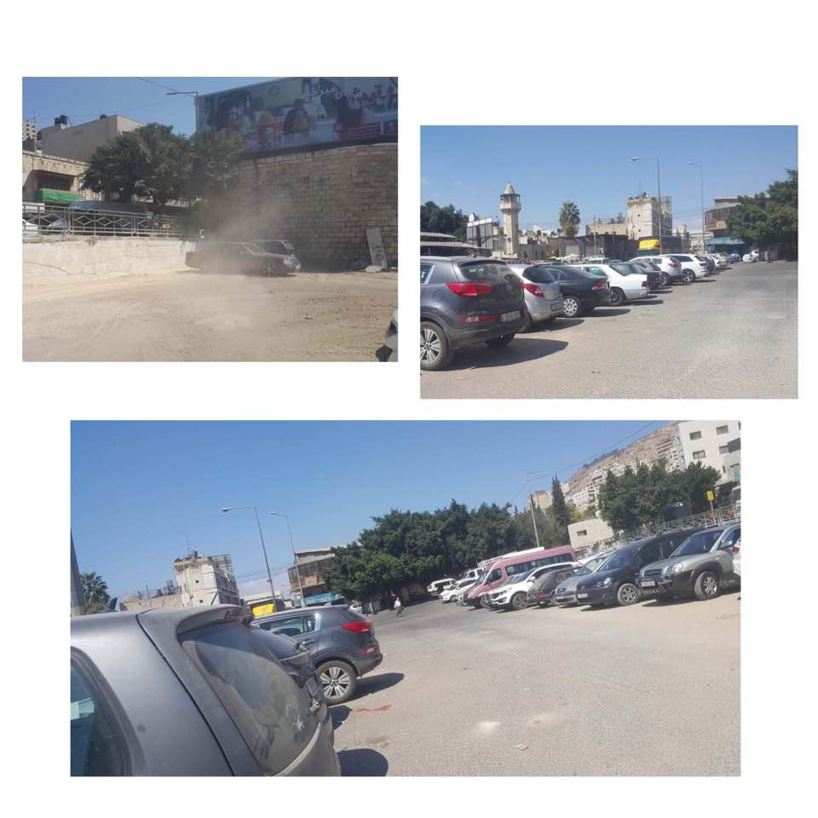
SITE ANALYSIS:
Proposed site location

Slide 7
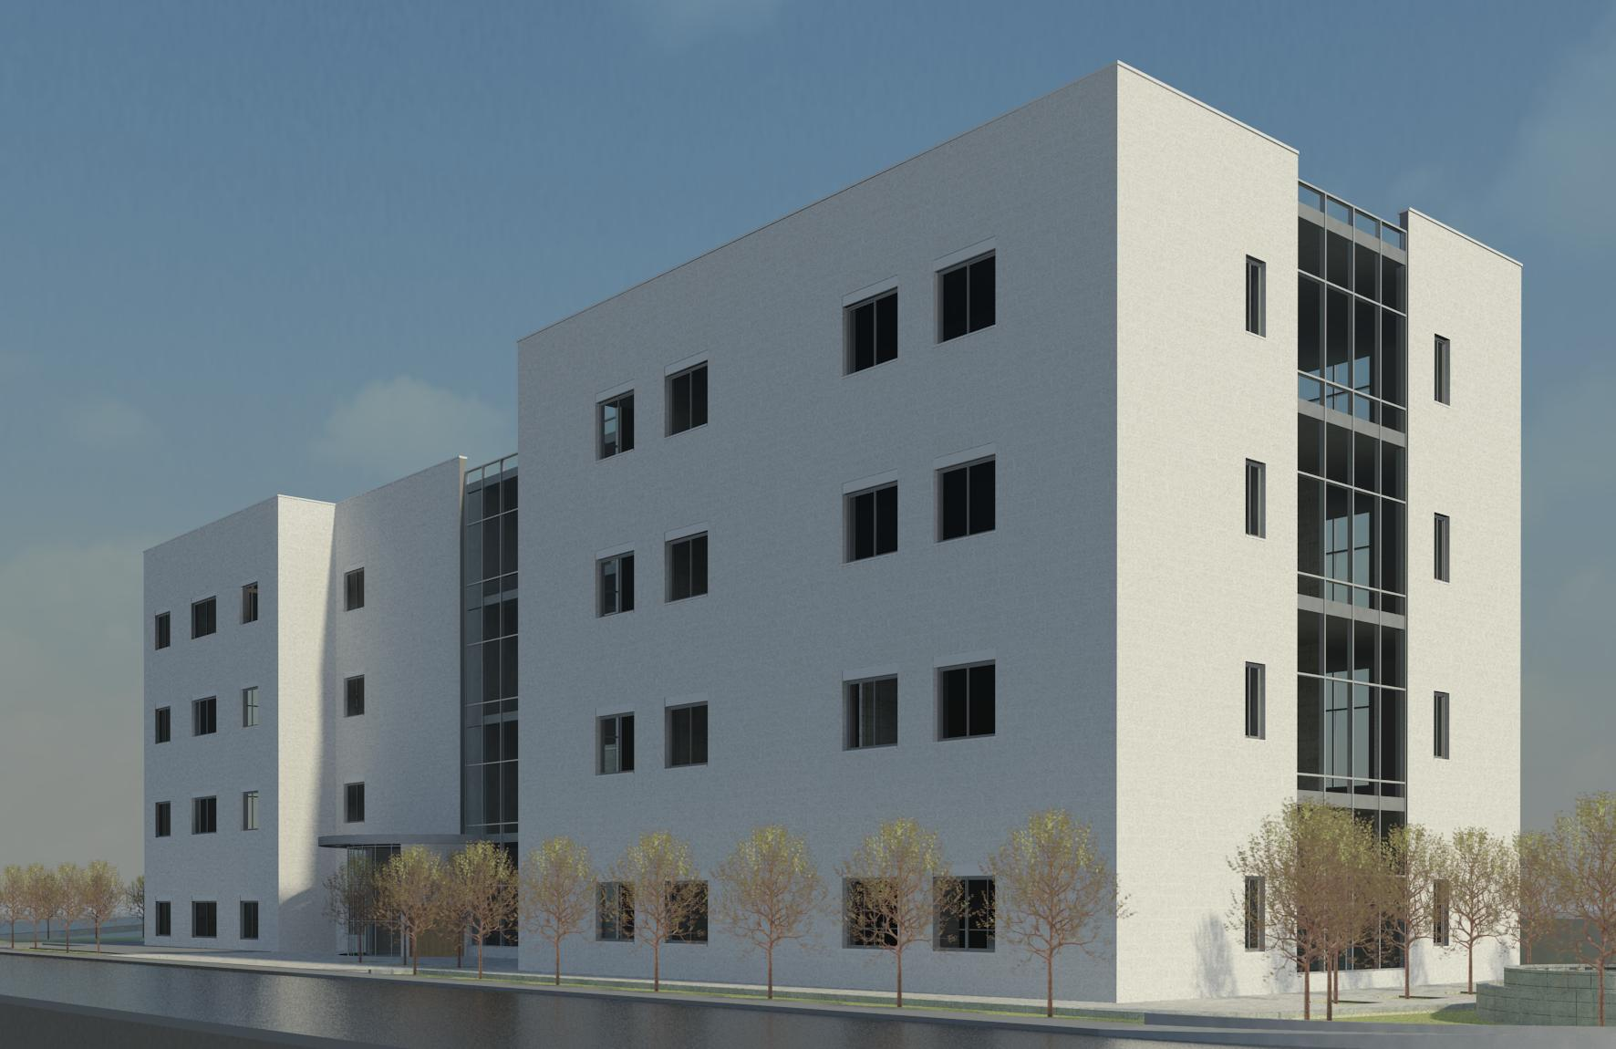
:
ARCHITECTURAL DESIGN:
Area of building:9885.7 m²

Slide 8
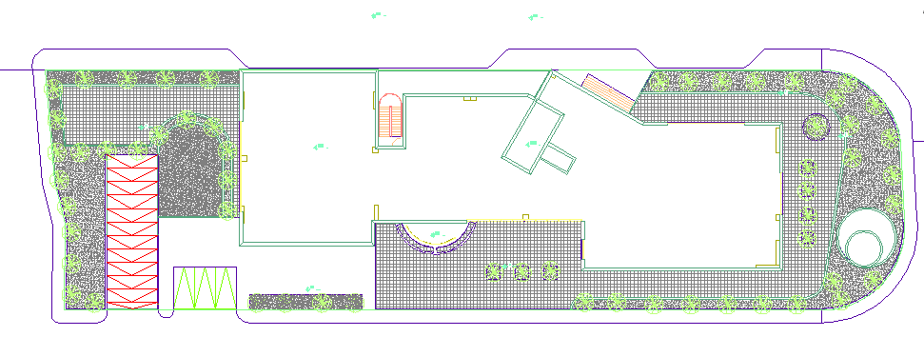
ARCHITECTURAL DESIGN:
:Site Plan
Area of site:3222.87 m²

Slide 9
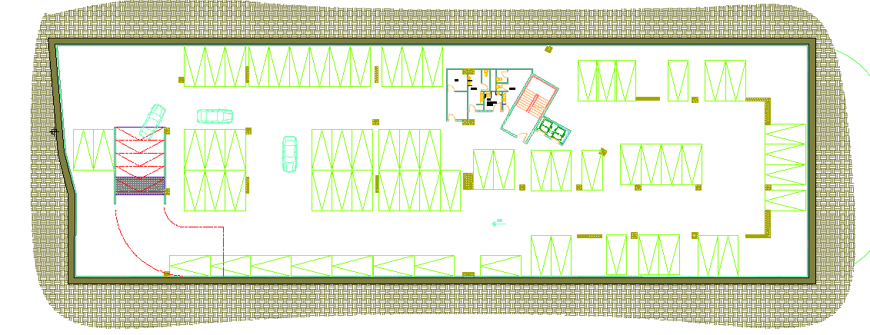
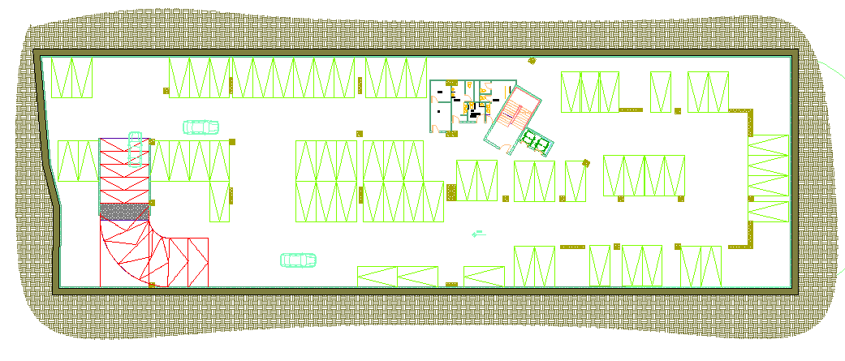
ARCHITECTURAL DESIGN:
2nd Basement :Floor
Area of floor:2598 m²
1st Basement :Floor

Slide 10
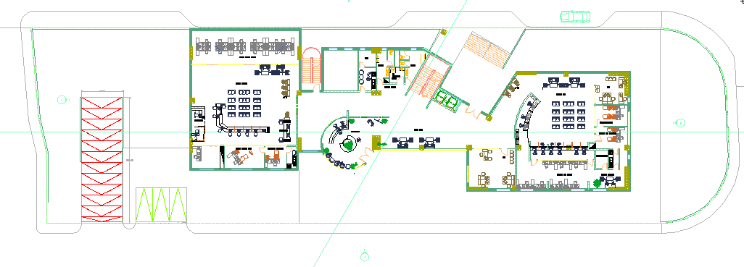
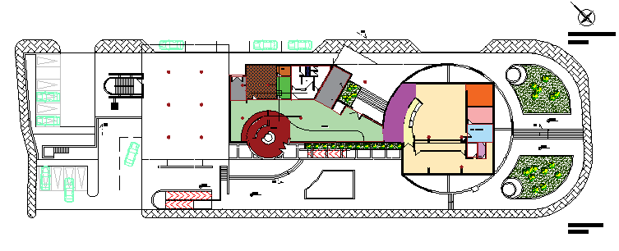
ARCHITECTURAL DESIGN:
Ground Floor:
Old Plan
Area of floor:1109.62 m²

Slide 11
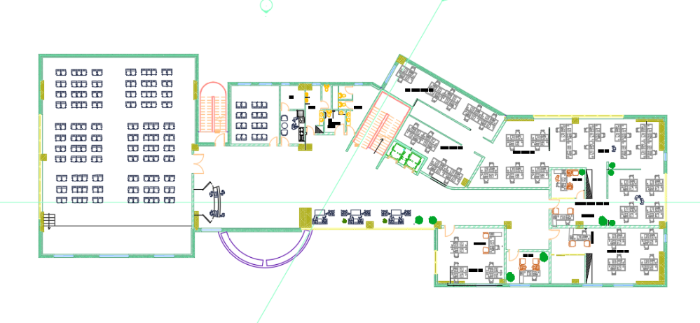
ARCHITECTURAL DESIGN:
First Floor:

Slide 12
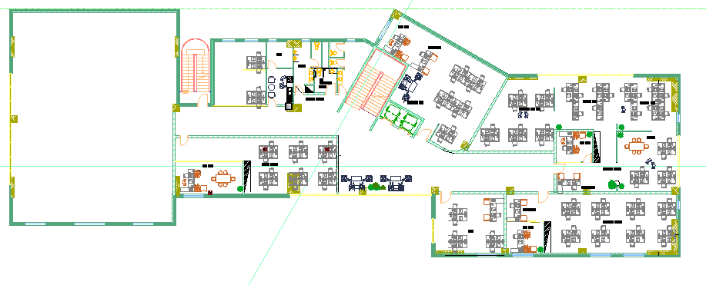
ARCHITECTURAL DESIGN:
Second Floor:

Slide 13
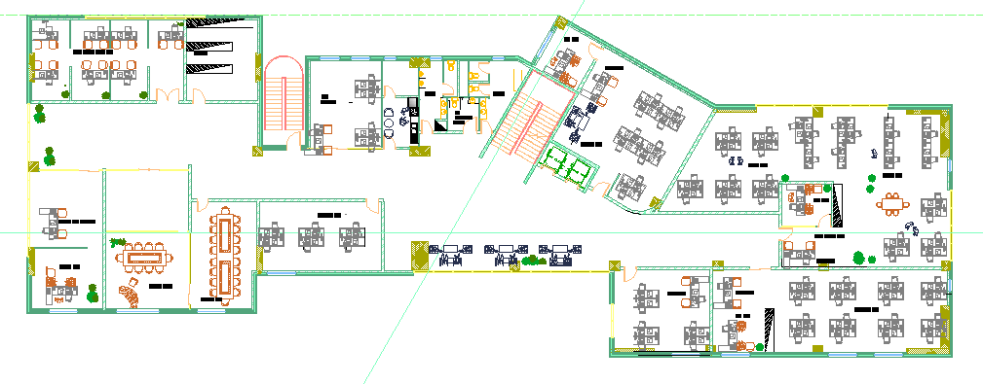
ARCHITECTURAL DESIGN:
Third Floor:
Movement
department
Fire department
Mechanical department

Slide 14
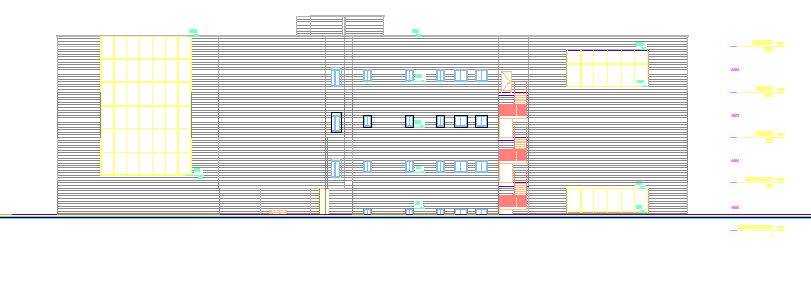
ARCHITECTURAL DESIGN:
East elevation:

Slide 15
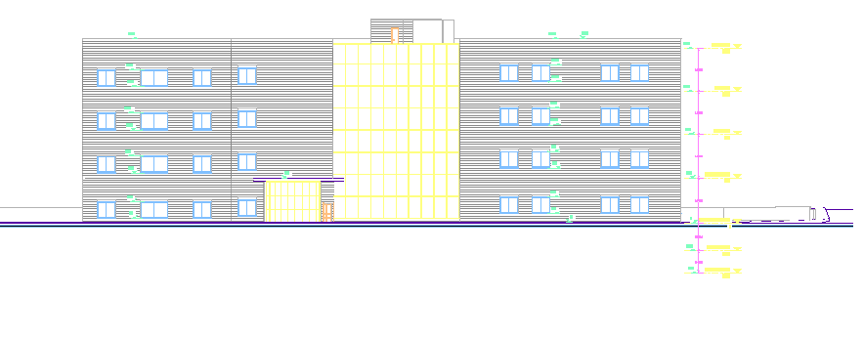
ARCHITECTURAL DESIGN:
West elevation:

Slide 16
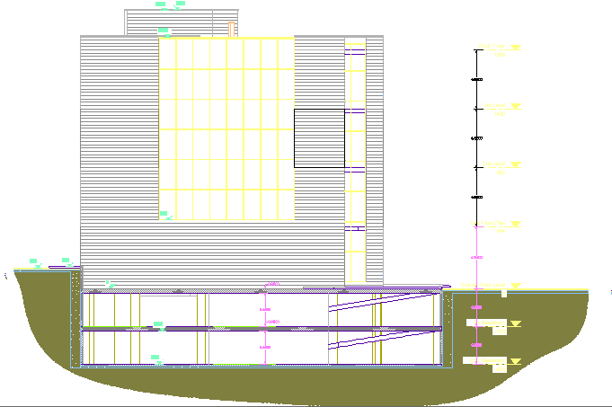
ARCHITECTURAL DESIGN:
North elevation:

Slide 17
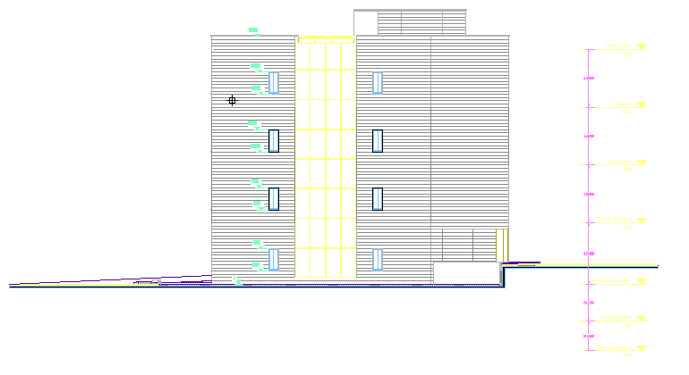
ARCHITECTURAL DESIGN:
South elevation:

Slide 18
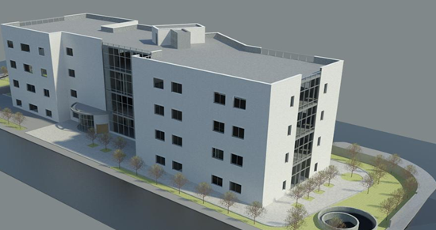
Structural Design

Slide 19
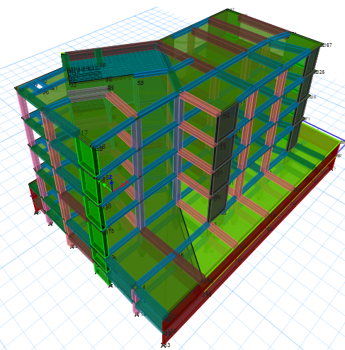
Modeling

Slide 20
Codes and Standards:
ACI -318-11 for reinforced concrete structural design.
UBC -97 for earthquake design.
ASCE 7 2010 for load combinations

Slide 21
Design data:
Concrete strength for all structural member f’_{c}=28 mpa.
Steel yield strength f_{y}=420 mpa.
Bearing capacity for soil = 125 kN/m²

Slide 22
Loads:
Load Type | Ribbed slab
Live | 5 (kN/m²)
S.I.D | 3.5 (kN/m²)

Slide 23
Lateral loads:
The city of structure is Nablus.
The seismic zone factor. Z=0.2.
The soil profile is type SE.
The acceleration seismic coefficient Ca=0.34
The velocity seismic coefficient Cv=0.64
The Seismic importance factor is 1.25.
The structural design type is intermediate, R=5.5

Slide 24
Verification of model
Compatibility check
Equilibrium check
Internal force check
Deflection check
Drift check
Period check
Base shear check

Slide 25
Compatibility check
Equilibrium check
 | Hand | ETABS | Error%
Live load | 23787.5 | 23854.5 | 2.8*10⁻³
SID | 29972.3 | 30056.7 | 2.8*10⁻³
DL | 62835 | 62549 | 4*10⁻³

Slide 26
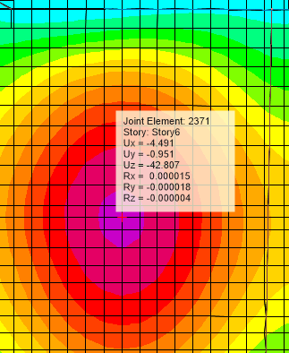
Deflection check
Period check
period from ETABS = 0.68 sec. , period from hand calc.= 40% of 0.564sec
T from ETABS < hand calc.
MAX. allowable deflection=29mm

Slide 27
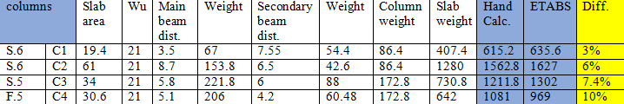

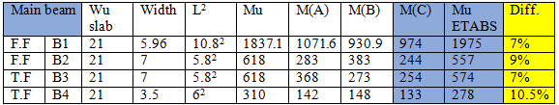
Internal force check

Slide 28

Drift check
Base shear check
V manual =19070
Vx = 26198 kN >19070 kN
Vy= 28845kN> 19070kN

Slide 29
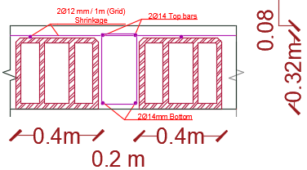
Slab Reinforcement

Slide 30
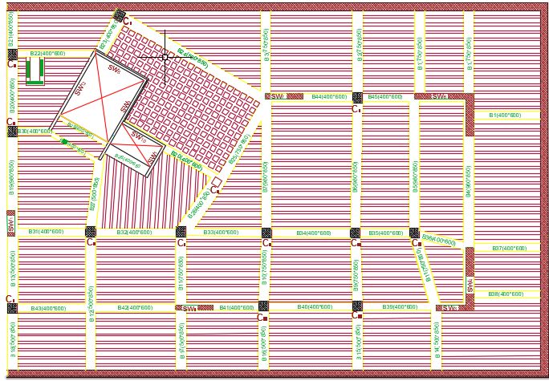
Beams and columns

Slide 31
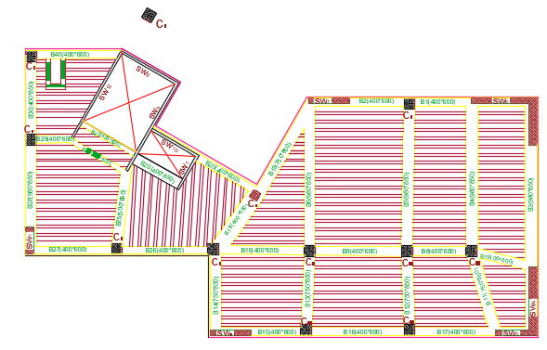
Beams and columns

Slide 32
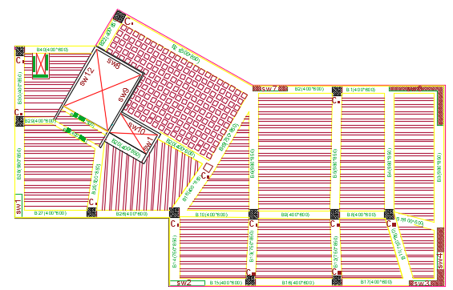
Beams and columns

Slide 33
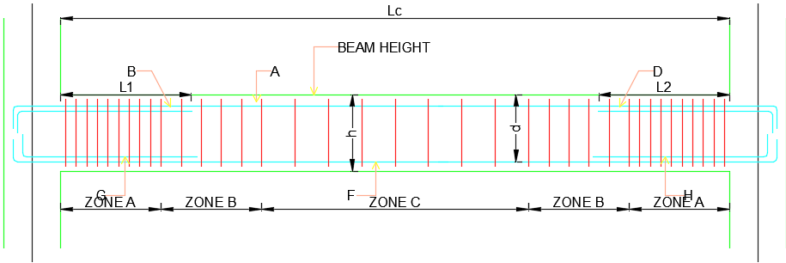
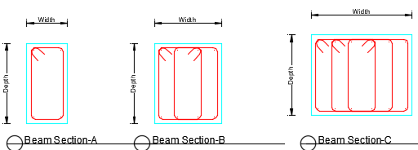
Beam Reinforcement

Slide 34
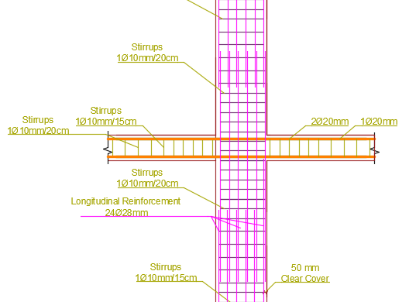
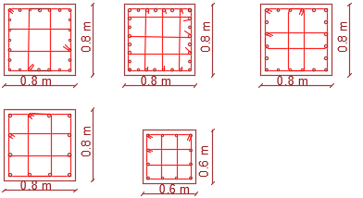
Columns Reinforcement

Slide 35
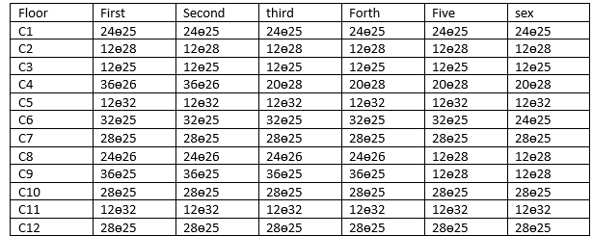
Columns Reinforcement

Slide 36
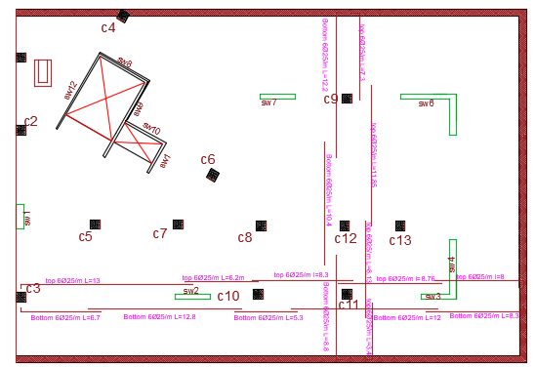

Footing Reinforcement

Slide 37
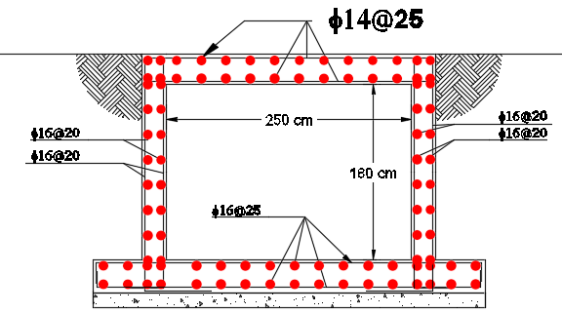
Water tanks Reinforcement

Slide 38
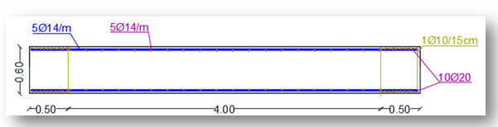
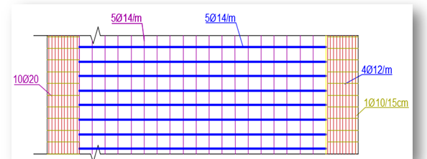
Shear wall reinforcement

Slide 39
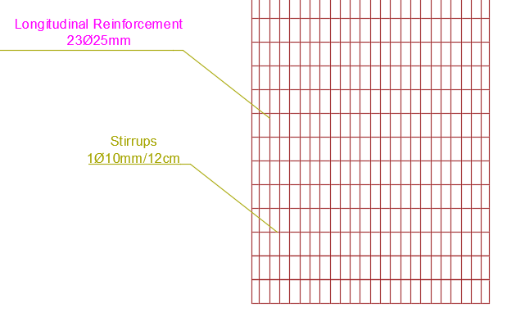
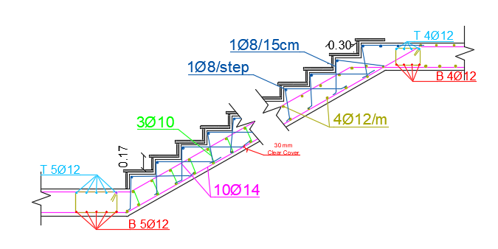
Sheet Piles.
Stairs Reinforcements.

Slide 40
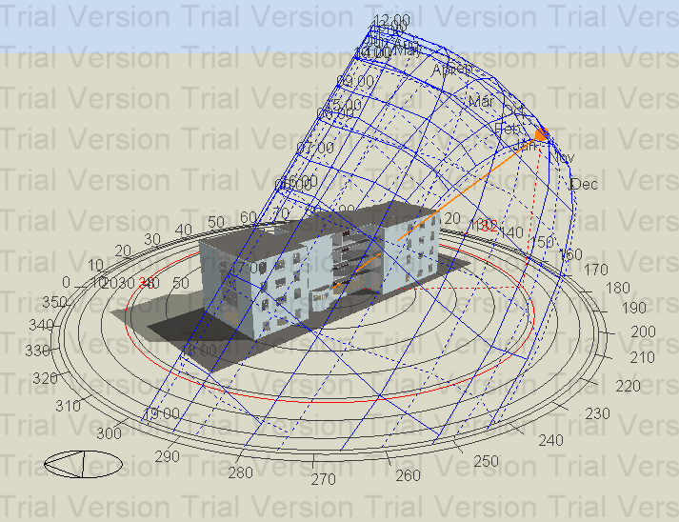
Environmental Design
1-Thermal insulation
2- Shading Design
3- Day Light
4-
4-acoustic design
5- Ventilation

Slide 41
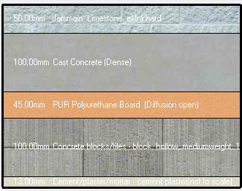
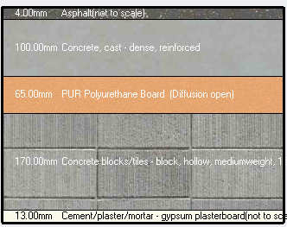
Thermal insulation
-External wall:
U-value (for external masonry wall before insulation material) =2.23 w\m^2-k.
U-value standard (for external wall =0.5 w\m^2k.
U-value (for external masonry wall after insulation material) =0.48w\m^2-k.
U-value (for external curtain wall)
=1.76 w\m^2-
U-value standard (for curtain wall)
=2.46 w\m^2-k
-Curtain wall (Glazing type:
Dbl loE (e2=1) clr 6mm\13mm air)
-Roof
U-value (for roof before insulation material) =2.23 w\m^2 - k.
U-value standard (for external wall) =0.39 w\m^2-k.
U-value (for roof after insulation material) =0.369 w\m^2-k.

Slide 42
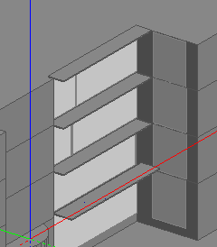
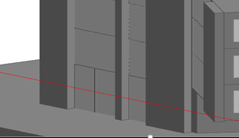
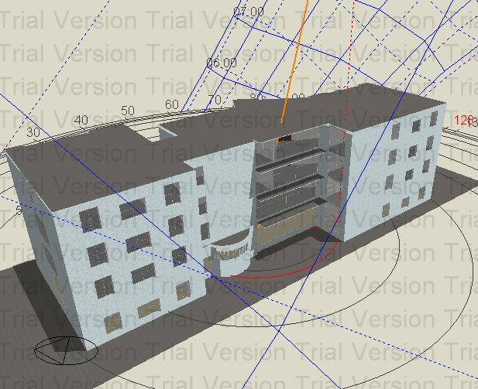
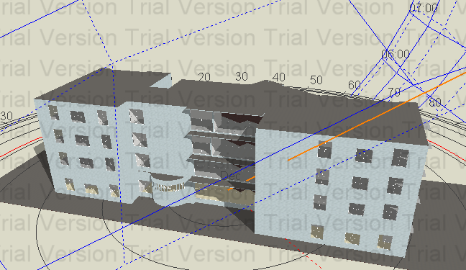
shading
1-cantilever
2- structural bulge
21-July (12.00 pm).
21-Jun (12.00 pm).

Slide 43
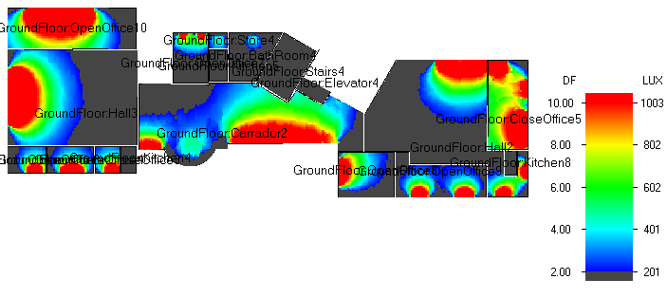
Daylight
-Map
-Day light average for building
Floor | Ground floor | First floor | Second floor | Third floor
average daylight | 4.06% | 3.89% | 3.83% | 4.48%
-Note: Average daylight factor for building good. Because, it is within range
(2-6) %.

Slide 44
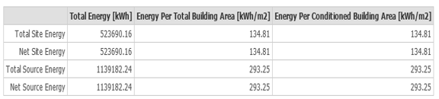
Thermal design
-Site energy
Not :134.81kw/m^2 < 207kw/m^2 it's good
-Heating and cooling Capacities.
73.5 Tons | 258.55 kW | Cooling
71 Tons | 250 kW | Heating

Slide 45
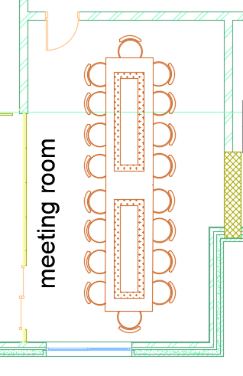
Acoustic
-Rt60 calculation before redesign
Room | Rt60(125Hz) | Rt60(250Hz) | Rt60(500Hz) | Rt60(1000Hz) | Rt60(2000Hz) | Rt60(4000Hz)
Meetings room | 1.21 | 1.13 | 1.10 | 1.09 | 1.47 | 1.19
Hall (Double volume) | 1.15 | 1.04 | 1 | 1. | 1.4 | 1.13
-Rt60 calculation after redesign
Room | Rt60(125Hz) | Rt60(250Hz) | Rt60(500Hz) | Rt60(1000Hz) | Rt60(2000Hz) | Rt60(4000Hz)
Meetings room | 0.8 | 0.82 | 0.08 | 0.75 | .803 | 0.73
-Standard value forRT60
Hall | RTS60(standard)
Meetings room | (0.6-0.8)
Hall(double volume) | (1.1-1.5)

Slide 46
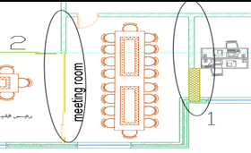
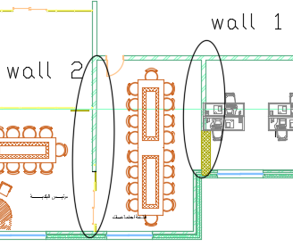
                Stc for Exterior walls -
Hall(doublevolume) | Department of the bids | Meeting room
21 | 20 | 20 | Noise level(db)
40-45 | 40-45 | 40-45 | Noise level slandered))(db
-Stc for internal walls
Room(Source) | Adjacent Area(s) (Receiver) | Sound Isolation Requirement (Min.) | Sound Isolation For internalwall in the building
meeting room) | Adjacent offices | 52 | 43
(Departmentof the bids) | Adjacent offices\ Corridor | 45 | 49
(Hall(double volume)) | Adjacent office General office areas Corridor or lobby | 45 | 49

Slide 47
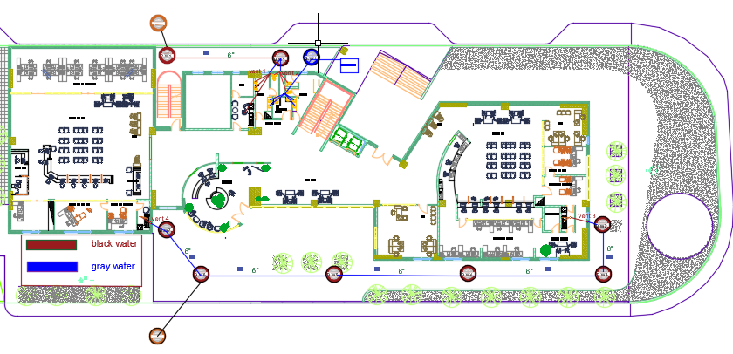
Mechanical
-Drainage system:
Manhole distribution

Slide 48
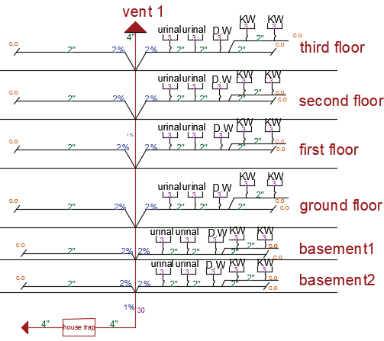


Black water
Gray water

Slide 49


-water supply system
Vertical diameter | Meter Diameter | Branch Diameter | Horizontal Diameter
2.5’’ | 1 ’’ | 3/4’’ | 1’’ | Tank 1 (storage water)
1.25 ’’ | 1 ’’ | 3/4’’ | 1’’ | Tank 2 (gray water)

Slide 50


-Safety and security design
-Fire system used in municipality building
-Emergency stair

Slide 51

HVAC system
Duct | V(m\s) | D(m) | Ѷ(m^3) | Δ𝒑/𝑬𝑳 | Δ𝒑
AB | 5 | 0 .61 | 1.46 | 0.49 | 0.94
BC | 4.69 | 0.55 | 1.14 | 0.49 | 7.6
CD | 4.4 | 0.5 | 0.866 | 0.49 | 6.75
DE | 3.95 | 0.43 | 0.576 | 0.49 | 2.25
EF | 3.34 | 0.348 | 0.326 | 0.49 | 2,25

Slide 52
ELECTRICAL DESIGN:
Standard for office
500 Lux | Visual task (Em)
300 Lux | Surrounding (Em)
100 Lux | Back ground (Em)
0.6 | Uniformity Emin/Em)
19 | Glare (UGR)
Standard for stairs and bathroom
100 Lux | Visual task (Em)
0 Lux | Surrounding (Em)
0 Lux | Back ground (Em)
0.5 | Uniformity Emin/Em)
25 | Glare (UGR)

Slide 53
ELECTRICAL DESIGN:
Standard for corridor
50Lux | Visual task (Em)
0 Lux | Surrounding (Em)
0 Lux | Back ground (Em)
0.5 | Uniformity Emin/Em)
25 | Glare (UGR)
Standard for multi-purpose hall
500Lux | Visual task (Em)
150Lux | Surrounding (Em)
50Lux | Back ground (Em)
0.5 | Uniformity Emin/Em)
45 | Glare (UGR)
Standard for kitchen
200 Lux | Visual task (Em)
0 Lux | Surrounding (Em)
0 Lux | Back ground (Em)
0.5 | Uniformity Emin/Em)
25 | Glare (UGR)

Slide 54

ELECTRICAL DESIGN:
Multi-Purpose hall:

Slide 55





layout of Multipurpose-hall
E avg 500= 500lux ✔
UGR= 16 < 19 ✔
U(Uniformity)=0.55✔

Slide 56

ELECTRICAL DESIGN:
Mechanical Department:

Slide 57



layout of mechanical department
E avg = 618ux > 500lux ✔
UGR= 17 < 19 ✔
U(Uniformity)=0.6✔

Slide 58

ELECTRICAL DESIGN:
Mayor office:

Slide 59


layout of mayor office
Eavg = 712lux > 500lux ✔
UGR= 17 < 19 ✔
U(Uniformity)=0.576✔

Slide 60

ELECTRICAL DESIGN:
Number of sockets=121

Slide 61

ELECTRICAL DESIGN:

Slide 62
ELECTRICAL DESIGN:
Spaces | Luminaries power(W) | Number Of Luminaries | Total power (W) | Number of sockets (2A) | Total load (A)
Mayor room | 88 | 9 | 792 | 3 | 6
Municipality manager | 88 | 5 | 440 | 3 | 6
Sec of manager | 88 | 6 | 528 | 4 | 8
Sec of Mayor | 88 | 6 | 528 | 3 | 6
Meeting room | 70 | 8 | 560 | 4 | 8
Computer units | 88 | 9 | 792 | 13 | 26
Council members room | 88 | 10 | 880 | 7 | 14
Archief | 70 | 4 | 280 | 2 | 4
Storage room | 88 | 8 | 704 | 7 | 14
Kitchen | 70 | 3 | 210 | 4 | 8
Bath rooms | 60 | 10 | 600 | 6 | 12
Corridor | 88 | 9 | 792 | 3 | 6
Electrical department | 88 | 6 | 528 | 10 | 20
Puplic work and services dep | 88 | 12 | 1056 | 24 | 48
Mechanical department | 88 | 16 | 1408 | 20 | 40
Security room | 88 | 4 | 352 | 8 | 16

Slide 63
Quantity Survey
cost | Stage
5556000 | Structural work
1967210 | Architectural work
358328 | Mechanical work
138000 | Electrical work
8028538 | Total
1650 | Total /m2

Slide 64
THANK YOU!

