Slide 1

Integrated Residential Building Design in Nablus Al-Jadida
An-Najah National University
Faculty of Engineering & Information Technology
Department of Building Engineering
Graduation Project ll
Prepared by: Supervisor:
Abdallah Zaid Dr. Luay Dwaikat
William Abdallah
Husam Salhi

Slide 2
Contents of Presentation
Project Definition
Site Analysis
Architectural Design
Structural Design
Environmental Design
Electro – Mechanical Design
PV System Design
Project Management &Quantity Surveying
Conclusion

Slide 3
Project Definition
Residential building Design in Nablus Al-Jadida
Design based on client’s requirements
Integrated building
Energy efficient Building
Notes:
Our project is a residential building design in Nablus Al-Jadida, it is a special design limited by a client requirements, our goal is to achieve the clients desires and to get the optimum design, exploiting every single advantage in the building region and get up with an integrated energy efficient building.

Slide 4
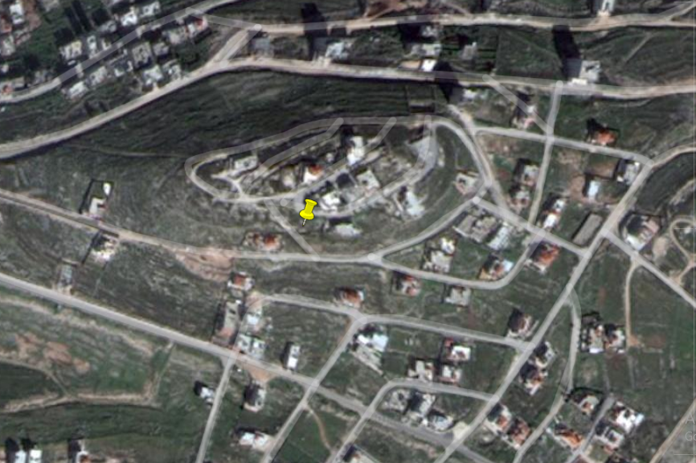
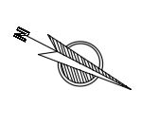
Site Analysis
Quran Radio Station Tower
Land Pin
Location
Nablus Al-Jadida Main Street
Notes:
Starting with the site analysis, here we can see a top view of the land location taken from google maps
The land is open to two streets, one of them is still unconstructed. North direction is shown here.

Slide 5
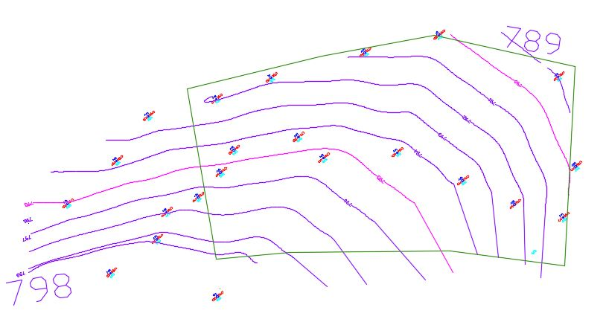
Site Analysis
Notes:
This illustrates the land contour lines. The land has a 9 meter slope starting with a top level of a 798m on the bottom left corner here and ending with a bottom level of 789m on the top right corner there.

Slide 6
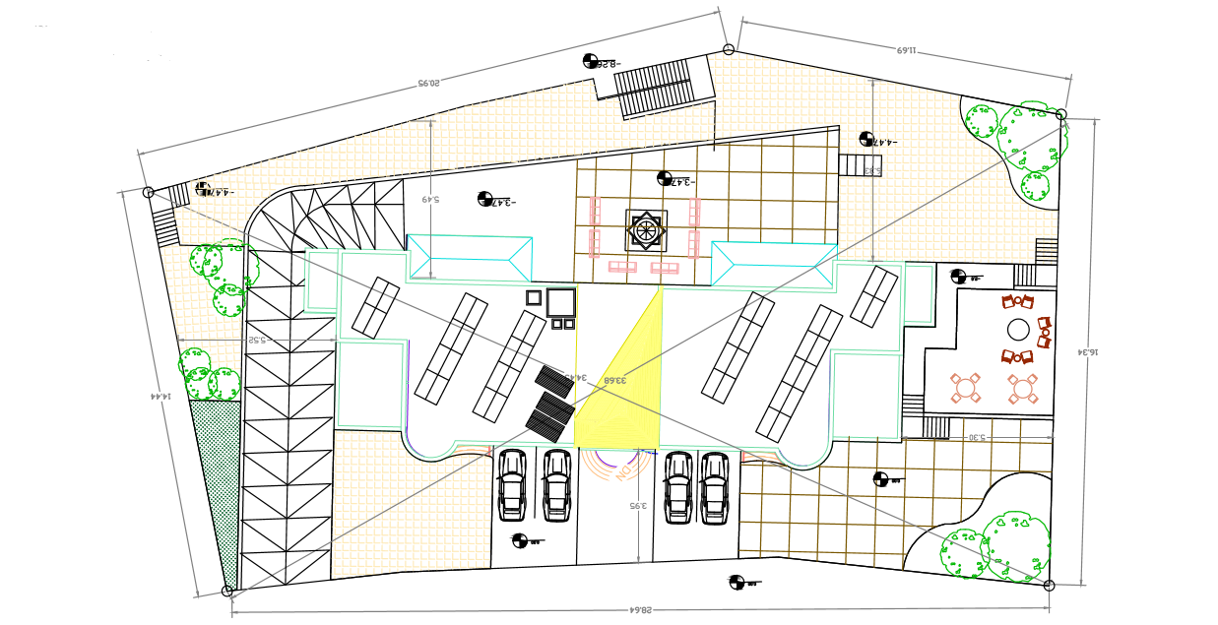
Site Analysis
Total site area = 2000 m²
Building area = 500 m²
Notes:
The site plan speaks for itself and it mainly shows how the building behaves with the surroundings. Total site land is approx. 2000 and the building area is 500
The basement garage ramp is shown here, building main entrance, parking spaces in front of the building.

Slide 7
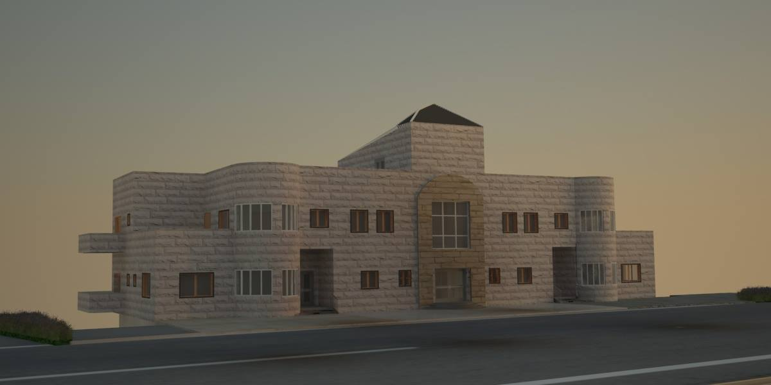
Architectural Design
Front 3D Shot
Notes:
Moving on to the first design phase, this slide shows a 3D shot of the building entrance modelled by 3D Max

Slide 8
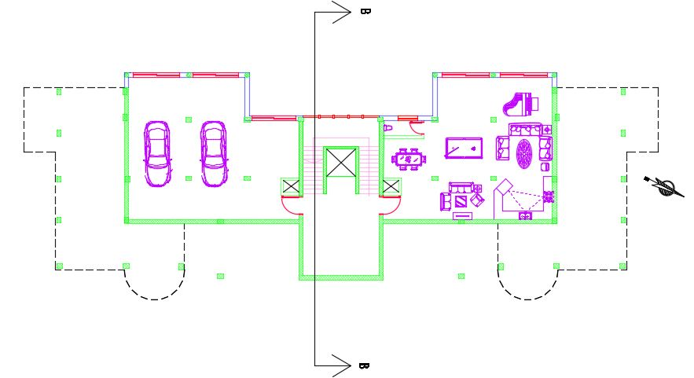
Architectural Design
Basement Floor
Notes:
The upcoming slides will present the main architectural drawings. This shows furnished basement floor plan

Slide 9
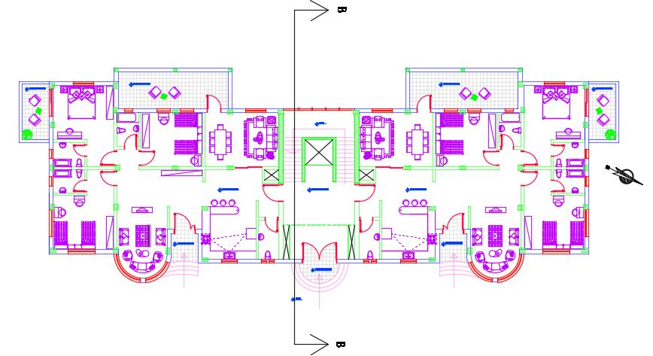
Architectural Design
Ground Floor
Notes:
Ground floor plan

Slide 10
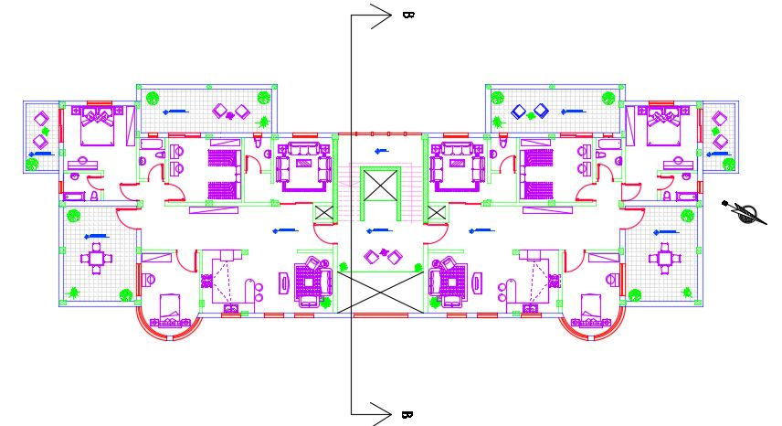
Architectural Design
First Floor
Notes:
First floor plan. Section B-B is taken in the floor plans here

Slide 11
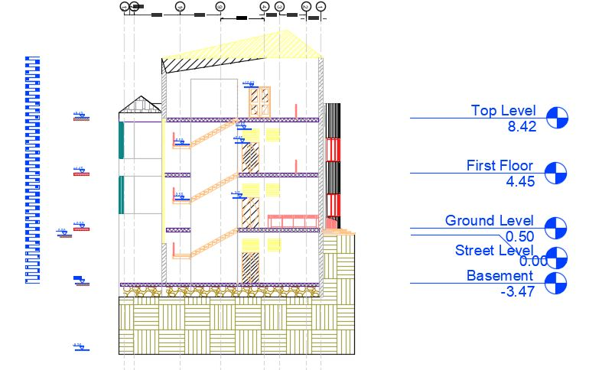
Architectural Design
Section B-B
Notes:
Section b-b in

Slide 12
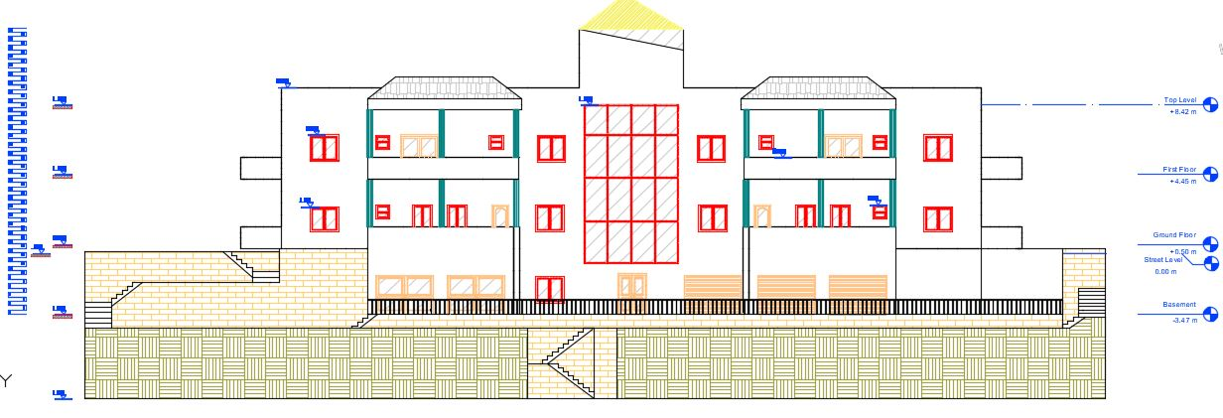
Architectural Design
South-Western Elevation
Notes:
SW Elevation

Slide 13
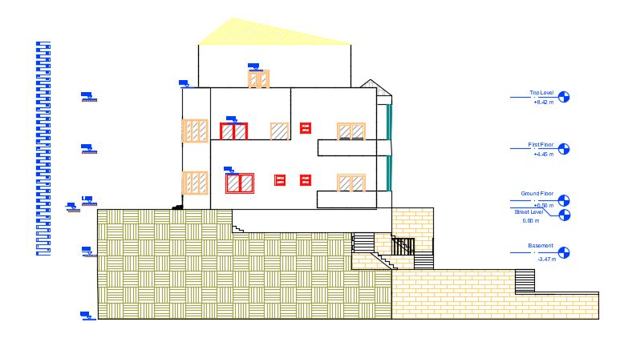
Architectural Design
North-Western Elevation
Notes:
NW Elevation

Slide 14
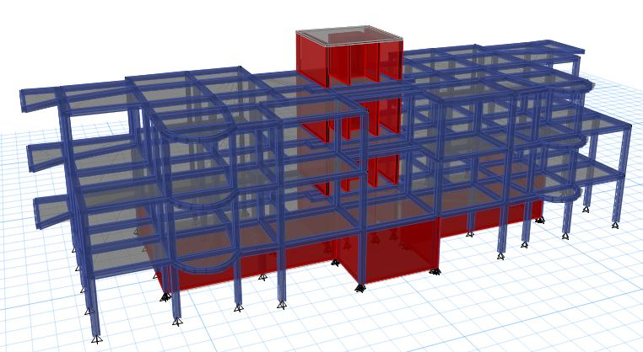
Structural Design
3D Structural Model
Notes:
The extruded 3D Model presented is taken from etabs

Slide 15
Structural Design
Design Codes
ACI -318-14 for Reinforced Concrete Structural Design
UBC -97 for Seismic Load Calculation Design
Design Data
Concrete B350 with fʹ_{c} = 28 MPa for All Structural Elements
Allowable Bearing Capacity of Soil = 175 KN/m²
Design Loads
Super Imposed Load = 4 KN/m²
Live Load = 3 KN/m²
Notes:
The design codes used in the design are 1 2 ..
Design data shows the used concrete in all structural elements which is the b350 with compressive strength of 28. Qall = 175
The SD load = 4 and the LL=3

Slide 16
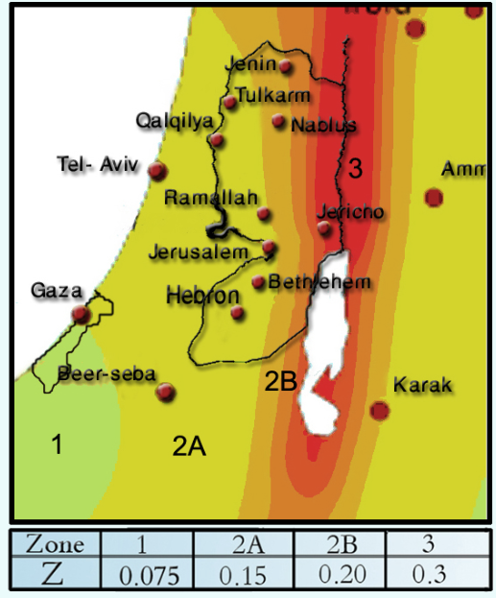
Structural Design
Seismic Design Data
Zone 2B
Z = 0.20
Soil type is S_{D}
C_{A} = 0.28
C_{V} = 0.40
I = 1.00
R = 5.5
Notes:
Moving on to the seismic design data, this graph shows that Nablus city lies in zone 2B, which gives the seismic zone factor z = 0.20
Soil type is Sd and other used seismic coefficients are presented (acceleration seismic coe Ca, velocity seismic coe Cv)
I – importance factor, R -

Slide 17
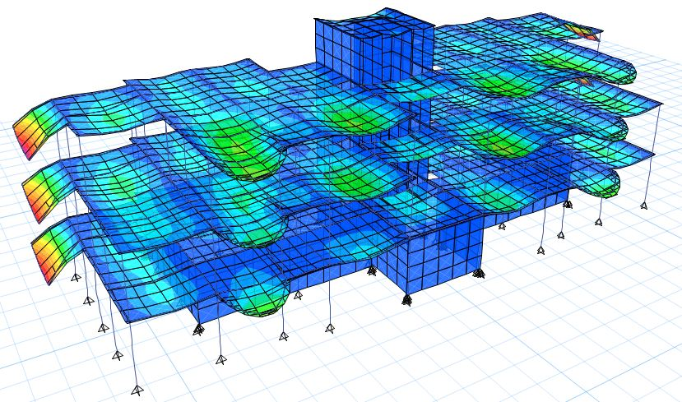
Structural Design
3D ETABs Deformed Model
Notes:
The building was structurally modelled using ETABs and This shows the structure’s deformed shape after running the model

Slide 18
Structural Design
Model Primary Checks
Model was checked and is valid for:
Compatibility
Equilibrium
Internal Stress-Strain Interaction
Notes:
Primary checks were conducted and the model is valid for compatibility, equil and the internal reactions are okay

Slide 19
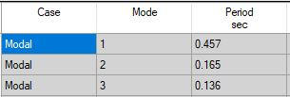
Structural Design
Model Dynamic Checks
Building Time Period Check
T_{manual} = 0.4836 sec
T_{ETABs} = 0.457 sec
Notes:
The four main dynamic checks were also obtained. The time period and base shear check are shown as a sample here.

Slide 20
Structural Design
Model Dynamic Checks
Base Shear Check
V_{manual} = 3417.9 KN
Load Case/Combo | FX | FY
 | kN | kN
EQx Max | 1648.2 | 653.5
EQy Max | 496.5 | 2171.5
EQx
 |  | V ETABs
Scale factor | 1783.6 | 1648.28
New SF | 3691 | 3417.87
EQy
 |  | V ETABs
Scale factor | 1783.6 | 2171.54
New SF | 2807.27 | 3417.87
Load Case/Combo | FX | FY
 | kN | kN
EQx Max | 3417.8 | 1027.1
EQy Max | 780 | 3425.6
Notes:
The calculated base shear check is equal to 3417 and the model base shear before modifying the scale factor is shown in the first table, and base shear values after the modification are shown in the last table

Slide 21
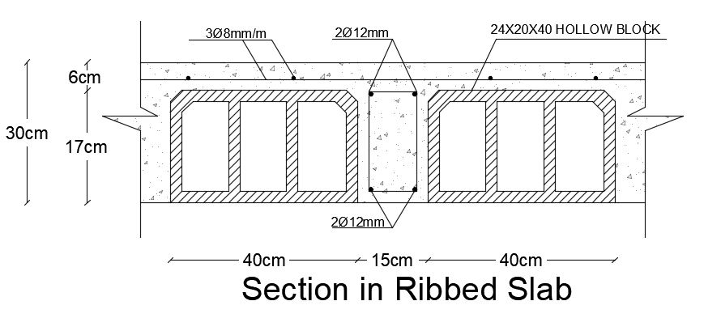

Structural Design
Results and Reinforcement
1. Slab Design
Ribbed Slab Thickness = 30cm
Blocks Height = 24cm
Shrinkage Steel = 3$∅$8 mm/m in Both Directions
Notes:
Moving on to the final stage of the structural design, results and elements reinforcement. The slab design section is shown here.

Slide 22
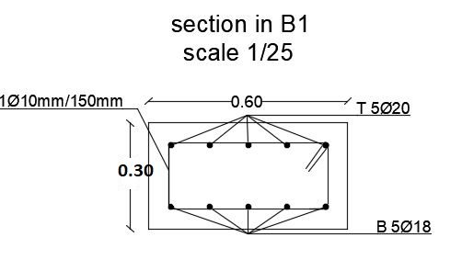
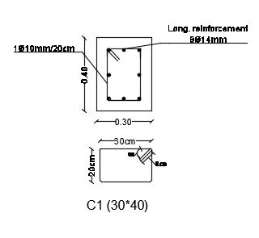
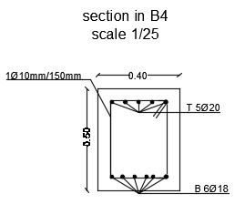
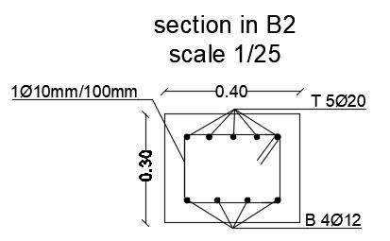
Structural Design
Results and Reinforcement
2. Beams and Columns Design
Column 30*40cm
Beams
Notes:
Beam and column sample detailings here.

Slide 23
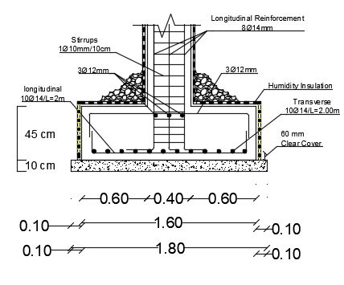
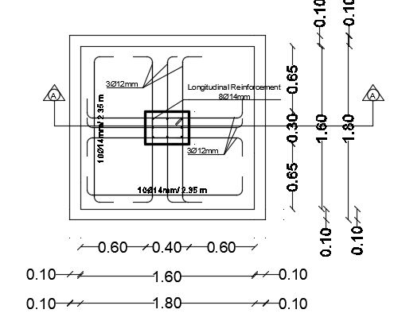
Structural Design
Results and Reinforcement
3. Footing Design
Notes:
Sample footing section and detailing here

Slide 24
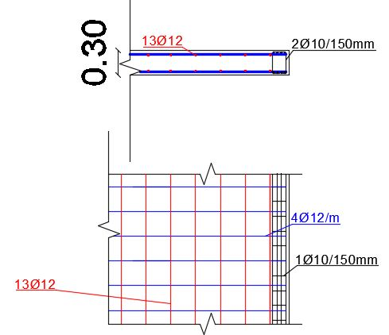
Structural Design
Results and Reinforcement
4. Shear Walls Design
Notes:
The slide shows a summary table of the shear walls design and it shows the total number of hor and ver steel bars along the walls

Slide 25
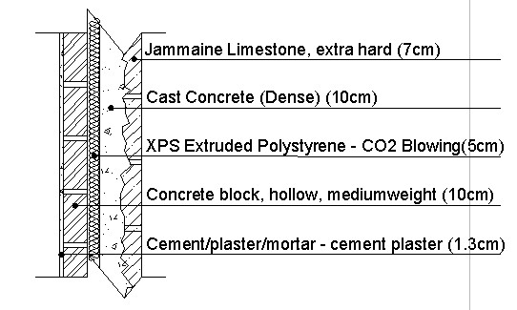
Environmental Design
External Wall
U-Value = 0.521 W/m².k
STC = 53 dB

Slide 26
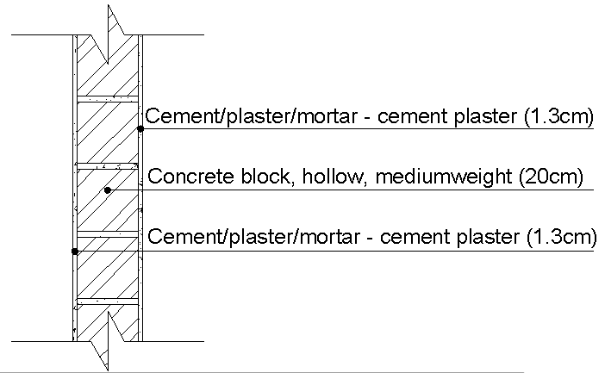
Environmental Design
Internal Wall
U-Value = 1.616 W/m².k
STC = 54 dB

Slide 27
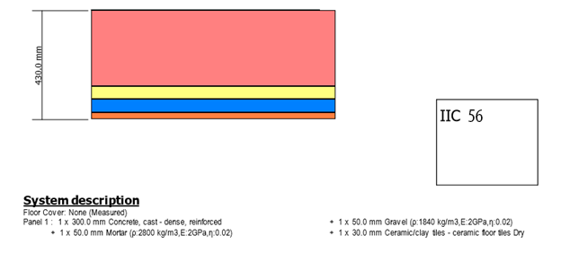
Environmental Design
Ceiling Section
U-Value = 1.595 W/m².k
IIC = 56 dB

Slide 28
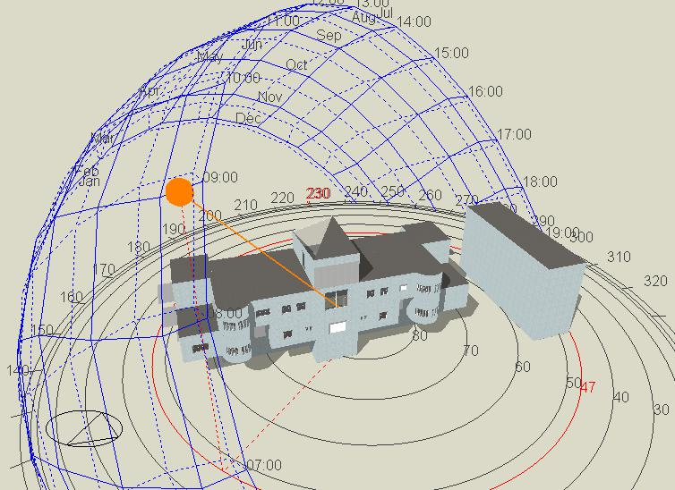
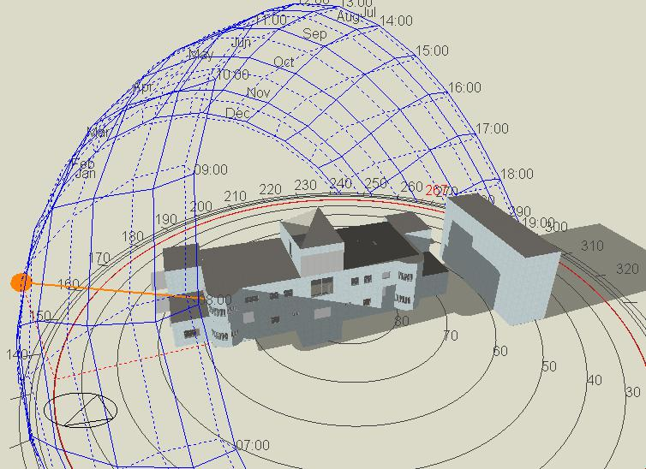
Environmental Design
3D Shot in Design Builder show shading on the building
Summer
21st Jul
9.00 a.m.
Winter
21st Jan
9:00 a.m.

Slide 29
Environmental Design
Without Solar Chimney with HVAC

Slide 30
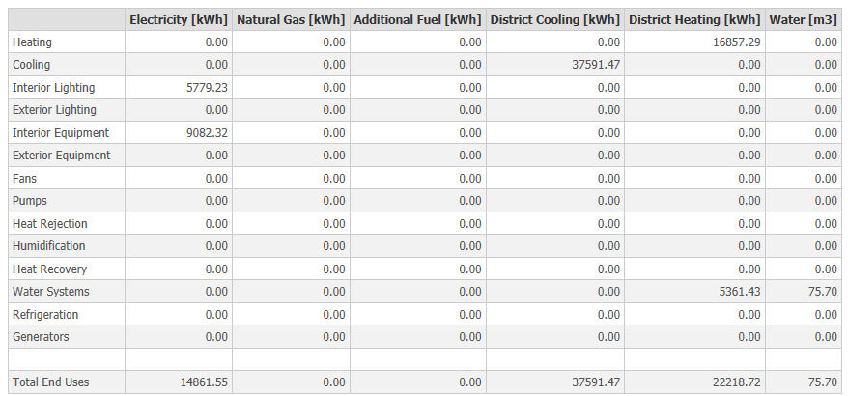
Environmental Design
Total heating load is 16857.29 kWh
Total cooling load is 37591.47kWh

Slide 31
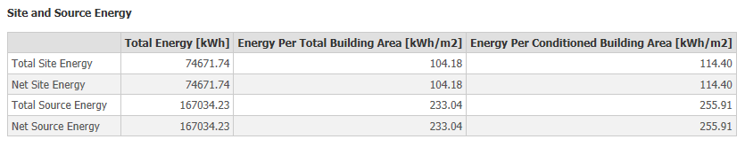
Environmental Design
Energy Consumption
The total energy consumption per conditioned building area is equal
114.40 kWh/m²

Slide 32
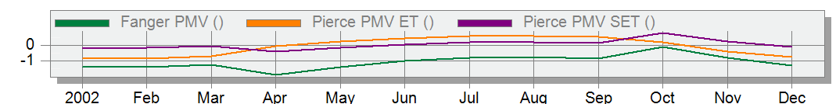
Environmental Design
PMV Values
Pierce PMV SET values nearly ranges within the limit (-0.5 and 0.5) throughout the year
0.5
-0.5

Slide 33
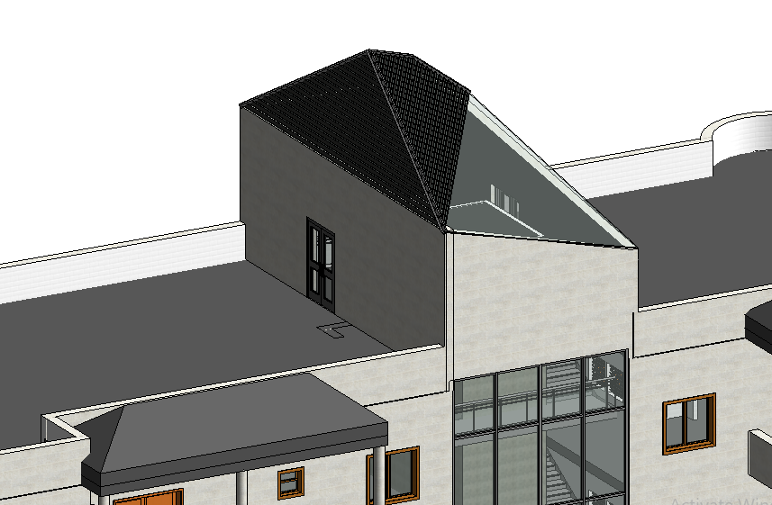
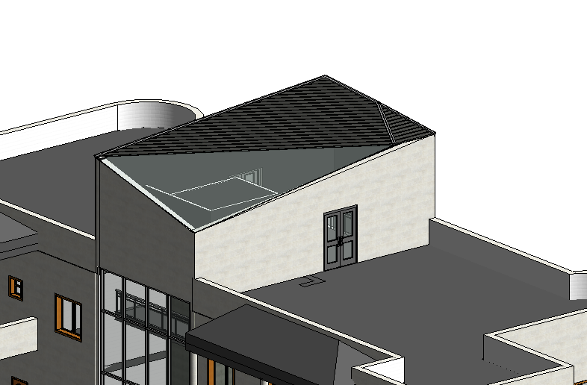
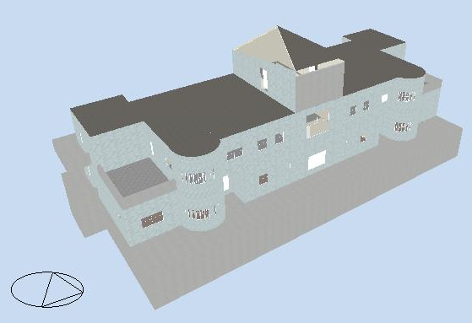
Environmental Design
Model with Solar Chimney 3D
Solar Chimney Absorptive Glass
Notes:
The solar chimney is a passive design implemented in our project built within the staircase in order to exploit the good air movement in the region, for enhancing the comfort in summer and winter, this is a design builder 3D shot for the building with solar chimney.

Slide 34
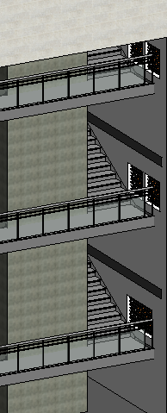
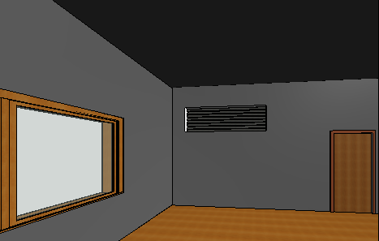
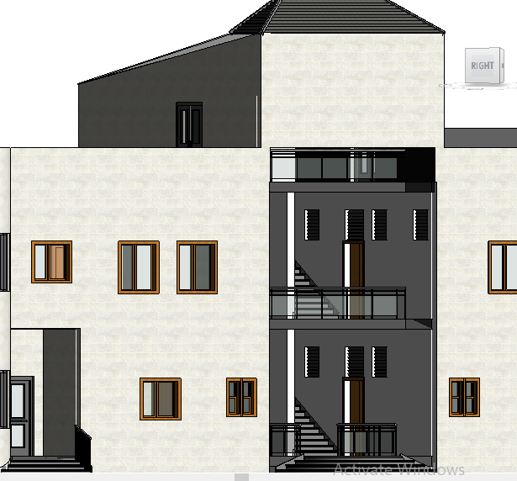
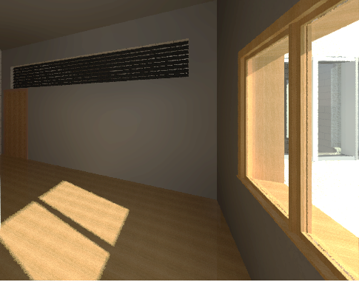
Environmental Design
Solar Chimney Louvers
Acoustical Louvers between the apartments and the stairwell
Acoustical Louvers in bedrooms
Notes:
here we have the acoustical louvers between the living spaces and the stairwell.

Slide 35
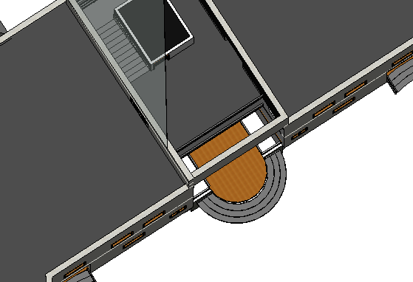
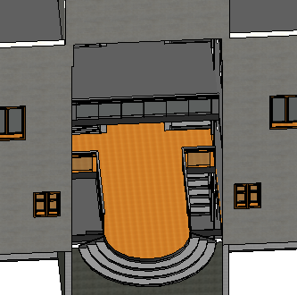
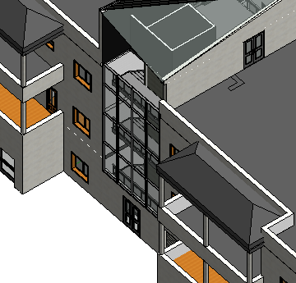
Environmental Design
Solar Chimney Shafts
Shafts
Notes:
These images are showing the stairwell shafts that help in air movement

Slide 36
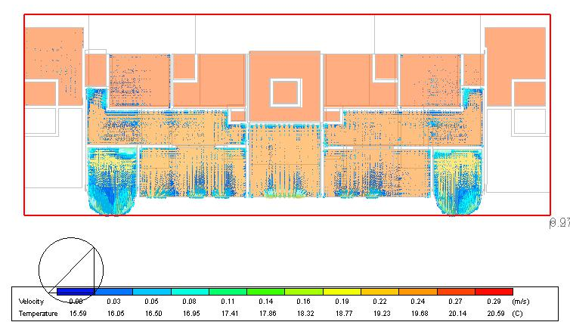
Environmental Design
Plan for CFD without Solar Chimney
Velocity = (0.03m/s – 0.05m/s)
Temperature = 19 ˚C

Slide 37
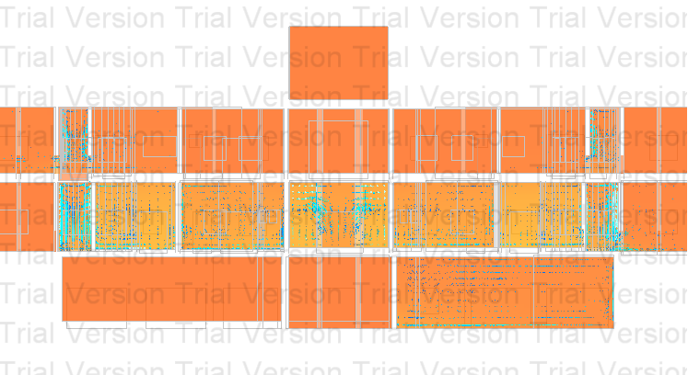
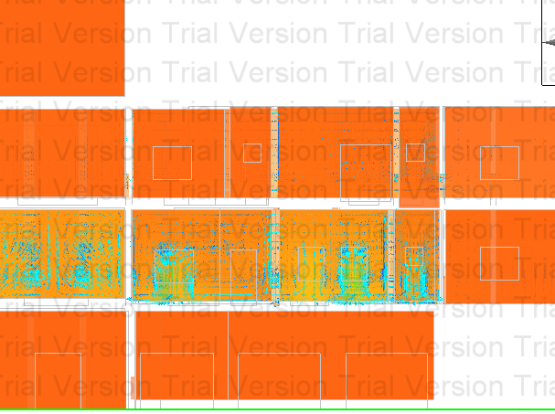
Environmental Design
Section for CFD without Solar Chimney
Notes:
These photos are showing that there is no strong air circulation before installing the solar chimney, since there are no holes and no louvers for the air to pass through.

Slide 38
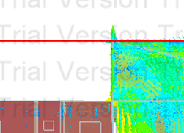
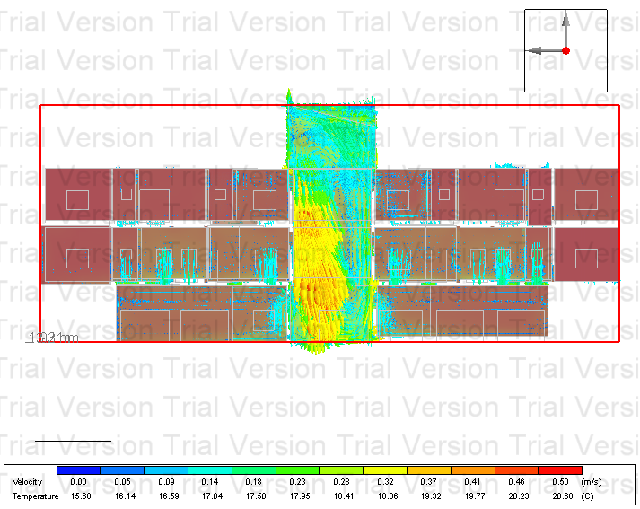
Environmental Design
Section for CFD with Solar Chimney in Summer
Velocity ≈ (0.2m/s)
Temp. ≈ 21˚C
Notes:
After installing the solar chimney we can see that the air velocity became 0.50 m/s which is a very good air velocity in residential buildings and gives a very good cool breeze.

Slide 39
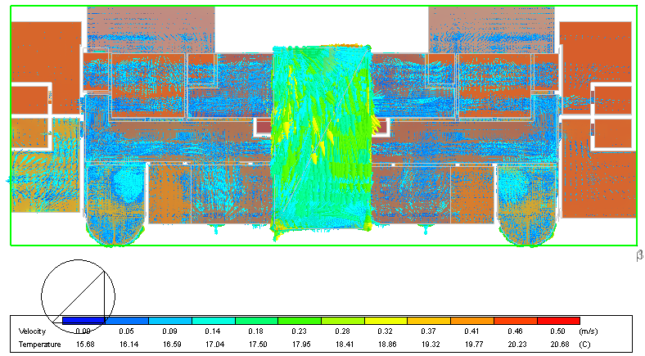
Environmental Design
FF Plan for CFD with Solar Chimney in Winter
Velocity ≈ (0.05m/s)
Temp. ≈ 21˚C
Notes:
Here we can see the air movement inside the building from the outside windows and make a good circulation in all over the building
then to the stairwell passing through the acoustical louvers, heading to outside building through the top vents.

Slide 40
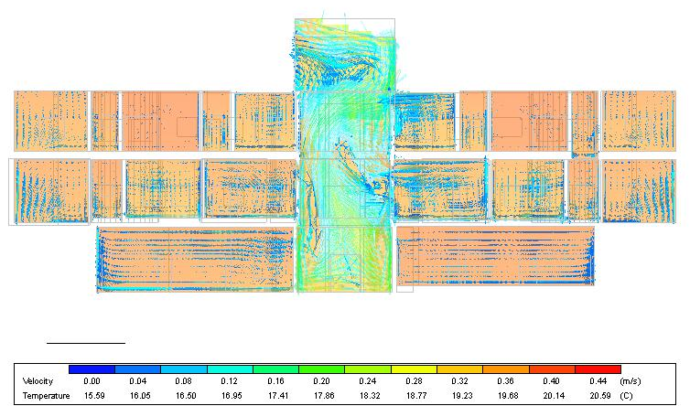
Environmental Design
Section for CFD with Solar Chimney in Winter
Notes:
Here is a closer shots.

Slide 41
Environmental Design
PMV Summary with natural ventilation
PMV Summary in Summer
Month | April | May | June | July | Aug. | Sep. | Oct. | Nov. | Dec. | Jan. | Feb. | March
PMV | -0.47 | -0.51 | -0.31 | -0.399 | 0.01 | 0.6 | 1.21 | 1.46 | 1.24 | 1.29 | 0.28 | -0.33
Month | April | May | June | July | August | September
Before | -0.41 | 0 | 0.6 | 1.21 | 1.46 | 1.24
After | -0.61 | -0.18 | 0.4 | 0.94 | 1.09 | 0.88
PMV Summary in Winter
Month | October | November | December | January | February | March
Before | 1.28 | 0.28 | -0.34 | -0.51 | -0.51 | -0.31
After | 1.36 | 0.33 | -0.3 | -0.48 | -0.45 | -0.22
Notes:
Last but not least we have the PMV comparison summary in summer and winter, we can see the improvement in the PMV values in both summer and winter.
We can figure that our solar chimney is working efficiently.

Slide 42
Environmental Design

Slide 43
Environmental Design
PMV Conclusion
In Summer
Before S.C. = (0.6 → 1.24)
After S.C. = (0.4 → 1.09)
In Winter
Before S.C. = (-0.34 → -0.51)
After S.C. = (-0.2 → -0.48)

Slide 44
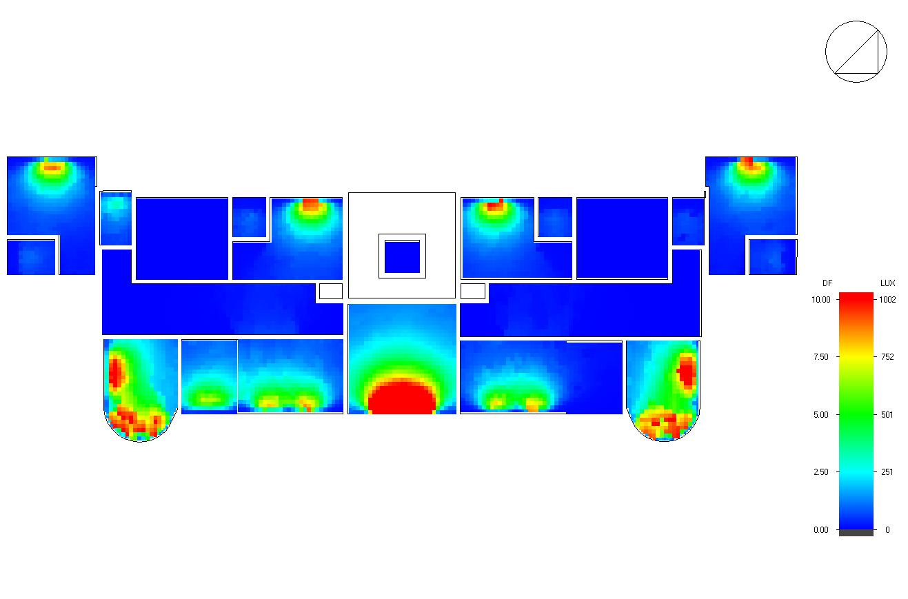
Environmental Design
Daylight Factor
For first floor D.F. = 2.299
Zone | Average Daylight factor (%)
M.Bedroom1 | 1.45
Guest room1 | 1.65
Guest room2 | 1.62
M.Bedroom2 | 1.5
Living room1 | 2.41
Living room2 | 2.05
Kitchen2 | 0.17
Bedroom4 | 4.91
Bedroom2 | 4.8
Kitchen1 | 2.43
Avg. | 2.299

Slide 45

Environmental Design
Acoustical Design
Reverberation time (RT60)
RT60 Range Should be <0.60
From table and figure, the RT60 of
Bedroom lower than the range.
 | TOTAL | SABINE | NOR-ER | MIL-SE
FREQ. | ABSPT. | RT(60) | RT(60) | RT(60)
63Hz: | 12.345 | 1.11 | 0.85 | 1.07
125Hz: | 16.137 | 0.86 | 0.78 | 0.8
250Hz: | 16.955 | 0.74 | 0.78 | 0.67
500Hz: | 22.085 | 0.57 | 0.7 | 0.5
1kHz: | 27.563 | 0.46 | 0.59 | 0.39
2kHz: | 33.407 | 0.38 | 0.48 | 0.3
4kHz: | 33.085 | 0.35 | 0.43 | 0.27
8kHz: | 32.577 | 0.29 | 0.35 | 0.23
16kHz: | 30.085 | 0.29 | 0.34 | 0.24

Slide 46


Environmental Design
Acoustical Design
Sound Transmission Class (STC)
For the internal partition
From Insul software, the
STC value between 2 adjacent
Bedrooms equals 54db is larger
than 52db

Slide 47
Environmental Design
Acoustical Design
Impact Insulation Class (IIC)
IIC between Bedroom and Bedroom 56 and above the limit 52

Slide 48
Electro-Mechanical Design
Water Supply System
Basement tank, roof tank and a pump are used in the building.
Total Demand = 3.9m³/day
Basement tank with 12m³ to collect water from municipality.
2 thermal storage roof 120 liters each are used.
3 Solar panels of ETC-30 evacuated tubes are used.
Pipes Diameters
Type | Vertical | Horizontal | Branch
Fresh | 2" | 1" | 3/4"
Grey | 2" | 1" | 3/4"
Notes:
Am going to start with the electro-mechanical design, starting with the water supply system.
A basement Tank and a roof tank and a pump were used in our design, the total demand of water in the building is 3.9 m3/day.
A basement tank of 12 m3 is used to collect water from the municipality.
2 thermal storage roof tanks each with 120 liters are used.
3 solar panels of ETC-30 evacuated tube will be used.

Slide 49



Electro-Mechanical Design
    Water Supply System
Notes:
These plans show the water system in the building, and here are two samples of the water piping system in ground floor and basement.

Slide 50


Electro-Mechanical Design
Sanitation System
Notes:
Moving to the sanitation system, These plans are showing a sample of the sanitation system of grey, black and storm water in the building.

Slide 51



Electro-Mechanical Design
HVAC System
VRF with split unit system was used in the building.
Toshiba
Outdoor
Unit
Split unit
Notes:
Talking about the HVAC system used in our design, VRF with split units were used in our building, here is the split units distribution in the ground floor.

Slide 52
Electro-Mechanical Design
VRF System
Block | Zone | Design Capacity (kW) | Max Design Capacity (BTU/h) | Ton Refrigerator (TR) | Capacity of Indoor Unit (TR)
BASEMENT | Living Room | 0.95 | 3242.32 | 0.270193 | 0.5
BASEMENT | Kitchen | 0.71 | 2423.21 | 0.201934 | 0.5
GROUND FLOOR | M.Bedroom2 | 1.96 | 6689.42 | 0.557452 | 1
GROUND FLOOR | LivingRoom2 | 1.93 | 6587.03 | 0.548919 | 1
GROUND FLOOR | Bedroom3 | 1.99 | 6791.81 | 0.565984 | 1
GROUND FLOOR | M.Bedroom1 | 1.84 | 6279.86 | 0.523322 | 1
GROUND FLOOR | Bedroom2 | 1.61 | 5494.88 | 0.457907 | 0.5
GROUND FLOOR | DiningRoom1 | 0.83 | 2832.77 | 0.236064 | 0.5
GROUND FLOOR | GuestRoom1 | 1.17 | 3993.17 | 0.332765 | 0.5
GROUND FLOOR | GuestRoom2 | 0.96 | 3276.45 | 0.273038 | 0.5
GROUND FLOOR | DiningRoom2 | 0.69 | 2354.95 | 0.196246 | 0.5
GROUND FLOOR | Bedroom4 | 1.05 | 3583.62 | 0.298635 | 0.5
GROUND FLOOR | LivingRoom1 | 2.03 | 6928.33 | 0.577361 | 1
GROUND FLOOR | Bedroom1 | 3.05 | 10409.56 | 0.867463 | 1
GROUND FLOOR | Kitchen1 | 2.08 | 7098.98 | 0.591581 | 1
GROUND FLOOR | Kitchen2 | 1.92 | 6552.9 | 0.546075 | 1
Notes:
A sample of the capacities of indoor units for each zone in basement and ground floor displayed as shown.

Slide 53


Electro-Mechanical Design
Fire Protection
A dry Riser is used as a firefighting system in the staircase
Notes:
The fire fighting system used in our design is a dry riser, it includes an inlet at street level on the outside face of the building that can be used by the fire department trucks and an outlet in each floor which helps in delivering water as quickly as possible in case of fire.

Slide 54
Electro-Mechanical Design
Artificial Lighting Design
Notes:
Moving to the design of the artificial lighting, Dialux evo were used for the calculations, we have a Dialux evo 3D shot at night here.

Slide 55

Electro-Mechanical Design
Artificial Lighting Design
Kitchen Results
7 Concentric Recessed Lamps
Eavg = 518 lux
U = 0.62
Max UGR =14
7 LED Luminaires
Notes:
Moving to the design of the artificial lighting, Dialux evo were used for these calculations
We have 3 rooms samples starting with the Kitchen results we used 7 concentric recessed lamps and we have got a 518 lux Illuminance and uniformity of 0.62 and the Max UGR = 14 and its all in its ranges and acceptable.

Slide 56

Electro-Mechanical Design
Kitchen Results
Dimming Sample
Eavg = 502 lux
U = 0.65
Notes:
In addition, we have a dimming sample, zero light here and 80% here and 100% here to get a good illuminance and acceptable uniformity in the presence of daylight and artificial lighting and its results 502 illuminance and the uniformity is 0.65 and it is acceptable.

Slide 57

Electro-Mechanical Design
Bedroom Results
4 Recessed Lamps
Eavg = 183 lux
U = 0.68
UGR = >10
LED Luminaires
16.2 W
1100 Lm
Notes:
A bedroom results 4 recessed lamps with 183 lux illuminance and uniformity of 0.68 and UGR of less than 10 so it is acceptable.

Slide 58

Electro-Mechanical Design
Bedroom Results
Eavg = 241 lux
U = 0.55
Dimming Sample
Notes:
And here is another dimming sample, 40% light here and 60% here and 100% here to get a good results in the presence of daylight and artificial lighting.

Slide 59

Electro-Mechanical Design
Living Room Results
3 Concentric Recessed Lamps
Eavg = 172 lux
U = 0.78
UGR = >10
LED Luminaires
18 W
1400 Lm
Notes:
A bedroom results 3 recessed lamps with 172 lux illuminance and uniformity of 0.78 and UGR of less than 10 so it is acceptable.

Slide 60

Electro-Mechanical Design
Electrical Installations
Total Building power = 82616 Watt
Total Building current = 300.42 Amp
The Main Circuit breaker is 3 Phase with 200 Amp with phase Dia. 50 mm2
Notes:
Electrical Installation design here illustrates the main distribution board and its branches and here are the total power of the building which is almost 83000 Watt and the total Current of the building which is 300 Amp.

Slide 61

Electro-Mechanical Design
Electrical Detailing Samples
GF Eastern Block Total Power
The Total Block power =
11821 Watt
Notes:
The electrical calculations of GF eastern block and its total power is approximately 12000 Watt.

Slide 62

Electro-Mechanical Design
Luminaires Distribution Sample in GF
Notes:
This photo shows the luminaires distribution and its wiring in GF

Slide 63

Electro-Mechanical Design
Sockets Distribution Sample in GF
Notes:
Ending up with this photo showing the sockets distribution and its wiring in GF, and you can find all the other plans in the drawing sheets.

Slide 64

PV System Design
System Design Software
PVSyst Premium Design Software was used to simulate the system
System Geographical Coordinates
Coordinates of the system are 32° latitude and 34.8° longitude
Notes:
The PV system was designed in integration with the electrical design. The design process started with determining the exact system location by using the coordinated of 32 latitude and 34.8 longitude.

Slide 65


PV System Design
System Layout
Grid connected PV System
Module Tilt Angle = 30°
Modules Selection
Based on the peak power of the system 14kw_{p}
Selected Modules Dimensions
Notes:
The used system is a grid connected system. Modules have a tilt angle of 30 degrees. The modules were selected based on the peak pwr of the system 14kwp
The figure shows the modules have a dimension of 2m length and 1width

Slide 66

PV System Design
PV System Modules Distribution on Roof Top
42 modules are used with 3.2 m self distance
2 inverters with 7 kw_{p} power
Each module has an optimizer installed
Notes:
The system needs 42 modules in order to generate 14kwp. The distribution of modules on the roof top surface is shown here with a self distance of 3.2m
2 inverters were used in the system, in order to eliminate mismatching caused by the separation of the module strings.
Each module has an optimizer installed to it which helps in eliminating the partial shading problem.

Slide 67

PV System Design
Simulation and Results
The array nominal (STC) power is 14.07 Kw_{p­}
Produced Energy 25.83 MW/year
Specific Prod. 1836 kWh/Kwp/year
At Performance Ratio PR 82.5 %
Notes:
The following graph is taken from the simulation report. Main result is the produced energy which is equal to 25.8mw/year at a PR of 82.5%

Slide 68

PV System Design

Slide 69
PV System Design
Economic Analysis
System initial cost = 93891 NIS
Depreciation factor for the system = 1 %
Assume selling cost for 1 KWh = 0.6 NIS
Life time cycle for the system = 25 years
Energy gained from the system = 25832.5 KWh
Saving from the system = 15499.5 NIS
Margin of profits + Initial investment=100 000 NIS
Notes:
Economic analysis was conducted with the following assumptions

Slide 70


PV System Design
Pay Back Period
PV System Cash Flow Diagram
A = 16970 NIS/year
Utility Cash Flow Diagram
A = 14400 NIS/year
Pay Back Period (PBP) = 7.6 years

Slide 71

Project Management & QS
Notes:
The success of any project depends on 3 main factors which are time, cost and quality, and in order to insure the highest value of each, a proper project management should be done. The project was scheduled using primavera software. Which allowed us to calculate the project total cost and time duration with the highest accuracy.

Slide 72

Project Management &QS
Assigned Activities Sample
Notes:
This shows a sample of the assigned activities to some of the work groups

Slide 73

Project Management & QS
Activities Bar Chart Sample
Notes:
Another sample of the activities shown in a bar chart

Slide 74

Project Management & QS
Total Project Direct Cost 2,665,378.12 NIS
Total Project Direct Cost Per Unit Area 1570.81 NIS/m²
Total Project Duration 233 days
Notes:
The assumed project starting date is on the 1st of jan 2018 and the assumed finished is on the 29th of sept 2018
Total project duration is 233 days. The project direct cost is 2665378nis and the indirect cost is 1570nis/m2

Slide 75

Project Management & QS
Project S-Curve

Slide 76
Conclusion
Solar chimney has proven to be an effective passive technique in the design that achieves thermal comfort and reduces HVAC loads and costs
PV System produces energy that will lead to a decent annual income after the pay back period is over
Full management of the project increases the accuracy of QS and this leads to major savings in the capital cost of the whole project
Clients requirements have been highly considered to ensure the highest levels of satisfactory
Notes:
A claim was raised previously that our building is energy and cost efficient and this is supported by
1.
2.
3.
4.Last but not least

