Slide 1

Design Of a Solid Waste Recycling System in Nablus city
Prepared By:
Ruba Taweel
Roa’a Jboor
Bayan Al-Khateeb
Malak Mohammad
Supervisor :
Dr. Ramiz Assaf

Slide 2
Outline
01
02
03
Introduction
Methodology
Feasibility study
04
05
Conclusion and Recommendation
Layout

Slide 3
Introduction
With the increase in population growth and technological development, the amount of waste of all kinds increased and became a threat to humans and the enviro nment, as the solid waste management system in Palestine suffers from many challenges.
After reviewing several recycling systems in many countries of the world, we noticed the importance of recycling. Accordingly, the project aims to design a system that works on waste recycling and a feasibility study for the system.

Slide 4
Methodology

Slide 5
1- Exacerbation of the waste problem at the Al-Serafi deportation point.
2- Designing a sorting system and a feasibility study for this system.
3- Collecting data related to waste and its costs.
4- Collecting more than one sorting line.
5- Determine the criteria in order to determine the best sorting line.
6- Building a model.
7- View the results of each of the selected sorting lines.
8- Choose the best font among the fonts.
9- A feasibility study for the chosen line.

Slide 6
Feasibility study

Slide 7

Introduction
After studying the situation, impact and quantities of waste in Palestine and in the city of Nablus in particular, and studying recycling and the waste sorting process, we noticed that the waste sorting process is necessary to contribute to reducing the amount of waste.
The aim of the project is to do recycling by sorting and to conduct a feasibility study for this system.

Slide 8
Current costs
Al-Serafi is the only waste removal point for the city of Nablus, on which work began in 2007. It is privately owned land of the Al-Serafi family, with an area of five dunums, and it is leased to the Nablus municipality.
The waste of the Nablus municipality is transported by a small car to the Al-Sirafi transfer point, which contains small containers of nineteen tons of waste, where an average of 400 tons of waste per day enters the transfer point, and this waste is transported by a contracting company (Jilan) via large trucks to a landfill Zahrt al Finjan

Slide 9
facility infrastructure
Monthly Information about Solid Waste in Nablus City:
Land rent cost | 40,000 Nis Monthly
The cost of collection and transportation per ton towards Serafi | 160 Nis
The cost of deportation and transportation per ton to Zahrat Al Finjan | 35 Nis
burial cost per ton in Zahrat al-Finjan | 26.5 Nis

Slide 10
Percentages of solid waste produced in the city of Nablus:
# | Type | percentage%
1 | Organic waste | 64
2 | Paper & carton | 14
3 | Plastic | 8
4 | Metals | 3
5 | Glass | 2
6 | Wood | 2
7 | Rubber | 2
8 | Others | 5

Slide 11
The amount of each type of waste is:
Types | Tons(Day) | Tons(Month)
Organic waste | 256 | 7,680
Paper & carton | 56 | 1,680
Plastic | 32 | 960
Others | 20 | 600

Slide 12
Sorting systems
Name | Area | Automation type | Cost | Production Capacity: | Working Time
Beston household waste sorting machine Model :BFX-400 | 3000㎡ | Fully automatic operation system | 1999 999.00 USD | 500T/D | 20 hours
baonan Model TS500 | 2000㎡ | Automatic & manual | 1999 000.00 USD | 500 Ton/D | 18 hours
Maxborn Model MB-400 | 800-2000㎡ | full-automatic and semi-automatic | 1899 000.00 USD | 400 Ton/D | 8-16 hours

Slide 13
Criteria for each sorting system of the three systems
criteria | weight | System 1 | System 2 | System 3
Area | 35% | 3,000 | 2,000 | 2,000
Cost | 25% | 1,999,999$ | 1,999,000 | 1,899,000
Automation level | 20% | full | semi | mostly automated
Capacity | 10% | 500 | 500 | 400
Working Time | 10% | 20 | 18 | 16

Slide 14
Special Scores for each of the criteria
criteria | weight | System 1 | System 2 | System 3
Area | 35% | 4 | 9 | 9
Cost | 25% | 6 | 6 | 7
Auto | 20% | 10 | 7 | 8
Capacity | 10% | 8 | 8 | 4
Working Time | 10% | 9 | 8 | 4
ToTAL | 100% | 6.6 | 7.65 | 7.3

Slide 15
Alternative Score = Σi weight i * Score i
Example for system 2 = (35% * 9) + (25% * 6) + (20% * 7) + (10% * 8) + (10% * 8)
= 7.65

Slide 16
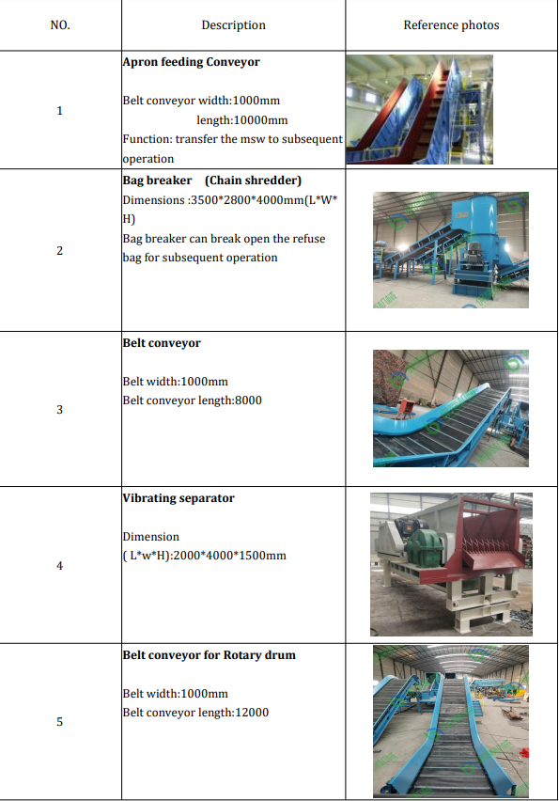
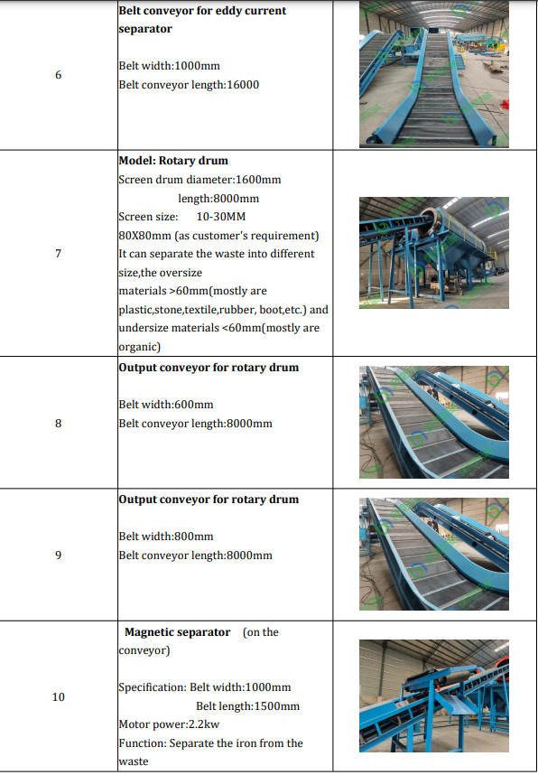
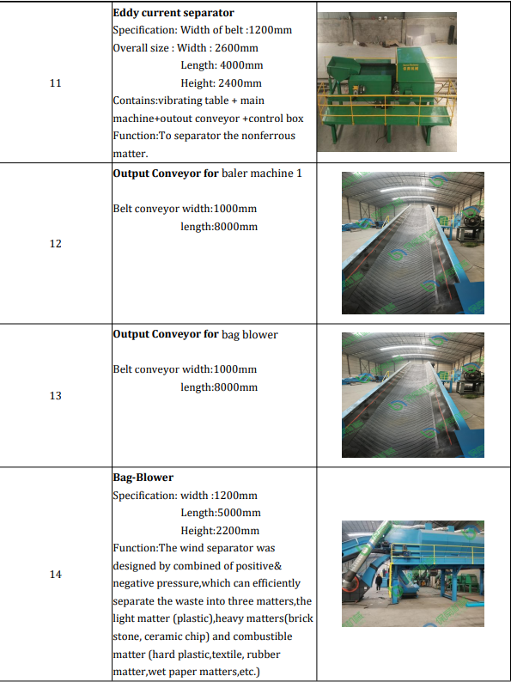
The second System is the better one:
Municipal Solid Waste Sorting System “ baonan Model TS5”

Slide 17
Cost of system “baonan Model TS500”
* shipping cost:
Transportation fees for the sorting system, and it assumes the need for 15 containers for the system transported from the port of China to the port of Ashdod, and then to the facility at an approximate cost of 2300 (dollars) per container. Total cost for the sorting system = 425,010 $
ID | Cost Type | Description | Cost (dollar)
1 | Shipping 15 containers from China port to Ashdod port | =15*2300(USD) | 34,500
2 | Shipping containers from Ashdod port to our facility & transportation office rent | =15*680(USD) +500 | 10,700
3 | Customs clearance and container floor (it assumes to be 17% for tax and about 2% for container floor, from the cost of container) | =19%*1999000 | 379,810

Slide 18
Running cost
➔ Salaries cost
ID | job description | Required number of workers | Average monthly salary per person | Total monthly salaries | Total yearly salary (NIS)
1 | General manager | 1 | 5,000 | 5,000 | 60,000
2 | Administrative employee | 1 | 2,500 | 2,500 | 30,000
3 | Production Supervisor | 1 | 3,000 | 3,000 | 3,000
4 | Accountant | 1 | 3,000 | 3,000 | 3,000
5 | Inventory Supervisor | 1 | 3,000 | 3,000 | 3,000
6 | Workers | 25 | 1,800 | 45,000 | 540,000
7 | Maintenance | 2 | 1,800 | 3,600 | 43,200
Total salaries in (Nis) |  |  |  |  | 682,200(Nis)
Total salaries in ($) |  |  |  |  | 187,472 $

Slide 19
Prices in the market
After communicating with the factories that will purchase the raw materials after the sorting process, We have decided that the sale be made at a price that suits the market and the financial capacity of potential customers, and that the price is competitive and less expensive.
Types | Tons(Day) | Recycling Efficiency | Cost per ton | Price per ton($) | Total (Daily) | Total (monthly) | Total (yearly)
Organic waste | 256 | 91% | 150-250 | 175 | $26,880 | $806,400 | $9,676,800
Paper & carton | 56 | 91% | 25-35 | 25 | $840 | $25,200 | $302,400
Plastic | 32 | 91% | 120-160 | 140 | $2,688 | $80,640 | $967,680
Total ($) |  |  |  |  | $30,408 | $912,240 | $10,946,880

Slide 20
Waste
The wasting of the remainder of the sorting process =36 ton per day moved to the dumb (Zahrat -Al finjan
= 400 ton daily - 364 of sorted waste
The estimated cost of transportation from the Al-Serafi transfer station to the Zahrat Al-Finjan landfill is 35(Nis) per ton, and the cost of burying waste in Zahrat Al-Finjan is estimated at 26.5(Nis)
* The cost of the waste to burial costs current = 26.5*400 = 10600(Nis) = 2858($) per day = 1028880($) per year
The cost of the waste to burial =26.5*36= 954 (Nis) = 256($) per day
=920160($) per year
Cost of burial saved = 1028880 - 920160 = 108,720 ($) per year
* Current transportation costs (all waste prior to sorting) to Zahrat Al-Finjan = 35*400=14,000 (Nis) per day = 3757($) = 1352520 ($) per year
* The cost of the waste to be transferred = 36 * 35 = 1260(Nis) = 338($) per day
= 121680($) per year
Cost of transportation saved = 1352520 ($) - 121680($) = 1230840($) per year

Slide 21
Electricity consumption
Electricity costs for services within the facility were estimated at 1200(Nis) per month, equivalent to 14400 shekels annually, which is equivalent to 3,957 ($) .
Water Consumption
Because the production system does not need water, the costs of water for services inside the factory
were estimated at 80 (Nis)per month, which is equivalent to 960 (Nis) = 263($)per year.
Internet and phone
Phone and internet costs are estimated at 300 (Nis) per month which is equal to 3600(Nis) = 987($) per year.

Slide 22
Maintenance
The factory needs periodic maintenance, and based on communication with the line suppliers, they informed us that the life of the line ranges from 8 to 10 years, and maintenance of the line needs about 100,000 dollars for 10 years, or 10,000 dollars for one year
Insurance
Based on the communication with the competent authorities of the Palestinian insurance companies, the insurance costs are for the workers(28-30) It is estimated at 8,000 dollars annually, and the facility insurance is 2,000 dollars annually
Construction
Based on communication with building engineers, it was agreed that the construction cost per square meter is 1,000 shekels, and the factory area is 3,796 square meters, so the construction cost is 3,796,000 shekels = $1,021,714.
The cost of asphalting is 60 shekels per square meter, and the street area is 1203. The cost of asphalting the street is 72,180 shekels = $19,428.
Construction costs = 19,428 + 1,021,714 = 1,041,142 $.

Slide 23
Running cost
ID | Type | Annual cost (Nis)
1 | Salaries | 187,472
2 | Electricity consumption | 3,957
3 | Water consumption | 263
4 | Internet and phone | 987
5 | Maintenance | 10,000
6 | Insurance | 10,000
7 | Construction | 1,041,142
8 | Waste | 218,520
Total annual cost |  | 1,464,341

Slide 24
Cash flow

Slide 25
Income Statement
End of Year | 0 | 1 | 2 | 3 | 4 | 5
Revenue |  | $18,000,000.00 | $18,400,000.00 | $187,000,000.00 | $19,000,000.00 | $19,500,000.00
Savings in Transportation |  | $1,300,000.00 | $1,326,000.00 | $1,400,000.00 | $1,400,000.00 | $1,500,000.00
Savings of burial cost |  | $108,720.00 | $110,900.00 | $113,120.00 | $115,400.00 | $117,700.00
Sales of Recycles Material |  | $16,700,000.00 | $17,034,000.00 | $17,400,000.00 | $17,800,000.00 | $18,160,000.00
Expenses |  | $550,000.00 | $560,000.00 | $570,000.00 | $590,000.00 | $600,000.00
Labor |  | $187,472.00 | $196,845.60 | $206,687.88 | $217,022.27 | $227,873.39
Materials |  | $4,000.00 | $4,200.00 | $4,410.00 | $4,630.50 | $4,900.00
Overhead |  | $111,250.00 | $113,500.00 | $115,800.00 | $118,120.00 | $120,500.00
Depreciation |  | $242,501.00 | $242,501.00 | $242,501.00 | $242,501.00 | $242,501.00
Taxable income |  | $16,160,000.00 | $16,500,000.00 | $16,800,000.00 | $17,220,000.00 | $15,600,000.00
Income Taxes(15%) |  | $2,430,000.00 | $2,480,000.00 | $2,520,000.00 | $2,600,000.00 | $2,340,000.00
Net income |  | $13,740,000.00 | $14,025,000.00 | $14,280,000.00 | $14,640,000.00 | $13,260,000.00
Cash Flow Statement
Operating Activities:
Net income |  | $13,740,000.00 | $14,025,000.00 | $14,280,000.00 | $14,640,000.00 | $13,260,000.00
Depreciation |  | $242,501.00 | $242,501.00 | $242,501.00 | $242,501.00 | $242,501.00
Investment Activities:
Recycling System Cost | -$2,000,000.00
Shipping and Insallation | -$425,010.00
Construction Cost | -$1,040,000.00
Working Capital | -$302,722.00
Net Cash Flow | -$3,767,732.00 | $14,000.00 | $14,300,000.00 | $14,525,000.00 | $14,900,000.00 | $13,505,000.00
Return on Investment | 152.01%
Net Present Value | $37,537,961.12
 |  | 1 | 2 | 3 | 4 | 5
 | -$3,767,732.00 | $1,166.67 | $1,166.67 | $1,166.67 | $1,166.67 | $1,166.67
 |  | -$3,766,565.33 | -$3,765,398.67 | -$3,764,232.00 | -$3,763,065.33 | -$3,761,898.67
PBP | 4 months

Slide 26
6 | 7 | 8 | 9 | 10
$19,800,000.00 | $20,000,000.00 | $20,700,000.00 | $21,000,000.00 | $21,500,000.00
$1,600,000.00 | $1,640,000.00 | $1,670,000.00 | $1,700,000.00 | $1,740,000.00
$120,060.00 | $122,500.00 | $125,000.00 | $127,500.00 | $130,050.00
$18,523,200.00 | $19,000,000.00 | $19,400,000.00 | $19,800,000.00 | $20,200,000.00
$610,000.00 | $630,000.00 | $640,000.00 | $660,000.00 | $680,000.00
$239,267.06 | $251,230.41 | $263,791.93 | $276,981.53 | $290,830.60
$5,150.00 | $5,410.00 | $5,700.00 | $6,000.00 | $6,300.00
$123,000.00 | $125,500.00 | $128,010.00 | $130,600.00 | $133,212.00
$242,501.00 | $242,501.00 | $242,501.00 | $242,501.00 | $242,501.00
$17,920,000.00 | $18,400,000.00 | $18,800,000.00 | $19,150,000.00 | $19,530,000.00
$2,700,000.00 | $2,760,000.00 | $2,820,000.00 | $2,880,000.00 | $2,930,000.00
$15,232,000.00 | $15,640,000.00 | $15,980,000.00 | $16,300,000.00 | $16,600,500.00
$15,232,000.00 | $15,640,000.00 | $15,980,000.00 | $16,300,000.00 | $16,600,500.00
$242,501.00 | $242,501.00 | $242,501.00 | $242,501.00 | $242,501.00
 |  |  |  | $302,722.00
$15,480,000.00 | $15,900,000.00 | $16,225,000.00 | $16,550,000.00 | $17,150,000.00
6 | 7 | 8 | 9 | 10
$1,166.67 | $1,166.67 | $1,166.67 | $1,166.67 | $1,166.67
-$3,760,732.00 | -$3,759,565.33 | -$3,758,398.67 | -$3,757,232.00 | -$3,756,065.33

Slide 27
Lay out

Slide 28
Layout
In this chapter, we will explain the division of the total area of ​​the facility using planning principles, as well as solid waste receiving sites and final sorted waste sites using factory space optimization.

Slide 29
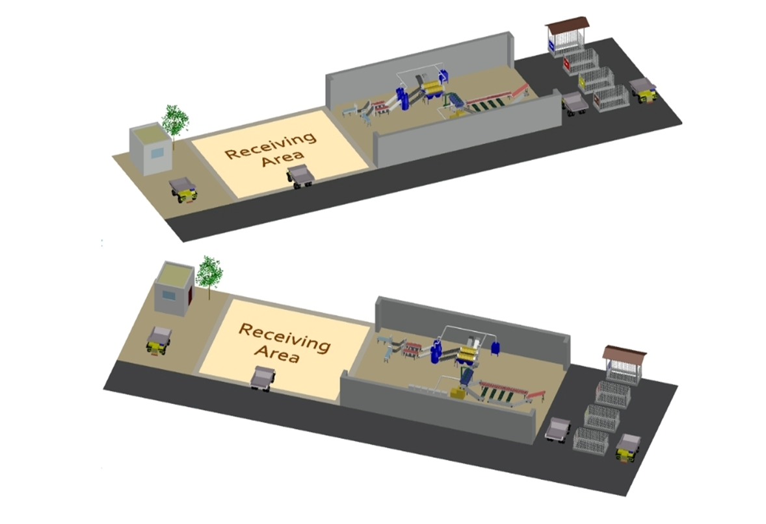
3D layout modeling

Slide 30
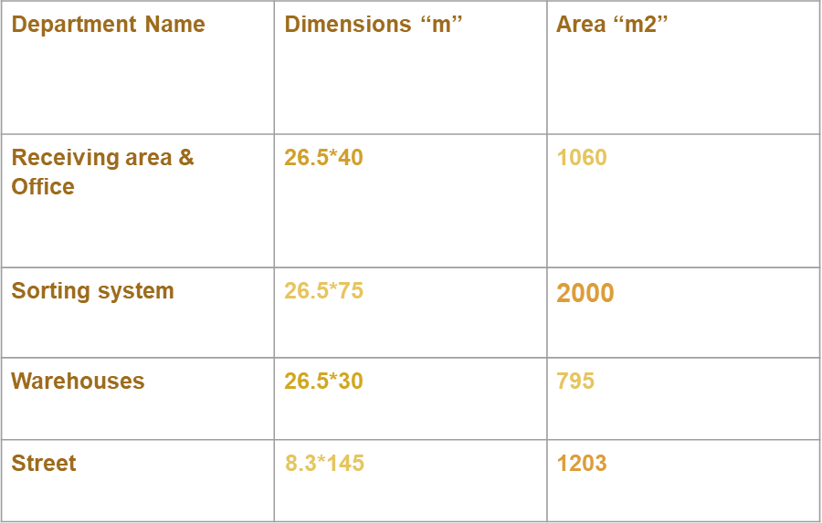

Slide 31
5000 m²
The total factory area

Slide 32


Slide 33
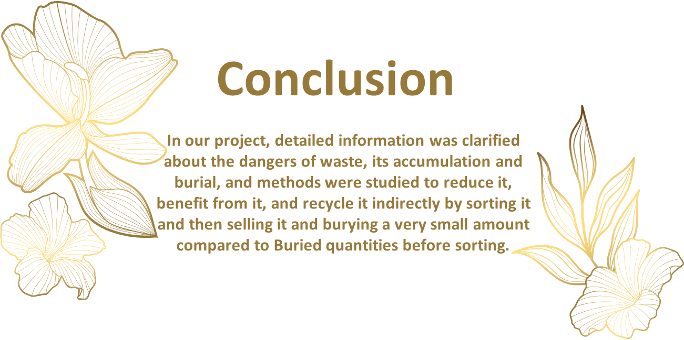

Slide 34
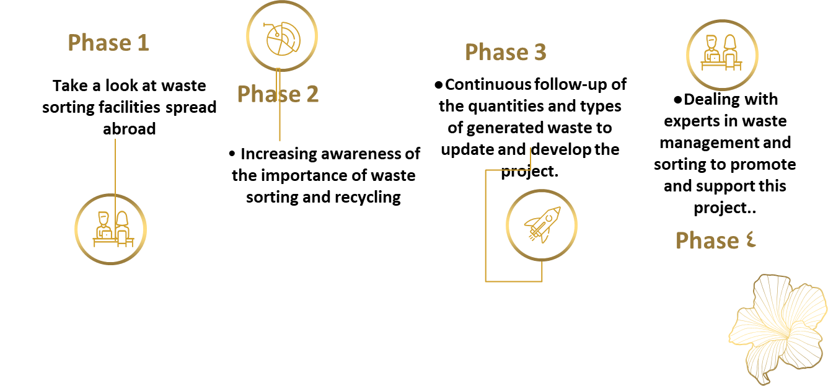
Recommendation

Slide 35
THANK YOU
ANY QUESTIONS?

