Slide 1
Heat from the street
Saif Hamdan
Ibraheem Younis
Ahmad Baniodeh
Araby Draghmeh
Supervisor: Dr. Ramiz Al_Khaldi.

Slide 2
contents
Introduction
Objectives
Problem Specification
Methodology
Model Components
Analysis
Conclusion

Slide 3

introduction
Sources of energy

Slide 4
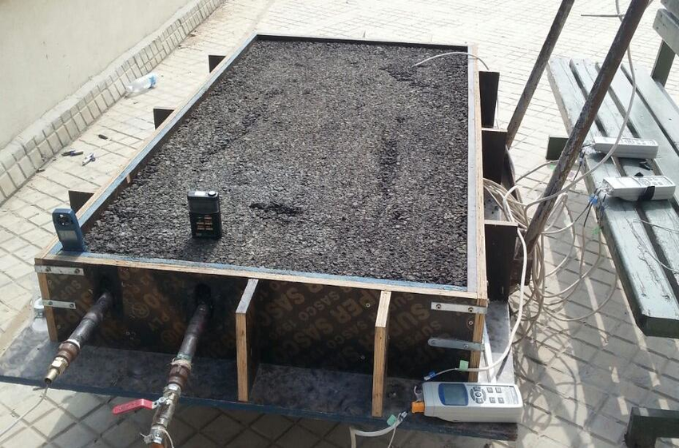
introduction
Asphalt pavements as solar collector

Slide 5
objectives
Investigate the temperature distribution along the depth of asphalt pavements with laboratory experiments.
Investigate the amount of energy captured by the (SCES) model and the factors that limits the captured energy.
Built model for street capturing energy system (SCES).
Investigate different pipe geometries to increase heat transfer from asphalt pavement to water.
Use theoretical approach develop a relationship among flow rate, pipe diameter, and pipe length.
Investigate the possibility of reducing Urban Heat-Island Effect.

Slide 6
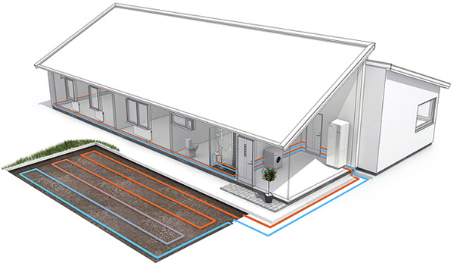
problem specification

Slide 7
heat transfer
There are three basic ways in which heat is transferred
Conduction
Convection
Radiation

Slide 8
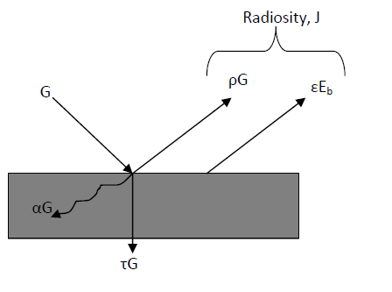
energy balance of asphalt pavement

Slide 9
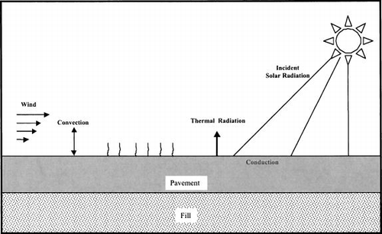
heat transfer in asphalt solar collectors

Slide 10
system components
Asphalt pavement
Pipes
Pipes layout
Pump
Valve

Slide 11
measurement tools
Flow meter
Thermocouple
Solar radiation meter
Digital anemometer

Slide 12
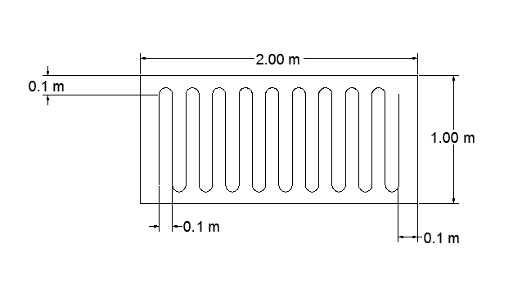
model

Slide 13
RESULR AND ANALYSIS
Construct the model
Collection of reading
Make comparison

Slide 14
CONCLUSION AND RECOMMENDATION
What is our project ?
How we can improve it ?
Why we go for this project ?

Slide 15
Thank you

